Slide 2
Galvanic Cell
Device in which chemical energy is changed to electrical energy.
Uses a spontaneous redox reaction to produce a current that can be used to do work.

Slide 3
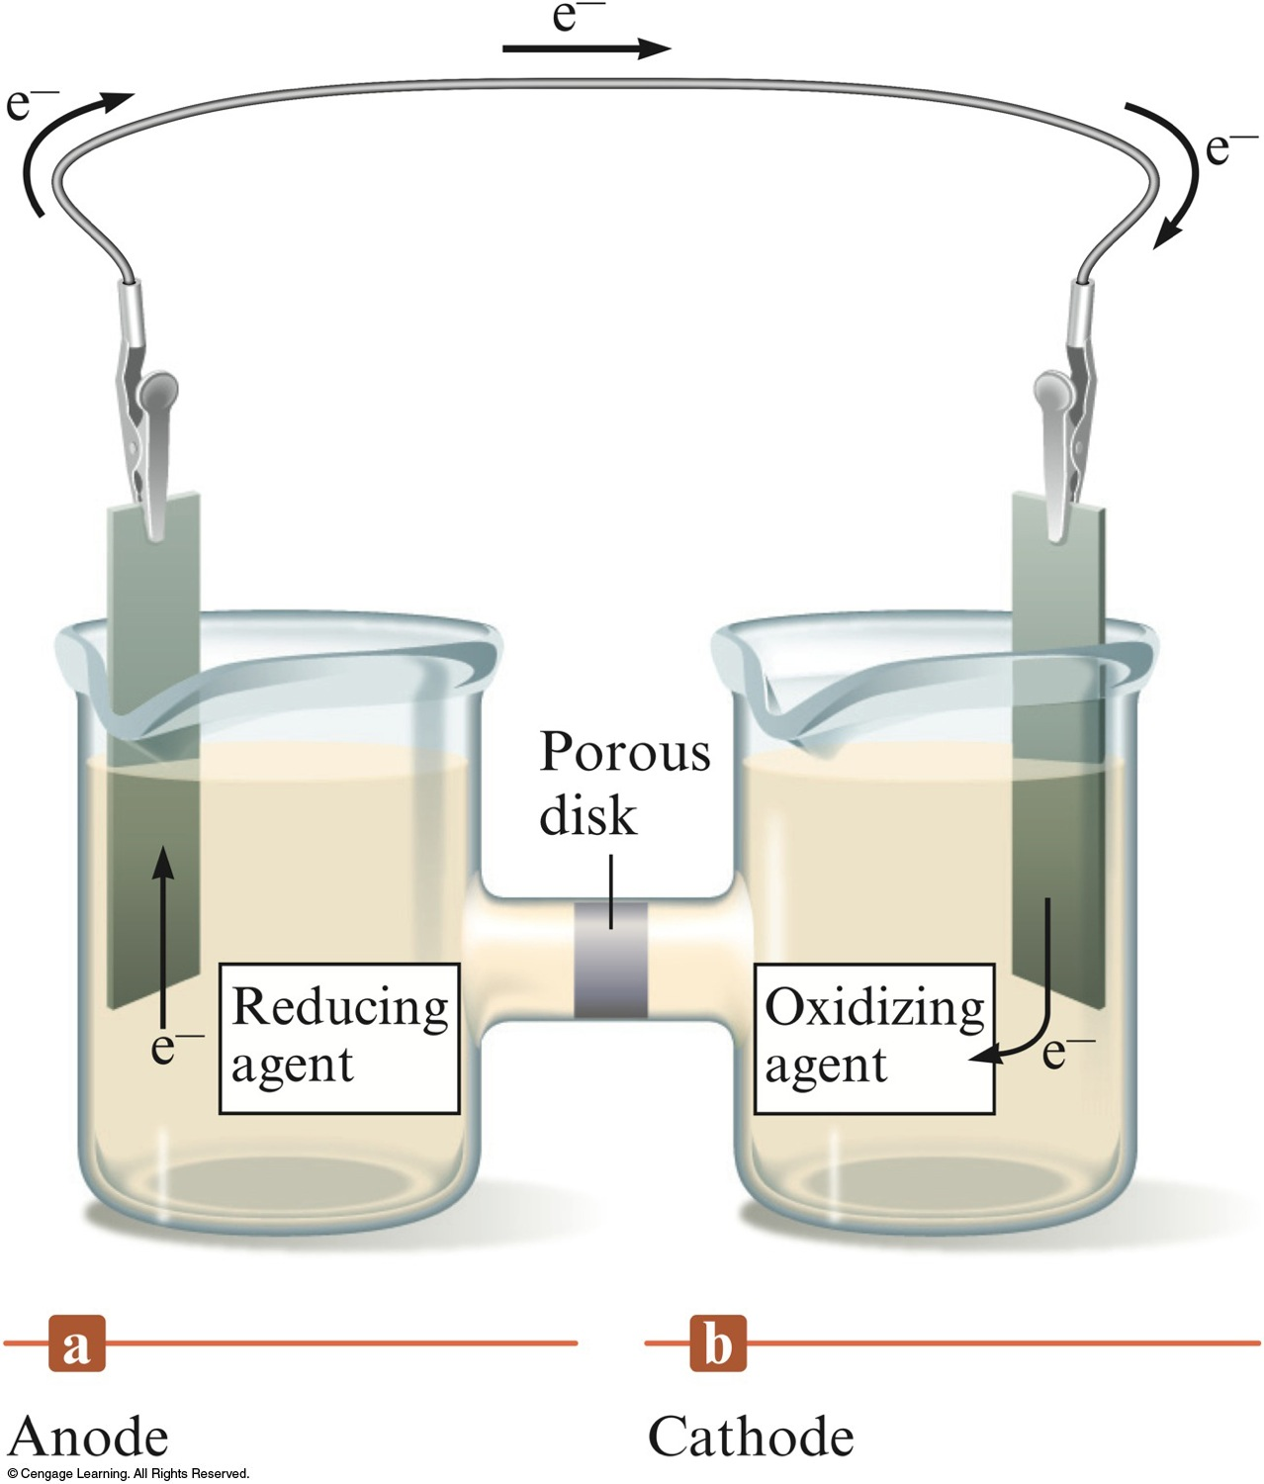
A Galvanic Cell

Slide 4
Galvanic Cell
Oxidation occurs at the anode.
Reduction occurs at the cathode.
Salt bridge or porous disk – devices that allow ions to flow without extensive mixing of the solutions.
  Salt bridge – contains a strong electrolyte held in a Agar Jelly.
  Porous disk – contains tiny passages that allow hindered flow of ions.

Slide 5
Cell Potential
A galvanic cell consists of an oxidizing agent in one compartment that pulls electrons through a wire from a reducing agent in the other compartment.
The “pull”, or driving force, on the electrons is called the cell potential ( ), or the electromotive force (emf) of the cell.
  Unit of electrical potential is the volt (V).
    1 joule of work per coulomb of charge transferred.

Slide 6
Galvanic Cell
All half-reactions are given as reduction processes in standard tables.
  Table 18.1 in the Textbook
  1 M, 1atm, 25°C
When a half-reaction is reversed, the sign of E° is reversed.
When a half-reaction is multiplied by an integer, E° remains the same.
A galvanic cell runs spontaneously in the direction that gives a positive value for E°_{cell}.

Slide 7
Example: Fe³⁺(aq) + Cu(s) → Cu²⁺(aq) + Fe²⁺(aq)
Half-Reactions:
  Fe³⁺ + e– → Fe²⁺ E° = 0.77 V
  Cu²⁺ + 2e– → Cu E° = 0.34 V
To balance the cell reaction and calculate the cell potential, we must reverse reaction 2.
  Cu → Cu²⁺ + 2e– – E° = – 0.34 V
Each Cu atom produces two electrons but each Fe³⁺ ion accepts only one electron, therefore reaction 1 must be multiplied by 2.
  2Fe³⁺ + 2e– → 2Fe²⁺ E° = 0.77 V

Slide 8
Overall Balanced Cell Reaction
2Fe³⁺ + 2e– → 2Fe²⁺ E° = 0.77 V (cathode)
Cu → Cu²⁺ + 2e– – E° = – 0.34 V (anode)
Balanced Cell Reaction:
  Cu + 2Fe³⁺ → Cu²⁺ + 2Fe²⁺
Cell Potential:
E°_{cell} = E°(cathode) – E°(anode)
  E°_{cell} = 0.77 V – 0.34 V = 0.43 V

Slide 9
Line Notation
Used to describe electrochemical cells.
Anode components are listed on the left.
Cathode components are listed on the right.
Separated by double vertical lines which indicated salt bridge or porous disk.
The concentration of aqueous solutions should be specified in the notation when known.
Example: Mg(s)|Mg²⁺(aq)||Al³⁺(aq)|Al(s)
  Mg → Mg²⁺ + 2e– (anode)
  Al³⁺ + 3e– → Al (cathode)

Slide 10
Description of a Galvanic Cell
The cell potential (always positive for a galvanic cell where E°_{cell} = E°(cathode) – E°(anode)) and the balanced cell reaction.
The direction of electron flow, obtained by inspecting the half–reactions and using the direction that gives a positive E°_{cell}.

Slide 11
Description of a Galvanic Cell
Designation of the anode and cathode.
The nature of each electrode and the ions present in each compartment. A chemically inert conductor is required if none of the substances participating in the half–reaction is a conducting solid.

Slide 12
Work
Work is never the maximum possible if any current is flowing.
In any real, spontaneous process some energy is always wasted – the actual work realized is always less than the calculated maximum.

Slide 13
Maximum Cell Potential
Directly related to the free energy difference between the reactants and the products in the cell.
  ΔG° = –nFE°
    F = 96,485 C/mol e–

Slide 14
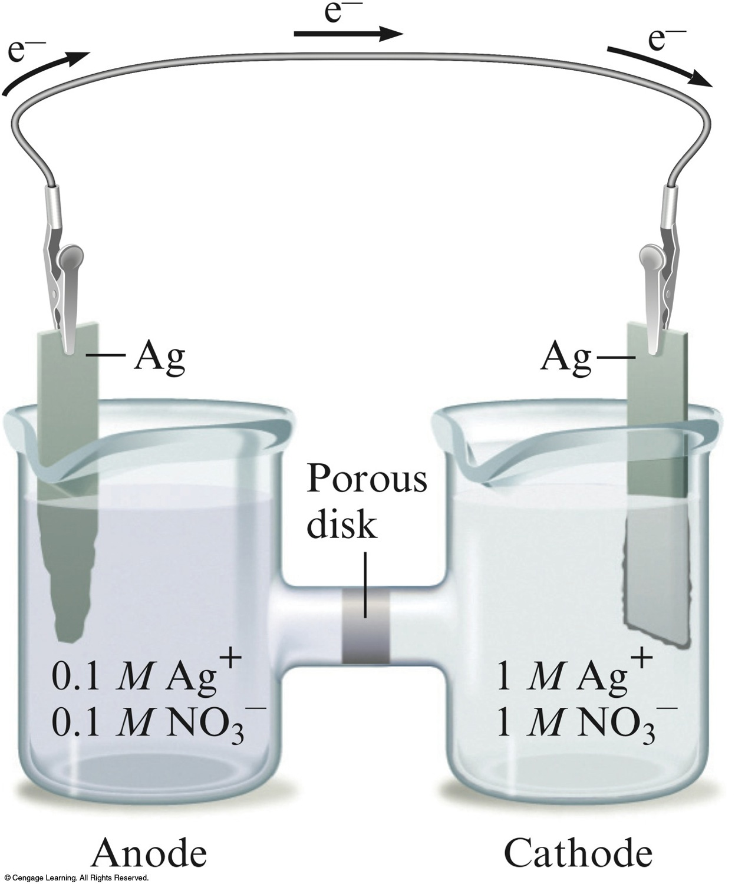
A Concentration Cell

Slide 15
Nernst Equation
The relationship between cell potential and concentrations of cell components
At 25°C:
or
(at equilibrium)

Slide 16
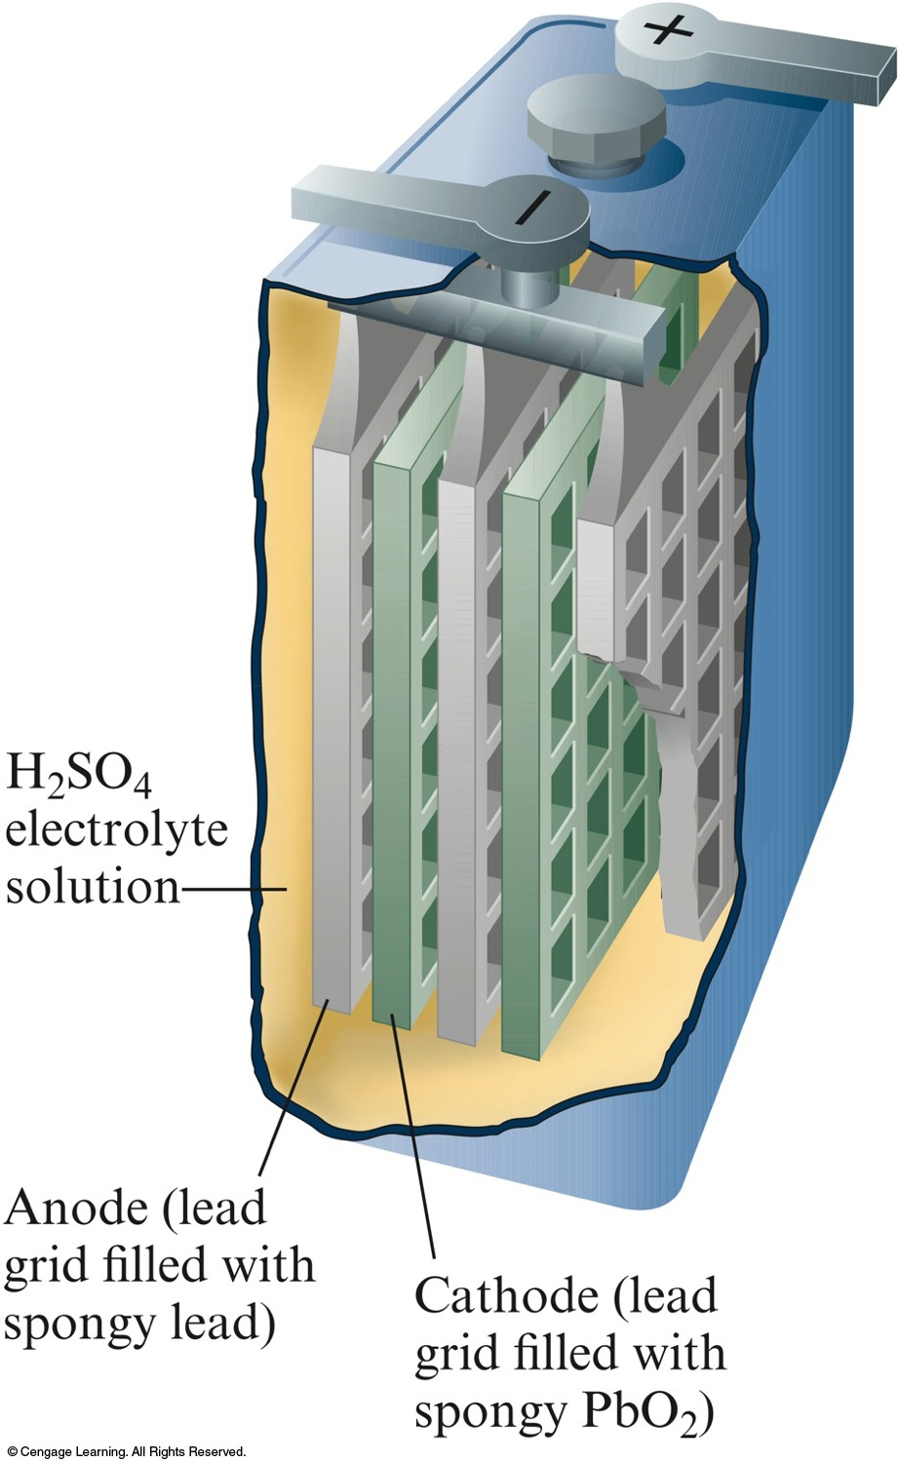
One of the Six Cells in a 12–V Lead Storage Battery

Slide 17
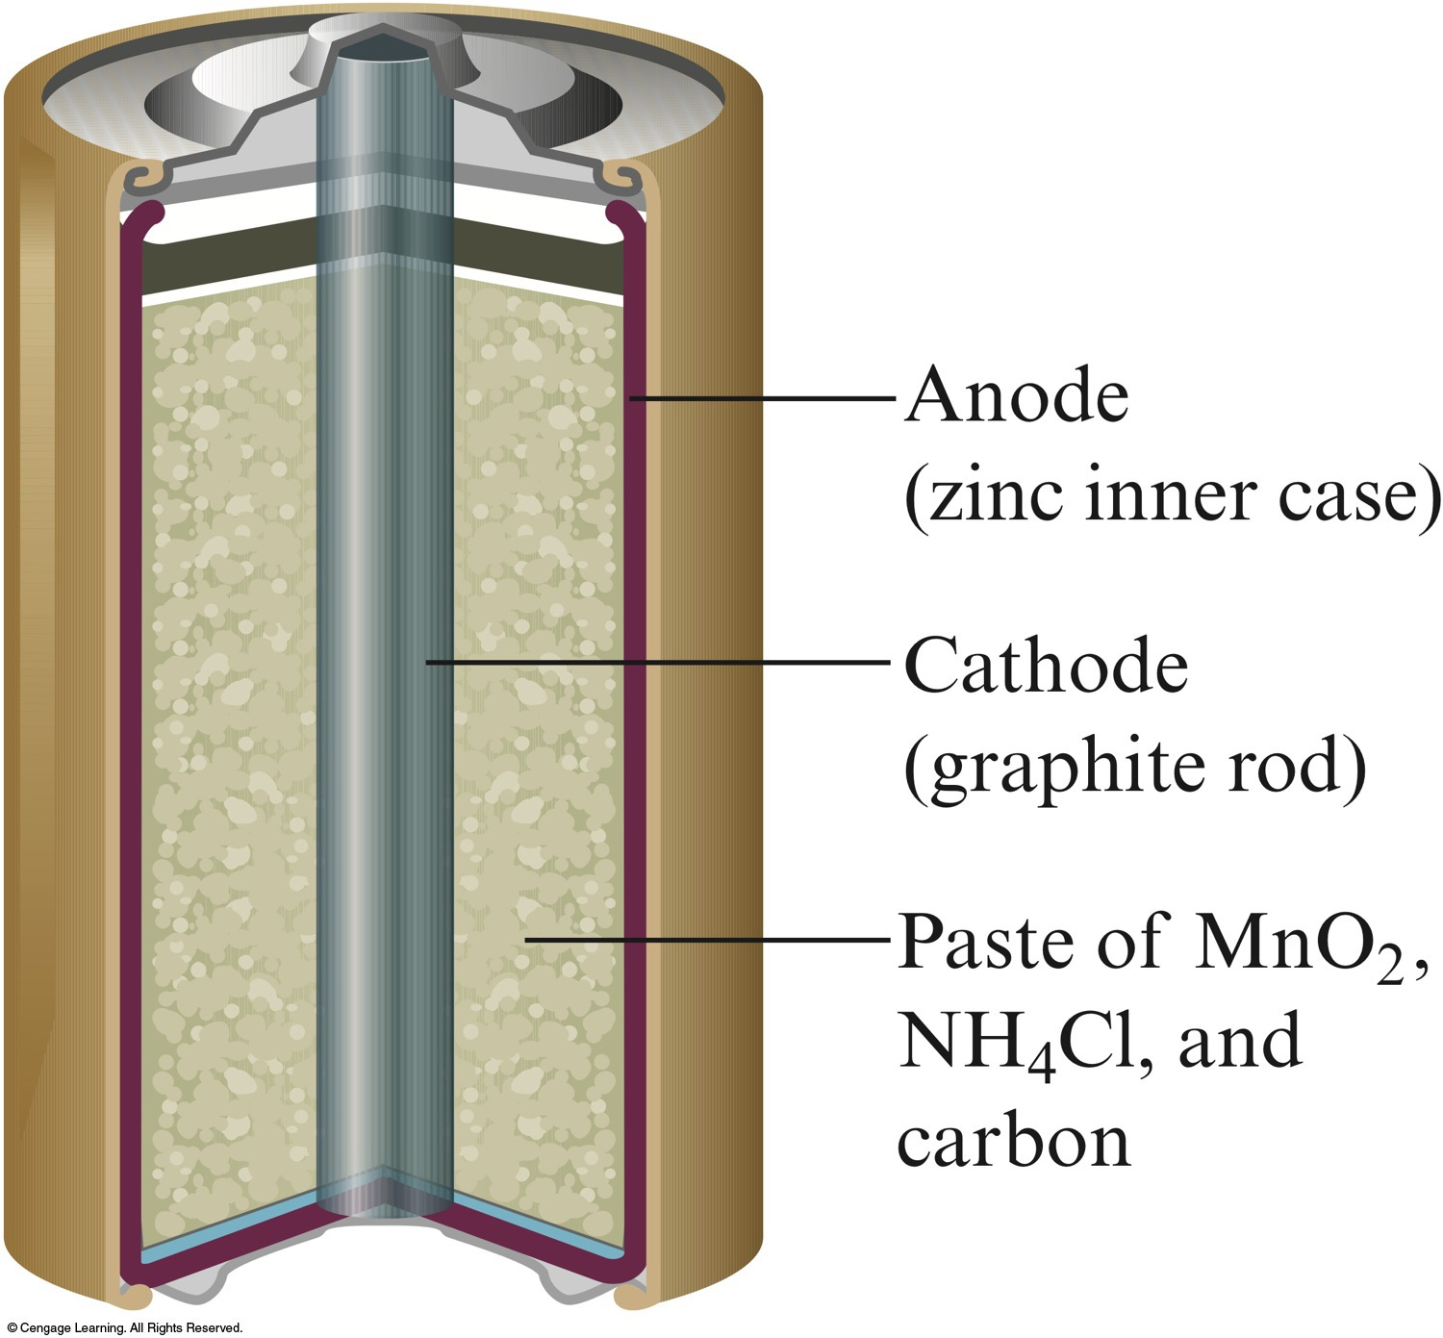
A Common Dry Cell Battery

Slide 18
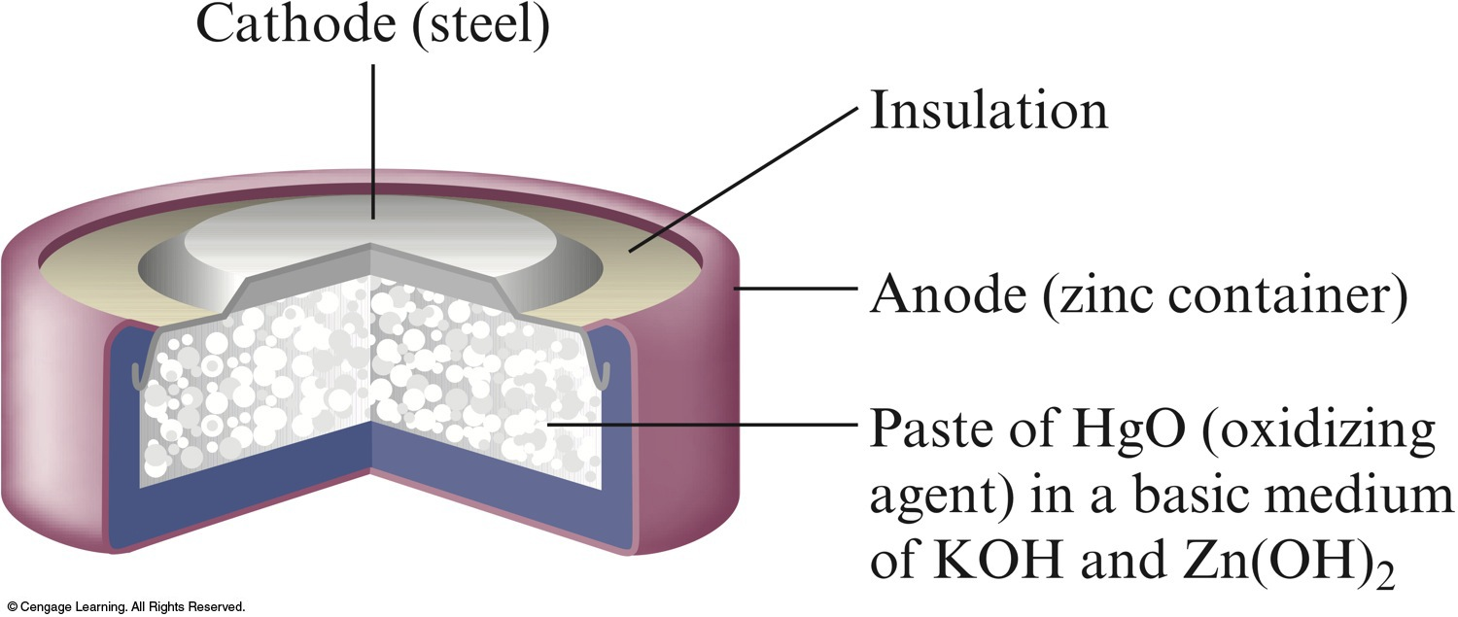
A Mercury Battery

Slide 19
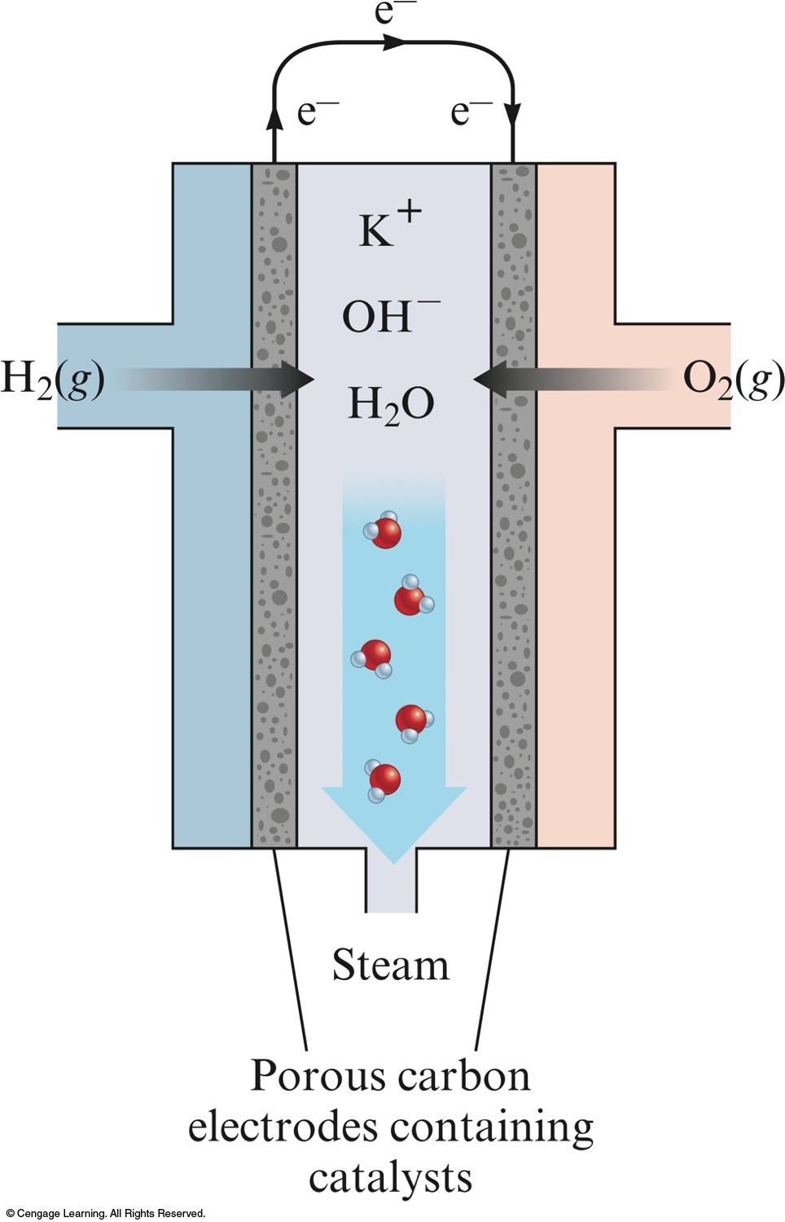
Schematic of the Hydrogen-Oxygen Fuel Cell

Slide 20
Process of returning metals to their natural state – the ores from which they were originally obtained.
Involves oxidation of the metal.

Slide 21
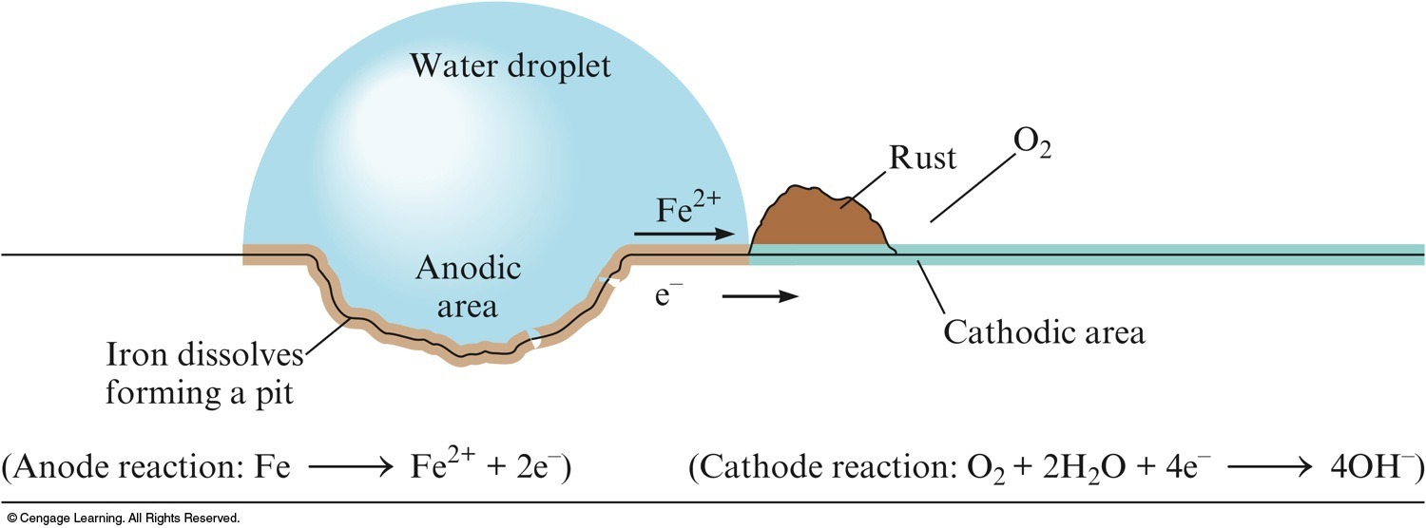
The Electrochemical Corrosion of Iron

Slide 22
Corrosion Prevention
Application of a coating (like paint or metal plating)
  Galvanizing
Alloying
Cathodic Protection
  Protects steel in buried fuel tanks and pipelines.

Slide 23
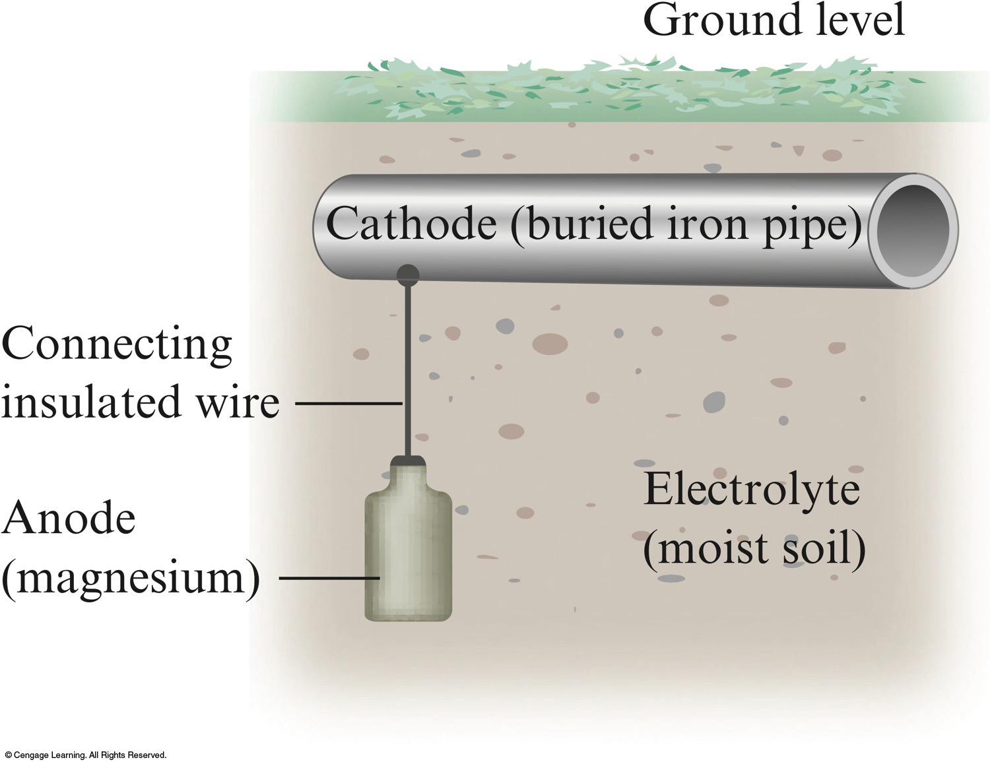
Cathodic Protection

Slide 24
Forcing a current through a cell to produce a chemical change for which the cell potential is negative.

Slide 25
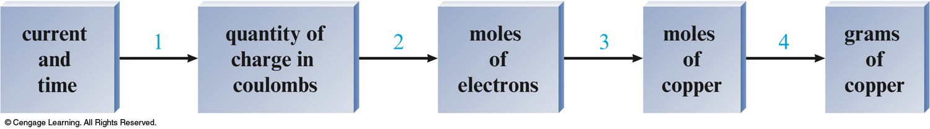
Stoichiometry of Electrolysis
How much chemical change occurs with the flow of a given current for a specified time?
current and time  quantity of charge 
  moles of electrons  moles of analyte 
  grams of analyte

Slide 26
Stoichiometry of Electrolysis
current and time  quantity of charge
  Coulombs of charge = amps (C/s) × seconds (s)
quantity of charge  moles of electrons

Slide 27
Production of aluminum
Purification of metals
Metal plating
Electrolysis of sodium chloride
Production of chlorine and sodium hydroxide

Slide 28
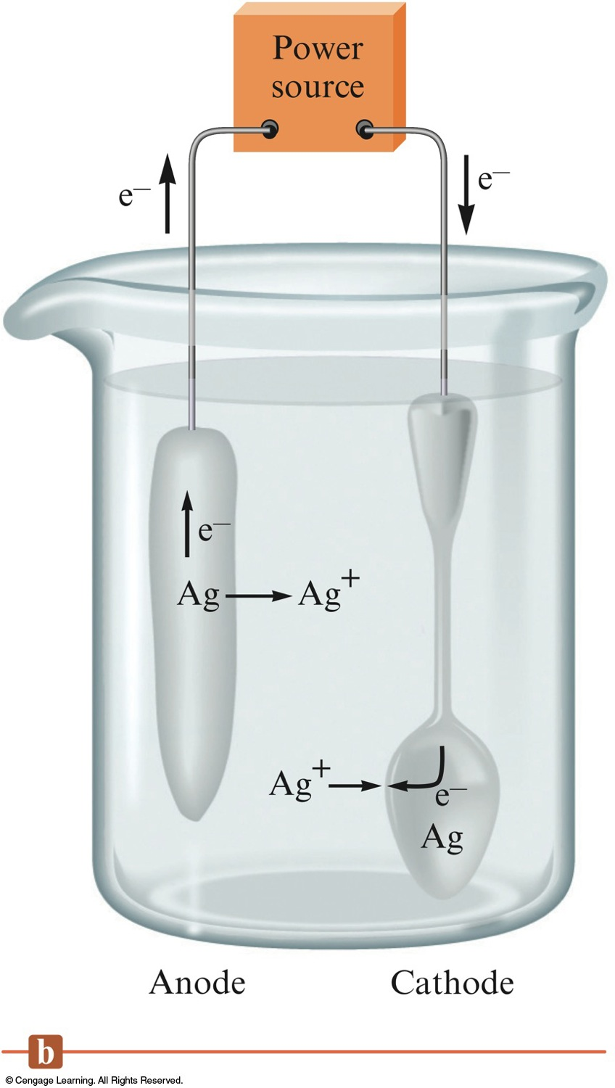
Electroplating a Spoon

