Slide 1
CLIMATE CHANGE
UNIT TEN

Slide 2
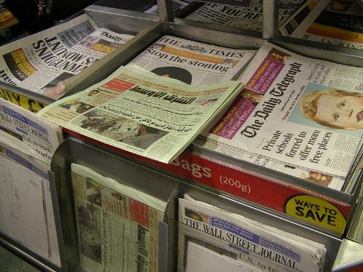
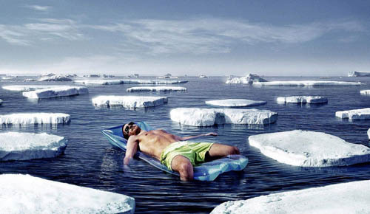
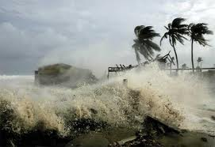
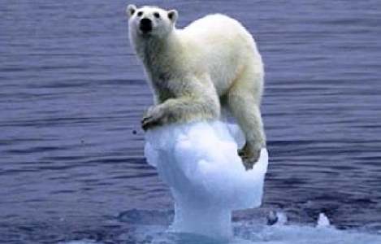
Notes:
Slide 1:
Are any of the students able to explain what they think ‘Climate Change Scepticsm’ is? – Pictures will act as clues.
Would be a good idea to let a number of students answer but not to explain the actual meaning, leaving them to think.

Slide 3
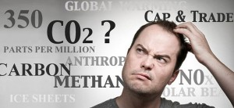
What is Climate Change?
Everyone has heard the phrase, but what does it actually mean?
Climate Change = The change in average conditions of a particular place over a long period of time. (We usually link ‘climate change’ to rising temperatures but this is NOT the full story).
It’s better to think of climate change causing more extreme and unpredictable events around the world.
HINT: Climate is what you expect, Weather is what you get!
Notes:
Slide 3:
Are the students able to explain what ‘Climate Change’ is?
Explain that ‘climate’ is different to ‘weather’: Make sure the students understand that the climate=the average temperature + atmospheric pressure + precipitation + humidity + wind of a particular place (long-term...meteorologists usually take 30 years as the average time)
You might need to explain the terms;
-Atmospheric Pressure: The force from the weight of the air (think about how the air pressure is different if you stand at the
top of a mountain).
-Humidity: Amount of moisture in the air.
-Precipitation- Rain, hail, snow.
Do the students know why this is an important topic?

Slide 4
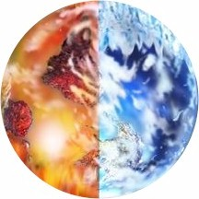
Earth’s climate is not constant.
It has warmed…
…and cooled
For BILLIONS of years!
It is the RATE that current climate change is happening that is different from what happened in the past. Since ~1800, the average global surface temperature has risen by about 1 degree Celsius.
Notes:
Slide 4:
1 degree C is a lot for the global average temperature to rise in such a short time-span (~200 years), although the number sounds small.
A few hundred thousand years ago, the UK was more like an African savannah with average temperatures only 2-3 degrees C warmer than present. 20,000 years ago, the UK was in the grips of the last Ice Age when global temperatures were 5 degrees C colder than present – a 1km thick ice sheet covered parts of the UK.
Compared to climate records from the past 800,000 years found in polar ice cores, we know that the rate of current climate change is unprecedented. (We will come back to this...)
Do the students know WHY we are making a difference to the rate of climate change?

Slide 5

Climate Change vs. Global Warming
What’s the difference?
Global warming refers to the rise in average surface temperature of the earth.
Climate change refers to all changing factors of Earth’s climate including temperature, rain, wind and humidity. Temperature is not the only thing that is changing and it is not just getting hotter.
Notes:
Slide 6:
These terms are often confused with each other and cannot be used interchangeably, ensure the pupils understand this before moving on.

Slide 6
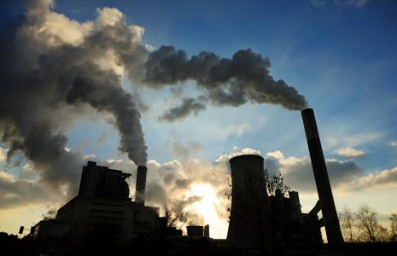
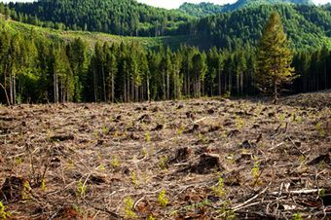
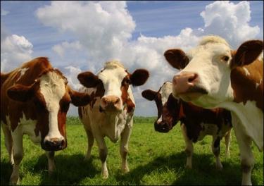
Where do WE come into this?
Everyday we do many things that are not good for our environment. By burning fossil fuels, cutting down entire forests and even breeding cows, we are polluting our atmosphere.
MOO!
Burning Fossil Fuels
Deforestation
Agriculture
By burning fossil fuels for energy such as coal, oil and gas, we are releasing extra CO2 into the atmosphere.
Trees use CO2 in the atmosphere for photosynthesis and to provide us with oxygen, but some trees are cut down for agricultural purposes.
We breed many cows for milk and meat, but when cows are ‘windy’… they release methane (another greenhouse gas) into the atmosphere. Lots of cows = lots of extra methane!
Notes:
Slide 5:
Everyone has a ‘Carbon footprint’- the total amount of greenhouse gasses produced by a person/ group of people.
Useful links: http://carboncalculator.direct.gov.uk/index.html – to work out your carbon footprints.
Or http://www.cooltheworld.com/kidscarboncalculator.php – for younger students.
Ask students if they know how to lower their carbon footprints? (Turn unnecessary electrical items and lights off, take public transport). Why does this help?
Cows are responsible for around 16% of the worlds methane emissions every year.

Slide 7
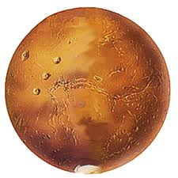
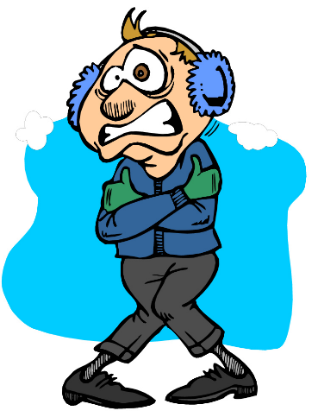
…without the Greenhouse Effect, the Earth would be too cold for life (we certainly wouldn’t be here). In fact, scientists say it might look a bit like MARS…
… Adding millions of tonnes of greenhouse gasses (including extra CO₂) to the atmosphere each year makes the greenhouse effect ‘too efficient’, causing climate change.
Notes:
Slide : 8
Make sure that the students understand that the greenhouse effect is not a ‘bad’ thing.
If Mars had a thick enough atmosphere it could be suitable for human life!
The average temperature of Earth without the greenhouse effect would be around -18 degrees Celsius.

Slide 8
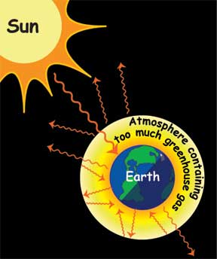
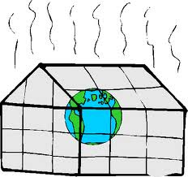
The greenhouse effect
Greenhouse gasses (including CO₂) accumulate in the atmosphere. They absorb thermal radiation (heat) from the Earth’s surface, and redirect it back down to the Earth, heating up our planet. This is called the GREENHOUSE EFFECT.
The greenhouse effect is natural.
Notes:
Slide 7:
Why is it called the greenhouse effect? – Atmosphere acts like a greenhouse, trapping the heat from the sun. Without it, this heat would be radiated from the earth and lost into space.
The parts per million of CO2 in the atmosphere at present is around 380.
Diagram (appears on click) shows how greenhouse gasses trap heat.

Slide 9
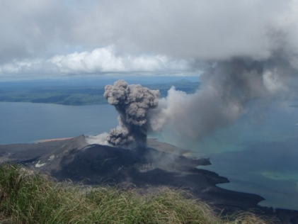
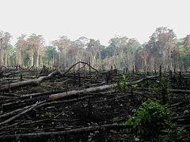
‘Most CO₂ comes from Volcanoes- it’s natural’
Many greenhouse gases in the atmosphere are produced by natural causes such as volcanoes.
The burning of fossil fuels emits far more greenhouse gas into the atmosphere than volcanoes. Explosive volcanoes can have an impact on the climate because of the ash they emit, but it only lasts a couple of years.
Notes:
Slide 31:
See: http://www.skepticalscience.com/human-co2-smaller-than-natural-emissions.htm – contains good scientific explanations of this sceptic argument.

Slide 10
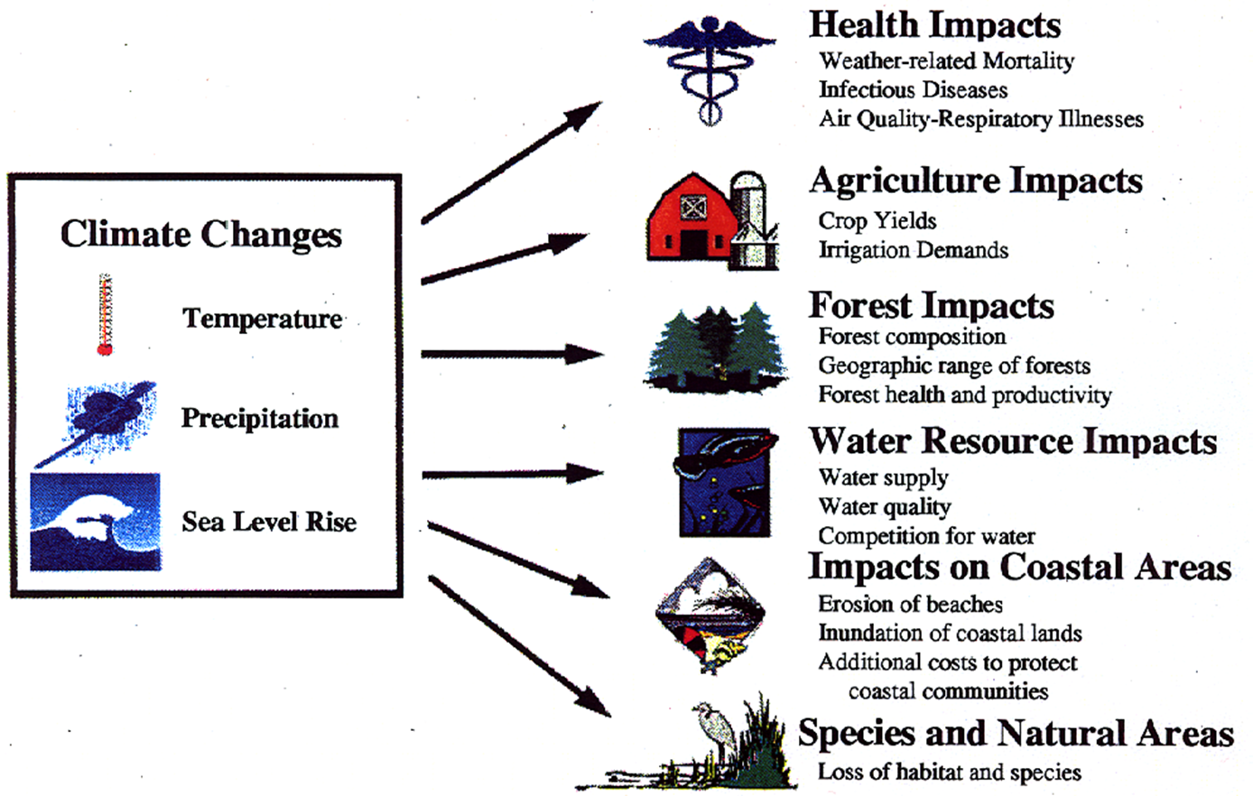
Implications of Climate Change for Africa

Slide 11
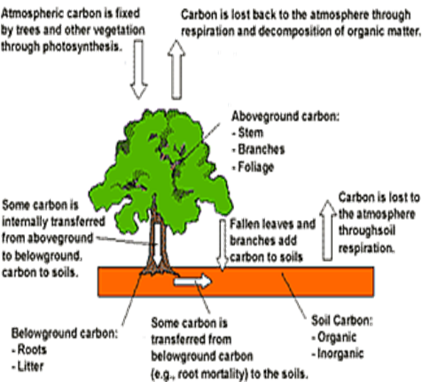
Why are Forests important in Climate Change?
Forests play a major role in the global carbon cycle and they can contribute to the mitigation of climate change through carbon sequestration, carbon substitution, and carbon conservation.
    Protected forest areas increase the resilience of ecosystems and landscapes to climate change (They conserve soil, protect watersheds, and buffer against natural disasters).
Forests, provide a ‘safety net’ for climate change adaptation through their genetic resources and ecosystem services (support livelihoods ).

Slide 12
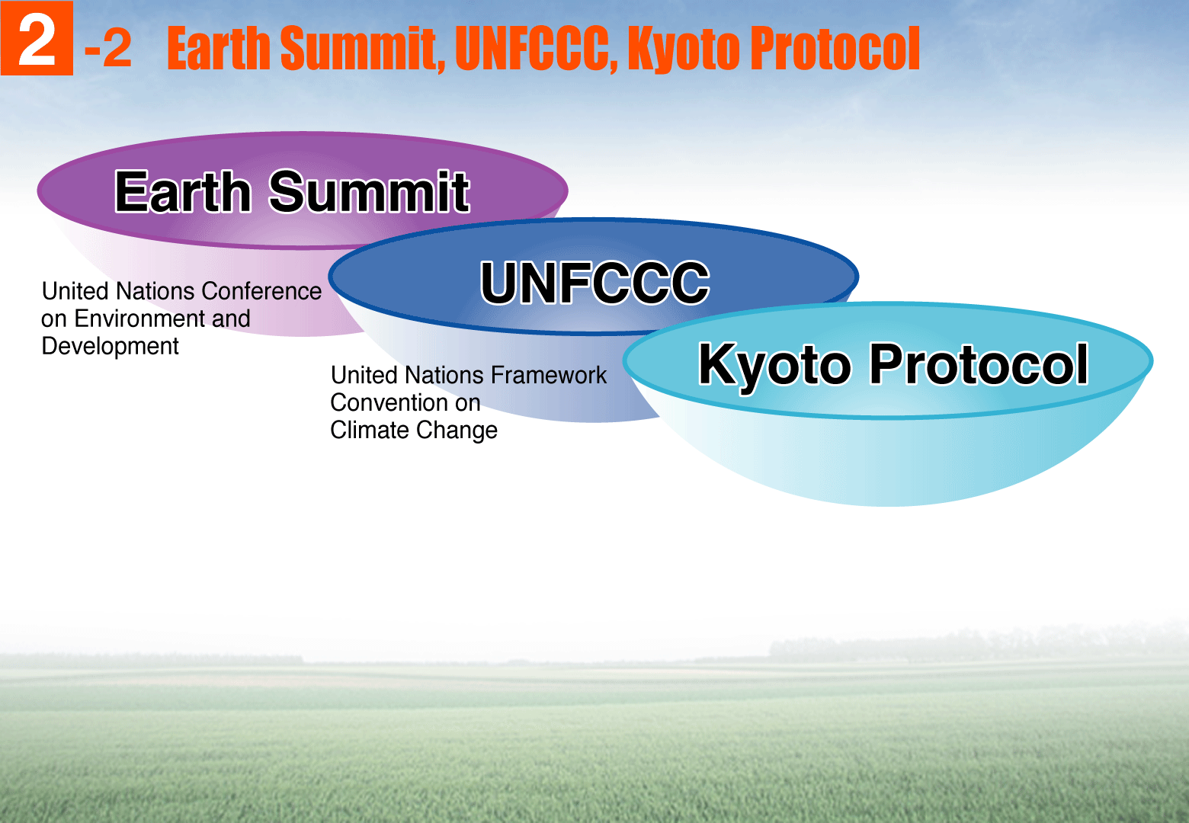
Background to Climate Change Mitigation

Slide 13
international community created the UN Framework Convention on Climate Change (UNFCCC) in 1992 to prevent dangerous climate change.
The Kyoto Protocol obliged developed nations to reduce their emissions to an average of 5.2 per cent less than their 1990 levels
both the UNFCCC and Kyoto Protocol talks meet at least twice a year, once during the COP/MOP.
The Paris Agreement builds upon the Convention and for the first time brings all nations into a common cause to undertake ambitious efforts to combat climate change

Slide 14
National Mitigation Regimes
Constitution of Zambia
Environmental Management Act
Forestry Act
Ionizing Radiation Act
Radiation Protection Act
Biosafety Act

Slide 15
Zambia’s Status
Zambia is party to both the United Nations Frameowork Convention on Climate Change (UNFCCC) and the Kyoto Protocol;
The Zambian Government signed the UNFCCC on 11th june 1992 and ratified it on 28th May 1993.
The country also signed the Kyoto Protocol on 5th August 1998 and ratified it on 7th July 2006
The Kyoto protocol came into force for the country on 5th October 2006.

Slide 16
END

