Slide 1
Environmental Impact Assessment
UNIT EIGHT

Slide 2
OVERVIEW
HISTORICAL PERSPECTIVE
DEFINITION
RATIONALE
BENEFITS Of EIA
STAKEHOLDERS
PROCESS
ENVIRONMENTAL PROJECT BRIEF
ENVIRONMENTAL IMPACT STATEMENT
THE LAW
STAGES & PRINCIPLES
CONCLUSION

Slide 3
Historical Perspective
Dates back to the 1960’s in the USA.EIA was legally first mandated in the USA under the National Environment Policy Act of 1969.
Similar legislation adopted in other countries such as Canada and most European countries. By end of 1970’s many countries had created legislation, policies and institutions to coordinate EIA programmes.
In Zambia the EIA process developed from several acts and consultations, starting with the adoption of National Conservation Strategy in 1985.

Slide 4
It was followed by the enactment of the Environmental Protection and Pollution Control Act (EPPCA) in 1990.
The National Conservation Strategy was later reviewed into the National Environmental Action Plan(NAEP) and finally the passing of Statutory Instrument No. 28 to provide for matters of EIA.

Slide 5
Definition
Environmental Management Act, Section 2 defines Environmental Impact Assessment as a systematic examination conducted to determine whether or not an activity or a project has or will have any adverse impacts
on the environment

Slide 6
Rationale
Provides information for decision makers before the project is launched on the expected effects.
Seeks to answer a few basic questions such as:
-What will happen if the project goes ahead?
-How much change is going to occur and do the
changes matter?
- What should be done about the changes?
It should be conducted in a quest to promote sustainable development.

Slide 7
Benefits of EIA
Facilitates informed decision making by providing clear, well structured analysis of the effect and consequences of proposed projects.
Ensures that potentially negative impacts are foreseen and discussed at an early stage
Identifies and enhances the positive impacts of the proposed project
Assists in the selection of alternatives.
Ensures appropriate participation of all stakeholders
Guides formal approval, including establishment of terms and conditions of project implementation and follow-up

Slide 8
Stakeholders
The Project Developer
Planning Authorities or Sectoral Agencies
Zambia Environmental Management Agency (ZEMA)
General Public
Interested and Affected Parties (IAPs)

Slide 9
Process
EIA in Zambia fall in two classes depending on the nature of the project. These are :
-Environmental Project Brief (EPB)
-Environmental Impact Statement (EIS).
The nature of the project determines whether the developer should prepare an EPB or EIS.

Slide 10
Environmental Project Brief (EPB)
Part II & III of SI 28 OF 1997
Report prepared in respect of projects with very low negative impacts on the environment.
A decision letter(prepared by ZEMA) on a project is issued within forty working (40) days of receiving the EPB from the developer.
Examples of projects which require an EPB are:
Urban area rehabilitation, water schemes and urban drainage systems,hydro power schemes, foundries etc.

Slide 11
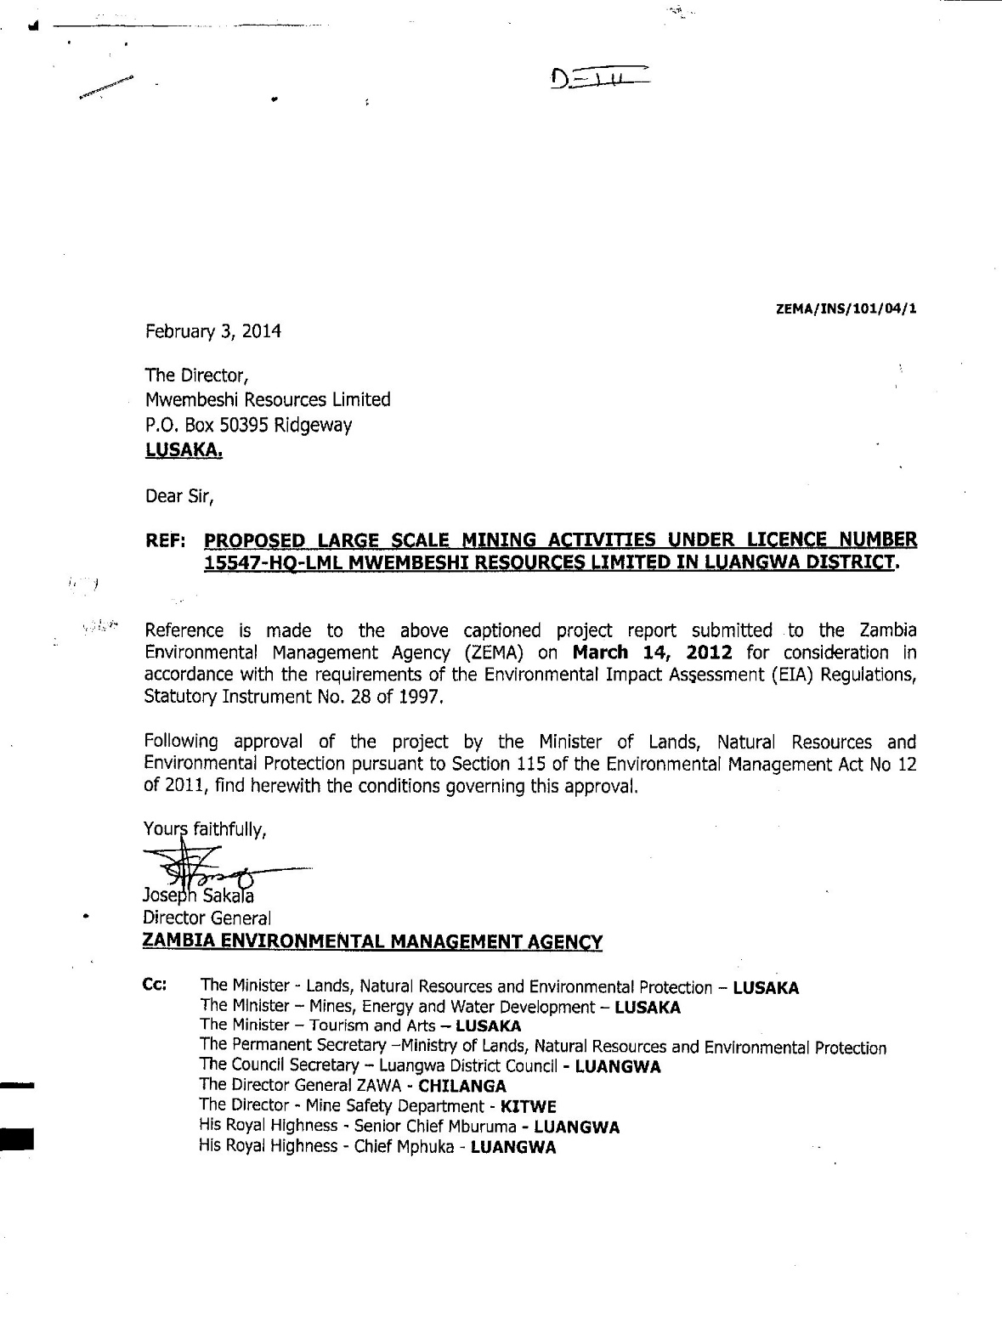
Example of decision letter

Slide 12
Environmental Impact Statement (EIS).
Part VI of SI 28 of 1997
Report prepared in respect of projects likely to have significant negative impacts on the environment.
The period within which ECZ is required to make a decision on a proposed project requiring an EIS is within sixty five (65) working days of receiving the EIS from the Developer.
An EIS is an extensive evaluation of the effects likely to arise from a project significantly affecting the national and man-made environment.
Consultation and participation are integrated to this evaluation and the study is undertaken by a group of experts. Report is signed by every individual involved.
Examples are proposed new mine, building of dam across a river etc

Slide 13
The Law
Environmental Management Act No.12 of 2011
Relevant provisions: Section 2, Section 36, Section 29 and
Section 30.
Statutory Instrument No 28 of 1997
Relevant provisions: Regulation3(1), Regulation
7(2)a.
Case Law
-Environmental Council of Zambia v Crushex 2005/HL/06
-Martha Muzite Kangwa & Others v ECZ & Others 2008/HP/245

Slide 14
Stages in conducting a full EIA
Fourth schedule of the SI 28 1997
Stage 1: Preliminary Actions
Stage 2: Scoping (Or Identification of Potential Impacts)
Stage 3: Baseline Study
Stage 4: Impact Evaluation
Stage 5: Public Participation in Environmental Impact Study
Stage 6: Identification of Mitigation Measures
Stage 7: Assessment (Or Comparison of Alternatives)
Stage 8: Decision making by the Developer
Stage 9: Submission of the report to ZEMA
Stage 10: Decision Making by ZEMA

Slide 15
Principles of Environmental Law in EIA Process
Principles of environmental law that can be evinced from stages of EIA process -:
Sustainable Development
Precautionary Principle
Public Participation
Polluter Pays Principle

Slide 16
1. Sustainable Development
Stage 3:The Team undertakes a detailed description of the existing environment including the social and economic activities.
Stage 7: The team compares all alternatives on the basis of economic, social, cultural and environmental gains and costs.
Stage 10: ZEMA either approves or rejects the projects.

Slide 17
2.Precautionary Principle
Stage 4: The team predicts and evaluates the various predicted impacts.
Stage 6: The team identifies measures for elimination or reduction of environmental impact.

Slide 18
3. Public Participation
Stage 2: The Coordinator, the team, the council and potentially affected and interested parties determine which od the impacts shall be subject of the study.
*(affected and interested parties)
Stage 5: The team seeks the view of the community which are likely to be affected by the project. Growing public concern for the environment spells out the need for involving the public in decision-making. Thus the community provides information on the local environment, culture and economic aspirations with regards proposed development.

Slide 19
6. Polluter Pays Principle
Stage 6: The team identifies measures for elimination (where possible), or reduction, of
environmental impacts for various alternatives identified in the study. This may involve:
- Engineering works such as prior treatment of
effluent, air pollution reduction measures and
solid waste minimisation through reclamation,
recycling etc
-Management measures such as reforestation
etc

Slide 20
Principles of Environmental Impact Assessment
-Participation
-Transparency
-Certainity
-Integrity
-Cost Effectiveness
-Practicality
-Accountability
-Flexibility
-Precautionary

Slide 21
Notable sections under SI 28 of 1997
-S3 – Project Brief and EIS requirement
-S9 – Approval of persons preparing EIS and conduct of EIA
-S11 – Contents of EIS
-S12 – Signatures of every individual person involved
-S17 – Public Hearing
-S21 – Decision Letter
-S34 – Offences and Penalties

Slide 22
END

