Slide 1
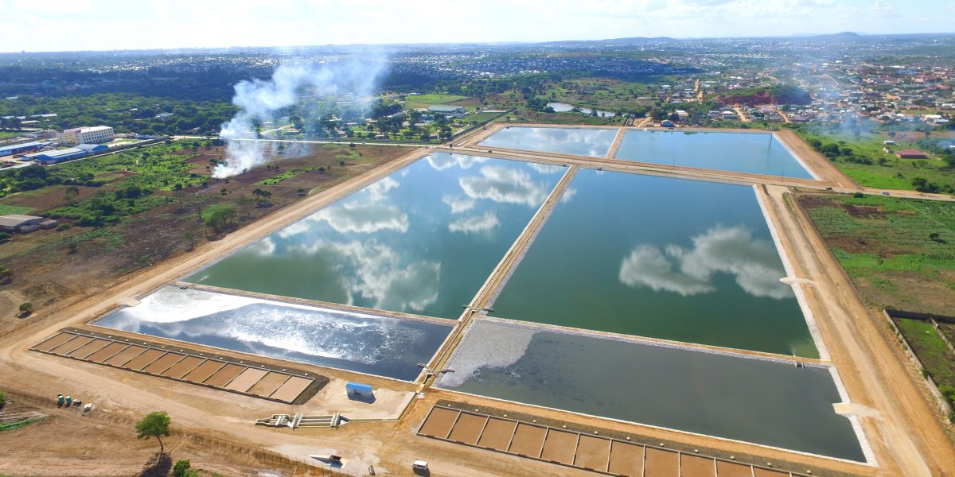
ROLE OF PLANNING LAW IN ENVIRONMENTAL LAW
UNIT SIX

Slide 2
Planning Law and Planning Control is primarily concerned with the type and location of new development and changes of use
Once broad land use have been sanctioned by the planning process, it is the job of pollution control to limit the adverse effects that operation may have on the environment
Sanctioned by Local Authoritie

Slide 3
History of Planning Law
Came from the effects of World War
Need to Plan the building of cities in England after mass destruction
Determination of type of use
Town Planning Act of 1949 in England
Planning Law in Zambia
  Modelled from the British Law- Town and Country Planning Act
  Provided for creation of local authorities
  Local Authorities specific to a particular jurisdiction or particular area e.g Lusaka City Council
Mandatory to get a planning permission before working on a project
Planning permission in relation with the Environmental Impact Assessment
Both require public participation
  MOTOR TRADERS ASSOCIATION OF CENTRAL AFRICA AND OTHERS V MUNICIPAL COUNCIL OF MUFULIRA

Slide 4
Urban and Regional Planning Act NO. 3 of 2015
Current legislation for the purposes of Planning Law in Zambia
Shows direct relationship between planning law and environmental law
Preamble provides for public participation
Highlights the principle of sustainable development by providing for social and economic sustainability in development activities
Section 2- the Act to work hand in hand with the Environmental Management Act when dealing with planning law
Section 3(e) Planning Authority to take into account the environment and ecological factors of a particular area in planning

Slide 5
Section 3(1) (c) planning procedures shall incorporate environmental standards and requirements specified in any law relating to the environment and natural resources;
Section 52 (3) in considering an application for a development permit take into account the Environmental Agency, whether the proposed development is likely to have adverse environmental effects.

Slide 6
Relationship between Planning Law and Environmental Law
GATEHEAD MBC V SECRETARY OF STATE FOR ENVIRONMENT [1995] Env. L.R.37
Glidewell L.J:stated that the government will guide the relationship between pollution control and planning control and further stated that planning control is primarily concerned with the type and location of new development and change of use, once broad land uses have been sanctioned by the planning process, it is the job of pollution control to limit the adverse effects that operations may have on the environment
“it is not the job of the planning system to duplicate controls which are the statutory responsibility of other bodies”.
Planning system to be carried out by a responsible department

Slide 7
1990 White Paper This Common Inheritance
  “Planning control is primarily concerned with the type and location of new development and changes of use.
  Once broad land uses have been sanctioned by the planning process, it is the job of pollution control to limit the adverse effects that operations may have on the environment. But in practice there is common ground. In considering whether to grant planning permission for a particular development, a local authority must consider all the effects, including potential pollution; permission should not be granted if that might expose people to danger.
  And a change in an industrial process may require planning permission as well as approval under the environmental protection legislation.”

Slide 8
Similarities between Planning Law and Environmental Law
There are both regulated by legislation
They are both aimed at controlling what happens in the environment
Both use the principle of public participation before a decision is made
They both enhance sustainable development
They both have a regulatory authority, local authority vs ZEMA

Slide 9
Key Differences between Planning Law and Environmental Law
Both use different legislation
One is aimed at planning and the other is used for regulating the effects of planning
Planning law occurs on a once off basis, meaning that you need not to renew the licence, whereas for environmental law you need to renew the licence e.g Section 34 Environmental Management Act- emission licence
Environmental licences are often personal (conditional ) ( fit and proper ) whereas planning law there is no need to be fit or proper to be granted a licence, focus is on the land
Licence under planning law, once granted is transferable to the next person (conveyancing) whereas environmental law, the person dies with the licence.

Slide 10
Regulating Authority
Section 13 Urban and Regional Planning Act
  provides for the establishment of Local Authorities as local planning authorities

Slide 11
Meaning of Development
Section 2 Urban and Regional Planning Act
  The carrying out of any building, rebuilding, mining or other works, or operations on or under land including the subdivision of land or change of use

Slide 12
Development Plans
Section 2 of the Urban and Regional Planning Act
  National Planning Framework, Regional development plan, provincial development plan, integrated development plan, local area plan and sectoral plan

Slide 13
Exemptions from the need of planning permission
Do not constitute development
Constitute development, permission is granted for those activities by legislation.

Slide 14
Distinction between Structure Plans and Local Plans
Structure plans are prepared in relation to a substantial region, such as a whole country whereas local plans Local plans translate the broad strategic issues dealt with in the structure plan into specific detailed policies and proposals.

Slide 15
Environmental Considerations in Development Plans
Widest sense in plan preparation.
Pollution control planning for healthier cities
Public participation and debate open for the public
  MOTOR TRADERS ASSOCIATION OF AFRICA V MUNICIPLA OF MUFULIRA
Reconciling conflicts between the need for development and the need to protect the environment.
Consulting Environmental Agency- ZEMA

Slide 16
Environmental Considerations in Planning Policy
Sustainable development - specific policies
Transport - housing, employment, retail, leisure education – reduce travel
Renewable energy
Nature and Landscape conservation-
  can significantly restrict new development.
  guiding principle of government policy - development in the countryside should benefit the rural economy, as well as maintaining or enhancing the environment.

Slide 17
Definition of planning control and respective aims
Control mechanisms are there to prevent breaches of planning control.
These are methods used by the planning authorities to remedy breaches done after the issuance of a planning permit
The aim of the planning control is to obtain information so as to resolve the matter amicably.
Failure to provide information can result in a fine
This is done through numerous notices issued by the planning authority

Slide 18
END

