Slide 1
DISPUTE SETTLEMENT IN THE WTO
UNIT 3

Slide 2
Learning Objectives
Identify and assess the general features of the dispute settlement system of the WTO
Understand dispute settlement processes
Understand the Functions of the Dispute Settlement Body

Slide 3
GATT Dispute Settlement
The GATT 1947 was not conceived as an international organization for trade, and, therefore, did not provide for an elaborate dispute settlement system
In fact, the GATT 1947 contained only two brief provisions relating to dispute settlement: Articles XXII and XXIII
Under the GATT 1947, a dispute, which parties failed to resolve through consultations, was in the early years of the GATT “handled” by working parties set up pursuant to Article XXIII:2.
These working parties consisted of representatives of all interested Contracting Parties not involved in the dispute
Decisions were made based on consensus

Slide 4
GATT Dispute Settlement Process – 1950s
Panel
3-5 Independent Experts
GATT Council
All Contracting Parties

Slide 5
Judicialisation
In 1983, a GATT Legal Office was established within the GATT Secretariat, to help panels, often composed of trade diplomats without legal training, with the drafting of panel reports.
During the 1980s, previous panel reports were increasingly used as a sort of “precedent” and the panels started using customary rules of interpretation of public international law.
Therefore, increasing “legalisation” of the GATT’s “diplomat’s jurisprudence”

Slide 6
Judicialisation
The GATT dispute settlement system evolved from a power-based system of dispute settlement through diplomatic negotiations into a system that had many features of a rules-based system of dispute settlement through adjudication.

Slide 7
Judicialisation
Power-based system
Rules-based system through adjudication
Diplomatic negotiations

Slide 8
Shortcomings
The most important shortcoming of the system was that the decision on the establishment of a panel, the decision on the adoption of the panel report and the decision to authorize the suspension of concessions, were to be taken by the GATT Council by consensus.
The responding party could thus delay or block any of these decisions and thus paralyze or frustrate the operation of the dispute settlement system
The fact that the losing party could prevent the adoption of the panel report meant that panels were often tempted to arrive at a conclusion that would be acceptable to all parties
Whether that conclusion was legally sound, and convincing was not a prime concern

Slide 9
Shortcomings
Contracting Parties regarded the dispute settlement process as unable to handle many of the politically sensitive trade disputes since the assumption was that the respondent would refuse to agree to the establishment of a panel or the losing party would prevent the adoption of the panel report

Slide 10
The WTO Dispute Settlement Understanding
The Understanding on Rules and Procedures Governing the Settlement of Disputes, commonly referred to as the Dispute Settlement Understanding or DSU, is attached to the WTO Agreement as Annex 2 and constitutes an integral part of that Agreement.
The DSU provides for an elaborate dispute settlement system and is often referred to as one of the most important achievements of the Uruguay Round negotiation

Slide 11
How the Dispute Settlement System works
The Dispute Settlement Body,
All Members
Establishes
No appeal?
DSB adopts the report
DSB adopts the reports
Panel
Report
Appellate Body
Notes:
Functions and composition of the DSB
The General Council discharges its responsibilities under the DSU through the DSB (Article IV:3 of the WTO Agreement). Like the General Council, the DSB is composed of representatives of all WTO Members. These are governmental representatives, in most cases diplomatic delegates who reside in Geneva (where the WTO is based) and who belong to either the trade or the foreign affairs ministry of the WTO Member they represent. As civil servants, they receive instructions from their capitals on the positions to take and the statements to make in the DSB. As such, the DSB is a political body.
The DSB is responsible for administering the DSU, i.e. for overseeing the entire dispute settlement process.
The DSB has the authority to establish panels, adopt panel and Appellate Body reports, maintain surveillance of implementation of rulings and recommendations and authorize the suspension of obligations under the covered agreements (Article 2.1 of the DSU). A later chapter on the stages of the dispute settlement procedure will explain exactly what all these actions mean. In less technical terms, the DSB is responsible for the referral of a dispute to adjudication (establishing a panel); for making the adjudicative decision binding (adopting the reports); generally, for supervising the implementation of the ruling; and for authorizing "retaliation" when a Member does not comply with the ruling.
The DSB meets as often as is necessary to adhere to the time‑frames provided for in the DSU (Article 2.3 of the DSU). In practice, the DSB usually has one regular meeting per month. When a Member so requests, the Director-General convenes additional special meetings. The staff of the WTO Secretariat provides administrative support for the DSB (Article 27.1 of the DSU).
Role of the chairperson
The DSB has its own chairperson, who is usually one of the Geneva-based ambassadors, i.e. a chief of mission of a Member's permanent representation to the WTO (Article IV:3 of the WTO Agreement). The chairperson is appointed by a consensus decision of the WTO Members. The chairperson of the DSB has mainly procedural functions, that is, passing information to the Members, chairing the meeting, calling up and introducing the items on the agenda, giving the floor to delegations wishing to speak, proposing and, if taken, announcing the requested decision. The chairperson of the DSB is also the addressee of the Members’ communications to the DSB.
In addition, the chairperson has several responsibilities in specific situations. For instance, the chairperson determines, upon request by a party and in consultation with the parties to the dispute, the rules and procedures in disputes involving several covered agreements with conflicting "special or additional rules and procedures" [1] if the parties cannot agree on the procedure within 20 days (Article 1.2 of the DSU). The chairperson can also be authorized by the DSB to draw up special terms of reference pursuant to Article 7.3 of the DSU. The DSB chairperson is further entitled to extend, after consultation with the parties, the time-period for consultations involving a measure taken by a developing country Member, if the parties cannot agree that the consultations have concluded (Article 12.10 of the DSU). In dispute settlement cases involving a least-developed country Member, the least-developed country can request the DSB chairperson to offer his/her good offices, conciliation and mediation before the case goes to a panel (Article 24.2 of the DSU). Lastly, the DSB chairperson is to be consulted before the Director-General determines the composition of the panel under Article 8.7 of the DSU[2], and before the Appellate Body adopts or amends its Working Procedures (Article 17.9 of the DSU).
[1] See above the section on A single set of rules and procedures on page 14.
[2] See further below in the section on the Composition of the panel on page 44.
Source: DS Handbook

Slide 12
Significant Innovations
The quasi-automatic adoption of requests for the establishment of a panel, of dispute settlement reports and of requests for the authorization to suspend concessions
The strict timeframes for various stages of the dispute settlement process
The possibility of appellate review of panel reports

Slide 13
Object and Purpose of the WTO Dispute Settlement System
Article 3.2 of the DSU states:
“The dispute settlement system of the WTO is a central element in providing security and predictability to the multilateral trading system. The Members recognize that it serves to preserve the rights and obligations of Members under the covered agreements, and to clarify the existing provisions of those agreements in accordance with customary rules of interpretation of public international law. Recommendations and rulings of the DSB cannot add to or diminish the rights and obligations provided in the covered agreements.”

Slide 14
Object and Purpose of the WTO Dispute Settlement System
Object: prompt settlement of disputes through multilateral proceedings, e.g.
EC – Bananas III
Request for Consultations 5 February 1996
Panel Report 22 May 1997
Appellate Body Report 7 September 1997

Slide 15
4 Different Methods of Dispute Settlement
Consultations/negotiations (Art 4)
Adjudication by panels/AB (Arts 6-20)
Arbitration (Art 21.3(c), 22.6 and 25)
Good offices, conciliation and mediation (Art 5)

Slide 16
Jurisdiction
Scope of Jurisdiction
Article 1.1 of DSU - Any dispute between WTO Members arising under what are called the covered agreement
However, some of the covered agreements provide for a few special and additional rules and procedures “designed to deal with the particularities of dispute settlement relating to obligations arising under a specific covered agreement” – Art 1.2
These special or additional rules and procedures prevail over the DSU rules and procedures to the extent that there is a conflict, between the DSU rules and procedures and the special and additional rules and procedures.

Slide 17
Jurisdiction
Compulsory Jurisdiction
Pursuant to Article 23.1 of the DSU, a complaining Member is obliged to bring any dispute arising under the covered agreements to the WTO dispute settlement system.
As a matter of law (Art 6.1) a responding Member, on the other hand, has no choice but to accept the jurisdiction of the WTO dispute settlement system.
Accession to the WTO constitutes consent to and acceptance of the compulsory jurisdiction of the WTO dispute settlement system.
With regard the jurisdiction of the WTO dispute settlement system, it should also be noted that the system has only contentious, and no advisory, jurisdiction.

Slide 18
Jurisdiction
Covers all main agreements
Compulsory, exclusive and contentious in nature
Access to DSB limited to Members:
Members have standing when it claims a benefit accruing to it in a WTO agreement has been impaired
If a violation is shown, there is a presumption that a benefit has been impaired
NGOs, industry associations or individuals have no access to the DSB, however, most disputes are brought at the instigation of companies or industry associations
Panels and ABs may accept amicus curiae (friend of the court) briefs from NGOs

Slide 19
Access to WTO Dispute Settlement
Access to, that is, the use of, the WTO dispute settlement system is limited to Members of the WTO
AB in US-Shrimp Case:
“It may be well to stress at the outset that access to the dispute settlement process of the WTO is limited to Members of the WTO. This access is not available, under the WTO Agreement and the covered agreements as they currently exist, to individuals or international organizations, whether governmental or non- governmental. Only Members may become parties to a dispute of which a panel may be seized, and only Members “having a substantial interest in a matter before a panel” may become third parties in the proceedings before that panel. Thus, under the DSU, only Members who are parties to a dispute, or who have notified their interest in becoming third parties in such a dispute to the DSB, have a legal right to make submissions to, and have a legal right to have those submissions considered by, a panel.”

Slide 20
Access to WTO Dispute Settlement
Causes of Action
Each covered agreement contains one or more consultation and dispute settlement provisions. These provisions set out when a Member can have recourse to the WTO dispute settlement system.
For the GATT 1994, the relevant provisions are Articles XXII and XXIII. Of particular importance is Article XXIII:1 of the GATT 1994.

Slide 21
Access to WTO Dispute Settlement
Causes of Action
In India – Quantitative Restrictions, the Appellate Body held:
“This dispute was brought pursuant to, inter alia, Article XXIII of the GATT 1994. According to Article XXIII, any Member which considers that a benefit accruing to it directly or indirectly under the GATT 1994 is being nullified or impaired as a result of the failure of another Member to carry out its obligations, may resort to the dispute settlement procedures of Article XXIII.”
The consultation and dispute settlement provisions of most other covered agreements incorporate by reference Articles XXII and XXIII of the GATT 1994.

Slide 22
Causes of Action
There is no explicit provision in the DSU requiring a Member to have a “legal interest” in order to have recourse to the WTO dispute settlement system.
It has been held that such requirement is not implied either in the DSU or any other provision of the WTO Agreement.
The Appellate Body explicitly agreed with the statement of the Panel in EC – Bananas III that:
“... with the increased interdependence of the global economy, ... Members have a greater stake in enforcing WTO rules than in the past since any deviation from the negotiated balance of rights and obligations is more likely than ever to affect them, directly or indirectly”

Slide 23
Composition:
Dispute Settlement Body (DSB):
Political body composed of all WTO Members
Establishes Panels
Adopts reports (by reverse consensus)
Authorizes suspension of obligations
Panels:
Ad hoc bodies established by the DSB
Dissolved when their task is done

Slide 24
Panels:
Parties must decide on composition of panels within 20 days or else complainant may approach director-general to appoint panellists
Panel consists of 3 well-qualified individuals from countries not involved in the dispute
Panel must only consider claims they must to resolve the matter at hand
Panel report must set out findings of fact, applicability of relevant provisions and basic rationale behind findings it makes at a minimum
Panel report legally binding when adopted by the DSB (by reverse consensus)

Slide 25
Appellate Body:
Comprises a standing international tribunal of 7 independent individuals of recognised authority, appointed by the DSB for 4 year terms
Composition of AB representative of WTO membership
AB hears appeals in divisions of 3 of its members
Appeals limited to issues of law covered by panel, and interpretation by panel
The Appellate Body can uphold, modify or reverse the legal findings and conclusions of a panel

Slide 26
Process:
Consultations – 60 days, if not resolved, complainant may request panel
Panel proceedings – within 1 week, Panel fixes its timetable for dispute. Parties submit “first written submission” then “rebuttal submission”. Panel meets with parties twice. Panel then finalizes report, meets with parties, translates into 3 languages and circulates to all WTO Members
Panel proceedings should not exceed 9 months, but in practice usually takes 12
After 60 days, Panel report is either adopted by DSB or appealed to AB

Slide 27
Remedies:
Withdrawal or amendment of WTO-inconsistent measure
Compensation
Suspension of concessions or other obligations
2 & 3 are temporary and retaliatory measures, whereas 1. is final

Slide 28
Remedies cont…
Compliance with ruling of the DSB must be immediate or within reasonable time
If not, the DSB will authorize the complainant to take retaliatory measures
  Eg: drastic increase in customs duties on strategically selected products
  Where parties fail to implement recommendations within reasonable time, other party may retaliate using Art 21.5 DSU

Slide 29
DISPUTE SETTLEMENT FROM 1995 - 2022
A total of 615 requests for consultations were circulated to the WTO membership, however not all disputes required a formal ruling to resolve them.
During this period 53 WTO members initiated at least one dispute.
61 members were a respondent in at least one dispute
A total of 90 members have participated as third parties in proceedings between two or more other WTO members.
Overall a total of 111 members have been active in dispute settlement as a party or third party.

Slide 30
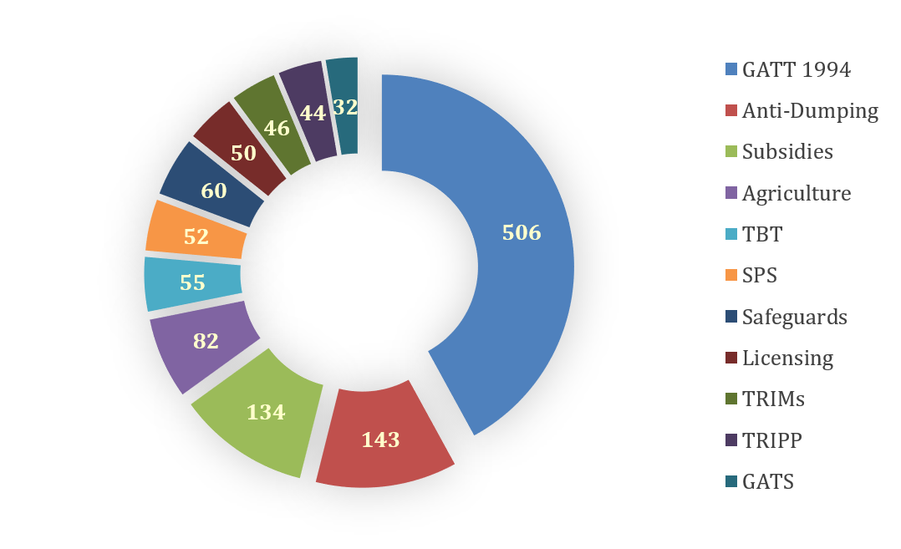
Agreements Raised in WTO disputes

Slide 31
The WTO dispute settlement system is “integrated”, such that several agreements can be at issue in the same dispute. The total numbers in the chart above therefore exceed the total number of distinct disputes initiated. In cases involving trade in goods, the GATT 1994 is frequently invoked alongside more specific agreements, which explains why it appears in 506 of the 615 disputes initiated between 1995 and 2022.

Slide 32
The Appellate Body
Currently the appellate body is unable to review appeals given its ongoing vaccancies. The term of the last sitting appellate body member expired on 30th November 2020.
As of December 2022, appeals in 25 proceedings were pending before the Appellate Body and cannot be further advanced until new members are appointed.
In the absence of a functioning Appellate Body, some members have resorted to an alternative appeal mechanism based on arbitration proceedings under Article 25 of the DSU. As of 31 December 2022, parties to ten disputes have agreed on procedures for such review of panel reports and arbitrators have issued awards in two such proceedings.

Slide 33
Because the appointment process for Appellate Body members operates by consensus, a member can block an appointment by formal objection. In 2016, the United States blocked one proposed reappointment to the Appellate Body and, starting in 2017, it has blocked every proposed appointment or reappointment. In the latter half of 2019 and 2020, the United States has continued its refusal to entertain measures to fill the vacancies, citing the lack of progress toward reforms of the Appellate Body.

Slide 34
In February 2020, the Office of the U.S. Trade Representative published a 121-page report detailing what the United States perceives to be the Appellate Body's shortcomings.
•The Appellate Body consistently ignores the mandatory deadline for deciding appeals;
•The Appellate Body allows individuals who have ceased to serve on the Appellate Body to continue deciding appeals as if their term had been extended by WTO Members in the Dispute Settlement Body;
•The Appellate Body has made findings on issues of fact, including issues of fact relating to WTO Members’ domestic law, although Members authorized it to address only legal issues;
•The Appellate Body has issued advisory opinions and otherwise opined on issues not necessary to assist the WTO Dispute Settlement Body in resolving the dispute before it;
•The Appellate Body has insisted that dispute settlement panels treat prior Appellate Body interpretations as binding precedent;
•The Appellate Body has asserted that it may ignore WTO rules that explicitly mandate it recommend a WTO Member to bring a WTO-inconsistent measure into compliance with WTO rules; and
•The Appellate Body has overstepped its authority and opined on matters within the authority of WTO Members acting through the Ministerial Conference, General Council, and Dispute Settlement Body.

Slide 35
In response to the deadlock, the European Union and eighteen other WTO members have established a Multi-Party Interim Appeal Arbitration Arrangement (MPIA) to function as a substitute for the Appellate Body.
The members notified the WTO of the MPIA on April 30, 2020, anticipating the pool of arbitrators to be formed three months from that date. Rather than pursuing an appeal through the Appellate Body under Articles 16.4 and 17 of the DSU, participating members have committed to receiving comparable review of panel decisions through arbitration, which, if mutually agreed upon, is a form of dispute settlement authorized by Article 25 of the DSU.
The MPIA will have a pool of ten arbitrators from which three are selected for each appeal. While the MPIA substantially mirrors the Appellate Body, it integrates new practices intended to improve the appellate process.
“Any WTO member [can] join the MPIA at any time,” and the interim arbitration procedure will only hear appeals between participants until the Appellate Body is able to hear new appeals again.”

