Slide 1
National Treatment
Article III of the GATT

Slide 2
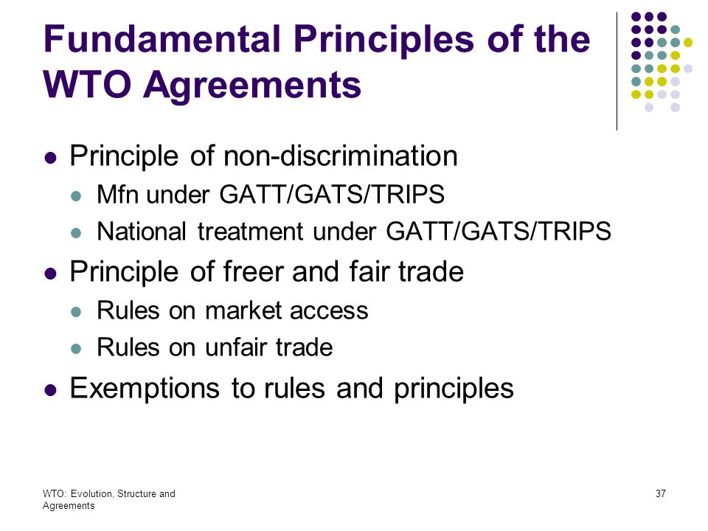

Slide 3
Art III:1
“The contracting parties recognize that internal taxes and other internal charges, and laws, regulations and requirements affecting the internal sale, offering for sale, purchase, transportation, distribution or use of products, and internal quantitative regulations requiring the mixture, processing or use of products in specified amounts or proportions, should not be applied to imported or domestic products so as to afford protection to domestic production.”
Contains general principles and informs and provides the context for the rest of Article III

Slide 4
Art III:2
“The products of the territory of any contracting party imported into the territory of any other contracting party shall not be subject, directly or indirectly, to internal taxes or other internal charges of any kind in excess of those applied, directly or indirectly, to like domestic products.
Moreover, no contracting party shall otherwise apply internal taxes or other internal charges to imported or domestic products in a manner contrary to the principles set forth in paragraph 1.” (i.e to afford protection to domestic production)

Slide 5
Art III:4
“The products of the territory of any contracting party imported into the territory of any other contracting party shall be accorded treatment no less favourable than that accorded to like products of national origin in respect of all laws, regulations and requirements affecting their internal sale, offering for sale, purchase, transportation, distribution or use. The provisions of this paragraph shall not prevent the application of differential internal transportation charges which are based exclusively on the economic operation of the means of transport and not on the nationality of the product.”

Slide 6
What does this mean?
NT principle ensures non-discrimination between domestic and foreign products, services or nationals
Generally, it prohibits a member from favouring its products over the imported like products of other member countries once those products have entered the domestic market
Objective: to provide equality of competitive conditions of imported products in relation to domestic products
Essentially, restricts discrimination between imported and domestic products

Slide 7
Illustration
E.g. Country V a WTO member adopts a regulation which imposes a sales tax of 20% on imported soft drinks and a sales tax of 1% on domestic soft drinks. In addition, it imposes a special packaging requirement for the internal transportation of soft drinks contained in glass bottles that this country does not apply to domestically produced soft drinks contained in glass bottles.
Can Country V apply a 20% sales tax on imported soft drinks and 1% sales tax on domestic soft drinks?
Can it impose a special packaging requirement only on imported soft drinks contained in glass bottles?
Border measures v internal measures

Slide 8
Italy - Agricultural Machinery
Facts
Special credit terms were given to Italian farmers if they purchased Italian agricultural machinery
Eligible purchasers may benefit from these favourable terms when they buy Italian agricultural machinery; if, on the other hand, they wish to buy foreign machinery on credit, the terms would be less favourable.
The United Kingdom delegation noted that Article III:4 of the General Agreement - alleged that Italian law presented a discrimination— an inconsistency with the provisions of Article III

Slide 9
Italy – Agricultural Machinery
1958 GATT Panel decision:
The intention of the drafters of the agreement was clearly to treat the imported products in the same way as the like domestic products once they have been cleared through customs. Otherwise indirect protection could be given.

Slide 10
Japan - Alcoholic Beverages II
Facts
Japanese Liquor Tax Law that established a system of internal taxes applicable to all liquors at different tax rates depending on which category they fell within. The tax law at issue taxed shochu at a lower rate than the other products.
Vodka and other alcoholic beverages such as liqueurs, gin, genever, rum, whisky and brandy, were taxed in excess of domestic shochu.

Slide 11
Japan – Alcoholic Beverages II
AB quoted Italy – Agricultural Machinery and US – Section 337 and added that Art III obliges members of the WTO to provide equality of competitive conditions for imported products in relation to domestic products.
NB:
The broad purpose is to avoid protectionism.

Slide 12
Note: Art III applies to INTERNAL measures only
This was an issue in China – Auto Parts (2009)
Read China Auto Parts as to the facts and legal issue.
Discuss the principle as it relates to an internal measure.
Do you offer any critique in this regard?

Slide 13
Article III:2
First Sentence –physical characteristics
Involves internal taxes and charges
A case-specific assessment and comparison is made of two or more products as to their physical properties, nature and quality, end uses, consumers' tastes and habits and any other point of comparison.
Under this test, the term “like product” is construed narrowly since the tests is in fact specific
Second Sentence – DCS
Subject of the interpretive note which provides that the term “like product” refers to a ‘directly competitive or substitutable product’
Broader range of products
Consideration given to not only physical characteristics but also marketplace factors, competition in relevant markets etc

Slide 14
Article III:2 first sentence
China – Auto Parts (2009):
Sets out 3-tier test:
Whether the measure is an internal tax or other internal charge on products?
Whether imported and domestic products are “like” products”
Whether the imported products are taxed in excess of the domestic products?
If all affirmative, then violation of Art III:2 first sentence. If not, then further examination for consistency with second sentence.
Note: second sentence requires Directly Competitive or Substitutable (DCS) Products enquiry, not “like” products.

Slide 15
China – Auto Parts
The measure:
The EC challenged the Chinese measures under which imported automobile parts, as defined by the measures, which were used in the manufacture of vehicles for sale in China are considered to fulfil the characteristics of a whole vehicle if they are imported in excess of certain thresholds. This is the case when specific combinations of parts of the later assembled vehicle are imported or when the price of the imported parts attain 60% or more of the vehicle.
If these thresholds are met, the measures provide that imported parts will be subject to charges equal the tariffs for a complete vehicle. These charges are assessed after the assembly of the parts into complete vehicles.

Slide 16
When is it an internal tax?
Mexico – Taxes on Soft Drinks:
Facts
Mexico's tax measures under which soft drinks using non-cane sugar sweeteners were subject to 20 per cent taxes on (i) their transfer and importation; and (ii) specific services provided for the purpose of transferring soft drinks and bookkeeping requirements.
Measure at issue: Mexico's tax measures under which soft drinks using non-cane sugar sweeteners were subject to 20 per cent taxes on their transfer and importation
AB found: tax measure inconsistent with Art III:2 first sentence (like products) by posing an indirect tax on non-can sugar sweeteners.

Slide 17
US – Tobacco:
Penalty provision for enforcement of domestic law found not to be an internal tax or charge, but rather an internal regulation in terms of Art III:4
US – Malt Beverages:
Measure preventing imported products from being sold in a manner that would enable them to avoid taxation was considered to be a measure within the scope of Art III:2 because it assigned a higher tax rate to the imported products.

Slide 18
Art III:2 Second sentence
The test (based on Japan – Alcohol II):
Whether the measure at issue is an internal tax or other charge on products
Whether the imported and domestic products are directly competitive and substitutable;
Whether the imported and domestic products are dissimilarly taxed; and
Whether the dissimilar taxation is applied so as to afford protection to domestic production

Slide 19
Art III:4
Korea – Various Measures on Beef
The AB considered whether Korea was infringing the national treatment obligation by maintaining a dual retail system for marketing beef that confined sales of imported beef to specialized stores.
Korean law created two distinct retail distribution systems for beef: one for domestic beef and another for imported beef. A large retailer could sell both domestic and imported beef as long as it maintained separate sale areas. Retailers selling imported beef were required to display a sign reading “Specialized Imported Beef Store”.
AB stated test for a violation of Art III:4:
Are they “like” products?
Is the measure at issue a ‘law, regulation, or requirement affecting their internal sale, offering for sale, purchase, transportation, distribution or use’?
Are the imported products accorded ‘less favourable’ treatment than like domestic products?

Slide 20
According to the Appellate Body, the dual retail system virtually cut off imported beef from access to the "normal" distribution outlets for beef, which modified the conditions of competition for imported beef to the disadvantage of the imported product.
In this connection, the Appellate Body said that the formally different treatment of imported and domestic products is not necessarily "less favourable" for imports within the meaning of Art. III:4.

Slide 21
European Communities Asbestos
In EC-Asbestos, the issue was whether chrystotile asbestos fibres are like fibres made from other materials, such aspolyvinyl alcohol, cellulose, and glass (PCG fibres)
AB were of the view that the word ‘like’ is to be interpreted to apply to products that are in such a competitive relationship
Thus, determination of like under Article III:4 is a determination about the nature and extent of a competitive relationship between and among products
Essentially, a synthesis of physical characteristics and marketplace ideas

Slide 22
NB for Art III:4
See “Like products” section, and add from EC – Asbestos:
“[A] determination of ‘likeness’ under Article III:4 is, fundamentally, a determination about the nature and extent of a competitive relationship between and among products.”
And note: the scope of Art III:4 like products is broader than Art III:2 first sentence, but not nearly as broad as DCS products (second sentence), but they cannot be significantly different

Slide 23
Less favourable treatment
US – Section 337:
Interpreted ‘no less favourable’ to mean effective equality of competitive opportunities. Subsequent Panel and AB reports have interpreted in the same way.
Dominican Republic – Cigarettes:
Tax stamp requirement for imported cigarettes effectively modified competitive relationship because of additional processes and costs on imported product, and it presented the product to consumers in a less appealing manner

Slide 24
Examples of measures covered by Art III:4
Dominican Republic – Cigarettes:
Requirement that imported cigarettes cannot leave the bonded warehouse unless tax stamps are affixed to each cigarette packet in the presence of a tax inspector
Brazil - Re-treaded Tyres:
Obligation to dispose of 10 used tyres as a pre-requisite for the importation of one re-treaded tyre
Mexico – Taxes on Soft Drinks
Specific services provided for the purpose of transferring soft drinks and bookkeeping requirements

Slide 25
Exceptions
Government Procurement: GATT Article III:8(a)
Permits governments to purchase domestic products preferentially, making government procurement one exception to the national treatment rule.
This exception is permitted because WTO Members recognize the role of government procurement in national policy.
For example, there may be a security need to develop and purchase products domestically, or government procurement may, as is often the case, be used as a policy tool to promote smaller business, local industry, or advanced technologies.
Note: in the context of government procurement, the national treatment rule applies only between those who have acceded to the Agreement on Government Procurement

Slide 26
Exceptions
Domestic Subsidies: GATT Article III:8(b)
Allows for the payment of subsidies exclusively to domestic producers as an exception to the national treatment rule, under the condition that it is not in violation of other provisions in Article III and the Agreement on Subsidies and Countervailing Measures
The reason for this exception is that subsidies are recognized to be an effective policy tool, and are recognized to be basically within the latitude of domestic policy authorities.
However, because subsidies may have a negative effect on trade, the Agreement on Subsidies and Countervailing Measures imposes strict disciplines on their use

Slide 27
Exceptions
Promoting domestic infant industries: GATT Article XVIII:C
Members in the early stages of development can raise their standard of living by promoting the establishment of infant industries, but this may require government support, and the goal may not be realistically attainable with measures that conform to the GATT.
In such cases, countries can use the provisions of GATT Article XVIII:C to notify WTO Members and to initiate consultations. After consultations are completed and under certain restrictions, these countries are then allowed to take measures that are inconsistent with GATT provisions.
The Article XVIII:C procedure allows both broader measures and violations of the national treatment obligations in order to promote domestic infant industries.

Slide 28
General Exceptions
GATT Article XX
Subject to the requirement that such measures are not applied in a manner which would constitute a means of arbitrary or unjustifiable discrimination between countries where the same conditions prevail, or a disguised restriction on international trade, nothing in this Agreement shall be construed to prevent the adoption or enforcement by any contracting party of measures:
(a) necessary to protect public morals;
(b) necessary to protect human, animal or plant life or health;
(c) …
(d) …
(e) …
(f) …
(g) relating to the conservation of exhaustible natural resources if such measures are made effective in conjunction with restrictions on domestic production or consumption;

Slide 29
Art XX in general
Used as a defence to a finding of a violation of MFN or National Treatment (or other obligation in the GATT)
Essentially a country may have violated a particular GATT related obligation and put up as a legal defense Article XX because this provision operates as a general exception to GATT itself.
In determining whether a particular exception applies, it must first be established
whether the measures falls within the ambit of any of the exceptions under Art XX and
whether there is in fact a genuine interest on the part of the State in preventing the risk involved.
Thereafter, it must be determined - keeping in mind the particular exception claimed - whether the measure complies with the requirements of the Article XX Chapeau, i.e. introductory paragraphs of Article XX.
Note the role of the chapeau in invoking the exceptions

Slide 30
A Two–tier test:
Does the measure meet the requirements of one of the exceptions under Art XX?
Does the measure meet the requirements of the chapeau?

Slide 31
The Chapeau
The Chapeau essentially prohibits any “arbitrary or unjustifiable discrimination between countries where the same conditions prevail, or a disguised restriction on international trade”
Stands as a qualification to the exceptions and at the same time ensures against abuse by the parties who resort to it
A Member’s right o invoke the exceptions is thus conditional and limited.
Three standards qualify the use of any of the exceptions in Article XX
A measure is not to be permitted if it is established as an:
1. arbitrary discrimination
2. unjustifiable discrimination
3. a disguised restriction on international trade

Slide 32
US – Shrimp (1998)
United States introduced an import ban on shrimp caught in a manner which threatened an endangered turtle species which occasionally migrated through US waters
Their solution: a certification procedure to certify certain producers as using Turtle Excluder Devices (TEDs)
TEDs patented in the United States
Relied on XX(g): allows trade restrictive measures if it relates to the conservation of exhaustible natural resources and are made effective in conjunction with restriction on domestic production or consumption

Slide 33
US –Shrimp…
The AB found that:
“it is not okay for a WTO member to use an economic embargo to require other Members to adopt essentially the same comprehensive regulatory program, to achieve a certain policy goal, as that in force within the Member’s territory without taking into consideration different conditions which may occur in the territories of the other Members.”
The measure was unjustifiable because it essentially required countries to duplicate the U.S. program without regard to the various circumstances of each country similarly situated and impacted by the import ban
It was also indicated that another facet of unjustifiable discrimination is the failure of a country to negotiate with countries affected by the measure.
A prior recourse to diplomacy as an instrument of environmental protection must be made and the failure to do so would necessarily resort in discrimination.

Slide 34
US Shrimp
Arbitrary discrimination – determined to exist as well in the case “because the U.S. authorities, in their certification process for shrimp imports, did not comply with the basic standards of fairness and due process with regard to notice, the gathering of evidence and the opportunity to be heard”.
Disguised restriction on international trade if it is one of a protectionist nature – found that if the measure is found to be discriminatory under the two preceding qualification, determining the application of the last test is irrelevant.

Slide 35
EC – Seals (2014)
Norway claimed that the European Communities seal regime provided for more favourable treatment of products originating in Danish territory and certain 3rd countries
The regime: banned import of seal products, subject to certain exceptions. Most notably: the Inuit population exception (IC exception)
Invoked Art XX(a) exception: public morals
AB found that the EU had not demonstrated that the EU Seal regime, with respect to the IC exception met the requirements of the chapeau of GATT Art. XX. Therefore, the EU had not justified the EU Seal regime under GATT Art. XX (a)

