Slide 1
Subsidies and Countervailing Measures
Unit 10

Slide 2
Learning objectives
Define a subsidy
Describe the categories of subsidies
Describe the legal framework that provides for the counter effects of subsidies

Slide 3
Introduction
Very sensitive matter in international trade relations
  On one hand, subsidies evidently used by governments to pursue legitimate objective of economic and social policy.
  On the other hand, subsidies may have adverse effects on the interests of trading partners, whose industries may suffer from unfair competition
Subsidies: can distort trade flows if they give an artificial competitive advantage to exporters or import competing industries.
Example of subsidies: aid to the poor, aid for technological development, special aids for education, aid to disadvantaged groups and regions etc.

Slide 4
Definition of subsidies, Art. 1
A financial contribution by a government or any public body within the territory of a member which confers a benefit to a specific recipient
Three elements must be present:
  Financial contribution
  Conferment of a benefit
  A specific recipient

Slide 5
Financial contribution
Direct transfer of funds or liabilities from the government e.g. grant, loan, loan guarantee
Government revenue that is forgone or not collected e.g. taxes
Provision of goods and services or a funding mechanism by the government

Slide 6
When is a benefit conferred?
Recipient of financial contribution should have received an advantage that could not be received on the market as per Canada Aircraft
for a financial contribution to be a subsidy it must be contributed by or at the direction of a government or any public body within the territory of a Member

Slide 7
The specific recipient
Could either be a natural or artificial person
A benefit can be conferred through a transfer to a firm or its shareholders

Slide 8
Categories of Subsidies
Specific subsidies
  Prohibited subsidies
  Actionable subsidies
Non - actionable subsidies

Slide 9
Specific subsidies, Art. 2
May take one of the following forms:
  (a) A statute provides that access to subsidy explicitly limited to certain enterprises
  (b) Subsidy limited to certain enterprises located within a designated geographical region within the jurisdiction of the granting authority
SCM agreement applies to specific subsidies

Slide 10
Prohibited subsidies Art. 3
May take one of the following forms:
  (a) granted on condition that recipient meets specified export targets
  This may be the sole reason for the grant of a subsidy, or it may be one of several other reasons for the said purpose
  Known as export subsidies

Slide 11
Prohibited subsidies Art. 3
  (b)Granted on the condition that products must have domestic goods (local content) and not imported goods
  Known as import substitution subsidy
Prohibited subsidies are a form of specific subsidy

Slide 12
Prohibited subsidies Art. 3
SCM provides that a member state may not grant these types of subsidies
Prohibited because they are intended to distort international trade
Annex 1 Of SCM provides in exhaustive list of prohibited subsidies

Slide 13
Prohibited subsidies Art. 3
Can be challenged in the GATT dispute settlement procedure
May be subject to countervailing measures

Slide 14
Actionable subsidies
Not defined in the SCM
Any subsidy which meets the provisions of Art 1 and 2, SCM and is not a prohibited subsidy

Slide 15
Actionable subsidies (Art 5)
Not prohibited
May be challenged through multilateral dispute settlement
May also be challenged through countervailing action (imposition of countervailing duty)
This maybe done when they cause adverse effects to the interests of another Member

Slide 16
Adverse effects Art 5, SCM
A member state must not impose subsidies within the definition in Article 1 of the SCM that will have any of the following adverse affects on the economy of another member state:
  injury to the domestic industry of another Member
  nullification or impairment of benefits accruing to other Members under the GATT 1994

Slide 17
Adverse effects Art 5, SCM
  serious prejudice on another member state
Where a member acts contrary to Article 5 SCM, affected member state may impose countervailing measures against the subsidies
May be done following the provisions of the SCM Agreement

Slide 18
Actionable subsidies (Art 5): adverse effects
Injury: subsidized imports cause injury to a domestic industry in the territory of the complaining Member.
Remedy may be multilateral or unilateral; authorised countermeasure or countervailing duty

Slide 19
Actionable subsidies (Art 5)
Serious prejudice: arises where the effect of a subsidy is:
  displacement of the complaining Member's exports
  significant price undercutting or depression or lost sales of the complaining Member's product in a given market
  an increase in the subsidizing Member's world market share

Slide 20
Actionable subsidies (Art 5)
Nullification or impairment:
benefits that accrue under the GATT 1994 lead to improved market access
This is presumed to flow from a bound tariff reduction
Subsidization makes this inoperative

Slide 21
Non – actionable subsidies Art. 8
Either:
(a) subsidies are not specific within the meaning of Article 2; OR
(b) subsidies which are specific within the meaning of Article 2 but which meet all of the following conditions:
  Subsidy granted by a government of a member state for assistance for research activities conducted by firms or by higher education institutions

Slide 22
Subsidy granted by a government of a member as assistance to disadvantaged regions within the territory of a Member
assistance that promotes the adaptation of existing facilities to new environmental requirements imposed by law and/or regulations which result in financial burden on firms

Slide 23
Subsidies addressed by the SCM agreement
The disciplines set out in the agreement only apply to specific subsidies i.e prohibited subsidies and actionable subsidies
They can be domestic or export subsidies.

Slide 24
Agreement on subsidies and countervailing measures
The WTO Agreement on Subsidies and Countervailing Measures disciplines the use of subsidies
Regulates the actions countries can take to counter the effects of subsidies.
Done in the following ways:

Slide 25
Agreement on subsidies and countervailing measures
Multilateral avenue: a country can use the WTO’s dispute-settlement procedure to seek the withdrawal of the subsidy or the removal of its adverse effects.
Unilateral avenue: charge extra duty (“countervailing duty”) on subsidized imports that are found to be hurting domestic producers after following laid down procedures; investigation

Slide 26
Agreement on subsidies and countervailing measures (SCM)
Agreement applies to agricultural goods as well as industrial products
The disciplines set out in the agreement only apply to specific subsidies.
They can be domestic or export subsidies

Slide 27
The End

Slide 28
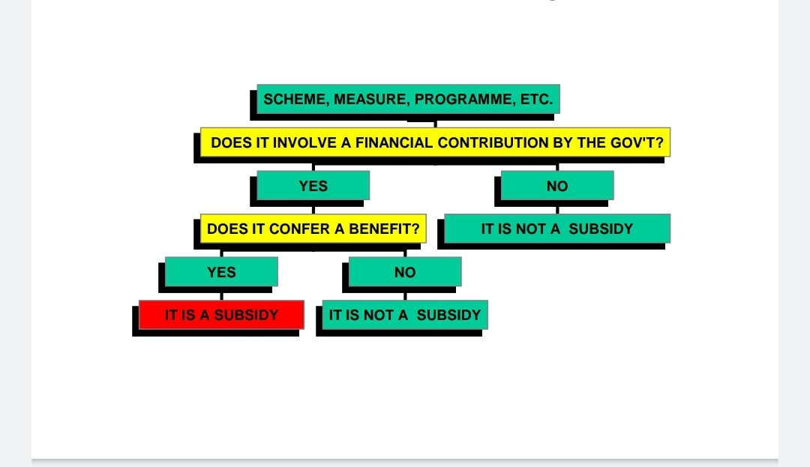
Elements of a Subsidy Recap

Slide 29
Counteracting subsidies: The multilateral option
Recall:
SCM Agreement disciplines use of subsidies
SCM Agreement regulates actions a country can take to counter the effects of subsidies:
  Multilateral avenue of SCM Agreement
  Unilateral avenue of SCM Agreement

Slide 30
Counteracting subsidies: The multilateral option
Multilateral disciplines are the rules regarding whether or not a subsidy may be provided by a Member.
They are enforced through invocation of the WTO dispute settlement mechanism.

Slide 31
Multilateral option may be used in the following circumstances:
  Where a member is maintaining subsidies with one of the following effects:
    It causes injury to the domestic industry of another member
    It nullifies or impairs the benefits accruing to another member under the GATT
    It causes serious prejudice to the interests of another Member
Where a member has reason to believe another member is granting or maintaining prohibited subsidies

Slide 32
Adverse effects Art. 5
The use of subsidies by one member has one of the following effects on the economy of another member:
  It causes injury to the domestic industry
  It nullifies or impairs the benefits accruing directly or indirectly to other Members under GATT 1994, Article II (MFN principle)
  serious prejudice

Slide 33
Counteracting subsidies: The multilateral option – procedure Art 4,7
Consultations – entered in to as quickly as possible
If a mutually agreed solution not reached within 30 days, matter referred to DSB
DSB establishes panel with consensus

Slide 34
The panel may request the assistance of the Permanent Group of Experts (the "PGE") with regard to whether the measure in question is a prohibited subsidy.
Panel prepares a report and submits it to members within 90 days
If found to be a prohibited subsidy, panel recommends its withdrawal without delay

Slide 35
If a defaulting member does not follow the recommendations of the DSB within the time-period specified, it shall grant authorization to the complaining Member to take appropriate countermeasures
In the case of subsidy causing adverse effects, must be proportionate to the adverse effects caused

Slide 36
Counteracting subsidies: The unilateral option Art VI GATT
A countervailing duty may be imposed against both actionable and prohibited subsidies if a WTO member is able to prove the following:
  The existence of a subsidy scheme
  Injury to its domestic industry
  A causal link between the aforementioned conditions

Slide 37
Existence of a subsidy scheme, Art 11 SCM
This is determined if the subsidy scheme is within the definition of a subsidy as provided for in Art. 1, SCM Agreement
An investigation must be carried out in order to ascertain the existence of a subsidy
Investigations are carried out based on a written complaint submitted by the domestic industry

Slide 38
The written complaint must contain following details:
  Identitiy of applicant
  Description of subsidised product
  Evidence of the existence amount and nature of subsidy
  Evidence of alleged injury

Slide 39
It must be supported by 50% of the domestic producers of the like product
Relevant authority will carry out investigation if evidence is sufficient
Member that producers the allegedly subsidised product must be allowed to engage in consultations to clarify matters and to explore a mutually agreed solution
Investigations must be completed within 18 months of initiation

Slide 40
  Injury to domestic industry, Art 15 SCM
  Provide affirmative and verifiable evidence of the volume of the subsidised imports
  Its impact on prices of like domestic products on the market
  Impact of subsidised imports on the domestic producers of like products
  It is sufficient to prove a threat to injury and not injury to a domestic industry

Slide 41
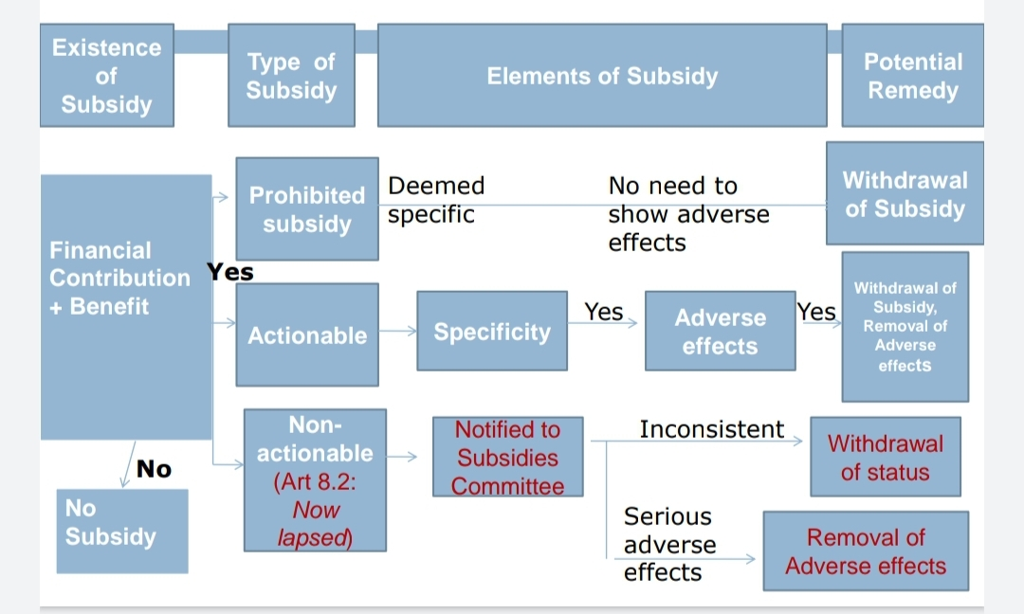
Recap: Multilateral Remedies

Slide 42
Provisional countervailing duties Art 17
After an investigation has been initiated in accordance with the provisions of Article 11, a member may impose provisional countervailing measures under the following circumstances:
  a public notice has been given to that effect
  interested Members and interested parties have been given adequate opportunities to submit information and make comments;

Slide 43
  a preliminary determination shows existence of a subsidy which is causing damage to a domestic industry
  relevant authorities concerned judge such measures necessary to prevent injury being caused during the investigation.

Slide 44
Provisional measures may take the form of provisional countervailing duties
Provisional measures shall only be applied 60 days from the date of initiation of the investigation.
The said measures shall not be applied for a period exceeding four months.

Slide 45
Imposition of countervailing duties Art 19
If investigations determine the following:
  The existence and amount of the subsidy and that,
  its effects are causing injury to domestic like products
it may impose a countervailing duty in accordance with the provisions of Art 19
Countervailing duty will not be imposed if the subsidy or subsidies are withdrawn

Slide 46
Countervailing duty imposed:
  Can match the level of the subsidy or
  Be lower than the level of subsidy but enough to counteract the damage suffered (lesser duty rule)
The countervailing duty cannot be applied retrospectively, Art 20

Slide 47
Review of countervailing duties Art 21
A countervailing duty remains in force for period necessary to counteract injury caused by subsidies
Sunset review: a WTO member must withdraw subsidy 5 years after imposition unless it has conducted a review which reveals that withdrawal may cause damage to domestic industry

Slide 48
Administrative review: when a reasonable time has passed after imposition of a countervailing measure, a review may be carried out upon request by any interested party
The said party must submit positive information substantiating the need for a review

Slide 49
Special Treatment for Developing Countries
Special treatment for developing countries and in the transformation of centrally-planned economies to market economies.
LDCs and DCs with less than $1,000 per capita GNP are exempted from disciplines on prohibited export subsidies.
-Other developing countries had until 2003 to get rid of their export subsidies and until 2000 to get rid of import substitution subsidies.
Least-developed countries must eliminate import-substitution subsidies by 2003 .
Developing countries also receive preferential treatment if their exports are subject to countervailing duty investigations.

Slide 50
Recommended readings
Impact of Anti Dumping and Countervailing duties UNCTAD Report 2000
US countervailing Duty Investigations on Dynamic Access Semi Conductors (DRAMS) Case
Canadian Countervailing Duties on Grain Corn from US (1993)

Slide 51
The End

