Slide 1
UNIT 1
The Birth of the GATT and the WTO

Slide 2
Bretton Woods And The ITO
After the founding of the UN in 1945, negotiations for an international trade organisation began
The idea was put forward in 1944 at a conference in New Hamphshire.
The negotiations were held in 3 places;
New york 1947
Geneva 1947
Havana 1948

Slide 3
.
The Geneva negotiations were pivitol as 3 objectives were reached
Draft the International Trade Organization Charter
Prepare schedules of tariff reductions
Prepare a multilateral treaty containing general principles of trade. The General Agreement on Tariffs and Trade (GATT)

Slide 4
.
In 1948, Havana Conference
countries completed work on the ITO Charter but it never came into force because it lacked the support of the USA.
Why was this a problem?

Slide 5
.
Unfortunatley work on Tariff reductions and GATT had been completed but the ITO was held off thus problems arose.
Solution?
To adopt a protocol of a provisional application to apply the GATT and its Tariff schedules that could be revised to be consistent to the charter.

Slide 6
What now?
The GATT becomes an international organization
The 3 pillar Bertton Woods economic structure was unsuccessful
GATT contracting parties held annual meetings and new contracting parties were added
The interim commission for the ITO formed the secretariet

Slide 7
Goals and main provisions of the GATT
Goals in the Preamble:
To raise standards of living
Ensure full employment
Steadily growing volume of real income and effective demand
“developing the full use of the resources of the world and expanding the production and exchange of goods”
This can be achieved by:
Reduction of tariffs and trade barriers
Elimination of discriminatory treatment in international commerce

Slide 8
The GATT and its Birth Defects
Prof Jackson said the GATT suffered from birth defects, inherent weaknesses that handicapped its operation.
The Charter did not grant the GATT legal personality and establish its procedures and organizational structure.
GATT had ‘provisional’ application.
The protocol of provisional application contained provisons enabling contracting parties to maintain legislation that was inconsistent with the GATT and those that existed before its accession.
Ambiguity existed around the GATTs authority, decision making ability and legal status.

Slide 9
GATT’s Success
The GATT, despite it’s birth defects was successful in;
Reducing tariffs and other trade barriers
It served as a basis for 8 rounds of multilateral negotiations
the Uruguay round was primary in reducing non-tariff barriers
The final act of the round transformed the GATT into a new international oprganisation called the World Trade Organisation.

Slide 10
Tariff Negotiation Rounds
Geneva 1947
Annecy 1949
Torquay 1950
Geneva 1956
Dillon 1960 -1961
Kennedy 1962 - 1967
Tokyo 1973 – 1979
Uruguay 1986 – 1994
  The establishment of the WTO
  removed tariffs in developed countries on tropical products
Doha 2001 - ??

Slide 11
Doha Agreement
Agreement's purpose was to boost the economic growth of developing countries.
It centered on reducing subsidies for developed countries’ agricultural industries. That would allow developing countries to export food, something they were already good at producing.
In return, the developing countries would open up their market to services, particularly banking. That would provide new markets to the developed countries’ service industries. It would also modernize these markets for developing countries.

Slide 12
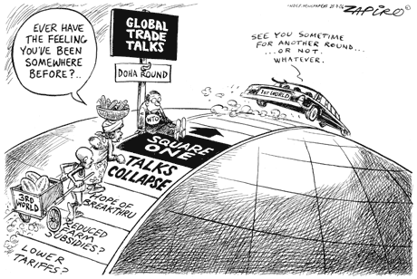

Slide 13
THE WTO
The requirement for better institutional mechanisms and a better system for resolving disputes led to discussions on the WTO.
Questions on its enforcability were cardinal as to not repeat what occured at the Topkyo round were several side agreements were only binding to those that accepted them.
The idea of nthe WTO was taken up in the FOGS negotiation (Function of the GATT system)
In April 1994, Marrakesh Morocco, the package of the agreement that brought the WTO were given for signature.

Slide 14
.
Established to cure the birth defects of the GATT, and create an effective dispute settlement mechanism: Dispute Settlement Understanding (DSU)
Required members to accept ALL agreements – therefore all agreements became binding on ALL parties as a single body of law
The various agreements which make up the Marrakesh Agreement combine as an indivisible whole; no entity can be party to any one agreement without being party to them all
Came into effect on 1 January 1995
Currently we have 164 member states

Slide 15
Some of these agreements:
Agreement on Agriculture
General Agreement on Trade in Services (GATS)
Agreement on the Application of Sanitary and Phytosanitary Measures (SPS)
Agreement on Textiles and Clothing
Agreement on Technical Barriers to Trade (TBT)
Agreement on Trade Related Investment Measures
Antidumping Agreement
Agreement on Subsidies and Countervailing Measures
Agreement on Safeguards
Agreement on Government Procurement
The Dispute Settlement Understanding (DSU)

Slide 16
Objectives of WTO
Important objectives of WTO are mentioned below:
to implement the new world trade system as visualised in the Agreement;
to promote World Trade in a manner that benefits every country;
to ensure that developing countries secure a better balance in the sharing of the advantages resulting from the expansion of international trade corresponding to their developmental needs;
to demolish all hurdles to an open world trading system and usher in international economic renaissance because the world trade is an effective instrument to foster economic growth;
to enhance competitiveness among all trading partners so as to benefit consumers and help in global integration;
to increase the level of production and productivity with a view to ensuring level of employment in the world;
to expand and utilize world resources to the best;
to improve the level of living for the global population and speed up economic development of the member nations.

Slide 17
Functions of WTO
The former GATT was not really an organisation; it was merely a legal arrangement. On the other hand, the WTO is a new international organisation set up as a permanent body. It is designed to play the role of a watchdog in the spheres of trade in goods, trade in services, foreign investment, intellectual property rights, etc.
Article III has set out the general purpose of WTO being; ‘facilitate the implementation, administration and operation and further the objec­tives of the WTO agreements.

Slide 18
Functions of the WTO
Beyond this general purpose the WTO has four tasks:
The WTO shall provide the forum for negotiations among its members both as to current matters and any future agreements
The WTO shall administer the system of dispute settlement;
To administer Trade Policy Review Mechanism; and
With a view to achieving greater coherence in global economic policy making, to cooperate, as needed, with the International Monetary Fund (IMF) and with the World Bank, and its affiliated agencies

Slide 19
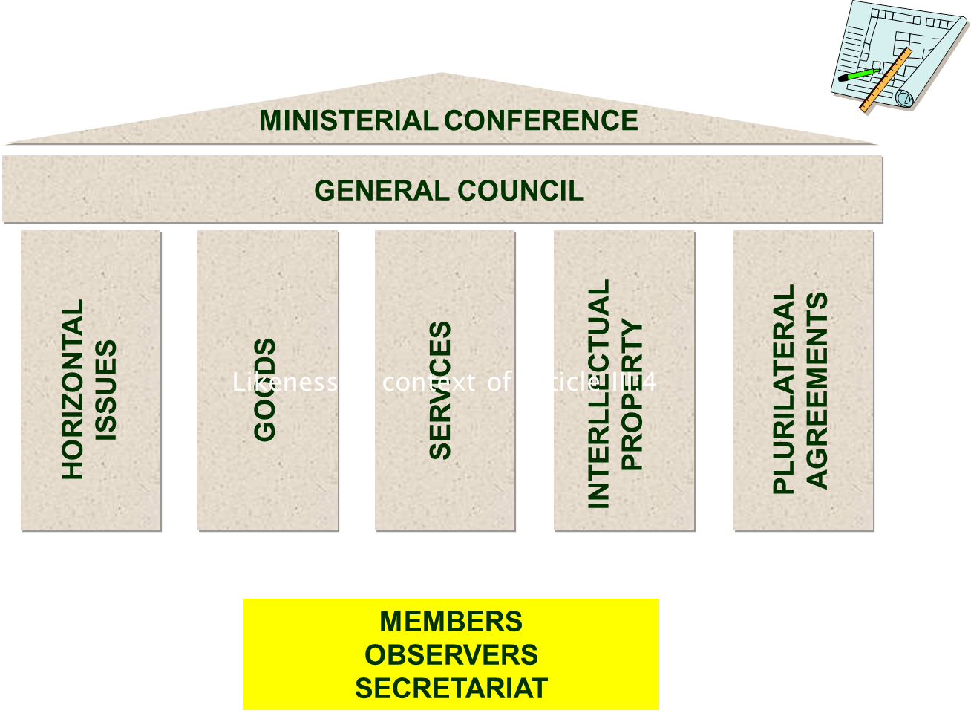
GOVERNING STRUCTURE

Slide 20
GOVERNING STRUCTURE
At The Apex is Ministerial Conference which meets not less often than every two years.
The General Council is the chief decision-making and policy body between meeting of the Ministerial Conference. It also discharges the responsibilities of the Dispute Settlement Body and the Trade Policy Review Body.
Specialized Councils and Committees that report to the General Council do much of the day-to-day work of the WTO.

Slide 21
ORGANIZATION: MEMBERSHIP, ACCESSION AND WITHDRAWAL
The original WTO membership consisted of all GATT contracting parties as of the entry into force of the WTO Agreement on 1 January 1995 and the European Community. This provided for under Article XI.
Countries may join the WTO only after negotiating terms of accession (Art XII). In practice, accession is completed through obtaining consensus of all WTO Members.
Any member may withdraw from the WTO Agreement after giving notice to the Director-General six months before the date on which it intends to withdraw.

Slide 22
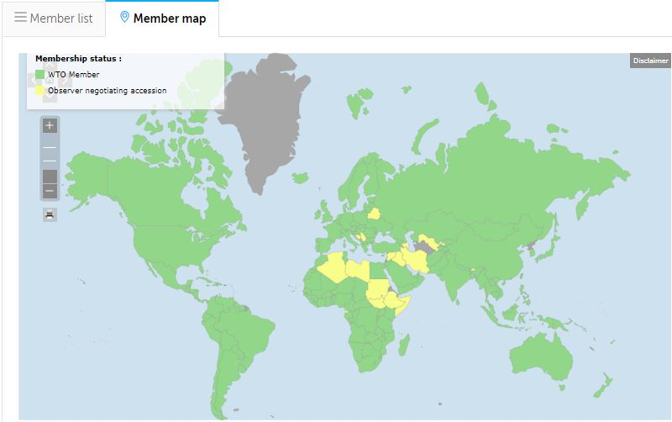
WTO Membership

Slide 23
DECISION MAKING
The WTO rules for decision making are mentioned in the Articles IX and X of the agreement that set-up the WTO.
Generally decisions are made by consensus. If consensus cannot be reached the matter is decided by voting with one country one vote principle.
Decisions can be made by simple majority unless otherwise provided in the WTO agreement or in the relevant multilateral Trade Agreements.
An exception is Article 2.4 of the DSU, according to which the DSB decides by consensus, with the notable exception of the reverse consensus mechanism for the key steps of a dispute settlement procedure.

Slide 24
ARTICLE X: AMENDMENTS
The Ministerial Conference has exclusive competence to vote on amendments
Certain provisions can only be amended by unanimous vote.
Other provisions can be amended by two-thirds vote, but such an amendment is binding only on those Members accepting it.
The Ministerial Conference by three-quarters vote, can decide that all members must accept an amendment, and recalcitrant Members either must withdraw from the WTO or remain a Member with the consent of the Ministerial Conference.

Slide 25
LEGAL PERSONALITY AND ORGANIZATIONAL ATTRIBUTES
Unlike GATT, the WTO Charter clearly:
establishes an international organization,
endows it with legal personality, and
supports it with the traditional treaty organizational clauses regarding "privileges and immunities," secretariat, director general, budgetary measures, and explicit authority to develop relations with other inter-government organizations and, important to some interests, non-government organizations.

Slide 26
Continuity with the GATT
Article XVI:1 of GATT 1947 provides that, except as otherwise provided, the WTO and the Multilateral Trade Agreements shall be guided by the decisions, procedures and customary practices followed by GATT 1947. The Secretariat of the GATT 1947 will generally become the WTO Secretariat.
The GATT 1994 and the GATT 1947 are “legally distinct”, as confirmed by Article II:4 of the WTO Agreement.
The provisions of the GATT 1947, incorporated into the GATT 1994, continue to have legal effect as part of the GATT 1994, itself a component of the WTO Agreement.
Please note that other parts of the WTO website might not make the above legal distinctions in all instances, and may refer to “GATT”, “GATT 1947” and “GATT 1994” interchangeably.

Slide 27
END
.

