Slide 1
MANIFESTO PRESENTATION
VONSE TI PENDA
EMMANUEL JONAH CHISHIMBA
TREASURER CANDIDATE

Slide 2
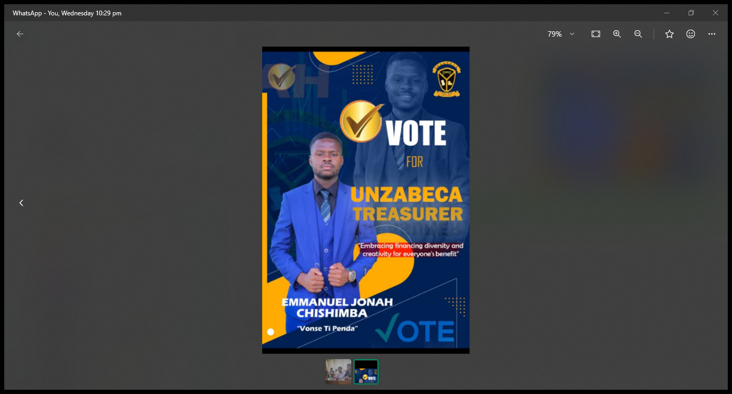

Slide 3
ABOUT CANDIDATE
My name is Emmanuel Jonah Chishimba, a 3rd year Economics student minoring in Business Administration.
Having been made aware of UNZABECA in my first year, I developed an interest over the years, which prompted my membership and subsequent service as a tutor.
I strongly believe that “Creativity breeds success” especially in the financial space. In my view, ingenuity and wit when applied to finance are the best way to alleviate and curb some of the financial pressure that UNZABECA experiences yearly.

Slide 4
UNDERSTADING MY ROLE
According to article 8.6 of the current UNZABECA constitution the treasurer;
Shall be responsible for the association’s funds and financial documents
Shall present a financial report at the first and last general meeting of the association or any other meeting provided 7 days’ notice
Collect membership fees and provide an up-to-date list of the paid-up members to the secretary for the record
The treasurer shall submit monthly financial reports to the president and shall disburse funds to the executive members when needed with the approval from the president

Slide 5
CONTINUATION OF ROLE
Furthermore, article 7.5 governs that the treasurer shall represent and head the Finance committee. The treasurer and the finance committee;
Shall undertake to organize all possible fundraising ventures to raise funds for the association in which all members of the association shall be called upon to participate.
Shall be in charge of the association’s owned businesses and/or partnerships and will carry out audits on such businesses on behalf of the association.
Shall be the main channel through which the association shall advocate for financial literacy and financial inclusion.
Shall be responsible for providing financial training to members of the association

Slide 6
MY PLANS ONCE IN OFFICE
use the current outgoing executive’s programs as a foundation for what is to come, as well as fine-tune them to ensure the development of the association.
The continuation of short courses and training for both affiliated and non-affiliated members which will generate revenue for the association while also providing beneficial information to the students.
It is hoped that this will also encourage more people to join as it will be more lucrative to be an affiliated member.

Slide 7
MY PLANS ONCE IN OFFICE 2
Another proposal is the continuation of tuition to the first year and the inclusion of second and third tuitions (strictly for quantitative courses). This is due to the fact that I am aware of the crucial role that UNZABECA's tuitions play in setting up a solid foundation in economics, business administration, and mathematics. Some of the short courses we plan to bring are;
Stata tuitions
Advanced Excel
Information and Communication Technology (ICT)
Monitoring and Evaluation
Project Planning and Management
Stata certificate lessons
Most of the short courses offered will be done in collaboration with partners like the Center for ICT.

Slide 8
MY PLANS ONCE IN OFFICE 3
We plan on Cooperating with other committees with similar ideas to avoid duplication of effort and promote efficiency within the organization.

Slide 9
MY PLANS ONCE IN OFFICE 4
My plan for office is to share as many opportunities with the UNZABECA members as well as the general populace. This will be done by strengthening relations with organizations UNZABECA is already partnered with as well as opening the door for new organizations to come on board.
Engaging the Zambian Institute for Policy Analysis & Research (ZIPAR) as well as ZANEC to provide both financial support as well as opportunities for members in the association
The goal is to ensure that we obtain as much financial muscle as we can to be able to facilitate UNZABECA’s goals and objectives.

Slide 10
My Plans for office 5
The inclusion of trips just like the ones previously undertaken Bank of Zambia trip.
Some of these organizations are ZANACO (Zambia National Commercial Bank) and ZICB (Zambia Industrial Commercial Bank) .
The selling of UNZABECA-branded T-shirts will be another avenue of exploration
Guidance of 1st and 2ND year course selection
Lastly, I together with my fellow executive members plan to push as much as possible for an association bank account. This will help with the easier tracking of the financial happenings of the association.

Slide 11
SUMMARY
Implementation of Stata lessons through volunteer tutors.
Offering of First year free tuitions for the first 3 sessions to get them acquainted.
Offering of short courses.
Naturing current relationships with current UNZABECA investors as well as building new one through networking opportunities
Guidance of 1ST and 2nd year course selection
Welcome member’s ideas and collaborating on similar ideas to increase efficiency and avoid duplication of effort.
Tutors of Stata will be given an incentive and will be recognized by giving certificates for the service they offered to the association.
Sell UNZABECA branded T-shirts to the student populace.
UNZABECA bank account sponsored by either a bank or an association.

Slide 12
VONSE TI PENDA
VOTE EMMANUEL JONAH CHISHIMBA FOR UNZABECA TREASURER

