Slide 1
WORD CLASSES
MORPHOLOGY

Slide 2
Tutorial questions
What are parts of speech? Definition according to Cambridge Dictionary “one of the grammatical groups, such as noun, verb, and adjective, into which words are divided depending on their use”
What criterion is used to classify words in traditional grammar? Answer: Notional/semantic(based on meaning)
Define each part of speech and provide an example and use it in a sentence.

Slide 3
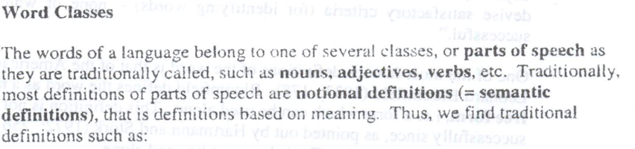
CLASSIFYING WORDS

Slide 4
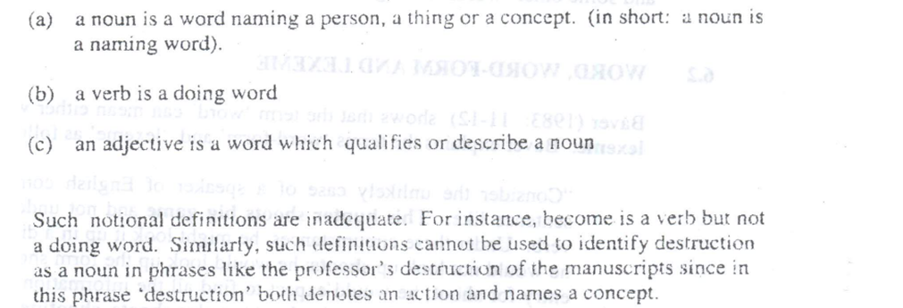
WORD CLASSES

Slide 5
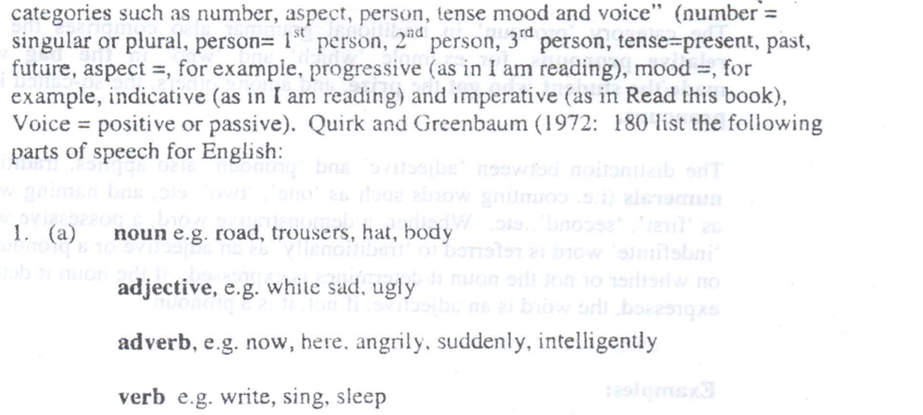
WORD CLASSES

Slide 6
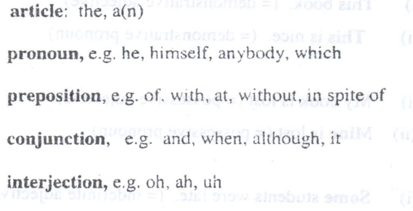
WORD CLASSES

Slide 7
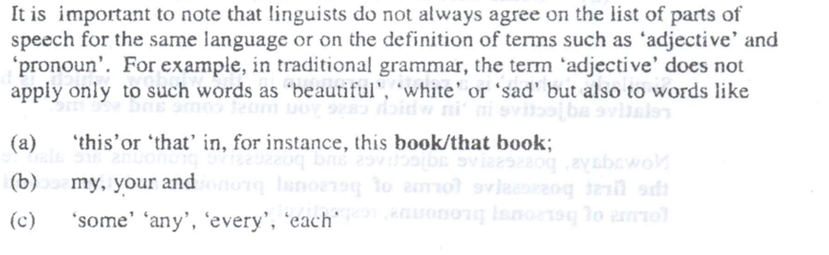
WORD CLASSES

Slide 8
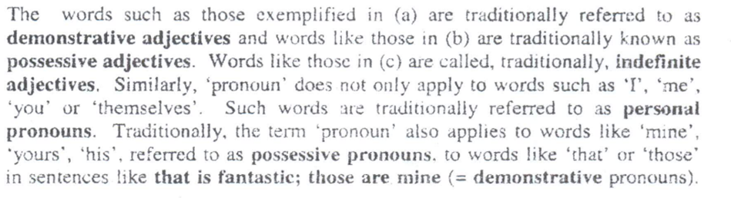
WORD CLASSES

Slide 9
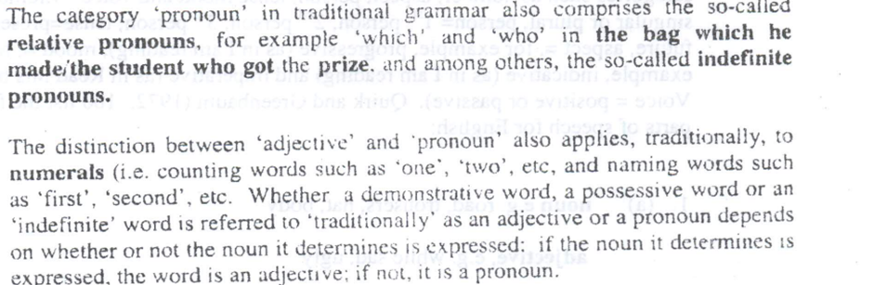
WORD CLASSES

Slide 10
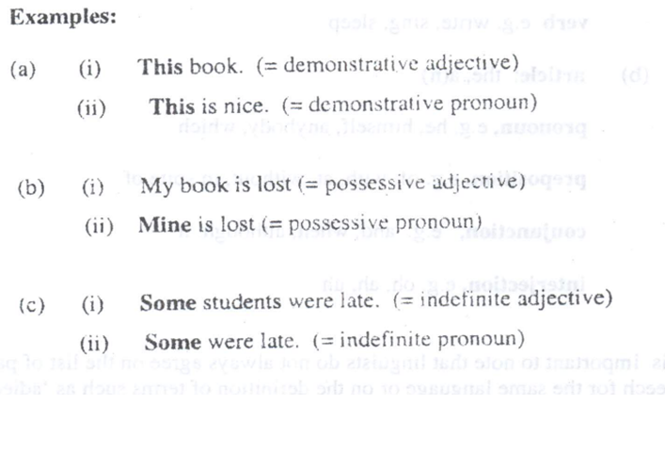
WORD CLASSES

Slide 11
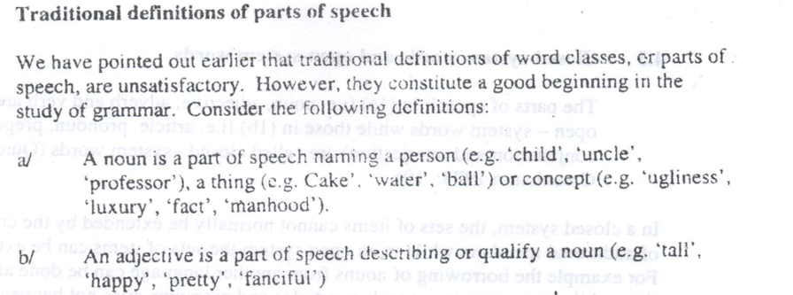
Word classes

Slide 12
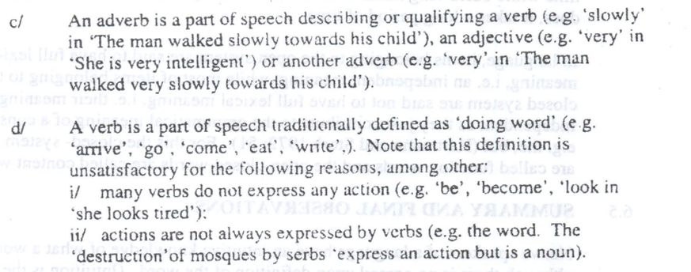
Word classes

Slide 13
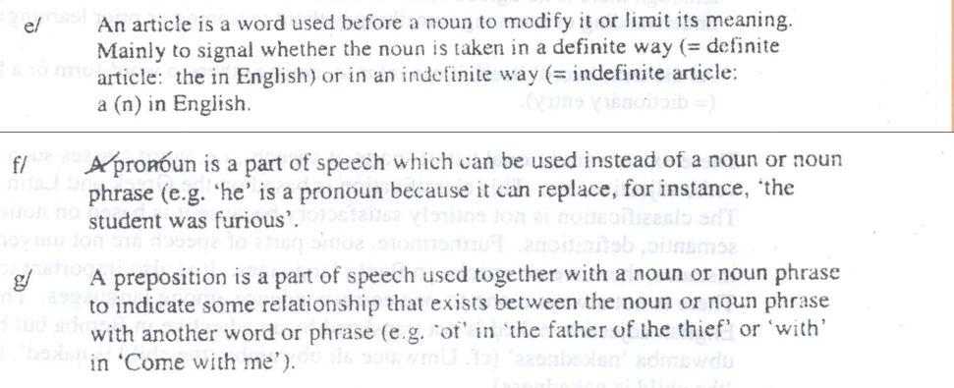
Word classes

Slide 14
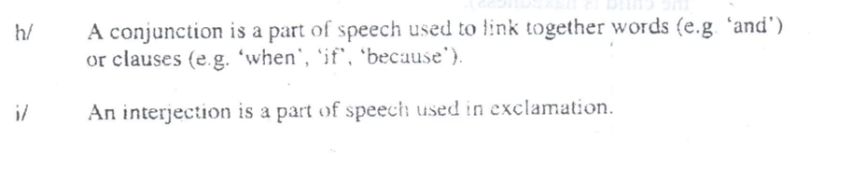
Word classes

