Slide 1

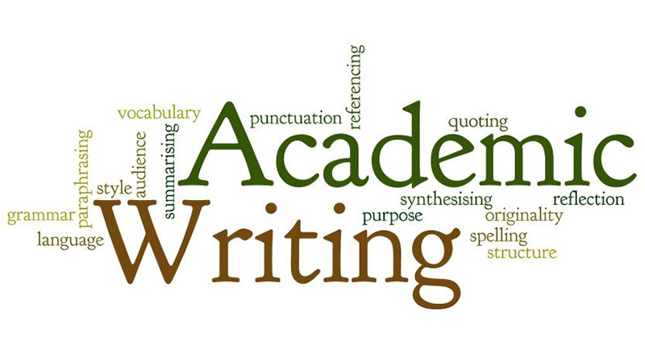
LAN 1210/1220
Topic: Academic Writing
By Mr. Simungala

Slide 2
Introducing Academic Writing
Academic writing is writing which communicates ideas, information and research to the wider academic community
Academic writing is a formal style of writing used in universities and scholarly publications.
Academic writing is correct grammar, clear organisation of written content and proper academic writing format.
Academic writing is clear, concise, focussed, structured and backed up by evidence. Its purpose is to aid the reader’s understanding.
Academic writing refers to a style of expression that researchers use to define the intellectual boundaries of their disciplines and specific areas of expertise.
Academic writing is the process of breaking down ideas and using deductive reasoning, formal voice and third person point-of-view.
Simply put, academic writing is the writing done for academic purposes.

Slide 3
The various definitions of Academic writing means that it is different from creative writing, which is the kind of writing you do when you write stories.
It is also different from personal writing, which is the kind of writing you do when you write letters or e-mails to your friends and family.
Creative writing and personal writing are informal, so you may use slang, abbreviations, and incomplete sentences.
However, academic writing is formal, so you should not use slang or contractions.
As will become apparent, one should take care to write complete sentences and to organize them in a certain way (Oshima & Hogue, 2007).

Slide 4
Features of Academic Writing
These features distinguish academic writing from all other forms of writing.
1. Precision
This entails specificity when writing.
-It requires the use of specific dates and figure for instance;
Mark (2000) said... (a specific citation for your work), in 1917 ( specific date), 300 cases were recorded... (specific figures) etc.
-You should avoid the use of vague expressions such as 'a lot of people, some people, someone said... etc.
2. Complexity
This is a sophisticated use of language from a grammatical standpoint.
It does not necessarily mean that the use of "big words" but use of formal language that has been well grammatically outlined.

Slide 5
3. Accuracy
-This refers to the accurate use of vocabulary.
-It entails the use of appropriate terms as each term has its own specific meaning and context of use and situation.
4. Formality
-In academic writing, it is very important to be formal.
-You are required to use formal language.
-Formal language is a type of language that does not use colloquial expressions such as 'sort of', stuff, guys.
-Use of contractions is not allowed such as isn't, wasn't etc instead you are encouraged to use 'is not, was not' etc.
5. Objectivity
-The fact of being based on facts and not influenced by personal beliefs or feelings.

Slide 6

Purpose of Academic Writing
To report on a piece of research the writer has conducted
To answer a question the writer has been given or chosen
To discuss a subject of common interest and give the writers view
To synthesise research done by others on a topic

Slide 7
REFERENCING IN ACADEMIC WRITING
Referencing is the practice of acknowledging in your own writing the intellectual work of others; work that has been presented in some way into the public domain
By the end of the lesson, you should know:
The why of referencing – the academic rationale for all styles of referencing and the principles underpinning the practice
The when of referencing – when to reference, and when it is not necessary
The how of referencing. The main differences between referencing styles in Britain will be described, and illustrated with examples of the types of sources that you will undoubtedly want to refer to in your assignments.

Slide 8
Reference and bibliography
References are the items you have read and specifically referred to (or cited) in your assignment.
A bibliography is a list of everything you read in preparation for writing an assignment.
A bibliography will, therefore, normally contain sources that you have cited and those you found to be influential but decided not to cite.

Slide 9
What to reference
Among many items to reference include:
• Books written by a single author
• Multiple edited books with contributions from a range of different authors
• Reference books of all types
• Notes supplied by a lecturer
• Legal documents
• Articles from journals
• Newspaper articles
• Reports of various kinds, e.g. official reports from government departments,university working papers, etc.
• Papers presented at conferences
• Internet sources, including weblogs (blogs) and email correspondence (but see
below)

Slide 10
When to reference
When to reference? There is no referencing practice more likely to confuse students than: ‘When exactly should I reference?
You should reference evidence in assignments in the following situations:
1 To give the reader the source of tables, statistics, diagrams, photographs and other illustrations included in your assignment
2 When describing or discussing a theory, model or practice associated with a particular writer (this links specifically to the next two items)
3 To give weight or credibility to an argument supported by you in your assignment
4 When giving emphasis to a particular theory, model or practice that has found a measure of agreement and support among commentators
5 To inform the reader of sources of direct quotations or definitions in your assignment
6 When paraphrasing another person’s work, which is outside the realm of common knowledge, and that you feel is particularly significant or likely to be a subject of debate. This can also include definitions.

Slide 11
WHEN you do not Need to Reference
There are four situations when you do not need to reference sources. These are:
1 When presenting historical overviews
2 When presenting your own experiences
3 In conclusions, when you are repeating ideas previously referenced
4 When summarizing what is regarded as ‘common knowledge’.

Slide 12
Why use references?
There are three principal reasons for providing references and citations:
(a) To show that you have read some of the authorities on the subject, which will give added weight to your writing.
(b) To allow readers to find the source, if they wish to examine the topic in more detail.
(c) To avoid plagiarism.
It is important to refer correctly to the work of other writers that you have used.
You may present these sources as a summary/paraphrase, as a quotation, or use both.

Slide 13
Giving citations
A quotation Author’s name, date of publication, page number (Smith, 2009: 37)
A summary Author’s name, date of publication Smith (2009)

Slide 14
REFERENCE VERBS
Summaries and quotations are usually introduced by a reference verb:
Smith (2009) argues that . . .
Janovic (1972) claimed that . . .
These verbs can be either in the present or the past tense.
Normally, the use of the present tense suggests that the source is recent and still valid, while the past indicates that the source is older and may be out of date, but there are no hard-and-fast rules.

Slide 15
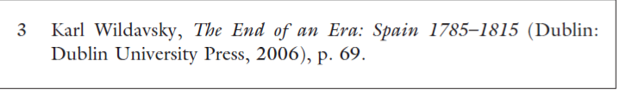
There are several main systems of referencing employed in the academic world, each used by different subjects.
(a) The Harvard system, generally used for the social sciences and business,
(b) The American Psychological Association system
(B) The footnote/endnote system, commonly used in the humanities, in which sources are listed at the bottom of the page or at the end of the paper.
The numbers in superscript run consecutively throughout the paper:
The effects of the French Revolution were felt throughout Europe.3

Slide 16
Using quotations
Using a quotation means bringing the original words of a writer into your work.
Quotations are effective in some situations, but must not be overused
According to Jones (2004), “students often had difficulty often had difficulty writing using the APA, especially when it was their first time”(p.199)

Slide 17
Abbreviations in citations
In-text citations use the following abbreviations, derived from Latin and printed in italics:
et al.: Usually used when three or more authors are given. The full list of names is given in the reference list:
Many Americans fail to vote (Hobolt et al., 2006: 137).
ibid.: taken from the same source (i.e. the same page) as the previous citation:
Older Americans are more likely to vote than the young (ibid.) . . .
op cit.: taken from the same source as previously, but a different page.
Note that journal articles increasingly tend to use full citations, but students should still usethe above in their work.

Slide 18
Please remember that referencing is very important to show your academic prowess as well as help you avoid plagiarism (which we will look at in another lesson) as this is a very serious offence in academia and if found guilty, one may even be jailed and at UNZA you may be excluded from school.
Learn to reference in all manner of assignment writing.

Slide 19
REFERENCING STYLES
There are many different types of referencing styles but we will concentrateon only three: Harvard, APA and MLA referencing styles
Author–date (Harvard) style
Cites name(s) of author(s) or organization, with year of publication, in the text, e.g. Handy (1995).
All sources are listed alphabetically at end of an assignment and labelled ‘References’ or ‘Bibliography’.
American Psychological Association (APA) style
Relatively small differences exist between Harvard and APA style, and in practice, they often merge into a hybrid.
The main noticeable differences tend to be with citation punctuation, the way multiple authors are cited and referenced, and with referencing electronic sources.

Slide 20
Modern Languages Association (MLA) style
This differs from Harvard and APA in that the page number, instead of year of publication, is cited in the text, e.g. (Handy 149).
The full list of references at the end of the text is also labelled ‘Works cited’, or ‘Works consulted’.
Proper words in the titles of works cited are capitalized and underlined.
The last name of an author is followed by the full first name(s), for example:
Handy, Charles. Beyond Certainty: The Changing Worlds of Organisations. London: Hutchinson, 1995.

Slide 21
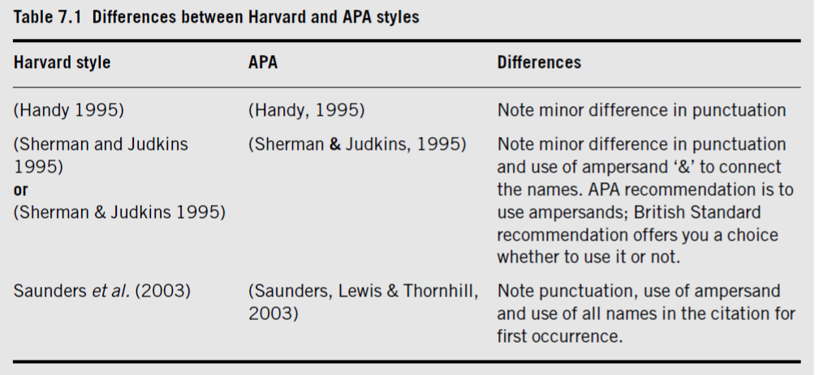

Slide 22
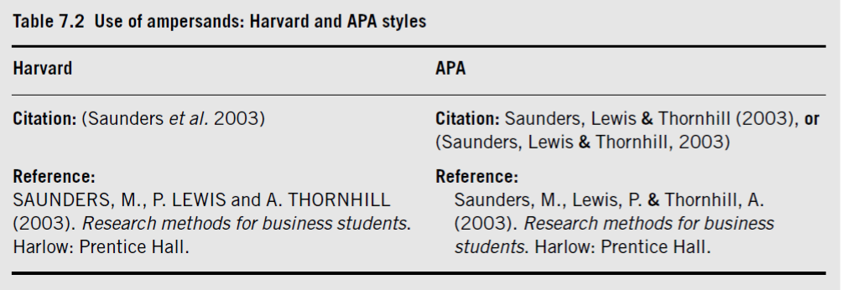

Slide 23
Modern Languages Association
The Modern Language Association of America was founded in 1883 at a time when modern languages were beginning to be established in the curriculum alongside classical languages.
1 Gibaldi, Joseph. MLA Handbook for Writers of Research Papers, Sixth Edition. New York: MLA, 2003.
2 Loach, Ken. (Director) and Sally Hibbin (Producer). Raining Stones. DVD. London: Channel Four Television (FilmFour), 1993.

Slide 24
When referencing
If you are using someone’s ideas in your own words do not use quotation marks. Indicate the source in brackets at the end or beginning and a page number is not required
If it’s a direct quote, ensure that you include a page number as well and t should be in quotation marks
If there is no author, you should write the title for example:
Ministry of education (2003)…

Slide 25
SOME EXAMPLES OF THE HARVARD REFERENCING STYLE
BOOK WITH TWO AUTHORS:
Richard, Petersen, and Shield, Graham (2010). Effecting Change in a Covid 19 World, 2nd Edn. Basingstoke: Palgrave macmillan
E-BOOK
Bell, Judith (2002). American Psycological Imapct. Dawsoner [Online] Available at: URL (Accessed 26 April 2012)

Slide 26
APA STYLE : SOME EXAMPLES
BOOK WITH ONE AUTHOR
Rogers, T. (2013). Conferences and Conventions: A Global Industry (3rd ed) New York, Ny: Routledge
EDITED BOOK
Williams, J. M., & Krane, V. (Eds). (2015). Applied Sport psychology: Personal Growth (7th ed). New York, NY: Palgrave Macmillan
CHAPTER FROM AN EDITED BOOK
Williams, J. M., & Mwape, S. (2016). Vowel Harmony. In P. S, Bwalya and L. Peters (Eds). Bantu Phonology (7th ed). London: Oxford University Press
REPORT
2018 Physical Advisory Committee. (2018). Women in Leadership Report. Ministry of Health. https//…

Slide 27
EXERCISE
Comment briefly on the following assertion:
A convict is condemned for life: the case of Dudley Fichite
REQUIREMENTS
Essay should be in clean and very clear hand writing
2 pages exclusive of cover page and reference page
3 references only
Use the APA referencing style

