Slide 1
TOPIC 5: GEOGRAPHY OF WEST AFRICA
Previously, the geography of West Africa could be subdivided into three major geographical or ecological regions.
These were the equatorial belt, the savannah region and the desert belt.

Slide 2
However, recent studies have increasingly shown that the West African sub-region should in fact be subdivided into five (5) ecological (or bioclimatic) zones, based on climate and vegetation.
These are: Saharan, Sahelian, Sudanian, Guinean, and Guineo-Congolian Regions (see map below).

Slide 3
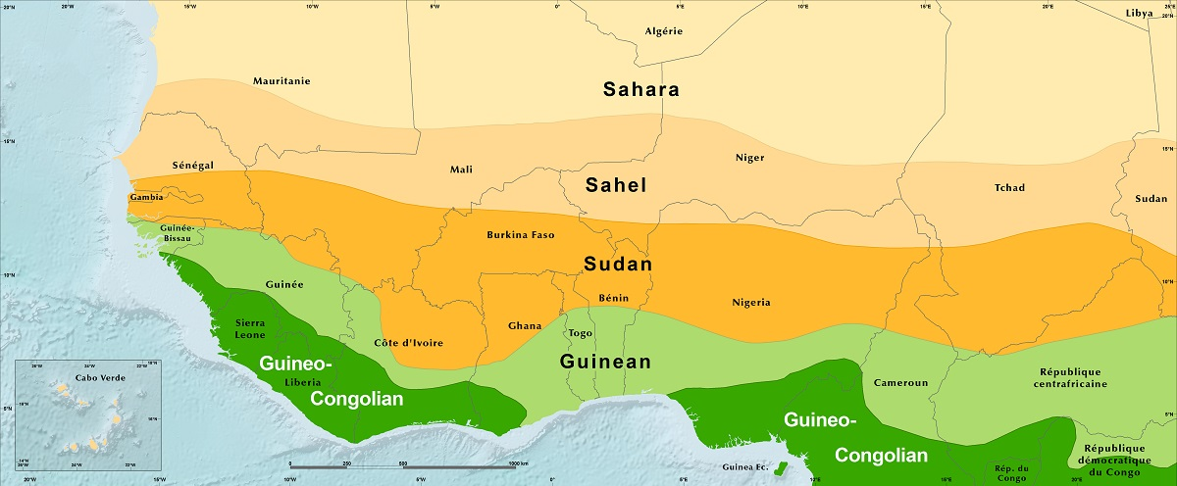
The Five Ecological Regions of West Africa

Slide 4
The dividing lines between regions merely represent transition along continuous ecological gradients rather than sharp boundaries.
Although there are considerable differences among authors in the definition and geographic delineation of these regions, most use long-term rainfall averages to define these boundaries.

Slide 5
1. Saharan Region
Formed by the Sahara Desert, this region stretches across the whole northern fringes (boundaries) of West Africa.
It comprises various arid landscapes varying from sandy sheets and sand dunes to gravel plains, low plateaus, and rugged mountains.

Slide 6
Vegetation is sparse (scattered) or actually absent, except in depressions, wadis, and oases, where water is present at or just below the surface.
Average annual rainfall ranges from 0 to 150 mm per year.
Below is a depiction of some features of the Sahara desert.

Slide 7
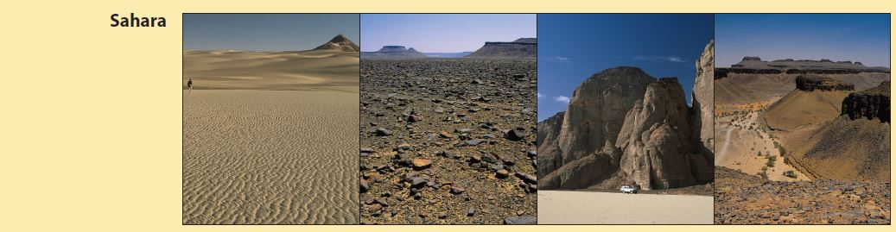
Landscapes of The Sahara Desert

Slide 8
2. Sahelian Region
The Sahel (or Sahelian) Region, is a broad semi-arid (semi-dry) belt, extending from the Atlantic Ocean in the west to Sudan and the Red Sea in north-east Africa, averaging about 350 km wide.
This region receives average annual rainfall between 150 and 600 mm which varies greatly in amount and timing each year.
The region has an ecologically dry season of 8 to 9 months each year.

Slide 9
Vegetation in the Sahel region generally comprises open herbaceous types (plain and short grass savannah) often mixed with woodland vegetation.
It has plenty of thorny trees, particularly of the genus Acacia type, and mostly annual grasses from the Aristida and Cenchrus families.
The number of woody plant species is relatively low. The present physiognomy of Sahelian vegetation results from long-term human and animal presence.

Slide 10
Annual grass fires often sweep across the Sahel destroying available grass cover.
The Sahel region also hosts countless small wetlands, like in eastern Mauritania, as well as major ones like in the Senegal Delta, the Inland Niger Delta, and the Lake Chad area.

Slide 11
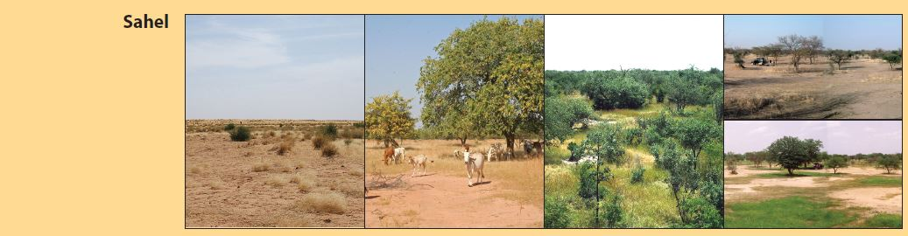
The Semi-arid Sahelian Region

Slide 12
3. Sudanian Region
The Sudan, or Sudanian Region is covered by a very large belt immediately south of the Sahel region.
It receives average annual rainfall of between 600 and 1,200 mm, with an ecologically dry season of 5 to 7 months.

Slide 13
It is dominated by the savannah which ranges from open tree grassland to wooded grassland and open woodlands..
As in the Sahel, rainfall is spread over the months when the sun is high (May to October).
The short, annual grasses of the Sahel are replaced in the Sudan Region by tall, perennial grasses, mainly of the genus Andropogon or tall beard grasses, with trees growing among these tall grasses.

Slide 14
In the northern part of the Sudanian Region, tree savannas tend to dominate, whereas the southern parts of this region typically transition into denser wooded savannas and open woodlands, with trees growing among the tall grasses.
Along the rivers and other water ways there are tall tree species common in the Guinean Region to the south, penetrating deep into the Sudanian Region.
These trees are generally not affected by bush fires and often act as natural fire breaks (see below).

Slide 15
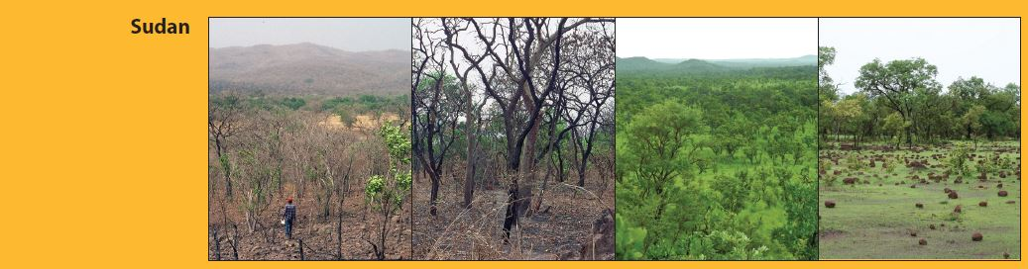
Sudanian Region

Slide 16
Guinean Region
The Guinean Region lies immediately south of the Sudanian Region.
It is generally defined by average annual rainfall between 1,200 and 2,200 mm.
It is dominated by the seasonally wet-and-dry deciduous or semi- deciduous forest, with a distinct dry season of 7 to 8 months, which distinguishes it from the Guineo-Congolian Region to the south.

Slide 17
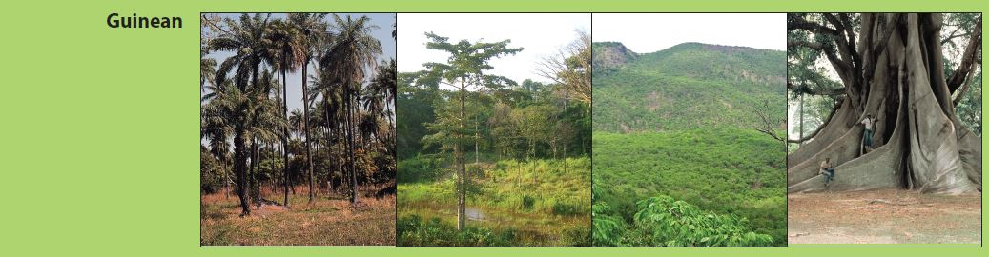
It has a generally closed and dense forest canopy with tall trees, averaging 18 to 20m as exemplified below.
Guinean Region

Slide 18
Guineo-Congolian Region
The Guineo-Congolian Region is the wettest in West Africa, with average annual rainfall between 2,200 and 5,000 mm.
The rainfall can be distributed across most of the year, or in two rainy seasons with short drier periods between the seasons.

Slide 19
This region is split geographically into western and eastern blocks, separated by the Dahomey Gap where savanna reaches the coast. These blocks are often referred to as the Upper Guinean and Lower Guinean Forests, respectively.
This region has the richest forest flora in West Africa, but it is no longer as densely forested as in the past. The forests are dense, with trees reaching over 60m, with a lot of creepers or climbers forming canopies up in the trees (see pictures below).

Slide 20
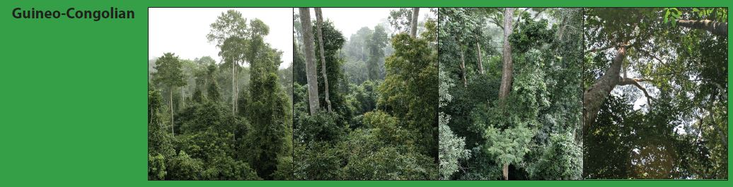
Guineo-Congolian Region

