Slide 1
TOPIC 7: THE SAVANNAH KINGDOMS OF WEST AFRICA
The most significant Savannah kingdoms of West Africa were Old (ancient) Ghana, Mali and Songhai (Songhay) kingdoms.
In the forest region to the south the most prominent kingdoms were Benin, Kanem-Bornu and Oyo Empire.

Slide 2
THE KINGDOM OF OLD GHANA
Old Ghana is the most well-known of all precolonial West African kingdoms.
It was the most involved in the Trans-Saharan gold trade.
Literate Arabic speakers who visited it wrote about it, but it had no connection with present day Ghana.
Old Ghana was situated 640 kilometres north-west of modern Ghana Republic.

Slide 3
Of course there were other ancient kingdoms like Tekrur, in the Senegal valley which had emerged as a powerful trading state even earlier than Old Ghana.
To the north-east of Lake Chad arose the empire of Kanem Bornu, which began around 900 AD.
It comprised several nomadic pastoralist clans under a single dynasty called Saifawa.
Origins of Old Ghana
The main ethnic group that founded the kingdom of Old Ghana were the Soninke people.

Slide 4
They spoke Soninke language, a branch of the Mande language which itself was a major branch of the Niger-Congo group of Bantu languages.
Old Ghana dominated the border region of modern Mauritania and Mali between the 5th and the 13th centuries AD.
The rulers of Old Ghana amassed wealth and increased their power by taxing the gold trade and importing luxury goods.

Slide 5
Thus, old Ghana emerged out of the natural ability of iron working farmers to form larger sedentary (settled) communities.
This was in addition to advantages gained from neighbouring communities such as the nomadic Saharan Berbers from whom they obtained horses.
Thus, Sahara raids could have contributed to the rise of Old Ghana as a powerful kingdom.

Slide 6
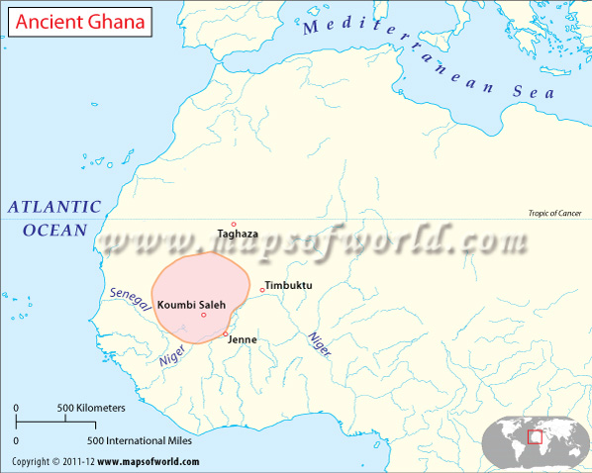

Slide 7
Trade
Ghana’s strategic location in the Trans-Saharan trade network gave it a privileged position which its rulers utilised to expand the kingdom.
Ghana was midway between the desert (source of salt) and the Bambuk gold fields of the upper Senegal River.
Initially Old Ghana traded gold dust with salt from the traders of Taghaza in the desert.

Slide 8
The introduction of the camel to Trans-Saharan trade in the 5th century boosted cross-desert trade.
It improved and made transportation steadfast.
The use of the camel widened North African access to West African gold.
It also increased West Africa’s access to North African salt and other commodities.
In the increasing gold trade, the Soninke acted as middlemen.

Slide 9
They passed Saharan salt to the gold producers of the Savannah woodland in the south.
Thus, it was from the 5th century that the growth of Old Ghana became significant.
The expansion of the Trans-Saharan trade in gold led to a growth in the power and size of Old Ghana Kingdom.
However, as trade expanded so did the rivalries between the Muslim Berbers of Awdaghust and the Soninke people of Old Ghana.

Slide 10
Growth of the Kingdom
At the height of its power in the 11th century, Old Ghana expanded to include Awdaghust (under Berber control) within its borders.
As far away as Baghdad in Iraq, Ghana was known for its gold.
An eighth century Arab geographer, al- Fazuri once described Old Ghana thus: ‘the territory of Ghana, the land of gold’.

Slide 11
The 11th century capital of Old Ghana, Kumbi Saleh, was administered as two separate towns situated a little distance from each other.
One was an Islamic town set apart for visiting Arab scholars and Berber merchants. It contained many mosques.
The other part of Kumbi Saleh was the king’s royal town, situated ten (10) kilometres away.
The area in between the two towns was covered with stone and wooden houses of the Soninke people.

Slide 12
This connected the two towns into one city called Kumbi Saleh.
Although the Muslim visitors were impressed by the power and wealth of the king and his court, they were never told about the source of the gold.
Ghanaians kept it a secret. They bought the gold from the Bambuk miners to the south, and exchanged it for salt, cloth and other manufactured goods from North Africa.

Slide 13
These goods were brought by the Muslim traders to the capital Kumbi Saleh for sale.
Decline of Old Ghana
By 1050 AD Old Ghana had expanded to include the Berber Muslim town of Awdaghust. Many Ghanaians also became Muslim.
Some writers argue that the Ghanaians converted to Islam through jihads.
Others state that it was done peacefully through trade.

Slide 14
Yet, the Berber-Soninke conflicts were a reality.
The wars, generally referred to as the Almoravid wars, greatly weakened Old Ghana’s former trading links which the kingdom had thrived on for centuries.
By the end of the 12th century Old Ghana had lost much of its monopoly of the gold trade.
This in turn caused raptures in the unity of the kingdom.

Slide 15
The opening up of the Bure gold fields in the south of the country in the 11th century enabled the southern Soninke and Malinke chiefs to assert their independence.
The Malinke struggle for independence from their Susu overloads gave birth to the great empire of Mali.
In addition, environmental deterioration by the early 13th century caused a reduction in food production.
The kingdom could no longer support a large population.

Slide 16
This caused the Soninke farmers and traders to disperse from Kumbi Saleh, towards the woodland savannah in the south and west.
This resulted in further trade and kingdom formation away from Old Ghana.
By 1200 AD, Kaniaga, a former vassal state of Old Ghana, had developed into a strong Susu kingdom, under Sumanguru.

Slide 17
In 1203 Sumanguru conquered what had remained of Old Ghana.
Ghana’s merchants and scholars fled to the north-east and established a new town at Walata.
In 1235 Sumanguru was defeated by Sundiata, ruler of another vassal state of Old Ghana.
Out of the small kingdom of Kangaba Sundiata built up what became the empire of Mali.
Thereafter, Sundiata conquered all former territories of Old Ghana.

Slide 18
As a result, all of Ghana’s wealth, power and splendour passed on to the Mandinka people of Mali under Sundiata Keita.

