Slide 1
TOPIC 4: THE GREAT ZIMBABWE

Slide 2
ORIGINS
During the First Millennium CE new farming practices spread from the north (particularly the Great Lakes region of East Africa) into central and southern Africa.
This brought about an increase in the population of the area.

Slide 3
The most pronounced impact was felt in the temperate grasslands of present day Zimbabwe, Transvaal, the Orange Free State and the coastal lowlands eastwards of the Drakensberg Mountains (Nguniland).
The new migrants were skilled iron workers, craftsmen and agriculturalists.
They practiced mixed farming involving crop agriculture and animal rearing (cattle, goats and sheep).

Slide 4
Crop production could not spread westwards due to inadequate water.
Iron working also did not spread westwards except in a few areas due to lack of timber for charcoal for iron smelting.
However, rearing of cattle, sheep and goats did spread westwards because there was some sparse pasture that enabled the animals to graze.

Slide 5
The greater part of present-day Zimbabwe was occupied by the Shona people, who also occupied the area between the Sabi and the Pungwe rivers up to the Indian Ocean in present-day Mozambique.
Therefore, the Shona culture developed between the Zambezi and the Limpopo rivers, resulting from interactions between the Late Stone Age peoples and the Bantu immigrants from the north and north-west.

Slide 6
Great Zimbabwe was the centre or capital of a large thriving early Shona state.
The word Zimbabwe or madzimbabwe (plural) comes from the Shona word dzimba dzamabwe, “meaning” stone building.
The use of dry stone walling for cattle enclosures and encircling the houses of the wealthy was nothing usual among the later Iron Age cattle keeping people of southern Africa.

Slide 7
What was unusual, though, about Great Zimbabwe was their elaborate development, first on the acropolis or hilltop and later from the early 1300s, in the valley.
By 1400 AD the stone masons of Great Zimbabwe had developed their craft to a fine art. The ten-metre-high great enclosure in the valley clearly demonstrates this.

Slide 8
The techniques developed at great Zimbabwe for building walls to such a height (10 metres) without the use of mortar were unique in the whole of Africa.
A Portuguese traveller, Fernandez, described Great Zimbabwe as a fortress built of heavy stones inside and outside, very curious and well-constructed building with no lime to join the stones may be seen.

Slide 9
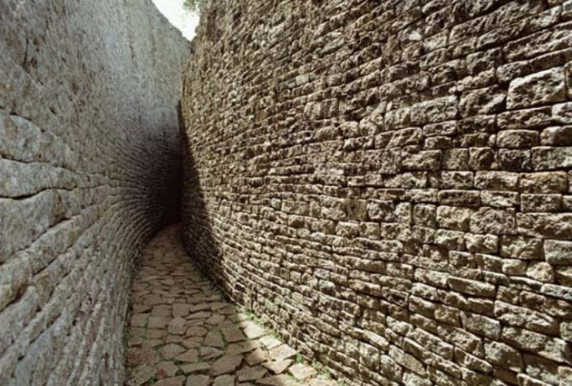

Slide 10
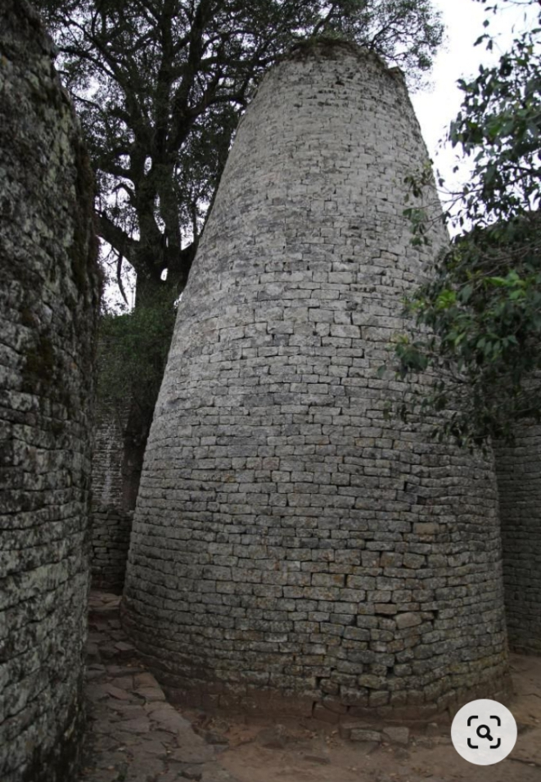

Slide 11
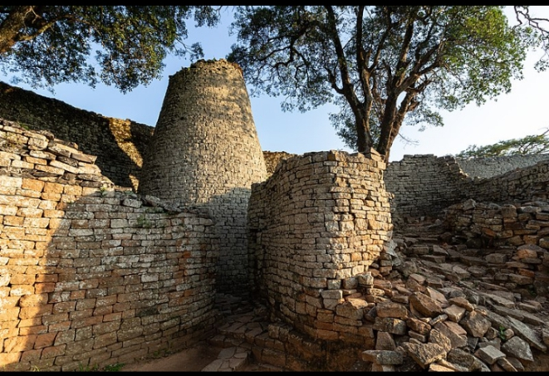

Slide 12
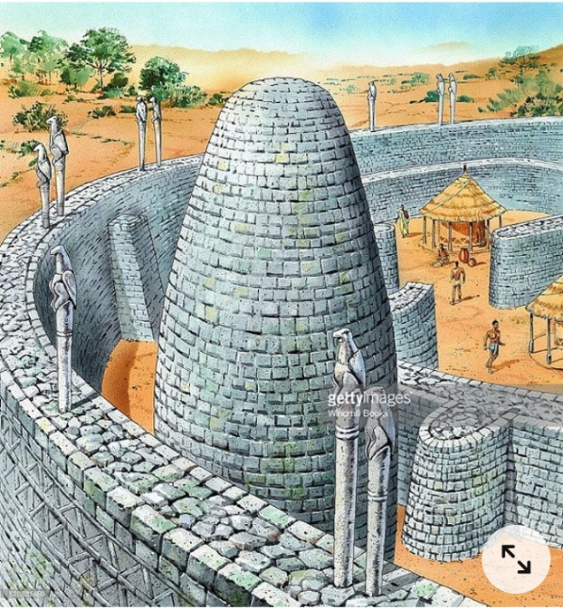

Slide 13
The GREAT ZIBAMBWE DEBATE
The controversy between the Eurocentric scholars and the Africanist writers regarding who built the Great Zimbabwe ruins generated what could be called the Great Zimbabwe debate.

Slide 14
Eurocentric Views
The elaborate and unique nature of the Great Zimbabwe buildings made various scholars to make assumptions that led most people, especially Europeans to believe that Great Zimbabwe was built by non- Africans.
They believed that Phoenician sailors might have built it because they were famous for carrying out long-distance trade during that time.

Slide 15
perhaps they could have been the ones behind the artefacts found at the ruins of Great Zimbabwe. Others believed that Egyptians under the reign of King Solomon could have built Great Zimbabwe because they collected gold in Central Africa.
Great Zimbabwe’s elaborate development could also have made most Europeans who saw the awesome buildings doubt they had been built by Africans.

Slide 16
Hence they thought that Great Zimbabwe must have been built by the forgotten whites who were inspired by Jewish and Arabic models of construction. Some thought that the lost mystic Christian kingdom of Prester John could have been behind these grand buildings.
Such assumptions were supported by some Eurocentric historians who wrote African history.

Slide 17
For instance, one of Hegel’s statements in his lectures (1830-31, before he died of cholera), on ‘Philosophy of History’ was that: “Africa is not a historical continent, it shows neither change nor development, as we see them (Africans) today, so have they always been”!
An Oxford professor was once heard saying:
          Perhaps in future, there will be some African history to teach, but at present there is none. There is only history of the Europeans in Africa, the rest is darkness... and is not a subject of history.

Slide 18
          We cannot therefore afford to amuse ourselves with unrewarding gyrations (dances) of barbarous tribes in picturesque (beautiful) but irrelevant corners of the globe.
These extremely negative views of Africa also led most Europeans who visited the ruins of Great Zimbabwe to doubt that it was the work of African people.

Slide 19
This is because to the best of their knowledge, Africans were savage and primitive people who gathered and hunted for their food and lived in caves!
In addition, 1871, Karl Mauch a Germany geologist also favoured the legend that the structures were built to replicate the palace of the queen of Sheba in Jerusalem.

Slide 20
Another European archaeologist called Theodore Bent, under Cecil John Rhodes’ patronage, upheld the theory that the walls could not have been constructed by Africans.
He argued that the builders must have had some Mediterranean or other non-sub-Sahara African connections.

Slide 21
Later, Africanist historians began to argue that the Great Zimbabwe buildings were the work of African peoples.
Africanist Writers’ Views
To resolve this debate, it took professional archaeologists who did excavations at the Great Zimbabwe site,

Slide 22
- to prove that indeed the awesome structures of Great Zimbabwe were built by indigenous Africans.
Archaeologists like David Randall McIver in the 1900s and Gertrude Caton Thompson in the 1920s, argued that Great Zimbabwe was the capital of an indigenous African state that flourished for several hundreds of years.

Slide 23
More later works by the Historical Monuments Commission of Zimbabwe, supported by carbon -14 dates, corroborated by Portuguese accounts written in the 16th and 17th centuries and also by oral tradition accounts from the Shona people, do confirm the African origins of Great Zimbabwe.
They also explain the foreign items found around the ruins of the Great Zimbabwe as having been brought by foreign traders, not foreign rulers or builders.

Slide 24
Archaeologists have concluded that Zimbabwe was in a good position for the development of long-distance trade with Sofala, a coastal settlement to the north and north-west of the gold bearing areas of Tati on the Zimbabwe plateau.
This enabled coastal traders to make trade contacts with people from all round the Indian Ocean; such as East Africa, Arabia, Persia and even China.

Slide 25
The Zimbabwean people’s main exports were gold and ivory while their main imports were shells, beads, and brightly coloured cotton clothes from India and finally pottery from Persia, China and Malaysia.
This explains the origins of the artefacts that were discovered at the site of the Great Zimbabwe.

Slide 26
Furthermore, the establishment and control of gold mining, ivory hunting and long-distance trade made the ancestors of the Shona to grow rich and powerful over the period between 14th and 15th centuries when gold trade was being extensively developed.
It was also around this time that the construction of Great Zimbabwe was beginning.

Slide 27
The wealth that the gold trade brought made it possible for the rulers of Great Zimbabwe to employ workers to help them construct the walls of Great Zimbabwe.
Unlike the Egyptian civilisation where slave labour is believed to have been extensively used to build the great pyramids, the construction of Great Zimbabwe does not show evidence of the use of slave labour in its construction.

Slide 28
Although some Africanist historians also suggest that there must have been early influences from the Venda people of Mapungubwe on the Shona people in their construction of the great stone buildings, most evidence points to the indigenous Shona people as the builders.
Some recent archaeological evidence provided by Peter Garlake shows very comprehensive descriptions of the Great Zimbabwe site.

Slide 29
David Beach and Thomas Huffman have produced a chronology detailing the development of Great Zimbabwe by indigenous Africans.
In addition, Gilbert Pwiti has published extensive analytical accounts on Great Zimbabwe’s Shona people’s trade links with foreign traders.
As such, the most recent historical consensus attributes the construction of Great Zimbabwe to the Shona people.

Slide 30
In conclusion, the series of excavations carried out by different archaeologists, appear to have finally settled the theory that Great Zimbabwe was built by Africans.
This is because they have produced conclusive evidence supporting the view that Africans were the ones who built the Great Zimbabwe.

Slide 31
The findings from the excavations have shown that the stone buildings were the work of Iron Age Africans.
Among the evidence, there is a royal palace.
This clearly shows that paramount rulers of the earliest inhabitants of Great Zimbabwe were generally established in large dwellings, often built of stones and, sometimes, as at Great Zimbabwe, of elaborate construction.

Slide 32
In addition, recent discoveries have revealed that the architects of the Great Zimbabwe stone buildings were Africans who practiced the art of stone building until about 150 years ago.
This is evident because the people who lived at Great Zimbabwe during this period were ancestors of the present day Shona speaking people in the modern Republic of Zimbabwe.
Eurocentric views are not convincing because they were merely based on assumptions.

