Slide 1
ELL 2220 LECTURE PHONOLOGY
LECTURER: MS. P. CHIKUTA

Slide 2
What is Phonology?
Phonology is the study of the sound system of a language; the component of a grammar which includes the inventory of sounds (phonetic and phonemic units) and rules for their combination and pronunciation; the study of the sound systems of all languages.
Phonology begins where phonetics ends.
Whilst phonetics simply describes the articulatory and acoustic properties of phones (speech sounds), phonology studies how sounds interact as a system in a language.
Phonetics studies which sounds are present in a language, while phonology studies how these sounds combine and how they change in combination, as well as which sounds can contrast to produce differences in meaning.

Slide 3
Variation of Minimal Pair Drills
Apart from the variation of a phoneme, there are three more ways in which an allophone can be presented: a) Tonal variation, b) Length, and c) Nasalization.
(a) Tonal Variation: In Bantu tone can be shown as a distinctive feature. Since allophone is defined as one of the variant of a phoneme, allophonic variants can be shown in tone. This is commonly so in tone languages for both distinctive and grammatical purposes.
Word + Tone Marking Meaning
i) ìtìpà n. mud
ìtípá n. knife
ii) ukunona ‘to be fat’
ukunona ‘to sharpen’

Slide 4
Conti..
(b) Variation by length
bin n. [bin]
been v. [bi:n]
(c) Variation by nasalization: [i] in bead and [ĩ.] in bean.

Slide 5
Types of Phonology
Segmental analysis: This involves ascertaining of the sound inventory using minimal pair drills and allophonic rules.
It focuses on “melody”: speech sounds (segments), their internal composition and external interactions.
One of the greatest discoveries in this area is that segments consist of features, and it is through these that segments interact with each other (Trubetzkoy 1939, Jakobson 1941).
Segmental phonology is therefore concerned with phonological features: what are they, and how are they organized inside segments and between segments?
Suprasegmental (prosodic) analysis: This involves tone, pitch, and stress. It focuses on aspects of the sound system “above” the level of segments, such as timing, stress and rhythm. Research into the nature and patterning of these phenomena suggests that speech sounds are not just arranged linearly, but are hierarchically organized into prosodic structure: segments into moras and syllables, syllables into metrical feet, metrical feet into prosodic words, prosodic words into phonological phrases, and so on.

Slide 6
Conti..
Suprasegmental (prosodic) phonology:
This involves tone, pitch, and stress.
It focuses on aspects of the sound system “above” the level of segments, such as timing, stress and rhythm.
Research into the nature and patterning of these phenomena suggests that speech sounds are not just arranged linearly, but are hierarchically organized into prosodic structure: segments into moras and syllables, syllables into metrical feet, metrical feet into prosodic words, prosodic words into phonological phrases, and so on.

Slide 7
Segmental phonology
Segments in phonology are conceptualized as consisting of bundles of features, or feature-value pairs.
ROOT FEATURES (MAJOR CLASS FEATURES)
Consonantal
Sonorant
Approximant
LARYNGEAL FEATURES
Voice
Constricted
Spread

Slide 8
Conti..
PLACE FEATURES
LABIAL : Round
CORONAL: Anterior and Distributed
DORSAL: Back, High, Low
MANNER FEATURES
Continuant,
Nasal,
Lateral,
Strident

Slide 9
Example…
 | STOPS | GLIDES | VOWELS | NASALS
CONSONANTAL | + | - | - | +
SONORANT | - | + | + | +
APPROXIMANT | - | + | + | _
CONTINUANT | - | + | + | _
NASAL | - | - | - | +
CORONAL | - | - | - | -
ANTERIOR | - | - | - | -

Slide 10
 | /t/ | /a/ | /k/ | /l/
Cons | + | _ | + | +
Son | _ | + | - | +
App | - | + | - | -
Cor | + | - | - | +

Slide 11
GENERATIVE PHONOLOGY
Generative phonology is a component of generative grammar that assigns the correct phonetic representations to utterances in such a way as to reflect a native speaker’s internalized grammar.
The following are some of the crucial components of generative phonology:
Levels of phonological representation
Phonological rules
Derivation
Distinctive features
Linearity

Slide 12
Suprasegmental Phonology
Tone, stress and intonation fall under suprasegmental (prosodic) studies.
The ‘segments’ of spoken language are the vowels and consonants, which combine to produce syllables, words and sentences.
At the same time as we articulate these segments, our pronunciation varies in other respects.
We make use of a wide range of tones of voices, which change meaning of what we say in a variety of different ways.
Suprasegmental analysis therefore is the study of (1) length, stress, and tone in relation to the syllable and (2) intonation in relation to phonetic phrases and sentences.

Slide 13
Stress or accent is relative emphasis or prominence given to a certain syllable in a word. The emphasis is typically caused by such properties as increased loudness and vowel length, full articulation of the vowel and changes in pitch. For example
Obˈject (verb) ˈObject (noun),
ˈReject (verb) Reˈject (noun)
Conˈvict (verb) ˈConvict (noun),
Reˈbel (verb) ˈrebel (noun)

Slide 14
Length – This feature deals with the duration of a sound. A sound can be considered to be either long or short depending on the time taken in its production.
/i:/ and /i/ as in Beat and bit
/u:/ and /u/ as in boot and put.
/e/, /ɜ:/ and /ə/ as in Bet, bird and better
Tone -Tone is a particular pitch pattern on a syllable used to make semantic distinctions. It is intonation on a word or phrase used phonemically either to differentiate between word meanings or convey grammatical distinctions.
E.g ukubomba (to work)
  Ukubomba (to be wet)

Slide 15
Phonological processes
How sounds in a particular language change.
When sounds are put together, there could be some changes
When words are put together-may affect the sounds.
Changes can occur:
Within a word
Between two different words
When we speak continuously
Pace of speech (intonation)

Slide 16
Assimilation
Dissimilation
Insertion/epenthesis
Deletion/elision
metathesis

Slide 17
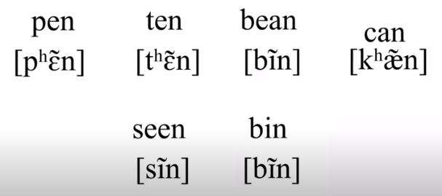
Assimilation
Assimilation- one sound becomes more similar to a nearby sound
The direction of assimilation (progressive) or backward (regressive)
Assimilation may be partial or total

Slide 18
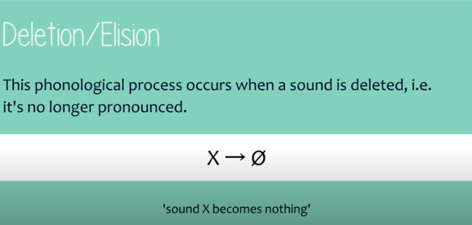

Slide 19
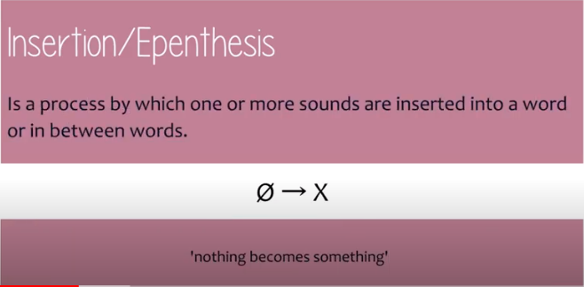

Slide 20
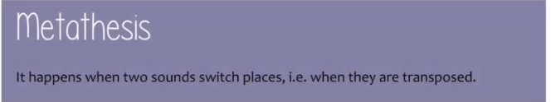

Slide 21
ASK
/æsk/ - /æks/
FIX
/fiks/ - /fisk/

Slide 22
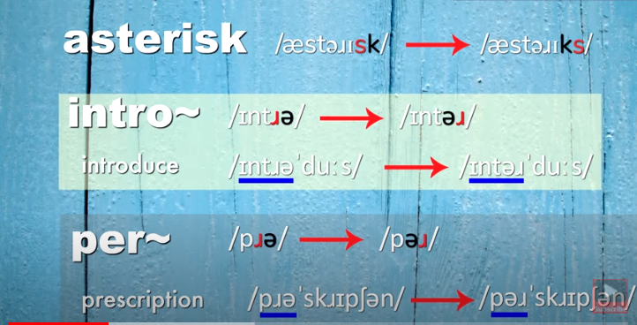

Slide 23
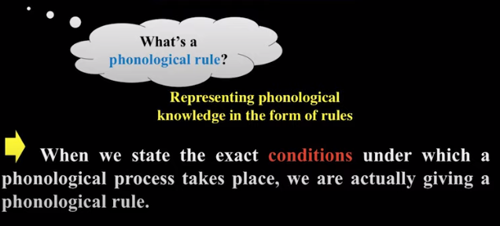
Phonological Rules

Slide 24
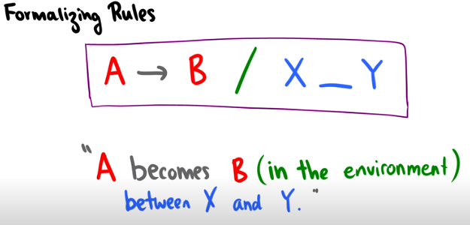
Phonological Rules

Slide 25
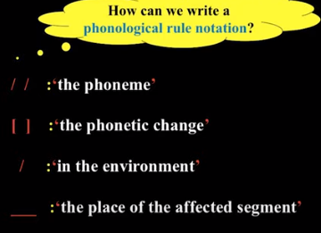

Slide 26
/A/ [B]/__ [X]
A sound A becomes sound B in the environment before sound X
/A/ [B]/[X]____
A sound A becomes sound B in the environment after sound X

Slide 27
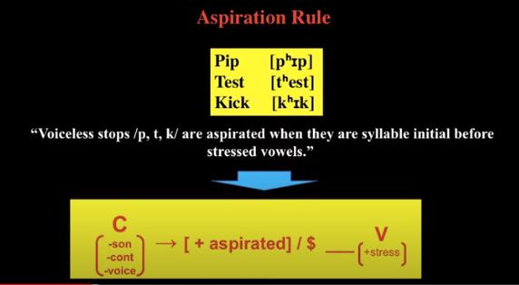

Slide 28
/p/ [p ͪ]/#_____
+cons +asp / # _______
-son
-voice
Pick
Mkllksa
Amkmal

Slide 29
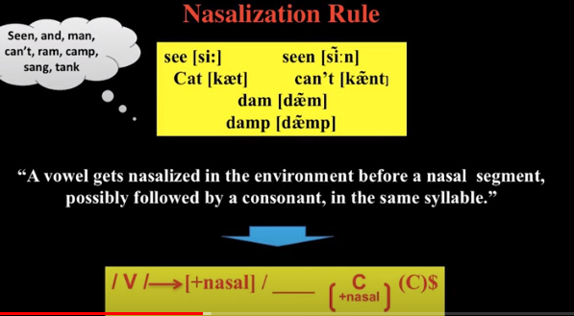

Slide 30
Man /mæn/

Slide 31
THE SYLLABLE AND PHONOTATIC CONSTRAINTS
A syllable is commonly defined as ‘ a unit of pronunciation typically larger than a single and smaller than a word’. (Crystal, 1985:297).
It has a psychological reality as we all seem to know (intuitively) where one syllable in word ends and where another begins.
For example, the Lozi word silamatela , we would easily know that it has si-, la-,ma-, te- and la as syllables.
A syllable must contain a vowel (or vowel-like) sound. The most common type of syllable in language also has a consonant before a vowel, often represented as CV. Other frequent sequences include CCCV, CCV and CVV
A rule of thumb is that each syllable ought to contain a vowel or vowel-like segment, as a nucleus.

Slide 32
ELEMENTS OF A SYLLABLE
Onset- sound at the beginning and it is always a consonant (optional)
Rhyme (rime)- broken down into nucleus and coda
Nucleus-the peak of a syllable and it is always a vowel sounds or vowel-like sound (mandatory)
Coda-sound at the end of syllable and it is always a consonant (optional)

Slide 33
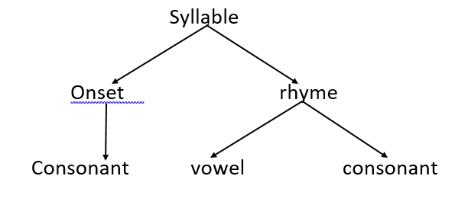
Structure of a syllable

Slide 34
Types of syllables
There are basically two types of syllables:
1. Open syllable (unchecked syllable)- one that ends in a vowel
2. Closed syllable (checked syllable)- one that ends in a consonant
Therefore, a syllable can be made up of:
a. Nucleus only e.g. are [a:] –open syllable
b. Onset + Nucleus e.g. fur [f3:]-open syllable
c. Nucleus + Coda e.g. eat [i:t]-closed syllable
d. Onset + Nucleus + Coda e.g. bet [bet]-closed syllable

Slide 35
Window- win.dow /win.dəƱ/ win=cvc-closed, dɘƱ- cvv -open
International=
Teacher /ti:.tʃə/ = 2 open syllables
School /sku:l/ = ccvc
Speaker /spi:.kə/
Strength /streŋƟ/- cccvcc

Slide 36
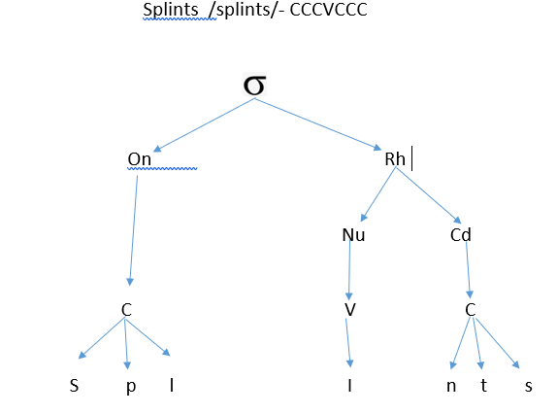

Slide 37
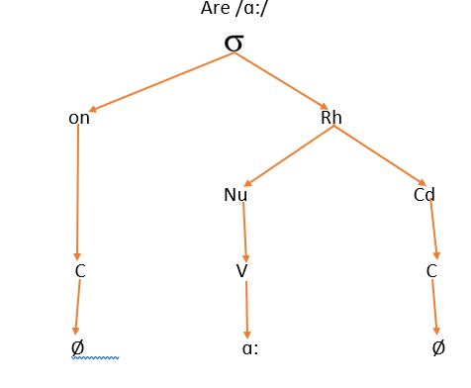

Slide 38
DRAW THE SYLLABLE STRUCTURE OF THE FOLLOWING WORDS.
1. International
2. Question
3. University
4. Employment
5. Linguistics

Slide 39
Phonotactics
Phonotactics is the study of the rules governing the possible phoneme sequences in a language.
Phonotactics also known as phoneme sequence constraints define permissible syllable structure, consonant cluster and vowel sequences by means of phonotactic constraints.
When discussing phonotactic constraints, it is important to structure the syllable hierarchically in terms of an onset and a rhyme, and sometimes also the syllable coda.
Phonotactic constraints can be discussed a) within the onset b) within the coda c) within the rhyme.

Slide 40
Some phonotactic constraints in English
All syllables have a nucleus.
b) No geminates (double or repeated speech sound).
c) No onset /ŋ/ sing, wrong, thinking
d) No /h/ in syllable coda
e) No affricates in complex onsets -
f) The first consonant in a complex onset must not be a voiced obstruent.
g) If the first consonant in a complex onset is not an /s/, the second must be a liquid or a glide or a stop e.g Sleep, stop, spring, sweet
h) Every subsequence contained within a sequence of consonants must obey all the relevant phonotactic rules.

Slide 41
i) No glides in codas.
j) If there is a complex coda, the second consonant must not be /ŋ/, /ʒ/, or /ð/.
k) If the second consonant in a complex coda is voiced, so is the first.
l) Non-alveolar nasals must be homorganic with the next segment.
m) Two obstruents in the same coda must share voicing.

Slide 42
END OF THE LESSON ON PHONOLOGY
THANK YOU!!!

