Slide 1
ELL 2220
SYNTAX
LECTURE 3: Phrases
LECTURER: MS. P. CHIKUTA

Slide 2
Introduction
Recap…
Having looked at words, we learn that words can be categories into three: Lexical words, Function words and Inserts
Words were described in terms of their morphology, syntactic role as well as from a semantic point of view.
We will now move on and look at phrases.

Slide 3
Consider the sentence below:
The opposition demands a more representative government.
This could have the following phrases:
[The opposition][demands][a more representative government].
A phrase may consist of a single word or a group of words.
Phrases can be identified by substitution-that is, by replacing one expression with another, to see how it fits into the structure.
In particular, a multi-word phrase can often be replaced by a single-word phrase without changing the basic meaning:

Slide 4
The opposition demands a more representative government
It demands something
We can also identify phrases by movement tests. A phrase can be moved as a unit to a different position
1a. The opposition demands a more representative government
1b. A more representative government is demanded by the opposition.

Slide 5
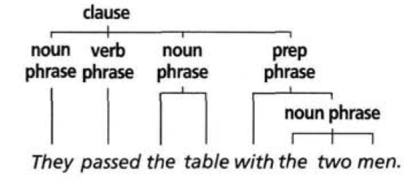

Slide 6
Syntactic Roles of Phrases
Phrase types differ both in their internal structure and in their syntactic roles i.e., their relations to larger structures. Recognizing syntactic roles, like subject and object, can be crucial for the interpretation of phrases. For example:
Martha loves Mary.
Subject- Verb –object
The syntactic roles here can also be interchanged.
Mary loves Martha
Subject-verb-object

Slide 7
Types of Phrases
For each class of lexical word, there is a major phrase type with an example of that class as the head: noun phrase, verb phrase, adjective phrase, adverb phrase, and prepositional phrase.
The head is the principal, obligatory word.
In fact, each phrase type can often consist of just one word: the head.

Slide 8
Noun Phrase
A phrase with a noun as its head is a noun phrase. The head can be preceded by determiners, such as the, a, her, and can be accompanied by modifiers elements which describe or classify whatever the head refers to. For example
A house , those houses, her house
A little girl, the big brown cat, the yellow and red dress

Slide 9
An abstract head noun can also be followed by complements, which complete the meaning of the noun, especially that-clauses or infinitive to-clauses.
Noun phrases containing a complement are shown below in ; heads are in bold, and complements are in italics:
1. The popular assumption that language simply serves to communicate is too simplistic.
2. He feels awkward about [her refusal to show any sign of emotion].
Besides common nouns, noun phrases can be headed by proper nouns, pronouns and (occasionally) adjectives
3. Lucy likes chocolate
4. They left yesterday.
5. Show me how the impossible can be possible.

Slide 10
Verb Phrase
Verb phrases have a lexical verb or primary verb as their head.
The main verb can stand alone or be preceded by one or more auxiliary verbs. The auxiliaries further define the action, state, or process denoted by the main verb.
Finite verb phrases show distinctions of tense (present/past) and can include modal auxiliaries.
Non-finite verb phrases do not show tense and cannot occur with modal auxiliaries, and so have fewer forms.
We will focus on finite verbs.

Slide 11
Verb phrases are the essential part of a clause, referring to a type of state or action.
The main verb determines the other clause elements that can occur in the clause

Slide 12
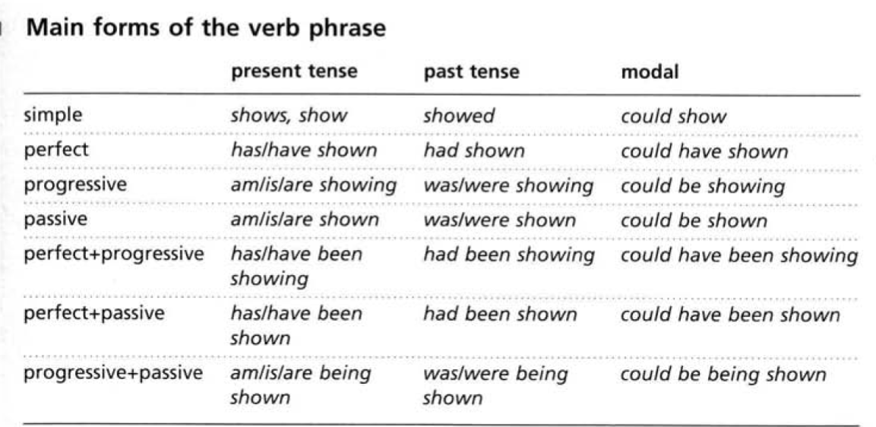

Slide 13
Adjective Phrase
Adjective phrases have an adjective as head, and optional modifiers that can precede or follow the adjective.
Modifiers typically answer a question about the degree of a quality, for instance: good enough, desperately poor

Slide 14
Adjective heads can also take complements. The complements are underlined below:
guilty of a serious crime
subject to approval by. . .
slow to respond
more blatant than anything they had done in the past
so obnoxious that she had to be expelled
Complements often answer the question 'In what respect is the adjectival quality to be interpreted?' (e.g. 'guilty/slow in what respect?').

Slide 15
The most important roles of adjective phrases are as modifier and subject predicative
1. As a modifier before a noun, where the adjective is called an attributive adjective (noun phrases are marked in [ ]:
He's [a deeply sick man].
We saw [a very good movie] the other night.
2. As a subject predicative, often following the verb be:
That's right.
He’s totally crazy.
Gabby was afraid to say anything more

Slide 16
Adjective phrases modifying nouns can be split into two parts by the noun head:
You couldn't have a better name than that.
Adjective phrase = better than that
When he plays his best, he's a really tough player to beat.
adjective phrase = really tough to beat

Slide 17
Adverb Phrase
Adverb phrases are like adjective phrases in structure, except that the head is an adverb
Optional modifiers may precede or follow the adverb head. They typically express degree
There quietly
pretty soon fortunately enough
so quickly you don't even enjoy it much more quickly than envisaged
Adverb phrases should be distinguished from adverbials: adverb phrases are structures, while adverbials are clause elements.
Adverb phrases, prepositional phrases, and adverbial clauses can all function as adverbials

Slide 18
The following syntactic roles are most usual for adverb phrases:
1. As a modifier in adjective or adverb phrases (the adjective or adverb phrase
modified is marked [ ]:
Those two were [pretty much horribly spoiled].
He was an attractive little creature with a [sweetly expressive] face.
2. As an adverbial on the clause level:
She smiled sweetly.
They sang boomingly well.

Slide 19
Prepositional Phrase
Prepositional phrases mostly consist of a preposition followed by a noun phrase, known as the prepositional complement.
The preposition can be thought of as a link relating the noun phrase to preceding structures.
1. to town 3. in the morning 5. on the night [of the first day]
2. to Sue 4. to him 6. in a street [with no name]

Slide 20
He worked [in a shop] [probably at that time]
He retired [after three minor heart attacks].
It was hard to live in Missouri [after spending so much time in California].
He was a poet, {a teacher [of philosophy]), and {a man [with a terrible recent history]).

Slide 21
Summary
Words are organized into larger units known as phrases.
The main classes of phrases are: noun phrase, verb phrase, adjective phrase, adverb phrase, and prepositional phrase.
The classes can be identified by their meaning, structure, and syntactic role.
Each of these phrases has a head from the corresponding word class: e.g. noun phrases usually have a noun as their head

Slide 22
END OF THE LECTURE
THANK YOU!

