Slide 1
ELL 2220 LECTURE PHONETICS
LECTURER: MS. P. CHIKUTA

Slide 2
Phonetics
Phonetics is the study and systematic classification of speech sounds.
It is the practical application of this science to language study.
Its study includes the study of the physical properties of speech sounds as sound waves (acoustic phonetics);
the study of speech perception (auditory phonetics);
the study of speech production (articulatory phonetics);
and the study of applications in legal cases involving speaker identification and the analysis of recorded utterances (forensic phonetics).
The major ones are acoustic, auditory and articulatory phonetics.

Slide 3
Phone, Phonemes and Allophones
Three categories of sounds must be recognised at the outset:
phones (human sounds),
phonemes (units which distinguish meaning in a language),
allophones (non-distinctive units).

Slide 4
A phone is a phonetic segment. This is the actual pronunciation of a sound. It is conventionally represented between square brackets [ ] e.g [p], [t], [g]
A phoneme is a sound segment that is distinct, that contrast or distinguish words (e.g. /p/ as in pit and /b/ in bit).
Phonemes are the essential mental representations of the phonological units of a language. A phoneme is conventionally represented by a letter symbol between slant lines / / e.g /p/, /t/, /g/
The various physical distinct sounds which count as executions of a given phoneme are called the allophones (or variants) of that phoneme

Slide 5
Minimal Pair Drills
A minimal pair drill is a pair (or set) of words which are identical except for one phoneme, occurring in the same place in the string.
When two words are identical in all respects, except for one segment, they are referred to as a Minimal pair.
The minimal pair test is a key principle of phonemic analysis.
Sounds are classified as separate phonemes if they are responsible for a difference in meaning in a minimal pair

Slide 6
Example: Minimal pair drills
sounds | Word-initially | Word-medially | Word-finally
/t, d/ | tip- dip |  | bet-bed
/i:, i/ |  | deep-dip feet-fit feast-fist
/n,m/ |  |  | Mean-meme

Slide 7
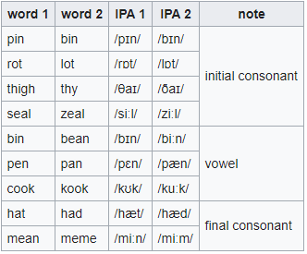

Slide 8
Allophones
An allophone is simply defined as one of the variants of a phoneme.
Allophones are derivational phonemes with similar prosodic units which are distinctive and whose constituent sounds or prosodic units are in complimentary distribution.
The phonemic underlying representations of words together with the phonological rules of a language, determine their pronunciation

Slide 9
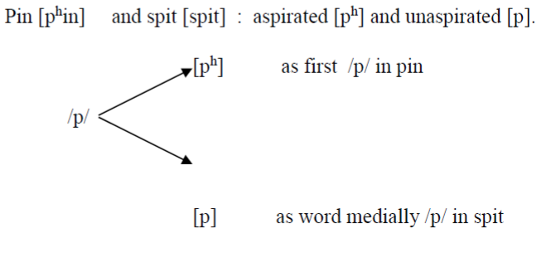

Slide 10
Phonetic Transcriptions: IPA and ASCII
Phonetic transcription is used in dictionaries to tell you how to pronounce words.
They are necessary because the spelling of an English word does not tell one how to pronounce it.
Phonetic transcriptions are normally written in the International Phonetic Alphabet (IPA).
However, there are a few problems that arise when using the IPA system.
Not all fonts include IPA symbols and some keyboards do not have keys for IPA symbols.
An alternative transcriptions system known as the ASCII Phonetic Alphabet created by Michal Ryszard Wojcik and Tomasz P. Szynalski uses symbols available on a normal keyboard.
Each English sound has its own symbol under these systems

Slide 11
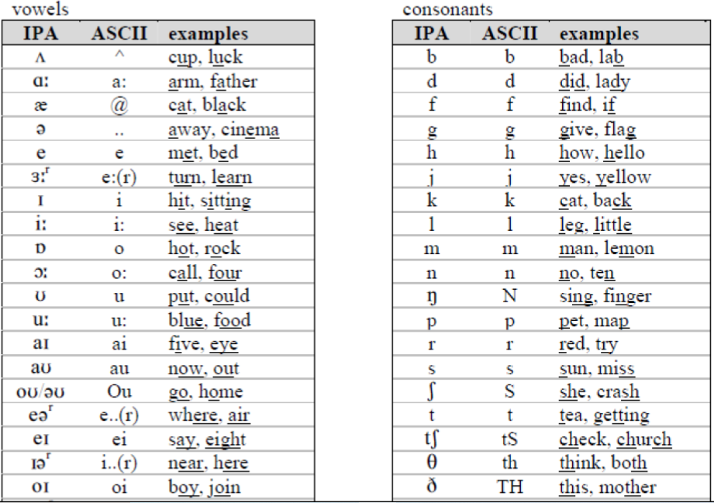
Examples of sounds: IPA and ASCII

Slide 12
Classification of Phonetic Sounds
Sounds can be divided into consonants and vowels. The former can be characterised according to:
1) place of articulation,
2) manner of articulation and
3) voice (voiceless or voiced).

Slide 13
Types of sounds: Consonants and Vowels
Consonants are sounds that are produced with partial or complete obstruction in the flow of air.
Vowels are sounds produced with relatively no obstruction in the flow of air.
Despite having these two types, some scholars categorize sounds into three-consonants, vowels and glide(semi-vowels). Others still argue that semi-vowels just belong to the vowel group. We will consider the later at the moment.

Slide 14
Vowels: characteristics
Vowels are all voiced.
Since their articulation involves no obstruction, they are pure voice, without noise:
they are the most sonorous sonorants.
Since there is no obstruction, they are continuants.
vowels differ from consonants in their behaviour, too: while consonants typically occur in syllable marginal positions – they appear at the peripheries of the syllable –, vowels form the very core of the syllable and occur in syllable central position.

Slide 15
Vowel classification
There are three classes of vowels. These are:
Monophthongs: in their articulation, the position of the tongue is relatively stable. E.g / ɪ, e, ʊ, ɔ:, ɑ:/
Diphthongs and triphthongs- The tongue moves from one position to the other either twice or three times respectively. E.g diphthongs there are two – /aɪ, eə, əʊ/ – while in triphthongs there are three – e.g., /aɪə, aʊə /
Vowels may be short – e.g. /ɪ, e, ʊ/ – or long – e.g., /ɔ:, ɑ:, eə, əʊ, aɪə/ – depending on their duration: long vowels are approximately twice as long as short ones.
Note that diphthongs and triphthongs are just as long as long monophthongs. Whenever we refer to long vowels, we always mean long monophthongs, diphthongs and triphthongs together

Slide 16
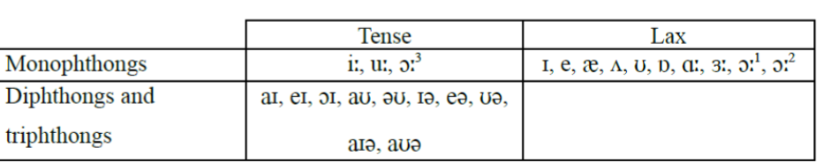
Within the class of full vowels, we may distinguish two subclasses: tense and lax vowels.
There are a few generalizations to be drawn on the basis of the above table: all short vowels are lax and all diphthongs and triphthongs are tense while long monophthongs are divided between the two classes. Non-high long monophthongs – that is /ɑ:/, /ɜ:/ and /ɔ:/ – are lax, except in the case of /ɔ:/.The behaviour of /ɔ:/ is twofold: sometimes it is tense, in other cases it is lax.

Slide 17
Conti..
In describing vowels, the criteria used are:
Tongue-height (Degree of aperture)- how raised is the tongue towards the palate or lowered below the neutral position.
High (close)vowels
High mid (half-close) vowels
Low mid (half-open) vowels
Low (open) vowels
Tongue advancement- tongue movement into forward or backward position i.e front, central and back vowels
Function of the lips- rounded, unrounded or spread

Slide 18
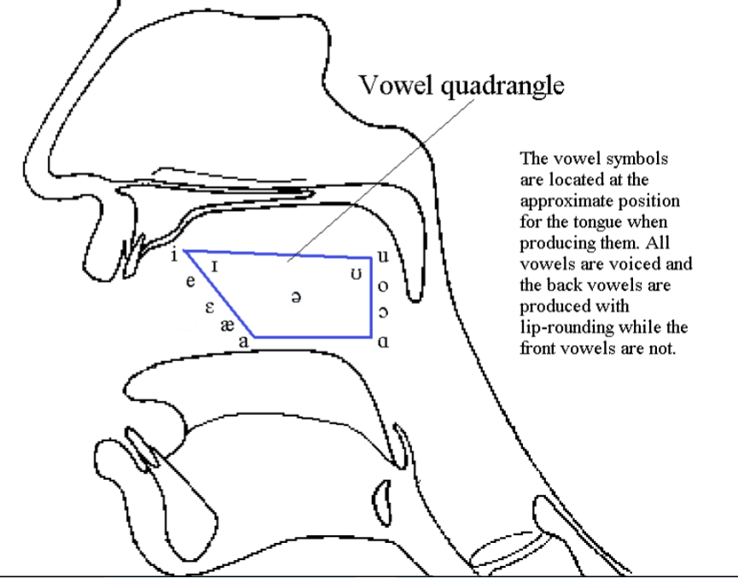
Vowel quadrangle

Slide 19
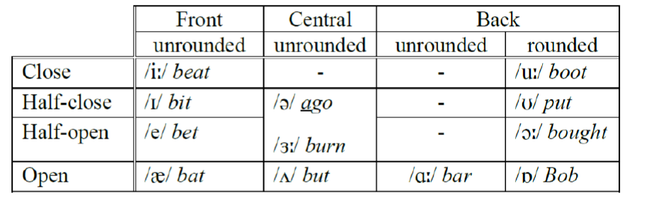
Conti..

Slide 20
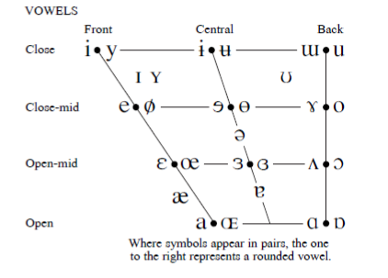

Slide 21
Some examples…
Contrast Practice of [i] and [I:]
[i:] [I] [i:] [I] [i:] [I]
Deep dip feet fit leave live
Bead bid seat sit ease is
Deed did seek sick feast fist
Sheep ship teak tick meal mill

Slide 22
Contrast Practice of [a: ] and [ᴅ]
[a:] [ᴅ] [ a:] [ᴅ] [ a:] [ᴅ]
Bard bob dart dot shark shock
Harp hop heart hot laughed loft
Sharp shop clerk clock mask mosque
Card cod dark dock cast cost

Slide 23
Consonant sounds
There are three ways in which consonant sounds are described ie voice, place of articulation and manner of articulation.
1) voice- relates to whether a sound during its production causes the vocal cords to vibrate or not thus yielding voiced and voiceless sounds.
2)place of articulation refers to which organ of speech is involved in the production of a particular sound.
3) manner of articulation refers to the behavior of air as it flows from the lungs during the production of a particular sound.

Slide 24
voice
Voiced sounds | Voiceless sounds
/b/ /m/ /n/ /g/ /j/ /ŋ/ /v/ /ð/ | /p/ /f/ /Ɵ/ /s/ /ʃ/ /t/ /k/

Slide 25
Place of articulation
1. Bilabial: made with the two lips (e.g. /p/, /b/, /m/).
2. Labiodental: the lower lip articulates with the upper teeth (e.g. /f/, /v/).
3. Dental: the tongue tip and rims articulate with the upper teeth (e.g. /Ɵ/, /ð/).
4. Alveolar: the tongue tip and/or blade articulates with the alveolar ridge (e.g. the RP English /n/, /s/).
5. Postalveolar (or palato-alveolar): the tongue blade articulates with the alveolar ridge, while the front of the tongue is raised towards the hard palate (e.g. the initial sounds in ship /ʃɪp/, check /tʃɛk/, and jail /dʒeɪl/) /Ȝ/
6. Palatal: the front (or blade) of the tongue articulates with the hard palate (e.g. /j/) yes, you, university.
8. Velar: the back of the tongue articulates with the soft palate (e.g. /k/, /g/).

Slide 26
Manner of articulation
1. Plosives (or stops): A complete closure at some point in the vocal tract, behind which the air pressure builds up and can be released with a sudden burst (plosion): e.g. /p, b, t, d, k, g/.
2. Fricatives : the airstream is partially obstructed, resulting in friction (or turbulence) in the flow of air: e.g. /f, s, z/.
3. Affricates: in the production of these sounds, there is a complete closure in the flow of air and then a gradual release. E.g /tʃ, dƷ…
4. Nasals: These are sounds in which the velum is lowered, while at the same time, there is an obstruction in the oral cavity: e.g./m, n, ŋ/. ==
5. Liquids: These sounds involve an obstruction of the airstream at some point in the mouth (usually in the denti-alveolar region and along the centre), with the air being allowed to escape on one or both sides of the tongue. There are two types; lateral /l/ and the other is called a retroflex /r/
6. Approximants (Glides) In the production of an approximant, one articulator is close to another, but the vocal tract is not narrowed to such an extent that a turbulent airstream is produced. Among the approximants, we find the RP /j/ and /w/, which are also referred to as semi-vowels.

Slide 27
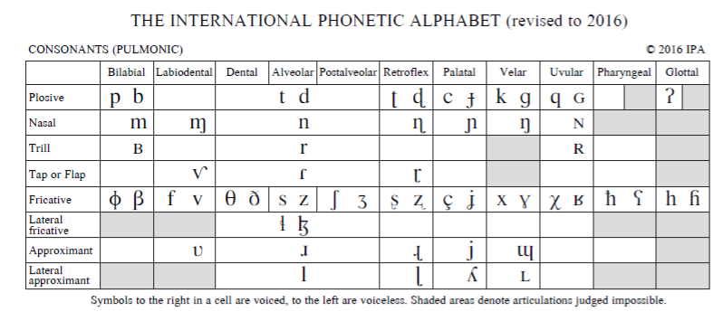
IPA: CONSONANTS

Slide 28
Some Phonetic transcriptions
Sing -/sɪŋ/
Deed /di:d/
School /sku:l/
Quiet /kwaiɘt/
Quality
Window
English /ɪŋgliʃ/
Linguistics /lɪŋgwɪstiks/
Language
Buy
Phonetics
Child
University

Slide 29
question
Identify the sound in bold and give a full description of the sound.
Measure
Combine
Three
Consonant
Philosophy
Queue
Free
Sugar
Sir

Slide 30
End of Lesson on Phonetics

