Slide 1

Introduction to Academic Writing and Study Skills
Dr. S. B. Mkandawire; Ms. M. Olson; Ms B. Ahmed
LTC 1100: Lecture week 1 & 2
The University of Zambia, 2024

Slide 2
What is academic writing?
A kind of writing that students, researchers and scholars use (Hutton & Gibson, 2019).
Academic writing is a formal style of writing used in colleges, universities and scholarly publications.
You will be expected to write your essays, research papers, and dissertations in academic style (https://www.scribbr.com/category/academic-writing/#:~:text=Academic%20writing%20is%20a%20formal,and%20dissertation%20in%20academic%20style.)

Slide 3

What are study skills?
These strategies used to remember information for later use (Mkandawire, 2015).
These are study habits, skills, attitude and constructs that help students retain information and improve academic performance (Credé & Kuncel, 2008).
Study skills may include chunking, mnemonic, memorisation, note making, note taking, PQRST, time management, listening skills, research skills, ability to use information technology productively and the ability to read and write at appropriate level

Slide 4
Features of Academic Writing
Formal vs informal Language. E.g.
Avoid contractions e.g. can’t=cannot., don’t = do not., I’m sorry= I am sorry., isn’t=is not., won’t=will not.
Avoid Slang/colloquialism (words/phrases that are not formal). e.g. gonna = going to., Wanna = want to., y’all = you all. There is more than one way to kill a cat = there are several methods of xxx.
Avoid personal language (first-person pronouns) e.g. I, me, we.

Slide 5
(d) Avoid the use of unexplained abbreviations. Abbreviations are split into two: Acronyms and initialisms.
Acronyms are abbreviations that read as if they are words. E.g. ZESCO, UNZA, UNICEF, UNESCO, UNIP, NIPA, OSCOLA.
Initialisms are abbreviations that are read by independent letters. E.g. ECZ, GRZ, CBU, MMD, PF, UPND, APA, MLA..

Slide 6
PAIR ACTIVITY 1: Correction Finder
In pairs, identify the informal language and replace with formal.
  Zambia didn’t qualify for the world cup last year and FAZ accused the coach for the failure.
  Lecturers still count on students to use correct grammar and punctuation in essays.
  I considered various research methods for the study.
  Everyone for themselves and God foraso.

Slide 7
Features of Academic Writing
Formal vs informal Language Continued…

Slide 8
(e) Avoid Vague Language
Vague language examples
Use more specific words
School is a big thing in my life.
Drinking while driving is bad.
There are about 212 people in class.
Vague language can be impolite. E.g. What did you learn in LTC 1100 class today, James? Response: some stuff.
This food is nice.
School is an important part of my life.
Drinking while driving can cause accidents and is therefore, dangerous.
There are 212 students in LTC 1100 class.
Appropriate response: We learned about the dynamics of making in-text citations in APA guide.
This food is delicious.

Slide 9
(f) Use formal Words and Expressions
AVOID Informal
USE Formal
My aunt has a lot of cool kids.
They messed up a good and nice legal system.
The lawyer was duped by her client in believing she was innocent.
My aunt has five brilliant children.
They disturbed a fair and precise legal system.
The lawyer was mislead by her client in believing she was innocent.

Slide 10
(g) Avoid generalization
Avoid saying…
Instead say…
All men are cheaters.
Zambian are good people.
Criminals are dangerous.
President Mulyokela must go. Zambians have spoken.
John and Andrew are cheaters.
Several Zambians are kind and helpful.
Violent criminals can be dangerous.
A faction of Zambian wants Mulyokela to stop politics.

Slide 11
(h) Avoid Hedging (Doubtful) language but provide factual information
Avoid saying: I believe that I will pass the exam.
Say: I will pass the exam.
Avoid saying: Let’s keep dating. We could get married someday.
Say: Let’s keep dating. We will get married on June 14, 2025.
Avoid saying: Lend me K400 and I might pay you back next month.
Say: Lend me K400 and I will repay you on the 30th of next month.

Slide 12
Activity 2: Quiz
Phase 1: Each student should prepare five questions based on what was taught in this session.
Phase 2: Find a partner and ask them your questions for them to answer. When you are through with your questions, you must answer their questions.
Phase 3: Swap partners at least three times.

Slide 13

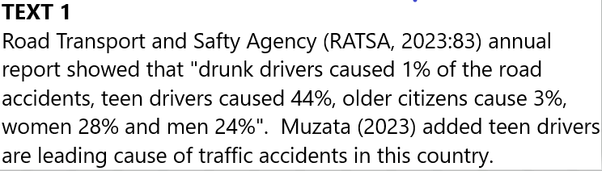
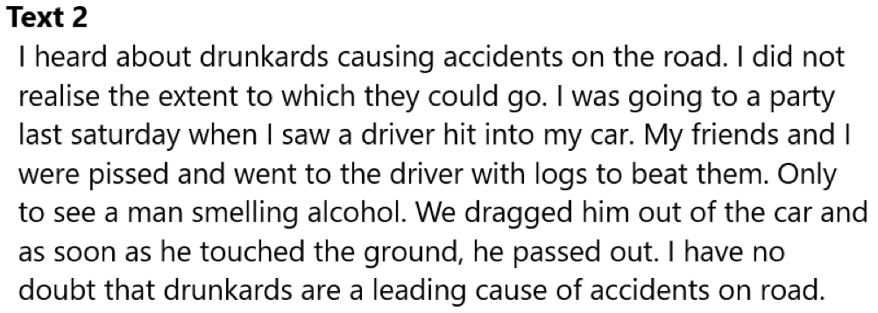
Features of Academic Writing
2. Responsibility and Giving Credit in Essays
Academic writing is not about what you know but what evidence you have presented to convince your readers (jury) – law principle
Evidential support in essays are citations showing source of data, information or ideas.
Which of the two texts would you believe and why?

Slide 14
https://openoregon.pressbooks.pub/wrd/chapter/crediting-your-sources/
2. Responsibility and Giving Credit in Essays
You have the responsibility to let your readers know this material is from other texts rather than original ideas from yourself
Giving credit adds to your own credibility as well as the original author
Giving credit helps trace the facts back to the main source

Slide 15
2. Responsibility and Giving Credit in Essays
Throughout your essay, use an in-text citation to identify accredited text (quotation, summary, or paraphrase) that are not yours.
      Narrative: Introducing the author/the material prior the accredited text
      Parenthetical: The author’s last name and the page number in parenthesis at the end of the sentence
      Citation marker: Adding a superscript/footnote
      Use linking or attributive language to continue talking about the source

Slide 16
Examples of In-Text Citations…
      Banda (2014) explains the importance of academic writing for students. (This is a narrative citation.)
      The legal system in Zambia needs exceptional improvements (Muzata, 2023). (This is a parenthetical citation.)
      There is a conundrum between customary law and statutory law on marriage¹. (This is a citation marker.)
https://openoregon.pressbooks.pub/wrd/chapter/crediting-your-sources/

Slide 17
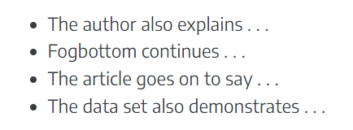
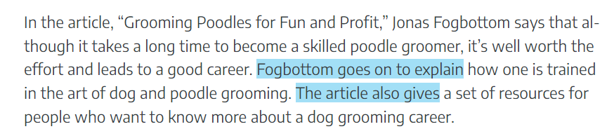
      Use linking or attributive language to continue talking about the source

Slide 18
(b) Your essay will end with a list of cited works or a “References” page or Bibliography
Sources in the reference list should have complete details about each publication
Each entry follows a specific and consistent format
Sources must be listed alphabetically

Slide 19

Features of Academic Writing
https://www.classace.io/answers/define-logical-presentation#:~:text=Logical%20presentation%20refers%20to%20the,follow%20and%20understand%20the%20topic.
3. Logical presentation
“Delivery of information and ideas in a clear, structured, and reasoned manner.”
Consider these components:
    Audience
    Presentation purpose
    Direction/stance
    Necessary supporting information

Slide 20

(b) Types of logical order
    Chronological order
    Compare/contrast
    Division of ideas
    Order of importance
    Cause/effect

Slide 21
Pair each essay topic with the logical order type that best fits.
The History of the Roman Empire
The Downfall of New York’s Twin Towers
The Tribes of Eastern & Western Zambia
Types of logical order
    Chronological order
    Compare/contrast
    Division of ideas
    Order of importance
    Cause/effect

Slide 22

Features of Academic Writing
4. Referencing style/guide
Each academic essay or material is expected to use one of the referencing styles/guide.
American Psychological Association (APA) Guide
Chicago Guide
Oxford Standard Citation Of Legal Authorities (OSCOLA)

Slide 23
Examples of In-Text Citations…
      Banda (2014) explains the importance of academic writing for students. (This is a narrative citation.) APA Guide
      The legal system in Zambia needs exceptional improvements (Muzata, 2023). (This is a parenthetical citation.) APA Guide
      There is a conundrum between customary law and statutory law on marriage¹. (This is a citation marker.) Chicago/OSCOLA
https://openoregon.pressbooks.pub/wrd/chapter/crediting-your-sources/

Slide 24

5. Precision and accuracy in facts and figures
Features of Academic Writing
Present precise data. No hedging language
Present facts without alteration but can be paraphrased.
Figures and numbers must be precisely captured even in translations.
Check your Bible verses:
1. When David defeated the King of Zobah, how many horsemen did he capture?
(1) Chron.: 18:4 David took SEVEN THOUSAND horsemen
(2) Samuel: 8:4 David took ONE THOUSAND SEVEN HUNDRED horsemen
2. How many stalls for horses did Solomon have?
(I ) Kings 4:26: FORTY THOUSAND
(2) Chron: 9:25 FOUR THOUSAND
3. The Temple contained how many baths?
(1) Kings 7:26 – TWO THOUSAND baths.
(2) Chron. 4:5 – THREE THOUSAND baths
4.How old was Jehoiachin when he became king of Jerusalem?
(2 )Kings 24:8 – EIGHTEEN years of age
(2) Chron. 36:9 EIGHT years of age

Slide 25

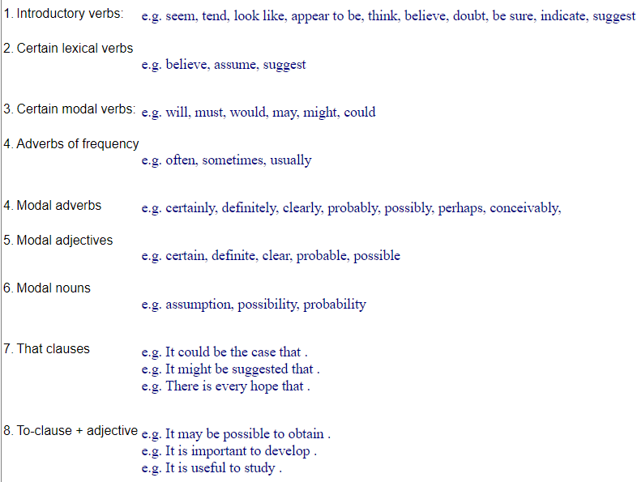
6. Avoid Hedging (Doubting language)
Features of Academic Writing

Slide 26

7. Grice’s Conversational Maxims (Cooperative Principal Theory)
Features of Academic Writing
From 1960s to 1980s, Grice believed that meaningful dialogue was characterized by cooperation.
This was based on his Cooperative Principle theory which assumes that participants in a conversation usually attempt to be truthful, informative, relevant, and clear in order to facilitate successful communication.
Based on these assumptions, Grice divided his cooperative principle into four conversational Maxims.
    The Maxim of Quality
    The Maxim of Quantity
    The Maxim of Relevance
    The Maxim of Manner

Slide 27

7.1 The Maxim of Quality
Abiding by the Maxim of quality means not telling a lie on purpose. When following this maxim during communication, you should:
  Only say things you believe to be true.
  Not say things that you cannot back up with evidence.
Example: “Kenneth Kaunda was the first president of the republic of Zambia.”
Here the speaker believe that they are telling the truth to the best of their knowledge.

Slide 28
7.2 The Maxim of Quantity
When following the Maxim of quantity, it is important not to withhold information during communication that would be necessary to keep the conversation going. However, it is also important not to bombard listeners with too much irrelevant information.
When abiding by this maxim of quantity during communication, you should:
    (i) Make your contribution to the conversation as informative as required.
    (ii) Do not contribute more information than is required.
Example:
Speaker A: Do you think Natasha passed the test?
Speaker B: Yes, I do. She did exceptionally well and got an A! In fact, she is the best in our class and that girl seem to have charms. She performs well in all the courses and I wonder how she study.

Slide 29
7.3 The Maxim of Relevance
Following the Maxim of relevance keep conversations on track, on point and this helps prevent random conversations that lack continuity.
When abiding by this Maxim, you should only say things that are relevant to the conversation or topic. Example:
  Speaker A: “Do you think Taonga is dating someone new?”
  Speaker B: “Well, she goes to Kabulonga most weekends.”
  Speaker C: “She bought a cake yesterday and it was not her birthday.”
  Speaker D: “No. It was her grandmother’s birthday in Kabulonga yesterday”
Due to the Maxim of relevance, we can infer/guess that there is a link between Taonga dating someone new and going to Kabulonga.
Speaker B is just randomly telling us about Taonga’s trips to Kabulonga but does not prove she has a new boyfriend and so is Speaker C.

Slide 30
7.4 The Maxim of Manner
The maxim of manner is a principle of effective communication that encourages speakers to be clear, concise, and orderly in their expression.
When following this Maxim, we should avoid using big or overly complex words that we know our listeners won't understand and should try our best to be concise and coherent. Example of Maxim of manner:
I'm writing an essay on metonymy. It's a type of figure of speech!'
Here the speaker knew that it was possible that the listener would not know the term metonymy and decided to give a quick explanation to help them understand.

Slide 31
Activity 3: The hot spot game (Goma Fields Activity)
Students split into five groups of 45.
At the beginning, one student volunteers to be at the center holding a folded paper pointed or any object that can be rotated to point at one person shaped like a kite or plane or anything pointed.
The volunteer student should throw or dice the paper or object from their head (for a paper) into the air. Or an object tossed or rotated on the ground.
Whoever is pointed at by the pointer paper or object should a question to a person rotating the object to answer.
If they answer the question right, the person asking questions gets to the center. If the answer is wrong, the person at the center remains tossing.

Slide 32
THE END
Thank you

