Slide 1
FROTH FLOTATION

Slide 2
Flotation Fundamentals
Froth Flotation
Froth flotation utilises the difference in physico-chemical surface properties of particles of various minerals.
After treatment with reagents, such properties between the minerals within the flotation pulp become apparent and, for flotation to take place, an air-bubble must be able to attach itself to a particle, and lift it to the water surface (Fig. 1).
The process can only be applied to relatively fine particles, as if they are too large the adhesion between the particle and the bubble will be less than the particle weight and the bubble will therefore drop its load.

Slide 3
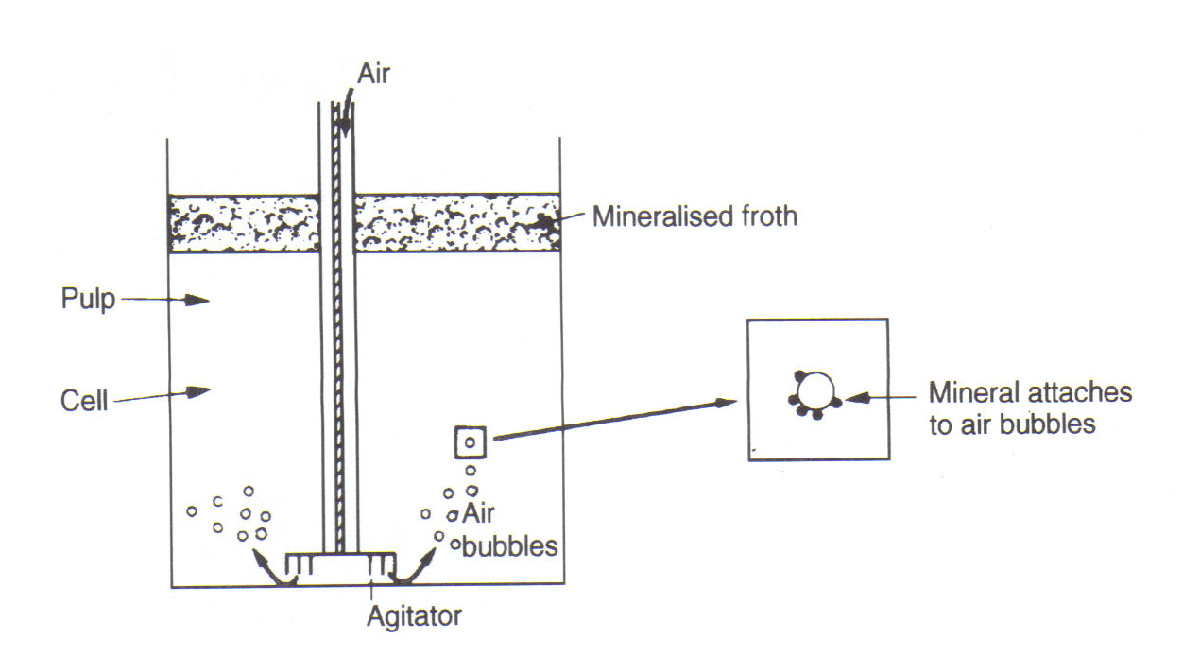
Figure 1: Principle of Flotation

Slide 4
Flotation Fundamentals
Froth Flotation
In flotation concentration, the mineral is usually transferred to the froth, or float fraction, leaving the gangue in the pulp or tailing.
This is direct flotation as opposed to reverse flotation, in which the gangue is separated into the float fraction.
The air-bubbles can only stick to the mineral particles if they can displace water from the mineral surface, which can only happen if the mineral is to some extent water repellent or hydrophobic.
Having reached the surface, the air bubbles can only continue to support the mineral particles if they can form a stable froth, otherwise they will burst and drop the mineral particles.

Slide 5
Flotation Fundamentals
Froth Flotation
To achieve these conditions it is necessary to use the numerous chemical compounds known as flotation reagents.
The activity of a mineral surface in relation to flotation reagents in water depends on the forces which operate on that surface.
The forces tending to separate a particle and a bubble are shown in Fig. 2. The tensile forces lead to the development of an angle between the mineral surface and the bubble surface.

Slide 6
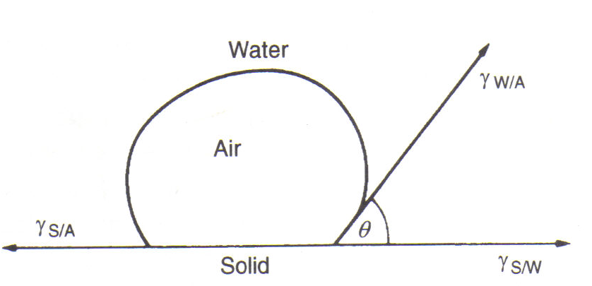
Figure 2: Contact angle between bubble and particle in an aqueous medium

Slide 7
Flotation Fundamentals
Froth Flotation
At equilibrium,
where ϒ_{S/A}, ϒ_{S/W} and ϒ_{WA} are the surface energies between solid-air, solid-water and water-air, respectively, and θ is the contact angle between the mineral surface and the bubble.
The force required to break the particle-bubble interface is called the work of adhesion, W_{S/A}, and is equal to the work required to separate the solid-air interface and produce separate air-water and solid-water interfaces, i.e.

Slide 8
Flotation Fundamentals
Froth Flotation
It can be seen that the greater the contact angle the greater is the work of adhesion between particle and bubble and the more resilient the system is to disruptive forces.
The floatability of a mineral therefore increases with the contact angle; minerals with a high contact angle are said to be aerophilic, i.e. They have a higher affinity for air than water.

Slide 9
Flotation Fundamentals
Froth Flotation
Most minerals are not water repellent in their natural state and flotation reagents must be added to the pulp.
The most important reagents are the collectors, which adsorb on mineral surfaces, rendering them hydrophobic (or aerophilic) and facilitating bubble attachment.
The frothers help maintain a reasonably stable froth.
Regulators are used to control the flotation process; these either activate or depress mineral attachment to air-bubbles and are also used to control the ph of the system.

Slide 10
Flotation Fundamentals
Froth Flotation
Froth flotation is a process used to separate minerals, suspended in liquids, by attaching them to gas bubbles to provide selective levitation of the solid particles.
It is the most extensively used process for the separation of minerals, to concentrate ore for economic smelting.
Floatable minerals can be classified into non-polar and polar types according to Wills (1988).
The segregation into these two types of minerals is based on their surface bonding.
The surfaces of non-polar minerals have relatively weak molecular bonds, difficult to hydrate, and in consequence such minerals are hydrophobic.

Slide 11
Flotation Fundamentals
Froth Flotation
Non-polar minerals include graphite, sulphur, molybdenite, diamond, coal, and talc, all naturally floatable in the pure state.
The ores containing these minerals for beneficiation usually require the addition of non-specific collectors to their pulp to aid the natural hydrophobicity of the floatable fraction.
Polar minerals (e.g. oxide minerals) have a strong covalent or ionic surface bonding, and exhibit high free energies at their surfaces.
Therefore, surface hydration is rapid due to the strong reaction with water molecules, which form multilayers on the mineral.
Thus these species are hydrophilic and need surface modifiers to render them amenable to flotation.

Slide 12
Flotation Fundamentals
Froth Flotation
Bulk flotation is a somewhat imprecise term that covers nearly all the normal rougher or scavenger flotation, where a single mineral or a group of related minerals is separated from gangue and other low value minerals in a single flotation step.
An example would be the recovery of a mixed copper sulphide concentrate from an ore containing pyrite and gangue.

Slide 13
Flotation Fundamentals
Froth Flotation
Differential flotation is the term normally used to describe the separation of complex ores, and is generally restricted to describing the separation of similar minerals from each other (e.g. copper, lead, zinc, cobalt and silver) where the successful and economic recovery of each component involves the sophisticated use of collectors, depressants and flotation activators.

Slide 14
Flotation Fundamentals
Flotation Reagents
For a flotation process to be successful, reagents must be added to the pulp. Flotation reagents ensure that the flotation process is highly selective and efficient.
Elaborate control of the wetting or non-wetting of mineral surfaces facilitates the separation, in the flotation system.
The reagents employed are generally interfacial surface tension modifiers, surface chemistry modifiers, and/or flocculants.
Usually they are classified under five headings: collectors (sometimes known as flotation promoters), frothers, modifiers, activators and depressants.
Each type of reagent has a specific purpose:

Slide 15
Flotation Fundamentals
Flotation Reagents
Collectors
Hydrophobicity has to be imparted to most minerals in order to float them.
In order to achieve this, surfactants known as collectors are added t the pulp and time is allowed for adsorption during agitation in what is known as the conditioning period.
Collectors are organic compounds which render selected minerals water-repellent by adsorption of molecules or ions on to the mineral surface, reducing the stability of the hydrated layer separating the mineral surface from the air bubble to such a level that attachment of the particle to the bubble can be made on contact.

Slide 16
Flotation Fundamentals
Flotation Reagents
Collectors
Collector molecules may be ionising compounds, which dissociate into ions in water, or non-ionising compounds, which are practically insoluble, and render the mineral water-repellent by covering its surface with a thin film.
Ionising collectors have found very wide application in flotation. They have complex molecules which are symmetrical in structure and are heteropolar, i.e. the molecule contains a non-polar hydrocarbon group and a polar group which may be one of a number of types.
The non-polar hydrocarbon radical has pronounced water-repellent properties, whereas the polar group reacts with water.

Slide 17
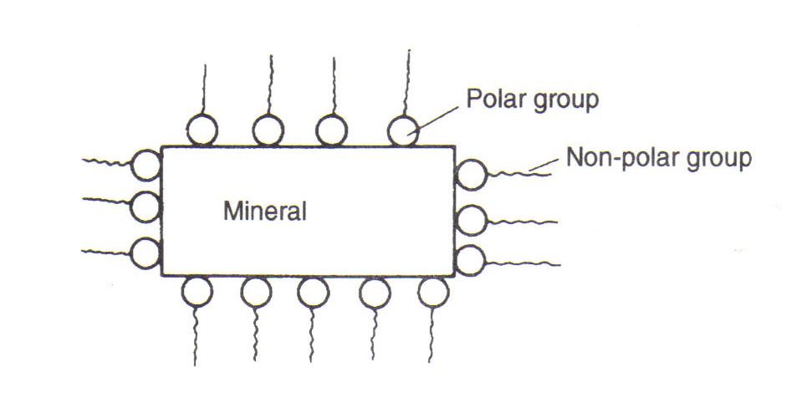
Figure 12.6: Collector adsorption on mineral surface

Slide 18
Flotation Fundamentals
Flotation Reagents
Frothers
Frothers are surface-active reagents that aid in the formation and stabilisation of air-induced flotation froths. They concentrate at the air-water interface, helping to keep the air bubbles dispersed and preventing their coalescence. Frothing agents increase the stability of the flotation froth by stabilising the mineralised bubble as it rises to the pulp surface.
A frother has a number of functions in flotation: first it reduces the surface tension of the air-liquid interface in order that a stable bubble is produced in the system; secondly, it influences the kinetics of bubble-particle adhesion; thirdly, it thins the liquid layer by interacting with the collector molecules and finally, it stabilises the bubble-particle aggregate.

Slide 19
Flotation Fundamentals
Flotation Reagents
Frothers
Frothers are generally heteropolar surface active organic reagents, capable of being adsorbed on the air-water interface.
The heteropolar structure of the frother molecule leads to its adsorption, i.e. the molecules concentrate in th surface layer with the non-polar groups oriented towards the air and the polar groups towards the water (Fig. 12.11).
Frothing action is thus due to the ability of the frother to adsorb on the air-water interface because of its surface activity and to reduce the surface tension, thus stabilising the air bubble.

Slide 20
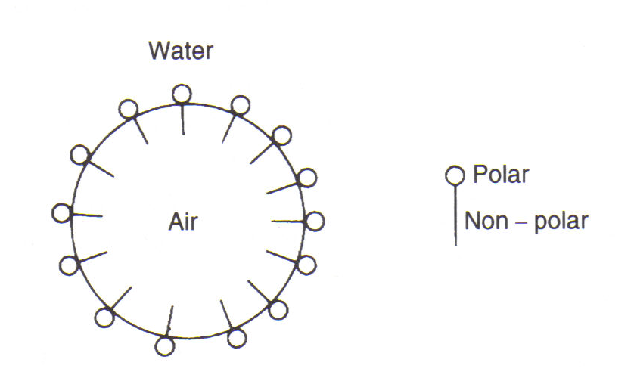
Figure 12.11: Action of the frother

Slide 21
Flotation Fundamentals
Flotation Reagents
Modifiers, Activators and Depressants
Flotation modifiers, activators and depressants are sometimes known as regulating agents.
The main purpose of these types of reagents is to control the effect of collectors on mineral particles, so that the selectivity of the flotation process is increased.
In the presence of a regulating agent, the collector activates basically those minerals, which are required to pass into the froth.

Slide 22
Flotation Fundamentals
Flotation Reagents
Modifiers, Activators and Depressants
In some cases, the regulating agent acts directly on the surface of a definite material, facilitating the subsequent interaction of this mineral and the collector and thus improving the results of flotation (activation).
In other cases the regulating agent has the reverse effect, producing an adverse condition for mineral activation by the collector and thus leading to relatively poor results in flotation (depression).
For pH control an environmental modifier such as lime may be used.

Slide 23
Flotation as a Process
Phenomenologically speaking, one can schematically describe the flotation process as shown in Fig. 1.
The ore ground to a predetermined fineness, having thus a given size distribution and distribution of free (liberated) and locked particles of valuable and gangue minerals, is subjected to a separation reaction in the flotation circuit.
Depending on the prevailing Eh-pH, temperature, and solution conditions, as well as the presence of various reagents, the feed is split into two products – one having the desired minerals known as concentrate, meant for further processing and the other having all unwanted gangue discarded as tails.
For a multimetal ore, there can be more than one concentrate.

Slide 24
Fig. 1: Schematic diagram of a flotation circuit
Concentrate
(Desired Grade)
Ground Ore
Feed
FLOTATION CIRCUIT
Tails

Slide 25
Flotation as a Process
The efficiency of such a separation process is conventionally represented in terms of the percent recovery of the valuable element in the concentrate and its grade as defined below.

Slide 26
BASIC FLOTATION CIRCUITS
Commercial flotation is a continuous process.
Cells are arranged in series forming a bank (Fig. 12.16).
Pulp first enters the first cell of the bank and gives up some of its valuable minerals as froth; the overflow from this cell passes to the next second cell, where more mineralised froth is removed, and so on down the bank, until barren tailings overflow the last cell in the bank.
The height of the froth column for each cell is determined by adjusting the height of the tailing overflow weir, the difference in height between this and the cell overflow lip determining the froth depth.

Slide 27
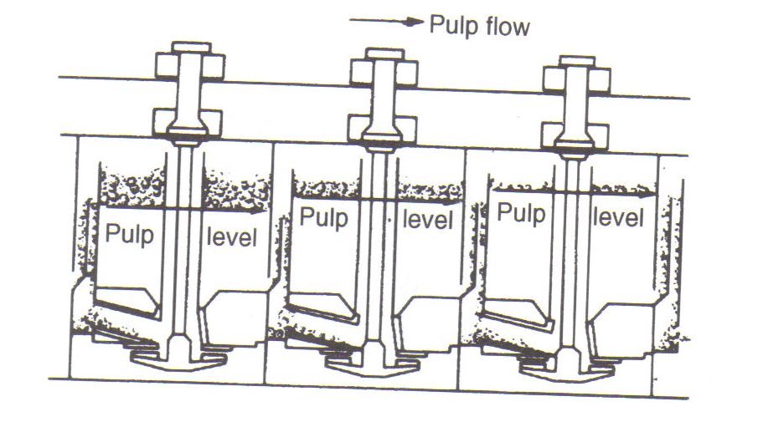
Fig 12.16: (a) Bank of flotation cells

Slide 28
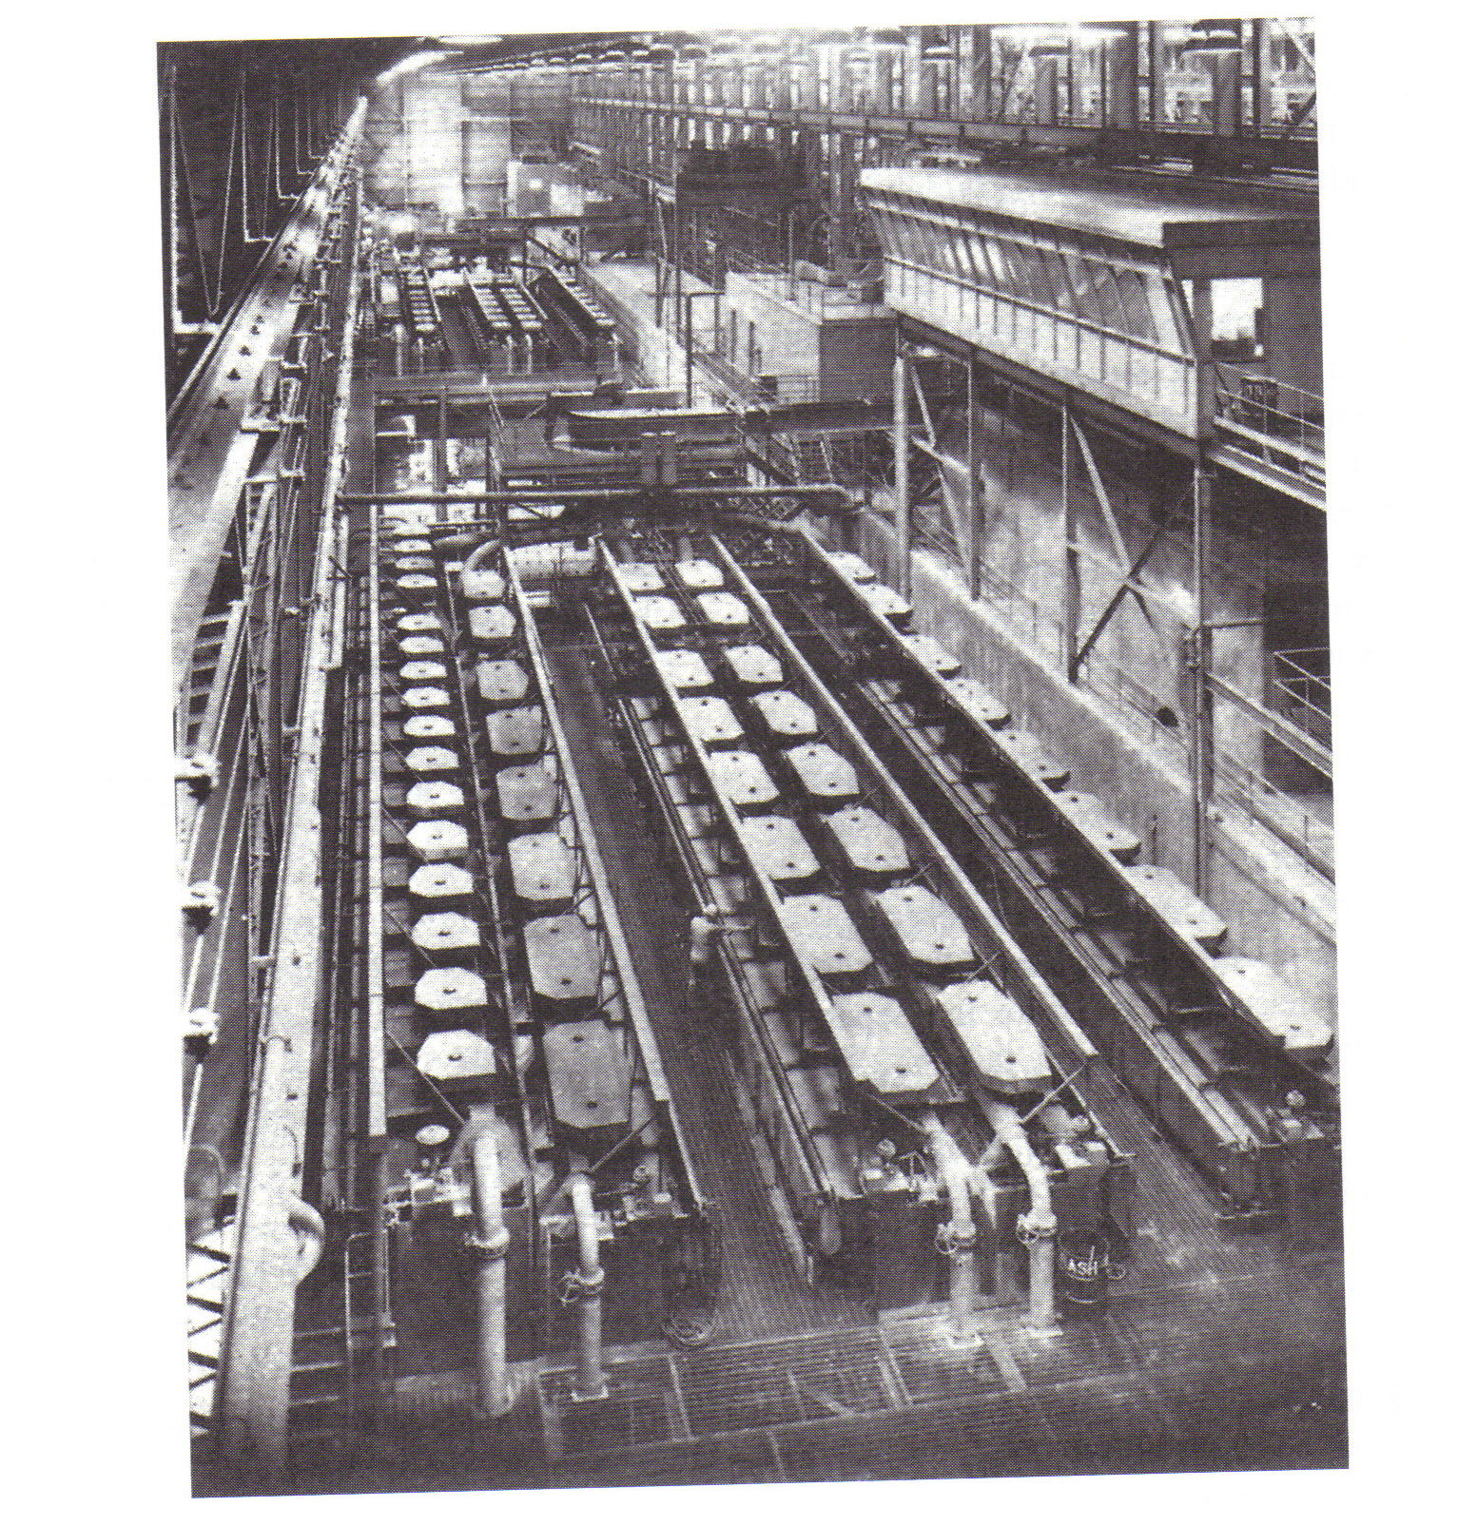
Fig 12.16: (b) Bank cells

Slide 29
Basic Flotation Circuits cont.
New feed enters the first cell of the bank, the froth column in the first few cell being kept high, since there are plenty of hydrophobic mineral particles to sustain it.
The pulp level is raised from cell to cell, as the pulp becomes depleted in floatable minerals, by progressively raising the cell tailings weir height.
The last few cells in the bank contain relatively low-grade froths, comprising weakly aerophilic particles.
These are the scavengers, usually containing middlings particles, which are often recirculated to the head of the system.
The scavenger cell, having little mineral to sustain a deep froth, have their tailings weirs raised so that pulp is almost overflowing the cell lip.
This policy, which is used to remove all weakly floating material (“pulling the cells hard”) ensures maximum recovery from the bank of cells.

Slide 30
Basic Flotation Circuits cont.
The flowsheet for this basic system is shown in Fig. 12.17.
This flowsheet can be successfully operated only when the gangue is relatively unfloatable.
A preferable system is to dilute the concentrate from the first few cells of the bank, known as rougher concentrates, and refloat them in cleaner cells, where the weirs are kept low to maintain a deep froth and produce a high-grade concentrate.
In this rougher-scavenger cleaner system (Fig 12.18), the cleaning cells receive a comparatively high-grade feed, whilst the scavenging section can be run with an excess of air so as to obtain maximum recovery.

Slide 31
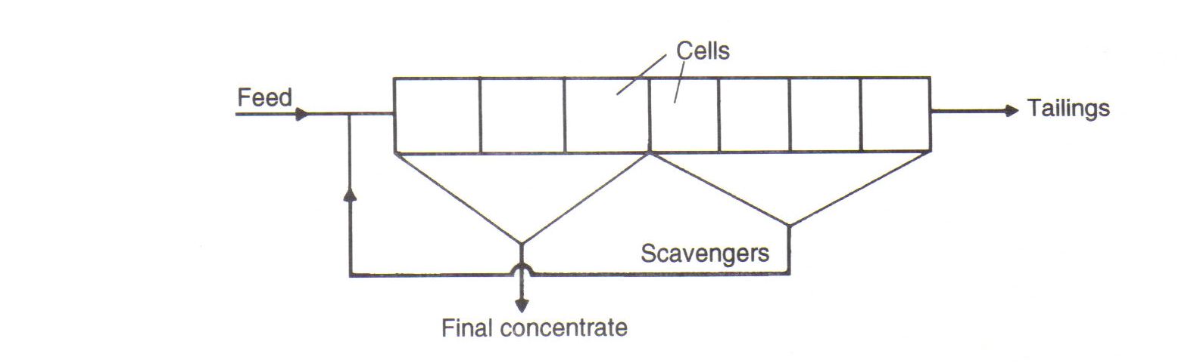
Figure 12.17: Simple flotation circuit

Slide 32
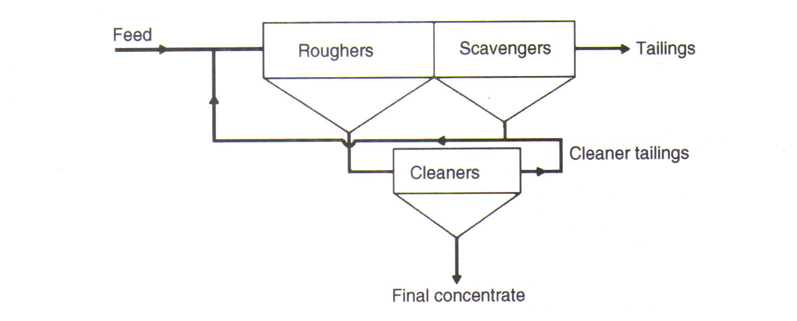
Fig 12.18: Rougher-scavenger-cleaner system

Slide 33
Basic Flotation Circuits cont.
Tailings from the cleaner cells, usually containing aerophilic mineral particles, are generally recirculated to the rougher cells, along with the scavengers.
This type of circuit, besides being useful for ores that need maximum amount of aeration at the end of the bank to produce profitable recovery, is often employed when the gangue has a tendency to float and is difficult to separate from the mineral.
In such cases, it may be necessary to utlise one or more recleaning banks of cells (fig. 12.19).

Slide 34
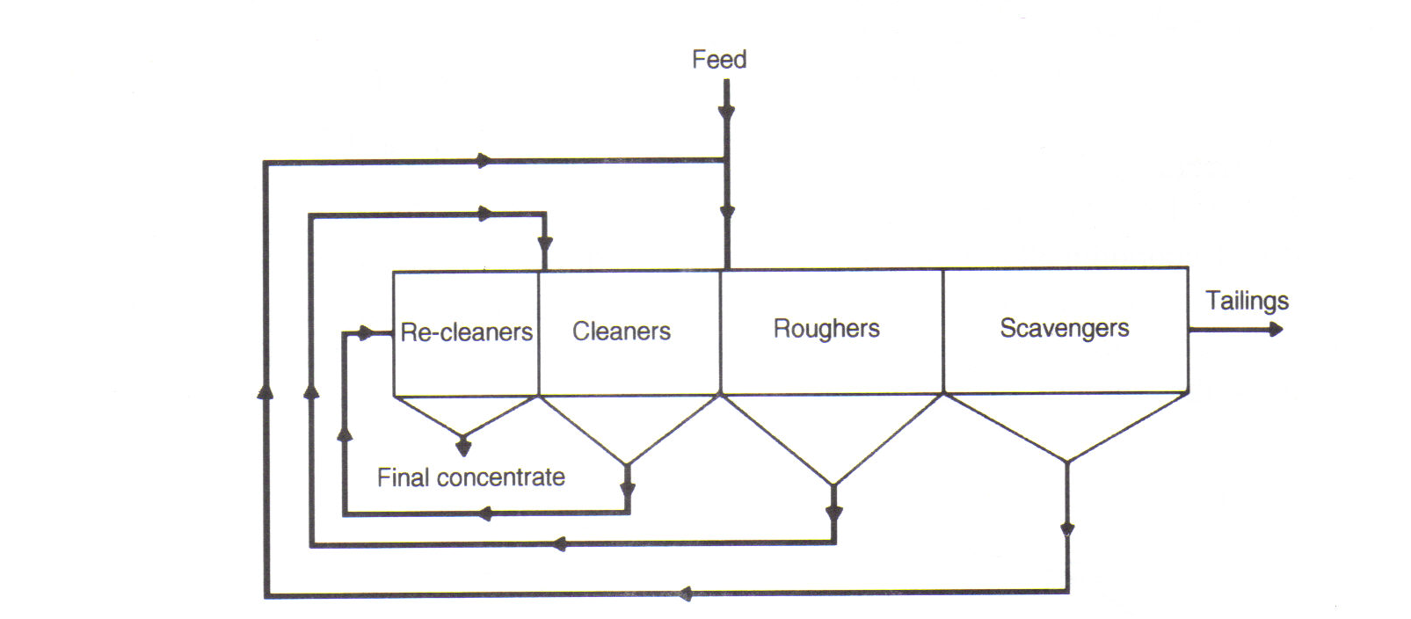
Fig 12.19: Circuit employing recleaning

Slide 35
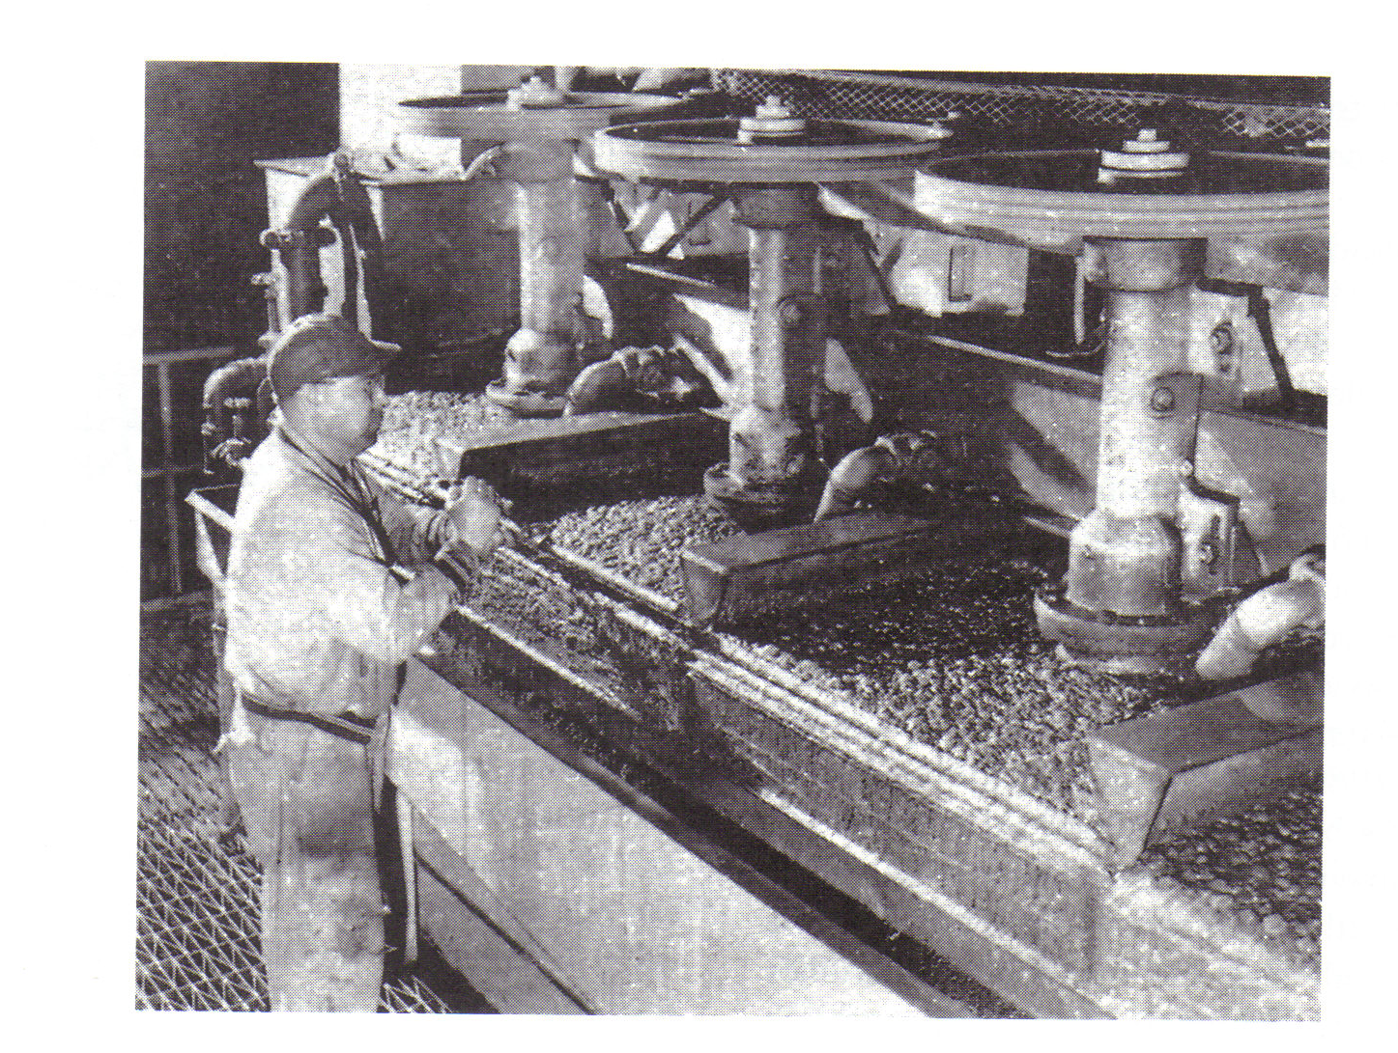
Fig 12.37: Mechanical Flotation cells

Slide 36
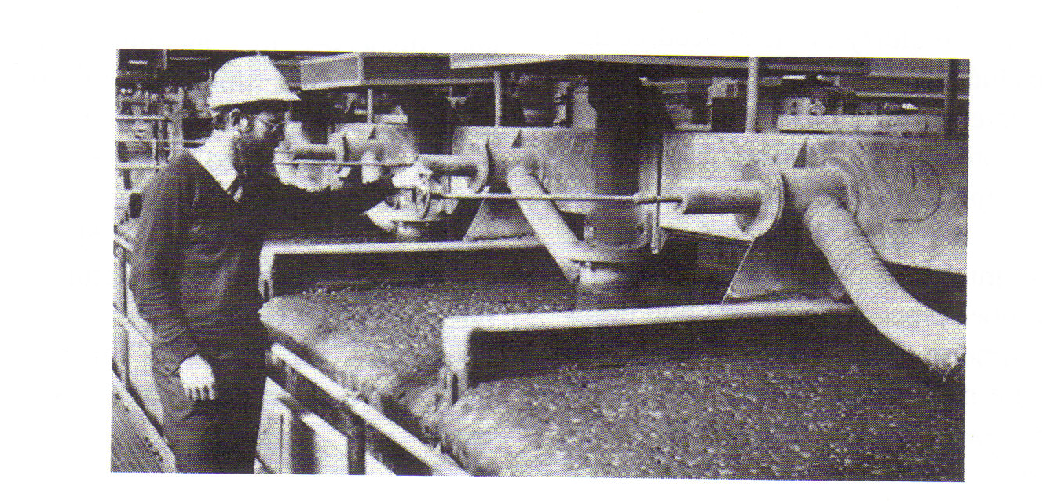
Fig 12.38: 14.2 m³ Denver D-R Flotation cells

Slide 37
FLOTATION MACHINES
Mechanical Flotation Machines
Most of the flotation machines now in use are of the “open flow” type, as they are much better suited to high throughputs and are easier to maintain than cell-to-cell types.
The Denver “Sub-A” is perhaps the most well known cell-to-cell machine, having been used widely in the past in small plants, and in multi-stage cleaning circuits, where the pumping action of the impellers permitted the transfer of intermediate flows without external pumps.
Widely used in coal cleaning with reported significant improvement in selectivity over open-flow designs.

Slide 38
FLOTATION MACHINES
Mechanical Flotation Machines
The flotation mechanism is suspended in an individual square cell separated from the adjoining cell by an adjustable weir (Fig. 12.39).
A feed pipe conducts the flow of pulp from the weir of the preceding cell to the mechanism of the next cell, the flow being aided by the suction action of the impeller.
The positive suction created by the impeller draws air down the hollow stand-pipe surrounding the shaft.
This air stream is sheared into fine bubbles by the impeller action and is intimately mixed with the pulp which is drawn into the cell onto the rotating impeller.

Slide 39
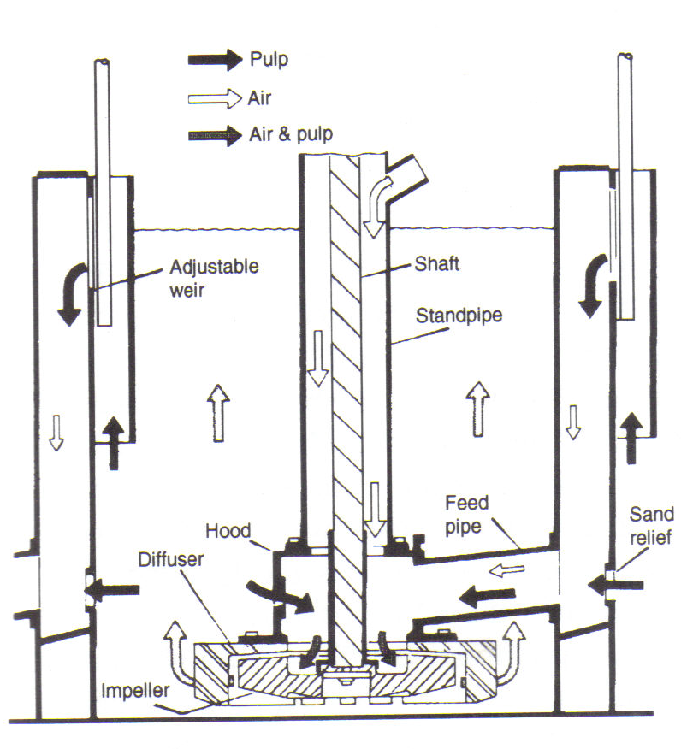
Fig 12.39: Denver sub-aeration cell

Slide 40
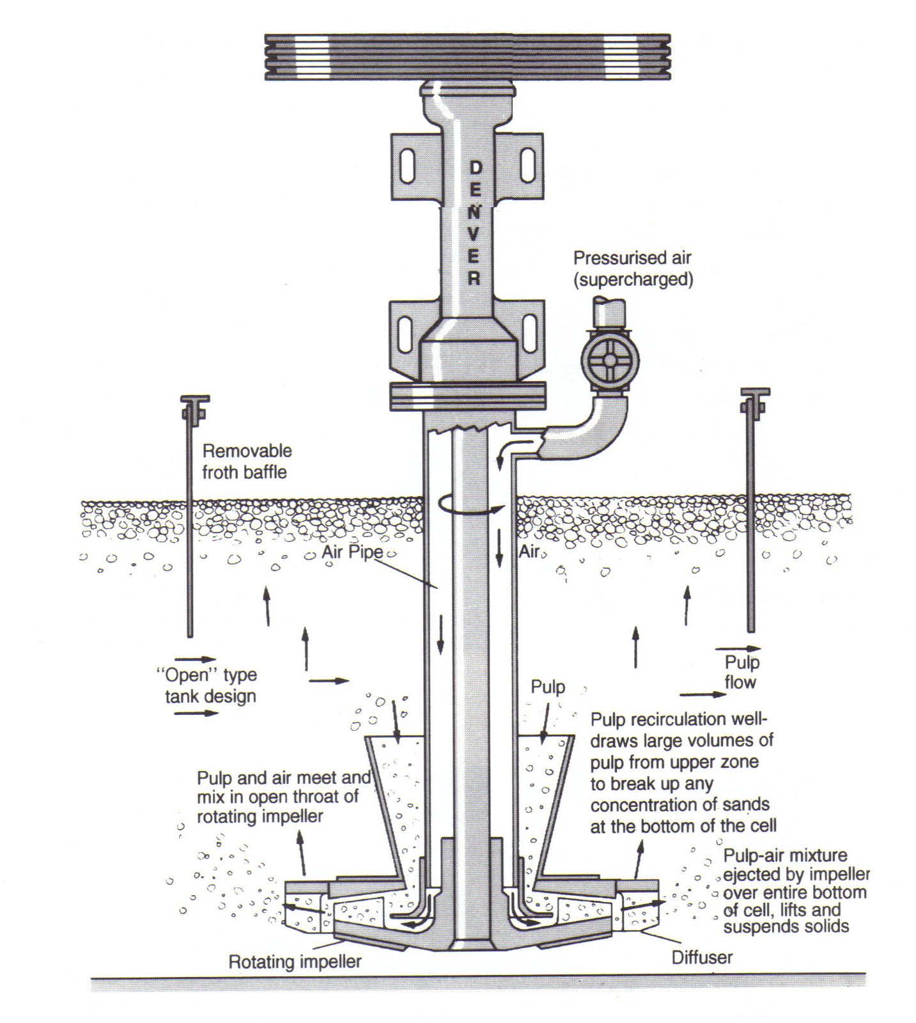
Fig 12.40: Denver D-R flotation machine

Slide 41
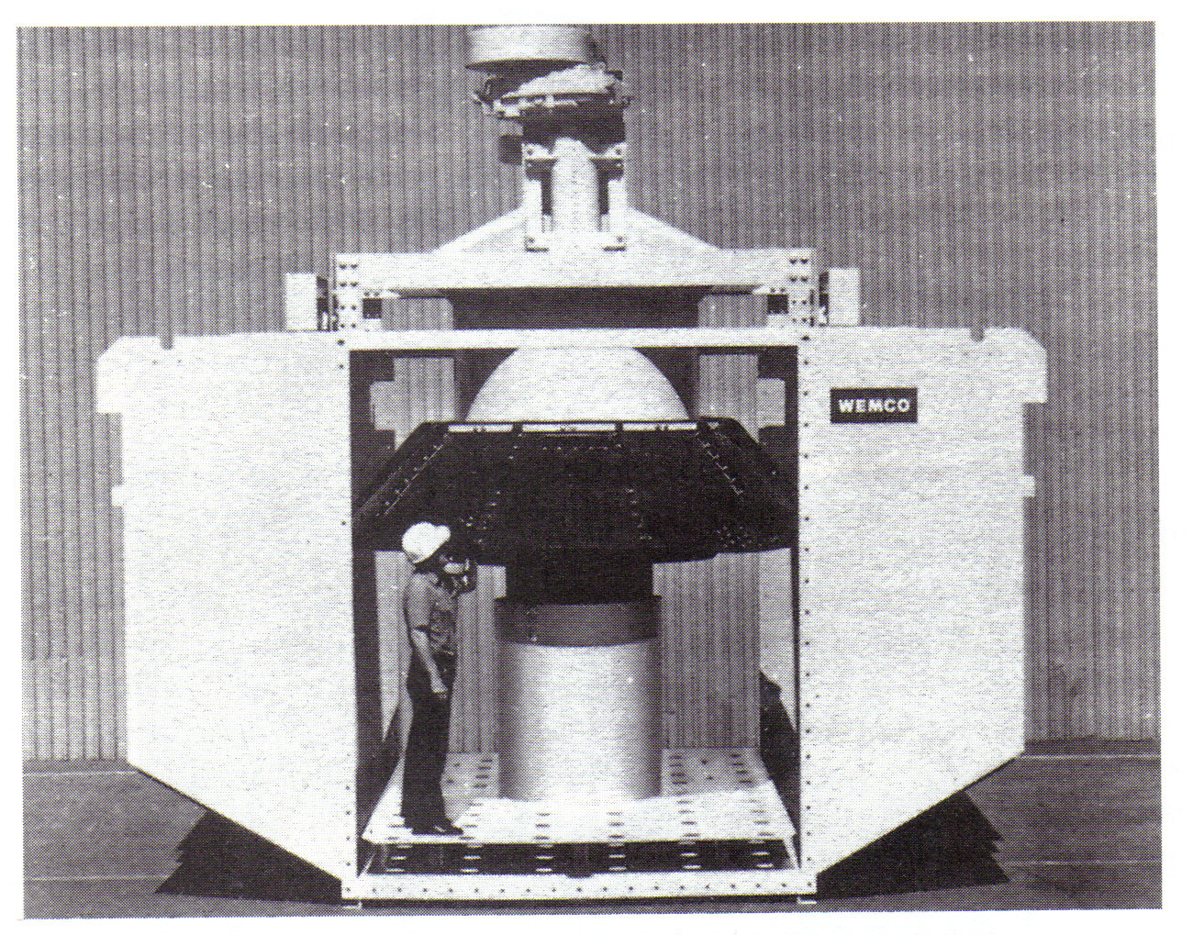
Fig 12.42: Wemco 42.5 m³ flotation cell

Slide 42
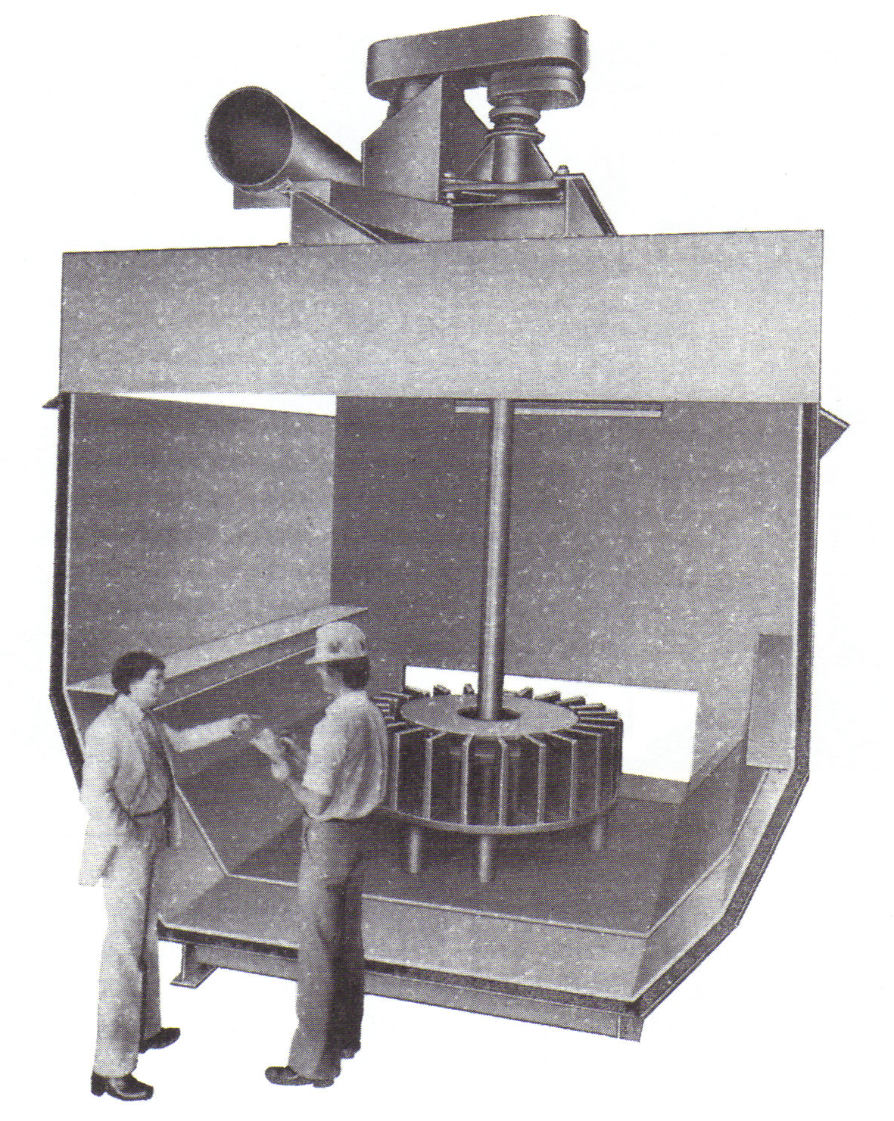
Fig 12.43: 42.5 m³ Agitair flotation machine

