Slide 1
COMMINUTION
CRUSHING

Slide 2
COMMINUTION
CRUSHING
In order to be able to separate minerals in an ore (concentration), the individual mineral particles have to be liberated.
This is normally achieved by breaking the rock (size-reduction = comminution).
The degree of size-reduction required is different for each ore. It is determined mainly by the characteristics of the ore (interlocking, dissemination) and by economic considerations (comparing the cost of further size-reduction to the additional recovery that can be achieved).

Slide 3
COMMINUTION
CRUSHING
The objective of mineral processing, regardless of the methods used, is always the same, i.e. To separate the minerals into two or more products with the values in the concentrates, the gangue in the tailings, and the locked” particles in the middlings.
Such separations are of course never perfect.

Slide 4
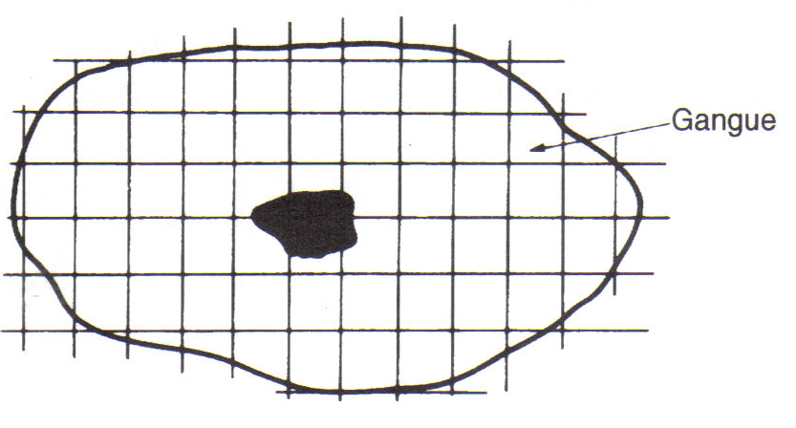
Figure: “Locking” of mineral and gangue

Slide 5
COMMINUTION
CRUSHING
Figure below shows a cross-section through a typical ore particle, and illustrates effectively the liberation dilemma facing the mineral processor.
Regions A represent valuable mineral, and region AA is rich i valuabl mineral, but is highly intergrown with gangue mineral.
Comminution produces a range of fragments, ranging from fully liberated mineral and gangue particles, to those illusrated.
Particles of type 1 are rich in mineral, and are classed as concentrate as they have an acceptable degree of locking with gangue, which limits the concentrate grade.

Slide 6
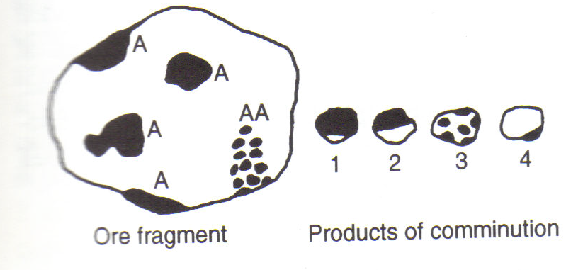
Figure: Cross-sections of ore particles

Slide 7
COMMINUTION
CRUSHING
Particles of type 4 would like-wise be classed as tailings, the small amount of mineral resent reducing the recovery of mineral into concentrate.
Particles of type 2 and 3, however, would probably be classed as middlings, although the degree of regrinding needed to promote economic liberation o mineral from particle 3 would be greater than in particle 2.

Slide 8
COMMINUTION
CRUSHING
Remember: The objective of size-reduction in mineral processing is the liberation of individual mineral particles NOT the production of fines.
An overproduction of fines not only increases costs unnecessarily, but will also complicate subsequent concentration processes and often leads to losses of valuable mineral particles.
Coarse size-reduction is also required to facilitate handling of ores. On occasion, crushed material is already the final product for sale (e.g. crushed stone for roads).

Slide 9
COMMINUTION
CRUSHING
A term, which is often used in connection with size-reduction, is the reduction ratio, Rr, which means, in principle:
In practice, this is a meaningless expression and therefore normally the “80% passing ratio”, R₈₀, is used:
The 80 % passing size (d₈₀) of feed and product can be found from plots of size-analyses of feed and product.

Slide 10
COMMINUTION
CRUSHING
Manufacturers of crushing equipment apply the term “reduction ratio” to their equipment and then it usually refers to the nominal settings of the feed and discharge openings of the crusher.
It should then be called the “apparent reduction ratio”, R_{A}:
The apparent reduction ratio does not show the actual size-reduction, but states, roughly, what the maximum size-reduction is, which the crusher can achieve in one pass.

Slide 11
COMMINUTION
CRUSHING
Size-reduction in mineral processing is nearly always done in stages, usually using different machines for each stage.
This is more efficient than attempting to achieve a very high reduction ratio in a single stage.
We distinguish:
Crushing: defined as the operations, required to reduce run-of-mine ore to the size, suitable to feed grinding mills.

Slide 12
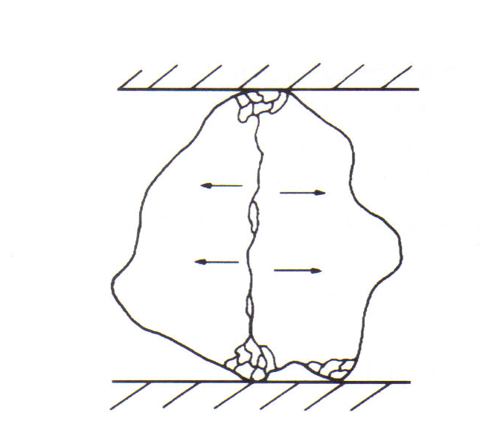
Figure: Fracture by crushing

Slide 13
COMMINUTION
CRUSHING
Grinding: defined as the operations, required to reduce the final crushed product to the optimum size required in the mineral separation (concentration) processes chosen (liberation-size).
Both the crushing and grinding operations themselves are normally carried out in stages:
Crushing: primary coarse from R.O.M. to 15 cm
secondary intermediate from 15 cm to 2.5 – 5 cm
tertiary fine from 5cm to 1 - 0.5 cm
Grinding: primary
secondary

Slide 14
COMMINUTION
CRUSHING
The efficiency of a crusher is greater when the reduction ratio is smaller; hence more crushing stages are desirable.
However, when the throughput is small, the equipment will be under-utilised and in such a case the installation of additional equipment for more crushing steps is not justified.
Therefore, we often find only two crushing stages and one grinding stage in small plants, while only large plants can afford to have three crushing stages and two grinding stages.

Slide 15
COMMINUTION
CRUSHING
In most cases, the operating stages are run in closed circuit, i.e. the product is sized (on a screen or other sizing device), wherefore the portion, which is sufficiently fine (the “undersize”) passes on to the next stage and the “oversize”, which is still too coarse, is returned to the breaker.
In open-circuit operation, the material passes straight through the breaker and the entire product passes on to the next stage.
As long as the feed does not alter drastically (size, hardness), the circulating load in closed circuit operation will be fairly constant.

Slide 16
COMMINUTION
CRUSHING
Circulating loads (CL) in closed circuit operation are normally expressed as a percentage of the new feed coming in.
In most crushing operations, circulating loads are relatively small (much less than 100%).
In modern grinding practice, however, circulating loads are often very high (300-700%).
Determination of circulating loads is an important task for the metallurgical staff on the concentrator.
Various methods of calculating circulating loads will be discussed separately.

Slide 17
COMMINUTION
CRUSHING
Very often the new feed to a crusher is screened to remove the material, which is already sufficiently fine to pass on to the next stage, and only the screen oversize passes through the crusher.
In the case of several stages in closed circuit, the crusher product is usually screened on the same screen.
This “scalping” of new feed gives the following advantages:
Removal of undersize reduces the amount of material passing through the crusher, hence increases its capacity;
Utilisation of energy in crushing is more effective in the absence of fines;
Improved feed rate to the crusher in the absence of most fines;
Less dust;
Less wear.

Slide 18
COMMINUTION
CRUSHING
Run-of-mine ore is sometimes screened on a “grizzley” (a very coarse screen, consisting of heavy parallel bars, e.g. old rails) which prevents very large rocks from entering and damaging the crusher.
This is done in particular with open pit ore, fed to a jaw crusher. With underground ores, such very large rocks are usually removed already before the ore is loaded in rail cars.
Secondary crushers, which have a relatively small discharge opening should be protected against large pieces of “tramp” metal (e.g. steel liner plates, hammer heads etc.), which can jam the crusher hence resulting in loss of production time and damaged equipment.
This is done by positioning a magnet or a magnetic pulley or, better still, a metal detector in the conveyor system between the primary and secondary crushers.

Slide 19
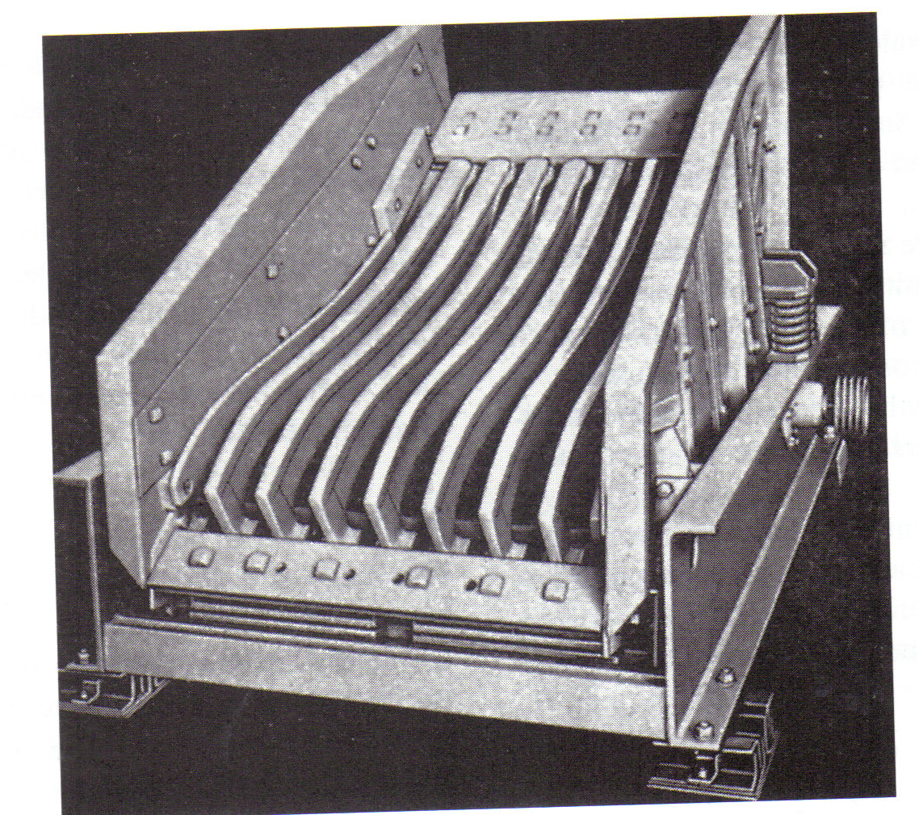
Figure: Vibrating grizzly

Slide 20
COMMINUTION:- CRUSHING
Physical Properties of Rock
Some expressions, which are still vague, but which describe a little more accurately than “hardness” the ease of, or the resistance to comminution, are the following:
brittleness: the ease of breaking by impact.
friability: the ease of breaking by abrasion.
ductility: the ability to flow, rather than break.
toughness: the ability to resist the propagation of cracks.
fragility: the opposite of toughness (NOT exactly the same as
brittleness or friability).

Slide 21
COMMINUTION:- CRUSHING
Physical Properties of Rock
The best expression, for practical purposes, is “grindability”, which is a measure of the energy consumed in the comminution process.
Unfortunately, different authors and different laboratories use different definitions of “grindability” and have developed different methods for its measurement.
The most widely used expression is F.C. Bond’s “work index”, W_{i}, which is defined as: the kilowatt-hours required to reduce one short ton of the ore from an infinite feed size to 80 % passing 100 microns.

Slide 22
COMMINUTION:- CRUSHING
Physical Properties of Rock
When the work index of a particular ore has been determined by a series of standard laboratory grinding tests, the energy required in the reduction of this ore from a certain feed size F to a certain product size P (both 80 % passing sizes) can be estimated by the relation:
From this relation it can easily be seen that the energy, required to achieve a particular reduction ratio F/P, increases rapidly in the finer size ranges. This is because the energy consumed in comminution is largely used in the creation of new surface area.

Slide 23
COMMINUTION:- CRUSHING
Physical Properties of Rock
Ores are essentially heterogeneous aggregates of minerals. The finer the ore is broken, the more homogeneous the mixture of particles becomes.
Weighing and sampling of the ore is therefore normally done on the finished product of a crushing plant, before it enters the grinding circuit, because this product is more homogeneous than run-of-mine ore and has not yet been ground into pulp.
Concentrator accounting is normally based upon these samples.
In modern plants, weighers and samplers are often automated devices.

Slide 24
COMMINUTION
Comminution Theory
For practical calculations the size in microns which 80 % passes is selected as the criterion of particle size.
The diameter in microns which 80 % of the product passes is designated as P, the size which 80 % of the feed passes is designated as F, and the work input in kilowatt hours per short ton is W. Bond’s third theory equation is:
where Wi is the work index. The work index is the comminution parameter which expresses the resistance of the material to crushing and grinding; numerically it is the kilowatt hours per short ton required to reduce the material from theoretically infinite feed size to 80 % passing 100 μm.

Slide 25
Bond Ball Mill Work Index Test (BBMWI)
The BBMWI is a measure of the resistance of the material to crushing and grinding. It can be used to determine the grinding power required for a given throughput of material under ball mill grinding condition.

Slide 26
and P = TxW
where W = Work input (kWh/t)
W_{i} = Work index (kWh/t)
P = Power Draw (kW)
T = Throughput of new Feed (t/h)
F₈₀ = 80% Passing size of Feed (µm)
P₈₀ = 80% Passing size of Product (µm)

Slide 27
Based on this equation it is possible to calculate, for example the specific energy requirement for a given grinding duty, BBMWI, feed size and required product size. It is then possible to determine the size of the mill required based on throughput, and therefore motor power.
Work Index: An empirical equation that relates power consumption in crushing and grinding to the feed and product size distribution.
The Bond Ball Mill Work Index provides a measure of how much energy is required to grinding a sample of ore in a ball mill. The following Table indicates some typical figures, and a relative measure of what they mean.

Slide 28
Table: BWI Figures
Property | soft | Medium | Hard | Very hard
Bond WI (kWh/t) | 7 - 9 | 9 - 14 | 14 - 20 | > 20

Slide 29
COMMINUTION
GRINDABILITY
Ore grindability refers to the ease with which materials can be comminuted and data from grindability tests are used to evaluate crushing and grinding efficiency.
Grindability is based upon performance in a carefully defined piece of equipment according to a strict procedure.
Deister (1987) has described the Bond standard grindability test in detail.
Table 1 lists standard Bond work indices for a selection of minerals.

Slide 30
Table 1: Selection of Bond work indices
Material | Work Index | Material | Work Index
Barite Bauxite Coal Dolomite Emery Ferro-silicon | 4.73 8.78 13.00 11.27 56.70 10.01 | Fluorspar Granite Graphite Limestone Quartzite Quartz | 8.91 15.13 43.56 12.74 9.58 13.57

Slide 31
COMMINUTION
GRINDABILITY
The standard Bond test is time consuming, and a number of methods have been used to obtain the indices related to the Bond work index.
Berry and Bruce (1966) developed a comparative method of determining the grindability of an ore.
The method requires the use of a reference ore of known grindability.
The reference ore is ground for a certain time and the power consumption recorded.
An identical weight of the test ore is then ground for a length of time such that the power consumed is identical with that of the reference ore.
If r is the reference ore and t the ore under test, then from Bond’s equation (2)

Slide 33
COMMINUTION
GRINDABILITY
Reasonable values for the work indices are obtained by this method as long as the reference and test ores are ground to about the same product size distribution.
Work indices have been obtained (Lowrison, 1974) from grindability tests on different sizes of several types of equipment, using identical feed materials.
The values of work indices obtained are indications of the efficiencies of the machines.
Thus the equipment having the highest indices, and hence the largest energy consumers, are found to be jaw and gyratory crushers and tumbling mills; intermediate consumers are impact crushers and vibration mills, and roll crushers are the smallest consumers.
The smallest consumers of energy are those machines, which apply a steady, continuous, compressive stress on the material.

Slide 34
COMMINUTION
GRINDABILITY
Values of operating work indices obtained from specific units can be used to asses the effect of operating variables, such as mill speeds, size of grinding media, type of liner, etc.
The higher the value of W_{i}, the lower is the grinding efficiency.
It should be noted that the value of W is the power applied to the pinion shaft of the mill.
Motor input thus has to be converted to power at the mill pinion shaft unless the motor is coupled direct to the pinion shaft.

Slide 35
COMMINUTION
Crushing Equipment
Primary crushing of ores is done close to the place of mining, to facilitate subsequent handling.
With underground ores, which are hoisted by skip, primary crushing is preferably carried out underground.
The most common type of crusher for underground operation is the jaw crusher.
Open pit ores are usually hauled out of the pit by trucks, which can dump the ore directly into a gyratory crusher.

Slide 36
Primary and secondary crushers both in open circuit. Primary crusher fed directly (e.g. Open pit ore with truck). Secondary cone crusher fed from surge bin via scalping screen
R.O.M Ore
U/S = Screen Undersize (fines)
O/S = Screen Oversize (coarse)
Gyratory Crusher (primary crushing)
Surge Bin
Ore Feeder
O/S
Cone Crusher (secondary crushing)
Scalping Screen
To Tertiary Crushing or grinding
U/S

Slide 37
Primary crusher in open circuit, secondary crusher in closed circuit with screen. Primary jaw crusher fed by ore from surge bin via grizzley.
R.O.M Ore
Surge Bin
Ore Feeder
S/O
Scalping Grizzley
Jaw Crusher (primary crushing)
U/S
Surge Bin
Cone Crusher (secondary crushing)
Ore Feeder
O/S
Scalping Screen
U/S
To Tertiary Crushing or Grinding

Slide 38
COMMINUTION
Jaw Crushers
The general principle of the most commonly used jaw crusher (Blake-type or double-toggle jaw crusher) is as follows:
The crusher consists essentially of two crushing surfaces set at a small angle convergent downward.
The one surface is fixed to the main frame, the other is moveable and is caused to approach and recede from the fixed surface alternately.
This movement is caused by the action of the toggle-plates and the pitman, actuated by the eccentric.
In the Blake crusher, the moveable jaw is pivoted on a shaft at the top of the crusher. The jaws are protected by replaceable jaw plates.

Slide 39
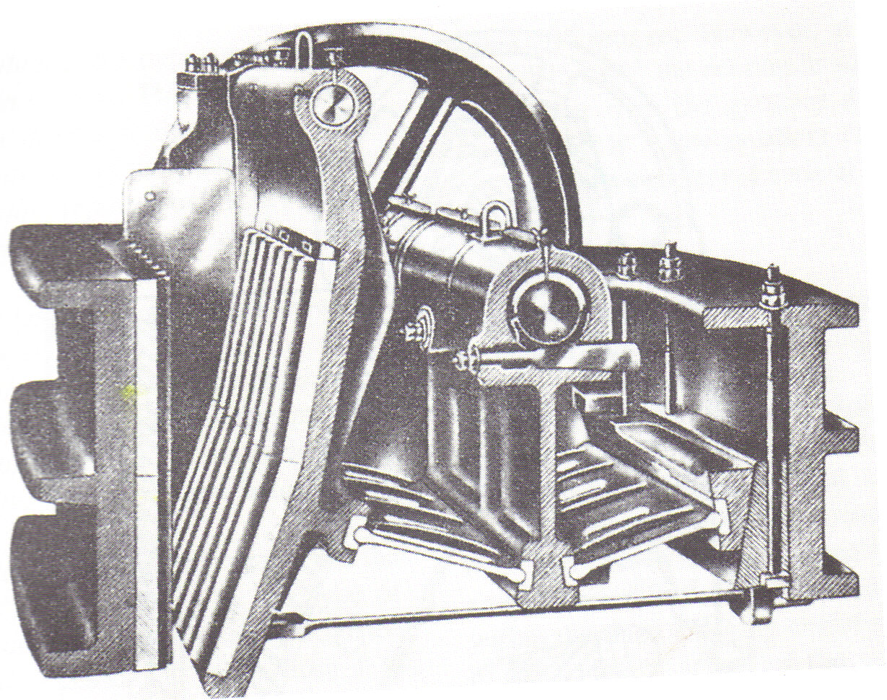
Figure: Cross-section through double-toggle crusher

Slide 40
COMMINUTION
Jaw Crushers
Ore is fed from the top and gravitates down between the two jaws.
The moving jaw advances toward the fixed jaw, fast at first and then more slowly, but with increasing power at the end of the stroke.
The rock particles are “nipped” between the jaws and broken by impact of the blow and the pressure exerted by the moving jaw.
When the moving jaws recedes on the backward stroke, the broken particles fall down until they are arrested, ether by the other rock particles or by the jaws.

Slide 41
COMMINUTION
Jaw Crushers
In the lower position, the cross-section is less and the overall volume occupied by rock has increased (“swelled”) by the newly created voids. The next blow, in this lower position, is delivered with greater amplitude. Crushing continues blow after blow until the crushed particles fall clear at the lower end.
Because of the time, required for down ward travel of the rock, the stroke frequency is rarely higher than 200 min⁻¹. Most modern jaw crushers use curved swing-jaw plates, with such plates, the downward travel of the broken rock is faster so that choking at the “throat” of the crusher is less likely to occur, in spite of the “swell” of the broken rock.

Slide 42
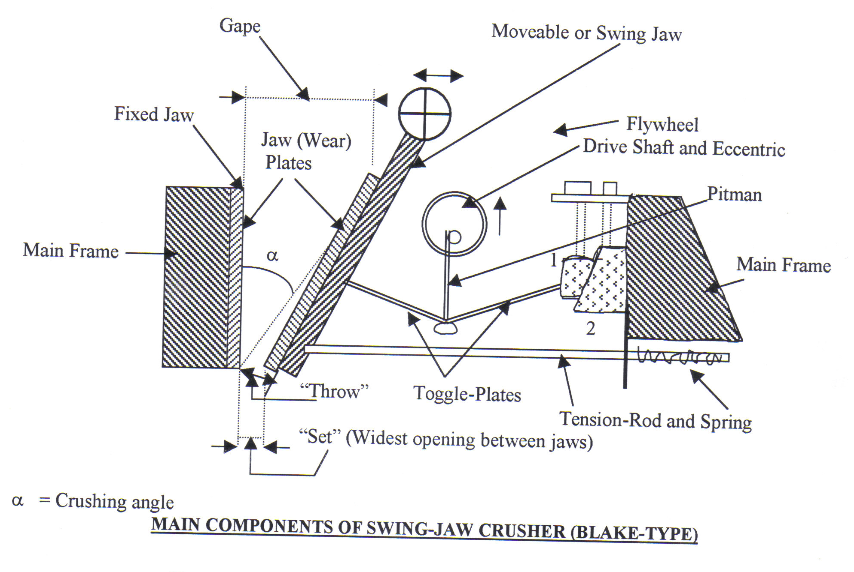

Slide 43
COMMINUTION
Jaw Crushers
The “set” of this crusher is the maximum opening between the jaws at the discharge point.
It is the maximum size (in one dimension) that a particle should have when it leaves the crushing zone.
Slabs of rock can of course pass through with much larger sizes in the other two dimensions.
The size of jaw crushers is expressed as the two dimensions of feed opening, e.g. 24 x 36 inch.
The smallest of these dimensions is called the “gape”.
The size of American-made machines is indicated in inches; European-made machines are designated in cm.
The gape indicates the maximum size of the rocks that can be accepted as feed to the crusher (approx. 0.8-0.9 x gape).

Slide 44
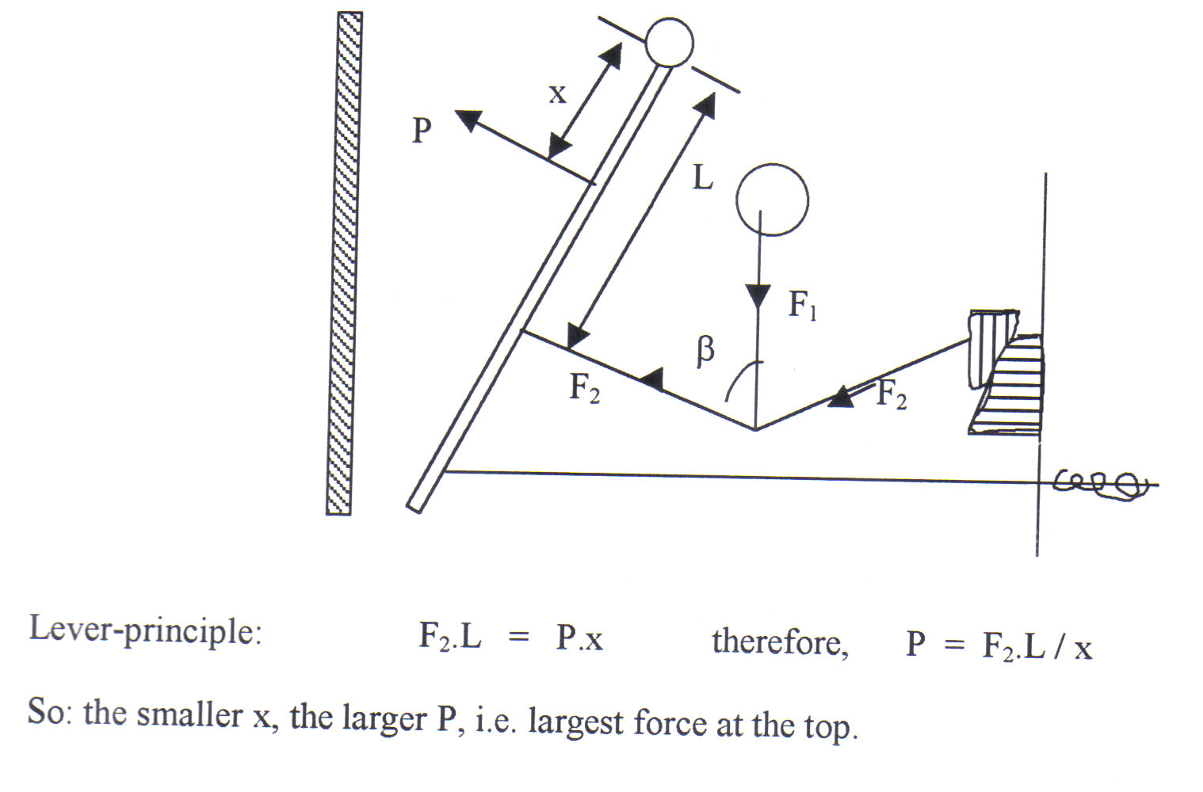

Slide 45
COMMINUTION
Jaw Crushers
A rough estimate of the reduction ratio of a jaw crusher is given by the ratio between the gape and set (the apparent reduction ratio, R_{A}).
The reduction ratio can be altered by adjusting the set. Small adjustments can be made by screwing adjustment block [(1) shown in the diagram] up or down.
For large adjustments, the toggle-plates have to be changed for toggles of a different length.
To adjust for wear of the jaw plates, adjustment block (2) is screwed up.
This adjusts the “throw”, i.e. the horizontal distance travelled by the swing jaw on each stroke.
The jaw plates wear rapidly and they are therefore easily replaceable. If possible, the jaw plates are first turned 180º, before they are discarded.

Slide 46
COMMINUTION
Jaw Crushers
The crushing angle is the maximum angle between the converging jaw plates.
It is usually between 18º and 24º.
If the set is reduced, the crushing angle is increased.
The crushing angle may never exceed the angle of nip, because then the rock particles would not be nipped and crushed, but just bounce up and down on the swing jaw.
The angle of nip is determined by the coefficient of friction between the jaw plates and the rock and varies between 20º and 30º for most types of dry rock.
With wet and smooth rock, the angle of nip is smaller (say, 16º) hence the crushing angle must be smaller still, hence the set must be larger and the reduction ratio smaller.
“Nip” can be improved by using corrugated jaw plates or by providing ribs on the jaw plates.
This then allows a smaller set, hence a slightly larger reduction ratio, but such jaw surfaces of course wear rapidly.

Slide 47
COMMINUTION
Jaw Crushers
The jaw crusher has an intermittent load (no force is exerted on the receding stroke of the swing jaw), hence a flywheel must be provided on the drive shaft, which stores the energy on the idling stroke and delivers it on the crushing stroke. This balancing action smoothes vibration and saves power. The starting torque of jaw crushers is very high.
A tension-rod holds the toggles on the swing jaw. The toggles break easily and are therefore easily accessible for replacement. Usually, the back toggle is deliberately weakened to serve as a “safety link”. In the case of excessive stress, this easily accessible point will then be the breaking point.

Slide 48
COMMINUTION
Jaw Crushers
Primary crushers in particular can be operated in one of two distinct modes: “free crushing” and “choked crushing”.
In free crushing, the particles are relatively free to fall between successive blows and the main force exerted upon a rock particle is applied directly by the crushing surfaces.
In choked crushing, the crusher is kept “choke-fed” and a substantial amount of comminution results from the impact of rock upon rock.
Choked crushing produces more fines and the throughput is less than when the same crusher would be crushing free.
Smaller plants, which can not afford many crushing stages, often choke-fed the crushers to achieve a higher reduction ratio at the lower throughput.
However, jaw crushers are prone to choking and should preferentially be free crushing.
This is achieved by feeding them with an ore feeder from a bin, usually via a scalping grizzley to take out fines prior to crushing.

Slide 49
COMMINUTION
Gyratory Crushers
The suspended-spindle type is the most commonly used gyratory crusher. Its general principle is as follows:
A conical breaking head is suspended on a spindle (the main shaft) from a two-armed “spider”, mounted on the main frame.
The main frame consists of an upper and lower shell.
The upper shell is an inverted conic frustrum with concave liners.
The head is given an eccentric gyration by an eccentric sleeve, which is rotated by a bevel gear and pinion, driven by a countershaft, which is coupled to the drive.
The gyrating head and the stationary concave are the crushing media. Just as concave liners protect the shell, the head is protected by a wear-resistant mantle.

Slide 50
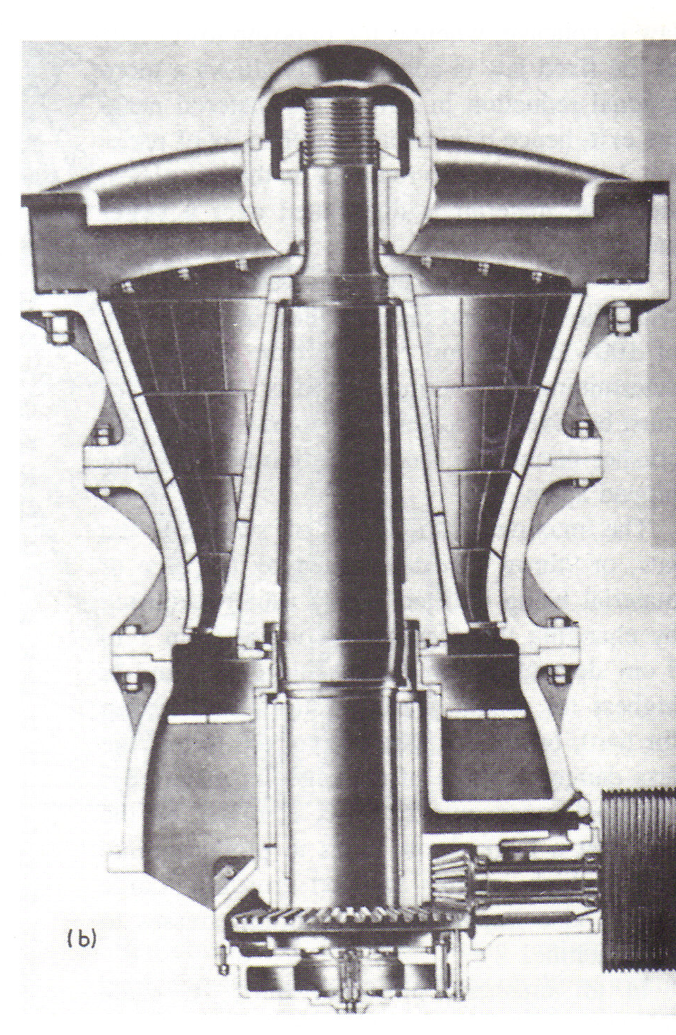
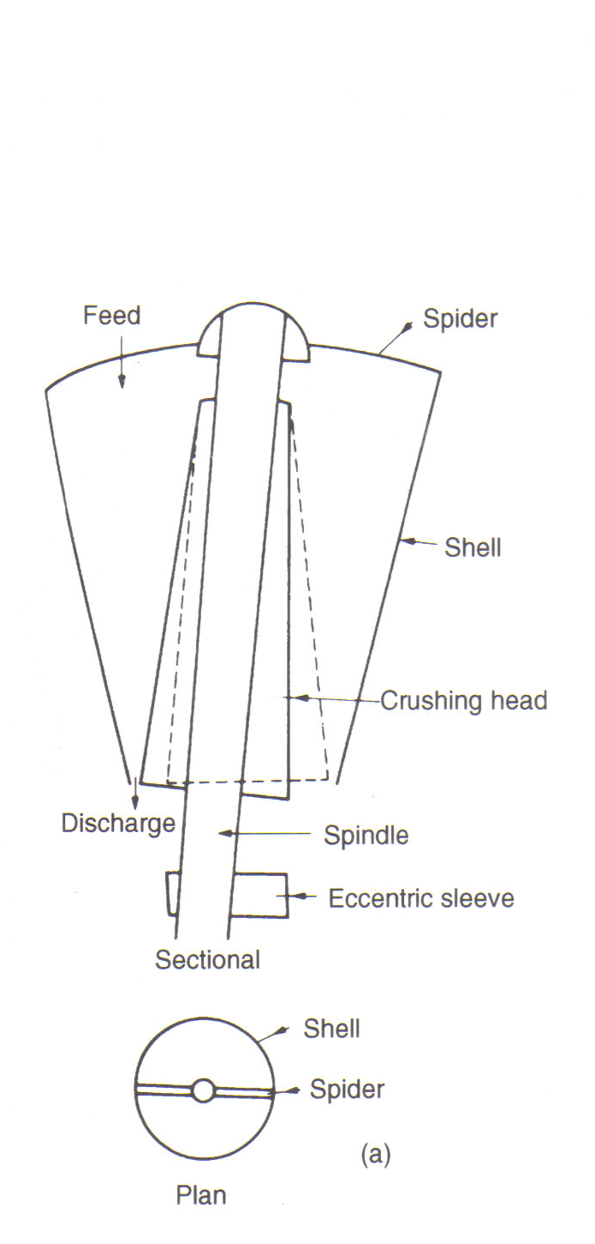
Figure: Gyratory Crusher: (a) functional diagram, (b) cross-section

Slide 51
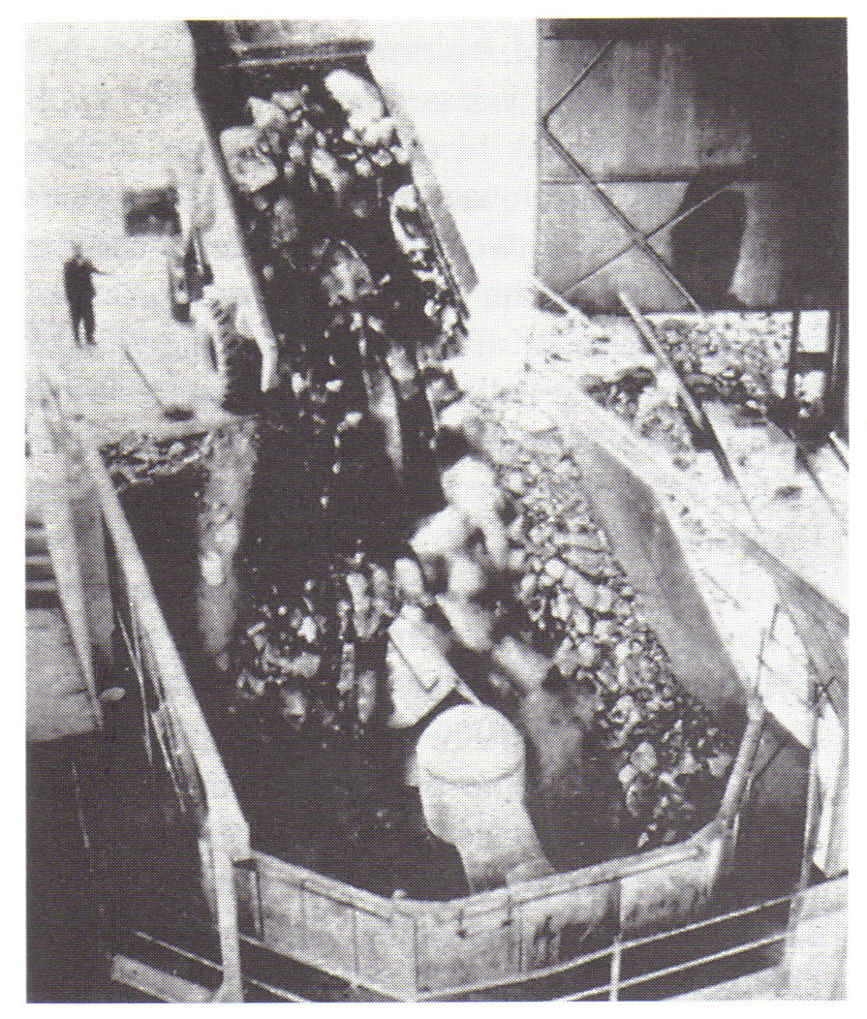
Figure: Gyratory crusher fed directly from truck

Slide 52
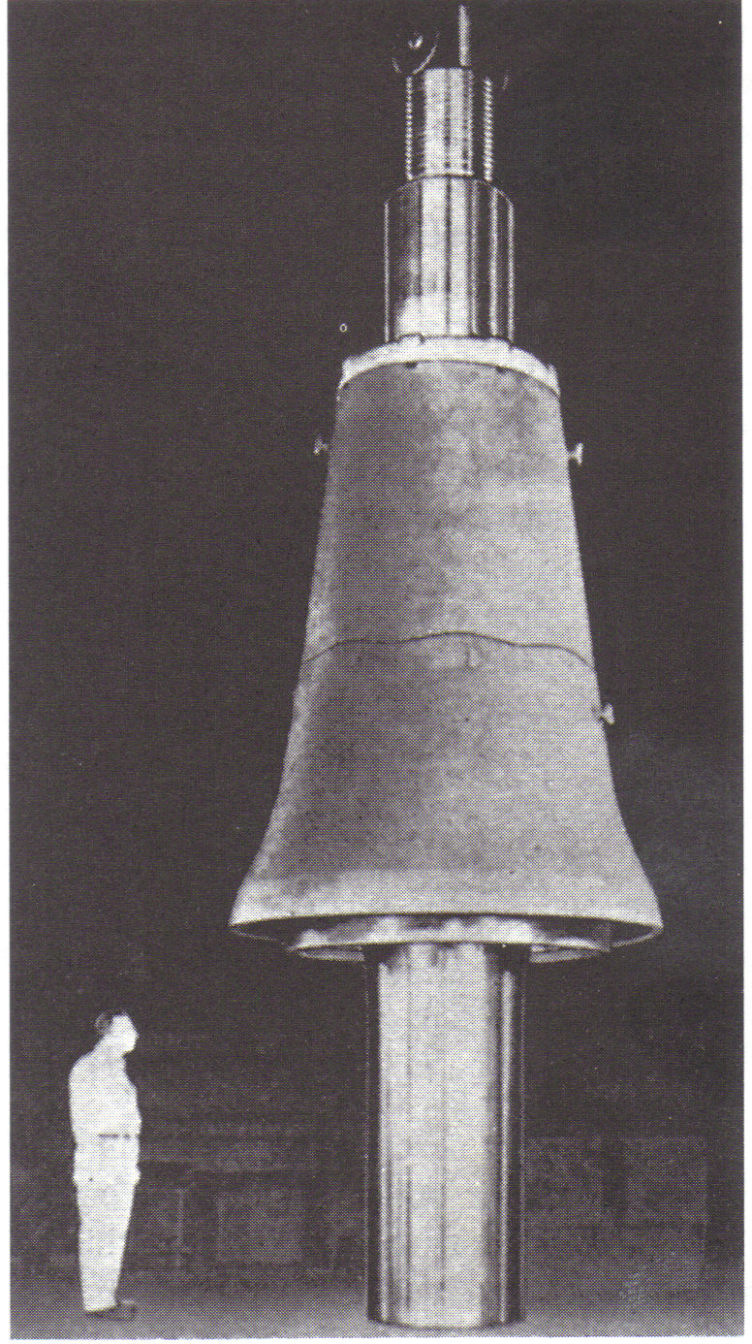
Figure: Crushing Head

Slide 53
COMMINUTION
Gyratory Crushers
Ore is fed from the top and falls until arrested.
The gyrating head continuously advances towards points along the stationary concave as it progresses, and recedes from its previous position.
Where the head advances, rock is crushed between head and concave. Where the head recedes, crushed rock can fall downward until arrested again.
This crushing continues until the crushed particles fall clear from the lowest annular opening between head and concave (the discharge point).
In each vertical cross-section of a gyratory crusher, therefore, the crushing action is quite similar to the action in a jaw crusher.

Slide 54
COMMINUTION
Gyratory Crushers
Like the jaw crusher, the “set” of a gyratory is the maximum opening between head and concave at the discharge point.
The “gape” is the size of the receiving opening.
The ratio gape: set gives a rough estimate of the reduction ratio (the apparent reduction ratio).
The size of gyratory crushers is usually expressed as the size of the receiving opening (the gape).

Slide 55
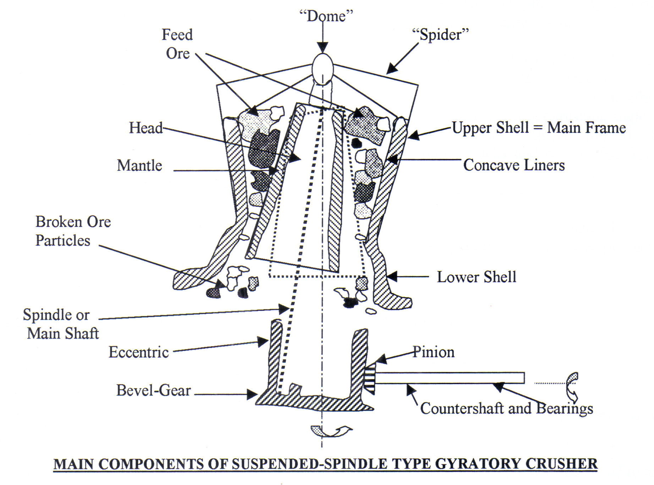

Slide 56
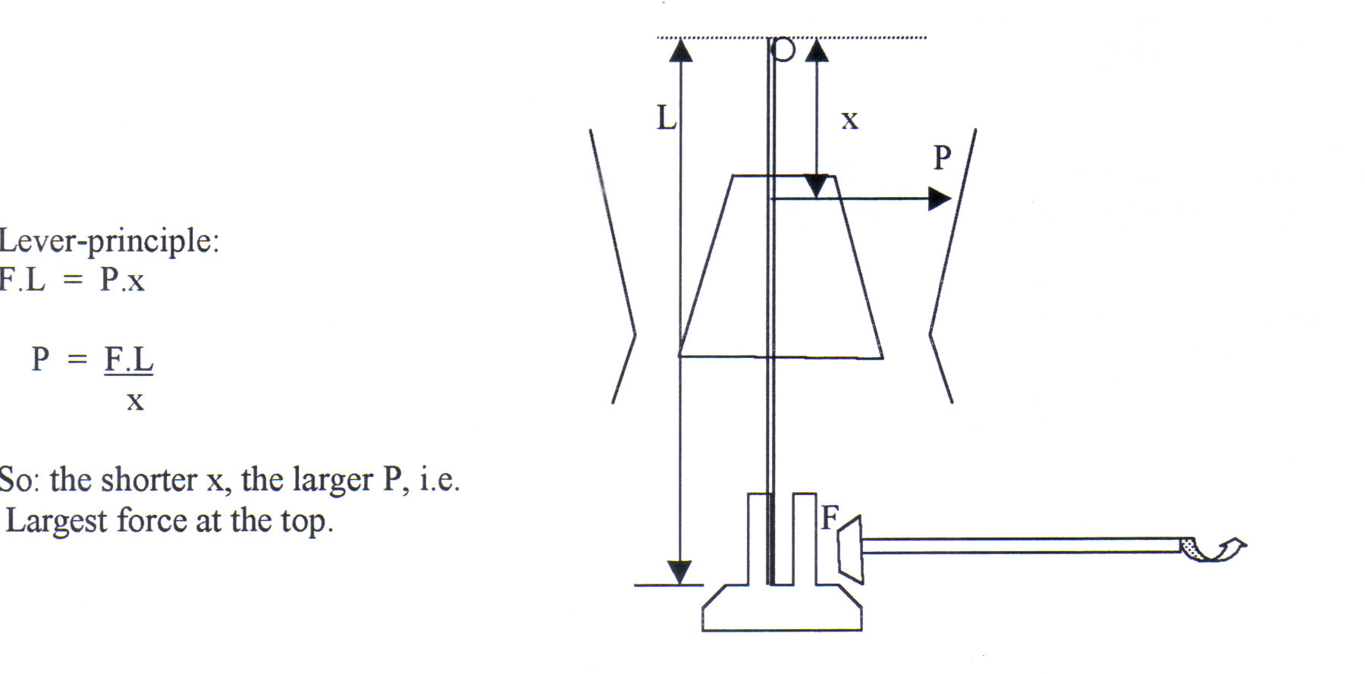

Slide 57
COMMINUTION
Gyratory Crushers
Contrary to the jaw crusher, a gyratory crusher can be choke-fed.
It is often fed directly from trucks, without bins, feeders and scalping Grizzleys.
It is suitable for “slaby” feed, because the annular shape of the crushing cavity will break up the slabs, whereas these could slide through a jaw crusher.
Sticky and clayey ores, however, are less suitable, since they will tend to choke the discharge opening.

Slide 58
COMMINUTION
Gyratory Crushers
Because the gyratory crusher can be kept full, the crushing angle can be somewhat larger than for the jaw crusher on similar material (22º – 30º).
The spindle can revolve freely around its own axis.
During crushing, friction between concave, ore and head will cause the head (mantle) and spindle to rotate in the direction opposite to the eccentric gyration.
This rotation of the spindle is superimposed upon the eccentric gyration. As a result, wear of the mantle is regular.
Gyratory crushers used in primary crushing are very large machines with a very large capacity.
Because they are tall, they are seldom used underground, but they are ideal for open pit ores. Smaller gyratory crushers are used for intermediate crushing.
With the larger gyratory crushers, the set is adjusted by screwing the spindle up or down with an adjustment nut in the spider cap (the “dome”). This is not an easy operation.

Slide 59
COMMINUTION
Gyratory Crushers
With some modern smaller gyratory crushers, the head and spindle are supported hydraulically (Allis-Chalmers Hydroset).
This system uses a hydraulic piston, which can raise or lower head and spindle, thus increasing or decreasing the set.
In the event of a power failure, the head can be lowered to allow the contents of the crushing chamber (the “load”) to drop out, before the crusher is restarted.
If there is also a “balance cylinder” provided with this system, this protects the crusher against damage from large uncrushable objects such as shovel teeth.
When such an object threatens to jam the crusher, the balance cylinder lowers head and spindle to allow the object to drop out of the crusher, and then automatically raises the head again to its original setting.

Slide 60
COMMINUTION
Cone Crushers
  The general principle of the most commonly used cone crusher (Symons standard cone crusher, manufactured by Nordberg Manufacturing Co.), is as follows:
A conical breaking head is given an eccentric gyration inside a stationary truncated cone, called the bowl.
The outside of the bowl is cylindrical.
The cross-section of the crushing cavity, i.e. the inside of the bowl, increases from top to bottom.

Slide 61
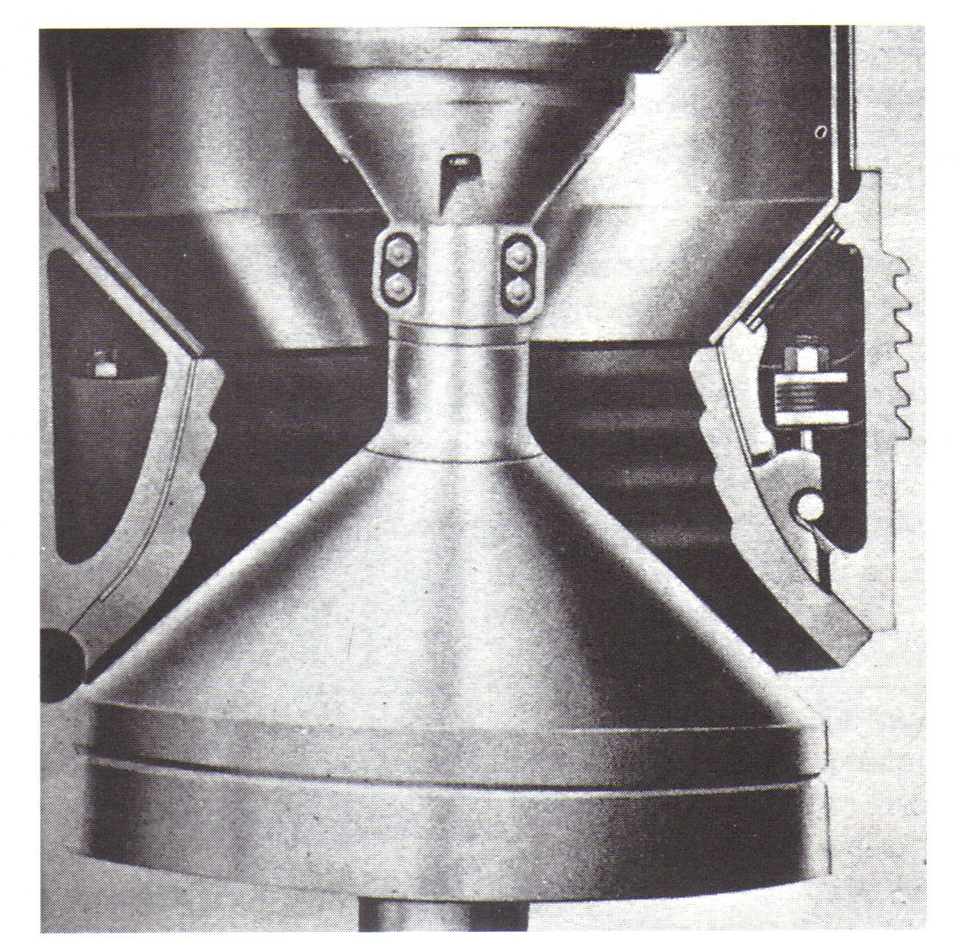
Figure: Standard cone crusher

Slide 62
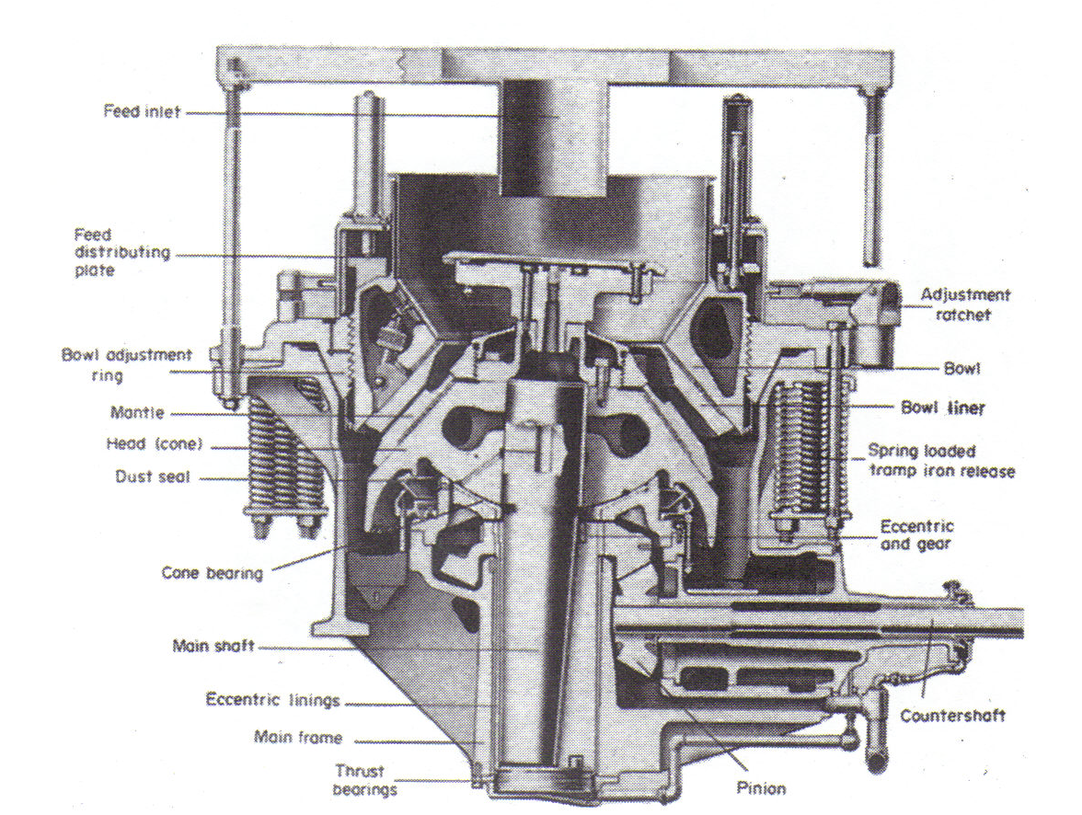
Figure: Cross-section of heavy-duty Symons cone crusher

Slide 63
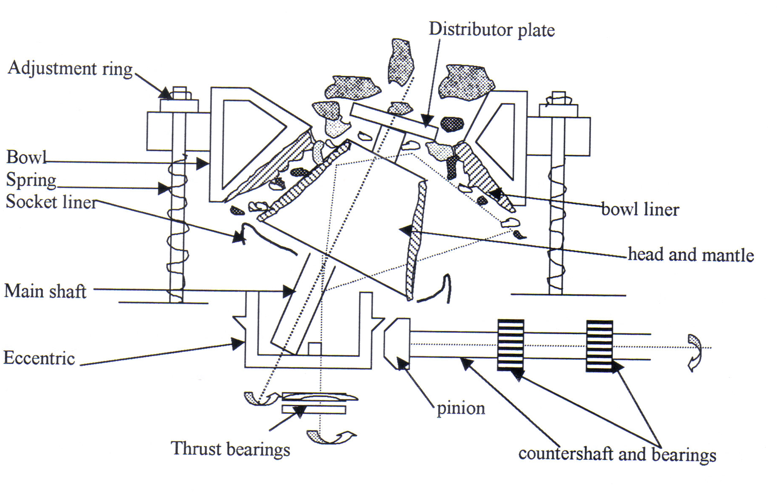

Slide 64
COMMINUTION
Cone Crushers
The head is lined with a wear-resistant mantle.
The inside of the bowl is lined with a wear-resistant bowl-liner, which comes in different shapes, thus determining the shape of the crushing cavity for different crushing purposes (fine, medium, coarse and extra-coarse).
The shape of all bowl liners is such that their lower end is roughly parallel with the mantle (“parallel zone”). The head with the mantle, gyrates at high speed (400-700 gyrations min ^{–1}).

Slide 65
COMMINUTION
Cone Crushers
Ore is fed from the top and gyrates down through the crushing cavity.
On its way down it receives a series of rapid blows from the crushing head, crushing the ore between mantle and bowl liner.
The increasing cross-section of the bowl allows for the “swell” of the ore as it breaks further, thus avoiding choked crushing.
The purpose of the parallel zone is that each particle will receive a number of blows in that zone, before it has a chance to drop out of the annular discharge opening, and thus will be at least as small as the minimum clearance between mantle and bowl liner before it leaves the crushing cavity.
Compared to jaw crushers and gyratory crushers, cone crushers thus deliver a more evenly sized product and the ”set” can be taken as the minimum clearance between mantle and bowl liner at the discharge point.

Slide 66
COMMINUTION
Cone Crushers
The main frame is a cylindrical shell, which holds the eccentric assembly and a socket with a hemispherical socket-liner, which supports the head assembly.
The eccentric and the inner eccentric bearing are rotated through a gear and pinion by the countershaft, which is coupled to the drive.
The weight of the eccentric and gear is carried by the eccentric-thrust bearings at the bottom.
The main shaft is pressed into the conical breaking head, which carries a replaceable mantle.
The tapered lower end of the main shaft is bushed onto the eccentric. Its upper end, above the head, carries the distributor plate, which gyrates with the head and is used to distribute the feed evenly over the crushing cavity.
Together this constitutes the head assembly.

Slide 67
COMMINUTION
Cone Crushers
The bowl is threaded onto an adjustment ring, which rests on to the main frame. The “set” of the crusher can be adjusted by screwing the bowl up and down with the adjustment ring, by means of a winch or a crane.
Bowl and adjustment ring are held onto the main frame by tensioned springs. These serve as a protection against excessive stress from oversize rocks or uncrushable material (e.g. tramp metal) which otherwise would jam or damage the crusher. When such material enters the crushing cavity, the springs will allow the bowl to move upwards, thereby allowing this material to pass through.
An oil circulation system lubricates eccentric and socket bearings, gears and countershaft bearings. The flow switch in the circulation system will trip out the crusher in the case of failure of the lubricating system.

Slide 68
COMMINUTION
Cone Crushers
Standard cone crushers are manufactured in a series of standard sizes (2 feet, 3 feet, 4 feet, 4¹_{/4} feet, 5 ½ feet and 7 feet), which sizes are those of the approximate diameter of the discharge annulus.
Each size can be supplied with four different bowl liners (fine, medium, coarse and extra-coarse), depending upon the customer’s requirements.
The construction and the crushing action of a cone crusher somewhat resemble those of a gyratory crusher, but there are significant differences.
The head of the cone crusher is a much flatter cone (height of cone : diameter of base ~ 1 : 2.5) and the eccentric is longer than for a gyratory crusher.

Slide 69
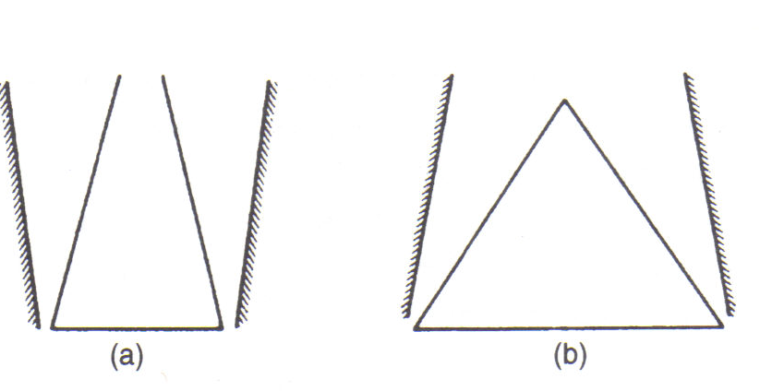
Figure: Head and shell shapes of (a) gyratory, and (b) cone crushers

Slide 70
COMMINUTION
Cone Crushers
As a result, the pressure per unit of surface is much lower than in a gyratory, so that its construction can be much lighter.
In contrast to a gyratory, the head assembly is not suspended from the top, but supported on a socket and socket liner.
The gyrating speed of the cone crusher is high.
This, combined with the low unit pressures, make a cone crusher a typical intermediate breaker.
The increasing cross-section of the crushing cavity from top to bottom and the high speed give it a very high capacity for its size.
The high speed and parallel zone result in a fairly evenly sized product. The reduction ratio is higher than for primary crushers.

Slide 71
COMMINUTION
Cone Crushers
The set of the cone crushers is normally checked at regular intervals (weekly, or whenever the set is suspected of having altered). The usual checking procedure is to pass lead billets through the crusher when it is otherwise running empty, and then to measure the billets. Their smallest dimension is then the size of the discharge opening. If required the set can then be adjusted by means of the adjustment ring.
With modern cone crushers, the set can be adjusted by means of a lever-operated hydraulic system (a hydraulic “ram”). With this system, the set can be adjusted during the normal operating period.

Slide 72
COMMINUTION
Related Crushers
  The Symons shorthead cone crusher (Nordberg Manufacturing Co.) has essentially the same frame and mechanism as the standard cone crusher, but a different head and bowl.
  The head angle is steeper, the feed opening is narrower and the parallel zone is longer. It should receive a finer feed and it delivers a finer product (0.4 – 1.5 cm) than the standard cone crusher. Its capacity is markedly lower. Like the standard cone crusher, it can be fitted with four different bowl liners.
  It is most often used as a tertiary crusher in closed circuit with a screen, receiving the secondary crusher product.

Slide 73
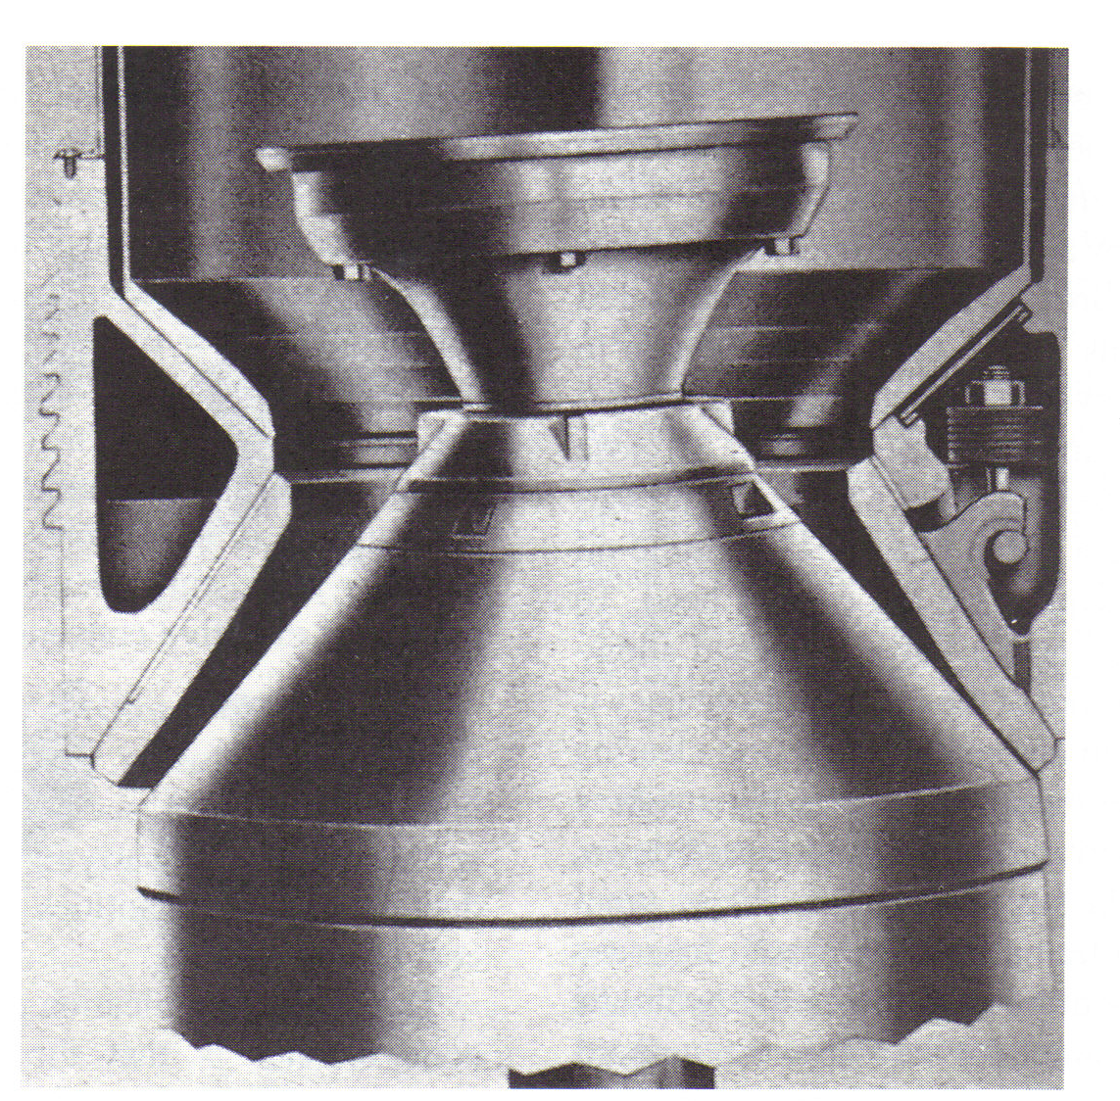

Slide 74
COMMINUTION
Related Crushers
  Reduction-gyratory crushers (Allis-Chalmers Manufacturing Co.) are small modifications of the common gyratory crusher, incorporating some of the characteristics of the cone crushers, such as high speed and large throw.
  The crushing head is a much flatter cone than in the common gyratory crusher (height of cone: diameter of base ~ 1 : 1) and the stationary concave start to flare outward at a much higher point than in the suspended-spindle gyratories.
  This provides a parallel crushing zone as in the cone crushers and reduces the chance of choking.
  They are used as intermediate crushers, in a somewhat coarser size range than usually covered by cone crushers.

Slide 75
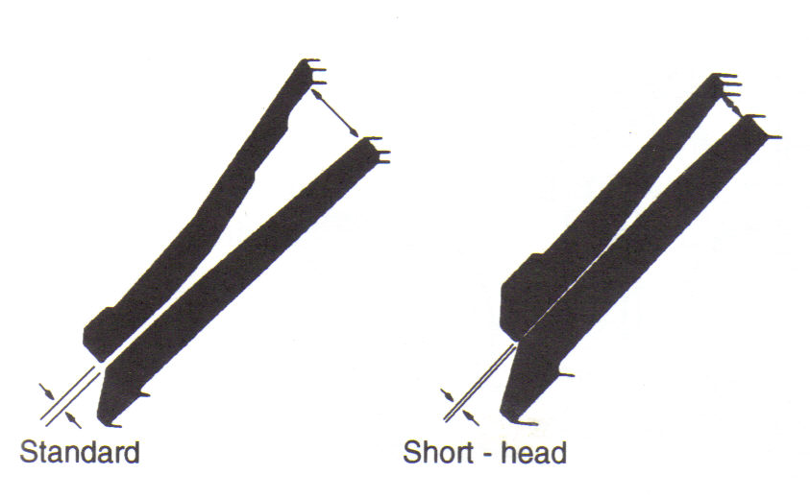
Fgure: Liners of standard and short-head cone crushers

Slide 76
END

