Slide 1
COMMINUTION
GRINDING

Slide 2
Grinding Mills
Introduction
Grinding is the last stage in the process of comminution; in this stage the particles are reduced in size by a combination of impact and abrasion, either dry or in suspension in water.
It is performed in rotating cylindrical steel vessels known as tumbling mills.
These contain a charge of loose crushing bodies – the grinding medium – which is free to move inside the mill, thus comminuting the ore particles.
The grinding medium may be steel rods, or balls, hard rock, or, in some cases, the ore itself.
In the grinding process, particles between 5 and 250 mm are reduced in size to between 10 and 300 μm.

Slide 3
Grinding Mills
Introduction
All ores have an economic optimum mesh of grind, which will depend on many factors, including the extent to which the values are dispersed in the gangue, and the subsequent separation process to be used.
It is the purpose of the grinding section to exercise close control on this product size and, for this reason, correct grinding is often said to be the key to good mineral processing.
Undergrinding of the ore will, of course, result in a product, which is too coarse, with a degree of liberation too low for economic separation; poor recovery and enrichment ratio will be achieved in the concentration stage.

Slide 4
Grinding Mills
Introduction
Overgrinding needlessly reduces the particle size of the subsequently liberated major constituent (usually the gangue) and may reduce the particle size of the minor constituent (usually the mineral value) below the size required for most efficient separation.
Much expensive energy is wasted in the process. It is important to realise that grinding is the most energy intensive operation in mineral processing.

Slide 5
Grinding Mills
Introduction
Grinding within a tumbling mill is influenced by the size, quantity, the type of motion, and the spaces between the individual pieces of the medium in the mill.
As opposed to crushing, which takes place between relatively rigid surfaces, grinding is a more random process, and is subject to the laws of probability.
Grinding can take place by several mechanisms, including impact or compressing, due to forces applied almost normally to the particle surface; chipping due to oblique forces; and abrasion due to forces acting parallel to the surfaces (Figure 1).
These mechanisms distort the particles and change their shape beyond certain limits determined by their elasticity, which causes them to break.

Slide 6
(a)
(b)
(c)
Figure 1 Mechanisms of breakage: (a) impact or compression, (b) chipping, (c) abrasion

Slide 7
Grinding Mills
Introduction
Grinding is usually performed wet, although in certain applications dry grinding is used.
When the mill is rotated the mixture of the medium, ore, and water, known as the mill charge, is intimately mixed, the medium comminuting the particles by any of the above methods depending on the speed of rotation of the mill.
Most of the kinetic energy of the tumbling load is dissipated as heat, noise, and other losses, only a small fraction being expended in actually breaking the particles.

Slide 8
Grinding Mills
Introduction
Apart from laboratory testing, grinding in mineral processing is a continuous process, material being fed at a controlled rate from storage bins into one end of the mill and overflowing at the other end after a suitable dwell time.
Control of product size is exercised by the type of medium used, the speed of rotation of the mill, the nature of the ore feed, and the type of circuit used.

Slide 9
Grinding Mills
The Motion of the Charge in a Tumbling Mill
The distinctive feature of tumbling mill s is the use of loose crushing bodies, which are large, hard, and heavy in relation to the ore particles, but small in relation to the volume of the mill, and which occupy slightly less than half the volume of the mill.
Due to the rotation and friction of the mill shell, the grinding medium is lifted along the rising side of the mill until a position of dynamic equilibrium is reached, when the bodies cascade and cataract down the free surface of other bodies, about a dead zone where little movement occurs, down to the toe of the mill charge (Fig. 2).

Slide 10
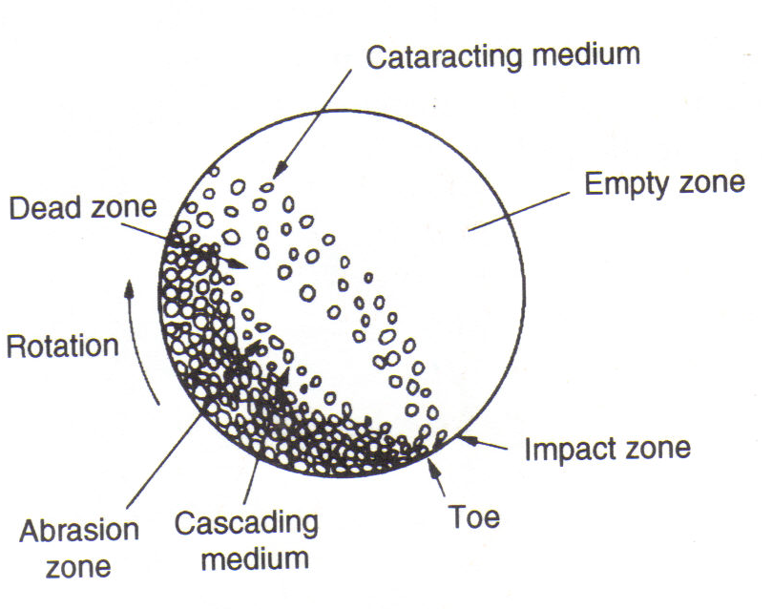
Figure 2 Motion of charge in a tumbling mill

Slide 11
Grinding Mills
The Motion of the Charge in a Tumbling Mill
The speed at which a mill is run is important, since it governs the nature of the product and the amount of wear on the shell liners.
The driving force of the mill is transmitted via the liner to the charge.
At relatively low speeds, or with smooth liners, the medium tends to roll down to the toe of the mill and essentially abrasive comminution occurs.
This cascading leads to finer grinding, with increased slimes production and increased liner wear.
At higher speeds the medium is projected clear of the charge to describe a series of parabolas before landing on the toe of the charge.
This cascading leads to comminution by impact and a coarser end product with reduced liner wear.
At the critical speed of the mill the theoretical trajectory of the medium is such that it would fall outside the shell.
In practice, centrifuging occurs and the medium is carried around in an essentially fixed position against the shell.

Slide 12
Grinding Mills
The Motion of the Charge in a Tumbling Mill
Mills are driven in practice at speeds of 50 – 90% of critical speed, the choice being influenced by economic considerations.
Increase in speed increases capacity, but there is little increase in efficiency (i.e. kWh t^{–1}) above about 40 – 50% of the critical speed.
Very low speeds are sometimes used when full mill capacity cannot be attained.
High speeds are used for high-capacity coarse grinding.
Cataracting at high speeds converts the potential energy of the medium into kinetic energy of impact on the toe of the charge and does not produce as much very fine material as the abrasive grinding produced by cascading at lower speeds.

Slide 13
Grinding Mills
The Motion of the Charge in a Tumbling Mill
It is essential, however, that the cataracting medium should fall well inside the mill charge and not directly onto the liner, thus excessively increasing steel consumption.
Most of the grinding in the mill takes place at the toe of the charge, where not only is there direct impact of the cataracting medium on to the charge, but also the ore packed between the cascading medium receives the shock transmitted.

Slide 14
Grinding Mills
Tumbling Mills
Tumbling mills are of three basic types: rod, ball, and autogenous. Structurally, each type of mill consists of a horizontal cylindrical shell, provided with renewable wearing liners and a charge of grinding medium.
The drum is supported so as to rotate on its axis on hollow trunnions attached to the end walls (Fig. 3).
The diameter of the mill determines the pressure that can be exerted by the medium on the ore particles and, in general, the larger the feed size the larger needs to be the mill diameter.
The length of the mill, in conjunction with the diameter, determines the volume, and hence the capacity of the mill.

Slide 15
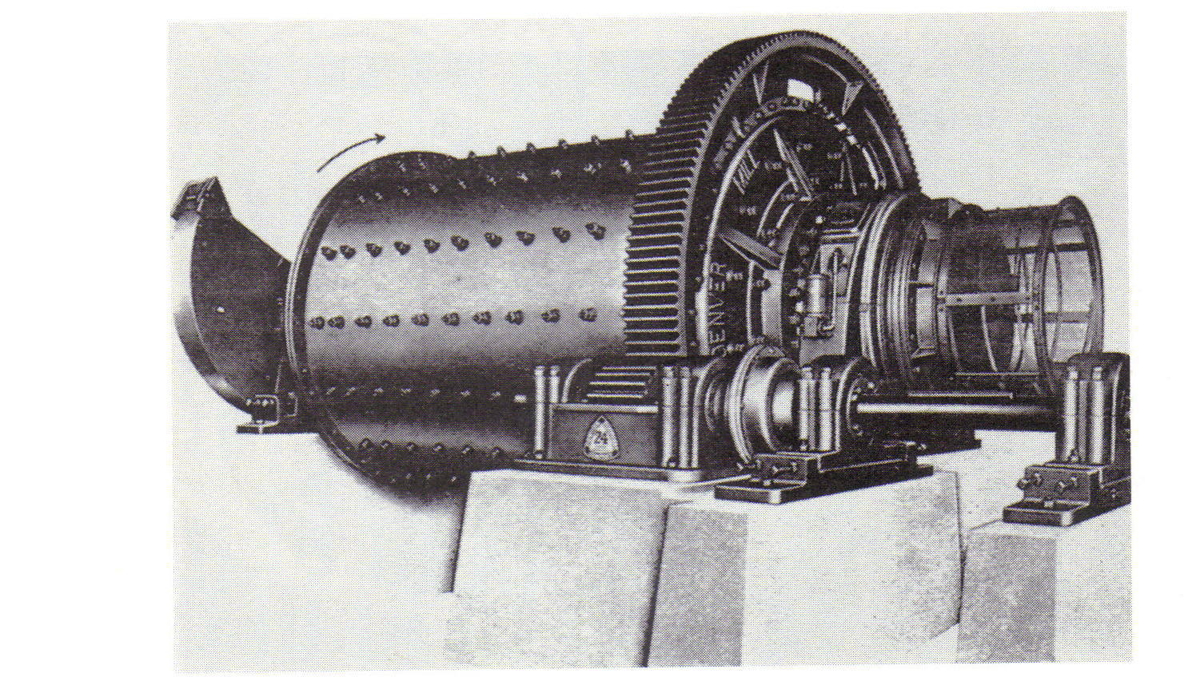
Figure 3 Tumbling mill

Slide 16
Grinding Mills
Tumbling Mills
The feed material is usually fed to the mill continuously through one end trunnion, the ground product leaving via the other trunnion, although in certain applications the product may leave the mill through a number of ports spaced around the periphery of the shell.
All types of mill can be used for wet or dry grinding by modification of feed and discharge equipment.

Slide 17
Grinding Mills
Liners of Tumbling Mills
The mill liners perform two major functions, i.e., (a) protect the cylindrical shell of the mill against abrasion by the tumbling mixture of ore, crushing bodies and water and thus prevent the wear of the mill, and (b) help in tumbling and rotating the mill load.
The liners are fixed or bolted to mill shell and thus revolve with the peripheral speed of the mill without slipping.
The crop load (mill load consisting of crushing media, ore and water) rests on liners, which is displaced by frictional drag against the rising side of the revolving mill.
If the liners are smooth, the crop load or charge will lose the contact soon after it starts to rise, causing the churning of load quietly.
If the liner surfaces are made with projecting ribs, a positive lifting force can be applied to the charge, resulting into higher climb of the charge.

Slide 18
Grinding Mills
Liners of Tumbling Mils
Thus in the latter case, the load falls with considerable violence, adding a shattering action to the abrasion characteristic of churning motion.
The wear of liner is much more in the central part than of liners at the end. Therefore, the materials employed for liners should be hard, tough, and resistant to corrosion.
Further the material chosen should not introduce any element in the ground product which may present problems in the subsequent concentrating process.
The usual materials employed for liners is alloy steel and alloy cast irons.
The consumption of liners depends on type of ore and mesh of grind, and usually varies from 0.015 to 0.15 kg/tonne of ore.

Slide 19
Grinding Mills
Liners of Tumbling Mils
Mill liners can be made in many shapes (Figure 4) but in general, they can be classified into the following three groups:
Smooth liners having simple frictional contact with the charge or crop load.
Grate liners (having pocket, grid, etc.) in which the ore and crushing media tend to wedge in the openings which form the wearing surface.
Lifting liners provided with longitudinal waves, ribs, lifters, wedge bars, etc., which grip the crop load to some extent on the rising side.

Slide 20
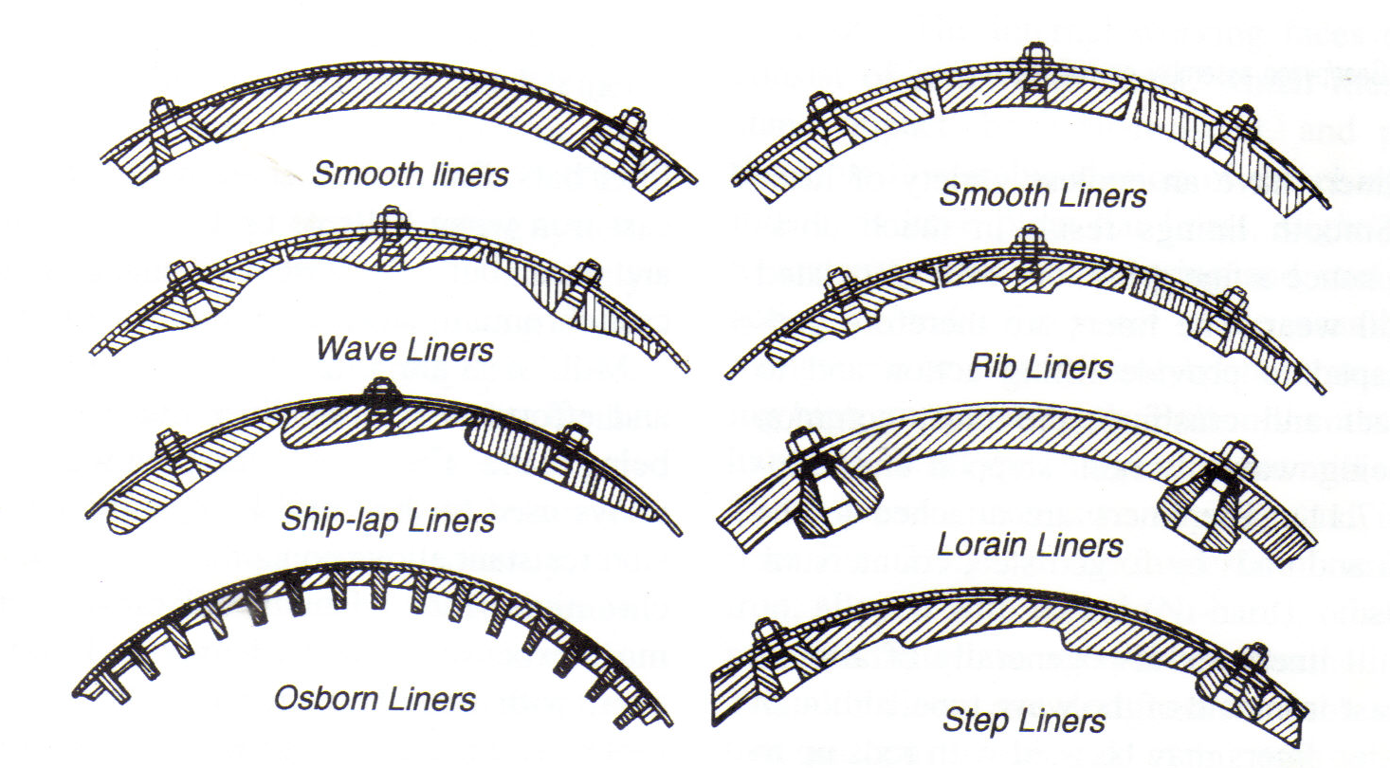
Figure 4 Mill shell liners

Slide 21
Grinding Mills
Types of Mill
(a) Rod Mills
These may be considered as either fine crushers or coarse grinding machines.
They are capable of taking feed as large as 50 mm and making a product as fine as 300 μm, reduction ratios normally being in the range 15 – 20: 1.
The are often preferred to fines crushing machines when the ore is “clayey” or damp, thus tending to choke the crushers.
The distinctive feature of a rod mill is that the length of the cylindrical shell is between 1.5 and 2.5 times its diameter (Figure 5).
This ratio is important because the rods, which are only a few centimetres shorter than the length of the shell, must be prevented from turning so that they become wedged across the diameter of the cylinder.

Slide 22
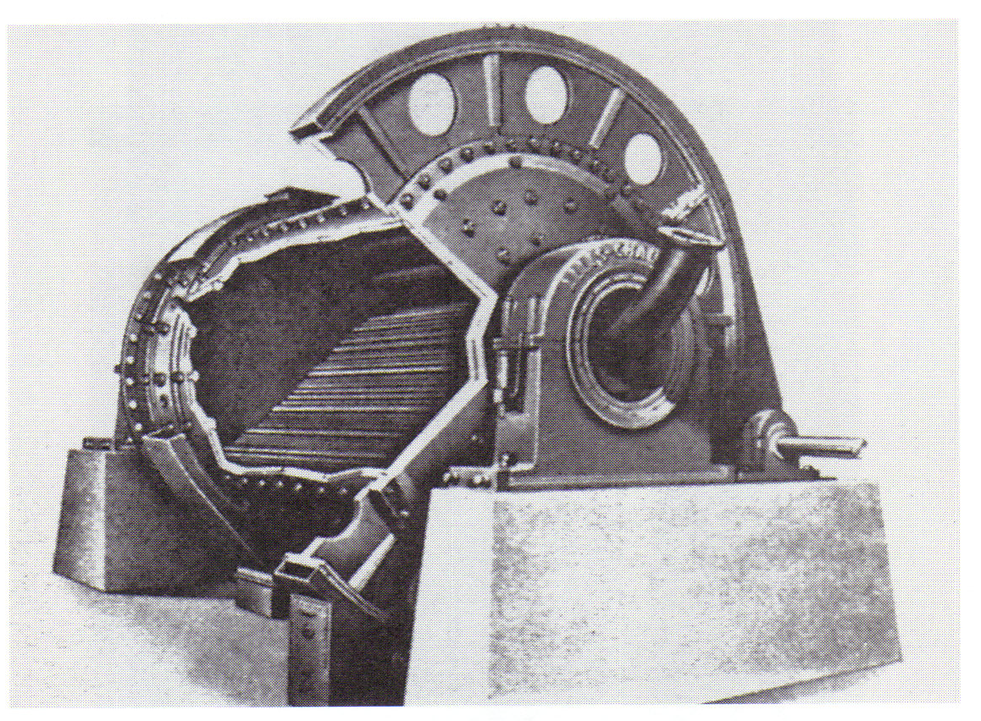
Figure 5 Rod mill

Slide 23
Grinding Mills
Types of Mill
(a) Rod Mills
Rod and other grinding mills are rated by power rather than capacity, since the capacity is determined by many factors, such as the grindability, determined by laboratory testing, and the reduction in size required.
The power required for a certain required capacity may be estimated by the use of Bond’s equation:

Slide 24
Grinding Mills
Types of Mill
(a) Rod Mills
The calculated power required is adjusted by utilising efficiency factors dependent on the size of mill, size and type of media, type of grinding circuit, etc., to give the operating power requirement (Rowland and Kjos, 1978).
Rod mills are classed according to the nature of the discharge.
A general statement can be made that the closer the discharge is to the periphery of the shell, the quicker the material will pass through and less overgrinding will take place.

Slide 25
Grinding Mills
Types of Mill
(a) Rod Mills
The most widely used type of rod mill in the mining industry is the trunnion overflow (Figure 8), in which the feed is introduced through one trunnion and discharges through the other.
This type of mill is used only for wet grinding and its principal function is to convert crushing-plant product into ball-mill feed.
A flow gradient is provided by making the overflow trunnion diameter 10 – 20 cm larger than that of the feed opening. The discharge trunnion is often fitted with a spiral screen to remove tramp material.

Slide 26
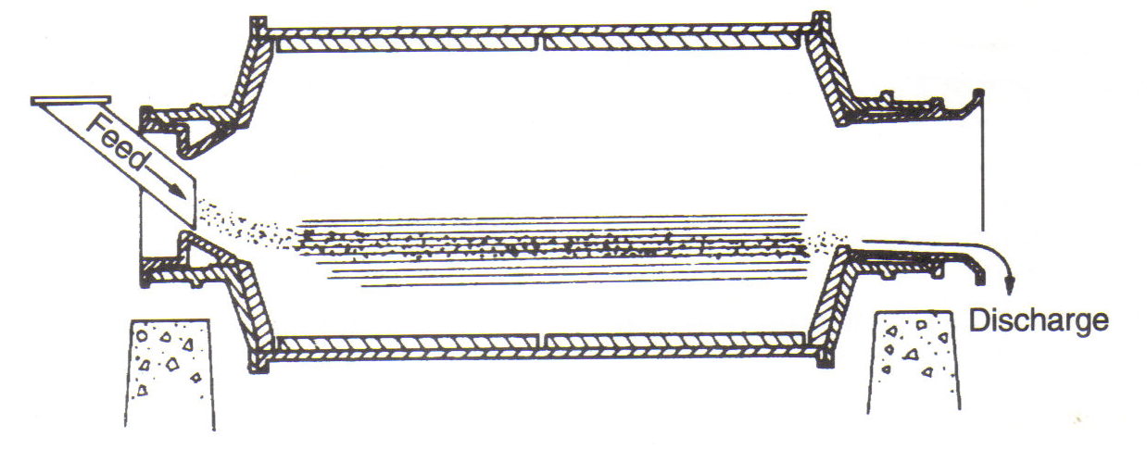
Figure 8 Overflow mill

Slide 27
Grinding Mills
Types of Mill
Rod Mills
Rod mills are charged initially with a selection of rods of assorted diameters, the proportion of each size being calculated to provide maximum grinding surface and to approximate to a seasoned or equilibrium charge.
A coarse feed or product normally requires larger rods.
Generally, rods should be removed when they are worn down to about 25 mm in diameter or less, depending on the application, as small one s tend to bend or break.
High carbon steel rods are used, as they are hard, and break rather than warp when worn, so do not entangle with other rods.
Optimum grinding rates are obtained with new rods when the volume is 35 % of that of the shell.
Overcharging results on inefficient grinding and increased liner and rod consumption.

Slide 28
Grinding Mills
Types of Mill
Rod Mills
Rod consumption varies widely with the characteristics of the mill feed, mill speed, rod length, and product size; it is normally in the range 0.1 – 1.0 kg of steel per tonne of ore for wet grinding, being less for dry grinding.
Rod mills are normally run between 50 – 65% of the critical speed, so that the rods cascade rather than cataract.
The feed pulp density is usually between 65 and 85% solids by weight, finer feeds requiring lower pulp densities.

Slide 29
Grinding Mills
Types of Mill
Rod Mills
The grinding action results from line contact of the rods on the ore particles; the rods tumble in essentially a parallel alignment, and also spin, thus acting rather like a series of crushing rolls.
The coarse feed tends to spread the rods at the feed end, so producing a wedge or cone-shaped array.
This increases the tendency for grinding to take place preferentially on the larger particles, thereby producing a minimum amount of extremely fine material (Fig. 9).

Slide 30
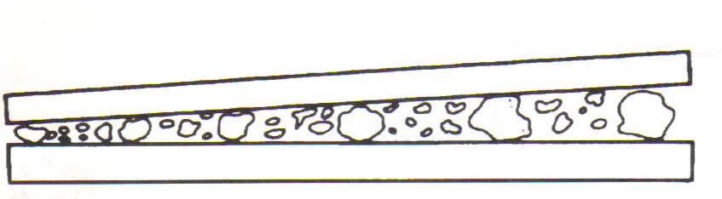
Figure 9 Grinding action of rods

Slide 31
Grinding Mills
Types of Mill
Rod Mills
This selective grinding gives a product of relatively narrow size range, with little oversize or slimes.
Rod mills are therefore suitable for preparation of feed to gravity concentrators, certain flotation processes with slime problems, magnetic cobbing, and ball mills.
They are nearly always run in open circuit because of this controlled size reduction.

Slide 32
Grinding Mills
Types of Mill
Ball Mills
The final stages of comminution are performed in tumbling mill using steel balls as the grinding medium and so designated ball mills.
Since ball mills have a greater surface area per unit weight than rods, they are better suited for fine finishing.
The term ball mill is restricted to those having a length to diameter ratio of 1.5 to 1 and less.
Ball mills in which the length to diameter ratio is between 3 to 5 are designated tube mills.
Ball mills are also classified by the nature of the discharge.
They may be simple trunnion overflow mills, operated in open or closed circuit, or grate discharge (low-level discharge) mills.

Slide 33
Grinding Mills
Types of Mill
Ball Mills
The latter type is fitted with discharge grates between the cylindrical mill body and the discharge trunnion.
The pulp can flow freely through the openings in the grate and is then lifted up to the level of the discharge trunnion (Fig. 10).
These mills have a lower pulp level than overflow mills, thus reducing the dwell time of particles in the mill.
Very little overgrinding takes place and the product contains a large fraction of coarse material, which is returned to the mill by some form of classifying device.

Slide 34
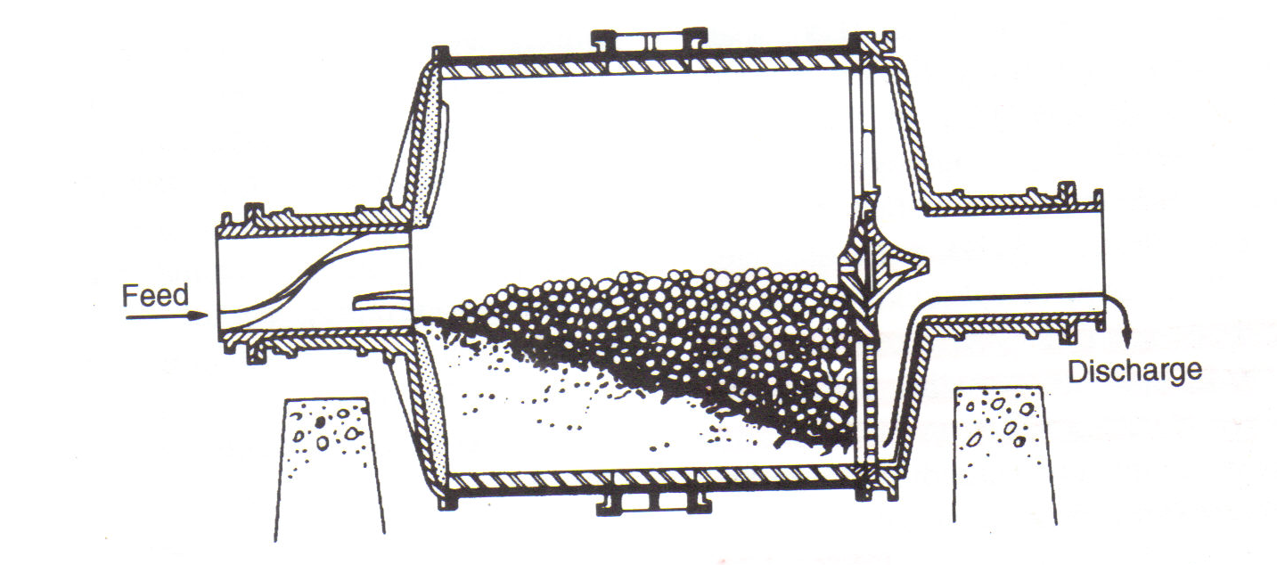
Figure 10 Grate discharge mill

Slide 35
Grinding Mills
Types of Mill
Ball Mills
Closed-circuit grinding (Fig. 11), with high circulating loads, produces a closely sized end product and a high output per unit volume compared with open circuit grinding.
Grate discharge mills usually take a coarser feed than overflow mills and are not required to grind so finely, the main reason being that with many small balls forming the charge the grate open area plugs very quickly.
The trunnion overflow mill is the simplest to operate and is used for most ball-mill applications, especially for fine grinding and regrinding.
Energy consumption is said to be about 15 % less than that of the grate discharge mill of the same size, although the grinding efficiencies of the two mills are the same (Lewis et al, 1976).
Ball mills are rated by power rather than capacity.

Slide 36
Feed
Ball Mill
Underflow
Overflow
(product)
Classifier
Figure 11 Simple closed-grinding circuit

Slide 37
Grinding Mills
Types of Mill
Ball Mills
Grinding in a ball mill is effected by point contact of balls and ore particles and, given time, any degree of fineness can be achieved.
The process is completely random – the probability of a fine particle being struck by a ball is the same as that of a coarse particle.
The product from an open-circuit ball mill therefore exhibits a wide range of particle size, and overgrinding of at least some of the charge becomes a problem.
Closed-circuit grinding in mills providing low residence time for the particles is almost always used in the last stages to overcome this.

Slide 38
Grinding Mills
Types of Mill
Ball Mills
Several factors influence the efficiency of ball mill grinding.
The pulp density of the feed should be as high as possible, consistent with ease of flow through the mill.
It is essential that the balls are coated with a layer of ore; too dilute a pulp increases metal-to-metal contact, giving increased steel consumption and reduced efficiency.
Ball mills should operate between 65 and 80% solids by weight, depending on the ore.
The viscosity of the pulp increases with the fineness of the particles, therefore fine-grinding circuits may need lower pulp densities.

Slide 39
Grinding Mills
Types of Mill
Ball Mills
The efficiency of grinding depends on the surface area of the grinding medium.
Thus balls should be as small as possible and the charge should be graded such that the largest balls are just heavy enough to grind the largest and hardest particles in the feed.
A seasoned charge will consist of a wide range of ball sizes and new balls added to the mill are usually of the largest size required.
Undersize balls leave the mill with the ore product and can be removed by passing the discharge over screens.

Slide 40
Grinding Mills
Types of Mill
Ball Mills
Segregation of the ball charge within the mill is achieved in the Hardinge mill (Fig. 12).
The conventional drum shape is modified by fitting a conical section, the angle of the cone being about 30º.
Due to the centrifugal force generated, the balls are segregated so that the largest are at the feed end of the cone, i.e. the largest diameter and greatest centrifugal force, and the smallest are at the discharge.
By this means, a regular gradation of ball size and of size reduction is produced.

Slide 41
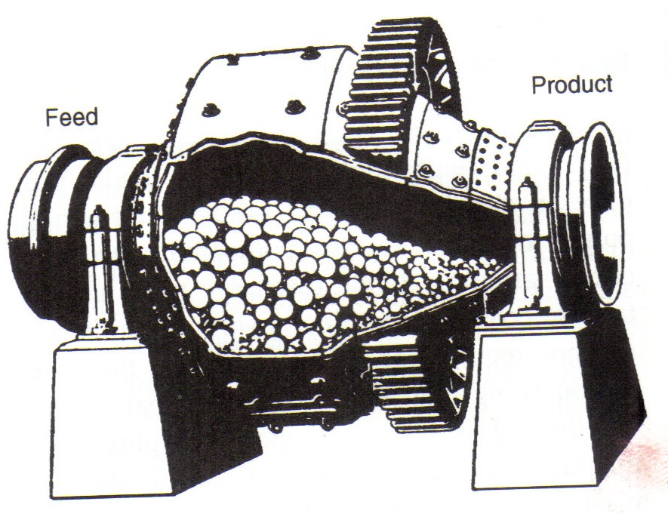
Figure 12 Hardinge mill

Slide 42
Grinding Mills
Types of Mill
Ball Mills
Finer grinding may lead to improved metallurgical efficiency, but at the expense of higher grinding energy and media consumption.
Therefore, particularly with ore of low value, where milling costs are crucial, the economic limit of grinding has to be carefully assessed.
The charge volume is about 40-50% of the internal volume of the mill, about 40% of this being void space.
The energy input to a mill increases with the ball charge, and reaches a maximum at a charge volume of approximately 50% (Fig. 13), but for a number of reasons, 40-50% is rarely exceeded.

Slide 43
Energy input
50
Charge volume, %
Figure 13 Energy input versus charge volume

Slide 44
Grinding Mills
Types of Mill
Ball Mills
The efficiency curve is in any case quite flat about the maximum. In overflow mills the charge volume is usually 40%, but there is a greater choice in the case of grate discharge mills.
The optimum speed increases with charge volume, as the increased weight of charge reduces the amount of cataracting taking place.
Ball mills are often operated at higher speeds than rod mills, so that the larger balls cataract and impact on the ore particles.

Slide 45
Grinding Mills
Types of Mill
Ball Mills
The work input to a mill increases in proportion to the speed, and ball mills are run at as high a speed as is possible without centrifuging.
Normally this is 70-80% of the critical speed, the higher speeds often being used to increase the amount of cataracting taking place in order to break hard or coarse feeds.

Slide 46
Grinding Mills
Types of Mill
Autogenous Mills
There has been increasing emphasis during recent years towards the use of autogenous (AG) and semi-autogenous grinding (SAG) circuits.
On suitable ores, the advantages over conventional circuits include lower capital cost, the ability to handle wet and sticky material, relative simple Flowsheets, the large size of available equipment, lower manpower requirements, and minimal grinding media expense (Jones and Holmberg, 1996; Mular and Agar, 1989).

Slide 47
Grinding Mills
Types of Mill
Autogenous Mills
The autogenous mill uses tumbling to effect comminution, but instead of utilising media such as steel rods or balls, comminution is achieved by the action of the ore particles on each other.
Semi-autogenous milling refers to grinding methods using a combination of the ore and a reduced load of steel balls as the medium.
Experience indicates that the ball charges used in semi-autogenous grinding have generally been most effect in the range of 6-10% of the mill volume, including voids.

Slide 48
Grinding Mills
Types of Mill
Autogenous Mills
Where the proportion of coarse fraction in the feed is too low, pebble milling is sometimes used. In this method the coarsest fraction of the feed is separated, by screening, and the remainder is crushed in conventional machinery to a considerable smaller size. This crushed material and the coarse fraction are then put into pebble mills for completion of fine grinding.
Autogenous milling may be performed wet or dry. Dry mills have more environmental problems, do not handle materials containing clay well, and are more difficult to control than wet mills. However, in certain applications, involving grinding of minerals such as asbestos, talc, and mica, dry semi-autogenous mills are operated in closed circuit, usually giving a finished product in one stage.

Slide 49
Grinding Mills
Types of Mill
Autogenous Mills
The main mechanism shown that of comminution in autogenous mills is considered to be abrasion.
Several tests have ores ground autogenously float faster and with better selectivity than if ground conventionally (Forssberg et al, 1988; Soderlund et al, 1989).
Grinding in steel mills can also suppress the natural floatabilities of minerals, due to release of iron into the slurry, and galvanic interaction between sulphide minerals and medium can affect flotation efficiency (Rao and Natarajan).

Slide 50
Grinding Mills
Factors Affecting the Operation of Grinding Mills
The various factors affecting the grinding are speed of mill, load of grinding media and material, pulp level, size and distribution of grinding media, solid-liquid ratio, and return load. The effect of these factors is discussed below:
Speed of Mill
The speed of the mills affects both efficiency of action of grinding media as well as grinding capacity.
The speed must be as high as possible without centrifuging the charge.
During the rising of grinding media, there is very little grinding.
As the speed of the mill is increased, work input increases at first in proportion to the speed and then slippage increases with a slow increase of work input compared to speed.

Slide 51
Grinding Mills
Factors Affecting the Operation of Grinding Mills
Speed of Mill
The work input increases until a critical speed is reached, beyond, which the power input, decreases rapidly to the vanishing point.
Under this condition, the solids are centrifuged on the shell of the mill and no work is done by the mill.
Where as at low speeds, the grinding media will roll and slide over one another in a mass near the bottom of the mill, giving an action called cascading action.
At intermediate speeds, the grinding media will be carried up to a certain extent and then fall on the material in the bottom of the mill, and this action is called cataracting action.

Slide 52
Grinding Mills
Factors Affecting the Operation of Grinding Mills
Load of Grinding Media and Material
Increasing load of grinding media and material will require more power until the maximum value is reached and then power requirement decreases with increasing load as the centre of gravity of the load approaches the axis of rotation.
In case of ball mill, the mill should be slightly more than half-full with material and balls.

Slide 53
Grinding Mills
Factors Affecting the Operation of Grinding Mills
Pulp Level
In wet grinding, the pulp level or quantity of material being ground is an important factor in the operation of the mill, since higher pulp level or quantity of material requires more power.
The lower pulp levels result in greater freedom of movement of grinding media with consequent more effective grinding.

Slide 54
Grinding Mills
Factors Affecting the Operation of Grinding Mills
Size Distribution of Grinding Media
The size distribution of grinding media should be near to close packing grading, but in practical replacement, grinding media are fed in at a single size (in case of balls and rods) or nearing the same size (pebbles and rocks) and allowed to degrade to extinction.
The grinding media balls, pebbles, rods, etc., should be of a size proportionate to the feed size, otherwise nipping of particles will not occur.

Slide 55
Grinding Mills
Factors Affecting the Operation of Grinding Mills
Solid-Liquid Ratio (Pulp Density)
The pulp dilution also influences the grinding efficiency and power input.
The energy input is maximum for a certain critical range of solid-liquid ratio of the pulp, which is usually obtained in a pulp consisting of 60-75% solids.
However, this range depends on the chemical composition, particle size, and specific gravity of the ore.
For an efficient use of energy in grinding, the ore particles should form a coating on liners and grinding media.
At the same time, the pulp should be sufficiently fluid to flow steadily through the mill.

Slide 56
Grinding Mills
Factors Affecting the Operation of Grinding Mills
Solid-Liquid Ratio (Pulp Density)
With too thin a pulp, the solids tend to settle and centrifuge outward, and the coatings on the grinding media becomes patchy to non-existent, so the grinding force is washed as the grinding media hit the grinding media.
If water is too little, the charge becomes sluggish and pasty. In this case the kinetic energy will be wasted in overcoming viscosity instead of being available for grinding and the ore will remain sandwiched between two grinding bodies instead of giving away for a fresh feed.

Slide 57
Grinding Mills
Factors Affecting the Operation of Grinding Mills
Return Load or Circulating Load
Any attempt to reduce all the feed to finishing size in one operation would result in wasteful overgrinding.
This difficulty can be overcome by building up the circulating load in closed circuit.
In order to have minimum overgrinding, the ore should move rapidly through the mill.
More effective grinding in terms of output and least overgrinding, can be obtained by faster rate of ore passing through the mill and higher capacity of classifier.
The practical limit is usually in between 5 : 1 to 6 : 1, as a ratio between return (circulating) sand and the new feed in case of primary grinding.

Slide 58
Grinding Mills
Factors Affecting the Operation of Grinding Mills
Return Load or Circulating Load
The ratio is lower in secondary grinding due to the limited sorting speed of the classifier. Increased circulating load results in the following effects:
Mean size of entering feed becomes lower.
Amount of nearly finished material is increased in circulating load.
The retention time and overgrinding of finished material are reduced.
Range of ball sizes is reduced.
Close adjustment of solid-liquid ratio is possible.

Slide 59
Grinding Mills
Factors Affecting the Operation of Grinding Mills
Presence of Fine Material
The presence of excessive fine material such as primary slime, clay, overground friable sulphide or gangue in the mill charge may create problems, since the surfaces of grinding media become coated with a film of fine material, which acts as a lubricant resulting into slip and reduction in impact grinding.

Slide 60
Grinding Mills
Grinding Circuits
The feed can be wet or dry, depending on the subsequent process and the nature of the product.
Dry grinding is necessary with some materials due to physical or chemical changes which, occur if water is added.
It causes less wear on the liners and grinding media and there is a higher proportion of fines in the product, which may be desirable in some cases.
Wet grinding is generally used in mineral processing operations because of the overall economies of operation.

Slide 61
Grinding Mills
Grinding Circuits
The advantages of wet grinding are:
Lower power consumption per tonne of product.
Higher capacity per unit mill volume.
Makes possible the use of wet screening or classification for close product control.
Elimination of the dust problems.
Makes possible the use of simple handling and transport methods such as pumps, pipes, and launders.

Slide 62
Grinding Mills
Grinding Circuits
Circuits are divided into two broad classifications: open and closed. In open circuit the material is fed into the mill at a rate calculated to produce the correct product in one pass (Fig. 14).
This type of circuit is rarely used in mineral processing applications as there is no control on the product size distribution.
The feed rate must be low enough to ensure that every particle spends enough time in the mill to be broken down to product size.
As a result, many particles in the product are overground, which consumes energy needlessly, and the product may subsequently be difficult to treat.

Slide 63
Mill
Product
Feed
Mill
Figure 14 Single-stage open-circuit grinding

Slide 64
Grinding Mills
Grinding Circuits
Grinding in the mining industry is almost always in closed circuit (Fig. 11), in which material of the required size is removed by a classifier, which returns the oversize to the mill.
The material returned to the mill by the classifier is known as the circulating load, and its weight is expressed as a percentage of the weight of new feed.
Closed circuit grinding reduces the residence time of particles in each pass, and so the proportion of finished sizes in the mill, compared with open-circuit grinding.
This decreases overgrinding and increases the energy available for useful grinding as long as there is ample supply of unfinished material present.
As the tonnage of new feed increases, so the tonnage of circulating load increases, since the classifier underflow becomes coarser, but the composite mill feed becomes finer due to this increase in circulating load.

Slide 65
Grinding Mills
Grinding Circuits
Due to the reduced residence time in the mill, the mill discharge correspondingly becomes coarser, so that the difference in mean size between the composite feed and the discharge decreases.
The capacity of the mill increases with decreasing ball diameter due to the increase in grinding surface, to the point where the angle of nip between contacting balls and particles is exceeded.
Consequently, the more near-finished material there is in the composite feed, the higher is the proportion of favourable nip angles, and the finer the composite feed the smaller need be the mean ball diameter.

Slide 66
Grinding Mills
Grinding Circuits
Within limits, therefore, the larger the circulating load the greater is the useful capacity of the mill.
The increase is most rapid in the first 100% of circulating load, then continues up to a limit, depending on the circuit, just before chokage of the mill occurs.
The optimum circulating load for a particular circuit depends on the classifier capacity and the cost of transporting the load to the mill. It is usually in the range 100-350%, although it can be as high as 600%.

Slide 67
Grinding Mills
Grinding Circuits
Rod mills are generally operated in open circuit because of their grinding action, especially when preparing feed for ball mills.
The parallel grinding surfaces simulate a slotted screen and tend to retard the larger particles until they are broken.
Smaller particles slip through the spaces between the rods and are discharged without appreciable reduction.
Ball mills, however, are virtually always operated in closed circuit with some form of classifier.

Slide 68
Grinding Mills
Grinding Circuits
Various types of classifying device can be used to close the circuit, mechanical classifiers being used in many older mills.
They are robust, easy to control, and smooth out and tolerate surges well.
They can handle very coarse sand products and are still used on many coarse-grinding circuits.
They suffer from the severe disadvantage of classifying by gravitational force, which restricts their capacity when dealing with extremely fine material, hence reducing the circulating load possible.

Slide 69
Grinding Mills
Grinding Circuits
Hydrocyclones (next Chapter) classify by centrifugal action, which speeds up the classification of fine particles, giving much sharper separations and increasing the optimum circulating load.
They occupy much less floor space than mechanical classifiers of the same capacity and have lower capital and installation costs.
Due to their much quicker action, the grinding circuit can rapidly be brought into balance if changes are made and the reduced dwell time of particles in the return load gives less time for oxidation to occur, which is important with sulphide minerals which are to be subsequently floated.
They have therefore become widely used in fine grinding circuits preceding flotation operations.

Slide 70
Grinding Mills
Grinding Circuits
The action of all classifiers in grinding circuits is dependent on the differential settling rates of particles in a fluid, which means that particles are classified not only by size but also by specific gravity.
A small dense particle may therefore behave in a similar way to a large, low-density particle.
Thus, when an ore containing a heavy valuable mineral is ground, overgrinding of this material is likely to occur, due to it being returned in the circulating load, even though it is below the required product size.

