Slide 1
DEWATERING

Slide 2
DEWATERING
Introduction
With few exceptions, most mineral-separation processes involve the use of substantial quantities of water and the final concentrate has to be separated from a pulp in which the water/solids ratio may be high.
Dewatering, or solid-liquid separation, produces a relatively dry concentrate for shipment.
Partial dewatering is also performed at various stages in the treatment, so as to prepare the feed for subsequent processes.

Slide 3
DEWATERING
Introduction
Dewatering methods can be broadly classified into three groups:
Sedimentation
Filtration
Thermal drying

Slide 4
DEWATERING
Introduction
Sedimentation is most efficient when there is a large density difference between liquid and solid.
This is always the case in mineral processing where the carrier liquid is water.
Sedimentation cannot always be applied in hydrometallurgical processes, however, because in some cases the carrier liquid may be high-grade leach liquor having a density approaching that of the solids.
In some cases, filtration may be necessary.

Slide 5
DEWATERING
Introduction
Dewatering in mineral processing is normally a combination of the above methods.
The bulk of the water is first removed by sedimentation, or thickening, which produces a thickened pulp of perhaps 55 – 65% solids by weight.
Up to 80% of the water can be separated at this stage.
Filtration of the thick pulp then produces a moist filter cake of between 80 and 90% solids, which may require thermal drying to produce a final product of about 95% solids by weight.

Slide 6
DEWATERING
Sedimentation
Rapid settling of solid particles in a liquid produces a clarified liquid, which can be decanted, leaving thickened slurry, which may require further dewatering by filtration.
The settling rates of particles in a fluid are governed by Stokes’ or Newton’s laws, depending on the particle size.
Very fine particles, of only a few microns diameter, settle extremely slowly by gravity alone, and centrifugal sedimentation may have to be performed.
Alternatively, the particles may be agglomerated, or flocculated, into relatively large lumps, called flocs, that settle out more rapidly.

Slide 7
DEWATERING
Gravity Sedimentation
Gravity sedimentation, or thickening, is the most widely applied dewatering technique in mineral processing, and it is a relatively cheap, high-capacity process, which involves very low shear forces, thus providing good conditions for flocculation of fine particles.
The thickener is used to increase the concentration of the suspension by sedimentation, accompanied by the formation of a clear liquid.
In most cases the concentration of the suspension is high and hindered settling takes place.

Slide 8
DEWATERING
Gravity Sedimentation
Thickeners may be batch or continuous units, and consist of relatively shallow tanks from which the clear liquid is taken off at the top, and the thickened suspension at the bottom.
The continuous thickener consists of a cylindrical tank, the diameter ranging from about 2 m to 200 m in diameter, and of depth 1 – 7 m.
Pulp is fed into the centre via a feed-well placed up to 1 m below the surface, in order to cause as little disturbance as possible (Fig. 4).
The clarified liquid overflows a peripheral launder, while the solids, which settle over the entire bottom of the tank, are withdrawn as a thickened pulp from an outlet at the centre.

Slide 9
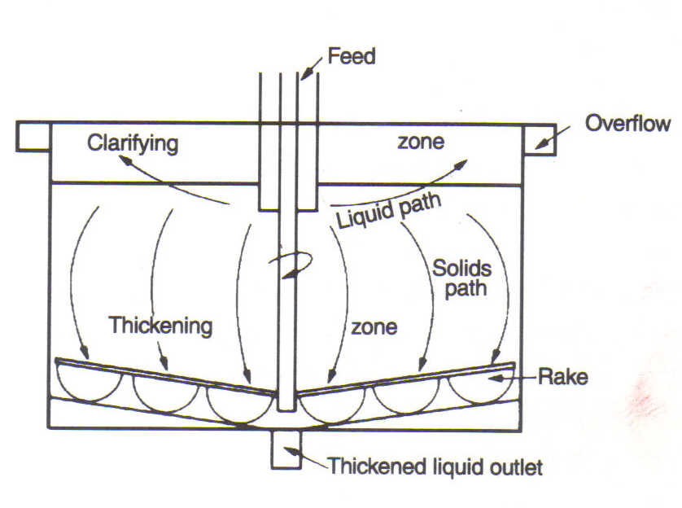
Figure 4 Flow in a continuous thickener

Slide 10
DEWATERING
Gravity Sedimentation
Within the tank is one or more rotating radial arms, from each of which are suspended a series of blades, shaped so as to rake the settled solids towards the central outlet.
On most modern thickeners these arms rise automatically if the torque exceeds a certain value, thus preventing damage due to overloading.
The blades also assist the compaction of the settled particles and produce a thicker underflow than can be achieved by simple settling.
Since capital is the major cost of thickening, selection of the correct size of thickener for a particular application is important.

Slide 11
DEWATERING
Gravity Sedimentation
Thickeners often incorporate substantial storage capacity so that, for instance, if the filtration section is shut down for maintenance, the concentrator can continue to feed material to the dewatering section.
During such periods the thickened underflow should be recirculated into the thickener feed-well.
At no time should the underflow cease to be pumped, as chokage of the discharge cone rapidly occurs.

Slide 12
DEWATERING
Gravity Sedimentation
The two primary functions of the thickener are the production of a clarified overflow and a thickened underflow of the required concentration.
For a given throughput the clarifying capacity is determined by the thickener diameter, since the surface area must be large enough so that the upward velocity of liquid is at all times lower than the settling velocity of the lowest-settling particle which is to be recovered.
The degree of thickening produced is controlled by the residence time of the particles and hence by the thickener depth.

Slide 13
DEWATERING
Gravity Sedimentation
The solids concentration in a thickener varies from that of the clear overflow to that of the thickened underflow being discharged.
Although the variation in concentration is continuous, the concentrations at various depths may be grouped into four zones, as shown in Fig. 5.
When materials settle with a definite interface between the suspension and the clear liquid, as is the case with most flocculated mineral pulps, the solids-handling capacity determines the surface area.

Slide 14
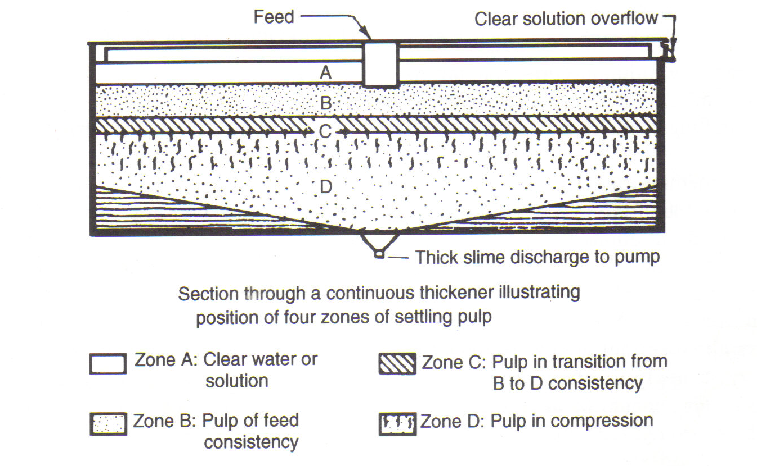
Figure 5 Concentration zones in a thickener

Slide 15
DEWATERING
Gravity Sedimentation
Solids-handling capacity is defined as the capacity of a material of given dilution to reach a condition such that the mass rate of solids leaving a region is equal to or greater than the mass rate of solids entering the region.
The attainment of this condition with a specific dilution depends on the mass subsidence rate being equal to or greater than the corresponding rise rate of displaced liquid.

Slide 16
DEWATERING
Gravity Sedimentation
The satisfactory operation of the thickener as a clarifier depends upon the existence of a clear-liquid overflow at the top.
If the clarification zone is too shallow, some of the smaller particles may escape in the overflow.
The volumetric rate of flow upwards is equal to the difference between the rate of feed of liquid and the rate of removal in the underflow.
Hence the required concentration of solids in the underflow, as well as the throughput, determines the conditions in the clarification zone.

Slide 17
DEWATERING
Filtration
Filtration is the process of separating solids from liquid by means of a porous medium, which retains the solid but allows the liquid to pass.
The conditions under which filtration are carried out are many and varied and the choice of the most suitable type of equipment will depend on a large number of factors.
Whatever type of equipment is used, a filter cake gradually builds up on the medium and the resistance to flow progressively increases throughout the operation.

Slide 18
DEWATERING
Filtration
Factors affecting the rate of filtration include:
The pressure drops from the feed to the far side of the filter medium. This is achieved in pressure filters by applying a positive pressure at the feed end and in vacuum filters by applying a vacuum to the far side of the medium, the feed side being at atmospheric pressure.
The area of the filtering surface.
The viscosity of the filtrate.
The resistance of the filter cake.
The resistance of the filter medium and initial layers of cake.

Slide 19
DEWATERING
Filtration
Filtration in mineral processing applications normally follows thickening.
The thickened pulp may be fed to storage agitators from where it is drawn off at uniform rate to the filters.
Flocculants are sometimes added to the agitators in order to aid filtration.
Slimes have an adverse effect on filtration, as they tend to “blind” the filter medium; flocculation reduces this and increases the voidage between particles, making filtrate flow easier.

Slide 20
DEWATERING
Filtration
The lower molecular weight flocculants tend to be used in filtration, as the flocs formed by high molecular weight products are relatively large, and entrain water within the structure, increasing the moisture content of the cake, even though pick-up may be improved.
Smaller flocs are formed with the lower molecular weight flocculants, which have a higher shear resistance, and the resultant filter cake is a uniform porous structure which allows rapid dewatering, yet prevents migration of the finer particles through the cake to the medium.

Slide 21
DEWATERING
Filtration
The choice of the filter medium is often the most important consideration in assuring efficient operation of the filter.
Its function is generally to act as a support for the filter cake, while the initial layers of the cake provide the true filter.
The filter medium should be selected primarily for its ability to retain solids without blinding.
It should be mechanically strong, corrosion resistant, and offer as little resistance to flow of filtrate as possible.

Slide 22
DEWATERING
Filtration
Filter media are manufactured from cotton, wool, linen, jute, nylon, silk, glass fibre, porous carbon, metals rayon and other synthetics, and miscellaneous materials such as porous rubber.
Cotton fabrics are by far the most common types of medium, primarily because of their low initial cost and availability in a wide variety of weaves.

Slide 23
DEWATERING
Types of Filter
Cake filters are the types most frequently used in mineral processing, where the recovery of large amounts of solids from fairly concentrated slurries is the main requirement.
Those where the main requirement is the removal of small amounts of solids from relatively dilute suspension are known as screening or clarification filters.
Cake filters may be pressure, vacuum, batch, or continuous types.

Slide 24
DEWATERING
Pressure Filters
Because of the virtual incompressibility of solids, filtration under pressure has certain advantages over vacuum.
Higher flow rates and better washing and drying may result from the higher pressures that can be used.
However, the continuous removal of solids from the pressure-filter chamber can be extremely difficult and consequently, although continuous pressure filters do exist, the vast majority operate as batch units.

Slide 25
DEWATERING
Pressure Filters
Filter presses are the most frequently used types of pressure filter.
They are made in two forms – the plate and frame press and the recessed plate or chamber press.
The plate and frame press (Fig. 6) consists of plates and frames arranged alternately.
The hollow frame is separated from the plate by the filter cloth.
The filter press is closed by means of a screw or hydraulic piston device and compression of the filter cloth between plates and frames helps to prevent leakages.
A tight chamber is therefore formed between each pair of plates.

Slide 26
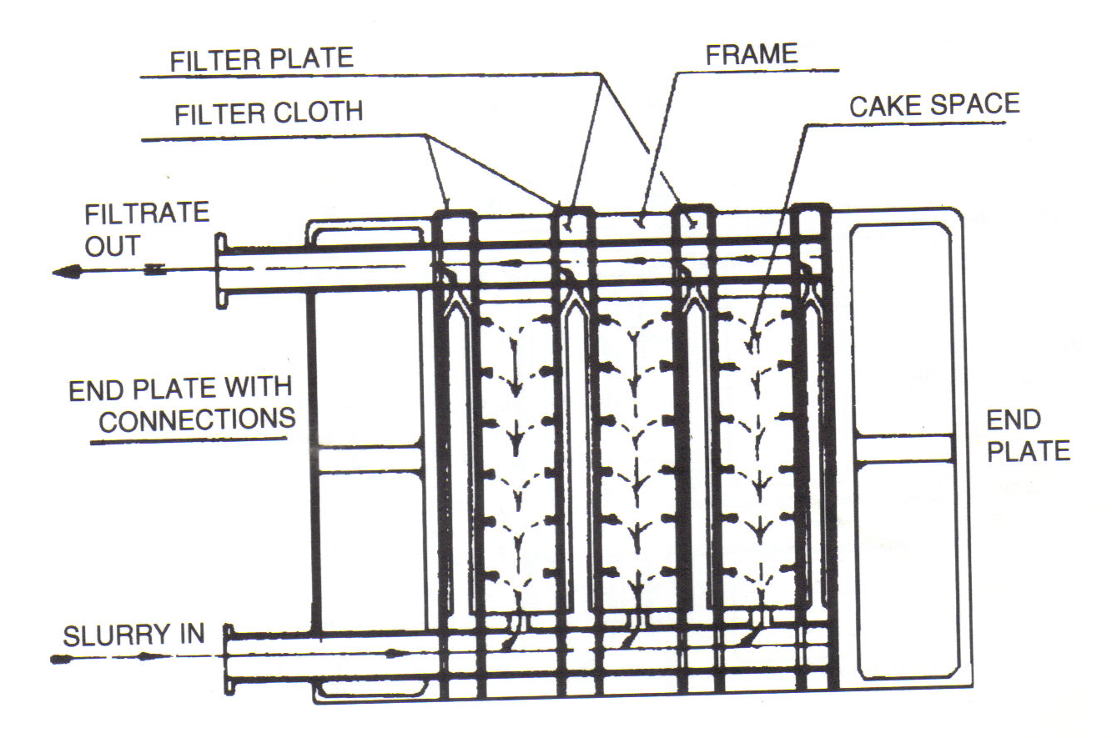
Figure 6 Plate and frame filter press

Slide 27
DEWATERING
Pressure Filters
The slurry is introduced to the empty frames of the press through a continuous channel formed by the holes in the corners of the plates and frames.
The filtrate passes through the cloth and runs down the grooved surfaces of the plates and is removed through a continuous channel.
The cake remains in the frame and, when the frame is full, the filter cake can be washed, after which the pressure is released and the plates and frames separated one by one.

Slide 28
DEWATERING
Pressure Filters
The filter cake in the frames can then be discharged, the filter press closed again and the cycle repeated.
The chamber press (Fig. 7) is similar to the plate and frame type except for the fact that the filter elements consist solely of the recessed filter plates.

Slide 29
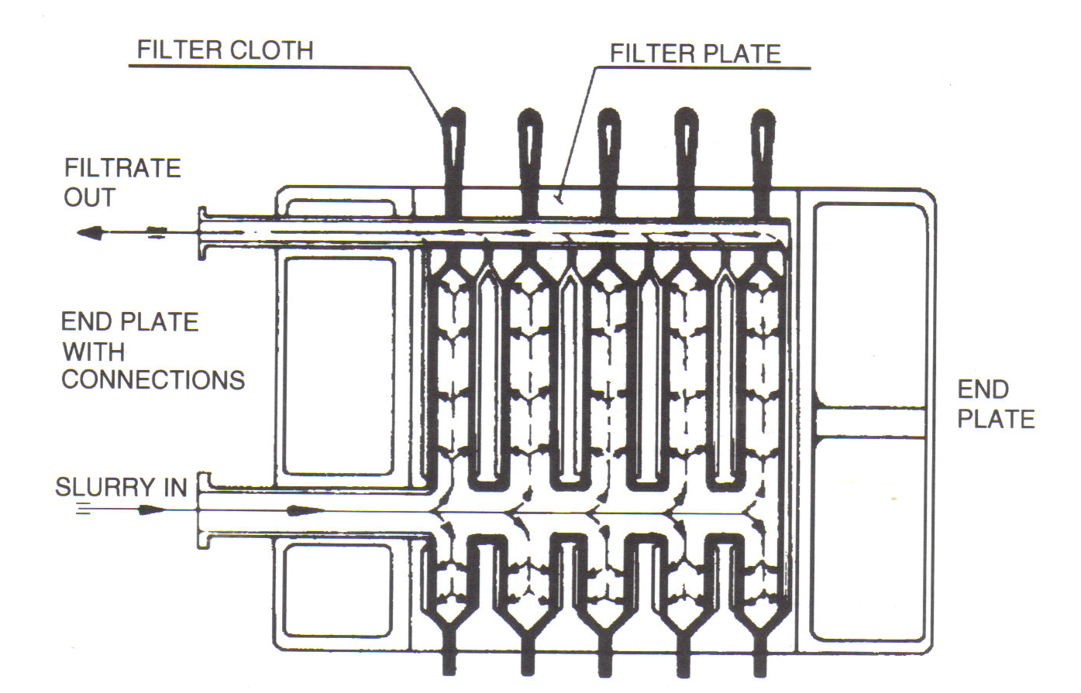
Figure 7 Chamber or recessed plate filter press

Slide 30
DEWATERING
Vacuum Filters
There are many different types of vacuum filter, but they all incorporate filter media suitably supported on a drainage system, beneath which the pressure is reduced by connection to a vacuum system.
Batch vacuum filters - The leaf filter has a number of leaves, each consisting of a metal framework or a grooved plate over which the filter cloth is fixed (Fig. 8).
Numerous holes are drilled in the pipe framework, so that when a vacuum is applied, a filter cake builds up on both sides of the leaf.

Slide 31
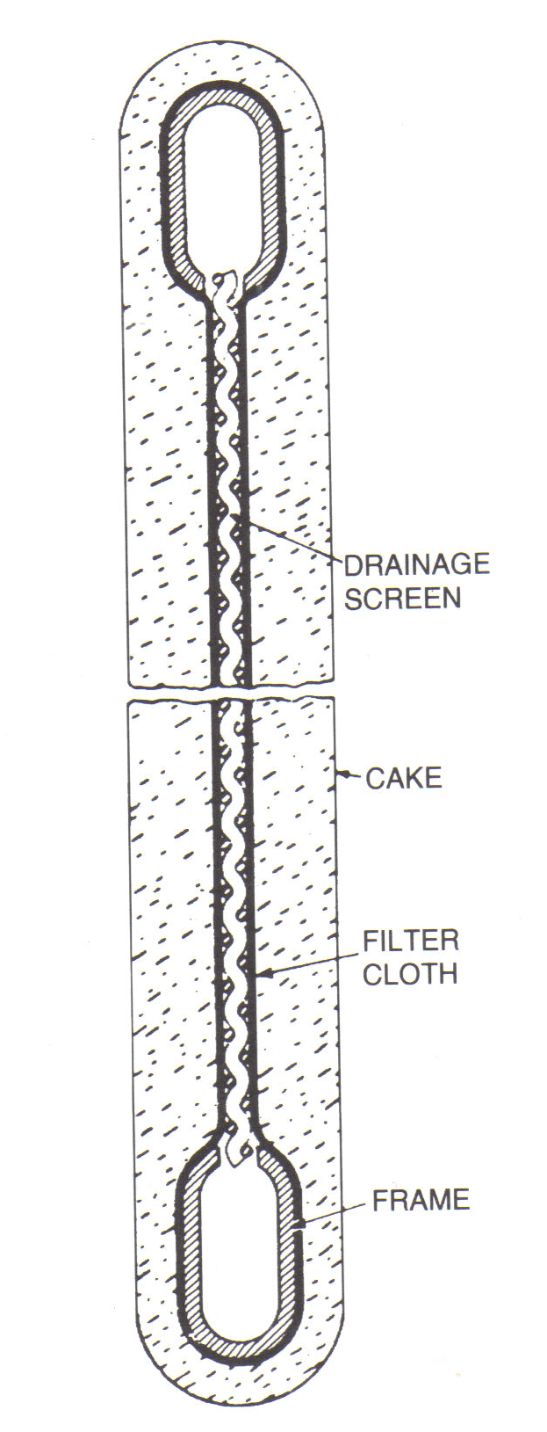
Figure 8 Cross-section of typical leaf filter

Slide 32
DEWATERING
Vacuum Filters
A number of leaves are generally connected and are first immersed in slurry held in a filter feed tank and then to a cake-receiving vessel where the cake is removed by replacing the vacuum by air pressure (Fig. 9).
Although simple to operate, these filters require considerable floor space and suffer from the possibility of sections of cake dropping from the leaves during transport from tank to tank.
They are now used for clarification, i.e. the removal of small amounts of suspended solids from liquors.

Slide 33
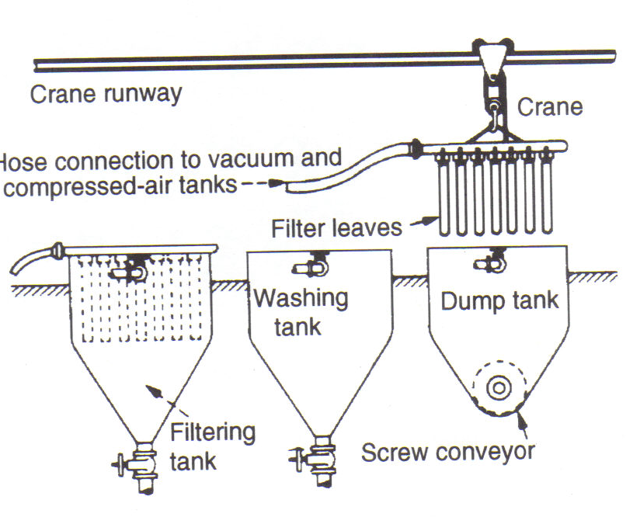
Figure 9 Typical leaf filter circuit

Slide 34
DEWATERING
Vacuum Filters
Continuous vacuum filters - These are the most widely used filters in mineral processing applications and fall into three classes – drums, discs, and horizontal filters.
The rotary-drum filter (Fig. 10) is the most widely used type in industry, finding application both where cake washing is required and where it is unnecessary.
The drum is mounted horizontally and is partially submerged in the filter trough, into which the feed slurry is fed and maintained in suspension by agitators.

Slide 35
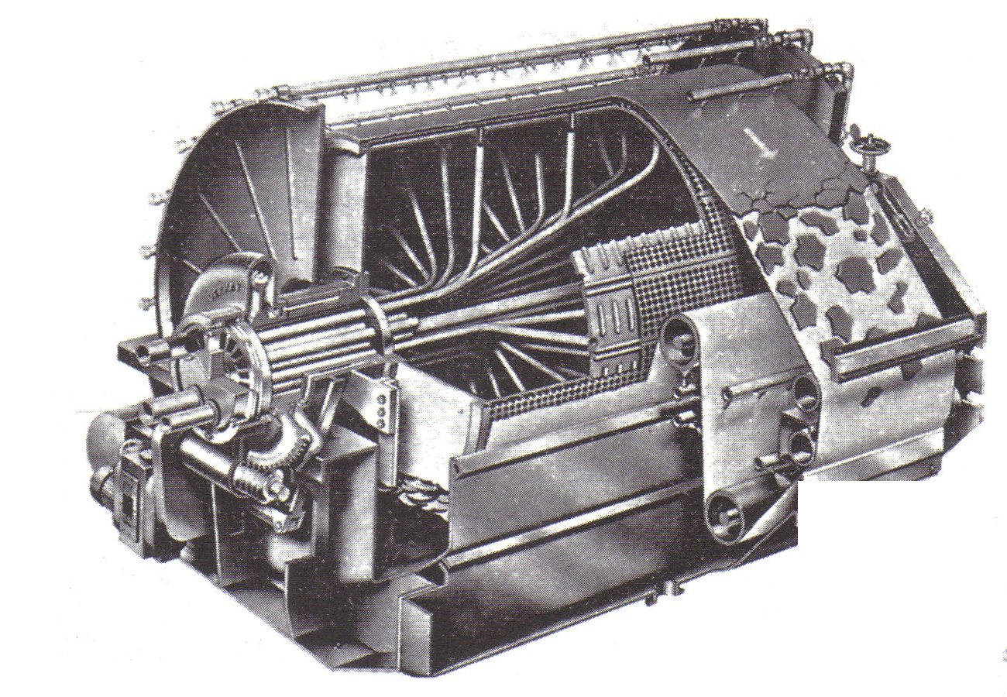
Figure 10 Rotary-drum filter with belt discharge

Slide 36
DEWATERING
Vacuum Filters
The periphery of the drum is divided into compartments, each of which is provided with a number of drain lines, which pass through the inside of the drum, terminating at one end as a ring of ports which are covered by a rotary valve to which vacuum is applied.
As the drum rotates, each compartment goes through the same cycle of operations, the duration of each being determined by the drum speed, the depth of submergence of the drum, and the arrangement of the valve.

Slide 37
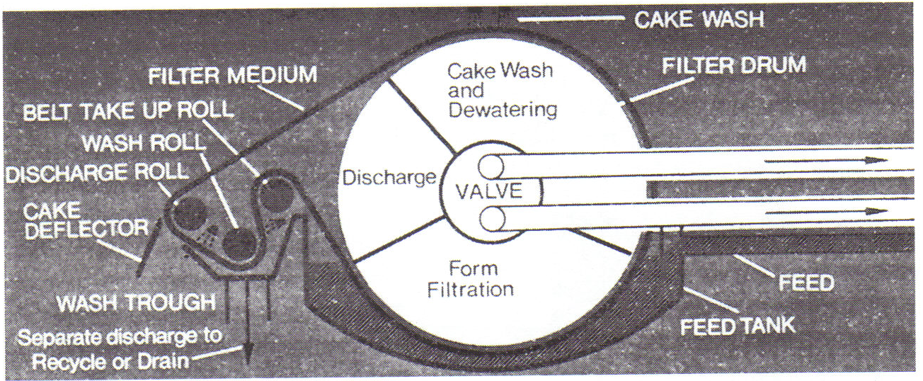
Figure 11 Belt discharge with cloth washing

Slide 38
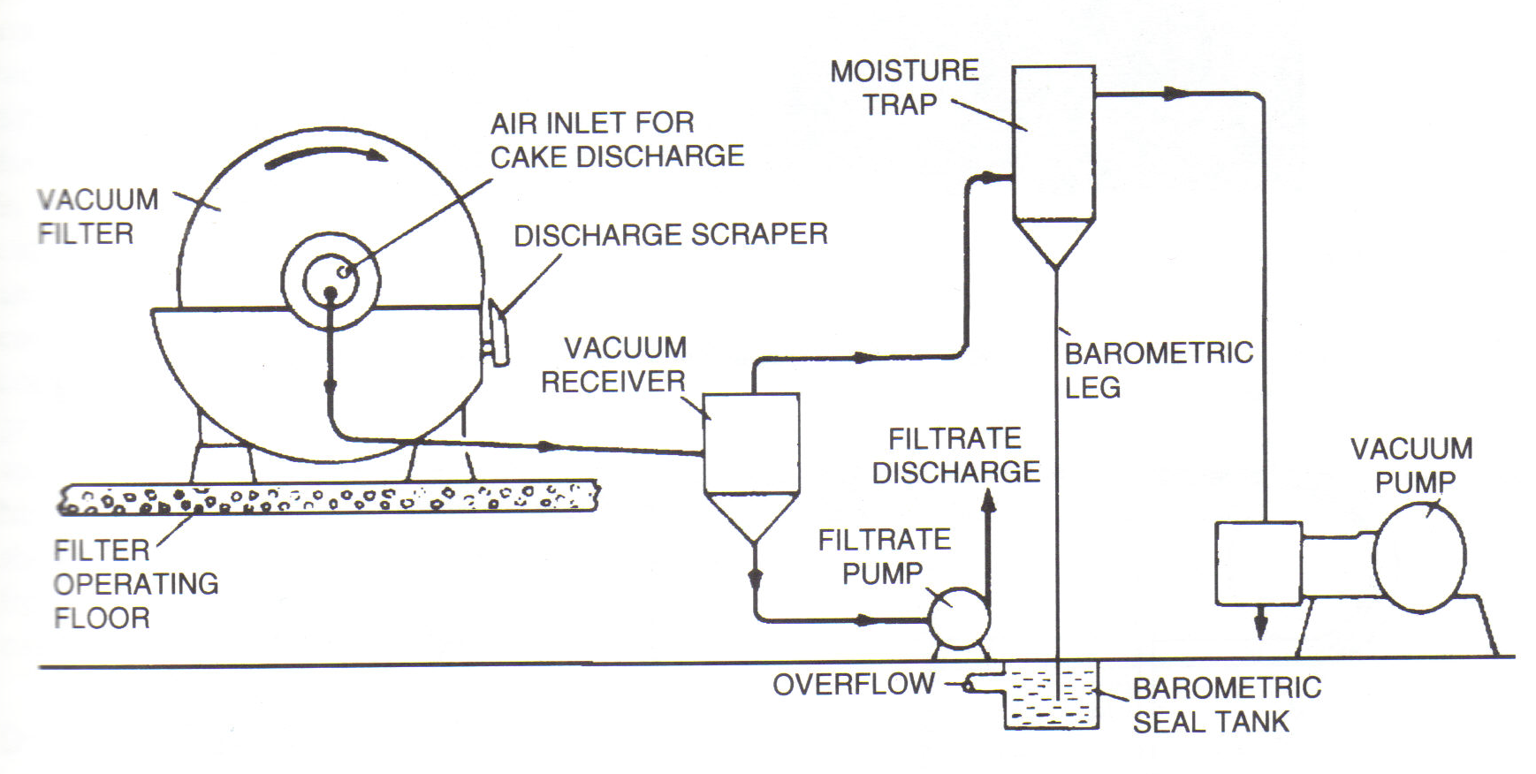
Figure 12 Typical rotary-drum filter system

Slide 39
DEWATERING
Vacuum Filters
The normal cycle of operations consists of filtration, drying and discharge, but it is possible to introduce other operations into the basic cycle, such as cake washing and cloth cleaning.
The principle of operation of disc filters (Fig. 13) is similar to that of rotary drum filters.
The solids cake is formed on both sides of the circular discs, which are connected to the horizontal shaft of the machine.
The discs rotate and lift the cake above the level of the slurry in the trough, whereupon the cake is suction-dried and is then removed by a pulsating air blow with the assistance of a scraper.

Slide 40
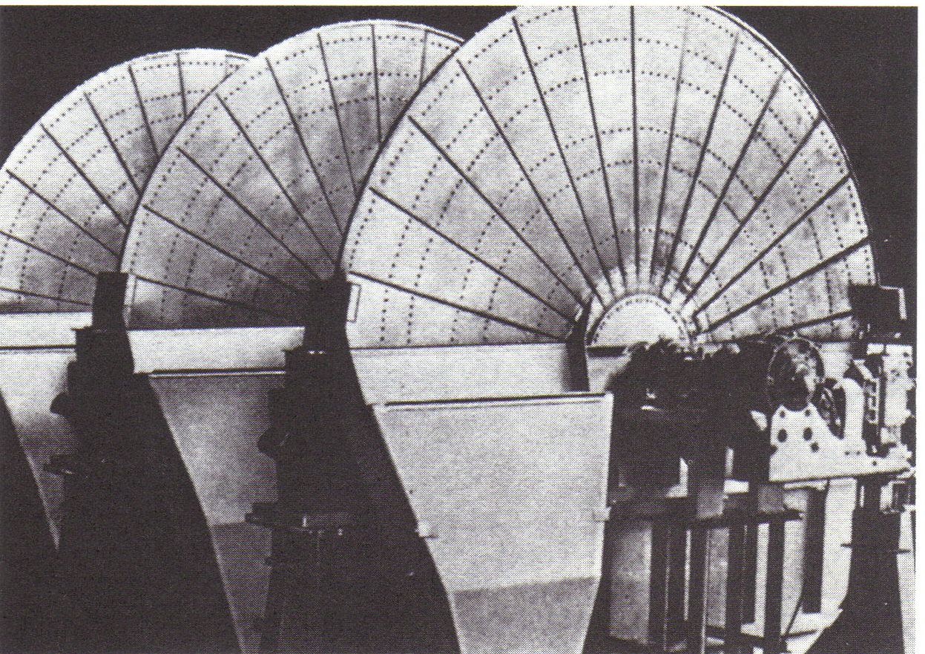
Figure 13 Rotary-disc filters

Slide 41
DEWATERING
Vacuum Filters
Cost per unit area is thus lower than for drum filters, but cake washing is virtually impossible and the disc filter is not as adaptable as a drum filter.
The horizontal belt filter (Fig. 14) consists of an endless perforated rubber drainage deck supporting a separate belt made from suitable filter cloth.
At the start of the horizontal travel, slurry flows by gravity on to the belt.
Filtration immediately commences, due partly to gravity and partly to the vacuum applied to the suction boxes which are in contact with the outside of the drainage deck during the course of its travel.

Slide 42
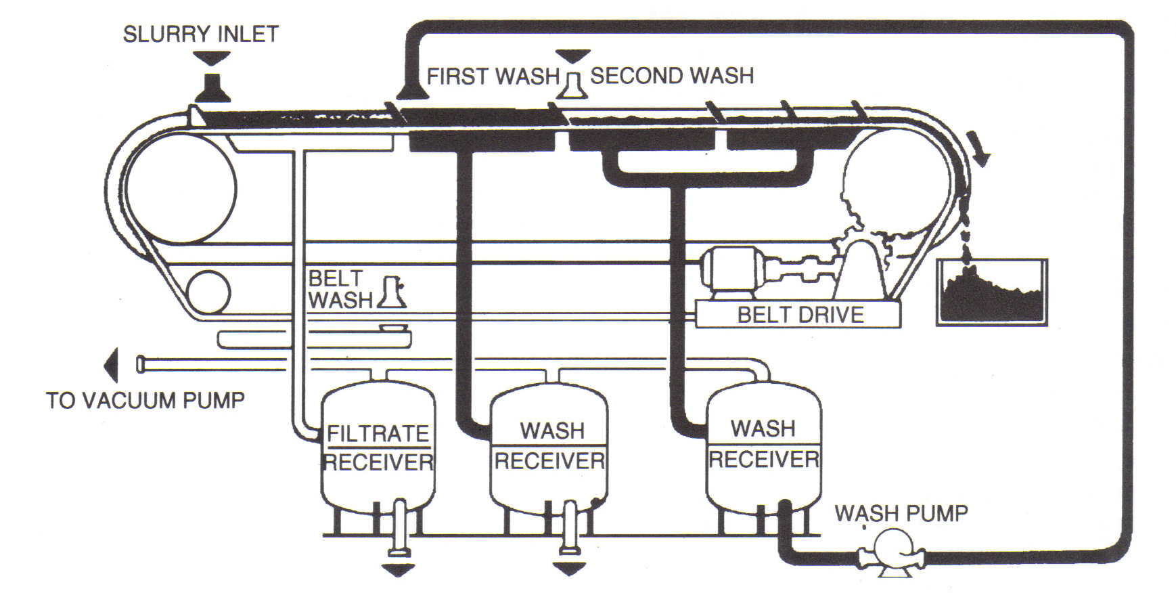
Figure 14 Horizontal belt filter

Slide 43
DEWATERING
Vacuum Filters
The cake which forms is dewatered, dried by drawing air through it, and then discharged as the belt reverses over a small-diameter roller.
If required one or more washes can be incorporated.
The applications for horizontal belt filters are increasing.
They are particularly suited to hydrometallurgical circuits where metal values are dissolved in alkali or acid.
These values can be recovered from waste solids by filtration of the leached slurry and countercurrent washing.

Slide 44
DEWATERING
Vacuum Filters
Belt filters are also suited for concentrated slurries of fast settling products, where efficient washing is required.
In addition to their low installed capital cost when compared with disc, drum, and press type filters, relatively low operating costs mean that these filters offer particularly cost-effective and reliable solution to filtration problems, especially with low-value material such as mine tailings.

Slide 45
DEWATERING
Drying
The drying of concentrates prior to shipping is the last operation performed in the mineral-processing plant.
It reduces the cost of transport and is usually aimed at reducing the moisture content to about 5% by weight.
Dust losses are often a problem if the moisture content is lower.
Rotary thermal dryers are often used.
These consist of a relatively long cylindrical shell mounted on rollers and driven at a speed of up to 25-rev min⁻¹.

Slide 46
DEWATERING
Drying
The shell is at a slight slope, so that material moves from the feed to discharge end under gravity.
Hot gases, or air, are fed in either at the feed end to give parallel flow or at the discharge to give counter-current flow.
The method of heating may be either direct, in which case the hot gases pass through the material in the dryer, or indirect, where the material is in an inner shell, heated externally by hot gases.
The direct-fired is the dryer most commonly used in the minerals industry, the indirect-fired type being used when the material must not contact the hot combustion gases.

Slide 47
DEWATERING
Drying
Parallel flow dryers (Figure 15) are used in the majority of current operations because they are more fuel-efficient and have greater capacity than counterflow types (Kram, 1980).
Since heat is applied at the feed end, build-up of wet feed is avoided, and in general these units are designed to dry material to not less than 1 % moisture.
The product from the dryers is often stockpiled, before being loaded on to trucks or railcars as required for shipment.
The containers may be closed, or the surface of the contents sprayed with skin-forming solution, in order to eliminate dust losses (Kolthammer, 1978).

Slide 48
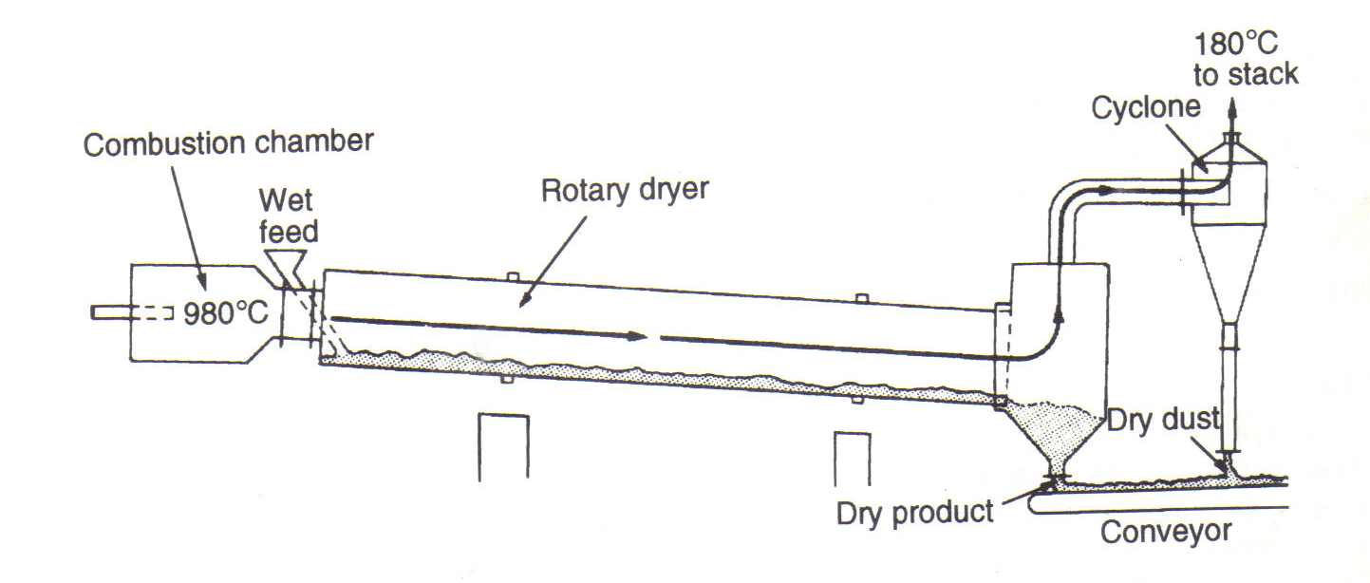
Figure 15 Direct fired, parallel flow rotary dryer

Slide 49
END

