Slide 1
CLASSIFICATION

Slide 2
CLASSIFICATION
Introduction
Classification is a method of separating mixtures of minerals into two or more products on the basis of the velocity with which the grains fall through a fluid medium.
In mineral processing, this is usually water, and wet classification is generally applied to mineral particles which are considered too fine to be sorted efficiently by screening.
Since the velocity of particles in a fluid medium is dependent not only on the size, but also on the specific gravity and shape of the particles, the principles of classification are important in mineral separations utilising gravity concentrators.

Slide 3
CLASSIFICATION
Principles of classification
When a solid particles falls freely in a vacuum, it is subjected to constant acceleration and its velocity increases indefinitely, being independent of size and density.
Thus a lump of lead and a feather fall at exactly the same rate.
In a viscous medium, such as air or water, there is resistance to this movement and the value increases with velocity.
When equilibrium is attained between the gravitational and fluid resistance forces, the body reaches its terminal velocity and thereafter falls at a uniform rate.
The nature of the resistance depends on the velocity of the descent.

Slide 4
CLASSIFICATION
Principles of classification
At low velocities motion is smooth because the layer of fluid in contact with the body moves with it, while the fluid a short distance away is motionless.
Between these two positions is a zone of intense shear in the fluid all around the descending particle.
Effectively all resistance to motion is due to the shear forces or viscosity of the fluid and s hence called viscous resistance.
At high velocities the main resistance is due to the displacement of fluid by the body, and viscous resistance is relatively small; this is known as turbulent resistance.

Slide 5
CLASSIFICATION
Principles of classification
Whether viscous or turbulent resistance predominates, the acceleration of particles in a fluid rapidly decreases and the terminal velocity is quickly reached.
Classifiers consist essentially of a sorting column in which a fluid is rising at a uniform rate (Figure 1).
Particles introduced into the sorting column either sink or rise according to whether their terminal velocities are greater or less than the upward velocity of the fluid.
The sorting column therefore separates the feed into two products – an overflow consisting of particles with terminal velocities less than the velocity of the fluid and an underflow or spigot product of particles with terminal velocities greater than the rising velocity.

Slide 6
Overflow (particles with terminal velocities < V
Fluid Velocity, V
Spigot product
(particles with terminal velocity > V
Figure 1 Classifier sorting column

Slide 7
CLASSIFICATION
Free Settling
Free settling refers to the sinking of particles in a volume of fluid which is large with respect to the total volume of particles, hence particle crowding is negligible.
For well-dispersed ore pulps, free settling predominates when the percentage of solids by weight is less than about 15 (Taggart, 1945).
Consider a spherical particle of diameter d and density Ds falling under gravity in a viscous fluid of density Df under free-settling conditions, i.e. Ideally in a fluid of infinite extent.
The particle is acted upon by three forces: a gravitational force acting downwards, an upward buoyant force due to the displaced fluid, and a drag force D acting upwards.

Slide 8
CLASSIFICATION
Free Settling
The equation of motion of the particle is
where m is the mass of the particle, m’ is the mass of the displaced fluid, x is the particle velocity, and g is the acceleration due to gravity.
When the terminal velocity is reached,

Slide 9
CLASSIFICATION
Free Settling
Stokes (1891) assumed the drag force on a spherical particle to be entirely due to viscous resistance and deduced the expression
where η is the fluid viscosity and ν is the terminal velocity.
Hence, substituting in equation 2,

Slide 10
CLASSIFICATION
Free Settling
This expression is known as Stokes’ law.
Newton assumed that the drag force was entirely due to turbulent resistance, and deduced:
Substituting in equation 2 gives
This is Newton’s law for turbulent resistance.

Slide 11
CLASSIFICATION
Free Settling
Stokes’ law s valid for particles below about 50 μm in diameter.
Newton’s law holds for particles larger than about 0.5 cm in diameter.
There is therefore, an intermediate range of particle size, which corresponds to the range in which most wet classification is performed, in which neither law fits experimental data.
Stokes’ law (4) for a particular fluid can be simplified to

Slide 12
CLASSIFICATION
Free Settling
and Newton’s law (6) can be simplified to
Where k₁ and k₂ are constants, and (Ds – Df) is known as the effective density of a particle of density Ds in a fluid of density Df.
Both laws show that the terminal velocity of a particles in a particular fluid is a function only of the particle size and density.

Slide 13
CLASSIFICATION
Free Settling
It can be seen that:
If two particles have the same density then the particle with the larger diameter has the higher terminal velocity.
If two particles have the same diameter, then the heavier particle has the higher terminal velocity.
Consider two mineral particles of densities Da and Db and diameters da and db respectively, falling in a fluid of density Df, at exactly the same settling rate.
Their terminal velocity must be the same, and hence from Stokes’ law (7):

Slide 14
CLASSIFICATION
Free Settling
This expression is known as the free-settling ratio of two minerals, i.e. The ratio of particle size required for the two minerals to fall at equal rates.
Similarly from Newton’s law (8), the free settling ratio of large particles is

Slide 15
CLASSIFICATION
Free Settling
Consider a mixture of galena (density 7.5) and quartz (density 2.65) particles classifying in water.
For small particles, obeying Stokes’ law, the free settling ratio (equation 9) is
i.e. a small particle of galena will settle at the same rate as a small particle of quartz which has a diameter 1.99 times as large.
For particles obeying Newton’s law, the free settling ratio (equation 10) is

Slide 16
CLASSIFICATION
Free Settling
The free-settling ratio is therefore larger for coarse particles obeying Newton’s law than for fine particles obeying Stokes’ law.
This means that the density difference between the particles has a more pronounced effect on classification at coarser size ranges.
This is important where gravity concentration is being utilised.
Overgrinding of the ore must be avoided, such that particles are fed to the separator in as coarse a state as possible, so that a rapid separation can be made.
The enhanced gravity effect does, however, mean that fine heavy minerals are more likely to be overground in conventional ball mill-classifier circuits, so it is preferable where possible to use rod mills for the primary coarse grind.

Slide 17
CLASSIFICATION
Free Settling
The general expression for free-settling ratio can be made from equations 9 and 10 as
where n = 0.5 for small particles obeying Stokes’ law and n = 1 for large particles obeying Newton’s law.
The value of n lies in the range 0.5-1 for particles in the intermediate size range of 50 μm-0.5 cm.

Slide 18
CLASSIFICATION
Hindered Settling
As the proportion of solids in the pulp increases, the effect of particle crowding becomes more apparent and the falling rate of the particles begin to decease.
The system begins to behave as a heavy liquid whose density is that of the pulp rather than that of the carrier liquid; hindered-settling conditions now prevail.
Because of the high density and viscosity of the slurry through which a particle must fall in a separation by hindered settling, the resistance to fall is mainly due to the turbulence created, and a modified form of Newton’s law (8) can be used to determine the approximate falling rate of the particles:

Slide 19
CLASSIFICATION
Hindered Settling
where Dp is the pulp density.
The lower the density of the particle, the more marked is the effect of reduction of the effective density, Ds – Dp, and the greater is the reduction in falling velocity.
Similarly, the larger the particle, the greater is the reduction in falling rate as the pulp density increases.
This is important in classifier design; in effect, hindered-settling reduces the effect of size, while increasing the effect of density on classification.

Slide 20
CLASSIFICATION
Hindered Settling
This can be illustrated by considering a mixture of quartz and galena particles settling in a pulp of density 1.5.
The hindered-settling ratio can be derived from equation 12 as
A particle of galena will thus fall in the pulp at the same rate as a particle of quartz which has a diameter 5.22 times as large.
This compares with the free-settling ratio, calculated as 3.94 for turbulent resistance.

Slide 21
CLASSIFICATION
Hindered Settling
The hindered-settling ratio is always greater than the free-settling ratio, and the denser the pulp, the greater is the ratio of the diameter of equal settling particles.
For quartz and galena, the greatest hindered-settling ratio that we can attain practically is about 7.5.
Hindered-settling classifiers are used to increase the effect of density on the separation, whereas free-settling classifiers use relatively dilute suspensions to increase the effect of size on the separation (Figure 2)

Slide 22
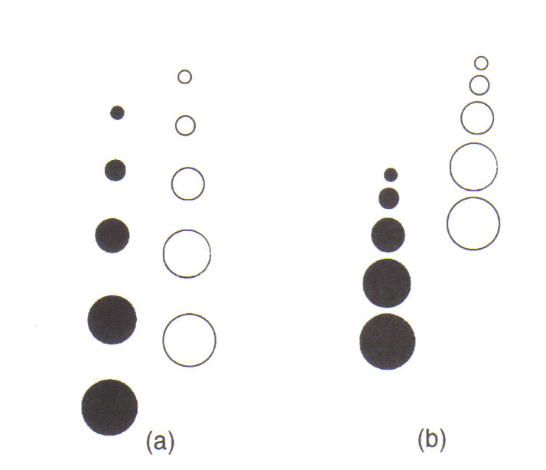
Figure 2 Classification by (a) free settling, (b) hindered settling

Slide 23
CLASSIFICATION
Types of Classifier
Many different types of classifier have been designed and built.
They may be grouped, however, into two broad classes depending on the direction of flow of the carrying current.
Horizontal current classifiers such as mechanical classifiers are essentially of the free-settling type and accentuate the sizing function.
Vertical current or hydraulic classifiers are usually hindered-settling types and so increase the effect of density on the separation.

Slide 24
CLASSIFICATION
Types of Classifier
Classifiers used for industrial sizing of fine particles, such as in grinding circuits, are classed in three main groups:
hydraulic classifiers;
mechanical classifiers;
hydrocyclones.

Slide 25
CLASSIFICATION
Types of Classifier
Hydraulic classifiers
These are vessels with ‘sorting columns’ in which the particles are made to settle against a rising current of water.
They give a sharp size separation, but their capacity is low and they use much water.
They are characterised by the use of water additional to that of the feed pulp, introduced so that its direction of flow opposes that of the settling particles.
They normally consists of a series of sorting columns through each of which a vertical current of water is rising and particles are settling out (Figure 3).

Slide 26
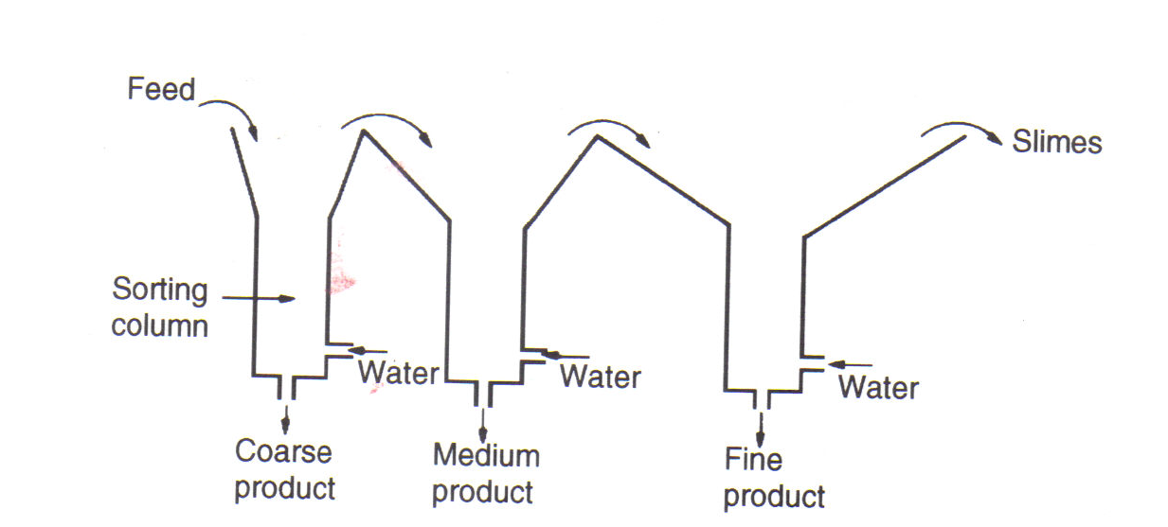
Figure 3 Principle of hydraulic classifier

Slide 27
CLASSIFICATION
Types of Classifier
Hydraulic classifiers
The rising currents are graded from a relatively high velocity in the first sorting column, to a relatively low velocity in the last, so that a series of spigot products can be obtained, with coarser, denser particles in the first spigot and the fines in the latter spigots.
The size of each successive vessel is increased, partly because the amount of liquid to be handled includes all the water used for classifying in the previous vessels and partly because it is desired to reduce, in stages the surface velocity of the fluid flowing from one vessel to the next.

Slide 28
CLASSIFICATION
Types of Classifier
Hydraulic classifiers
The greatest use for hydraulic classifiers in the mineral industry is for sorting the feed to certain gravity concentration processes.
Since the ratio of sizes of equally settling particles is high, the classifier is capable of performing a concentrating effect, and the first spigot product is normally of higher grade than the other products (Fig. 4).

Slide 29
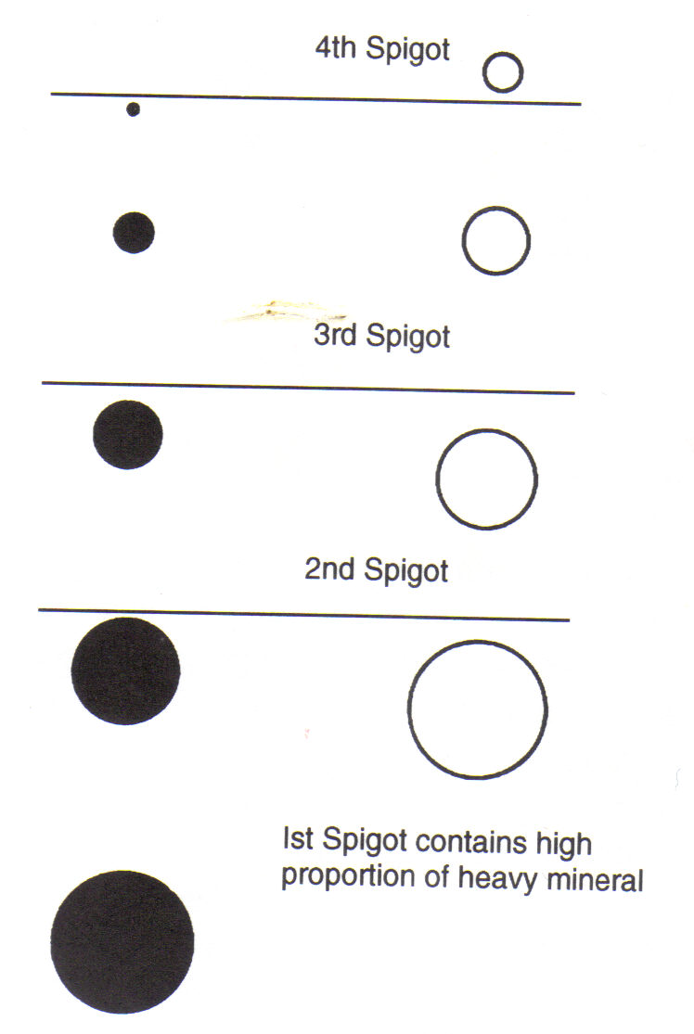
Figure 4 Added increment of hindered-settling classifier

Slide 30
CLASSIFICATION
Types of Classifier
The Hydrocyclone
This is a continuously operating classifying device that utilises centrifugal force to accelerate the settling rate of particles.
It is one of the most important devices in the mineral industry (Pearse, 1988), its main use in mineral processing being as a classifier, which has proved extremely efficient at fine separation sizes.
It is widely used in closed circuit grinding operations ( Barber et al, 1980) but has found many other uses, such as de-sliming, and thickening.

Slide 31
CLASSIFICATION
Types of Classifier
The Hydrocyclone
A typical hydrocyclone (Fig. 12) consists of a conically shaped vessel, open at its apex, or underflow, joined to a cylindrical section, which has a tangential feed inlet.
The top of the cylindrical section is closed with a plate through which passes an axially mounted overflow pipe.
The pipe is extended into the body of the cyclone by a short, removable section known as the vortex finder, which prevents short-circuiting of feed directly into the overflow.

Slide 32
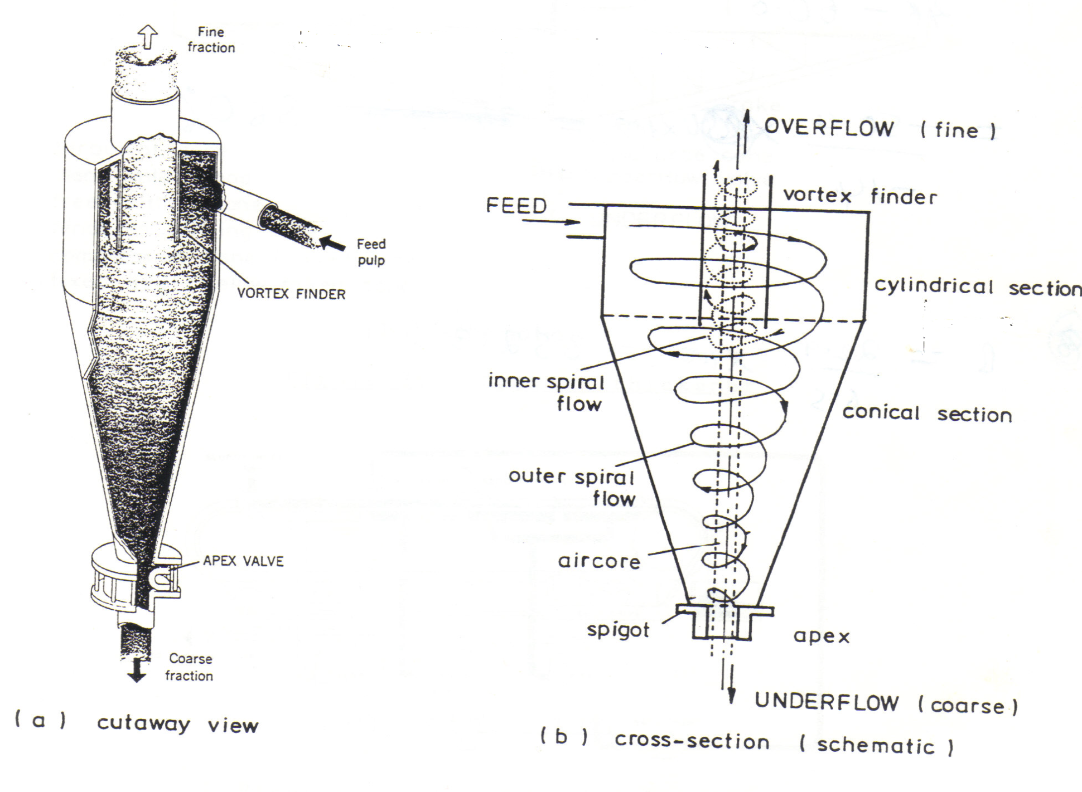
Figure 12: Hydrocyclone

Slide 33
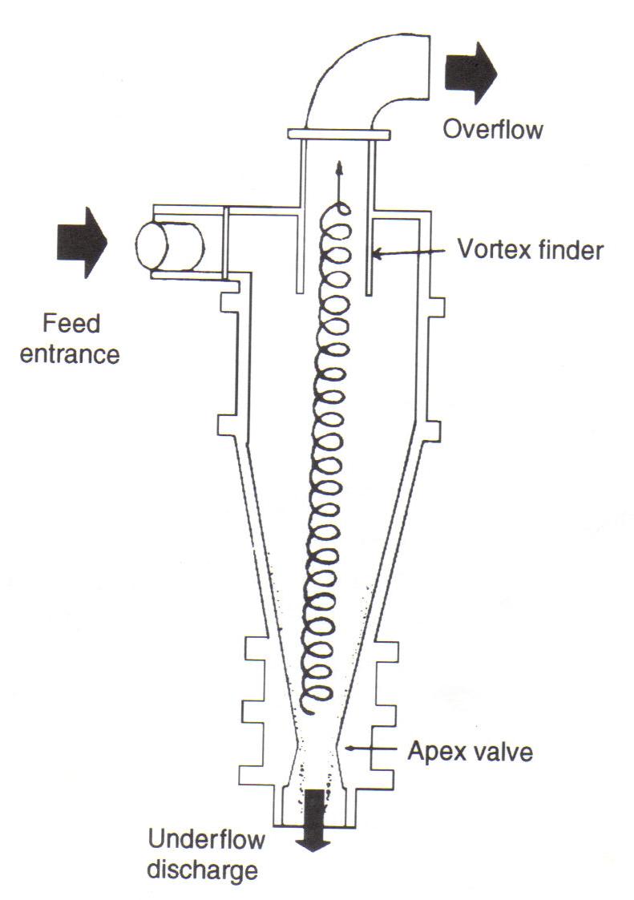
Figure 12 Hydrocyclone

Slide 34
CLASSIFICATION
Types of Classifier
The Hydrocyclone
The feed is introduced under pressure through the tangential entry which imparts a swirling motion to the pulp.
This generates a vortex in the cyclone, with a low-pressure zone along the vertical axis.
An air core develops along the axis, normally connected to the atmosphere through the apex opening, but in part created by dissolved air coming out of solution in the zone of low pressure.

Slide 35
CLASSIFICATION
Types of Classifier
The Hydrocyclone
The classical theory of hydrocyclone action is that particles within the flow pattern are subjected to two opposing forces – an outward centrifugal force and an inwardly acting drag (Fig. 13).
The centrifugal force developed accelerates the settling of the particles (there is evidence to show that Stokes’ law applies with reasonable accuracy to separations in cyclones of conventional design), thereby separating the particles according to size and specific gravity.
Faster settling particles move to the wall of the cyclone, where the velocity is lowest, and migrate to the apex opening.

Slide 36
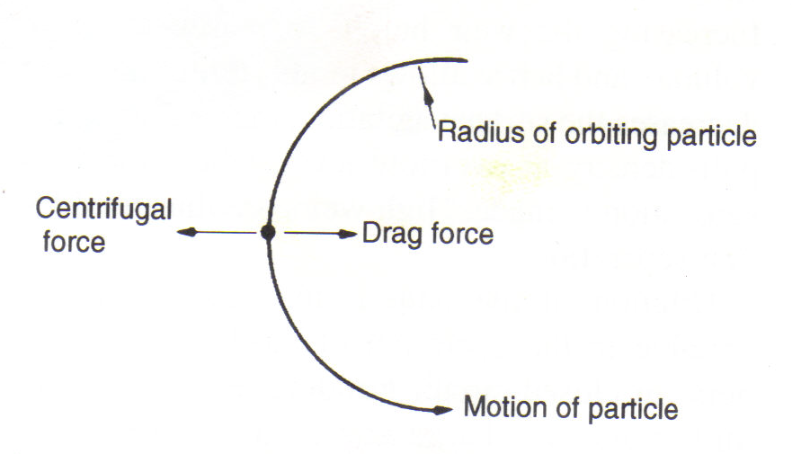
Figure 13 Forces acting on an orbiting particle in the hydrocyclone

Slide 37
CLASSIFICATION
Types of Classifier
The Hydrocyclone
Due to the action of the drag force, the slower-settling particles move towards the zone of low pressure along the axis and are carried upward through the vortex finder to the overflow.
The existence of an outer region of downward flow and an inner region of upward flow necessitates a position at which there is no vertical velocity.
This applies throughout the greater part of the cyclone body, and an envelope of zero vertical velocity should exist throughout the body of the cyclone (Fig. 14).
Particles thrown outside the envelope of zero vertical velocity exit via the underflow, while particles swept to the centre by the greater drag force leave in the overflow.

Slide 38
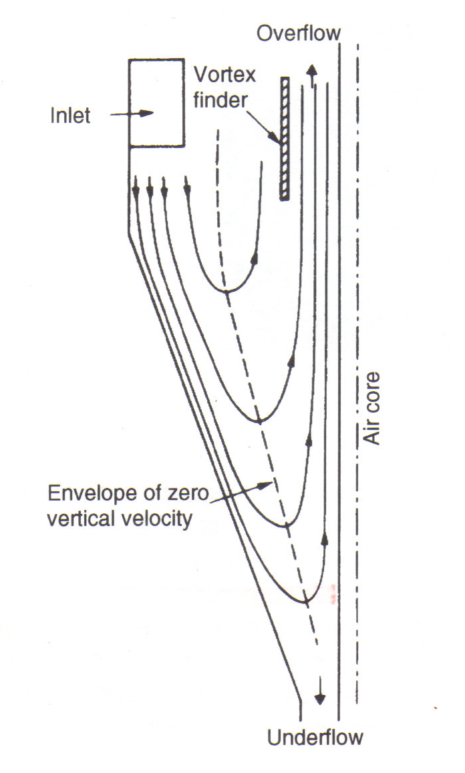
Figure 14 Distribution of vertical and radial components of velocity in a hydrocyclone

Slide 39
CLASSIFICATION
Types of Classifier
The Hydrocyclone
Hydrocyclones have replaced mechanical classifiers in most modern grinding plants (Fig. 15), as they are more efficient, especially in the finer size ranges, and they require less floor space.
Due to the relatively short residence time of particles within the cyclone, the ball mill circuit can rapidly be brought into balance if any changes are made and oxidation of particles within the circuit is reduced.
They are almost universally used for classification between 150 and 5 μm, although coarser separations are possible.

Slide 40
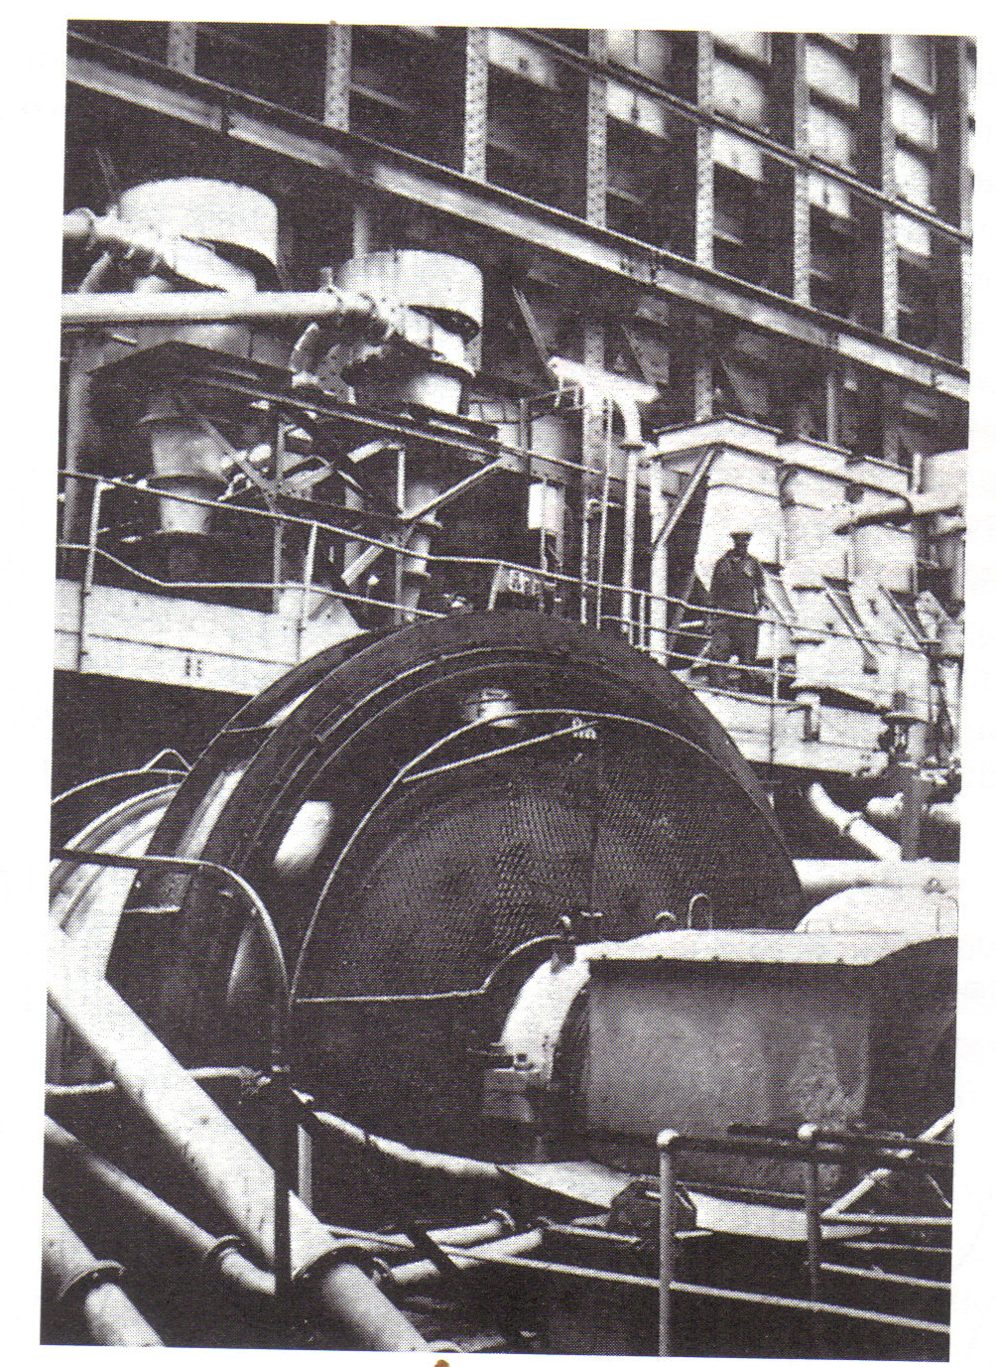
Figure 15 Ball mill in closed-circuit with hydrocyclone

Slide 41
CLASSIFICATION
Types of Classifier - The Hydrocyclone
Cyclone Efficiency
The commonest method of representing cyclone efficiency is by a performance or partition curve (Fig. 16), which relates the weight fraction, or percentage, of each particle size in the feed, which reports to the apex, or underflow, to the particle size.
The cut point, or separation size, of the cyclone is often defined as that point on the partition curve for which 50 % of particles in the feed of that size report to the underflow, i.e. particles of this size have an equal chance of going either with the overflow or underflow (Svarovsky, 1984).

Slide 42
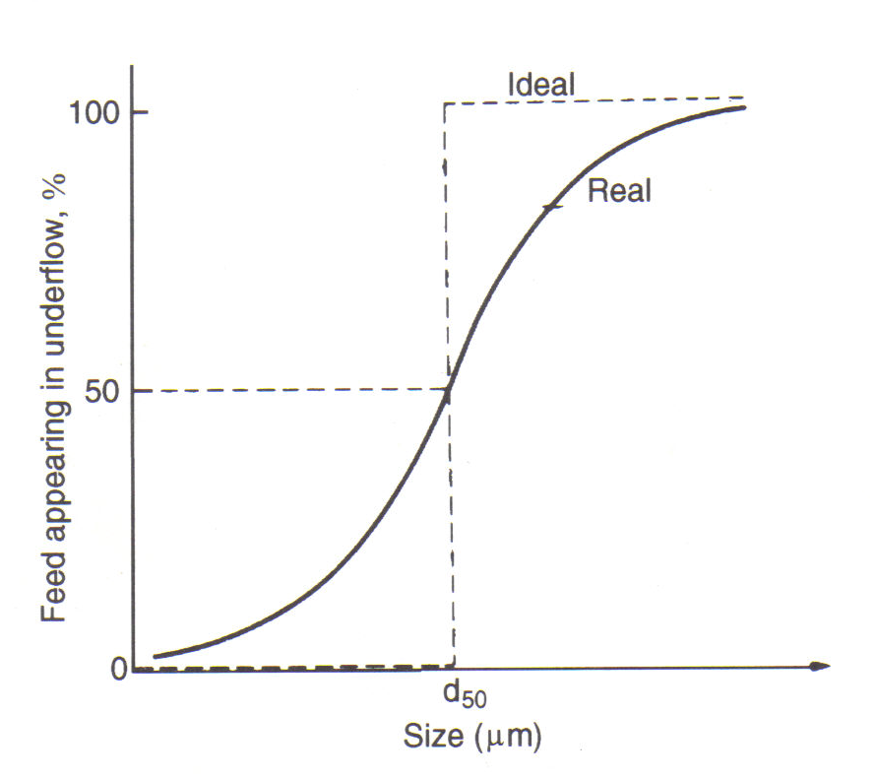
Figure 16 Partition curve for hydrocyclone

Slide 43
CLASSIFICATION
Types of Classifier - The Hydro cyclone
Cyclone Efficiency
This point is usually referred to as the d₅₀ size.
The sharpness of the cut depends on the slope of the central section of the partition curve; the closer to vertical is the slope, the higher is the efficiency.
The slope of the curve can be expressed by taking the points at which 75 % and 25 % of the feed particles report to the underflow.
These are the d₇₅ and d₂₅ sizes respectively. The efficiency of separation, or the so-called imperfection I, is then given by

Slide 44
END

