Slide 1
TAILINGS DISPOSAL

Slide 2
TAILINGS DISPOSAL
Introduction
The disposal of mill tailings is a major environmental problem, which2 is becoming more serious with the increasing exploration for metals and the working of lower-grade deposits.
Apart from the visual effect on the landscape of tailings disposal, the major ecological effect is usually water pollution, arising from the discharge of water contaminated with solids, heavy metals, mill reagents, sulphur compounds etc. (Chalkley et al, 1989).
The nature of tailings varies widely; they are usually transported and disposed of as slurry of high water content, but they may be composed of very coarse dry material, such as the float fraction from dense medium plants.

Slide 3
TAILINGS DISPOSAL
Methods of Disposal of Tailings
The methods used to dispose of tailings have developed due to environmental pressures, changing milling practice, and realisation of profitable applications.
Early methods included discharge of tailings into rivers and streams, which is still practised at some mines, and the dumping of coarse dewatered tailings on to land.

Slide 4
TAILINGS DISPOSAL
Tailings Dams
The design, construction, and operation of tailings dams is a major consideration for most new mining developments, as well as for many existing operations (Klohn, 1981; Vick, 1981).
It is economically advantageous to site the impoundment close to the mine, but this imposes limits on site selection.
The ground underlying the dam must be structurally sound and able to bear the weight of the impoundment.
If such a site cannot be found close to the mine, it may be necessary to pump the tailings, at a high slurry density, to a suitable location.

Slide 5
TAILINGS DISPOSAL
Tailings Dams
Tailings dams may be built across river valleys, or as curved or multi-sided dam walls on valley sides, this latter design facilitating drainage.
On flat, or gently sloping ground, lagoons are built with walls on all sides of the impoundment.
The disposal of tailings adds to the production costs, so it is essential to make disposal as cheap as possible.
This requirement led initially to the development of the once commonly used upstream method of tailings dam construction, so named because the centre line of the dam moves upstream into the pond.

Slide 6
TAILINGS DISPOSAL
Tailings Dams
In this method a small starter dam is placed at the extreme downstream point (Fig. 1) and the dam wall is progressively raised on the upstream side.
The tailings are discharged by spigoting off the top of the starter dyke and, when the initial pond is nearly filled, the dyke is raised and the cycle repeated.
Various methods are used to raise the dam;
Material may be taken from the dried surface of the previously deposited tailings and the cycle repeated, or more commonly the wall may be built from the coarse fraction of the tailings, separated out by cyclones, or spigots, the fines being directed into the pond (Figs. 2 and 3)

Slide 7
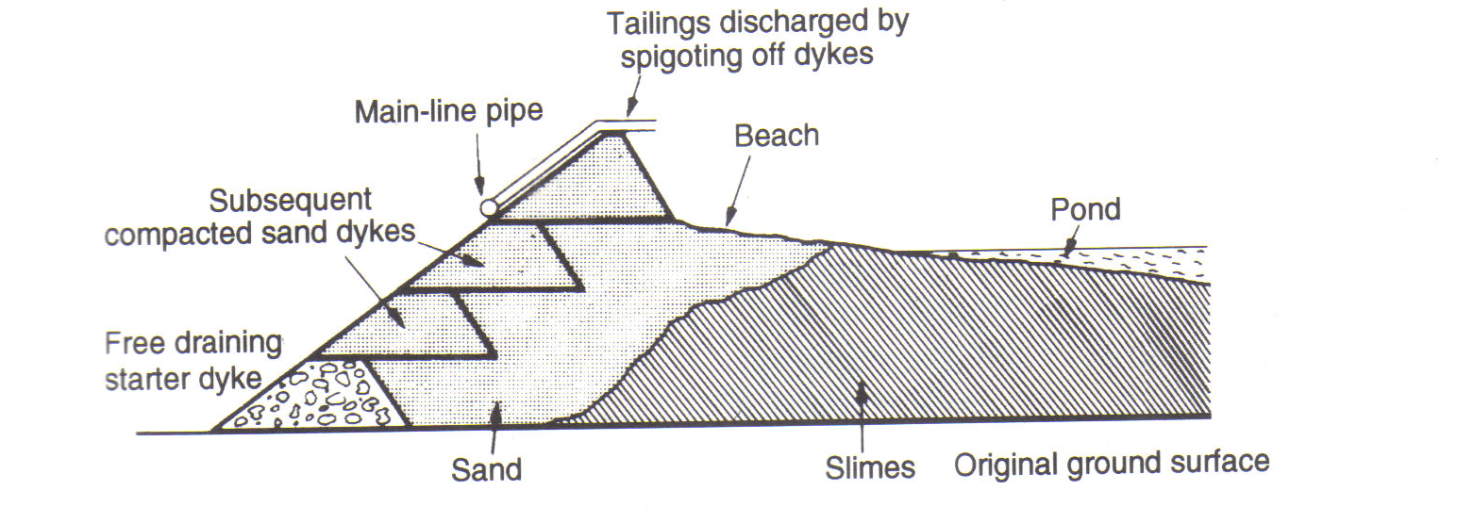
Figure 1: Upstream Tailings Dam

Slide 8
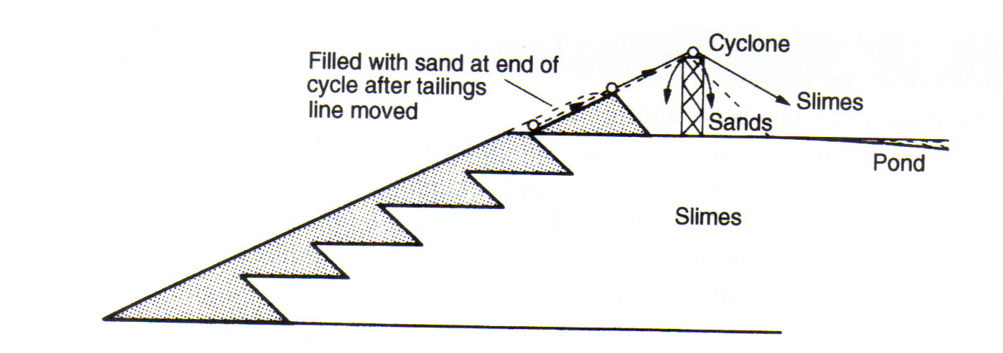
Figure 2: Construction of upstream tailings dam using cyclones

Slide 9
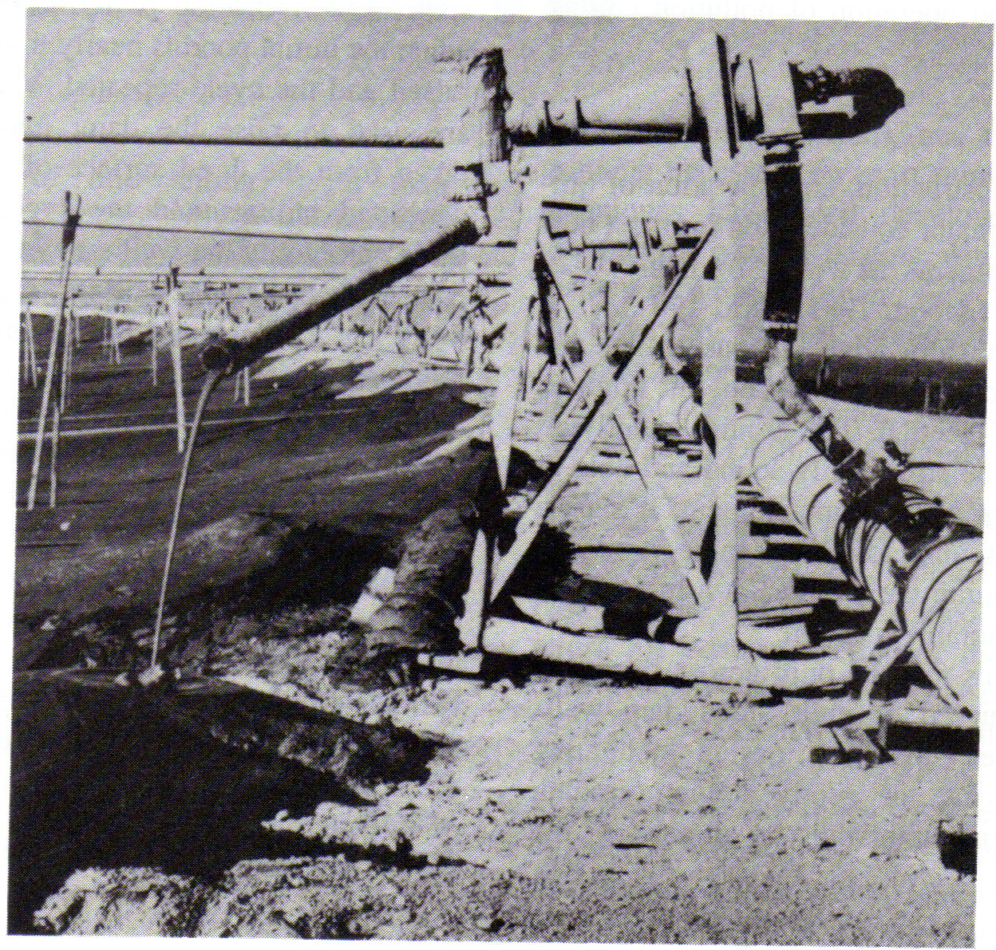
Figure 3: Construction of tailings dam wall utilising cyclone underflow

Slide 10
TAILINGS DISPOSAL
Tailings Dams
The main advantages of the upstream construction are the low cost and the speed with which the dam can be raised by each successive dyke increment.
The method suffers from the disadvantage that the dam wall is built on top of previously deposited unconsolidated slimes retained behind the wall.
There is a limiting height to which this type of dam can be built before failure occurs and the tailings flow out and, because of this, the upstream method of construction is now less commonly used.

Slide 11
TAILINGS DISPOSAL
Tailings Dams
The downstream method has evolved as a result of efforts to devise methods for constructing larger and safer tailings dams.
It is essentially the reverse of the upstream method, in that as the dam wall is raised, the centreline shifts downstream and the dam remains founded on coarse tailings (Fig. 4).
Most procedures involve the use of cyclones to produce sand for the dam construction.

Slide 12
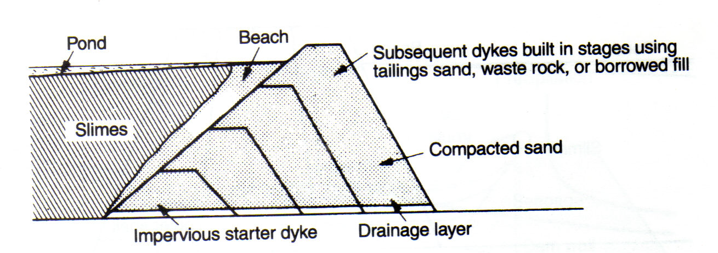
Figure 4: Downstream tailings Dam

Slide 13
TAILINGS DISPOSAL
Tailings Dams
Downstream dam building is the only method that permits design and construction of tailings dams to acceptable engineering standards.
All tailings dams in seismic areas, and all major dams, regardless of their location, should be constructed using some form of downstream method.
The major disadvantage of the technique is the large amount of sand required to raise the dam wall.
It may not be possible, especially in the early stages of operation, to produce sufficient sand volumes to maintain the crest of the tailings dam above the rising pond levels.

Slide 14
TAILINGS DISPOSAL
Tailings Dams
The centre-line method (Fig. 5) is a variation of that used to construct the downstream dam and the crest remains in the same horizontal position as the dam wall is raised.
It has the advantage of requiring smaller volumes of sand-fill to raise the crest to any given height.
The dam can thus be raised more quickly and there is less trouble keeping it ahead of the tailings pond during the early stages of construction.
Care, however, must be exercised in raising the upstream face of the dam to ensure that unstable slopes do not develop temporarily.

Slide 15
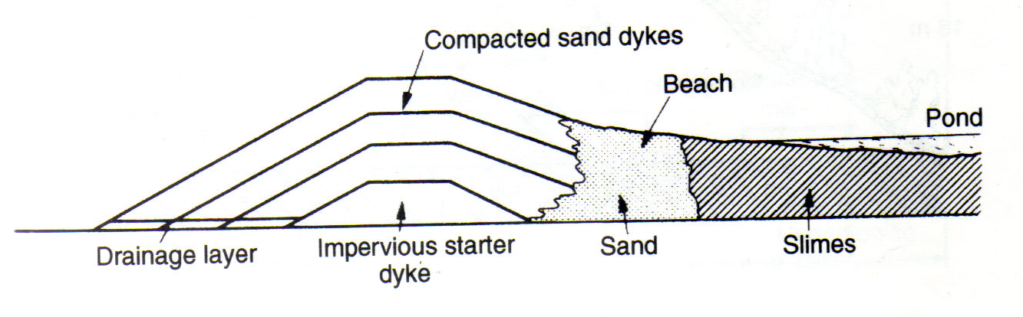
Figure 5: Centre-line Tailings Dam

Slide 16
TAILINGS DISPOSAL
Tailings Dams
Very stable tailings dams can be constructed from open-pit over-burden, or waste rock, according to the local circumstances.
An example is shown in Fig. 6.
Since the tailings are not required for the dam construction, they may be fed into the pool without separation of the sands fro the slimes.
In some cases the output of overburden may not be sufficient to keep the dam crest above the tailings pond, and it may be necessary to combine waste rock and tailings sand-fills to produce a safe economical dam.

Slide 17
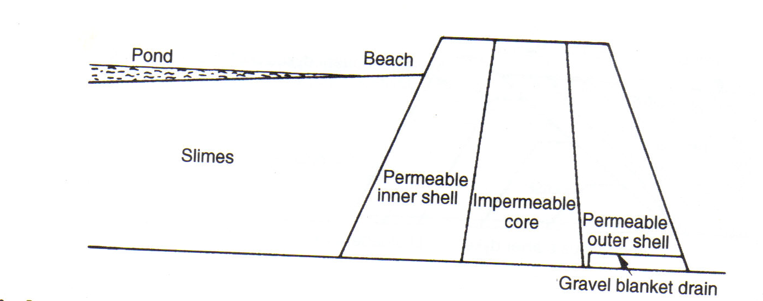
Figure 6: Dam construction from overburden

Slide 18
TAILINGS DISPOSAL
Environmental Effects of Tailings Disposal
Erosion of dams due to wind and rain can affect the stability and produce environmental problems.
Many methods are used to combat this, such as vegetation of the dam banks and chemical stabilisation to form an air and water-resistant crust.
There is little doubt that tailings dams have a visual impact on the environment due to their regular geometric shape.
Perhaps the most conspicuous is the downstream type, whose outer wall is continually being extended, and cannot be re-vegetated until closure.

Slide 19
TAILINGS DISPOSAL
Environmental Effects of Tailings Disposal
The most serious problem associated with the disposal of tailings is the release of polluted water, and this has been extensively investigated (Anon, 1980).

Slide 20
TAILINGS DISPOSAL
Environmental Effects of Tailings Disposal
The main effects of pollution are due to the effluent pH, which may cause ecological changes;
dissolved heavy metals, such as copper, lead, zinc, etc., which can be lethal to fish-life if allowed to enter local water-courses;
mill reagents, which are usually present in only very small quantities, but, nevertheless, may be harmful;
and suspended solids, which should be minimal if the tailings have spent long residence times in the dam, thus allowing the solids to settle and produce a clear decant.

Slide 21
TAILINGS DISPOSAL
Environmental Effects of Tailings Disposal
Figure 7 shows a generalised representation of water gain and loss at a tailings impoundment (Down and Stocks, 1977b).
With the exception of precipitation and evaporation, rates and volumes of water can be controlled to a large extent.

Slide 22
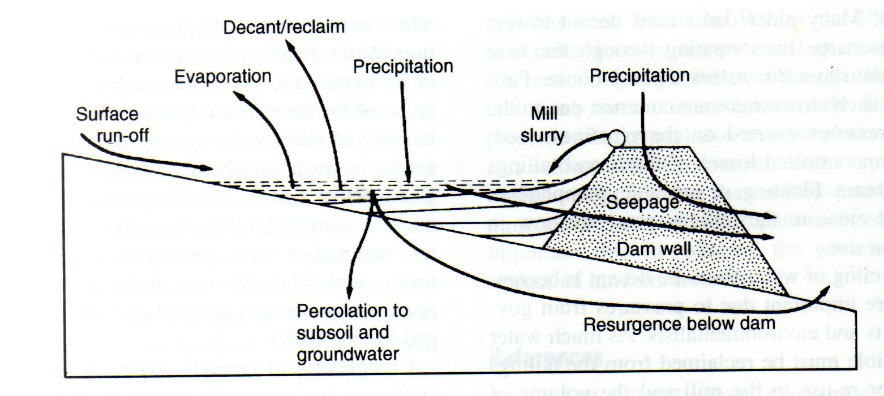
Figure 7: Water gain and loss in a typical tailings dam

Slide 23
TAILINGS DISPOSAL
Environmental Effects of Tailings Disposal
It is more satisfactory to attempt to prevent the contamination of natural waters rather than to purify them afterwards, and if surface run-off to the dam is substantial, then interception ditches should be installed.
It is difficult to quantify the amount of water lost to groundwater, but this can be minimised by selecting a site with impervious foundations, or by sealing with an artificial layer of clay.
Seepage through the dam wall is often minimised by an impervious slimes layer on the upstream face of the dam, but this is expensive, and many mines prefer to encourage free-drainage of the dam through pervious, chemically barren material.

Slide 24
TAILINGS DISPOSAL
Environmental Effects of Tailings Disposal
In the case of upstream dams, this can be a barren starter dyke, while with downstream and centre-line constructions, a free-draining gravel blanket can be used.
A small seepage pond with impervious walls and floors situated below the main dam can collect this water, from where it can be pumped back into the tailings pond.
If the dam wall is composed of metal-bearing rock, or sulphide tailings, the seepage is often highly contaminated due to its contact with the solid tailings, and may have to be treated separately.

Slide 25
TAILINGS DISPOSAL
Environmental Effects of Tailings Disposal
The tailings are often treated with lime in order to neutralise acids and precipitate heavy metals as insoluble hydroxides before pumping to the dam.
Such treated tailings may be thickened and the overflow, free of heavy metals, returned to the mill, thus reducing the water and pollution input to the tailings dam.
Recycling of water from the decant is becoming more important due to pressures from governments and environmentalists.
The main disadvantage of water reclamation is the circulation of pollutants to the mill which, can interfere with processes such as flotation.

Slide 26
TAILINGS DISPOSAL
Environmental Effects of Tailings Disposal
The mineralogical nature of the tailings often provides natural pollution control.
For instance, the presence of alkaline gangue minerals such as limestone can render metals less soluble and neutralise oxidation products.
Such ores thus present less problems than sulphide ores associated with neutral-acid gangues, which oxidise to produce sulphuric acid, and apart from acidifying the water, consume dissolved oxygen as well (Down and Stock, 177c).
Chemical treatment of such acid effluents s essential, neutralisation by lime usually being performed, which precipitates the heavy metals, and promotes flocculation as well as reducing acidity.

