Slide 1
PARTICLE SIZE ANALYSIS

Slide 2
INTRODUCTION
Size analysis of various products of a mill constitutes a fundamental part of laboratory testing procedure.
It is of great importance in determining the quality of grinding and in establishing the degree of liberation of the values from gangue at various particle sizes.
In the separation stage, size analysis of the products is used to determine the optimum size of the feed to the process for maximum efficiency and to determine the size range at which losses are occurring in the plant, so that they may be reduced.

Slide 3
INTRODUCTION
It is essential, therefore, that methods of size analysis must be accurate and reliable, as important changes in plant operation may be made on the results of the laboratory tests.
Since only relatively small amounts of material are used in the sizing tests, it is essential that the sample is representative of the bulk material and the same care should be taken over sampling for size analysis as for assay.

Slide 4
Particle Size Analysis
Sieve Analysis
Sieve analysis is one of the oldest methods of size analysis and is accomplished by passing a known weight of sample material successively through finer sieves and weighing the amount collected on each sieve to determine the percentage weight in each size fraction.
Sieving is carried out with wet or dry materials and the sieves are agitated to expose all the particles to the openings.
Testing Methods
The sieves chosen for the test are arranged in a stack, or nest, with the coarsest sieve on the top and the finest at the bottom.
A tight-fitting pan or receiver is placed below the bottom sieve to receive the final undersize, and a lid is placed on top of the coarsest sieve to prevent escape of the sample.

Slide 5
Particle Size Analysis
Testing Methods
The material to be tested is placed in the uppermost, coarsest sieve, and the nest is then placed in a sieve shaker which vibrates the material in a vertical plane (Figure below).
The duration of screening can be controlled by an automatic timer.
During the shaking, the undersize material falls through successive sieves until it is retained on the sieve having apertures which are slightly smaller than the diameter of the particles.

Slide 6
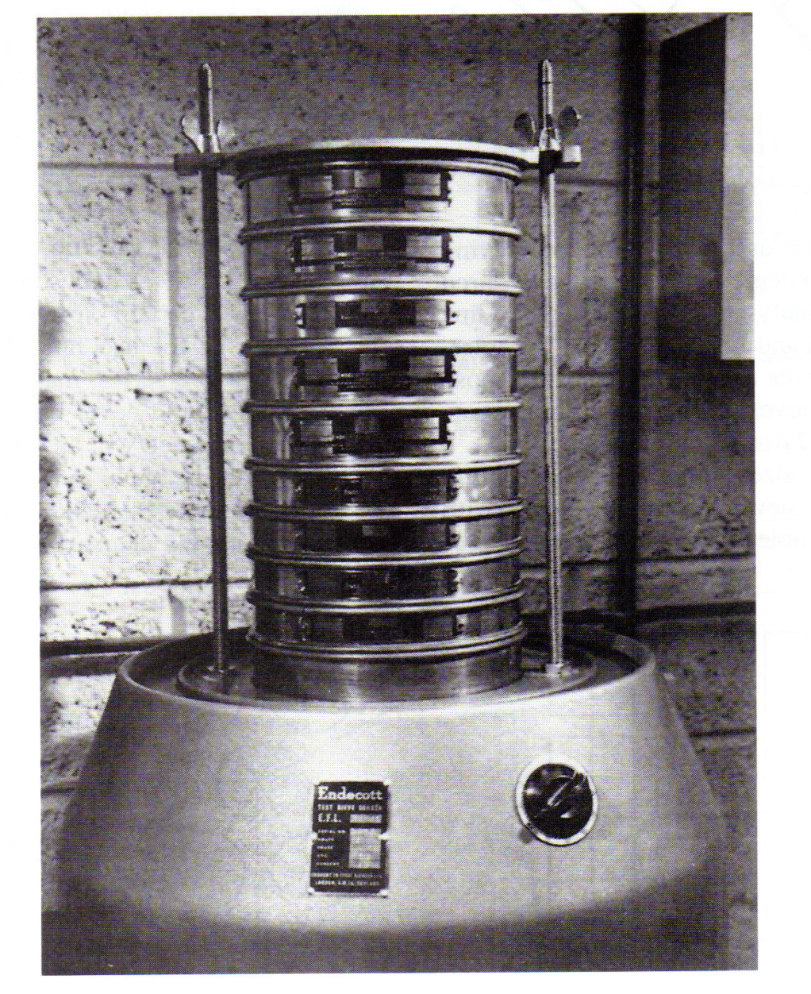

Slide 7
Particle Size Analysis
Presentation of Results
There and several ways in which the results of a sieve test can be tabulated.
The three most convenient methods are shown in Table below.

Slide 8
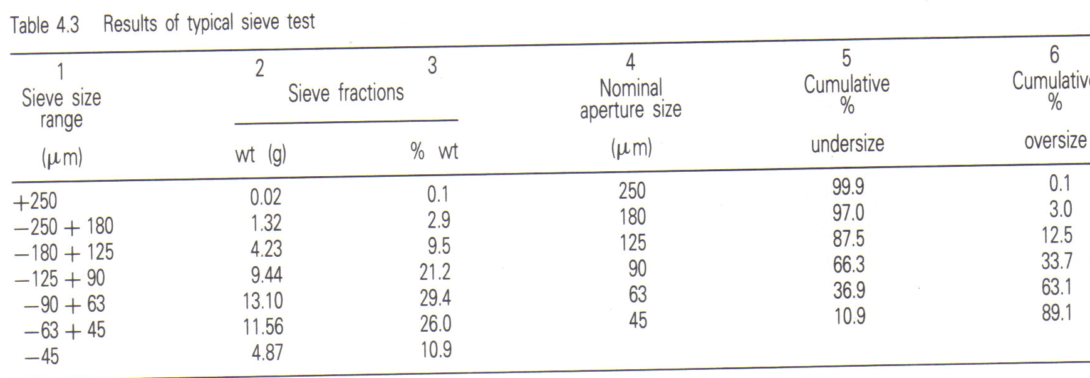

Slide 9
Particle Size Analysis
Presentation of Results
The Table above shows:
The sieve size ranges used in the test.
The weight of material in each size range, e.g. 1.32 g of material passed through the 250 μm sieve, but was retained on the 180 μm sieve: The material therefore is in the size range -250 + 180 μm.
The weight of material in each size range expressed as a percentage of the total weight.
The nominal aperture sizes of the sieves used in the tests.
The cumulative percentage of material passing through the sieves, e.g. 87.5% of the material is less than 125 μm in size.
The cumulative percentage of material retained on the sieves.

Slide 10
Particle Size Analysis
Presentation of Results
The results of a sieving test should always be plotted graphically in order to assess their full significance.
There are many different ways of recording the results, the most common being that of plotting cumulative undersize (or oversize) against particles size.
Although arithmetic graph paper can be used, it suffers from the disadvantage that points in the region of the finer aperture sizes tend to become congested.
A semi-logarithmic plot avoids this, with a linear ordinate for percentage oversize or undersize and a logarithmic abscissa for particle size.
The Figure below shows graphically the results of the sieve test tabulated in Table above.

Slide 11
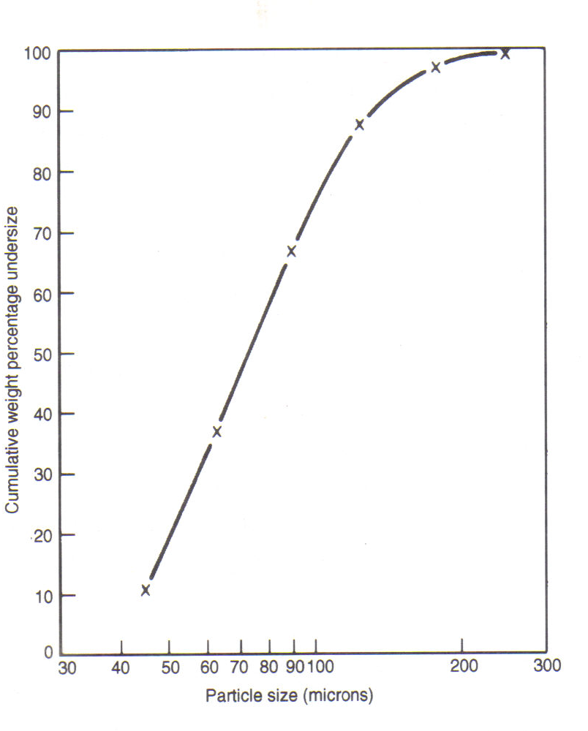

Slide 12
SCREENING
  Industrial sizing of broken rock may be carried out for any of the following purposes:
To prevent oversize material entering equipment unsuitable to deal with it;
To remove undersize prior to a comminution stage, which is set to reduce material to that size;
To present a correctly sized feed to a concentration process;
To grade crushed rock into specified sizes as the final products;
To remove undesirable material (wood, mill rejects, etc.) at any stage in the operating sequence.

Slide 13
SCREENING
In screening, material is graded into different size-fractions, according to the minimum cross-section presented to the apertures of the screen “cloth” during the passage of the material over the screen.
Particles that pass through a screen are termed screen “undersize”; particles that fail to pass are termed screen “oversize”.

Slide 14
SCREENING
  Those particles in the feed to a screen, that could pass through a screen, are usually termed “true undersize”.
  In practice, not all-true undersize particles report to the screen undersize; some report to the oversize.
  The less of the true undersize reports to the oversize fraction, the higher the efficiency of the screen.

Slide 15
SCREENING
    The objective of screening is to pass the true undersize particles through the apertures of the screen and to reject the oversize.
Some obvious difficulties in achieving this objective are:
When there is a large number of particles on the screen, they will interfere with each other;
The particles will have a considerable velocity over the screen in a direction nearly parallel to the screen surface;
The edges of the screen openings will offer an obstruction;
The greatest dimensions of the particles will normally be parallel to the surface.

Slide 16
EFFICIENCY OF SCREENING
There is no uniformly established expression for the efficiency of a screening process.
The most logical method, which is also the most widely used method, is based upon the recovery of undersize.
Here the efficiency is expressed as the weight of the undersize actually obtained, as a percentage of the weight of the true undersize actually in the feed:

Slide 17
EFFICIENCY OF SCREENING
wherein:
f = percentage of true undersize in the feed
u = percentage of true undersize in the undersize
o = percentage of true undersize in the oversize
(note that this equation is the two-product formula, commonly used in the calculation of recoveries)
If we may assume that all the material in the undersize fraction is true undersize material, then u = 100 % and the equation reduces to:

Slide 18
EFFICIENCY OF SCREENING
To determine the screening efficiency with this method, representative samples are taken of feed to the screen and of the oversize and undersize fractions, and screen analyses are made to determine the percentages of undersize in feed and products.
This test should be repeated several times and similar results should be obtained each time.
If the results of the test differ appreciably each time, it is likely that the samples taken were not representative.

Slide 19
Efficiency of Screening
The efficiency of screening generally increases with:
Percentage of opening in the screen area;
Smoothness of the screen surface;
Time taken in transit (greater length of screen, lower velocity over the screen);
Suitability of shape of apertures to shape of particles;
Percentage of undersize in the feed;
(for dry and fine material) temperature.

Slide 20
Efficiency of Screening
The efficiency generally decreases with:
slackness of the screen cloth;
increased feed rate to the screen;
increase in thickness of the layer on the screen;
too steep a slope of the screen;
excessive movement;
unfavourable shapes of particles (slabs, fibres);
moisture content of the feed ( as long as it is not a true pulp);
increased proportion of “near-mesh” particles in the feed.

Slide 21
Near-mesh Particles
Particles that are small in comparison to the screen apertures will easily fall through.
Particles that are large in comparison to the screen apertures will be rejected easily and will leave ample room between them for the passage of the smaller particles.
The difficult particles are those of, say 0.75 to 1.5 times the size of the screen apertures.
Such “near-mesh” particles will:
tend to blind the screen cloth, because they get wedged into openings, which are just a little smaller than the particles;

Slide 22
Near-mesh Particles
tend to build up in an excessive circulating load if the screen is in closed circuit with a crusher, because most of the near-mesh particles will be rejected into the oversize, and they will undergo very little further size-reduction when they are re-circulated to a crusher, which has a discharge gap setting equal to, or almost equal to the screen apertures.

Slide 23
Screening Surfaces
The screening surface can be made of parallel bars or rods, of punched plate or of woven-wire cloth.
Bars are used for very coarse screening (grizzleys), intermediate screening (rod-deck screens) and in fine, wet screening (DSM sieve bends).
Punched plate is used in coarse and intermediate screening. Woven-wire cloth is used for intermediate, fine and even very fine screening.
A very popular material for the bars in very coarse stationary grizzleys is old rails, which are scrapped in the mine and therefore cheap.
The bars used for screening should preferably have a wedge-shaped profile to minimise blinding, not an I-profile.

Slide 24
Screening Surface
Stationary grizzleys bars are normally positioned parallel to the direction of feeding, to assist flow and to minimise blinding. The angle of incline is usually 25-50º.
Rod-deck screens are used for intermediate screening (3-25 mm). The rods are held in the deck by moulded rubber spacers and can be replaced individually, so that in the case of slight damage only one or several rods and not the entire deck have to be replaced.
Wedge-wires are used in fine screening devices, as sieve bends. Such screens are strong and have relatively large areas. The wedge profile (Figure below) minimises particle blinding.

Slide 25
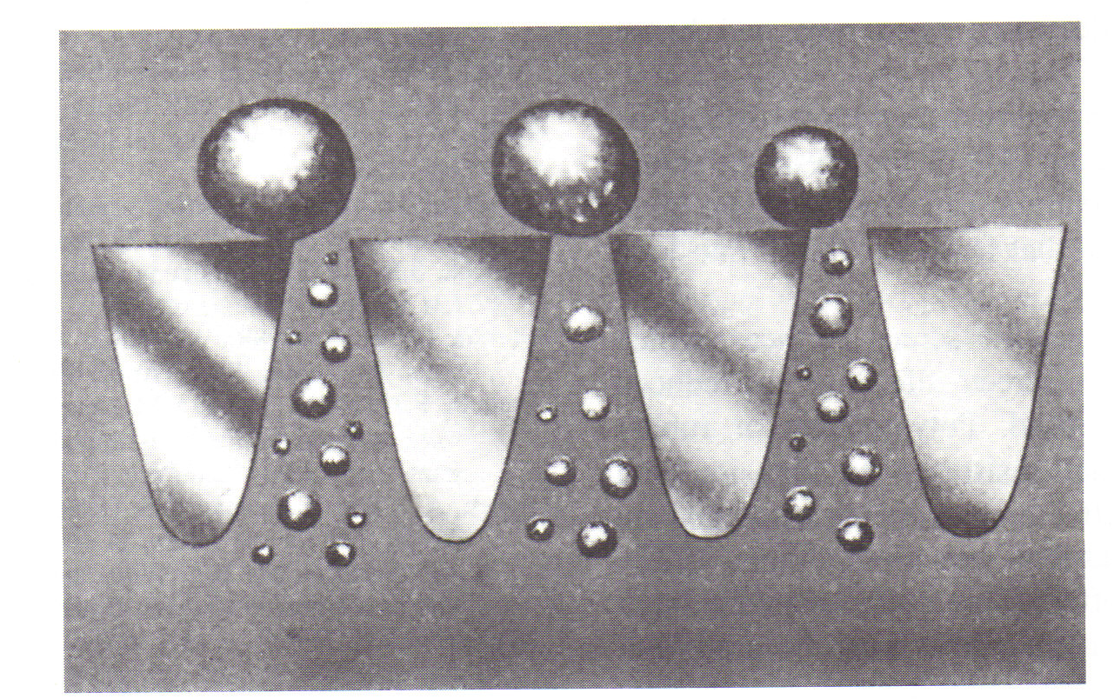
Figure: Wedge wire screen

Slide 26
Screening Surface
Punched plate is used in screening coarse and intermediate material.
The openings can be made in any variety of shapes, which is considered to be suitable.
Round openings are recommended for coarse screening, because the relatively low percentage of openings leaves the screen cloth (the perforated plate) stronger than in the case of rectangular (slotted) openings.
Slotted openings give a higher percentage of openings and are preferred for finer screening and for acicular (needle-like) particles.

Slide 27
Screening Surface
In comparison to woven-wire screens and bars, punched screens have a relatively smooth surface. This has the following advantages:
more evenly distributed wear, hence a longer life;
less slope required, hence less headroom required;
less interference with stratification.
To minimise cloth blinding, the edges of the openings in punched screen should slant away from the openings, thus simulating the wedge profile in bars and wedge-wire.

Slide 28
Screening Surface
Woven-wire screens are available from 10 cm aperture down to 37 μm (400 mesh), though for the coarser applications (10 – 2 cm) punched plate is usually recommended and in the finer range (below 1 mm = 16 mesh) sieve bends and classifiers are more satisfactory because of their much larger capacity in this range and very fine woven-wire cloth is very expensive and easily damaged.

Slide 29
Screening Surface
Woven-wire cloth has a higher percentage of openings than corresponding punched plate, but is less strong and the surface is less smooth.
Woven-wire cloths, usually constructed from steel, stainless steel, copper, or bronze, are by far the most widely used screening surfaces, especially in the range encountered in crushing circuits.
Fine screens can have the same or greater open areas than coarse screens, but the wires used must be thinner and hence more fragile (Figure below).

Slide 30
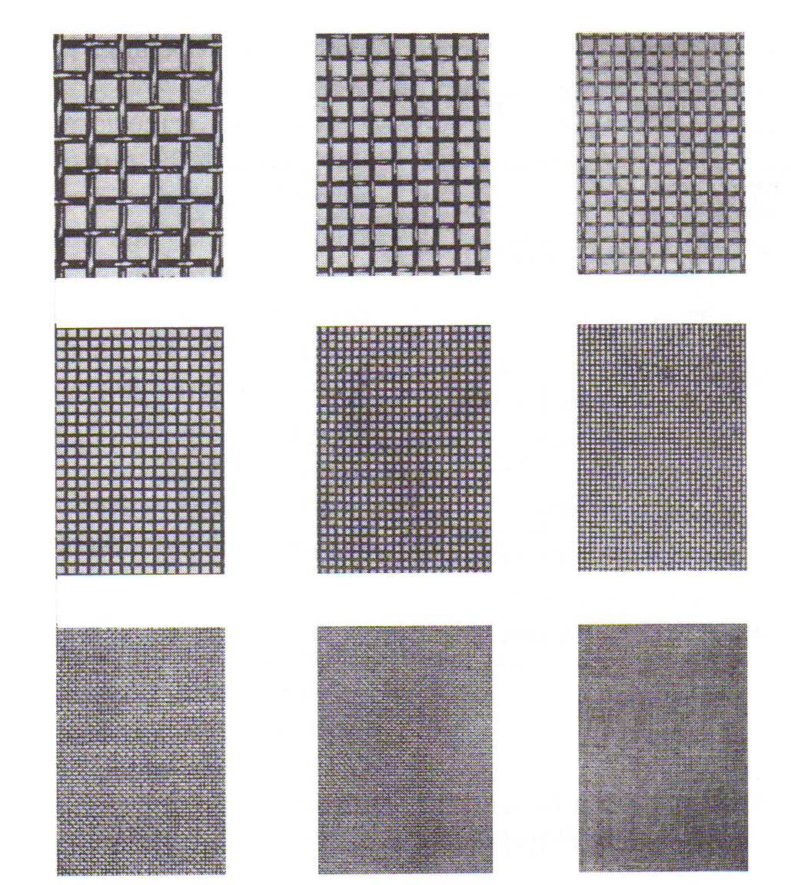

Slide 31
Capacity of Screens
It is difficult to come up with a well-defined expression for the capacity of a screen.
For many pieces of equipment the capacity can be said to be the maximum possible throughput (feed rate).
In the case of screens, this would not be a useful expression, since very high throughputs might be possible (very high velocity over the screen, very thick layer on the screen), but at unacceptably low efficiencies.
The usual expression for the capacity of a screen is:
“The capacity of a screen is the maximum feed rate at which the screen will still perform satisfactorily”.

Slide 32
Capacity of Screens
“Satisfactorily” is of course, highly subjective. This is usually taken to mean a screening efficiency of 80-90 % for coarser screening (above 5-6 mm) and 70-80 % for finer screening, though at fine screening below 1-2 mm, efficiencies of 65-70 % are accepted.
There is no uniformly established notation for screen capacities. Screen ratings are usually given in mass (metric tonnes or short tons) per unit of screen surface (m² or foot²) per mm screen aperture per unit of time (hour or 24 hour day), e.g.:
Tonne / m² / mm / 24 hours

Slide 33
Capacity of Screens
Note that this notation for the capacity of a screen uses the screen “throughput” (the feed rate to the screen) and not the rate of production of undersize.
Multiple-deck screens (double or triple-deck screens, very rarely quadruple-deck) have a coarse screen on top with one or two progressively finer screens underneath.
The aperture size of the lowest screen is the limiting size (separating size) for the unit. The oversize from all screens is combined.

Slide 34
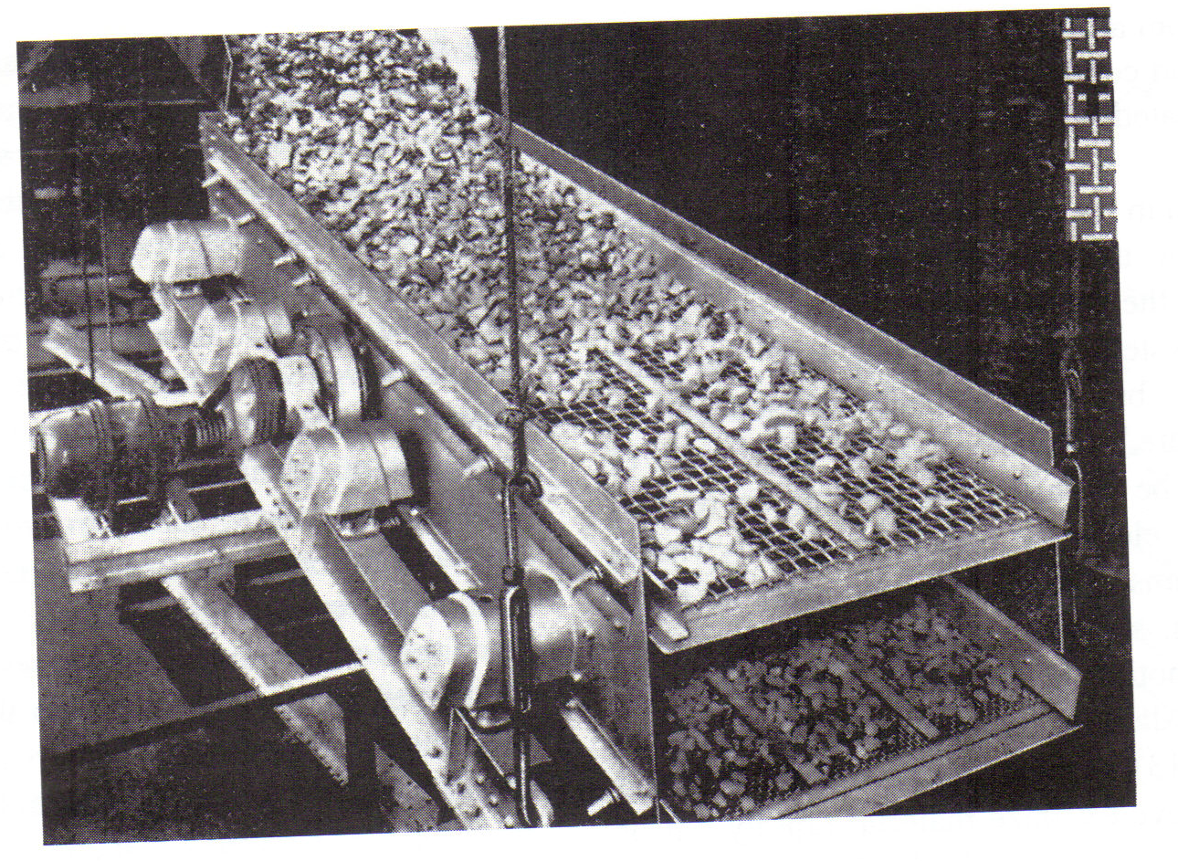

Slide 35
Capacity of Screens
The coarse upper screen serves the double purpose of reducing the amount of material, presented to the lower screen(s), and at the same time protecting the lower screen(s) from the impact of heavy, coarse rock, so that the lower screen(s) can have a higher percentage of opening and thus a higher efficiency.
The efficiency of the lower screen(s) is also improved because a significant proportion of the total load has been taken off by the upper screens. Consequently, the feed rate to the system can be high, without loss of efficiency.

Slide 36
Industrial Screens
The screening machinery used in industry falls in the following categories, based upon the objective:
Scalping screens
Separating screens
Dewatering screens
Trash removing screens
The screens used for size-separation can be roughly classified as follows:

Slide 37
Coarse (> 4 cm) | Grizzleys (fixed or vibrating or with rotating rolls) | Bars (rails or rods)
Intermediate (from 100 mm down to 1-2 mm) | Fixed screens Revolving screens (trommel screens) rod-deck screens shaking screens vibrating screens | Punched or slotted plates, rods or Woven-wire screen cloths
Fine (from 10 mm down to 0.3 mm) | Travelling belt screens | Woven-wire cloth
 | Sieve bends (DSM screens) | Wedge-wire bars
Very fine (down to 40 μm) | Gyratory screens Reciprocating screens | Woven-wire cloth

Slide 38
Grizzleys
Grizzleys consist basically of a series of heavy, parallel bars, usually mounted in a frame (Figure below).
They are commonly used for coarse and very coarse screening.
Their purpose is mainly to prevent oversize material from entering equipment (bins, chutes, rail cars, crushers) unsuitable to deal with it.
They can also be used to remove undersize prior to primary crushing (scalping).

Slide 39
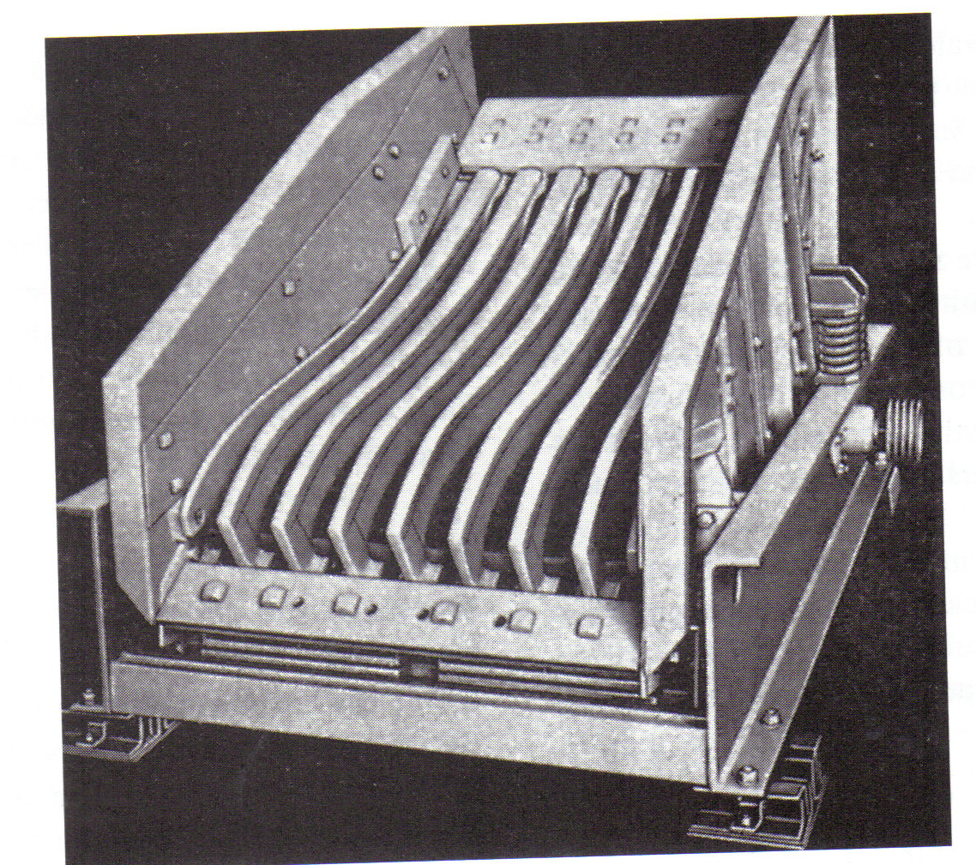
Figure: Vibrating grizzly

Slide 40
Grizzleys
Grizzleys are usually given a slope of 25-50º, dependent upon their application and the characteristics of the ore. The greater the angle, the greater the throughput, but the lower the efficiency.
With stationary grizzleys, the bars are parallel to the slope and the feed is in the direction of the bars, to facilitate the flow. The bars should preferably be wedge-shaped to minimise clogging.

Slide 41
Trommel Screens
In trommel screens, the screen surface rotates around a horizontal or slightly inclined cylinder axis (Figure below).
They can be cylindrical or conical.
The side of the trommel is the screening surface, which is connected to the main shaft by a number of “spiders”.
The main shaft and hence the entire trommel revolves.
The feed enters the trommel at one end and moves towards the other end.
During this transit, the undersize is removed through the screen apertures and the oversize leaves the trommel at the discharge end.
The revolving speed is slow (below “critical” speed), so the trommel screen does not work like a centrifuge.

Slide 42
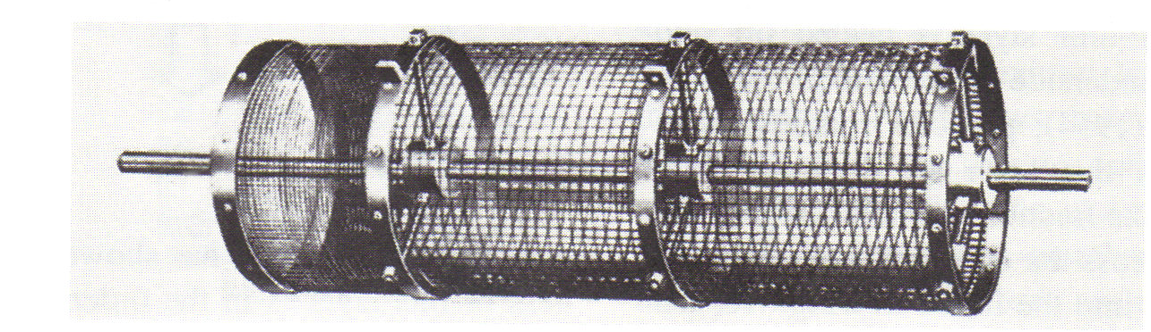
Figure: Trommel screen

Slide 43
Trommel Screens
Trommel screens can be used either wet or dry. For a long time they were the most commonly used screens, but have now largely been replaced by vibrating screens, which have a much higher capacity and efficiency.
The screening surface can be punched plate or woven-wire cloth.
The slope of the trommel affects the rate of travel. To a certain limit an increase in slope increases both capacity and efficiency.

Slide 44
Vibrating Screens
Vibrating screens are the most important screening machines for mineral processing applications (Crissman, 1986; Pritchad, 1980a; Pritchard, 1980b). Figure below.
They handle material up to 25 cm in size down to 250 μm.
Their main application is in crushing circuits where they are required to handle material ranging, in general, from 25 cm to 5 mm in size.
With vibrating screens, the frequency of vibration is much larger than with shaking screens (600-700 min ^{–1}), but the amplitude is much smaller (2-20 mm).

Slide 45
Figure: Double-deck Vibrating Screen

Slide 46
Vibrating Screens
Vibrating screens are now by far the most widely used screens in industrial practice, thanks to:
Large capacity per unit of screen area;
Low cost of operation;
Low cost of maintenance;
Flexibility and ease of operation;
Easy accessibility;
Good visual control little headroom required.

Slide 47
Sieve Bend or DSM-Screen
Sieve bends were developed by the Dutch State Mines for use in coal washing plants.
Since they are compact and have a very high capacity, they have found ready application in recent years in ore grinding units, usually in combination with classifiers or hydrocyclones.
They are excellent for the screening of fine slurries down to 250 – 300 μm and several plants have reported the satisfactory commercial use of sieve bends for even finer screening, down to 50 μm.

Slide 48
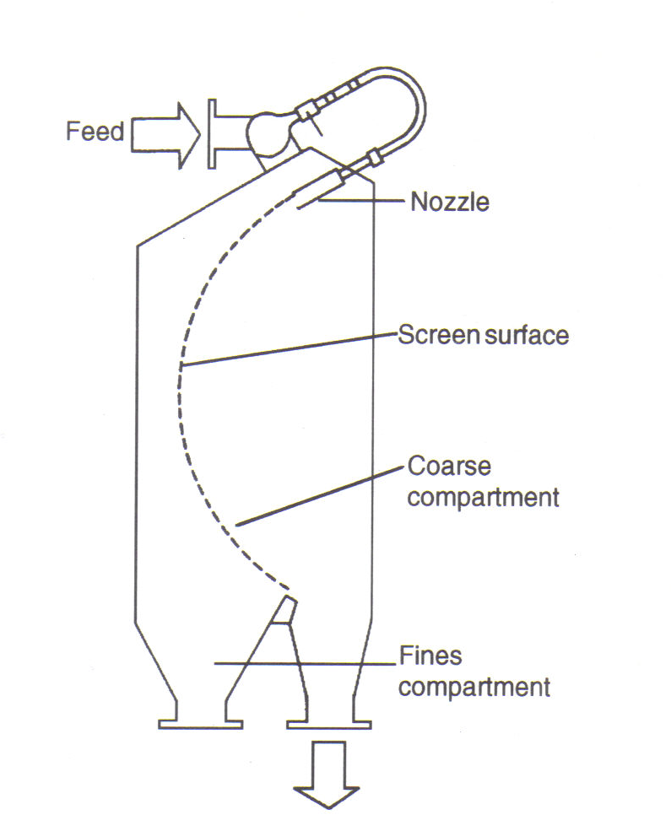
Figure: Sieve bend

Slide 49
Sieve bend
The screen surface of the original DSM-screens (Figure above) is curved and consists of horizontal wedge-wire bars, set across the direction of the pulp flow.
The feed slurry passes through the feed inlet at the top rear of the feed box and flows over the weir and through the feed spout, reaching the upper surface of the screen tangentially.
It then flows down the concave surface at a right angle to the openings between the wedge-wire bars.

Slide 50
Sieve bend
Each of the wedge bars in turn acts as a “knife” on the underside of the passing slurry.
A layer of liquid and fine solid particles strikes the sharp edges of the bars, is “sliced off” by these knife-edges and these thin layers of liquid and fine particles pass through the apertures between the wedge-wire bars into the screen box.

Slide 51
Sieve bend
the upper edges of the screen bars are worn, the knife-edges are blunter, less liquid will be sliced off to pass through the openings and the screen underflow will become finer. The sieve bend is the only type of screen in which the undersize becomes finer as the screen surface is worn.
When wear on the upper edges of the screen bars become excessive, the screen can be turned 90º on most versions, so that the former upper portion of the bars becomes the lower portion. This doubles the life of the screen.

Slide 52
Sieve bend
Sieve bends have found an important application in closed circuit grinding of heavy mineral ores.
Overgrinding of heavy minerals, which can occur when conventional classification is used, can be greatly reduced by the combination of classifiers and sieve bends (Woodcock, 1975).

