Slide 1
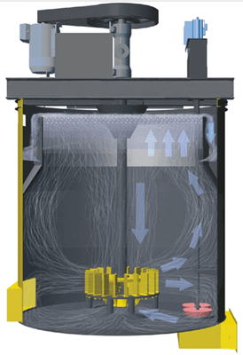
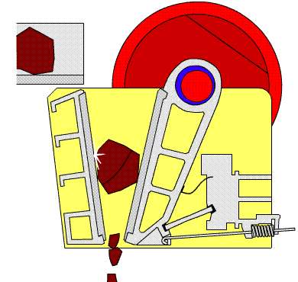
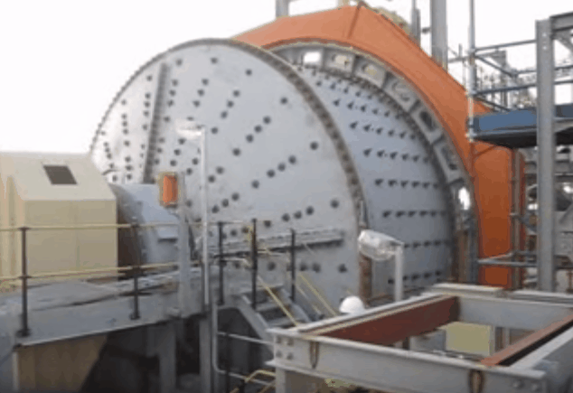

MET 3145: Mineral Processing
By
Marthias SILWAMBA (PhD)
Metallurgical Engineering Department
Marthias.silwamba@unza.zm

Slide 2
Lecture 6
Concentration of valuable minerals
MS© 2021

Slide 3
Lecture of objective(s)
By the end of the lecture students are expected to:-
Understand the principle of particles hydrophobicity and criterion for the spontaneous adhesion of air bubble and particle surface
Function and types of flotation reagents
Understands how surfaces of minerals are modified, activated and depressed
Understands and explain the recovery-grade curves
Explain the mineral concertation by jig, spiral, magnetic separator and dense media separator.
MS© 2021

Slide 4
Lecture content
6.1. Introduction
6.2. Froth flotation fundamentals
6.3. Jig
6.4. Spiral
6.5. Dense media separation
6.6 Magnetic separators
MS© 2021

Slide 5
Lecture content
6.1. Introduction
6.2. Froth flotation fundamentals
6.3. Jig
6.4. Spiral
6.5. Dense media separation
6.6 Magnetic separators
MS© 2021

Slide 6
6.1. Introduction
Valuable minerals are concentrated by separation from the gangue minerals using various techniques.
Froth flotation
Valuable mineral concentration
Magnetic separator
Liberated minerals
Electrical separator
jigging
Spiral
Gravity separator
Shaking table
Dense media
MS© 2021

Slide 7
6.1. Introduction (cont.)
Separation methods and the physical properties utilized to achieve seperation (concentration).
Separation methods | Physical property for separation | Particle size [cm]
Gravity separation (Jig) | Density | 0.5-200
Gravity separation (Air table) |  | 0.5-50
Gravity separation (Shaking table) |  | 0.05-1
Dense medium separation |  | 0.5-300
Magnetic separation | Magnetism | 0.15-200
Eddy current separation | Electrical conductivity | 5-40
Electrostatic separation |  | 0.1-4
Flotation | Surface wettability | 0.005-0.5
MS© 2021

Slide 8
Lecture content
6.1. Introduction
6.2. Froth flotation fundamentals
6.3. Jig
6.4. Spiral
6.5. Dense media separation
MS© 2021

Slide 9

6.2. Froth flotation fudamentals
Froth flotation utilises the difference in physico-chemical surface properties of particles of various minerals.
Literally speaking, flotation separates materials based on the differences in surface wettability.
To enhance the differences in surface wettability, particles are treated with reagents, and, for flotation to take place, an air-bubble must be able to attach itself to hydrophobic particle, and lift it to the water surface.
Water
Air
A: hydrophobic surface
B: hydrophilic surface
MS© 2021

Slide 10
6.2. Froth flotation fudamentals (cont.)
Hydrophilic (or water-friendly or wettable) – are substances with greater affinity for water
Hydrophobic (i.e. averse to water or non-wettable) – are substances with greater affinity for air.
Only a few minerals are naturally hydrophobic, but several minerals can be made hydrophobic by adsorption of certain chemicals
MS© 2021

Slide 11
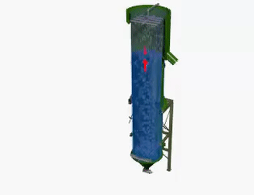
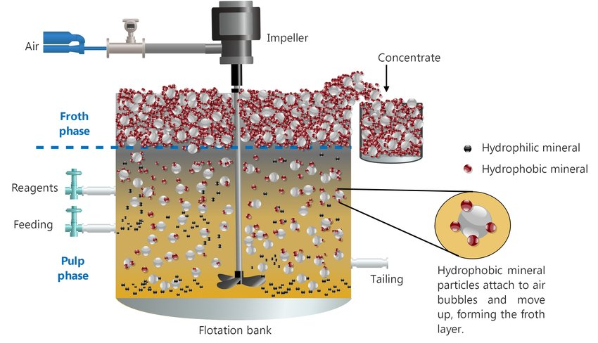
6.2. Froth flotation fudamentals (cont.)
MS© 2021

Slide 12
6.2. Froth flotation fudamentals (cont.)
Criterion for the Spontaneous Adhesion of Air Bubble on Solid Surfaces
Before adhesion
Water
After adhesion
Air
Adhesion
Air
γ_{W/A}
γ_{S/A}
Three surfaces
γ_{S/W}
Solid
Solid
γ:surface tension
ΔE = after – before = γ_{S/A} – (γ_{W/A} + γ_{S/W}) …(1)
Energy required for adhesion
Change of free energy
created
disappeared
When ΔE < 0 adhesion occurs.
We can measure γ_{W/A} only
MS© 2021

Slide 13
6.2. Froth flotation fudamentals (cont.)
Criterion for the Spontaneous Adhesion of Air Bubble on Solid Surfaces (cont.)
The forces tending to separate a particle and a bubble are shown below.
The attachment of the bubbles to the surface is determined by the interfacial energies between the solid, liquid, and solid phases. This is determined by the Young
γ_{S/A} = γ_{S/W} +γ_{W/A} cosθ …(2)
where ϒ_{S/A}, ϒ_{S/W} and ϒ_{WA} are the surface energies between solid-air, solid-water and water-air, respectively. From the figure below θ is the contact angle between the mineral surface and the bubble.
Water
γ_{W/A}
Air
γ_{S/A}
θ
γ_{S/W}
MS© 2021
Solid

Slide 14
6.2. Froth flotation fudamentals (cont.)
Criterion for the Spontaneous Adhesion of Air Bubble on Solid Surfaces (cont.)
Substituting Eq. 2 into 1 leads to
ΔE = γ_{S/A} - (γ_{W/A} + γ_{S/W}) = γ_{W/A} (cosθ-1）
The above entails that if the contact angle is very small, then the bubble does not attach to the surface, while a very large contact angle results in very strong bubble attachment.
That is, the floatability of a mineral therefore increases with the contact angle; minerals with a high contact angle are said to be aerophilic (hydrophobic), i.e., they have a higher affinity for air than water.
In most cases a contact angle near 90° is sufficient for effective froth flotation.
MS© 2021

Slide 15
6.2. Froth flotation fudamentals (cont.)
Particle-Bubble Contact
Once the particles are rendered hydrophobic, they must be brought in contact with gas bubbles so that the bubbles can attach to the surface.
If the bubbles and surfaces never come in contact, then no flotation can occur.
Particle-bubble collision is affected by the relative sizes of the particles.
If the bubbles are large relative to the particles, then fluid flowing around the bubbles can sweep the particles past without coming in contact.
It is therefore best if the bubble diameter is comparable to the particle diameter in order to ensure good particle-bubble contact.
MS© 2021

Slide 16
6.2. Froth flotation fudamentals (cont.)
Particle-Bubble Contact (cont.)
Bubble
Bubble
Bubble
Too coarse particle
Coarse particle
Too fine particle
MS© 2021

Slide 17
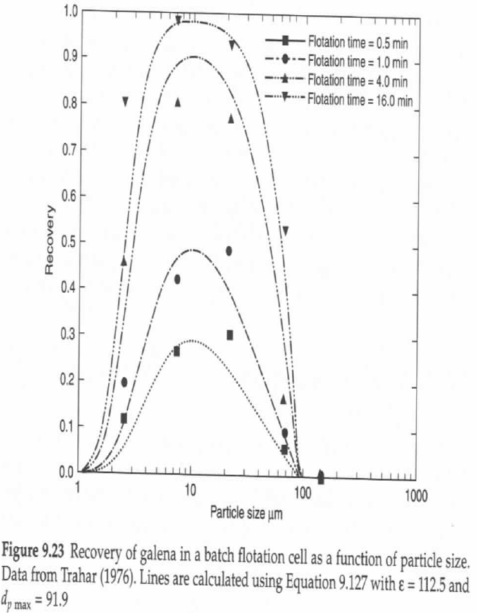
6.2. Froth flotation fudamentals (cont.)
Particle-Bubble Contact (cont.)
4min
PbS
Recovery
1min
30s
Particle size μm
Modeling & simulation of mineral processing systems, p342
MS© 2021

Slide 18
6.2. Froth flotation fudamentals (cont.)
Flotation Reagents
Although some minerals are naturally hydrophobic, they are rarely suitable for froth flotation and the conditions are not favourable to achieve desired concentration of valuable mineral.
Chemicals are needed both to control the relative hydrophobicities of the mineral particles, and to maintain the proper froth characteristics.
There are therefore many different flotation reagents involved in the froth flotation process, with the selection of reagents depending on the specific mineral mixtures being treated.
MS© 2021

Slide 19
6.2. Froth flotation fudamentals (cont.)
Flotation Reagents (cont.)
Collectors
Collectors are reagents that are used to selectively adsorb onto the surfaces of particles.
They form a monolayer on the particle surface that essentially makes a thin film of non-polar hydrophobic hydrocarbons.
For example, if two minerals A and B are hydrophilic, collector ( ) can selectively adsorbs mineral A hence only mineral A becomes hydrophobic. Minerals A and B can be separated by flotation.
Different surface characteristic of the minerals facilitates selective adsorption!
A
B
hydrophobic
MS© 2021

Slide 20
6.2. Froth flotation fudamentals (cont.)
Flotation Reagents (cont.)
Collectors (cont.)
The collectors greatly increase the contact angle so that bubbles will adhere to the surface.
Selection of the correct collector is critical for an effective separation by froth flotation.
Adsorption mechanisms of collectors onto mineral surface are classified into two types.
I. Chemical adsorption II. Physical Adsorption
-
-
-
-
-
-
+
+
+
-
-
+
+
-
e.g., Anionic collector on positively charged solid surface
-
+
+
+
-
-
-
-
-
-
MS© 2021
Chemical bond

Slide 21
6.2. Froth flotation fudamentals (cont.)
Flotation Reagents (cont.)
Frothers
Frothers are compounds that aid and formation and stabilization of air bubbles so that they will remain well-dispersed in the slurry, and will form a stable froth layer that can be removed before the bubbles burst.
A frother has a number of functions in flotation:
  It reduces the surface tension of the air-liquid interface in order that a stable bubble is produced in the system; I
  t influences the kinetics of bubble-particle adhesion;
  It thins the liquid layer by interacting with the collector molecules
  It stabilises the bubble-particle aggregate.
MS© 2021

Slide 22
6.2. Froth flotation fudamentals (cont.)
Flotation Reagents (cont.)
Modifiers, Activators and Depressants
Modifiers are chemicals that influence the way that collectors attach to mineral surfaces. They may either increase the adsorption of collector onto a given mineral (activators), or prevent collector from adsorbing onto a mineral (depressants).
  Activators
  Activators are specific compounds that make it possible for collectors to adsorb onto surfaces that they could not normally attach to.
  A classic example of an activator is copper sulfate as an activator for sphalerite (ZnS) flotation with xanthate collectors.
MS© 2021

Slide 23
6.2. Froth flotation fudamentals (cont.)
Flotation Reagents (cont.)
Modifiers, Activators and Depressants (cont.)
  Activators (cont.)
  When ZnS is untreated (activated), xanthate cannot attach to its surface because it forms a zinc-xanthate compound that quickly dissolves.
  Therefore, CuSO4 is added and it is activated as shown.
ZnS(surface)+Cu²⁺=CuS(surface)+Zn²⁺
Adsorption of Xanthate (X⁻)
MS₂O₃+2X⁻ = MX₂+S₂O₃²⁻
Cu²⁺
CuS
 | Solubility product
CuX₂ | 5.2X10⁻²⁰
ZnX₂ | 4.9X10⁻⁶
ZnS
Zn²⁺
MS© 2021

Slide 24
6.2. Froth flotation fudamentals (cont.)
Flotation Reagents (cont.)
Modifiers, Activators and Depressants (cont.)
  pH Control modifier
  The surface chemistry of most minerals is affected by the pH. In general minerals develop a positive surface charge under acidic conditions and a negative charge under alkaline conditions.
Since each mineral changes from negatively-charged to positively-charged at some particular pH, it is possible to manipulate the attraction of collectors to their surfaces by pH adjustment.
MS© 2021

Slide 25
6.2. Froth flotation fudamentals (cont.)
Flotation Reagents (cont.)
Modifiers, Activators and Depressants (cont.)
  Depressants
  Depressants have the opposite effect of activators, by preventing collectors from adsorbing onto particular mineral surfaces.
ZnSO₄ addition as the depressant for flotation of ZnS
CuS（ZnS-surface）+ Zn²⁺ →ZnS + Cu²⁺
Cu²⁺
ZnS
ZnS
Zn²⁺
MS© 2021

Slide 26
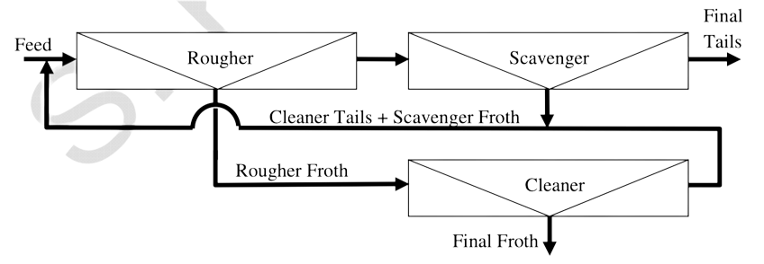
6.2. Froth flotation fudamentals (cont.)
Basic flotation circuits
It is common for conventional flotation cells to be assembled in a multi-stage circuit, with “rougher”, “cleaner”, and “scavenger” cells, which can be arranged circuit configurations.
MS© 2021

Slide 27
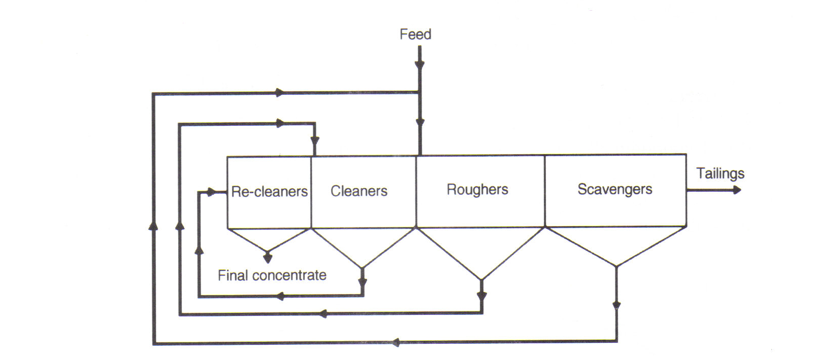
6.2. Froth flotation fudamentals (cont.)
Basic flotation circuits (cont.)
The flotation circuit may also include recleaning aiming to get very high grade of concentrate as shown.
MS© 2021

Slide 28
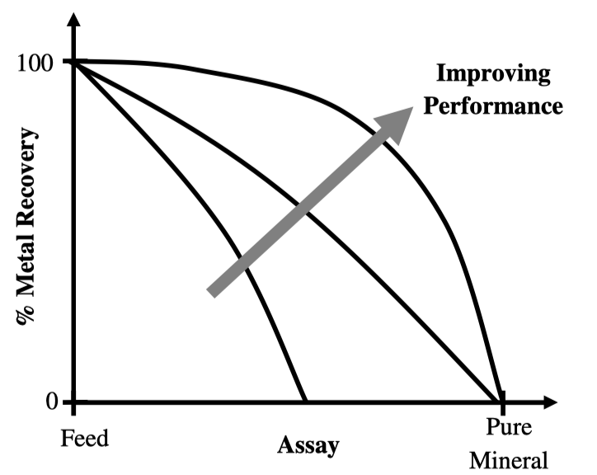
6.2. Froth flotation fudamentals (cont.)
Recovery-grade curves
Recovery–grade curves are graphs of the recovery of the valuable metal achieved versus the product grade at that recovery, and is particularly useful for comparing separations where both the grade and the recovery are varying.
MS© 2021

Slide 29
6.2. Froth flotation fudamentals (cont.)
Recovery-grade curves (cont.)
If 100% of the feed is recovered to the product, then the product will obviously have the same composition as the feed, and so the curve starts at the feed composition with 100% recovery.
Similarly, if the purest mineral grain that contains the metal of interest is removed, this will be the maximum grade that can be produced by a physical separation, and so the 0% recovery end of the curve terminates at an assay less than or equal to the assay of the purest grains available in the ore.
MS© 2021

Slide 30
Lecture content
6.1. Introduction
6.2. Froth flotation fundamentals
6.3. Jig
6.4. Spiral
6.5. Dense media separation
MS© 2021

Slide 31
6.3. Jig
Jigs are normally used to concentrate material of relatively course particle sizes (≥ 1mm) and fairly closed size range (top size to bottom size ≅ 3:1, i.e. 3 – 10mm).
In principle, liberated valuable minerals and gangue particles of different specific gravities, sizes and shapes are fed to the jig chamber.
Particles in a jig chamber are supported by the jig support screen or ragging materials and form a jig bed.
Fluid, usually water for a traditional jig, is vertically pulsated vertically through the bed of particles by either a piston or diaphragm.
MS© 2021

Slide 32
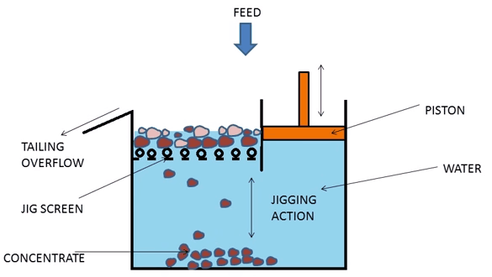
6.3. Jig (cont.)
Jigs are normally used to concentrate relatively material of course particle sizes (≥ 1mm) and fairly closed size range (top size to bottom size ≅ 3:1, i.e. 3 – 10mm).
Low SG*
Separation chamber
(Settling velocity: slow）
Bottom screen
High SG*
Release
Air injection
Air chamber
(Settling velocity: fast）
Water
Denver jig
MS© 2021
Batac jig

Slide 33
6.3. Jig (cont.)
Behaviour of bed, particles and mechanism of stratification of particles
Source: Mineral processing design and operations an introduction p508
The upward stroke makes the bed to expand (during this stage particles move against gravity) while the downward stroke make the bed to contract (particles fall to the support screen or ragging material due to gravity). This causes stratification.
Dense and course particles, migrate towards the bottom of the jig bed and removed as concentrate.
Jig are widely used in iron ore, tungsten, tin, and coal concentration
MS© 2021

Slide 34
Lecture content
6.1. Introduction
6.2. Froth flotation fundamentals
6.3. Jig
6.4. Spiral
6.5. Dense media separation
MS© 2021

Slide 35
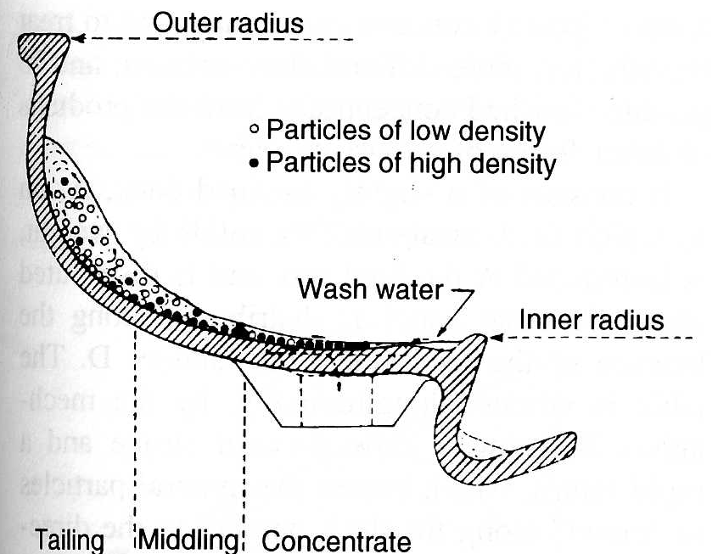
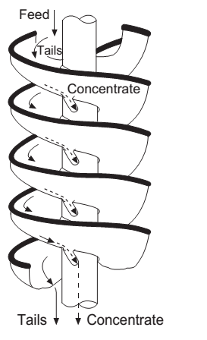
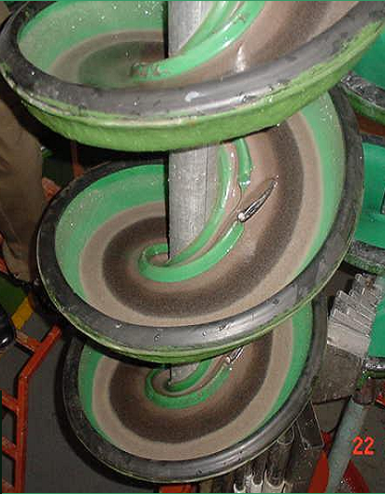
6.4. Spiral
Spiral concentrators consist of a curved-bottom launder which is twisted/turned around a vertical axis in form of a helix.
Slurry, feed material of size range 0.1- 1.5mm, composed of valuable minerals and gangue is fed at the top of the spiral concentrator.
MS© 2021
Source: Mineral processing design and operations, p524

Slide 36
6.4. Spiral (cont.)
Less dense minerals particles being suspended in water attain higher tangential velocities than the dense mineral particles, and migrate toward the outer rim of the spiral.
With the help of added wash water, and after many turns, band of dense mineral particles form inside the rim while less dense mineral particles towards the outer rim.
Ports for removal of dense mineral particles are spaced along the inner rim while the less dense mineral particles remains in the spiral and discharges at the bottom.
Spirals are widely used in gold, coal, tungsten, and iron ore concentration.
MS© 2021

Slide 37
Lecture content
6.1. Introduction
6.2. Froth flotation fundamentals
6.3. Jig
6.4. Spiral
6.5. Dense media separation
MS© 2021

Slide 38
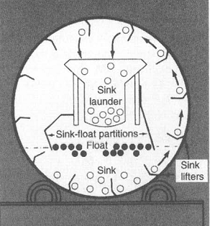
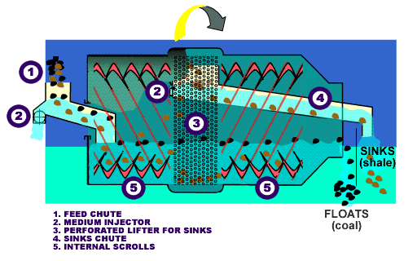
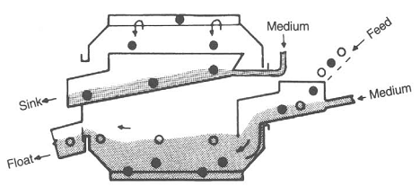
6.5. Dense media seperation
Dense media separation is widely used in upgrading/concentration of iron ore, coal, tin, gold and tungsten.
It operates on the sink-float principle (heavy minerals/materials sink while less dense minerals/materials floats).
Source: Wills, B. A., and Napier-Munn, T., 2005)
MS© 2021

Slide 39
6.5. Dense media seperation (cont.)
Medium which has a specific gravity (sg) between valuable mineral sg and gangue material sg is mostly prepared by adding finely ground ferro-silicon (15% silicon and 85% iron) in water.
Feed material composed of gangue and valuable mineral particles is added into the vessel containing medium of a given s.g.
For example, silica-rich particles with a specific gravity (s.g 2.6) lower than specific gravity of made media (e.g. s.g 3.0) floats on the surface while the iron rich particles (s.g 4.0) sink to the bottom.
Ferrosilicon is washed from the sink and float products on fine screens and is recovered from the wash water with magnetic separators and recycled.
MS© 2021

Slide 40
Lecture content
6.1. Introduction
6.2. Froth flotation fundamentals
6.3. Jig
6.4. Spiral
6.5. Dense media separation
6.6. Magnetic separator
MS© 2021

Slide 41
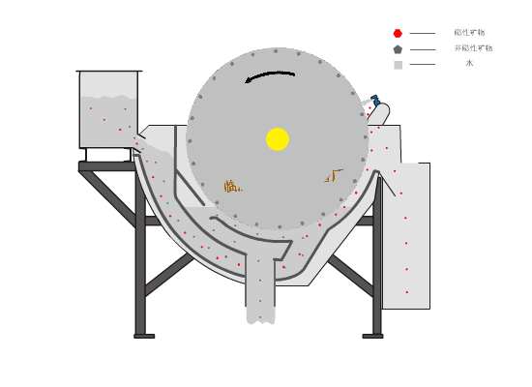
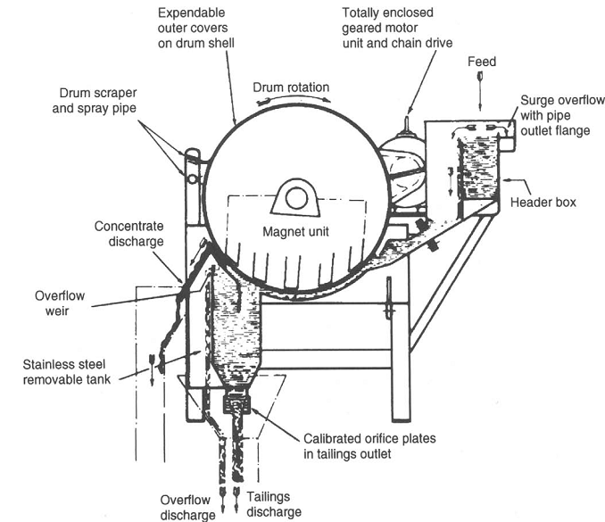
6.6. Magnetic separators
Magnetic separation is the simple iron ore upgrading/concentration processes that depends on the differences in magnetic properties between iron minerals and gangue minerals.
Iron ore
Gangue
MS© 2021
Source: King, I., 2000 and Will, B.A., and Napier-Munn, T., 2005)

Slide 42
6.6. Magnetic separators (cont.)
The concentration process is either wet or dry for fine and course particles, respectively.
For less magnetic iron ore, say hematite, High Intensity Magnetic Separators (HIMS) are used, whereas for high magnetic iron ore, say magnetite, Low Intensity Magnetic Separators (LIMS) are used.
Separator consists of a rotating drum and a stationary internal magnet. Magnetic iron ore minerals adhere to the drum as it passes through the suspension of iron ore particles in water.
When the adherent solids are carried out of the magnetic field they are scrapped off the drum and transferred to a receiving vessel.
MS© 2021

Slide 43
End of Lecture 6

