Slide 1
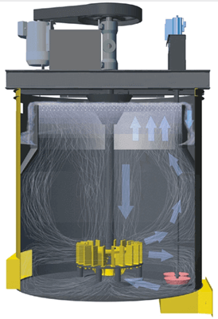
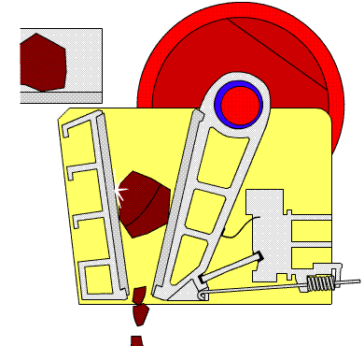


MET 3145: Mineral Processing
By
Marthias SILWAMBA (PhD)
Metallurgical Engineering Department
Marthias.silwamba@unza.zm

Slide 2
Lecture 7
Dewatering and tailing disposal
MS© 2021

Slide 3
Lecture of objective(s)
By the end of the lecture students are expected to:-
Understand the need for dewatering and drying of the concentrate produced.
Understand the dewatering stages; thickening, filtering and drying
Know and understand tailing disposal methods
MS© 2021

Slide 4
Lecture content
7.1. Introduction
7.2. Thickening
7.3. Filtration
7.4. Drying
7.5. Tailings and tailing disposal
7.6. Construction elements of a tailing dam
MS© 2021

Slide 5
Lecture content
7.1. Introduction
7.2. Thickening
7.3. Filtration
7.4. Drying
7.5. Tailings and tailing disposal
7.6. Construction elements of a tailing dam
MS© 2021

Slide 6
7.1. Introduction
Nearly all mineral concentration processes are carried out in water.
Dewatering is the partial/complete removal of water from a mixture of solids & water.
Dewatering is aimed at:
    Reducing transportation & storage costs (i.e., reduce on weight and help in easy handling)
    Reducing the cost of pyrometallurgical treatment (i.e., during any pyrometallurgical process, water should be completely driven off which increase the cost if the content is too high)
    Controlling a pulp that may be too dilute for the next treatment step
The optimum moisture content will be different in each individual case, but will usually lie between 3 and 10 % by weight for the concentrate.
MS© 2021

Slide 7
7.1. Introduction (cont.)
Dewatering of such products is normally carried out in successive stages and more water at each stage is removed.
Depending on the materials (concentrate or tailings) treated for dewatering the order is as follows;
  Thickening
  Filtration
  Drying.
How far dewatering is carried out, is dependent upon the requirements in each individual case.
MS© 2021

Slide 8
Lecture content
7.1. Introduction
7.2. Thickening
7.3. Filtration
7.4. Drying
7.5. Tailings and tailing disposal
7.6. Construction elements of a tailing dam
MS© 2021

Slide 9
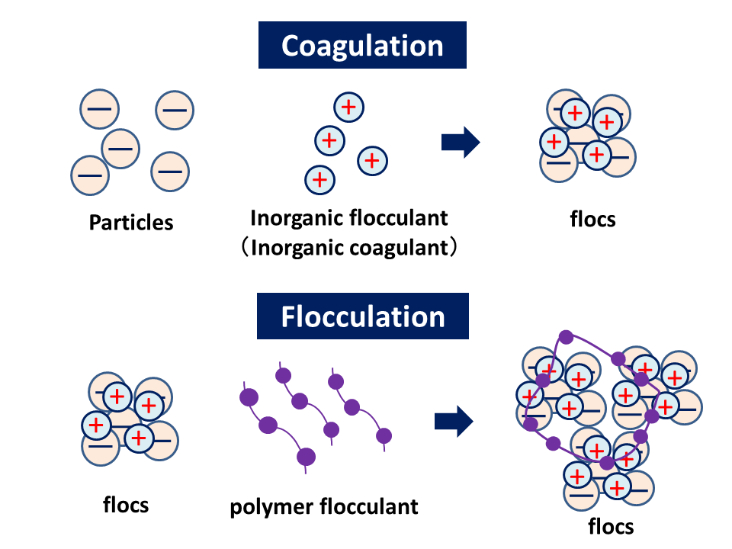
7.2. Thickening
In thickening, the initial dilute pulp is concentrated to a thick pulp, by rejecting liquid that is substantially free of solids. Thickening is based upon the process of sedimentation.
In thickening, the liquid forms the continuous phase, the solids the discrete phase.
If it is required that the water, rejected by a thickener, should be absolutely free of solids, this water is usually passed through a settling pond after the thickener.
To assist settling of very fine particles, flocculants are often used.
MS© 2021

Slide 10
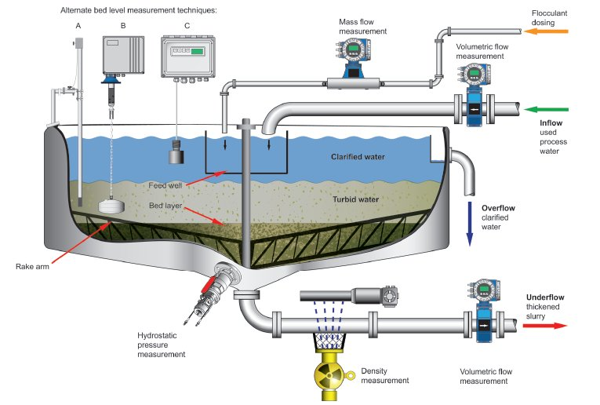
7.2. Thickening (cont.)
https://www.sustainabilitymatters.net.au/content/wastewater/article/optimising-thickener-efficiency--1370645427
MS© 2021

Slide 11
Lecture content
7.1. Introduction
7.2. Thickening
7.3. Filtration
7.4. Drying
7.5. Tailings and tailing disposal
7.6. Construction elements of a tailing dam
MS© 2021

Slide 12
7.3. Filteration
During filtration, the separation of liquid and solids is more complete than is possible by sedimentation (thickening ) only.
This separation is effected by means of a porous medium, which allows the liquid (the filtrate) to pass through, while retaining the solids (the filter cake).
The driving force in filtration is a difference in pressure.
Usually the medium serves mainly to support the filter cake formed and filtration takes place essentially through the filter cake (cake filtration).
MS© 2021

Slide 13
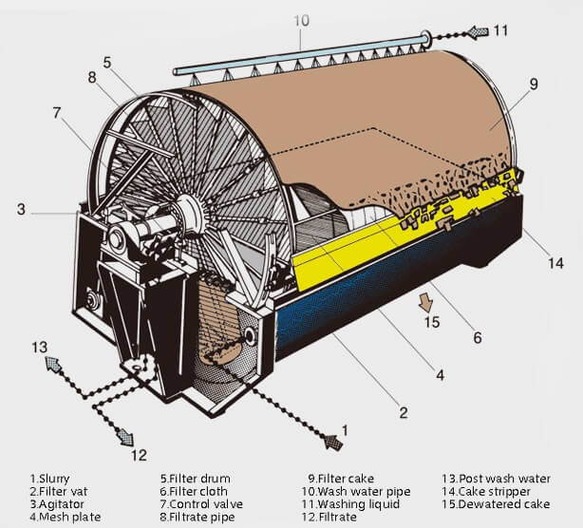
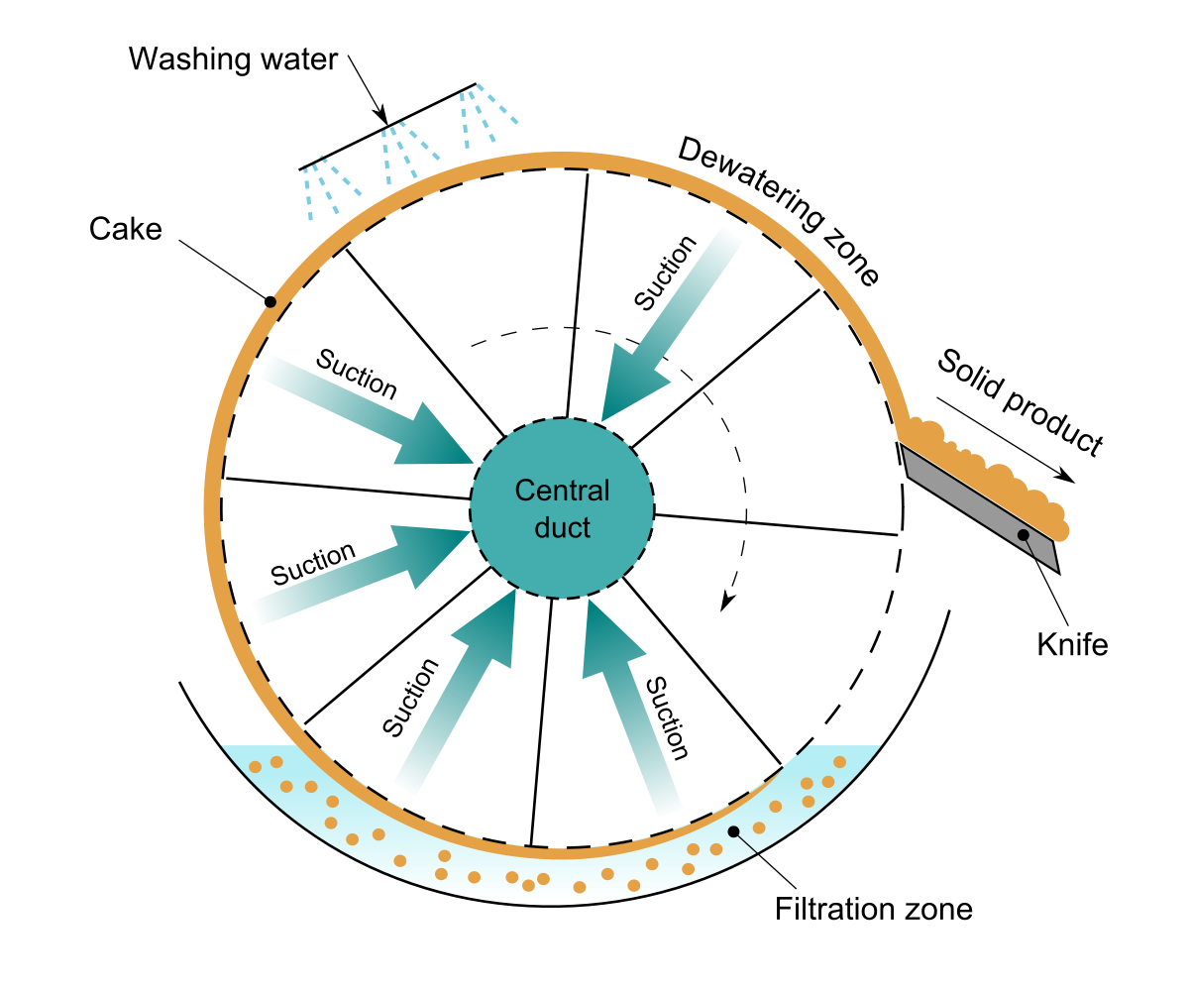
7.3. Filteration (cont.)
Drum filter
Source:https://www.zerodayllc.com/blog/2015/01/26/thickener-operation/
MS© 2021

Slide 14
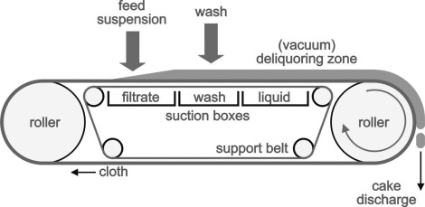
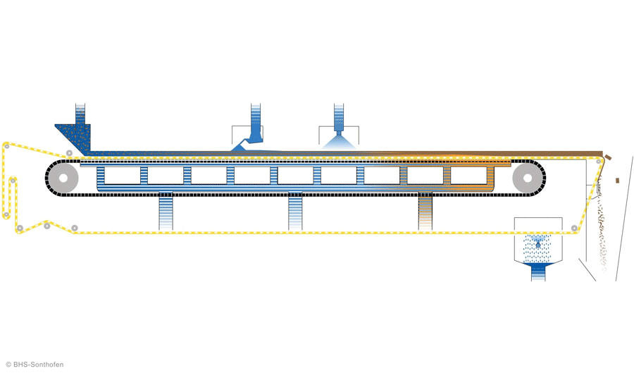
7.3. Filteration (cont.)
Belt filter
MS© 2021

Slide 15
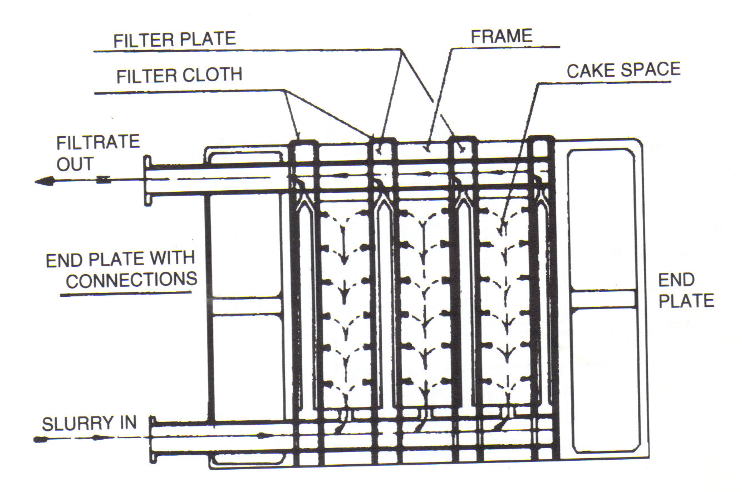
7.3. Filteration (cont.)
Plate and frame filter press
MS© 2021

Slide 16
Lecture content
7.1. Introduction
7.2. Thickening
7.3. Filtration
7.4. Drying
7.5. Tailings and tailing disposal
7.6. Construction elements of a tailing dam
MS© 2021

Slide 17
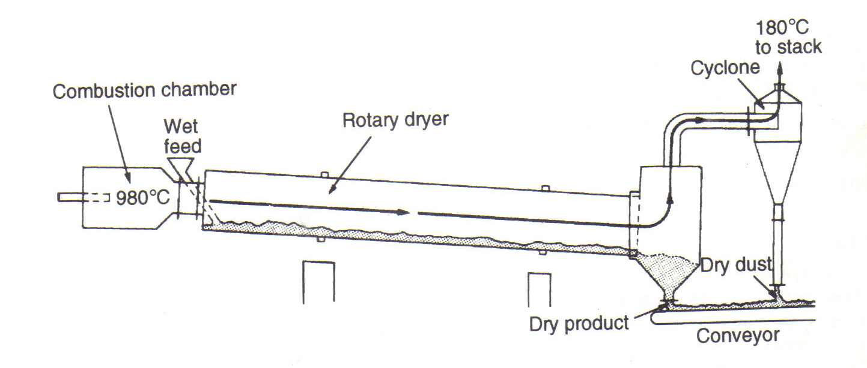
7.4. Drying
Drying is the last stage in a dewatering sequence.
It is effected by evaporation of most of the water still remaining after filtration.
It is far more expensive than thickening or filtration and it is therefore only carried out prior to pyrometallurgical treatment or when shipment cost are very high.
In view of the difference in cost between the two operations, it is also very important that as much water as possible is removed by filtration, prior to drying.
MS© 2021

Slide 18
Lecture content
7.1. Introduction
7.2. Thickening
7.3. Filtration
7.4. Drying
7.5. Tailings and tailing disposal
7.6. Construction elements of a tailing dam
MS© 2021

Slide 19
7.5. Tailings and tailing disposal
Tailings consist of a liquid and solid components and the composition is usually around 20-40 wt% solid.
The composition of waters and solids is mainly site-specific (i.e., it depends on the chemicals used as well as nature of the water used in the process and the gangue minerals.
Tailings waters may be alkaline (cyanide used in processing), acidic (sulphuric acid used in the processing) or saline (saline water was used in the processing).
Tailings solid are composed of finely ground rock (gangue minerals) from the mills.
MS© 2021

Slide 20
7.5. Tailings and tailing disposal (cont.)
Tailings are mostly stored in engineered structures or impoundments called ‘’Tailing storage facilities’’ TSF or ’’Tailing Dams’’ TD.
Tailing dams (TD) should be constructed to
  Contain waste materials indefinitely, and provide long term stability against erosion and mass movement.
  Achieve negligible seepage of tailings liquids into ground and surface waters to prevent contamination
  Prevent failure of dam structure
MS© 2021

Slide 21
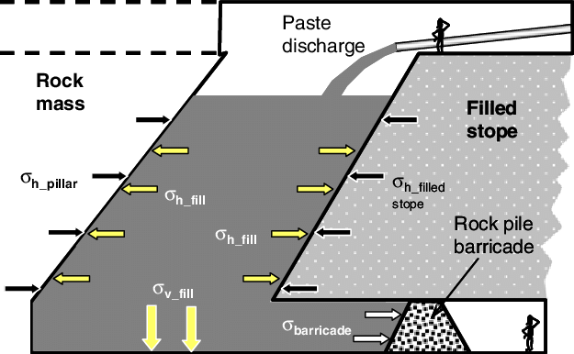
7.5. Tailings and tailing disposal (cont.)
Different tailings disposal methods
Backfilling
Tailings that may contain hazardous materials may be stored underground by backfilling in special constructed facilities or simply just from mined tunnels.
MS© 2021

Slide 22
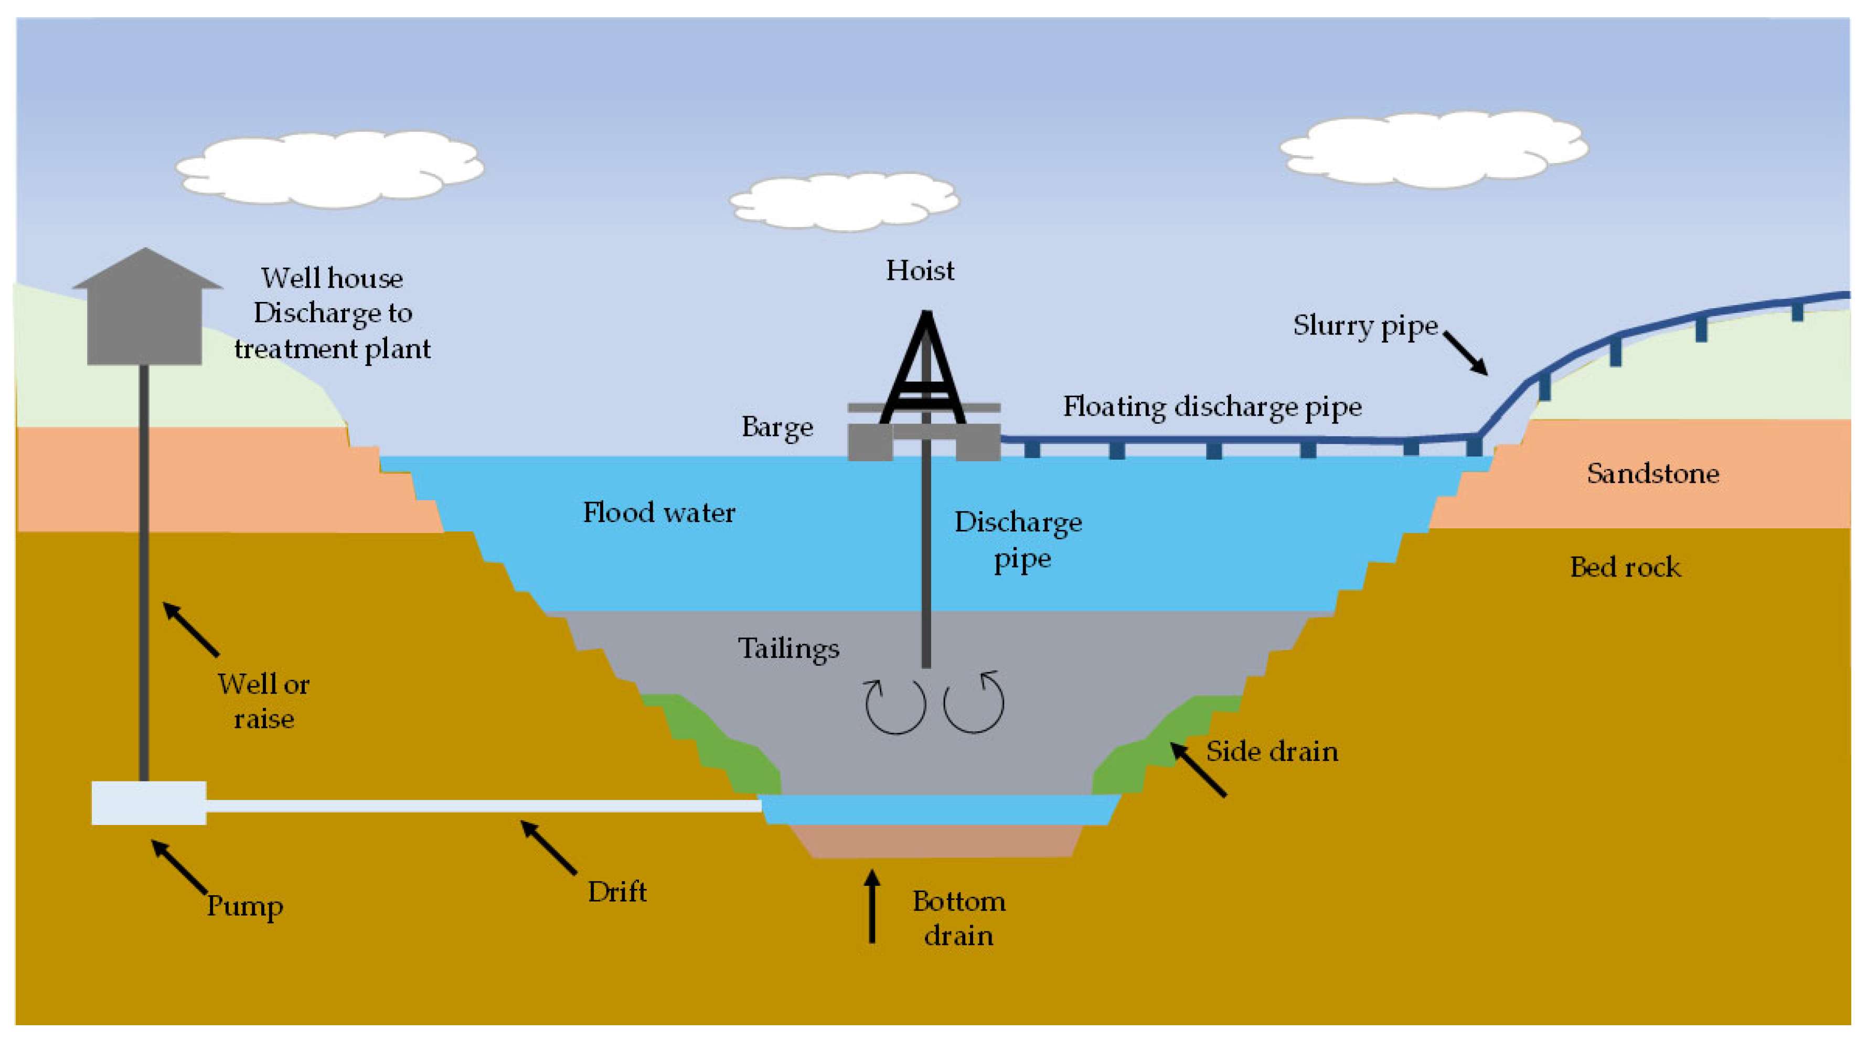
7.5. Tailings and tailing disposal (cont.)
Different tailings disposal methods
In-pit
In-pit tailings storage is simply the process of backfilling abandoned open pit surface mines or any special constructed pit with tailings.
MS© 2021

Slide 23
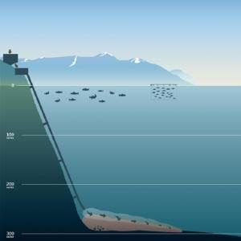
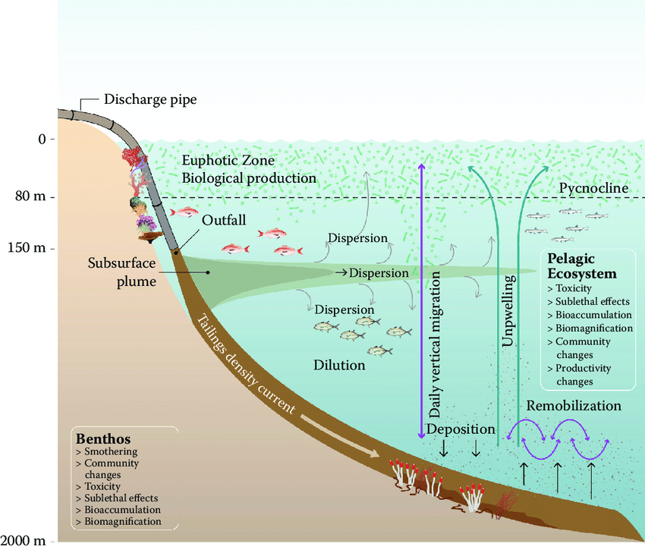
7.5. Tailings and tailing disposal (cont.)
Different tailings disposal methods
Submarine/Deep sea tailing disposal
Mines near the sea this a very good options as it eliminates the acid mine drainage associated with tailings.
MS© 2021

Slide 24
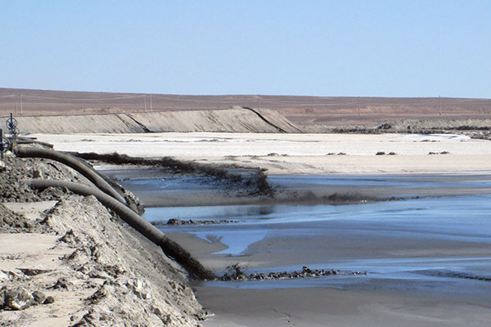
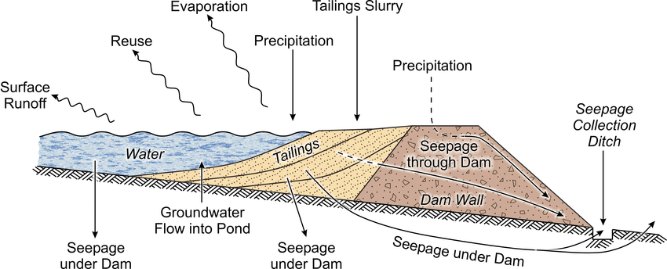
7.5. Tailings and tailing disposal (cont.)
Different tailings disposal methods
Surface TSF
This is arguably the predominant method of tailings disposal. It evolves pumping and sub-aerial deposition of an aqueous slurry.
MS© 2021

Slide 25
7.5. Tailings and tailing disposal (cont.)
Factors that effect the choice of tailing disposal methods include
  Composition of tailings
  Local land use
  Local topography
  Costs
  Environmental concerns
MS© 2021

Slide 26
Lecture content
7.1. Introduction
7.2. Thickening
7.3. Filtration
7.4. Drying
7.5. Tailings and tailing disposal
7.6. Construction elements of a tailing dam
MS© 2021

Slide 27
7.6. Construction elements of a tailing dam
Tailing dams hold up many tone of solid in from of pulp and many millions litres of water from processing the ore and precipitation.
The construction elements of tailing dams include
  Dam walls (Dykes)-to contain the tailing
  These are normally constructed using waste rock and materials available at the dam site.
  The height of the dam wall defers but the maximum can be as high as 100 m
MS© 2021

Slide 28
7.6. Construction elements of a tailing dam (cont.)
  Impermeable liners- at the bottom to prevent leakage of fluids.
  Linings may consist of geomembranes (polyethylene or PVC), clay layers, or a combination of the two.
  Drainage ditches
  These are lounder dug around the periphery of the tailings dams to collect the seepage.
  Under-drains
  To facilitate drainage and consolidation of the tailings in the dam.
  Note that not all TD have underdrain, in that case fluid dry out by evaporation and seepage only which take really long.
MS© 2021

Slide 29
7.6. Construction elements of a tailing dam (cont.)
  Impermeable liners- at the bottom to prevent leakage of fluids.
  Linings may consist of geomembranes (polyethylene or PVC), clay layers, or a combination of the two.
  Drainage ditches
  These are lounder dug around the periphery of the tailings dams to collect the seepage.
  Under-drains
  To facilitate drainage and consolidation of the tailings in the dam.
  Note that not all TD have underdrain, in that case fluid dry out by evaporation and seepage only which take really long.
MS© 2021

Slide 30
7.6. Construction elements of a tailing dam (cont.)
MS© 2021

Slide 31
End of Lecture 7

