Slide 1
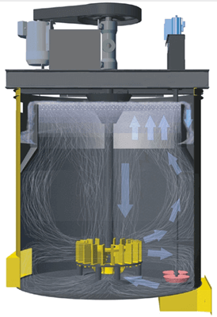
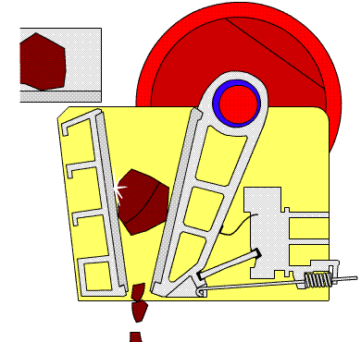


MET 3145: Mineral Processing
By
Marthias SILWAMBA (PhD)
Metallurgical Engineering Department
Marthias.silwamba@unza.zm

Slide 2
Lecture 5
Classification
MS© 2021

Slide 3
Lecture of objective(s)
By the end of the lecture students are expected to:-
Understand the principle of particles settling (free and hindered settling)
Know the types and working principles of classifiers
Understand the measure of efficiency of classifiers and effects of operating variables
MS© 2021

Slide 4
Lecture content
5.1. Introduction
5.2. Principle of classification: Settling
5.3. Types of classifiers
MS© 2021

Slide 5
Lecture content
5.1. Introduction
5.2. Principle of classification: Settling
5.3. Types of classifiers
MS© 2021

Slide 6
5.1. Introduction
Classification is a method of separating mixtures of minerals into two or more products on the basis of the velocity with which the grains fall through a fluid medium.
It takes advantage of the principle that particles of the same density but of different sizes settle in fluid at different rates (velocities).
Meanwhile, particles of the same sizes but different densities will equally settle in fluid at different velocities.
Exploring the difference in the settling rates allows for the separation of particles based on size and density.
In mineral processing, classification is generally applied to mineral particles that are considered too fine to be sorted (classified/sieved) efficiently by screening.
MS© 2021

Slide 7
Lecture content
5.1. Introduction
5.2. Principle of classification: Settling
5.3. Types of classifiers
MS© 2021

Slide 8
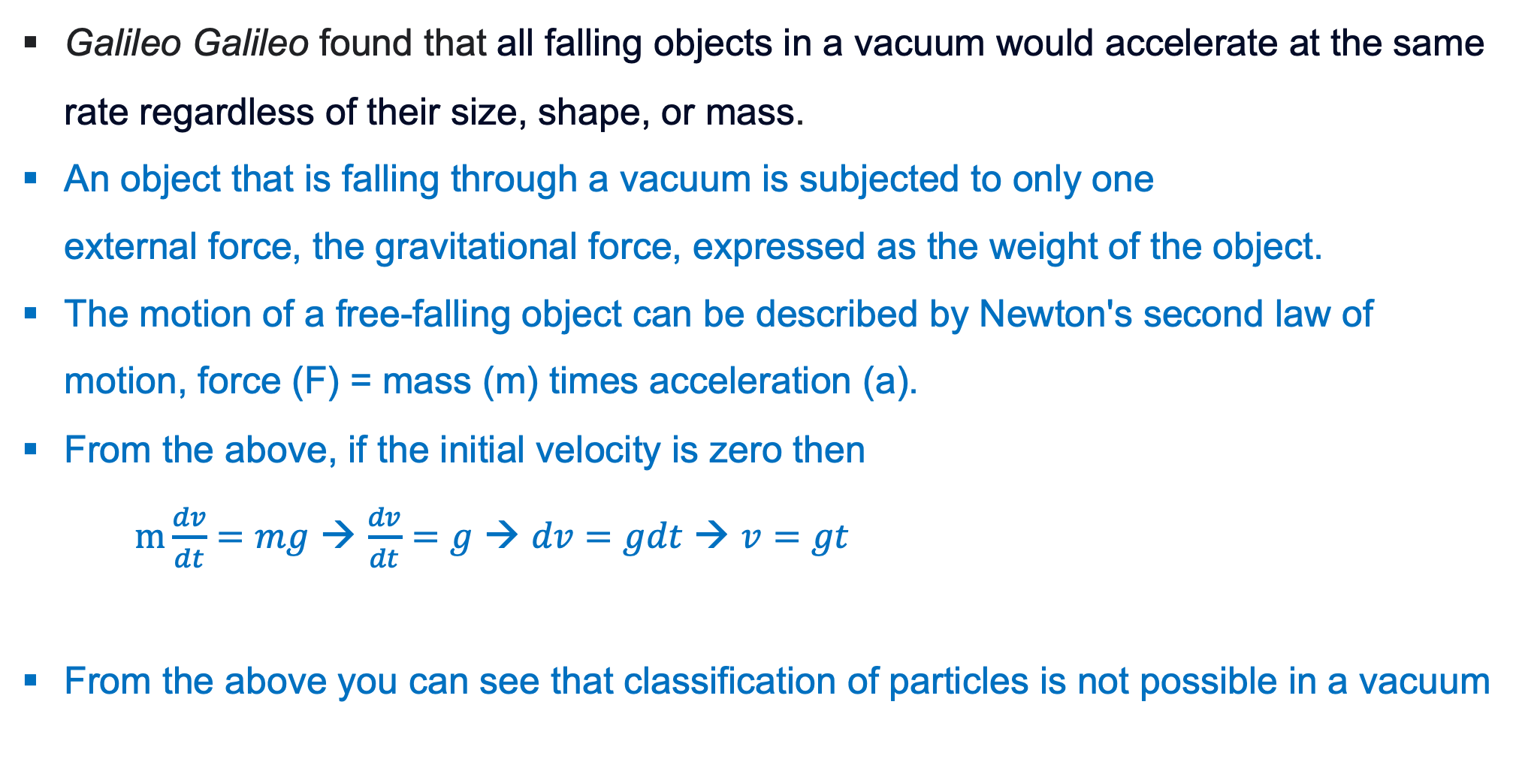
5.2. Principle of classification: Settling
Galileo Galileo found that all falling objects in a vacuum would accelerate at the same rate regardless of their size, shape, or mass.
An object that is falling through a vacuum is subjected to only one external force, the gravitational force, expressed as the weight of the object.
The motion of a free-falling object can be described by Newton's second law of motion, force (F) = mass (m) times acceleration (a).
From the above, if the initial velocity is zero then
$m\frac{dv}{dt}=mg$ → $\frac{dv}{dt}=g$ → $dv=gdt$ → $v=gt$
From the above you can see that classification of particles is not possible in a vacuum
MS© 2021

Slide 9

5.2. Principle of classification: Settling (cont.)
However, when particle fall through fluid the following are three forces that acts on the particle
$m\frac{dv}{dt}=mg−m^{′}g − F_{D}$
At terminal velocity $m\frac{dv}{dt}=0$, hence $F_{D}=g\left(m−m^{′}\right)= \frac{πgd^{3}}{6} \left(ρ_{s} −ρ_{f}\right)$ …(1)
Drag force: F_{D}
Gravity force: mg
Buoyancy force: m’g
MS© 2021

Slide 10
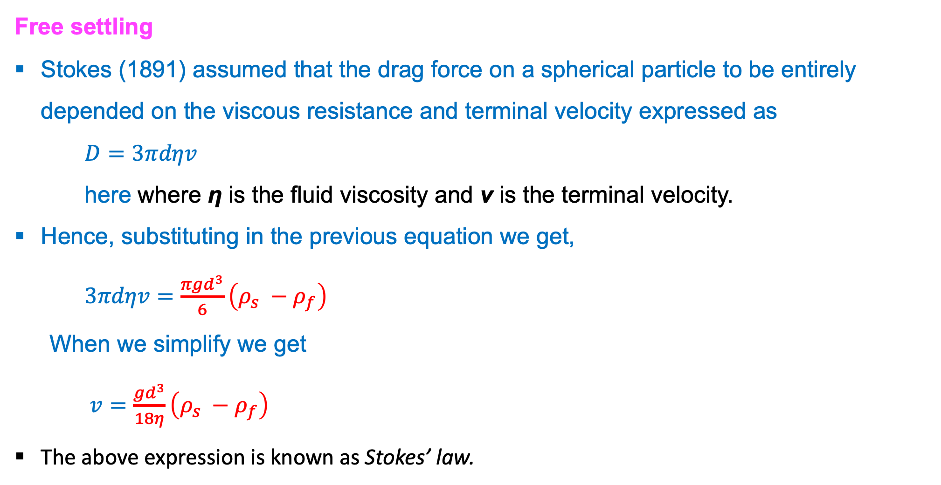
5.2. Principle of classification: Settling (cont.)
Free settling
Stokes (1891) assumed that the drag force on a spherical particle to be entirely depended on the viscous resistance and terminal velocity expressed as
$D=3πdηv$
here where η is the fluid viscosity and ν is the terminal velocity.
Hence, substituting in the previous equation we get,
$3πdηv=\frac{πgd^{3}}{6}\left(ρ_{s} −ρ_{f}\right)$
  When we simplify we get
  $v=\frac{gd^{3}}{18η}\left(ρ_{s} −ρ_{f}\right)$
The above expression is known as Stokes’ law.
MS© 2021

Slide 11
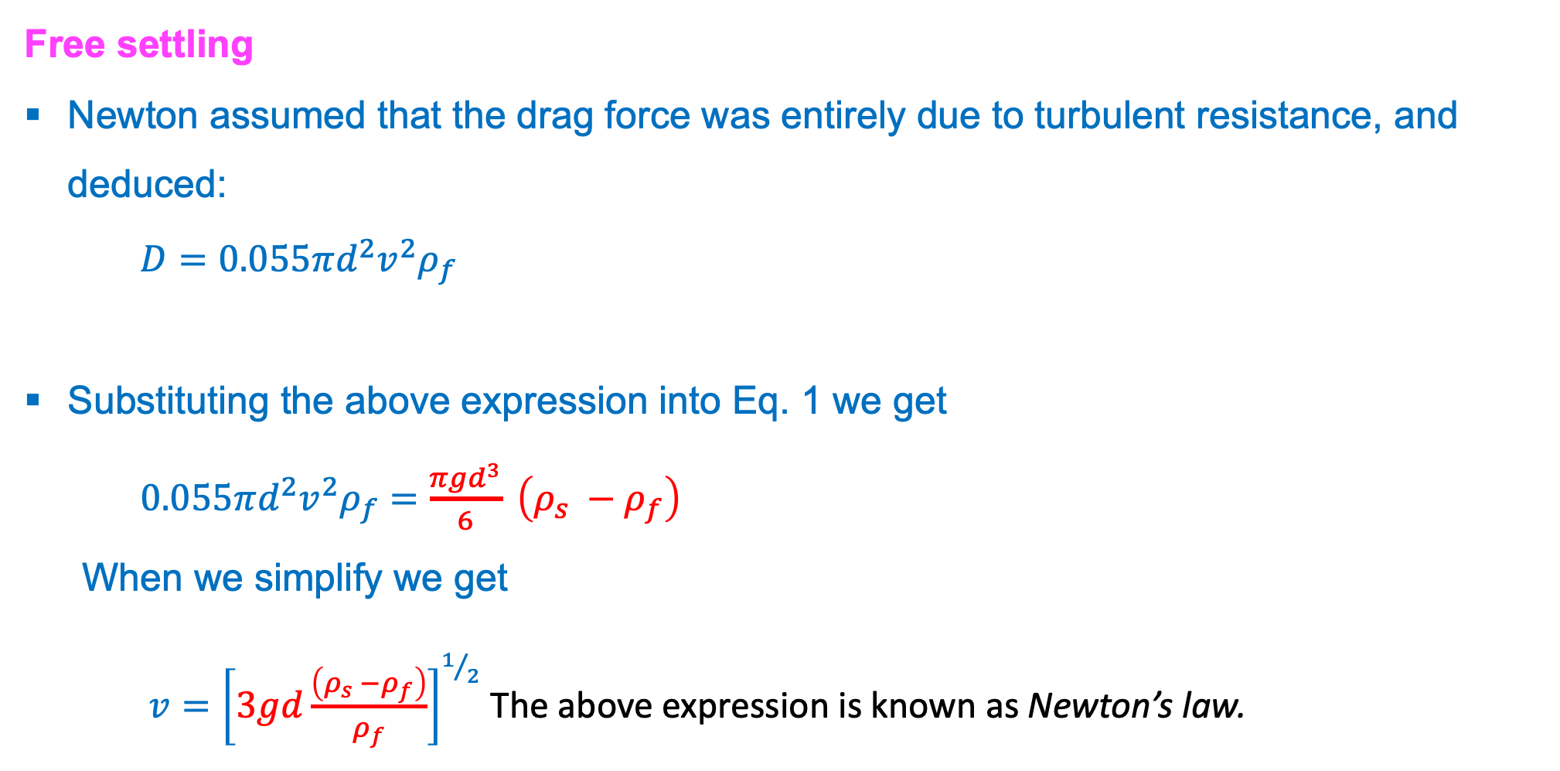
5.2. Principle of classification: Settling (cont.)
Free settling
Newton assumed that the drag force was entirely due to turbulent resistance, and deduced:
$D=0.055πd^{2}v^{2}ρ_{f}$
Substituting the above expression into Eq. 1 we get
$0.055πd^{2}v^{2}ρ_{f}=\frac{πgd^{3}}{6} \left(ρ_{s} −ρ_{f}\right)$
  When we simplify we get
  $v={\left[3gd\frac{\left(ρ_{s} −ρ_{f}\right)}{ρ_{f}}\right]}^{1/2}$ The above expression is known as Newton’s law.
MS© 2021

Slide 12
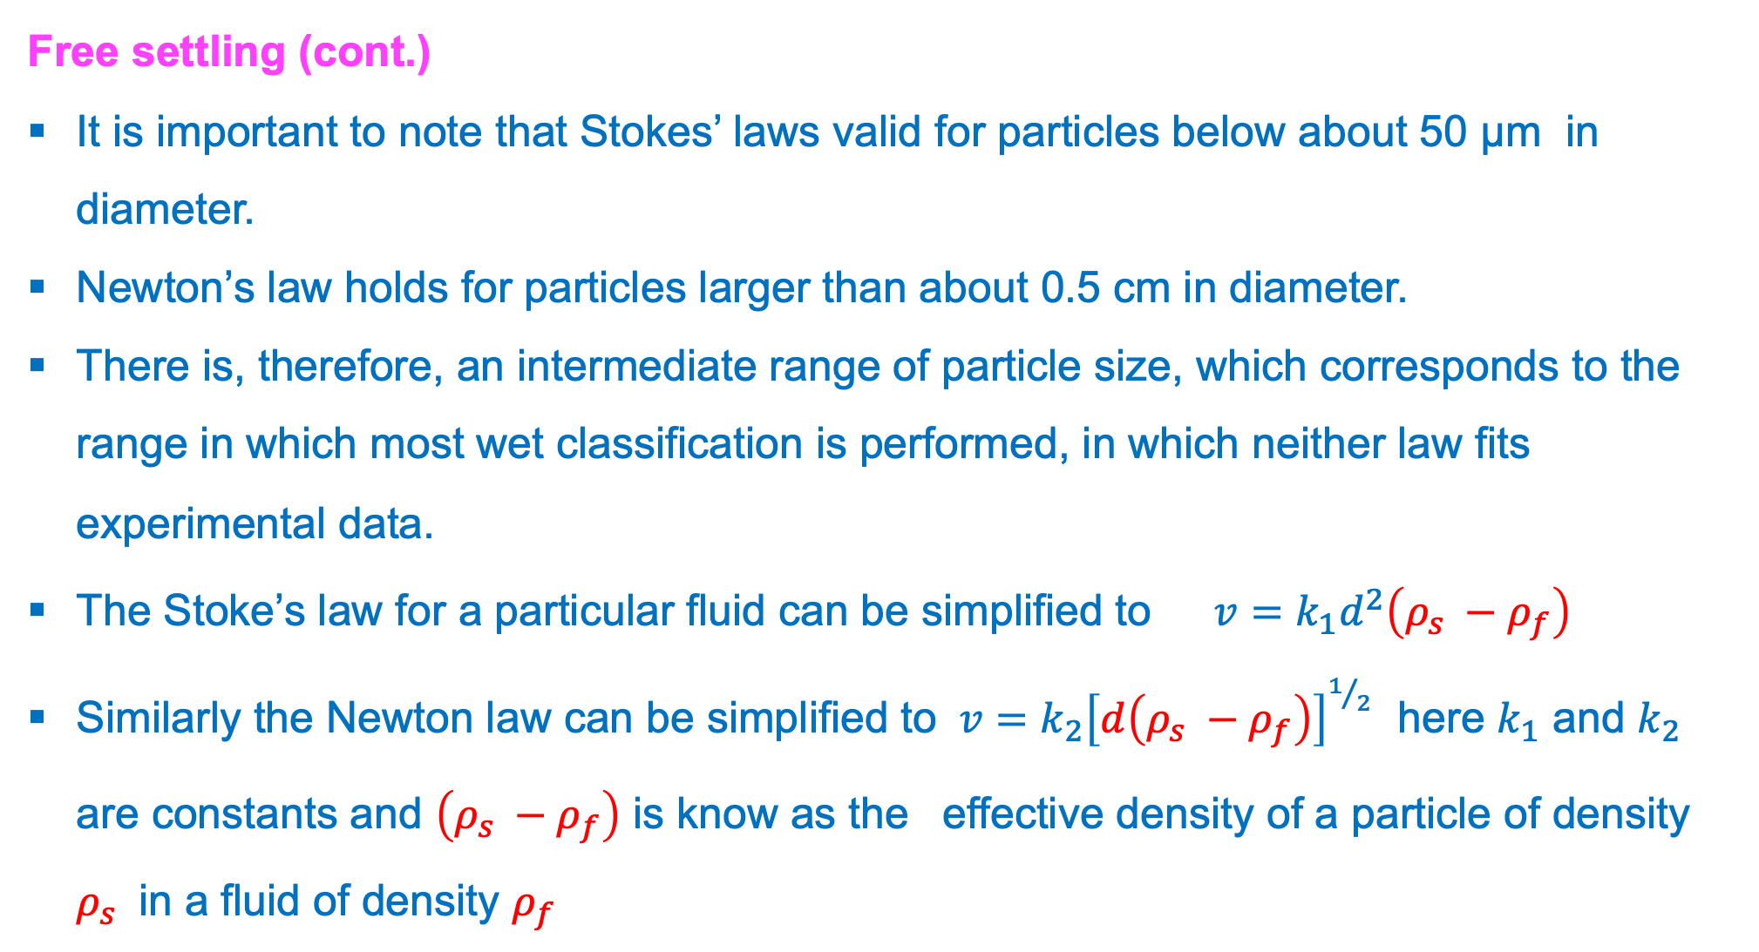
5.2. Principle of classification: Settling (cont.)
Free settling (cont.)
It is important to note that Stokes’ laws valid for particles below about 50 μm in diameter.
Newton’s law holds for particles larger than about 0.5 cm in diameter.
There is, therefore, an intermediate range of particle size, which corresponds to the range in which most wet classification is performed, in which neither law fits experimental data.
The Stoke’s law for a particular fluid can be simplified to $v=k_{1}d^{2}\left(ρ_{s} −ρ_{f}\right)$
Similarly the Newton law can be simplified to $v={k_{2}\left[d\left(ρ_{s} −ρ_{f}\right)\right]}^{1/2}$ here $k_{1}$ and $k_{2}$ are constants and $\left(ρ_{s} −ρ_{f}\right)$ is know as the effective density of a particle of density $ρ_{s}$ in a fluid of density $ρ_{f}$
MS© 2021

Slide 13
5.2. Principle of classification: Settling (cont.)
Free settling (cont.)
Both laws show that the terminal velocity of a particles in a particular fluid is a function only of the particle size and density.
Then we can state that:–
  If two particles have the same density then the particle with the larger diameter has the higher terminal velocity.
  If two particles have the same diameter, then the heavier particle has the higher terminal velocity.
MS© 2021

Slide 14
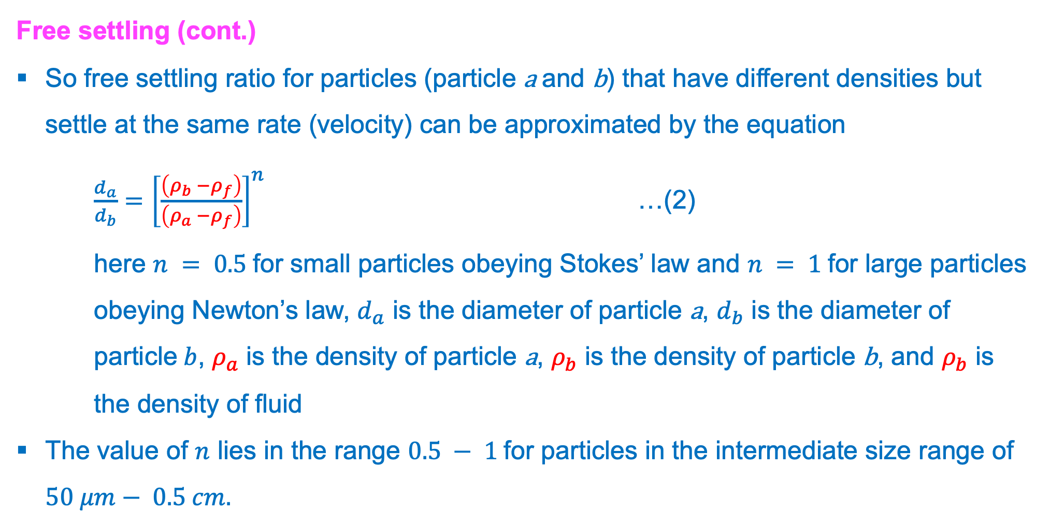
5.2. Principle of classification: Settling (cont.)
Free settling (cont.)
So free settling ratio for particles (particle a and b) that have different densities but settle at the same rate (velocity) can be approximated by the equation
$\frac{d_{a}}{d_{b}}={\left[\frac{\left(ρ_{b} −ρ_{f}\right)}{\left(ρ_{a} −ρ_{f}\right)}\right]}^{n}$ …(2)
here $n = 0.5$for small particles obeying Stokes’ law and $n = 1$for large particles obeying Newton’s law, $d_{a}$ is the diameter of particle a, $d_{b}$ is the diameter of particle$b$, $ρ_{a}$ is the density of particle a, $ρ_{b}$ is the density of particle b, and $ρ_{b}$ is the density of fluid
The value of $n$ lies in the range $0.5 − 1$for particles in the intermediate size range of $50 μm− 0.5 cm.$
MS© 2021

Slide 15
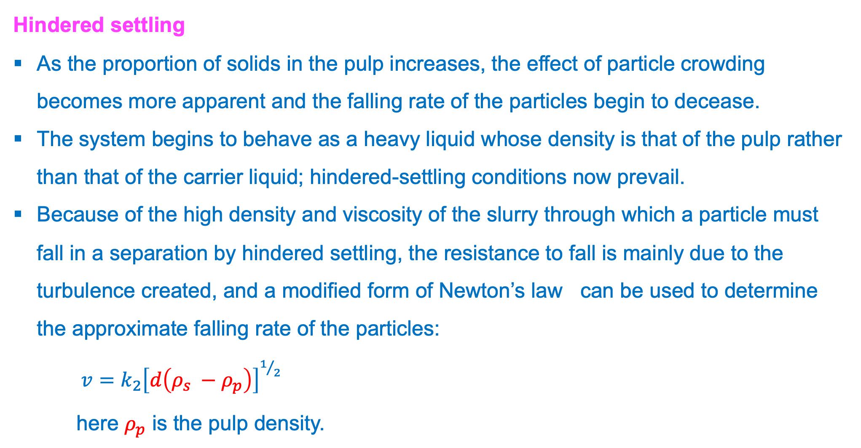
5.2. Principle of classification: Settling (cont.)
Hindered settling
As the proportion of solids in the pulp increases, the effect of particle crowding becomes more apparent and the falling rate of the particles begin to decease.
The system begins to behave as a heavy liquid whose density is that of the pulp rather than that of the carrier liquid; hindered-settling conditions now prevail.
Because of the high density and viscosity of the slurry through which a particle must fall in a separation by hindered settling, the resistance to fall is mainly due to the turbulence created, and a modified form of Newton’s law can be used to determine the approximate falling rate of the particles:
$v={k_{2}\left[d\left(ρ_{s} −ρ_{p}\right)\right]}^{1/2}$
here $ρ_{p}$ is the pulp density.
MS© 2021

Slide 16
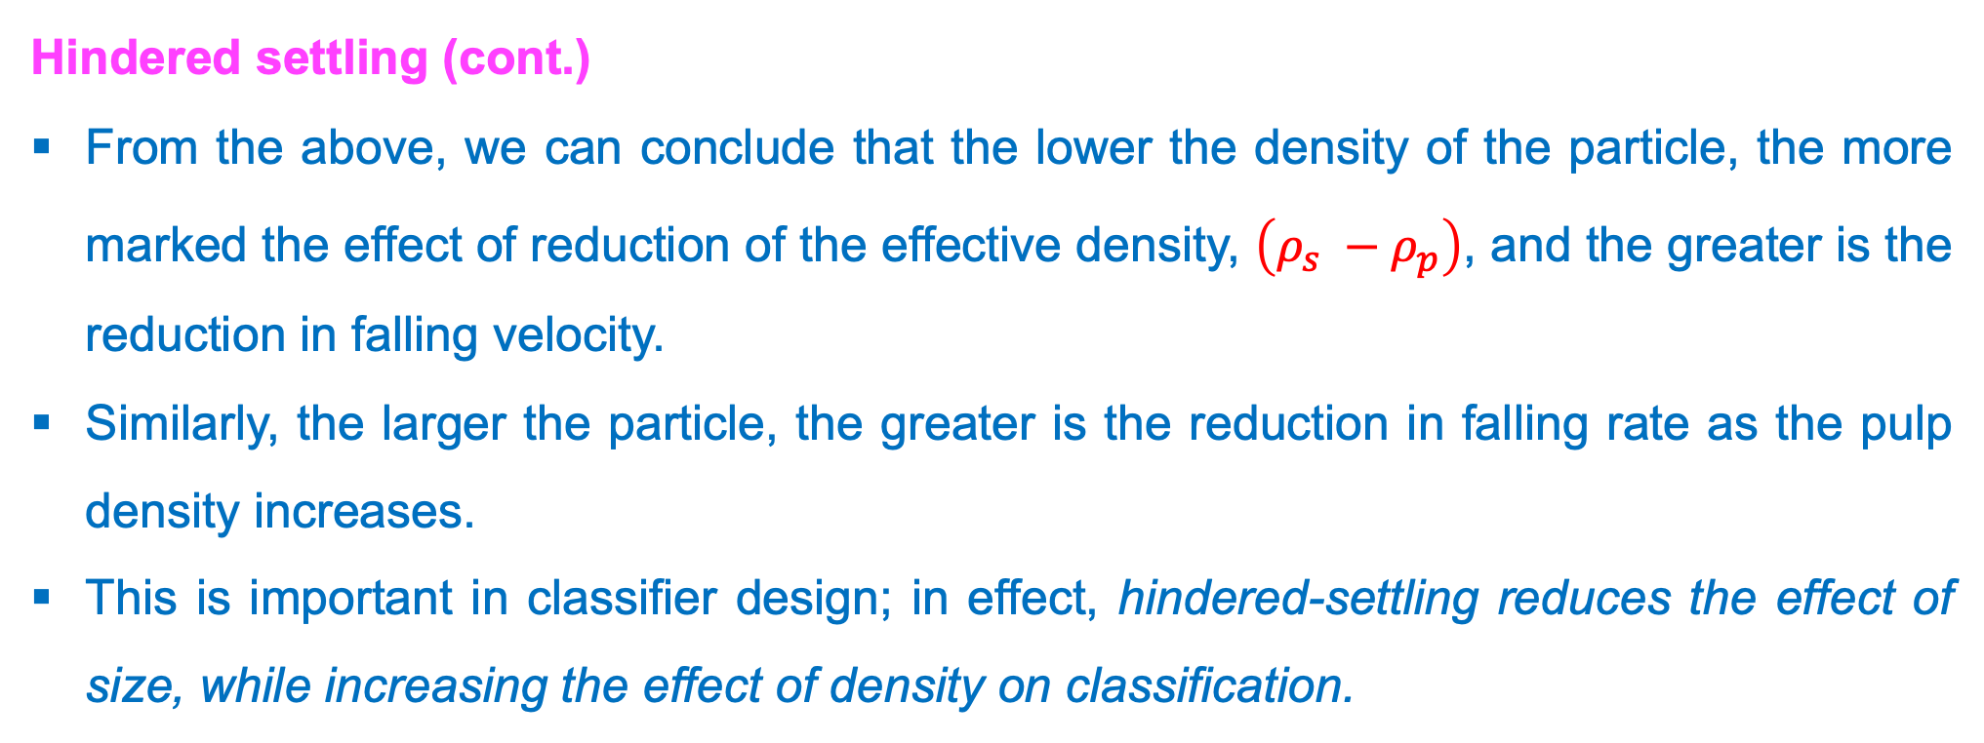
5.2. Principle of classification: Settling (cont.)
Hindered settling (cont.)
From the above, we can conclude that the lower the density of the particle, the more marked the effect of reduction of the effective density, $\left(ρ_{s} −ρ_{p}\right)$, and the greater is the reduction in falling velocity.
Similarly, the larger the particle, the greater is the reduction in falling rate as the pulp density increases.
This is important in classifier design; in effect, hindered-settling reduces the effect of size, while increasing the effect of density on classification.
MS© 2021

Slide 17
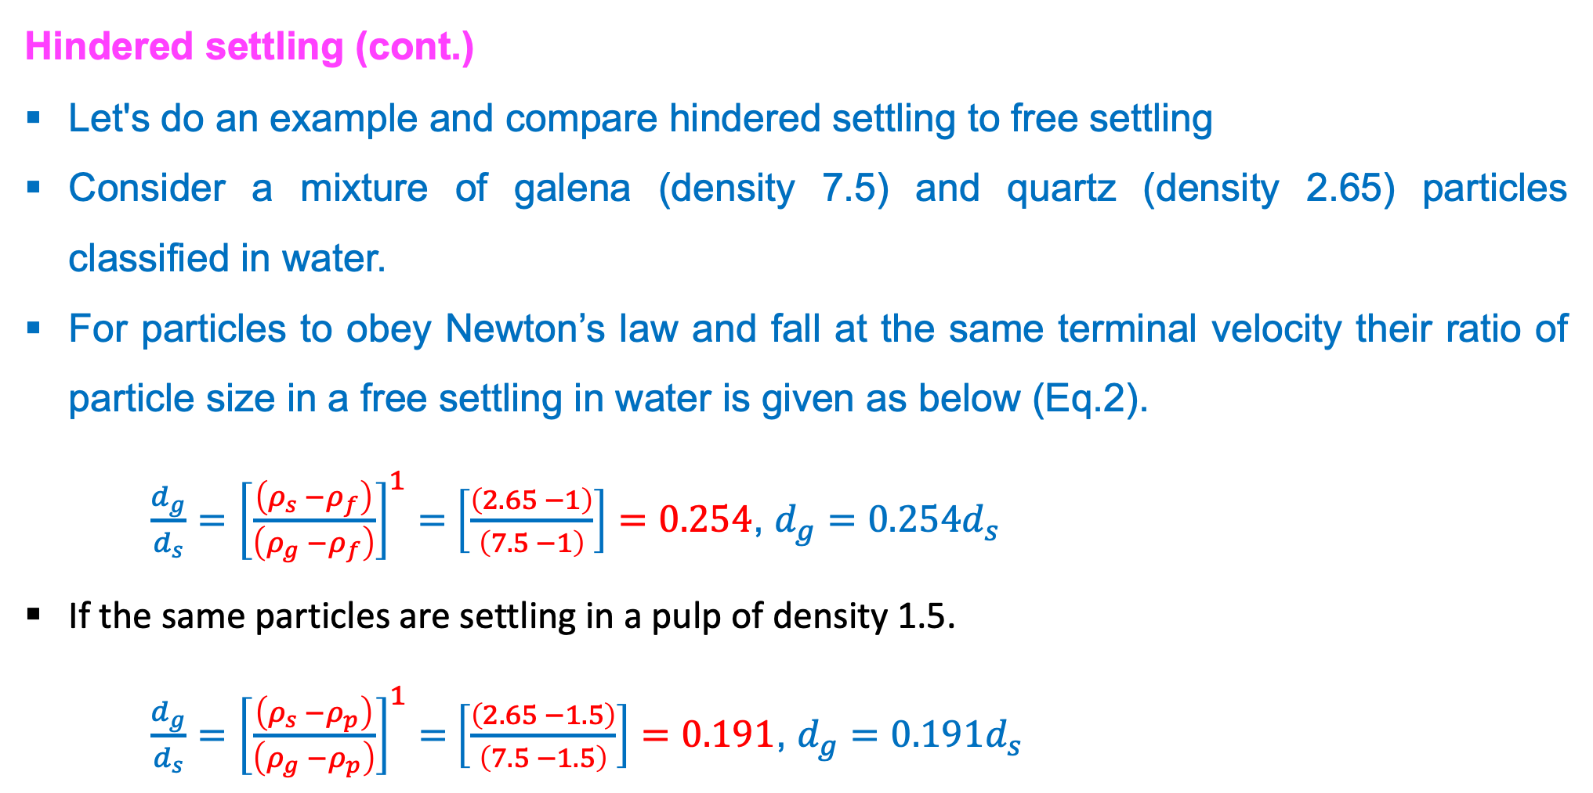
5.2. Principle of classification: Settling (cont.)
Hindered settling (cont.)
Let's do an example and compare hindered settling to free settling
Consider a mixture of galena (density 7.5) and quartz (density 2.65) particles classified in water.
For particles to obey Newton’s law and fall at the same terminal velocity their ratio of particle size in a free settling in water is given as below (Eq.2).
$\frac{d_{g}}{d_{s}}={\left[\frac{\left(ρ_{s} −ρ_{f}\right)}{\left(ρ_{g} −ρ_{f}\right)}\right]}^{1}=$ $\left[\frac{\left(2.65 −1\right)}{\left(7.5 −1\right)}\right]=0.254$, $d_{g}=0.254d_{s}$
If the same particles are settling in a pulp of density 1.5.
$\frac{d_{g}}{d_{s}}={\left[\frac{\left(ρ_{s} −ρ_{p}\right)}{\left(ρ_{g} −ρ_{p}\right)}\right]}^{1}=$ $\left[\frac{\left(2.65 −1.5\right)}{\left(7.5 −1.5\right)}\right]=0.191$, $d_{g}=0.191d_{s}$
MS© 2021

Slide 18
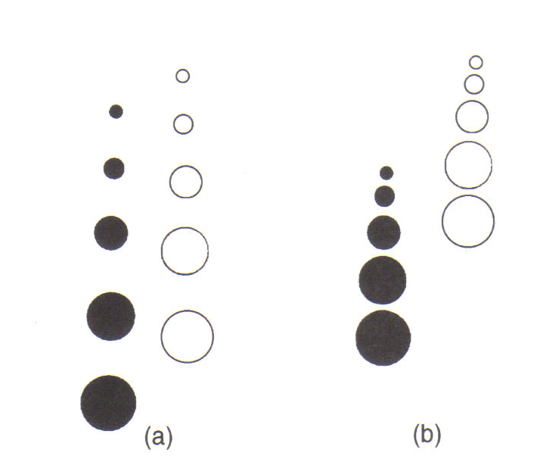
5.2. Principle of classification: Settling (cont.)
Hindered settling (cont.)
The hindered-settling ratio is always greater than the free-settling ratio, and the denser the pulp, the greater is the ratio of the diameter of equal settling particles.
Hindered-settling classifiers are used to increase the effect of density on the separation, whereas free-settling classifiers use relatively dilute suspensions to increase the effect of size on the separation.
Classification by (a) free settling, (b) hindered settling
MS© 2021

Slide 19
Lecture content
5.1. Introduction
5.2. Principle of classification: Settling
5.3. Types of classifiers
MS© 2021

Slide 20
5.3. Types of classifiers
Classifiers used for industrial sizing of fine particles in grinding circuits.
These classifiers are categorized in three main groups:
  Hydraulic classifiers
  Mechanical classifiers
  Hydrocyclones
As you will see, the above classes can be in two broad classes depending on the orientation.
  Horizontal current classifiers such as mechanical classifiers are essentially of the free-settling type and accentuate the sizing function.
  Vertical current or hydraulic classifiers are usually hindered-settling types and so increase the effect of density on the separation.
MS© 2021

Slide 21
5.3. Types of classifiers (cont.)
Hydraulic classifiers
These are vessels with ‘sorting columns’ in which the particles are made to settle against a rising current of water.
They give a sharp size separation, but their capacity is low and they use much water.
They are characterised by the use of water additional to that of the feed pulp, introduced so that its direction of flow opposes that of the settling particles.
The operation of the hydraulic classifiers is as shown in the next slide.
MS© 2021

Slide 22
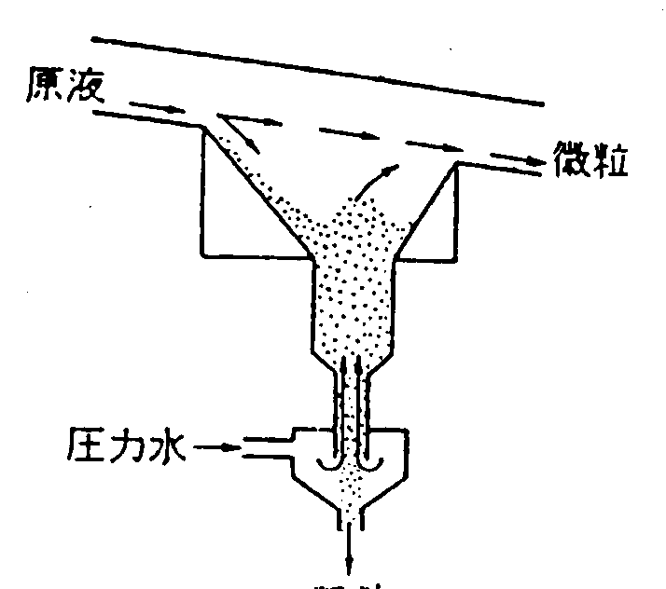
5.3. Types of classifiers (cont.)
Hydraulic classifiers (cont.)
Feed
Smaller particles
Pressured water
粗粒
Larger particles
MS© 2021

Slide 23
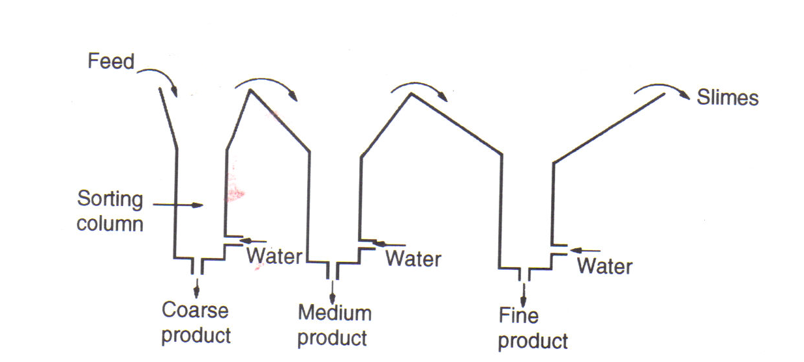
5.3. Types of classifiers (cont.)
Hydraulic classifiers (cont.)
They normally consists of a series of sorting columns through each of which a vertical current of water is rising and particles are settling out
MS© 2021

Slide 24
5.3. Types of classifiers (cont.)
Hydraulic classifiers (cont.)
The greatest use for hydraulic classifiers in the mineral industry is for sorting the feed to certain gravity concentration processes.
Since the ratio of sizes of equally settling particles is high, the classifier is capable of performing a concentrating effect, and the first spigot product is normally of higher grade than the other products
MS© 2021

Slide 25
5.3. Types of classifiers (cont.)
Hydraulic classifiers: Settling cones
These are the simplest form of hydraulic classifier, in which there is little attempt to do more than separate solids from the liquid, i.e. They are sometimes used as dewatering units in small-scale operations.
They are often used in the aggregate industry to de-slime coarse sands products.
The pulp is fed into the tank as a distributed stream at F, with the spigot discharge S initially closed.
When the tank is full, overflow of water and slimes commences, and a bed of settled sand builds up until it reaches the level shown.
MS© 2021

Slide 26
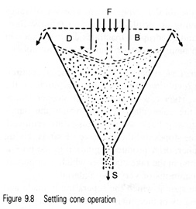
5.3. Types of classifiers (cont.)
Hydraulic classifiers: Settling cones (cont.)
Feed
Feed
Smaller particles
MS© 2021

Slide 27
5.3. Types of classifiers (cont.)
Mechanical classifiers
Several forms of classifier exist in which the material of lower settling velocity is carried away in a liquid overflow, and the material of higher settling velocity is deposited on the bottom of the equipment and is dragged upwards against the flow of liquid by some mechanical means.
Mechanical classifiers have widespread use in closed-circuit grinding operations and in the classification of products from ore-washing plants. In washing plants they act more or less as sizing devices, as the particles are essentially unliberated, so are of similar density. In closed circuit grinding they have a tendency to return small dense particles to the mill, causing overgrinding.
MS© 2021

Slide 28
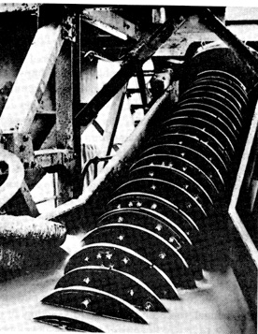
5.3. Types of classifiers (cont.)
Mechanical classifiers (cont.)
Feed
Slurry pool
Screw
Overflow
(smaller particles)
Lift up
Underflow
(larger particles)
Coarse
Fine
MS© 2021
Settling velocity of particles in fluid

Slide 29
5.3. Types of classifiers (cont.)
Hydrocyclone
This is a continuously operating classifying device that utilises centrifugal force to accelerate the settling rate of particles.
It is widely used in closed circuit grinding operations but has found many other uses, such as de-sliming, degritting, and thickening.
A typical hydrocyclone consists of a conically shaped vessel, open at its apex, or underflow, joined to a cylindrical section, which has a tangential feed inlet.
The top of the cylindrical section is closed with a plate through which passes an axially mounted overflow pipe.
The pipe is extended into the body of the cyclone by a short, removable section known as the vortex finder, which prevents short-circuiting of feed directly into the overflow.
MS© 2021

Slide 30
5.3. Types of classifiers (cont.)
Hydrocyclone (cont.)
The feed is introduced under pressure through the tangential entry which imparts a swirling motion to the pulp.
This generates a vortex in the cyclone, with a low-pressure zone along the vertical axis.
An air core develops along the axis, normally connected to the atmosphere through the apex opening, but in part created by dissolved air coming out of solution in the zone of low pressure.
MS© 2021

Slide 31
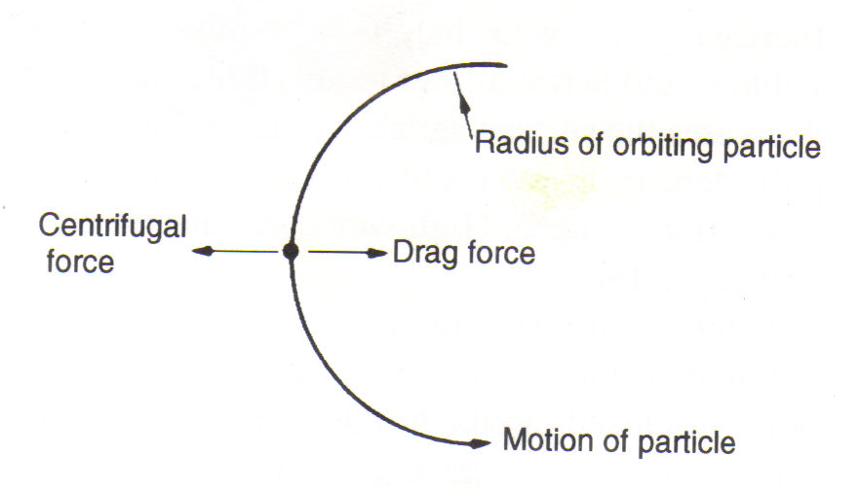
5.3. Types of classifiers (cont.)
Hydrocyclone (cont.)
The classical theory of hydrocyclone action is that particles within the flow pattern are subjected to two opposing forces–an outward centrifugal force and an inwardly acting drag force.
MS© 2021

Slide 32
5.3. Types of classifiers (cont.)
Hydrocyclone (ccont.)
The centrifugal force developed accelerates the settling of the particles (there is evidence to show that Stokes’ law applies with reasonable accuracy to separations in cyclones of conventional design), thereby separating the particles according to size and specific gravity.
Faster settling particles move to the wall of the cyclone, where the velocity is lowest, and migrate to the apex opening.
Due to the action of the drag force, the slower-settling particles move towards the zone of low pressure along the axis and are carried upward through the vortex finder to the overflow.
MS© 2021

Slide 33
5.3. Types of classifiers (cont.)
Hydrocyclone (cont.).
Overflow:
Smaller particles + water
Particles +water
Typical trajectory of a smaller particle
Inner region: upward flow
Feed: introduced under pressure through the tangential entry
Centrifugal force
Drag force
Motion of particle
Typical trajectory of a larger particle
Outer region: downward flow
Underflow:
Larger particles + water
MS© 2021

Slide 34
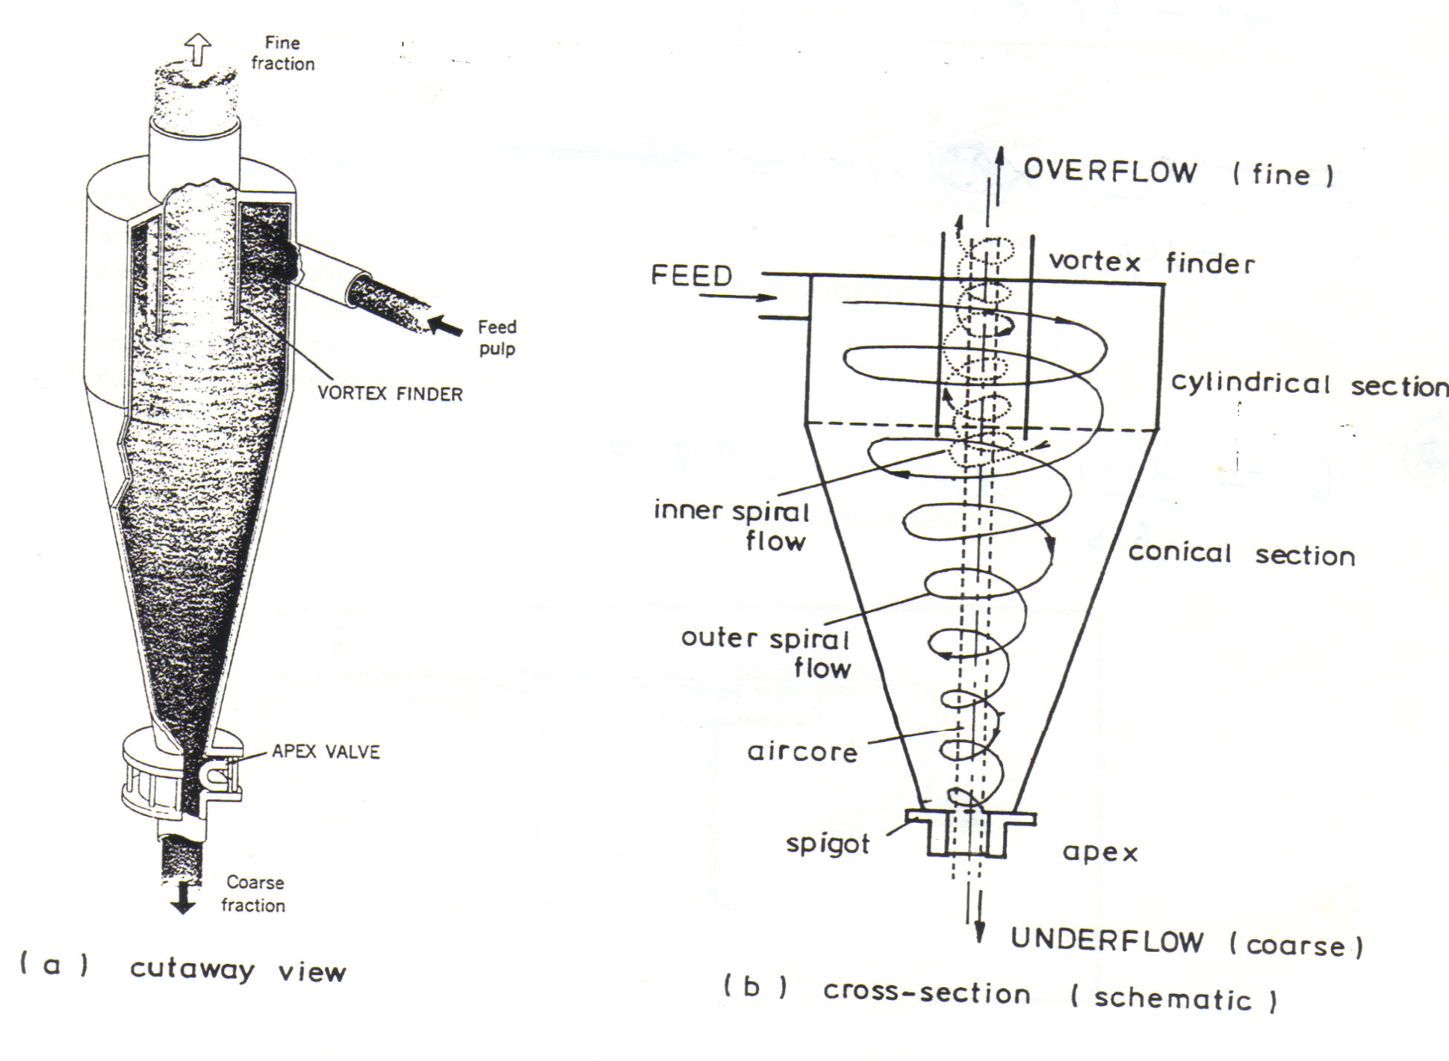
5.3. Types of classifiers (cont.)
Hydrocyclone (cont.).
MS© 2021

Slide 35
5.3. Types of classifiers (cont.)
Efficiency: Hydrocyclone
The commonest method of representing cyclone efficiency is by a performance or partition curve, which relates the weight fraction, or percentage, of each particle size in the feed, which reports to the apex, or underflow, to the particle size.
The cut point, or separation size, of the cyclone is often defined as that point on the partition curve for which 50 % of particles in the feed of that size report to the underflow, i.e. particles of this size have an equal chance of going either with the overflow or underflow
This point is usually referred to as the d₅₀ size.
MS© 2021

Slide 36
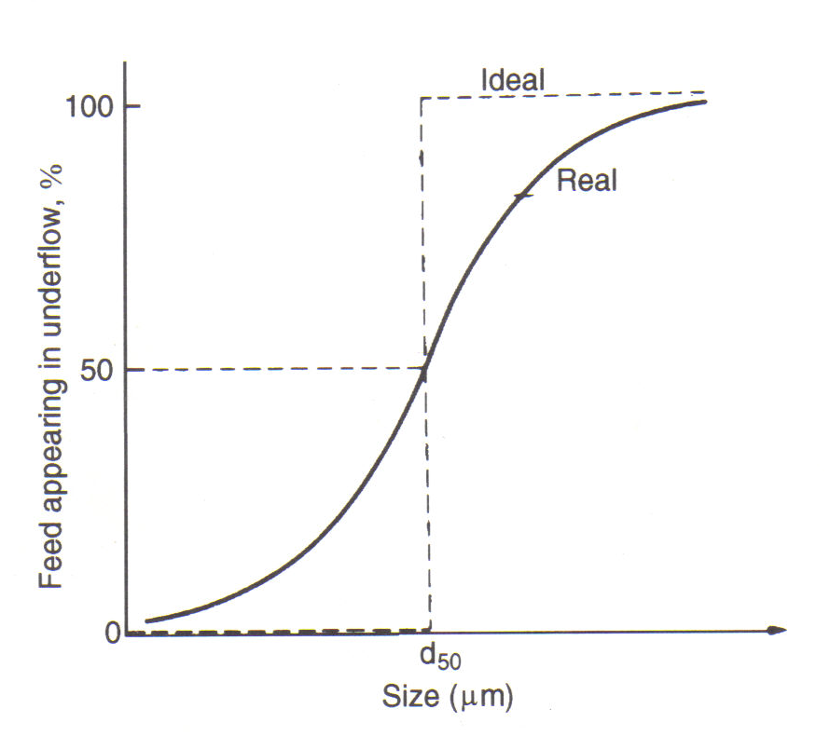
5.3. Types of classifiers (cont.)
Efficiency: Hydrocyclone (cont.)
MS© 2021

Slide 37
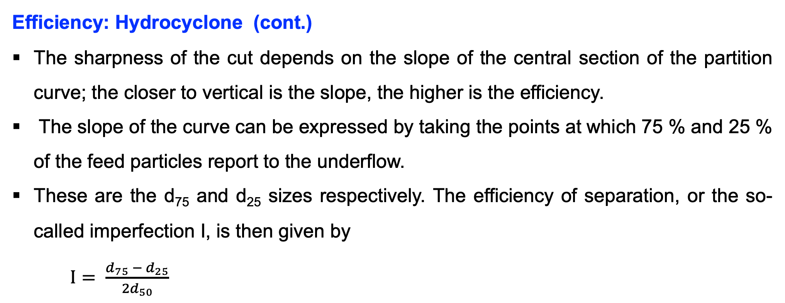
5.3. Types of classifiers (cont.)
Efficiency: Hydrocyclone (cont.)
The sharpness of the cut depends on the slope of the central section of the partition curve; the closer to vertical is the slope, the higher is the efficiency.
The slope of the curve can be expressed by taking the points at which 75 % and 25 % of the feed particles report to the underflow.
These are the d₇₅ and d₂₅ sizes respectively. The efficiency of separation, or the so-called imperfection I, is then given by
$I= \frac{d_{75} − d_{25}}{2d_{50}}$
MS© 2021

Slide 38
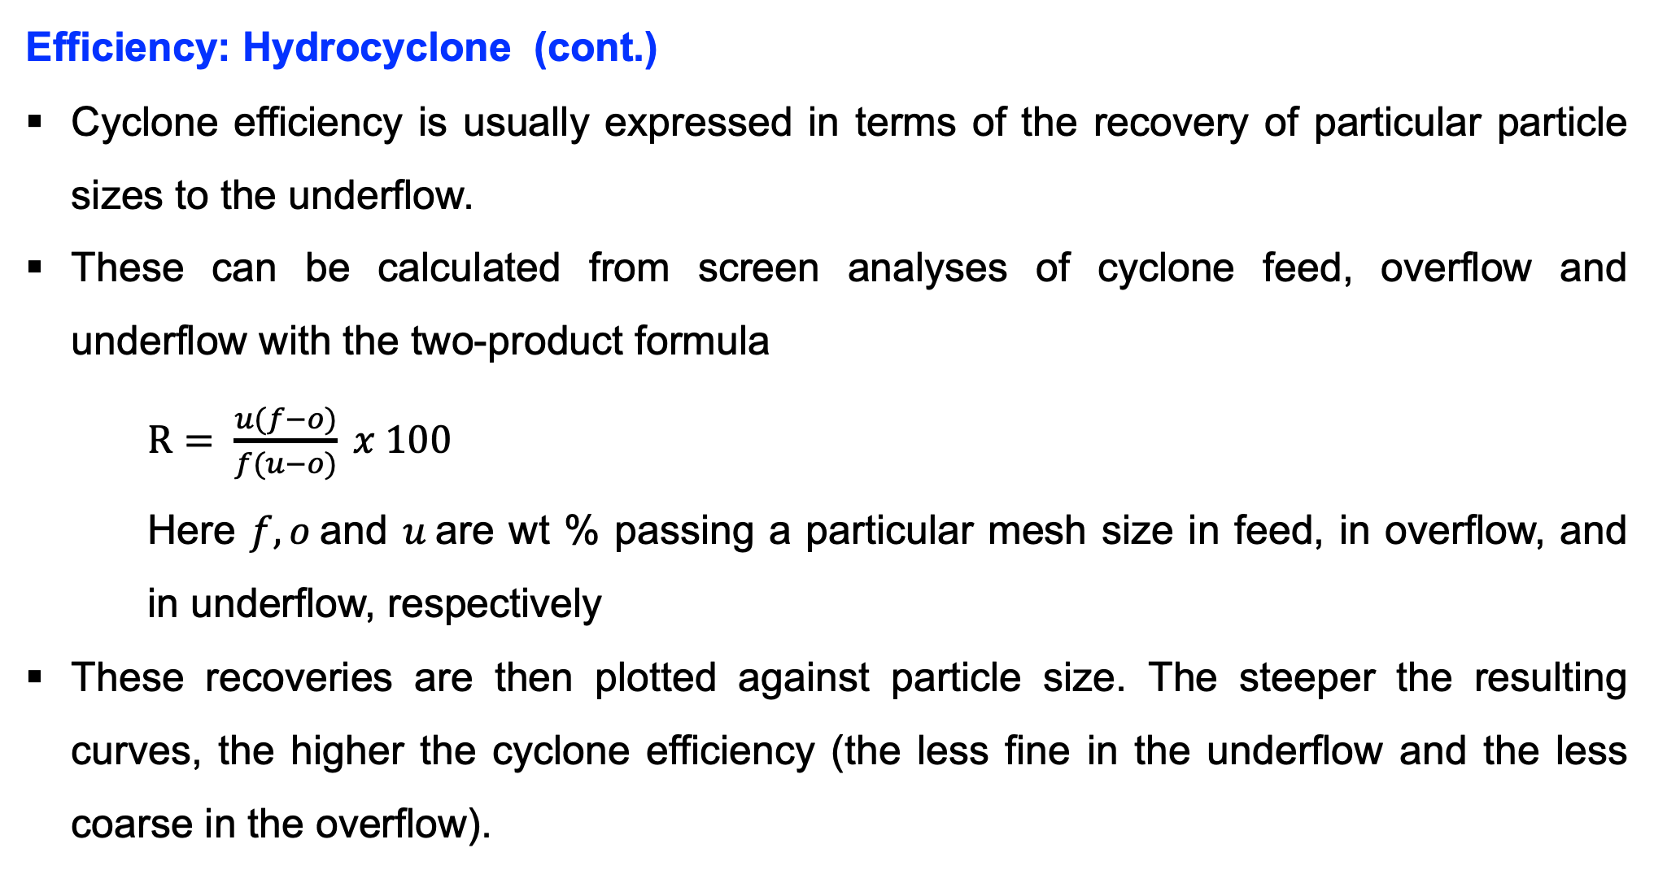
5.3. Types of classifiers (cont.)
Efficiency: Hydrocyclone (cont.)
Cyclone efficiency is usually expressed in terms of the recovery of particular particle sizes to the underflow.
These can be calculated from screen analyses of cyclone feed, overflow and underflow with the two-product formula
$R= \frac{u(f−o)}{f(u−o)} x 100$
Here $f, o$and $u$are wt % passing a particular mesh size in feed, in overflow, and in underflow, respectively
These recoveries are then plotted against particle size. The steeper the resulting curves, the higher the cyclone efficiency (the less fine in the underflow and the less coarse in the overflow).
MS© 2021

Slide 39
5.3. Types of classifiers (cont.)
Efficiency: Hydrocyclone (cont.)
Cyclone efficiency is usually expressed in terms of the recovery of particular particle sizes to the underflow.
These can be calculated from screen analyses of cyclone feed, overflow and underflow with the two-product formula
$R= \frac{u(f−o)}{f(u−o)} x 100$
Here $f, o$and $u$are wt % passing a particular mesh size in feed, in overflow, and in underflow, respectively
These recoveries are then plotted against particle size. The steeper the resulting curves, the higher the cyclone efficiency (the less fine in the underflow and the less coarse in the overflow).
MS© 2021

Slide 40
5.3. Types of classifiers (cont.)
Operating parameters: Hydrocyclone
The main operating parameters are the pulp density of the feed and the size of the apex opening.
In general, when only one of these variables is changed at a time:
Increasing the pulp density increases the separating size (the overflow becomes coarser);
Increasing the apex opening decreases the separating size (the overflow becomes finer).
MS© 2021

Slide 41
End of Lecture 5

