Slide 1
TOPIC 5: PRODUCTION FUNCTIONS

Slide 2
Production: Any activity that creates value is production. It is a series of activities by which resource inputs (raw materials, labour, capital, land utilization and managerial talents) are transformed over time into outputs of goods and services.
This relationship can be expressed symbolically as:
Q = f(Xa, Xb, Xc,… Xn)
Where,
Xa, Xb, Xc,… Xn = Quantities of different types of inputs
Q = Quantity of output per period of time

Slide 3
Fixed and Variable inputs
Fixed input:
Definition
An item required to produce goods and services that do not demonstrate short term variations. For example, a fixed input for a manufacturing business might be its factory, production machinery, key managerial personnel or other large assets that are consistently used to produce its finished goods.
Variable input:
Definition
Usage rate can be altered easily in desire to lower or increase volume of output (electric power, labour, most raw materials).

Slide 4
Short-run – Time period so short that the firm is constrained from varying the quantity of its fixed inputs.
Long-run – Time period sufficiently long to allow all inputs to be varied – no inputs are fixed including technology
Short-run production function
Q = f (Xa, Xb, / Xc,…….. Xn)
Variable fixed inputs

Slide 5
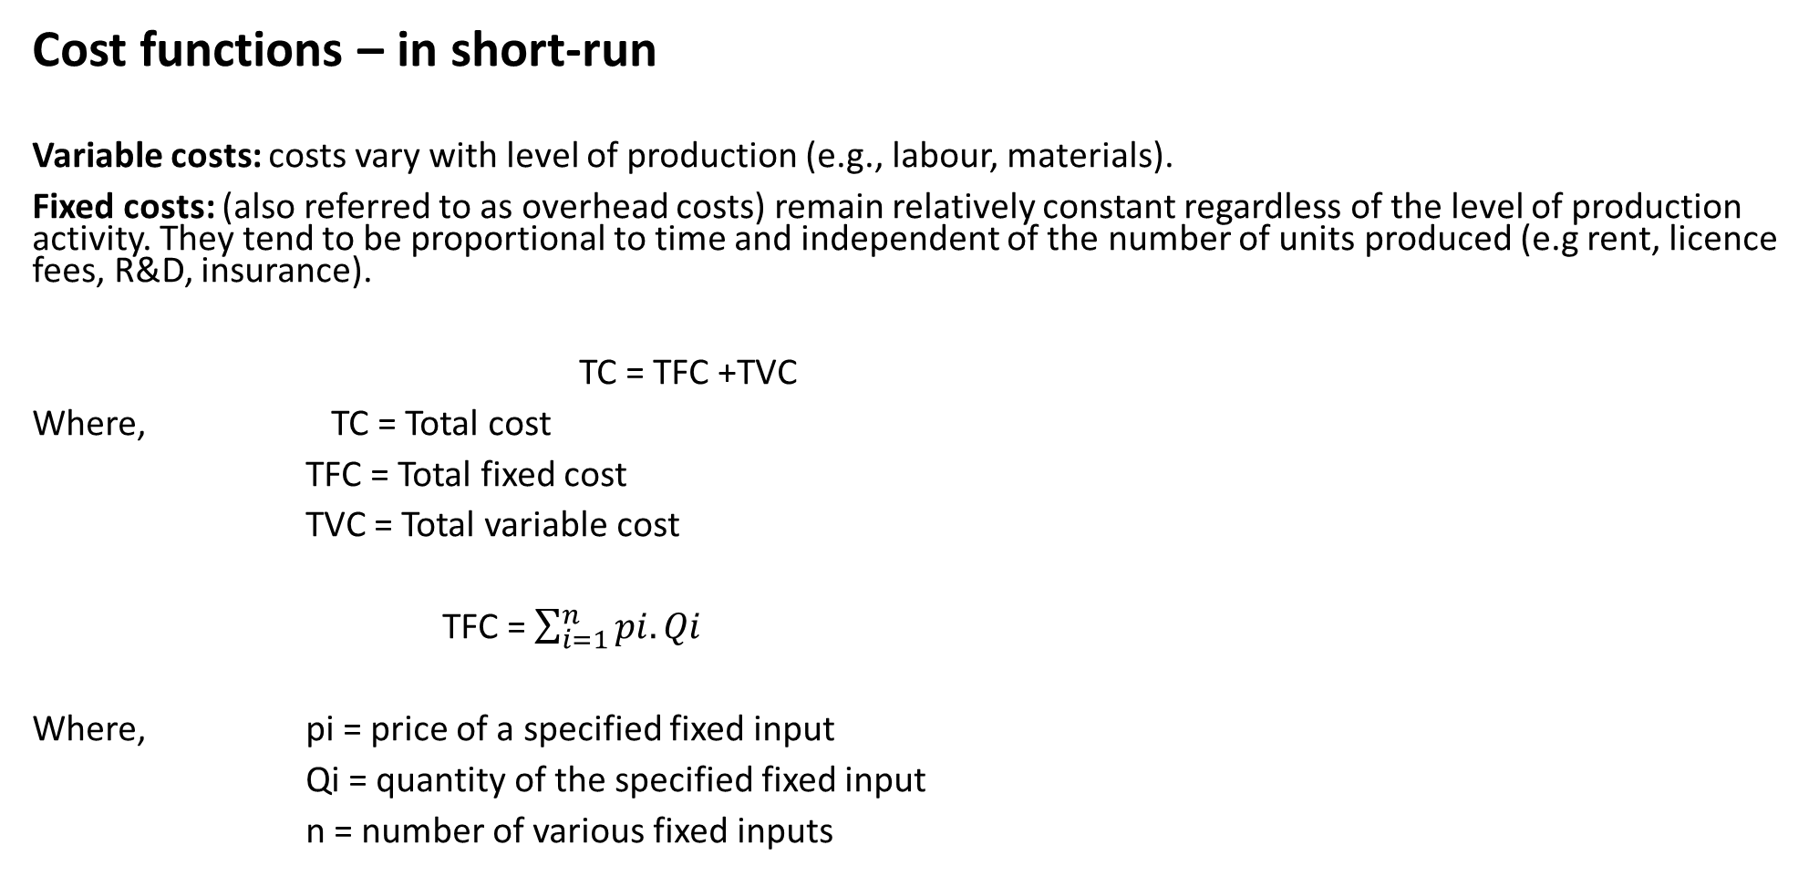
Cost functions – in short-run
Variable costs: costs vary with level of production (e.g., labour, materials).
Fixed costs: (also referred to as overhead costs) remain relatively constant regardless of the level of production activity. They tend to be proportional to time and independent of the number of units produced (e.g rent, licence fees, R&D, insurance).
TC = TFC +TVC
Where, TC = Total cost
TFC = Total fixed cost
TVC = Total variable cost
TFC = $\sum_{i=1}^{n}{pi.Qi}$
Where, pi = price of a specified fixed input
Qi = quantity of the specified fixed input
n = number of various fixed inputs

Slide 6
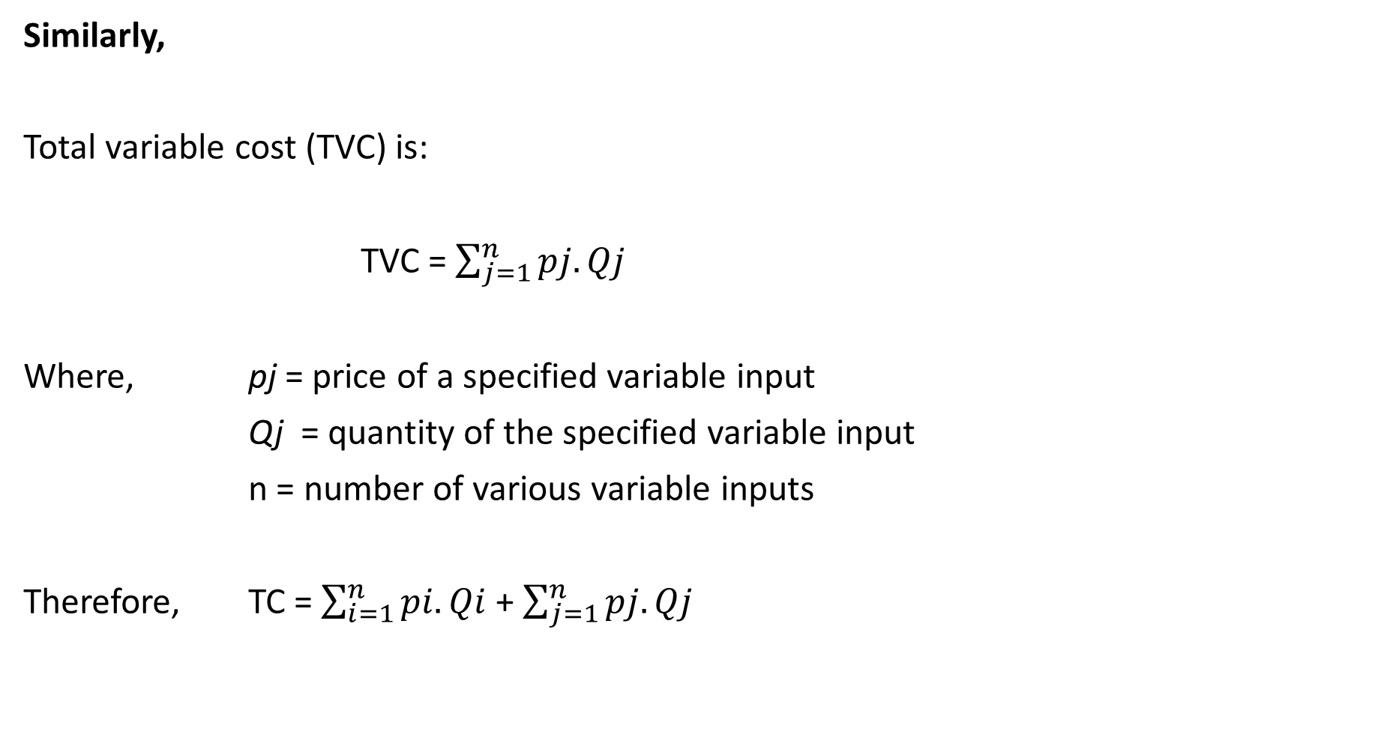
Similarly,
Total variable cost (TVC) is:
TVC = $\sum_{j=1}^{n}{pj.Qj}$
Where, pj = price of a specified variable input
Qj = quantity of the specified variable input
n = number of various variable inputs
Therefore, TC = $\sum_{i=1}^{n}{pi.Qi}$ + $\sum_{j=1}^{n}{pj.Qj}$

Slide 7
DEFINITIONS:
Totals: Total (costs, revenues, profits) as a function of output
Averages: (costs, revenues, profits) at a given level of output.
Marginals: Amount of (cost, revenue, profit) added to the total amount by each additional unit of output, at a given level of output.

Slide 8
Cost behavior with increasing and decreasing returns to variable input in short-run

Slide 9
Cost ($)
TR
TC =Q = a + bQ - cQ² + dQ³
TVC
BE = breakeven output
TFC
BE
Output Quantity (Q)
Figure: Cost functions curves – short-run

Slide 10
TVC = bQ - cQ² + dQ³
TC = a + bQ - cQ² + dQ³
dTc/dQ = MC = b - 2cQ + 3dQ²
ATC = a/Q + b - cQ + dQ²
ATC = b - cQ + dQ²
AFC = a/Q

Slide 11
TC
Cost ($)
TVC
TFC
Output Quantity (Q)
Cost ($)
Stage 1
Stage 2
DMR = Diminishing marginal return
DAR = Diminishing average return
DMR
Output Quantity (Q)

Slide 12
Why do diminishing returns occur?
In the short run, the law of diminishing returns states that as we add more units of a variable input to fixed amounts of land and capital, the change in total output will at first rise and then fall. Diminishing returns to labour occurs when marginal product of labour starts to fall.
For example, a Small-scale mine (SSM) has 30 employees. And every day the SSM produces 300 tonnes of ore. When there are 10 employees, 120 tonnes of ore is produced. When you add 10 more employees, the output is increased to 220. And an additional 10 employees increases the output by 80 making the output 300.
This is because of the law of diminishing marginal returns. As the employees increase in number, the marginal (additional) output decreases.
Given that 30 employees is the maximum amount of employees the factory needs, additional employees, given the law of diminishing marginal returns, will decrease the level of output.
Some of the reasons for these may be the limited number of machines or equipment in the factory. Too many employees may cause overcrowding in these machines and decrease the level of output due to lack of space and a chaotic overcrowded workplace. Or it may be that too many employees cause other employees to slack off and talk to the other employees which will divide their attention and decrease output. These are just some examples that can explain the law of diminishing marginal returns.

Slide 13
Totals Averages Marginals
TC = f(Q) AC = TC/Q MC = dTc/dQ
TR = f(Q) AR = TR/Q MR = dTR/dQ
TP = TR-TC AP = TP/Q MR = dTR/dQ
Where, Q = output
Break-even occurs when TR = TC
When, dTC/dQ = 0, we have minimum cost

Slide 14
Long –run cost-output relationships
In the LR, all resource inputs are variable.
A firm can alter its usage of major capital equipment, change top management, build new plant capacity, close down obsolete facilities, update its use of technology, or in any other way modify its production process and use of resources per period of time.
Generally, the firm’s LR cost objective is to be in a position to produce the desired output at the lowest possible cost.
This means adjusting its scale of production so as to be the RIGHT SIZE.

Slide 15
Sometimes economies can be attained by dividing the production process into smaller production units
On other occasions, lower unit costs can be achieved by enlarging the scale of production
In examining how efficiency and costs are affected by scale of production, it is important to distinguish between PLANT and FIRMS because the cost efficiency advantage of each are different.

Slide 16
Usually, s firm will have more than just 3 plant sizes to choose from. When the number of alternative plant sizes approaches infinity, the LRAC is an envelope of the short-run curves that is tangent to each of the short-run curves.

Slide 17
Average Cost
SLACS
SLACl
SLACm
SLAC (Solid portion of the Short-term average cost curves)
Output
Q1 Q2

Slide 18
Here again, the LRAC curve should be interpreted as representing the least unit cost attainable for a given output rate when the firm has time to change the rate of usage of any and all inputs.
Of all the possible plant sizes, the one which is most efficient all is the one whose SRAC curve is tangent to the LRAC curve at the minimum point of the LRAC curve (Qoptimum). The plant capable of producing the product at the lowest unit cost of all the other plants is termed the OPTIMUM PLANT SIZE.

Slide 19
Average Cost
SLAC1
SLACn
LRAC
SLAC2
Output (Q)
Qoptimum

Slide 20
ECONOMIES OF SCALE
Sometimes called “economies of large-scale”.
Occurs when average costs of the firm decrease as it grows larger

Slide 21
Average Cost
AC1
AC2
ACL
AC4
AC3
ECONOMIES OF SCALE DISECONOMIES OF SCALE
A B C D
Output
0

Slide 22
The firm produces at lowest with output A1
AC1 - average cost of producing different outputs when size of the firm does not change.
AC2, AC3 AND AC4 are additional fixed plant size average cost curves.
B, C and D – are firm’s average costs at sizes B, C and D.
Economies of scale A to C. After C, diseconomies set it

Slide 23
REASONS FOR ECONOMIES OF SCALE AT PLANT LEVEL
Up to a point, larger operations allow greater subdivision of the production process and specialization in the use of resource inputs (capital, labour, supervision, etc). Almost invariably, specialization along functional or task-specific lines, maximizes the efficiency gains and cost savings to be had from the “learning curve” or “experience”.
Greater volume of production and more intensive utilization of such facilities, the lower are the unit fixed costs because fixed investment costs of capital intensive techniques are being spread over a large number of units of output.
Centralizing and integrating manufacturing stages into a single continuous process offers another avenue for achieving scale of economies at plant level. For instance, steel firms have found it advantageous to have pig iron, raw steel, and semi-finished steel products produced in one continuous operation in order to economize on reheating materials between phases of the production process.

Slide 24
Also the larger a plant, the greater the opportunities for taking advantage of and utilizing by-products which add revenues to apply against production costs associated with the primary product.
Large-scale plants are in a position to take advantage of quantity discounts on their purchase of raw materials (inputs) and utility services. Similarly, larger plants can realize transportation savings by instituting their own shipping.
Eventually, of course plants can be enlarged to a point where all economies of scale are exploited and bring no additional savings in unit costs. It is here that the minimum level of the LRAC curve for plants is reached.

Slide 25
REASONS FOR DISECONOMIES OF SCALE AT PLANT LEVEL.
The more space over which a plant is spread, the greater the bottlenecks and costs of getting labour, materials and semi-finished goods from one place in the plant to another.
The larger the plant, the more likely that needed raw materials will have to be shipped from more distant suppliers, thereby driving up transportation costs of incoming materials.
The larger the plant output, the further distances outputs may have to be shipped to reach potential buyers thereby raising the costs of transporting the product from manufacturer to the final consumer.
Growing difficulties of maintaining efficient supervision and coordination.

