Slide 1
THE UNIVERSITY OF ZAMBIA
SCHOOL OF MINES
DEPARTMENT OF MINING ENGINEERING
BASIC ROCK MECHANICS-MIN 3029
INSITU STRESSES

Slide 2
Introduction
In this topic;
  We will be describing why a knowledge of in situ rock stress is important for rock engineering,
  How the in situ stress data are determined and presented,
  What we would expect the in situ stresses to be,
  Collating stress state data from around the world, and finally commenting on rock stress variability

Slide 3
Why determine in situ stress?
The basic motivations for in situ stress determination are two-fold
  To have a basic knowledge of the stress state for engineering, e.g. in what direction and with what magnitude is the major principal stress acting? What stress effects are we defending ourselves and our structures against? In what direction is the rock most likely to break? All other things being equal, in what direction will the groundwater flow? Even for such basic and direct engineering questions, a knowledge of the stress state is essential.
  To have a specific and 'formal' knowledge of the boundary conditions for stress analyses conducted in the design phase of rock engineering projects

Slide 4
Presentation of in situ stress state data
The stress state at a given point in a rock mass is generally presented in terms of the magnitude and orientation of the principal stresses (remember that the stress state is completely described by six parameters).
We recall that the principal stresses have a certain orientation, and in that the principal stresses have certain magnitudes
The orientations are often presented via a stereographic projection as shown on the next slide

Slide 5
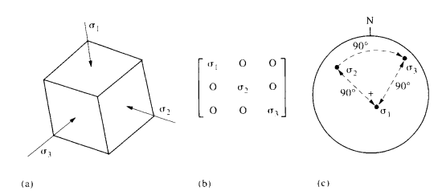
Presentation of in situ stress state data
(a) Principal stresses acting on a small cube, (b) Principal stresses expressed in matrix form, (c) Principal stress orientations shown on a hemispherical projection

Slide 6
Methods of stress determination
Any system utilized for estimating the in situ stress state must involve a minimum of six independent measurements.
In this lecture, we going to discuss the four main methods recommended by the International Society for Rock Mechanics (ISRM) for direct determination of stress
The following are the four methods that we are going to discuss
  The flatjack test;
  The hydraulic fracturing test;
  The United States Bureau of Mines (USBM) overcoring torpedo; and
  The Commonwealth Scientific and Industrial Research Organization (CSIRO) overcoring gauge.

Slide 7
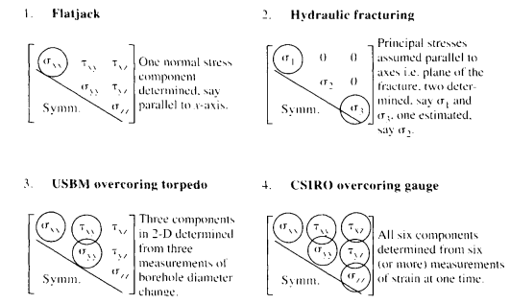
Methods of stress determination
In figure below, we have shown four stress tensors and indicated the ability of each method to determine the six components of the stress tensor in one application

Slide 8
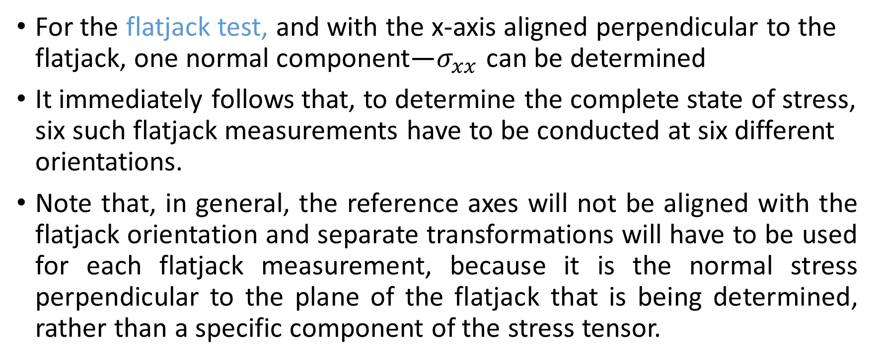
Methods of stress determination
For the flatjack test, and with the x-axis aligned perpendicular to the flatjack, one normal component—$σ_{xx}$ can be determined
It immediately follows that, to determine the complete state of stress, six such flatjack measurements have to be conducted at six different orientations.
Note that, in general, the reference axes will not be aligned with the flatjack orientation and separate transformations will have to be used for each flatjack measurement, because it is the normal stress perpendicular to the plane of the flatjack that is being determined, rather than a specific component of the stress tensor.

Slide 9
Methods of stress determination
The shear components in the tensor must be calculated from the measurements of normal stresses in different directions; they cannot be measured directly.
It should also be remembered that this technique determines the stress tensor in an excavation wall and therefore determines the induced stress rather than the field stress.
However, large flatjacks can be used to determine the in-situ stress in rockmass

Slide 10
Methods of stress determination
The shear components in the tensor must be calculated from the measurements of normal stresses in different directions; they cannot be measured directly.
It should also be remembered that this technique determines the stress tensor in an excavation wall and therefore determines the induced stress rather than the field stress.
However, large flatjacks can be used to determine the in-situ stress in rockmass

Slide 11
Methods of stress determination
The basic hydraulic fracturing method provides only two items of information the basic break down pressure and the shut in pressure
With this method only the minor and principal stress can be established
The minor stress is assumed to be the shut in pressure while the principal stress is assumed to be shut in pressure
The value of minor stress is equal to the tensile strength on the rock
Hydraulic fracturing test cannot be done in different orientation like the flatjack test because they conducted in deep bore holes

Slide 12
Methods of stress determination
The major advantage of hydraulic fracturing is that it is the only method of determining part of the stress state more than a few hundred metres from man-access, and, indeed, may be used up to 5 or 6 km depth
However, the major disadvantage is that assumptions have to be made in order to complete the stress tensor. These assumptions are that the principal stresses are parallel and perpendicular to the borehole axis, and that the vertical principal stress can be estimated from the depth of overburden

Slide 13
Methods of stress determination
As a result, in the hydraulic fracturing stress tensor in figure on former slides the two circled components are determined but the three zero values for the shear stresses are an assumption, as is the value of intermediate stress

Slide 14
Methods of stress determination
In the case of the USBM overcoring torpedo, a two-dimensional state of stress is determined, i.e. the three circled components in the diagram in Fig. 4.3, giving three components of the three-dimensional stress tensor.
Thus, two, and preferably three, non-parallel boreholes must be used to determine the complete state of stress.
It should be noted that in the cases of the flatjack and hydraulic fracturing, the material properties of the rock have not been used except for the tensile strength which is required in hydraulic fracturing.
For the flatjack, only the transformation equations are required; for hydraulic fracturing, only the stress concentration factors for a circular hole are required and these are independent of material properties (assuming ideal elasticity); but, for the USBM overcoring torpedo, in order to convert the measured displacements to stresses, the elastic properties of the rock are required. This introduces a whole new series of assumptions.

Slide 15
Methods of stress determination
Finally, in the case of the CSIRO overcoring gauge, as we have shownin Fig. 4.3, the complete state of stress can be determined from measurements of strain in six or more different directions taken during one application of the method.
The material properties of the rock are also required for this method: a device which is equipped with nine or 12 strain gauges can determine the state of stress in a transversely isotropic rock with five elastic parameters.
It is emphasized that the understanding of how the components of the stress tensor are established by these four different methods is crucial to the planning of an optimal strategy for stress measurement.

Slide 16
Predictions of natural in situ stress states based on elasticity theory
We have mentioned that the in situ stress field is conveniently expressed via the orientations and magnitudes of the principal stresses.
As a first approximation, therefore, let us assume that the three principal stresses of a natural in situ stress field are acting vertically (one component) and horizontally (two components).
Following this assumption concerning orientations, it becomes possible to predict the magnitudes of these principal stresses through the use of elasticity theory.

Slide 17
Predictions of natural in situ stress states based on elasticity theory
We might expect that the vertical stress component increases in magnitude as the depth below the ground surface increases, due to the weight of the overburden.
More generally, we should use the expression;
This approach is always used as an estimate of the vertical stress component unless, of course, the stress determination programme does include direct measurement of the vertical stress.

Slide 18
Predictions of natural in situ stress states based on elasticity theory
We now consider the magnitudes of the horizontal stress components.
Given that the vertical stress has a particular magnitude at a point in a rock mass, we might expect that a horizontal stress would be induced as a result of the vertical compression of the rock.
To provide an initial estimate of this stress, based on elasticity theory and assuming isotropic rock, we must introduce the parameters Young's modulus and Poisson's ratio

Slide 19
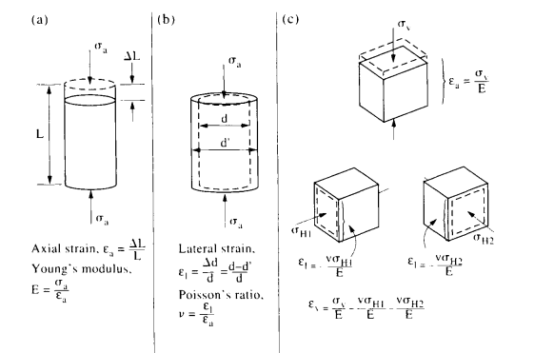
Predictions of natural in situ stress states based on elasticity theory
Strains on a small element of rock,
Axial strain and Young's modulus,
Lateral strain and Poisson's ratio,
Vertical and horizontal strains

Slide 20
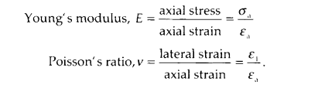
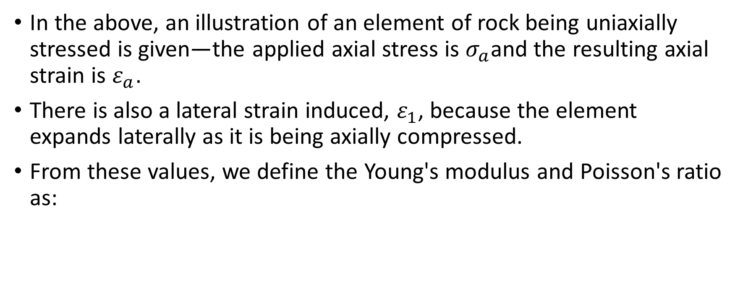
Predictions of natural in situ stress states based on elasticity theory
In the above, an illustration of an element of rock being uniaxially stressed is given—the applied axial stress is $σ_{a}$and the resulting axial strain is $ε_{a}$.
There is also a lateral strain induced, $ε_{1}$, because the element expands laterally as it is being axially compressed.
From these values, we define the Young's modulus and Poisson's ratio as:

Slide 21


Predictions of natural in situ stress states based on elasticity theory
Using the above expressions, the horizontal stress component can be expressed as follows;
where $σ_{H}$ = $σ_{H1}$ = $σ_{H2}$

Slide 22
Rock anisotropy
We will be discussing anisotropy in much greater detail in the next topic , on strain, and in the topic on inhomogeneity and anisotropy
It is worth mentioning here, though, that there are three types of isotropy commonly considered in rock mechanics, namely:
  Complete isotropy-having the same properties in all directions
  Transverse isotropy-having different properties in the vertical direction to the horizontal directions
  Orthotropy-having different properties in three perpendicular directions
These are as shown in figure below;

Slide 23
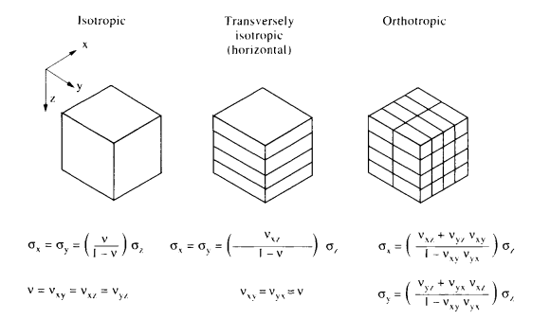
Rock anisotropy

Slide 24
END

