Slide 1
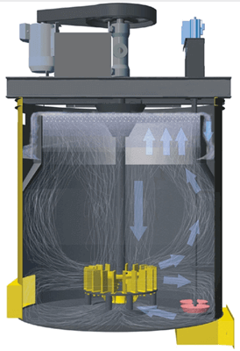
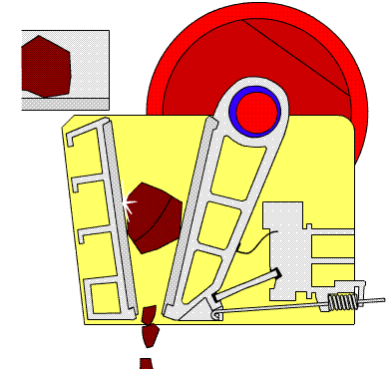


CME 1025: Introduction to Mineral Sciences
By
Marthias SILWAMBA (PhD)
Metallurgical Engineering Department
Marthias.silwamba@unza.zm

Slide 2
Lecture 3
Comminution: Crushing
MS© 2021

Slide 3
Lecture of objective(s)
By the end of the lecture students are expected to:-
Understand liberation of particles.
Know and understand crushing mechanisms.
Understand and describe different crushing circuits and crushing theories.
Know the types of crushers
MS© 2021

Slide 4
Lecture content
3.1. Introduction
3.2. Liberation
3.3. Size reduction
3.4. Crushing
3.5. Type of crusher and crushing mechanism
3.6. Crushing stages and circuit
3.7. Properties of rock/ore
3.8. Comminution theory
3.9. Crushing equipment
3.10. Crushing equipment: Jaw crusher
3.11. Crushing equipment: Gyratory crusher
3.12. Crushing equipment: Cone crusher
3.13. Crushing equipment: Roll crusher
3.14. Crushing equipment: Impact/hammer crusher
MS© 2021

Slide 5
Lecture content
3.1. Introduction
3.2. Liberation
3.3. Size reduction
3.4. Crushing
3.5. Type of crusher and crushing mechanism
3.6. Crushing stages and circuit
3.7. Properties of rock/ore
3.8. Comminution theory
3.9. Crushing equipment
3.10. Crushing equipment: Jaw crusher
3.11. Crushing equipment: Gyratory crusher
3.12. Crushing equipment: Cone crusher
3.13. Crushing equipment: Roll crusher
3.14. Crushing equipment: Impact/hammer crusher
MS© 2021

Slide 6

3.1. Introduction
In order to be able to separate valuable minerals in mined ores (concentration) from gangue minerals, the individual mineral particles have to be liberated.
Concentrate
Comminution
Crushing/grinding
Valuables mineral
Separation (concentration)
Non-valuables
(gangue minerals)
Liberated minerals
(i.e., valuable mineral particles are liberated from gangue mineral particles)
Tailings
MS© 2021

Slide 7
Lecture content
3.1. Introduction
3.2. Liberation
3.3. Size reduction
3.4. Crushing
3.5. Type of crusher and crushing mechanism
3.6. Crushing stages and circuit
3.7. Properties of rock/ore
3.8. Comminution theory
3.9. Crushing equipment
3.10. Crushing equipment: Jaw crusher
3.11. Crushing equipment: Gyratory crusher
3.12. Crushing equipment: Cone crusher
3.13. Crushing equipment: Roll crusher
3.14. Crushing equipment: Impact/hammer crusher
MS© 2021

Slide 8
3.2. Liberation
Liberation of valuable mineral from the gangue minerals is achieved by size reduction of mined ore (breaking down ore particles-comminution).
The degree of size-reduction required is different for a given mined ore.
It is determined mainly by the characteristics of the ore (interlocking, dissemination) and by economic considerations (comparing the cost of further size-reduction to the additional recovery that can be achieved).
As stated earlier, the objective of mineral processing, regardless of the methods used, is always the same, i.e.,
  to separate the minerals into two or more products with the values in the concentrates, the gangue in the tailings, and the “locked” particles in the middlings.
MS© 2021

Slide 9
3.2. Liberation (cont.)
Valuable mineral
Liberated particles
(valuable minerals)
Crushing
Unliberated particles
Ore
Non-valuable mineral
Unliberated particles: middling, locked particles
Liberated particles (waste rocks)
MS© 2021

Slide 10
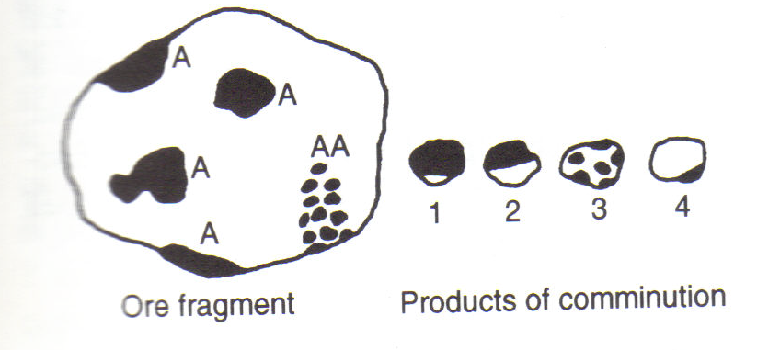
3.2. Liberation (cont.)
Lets consider the following case
Regions A represent valuable mineral, and region AA is rich in valuable mineral, but is highly intergrown with gangue mineral.
Comminution produces a range of fragments, ranging from fully liberated mineral and gangue particles, to those illustrated.
MS© 2021

Slide 11
3.2. Liberation (cont.)
Particles of type 1 are rich in valuable minerals and are graded as concentrate as they have an acceptable degree of locking with gangue, which limits the concentrate grade.
Particles of type 2 and 3, however, would probably be classed as middlings, although the degree of regrinding needed to promote economic liberation of mineral from particle 3 would be greater than in particle 2.
Particles of type 4 would likewise be classed as tailings, the small amount of mineral represents reducing the recovery of the valuable minerals into concentrate.
MS© 2021

Slide 12
Lecture content
3.1. Introduction
3.2. Liberation
3.3. Size reduction
3.4. Crushing
3.5. Type of crusher and crushing mechanism
3.6. Crushing stages and circuit
3.7. Properties of rock/ore
3.8. Comminution theory
3.9. Crushing equipment
3.10. Crushing equipment: Jaw crusher
3.11. Crushing equipment: Gyratory crusher
3.12. Crushing equipment: Cone crusher
3.13. Crushing equipment: Roll crusher
3.14. Crushing equipment: Impact/hammer crusher
MS© 2021

Slide 13
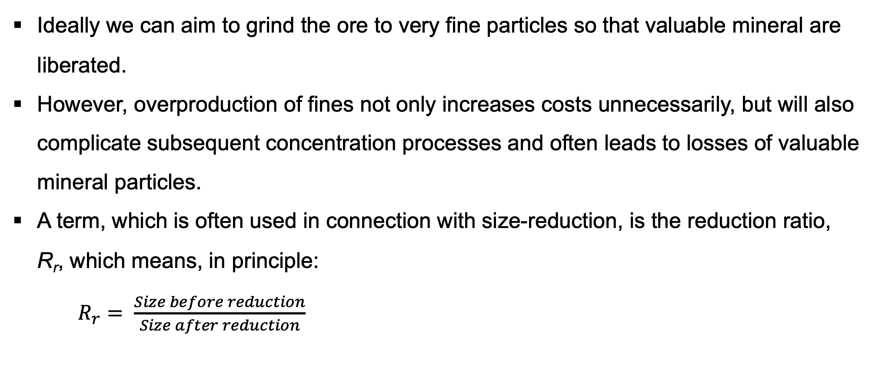
3.3. Size reduction
Ideally we can aim to grind the ore to very fine particles so that valuable mineral are liberated.
However, overproduction of fines not only increases costs unnecessarily, but will also complicate subsequent concentration processes and often leads to losses of valuable mineral particles.
A term, which is often used in connection with size-reduction, is the reduction ratio, R_{r}, which means, in principle:
$R_{r}= \frac{Size before reduction}{Size after reduction}$
MS© 2021

Slide 14
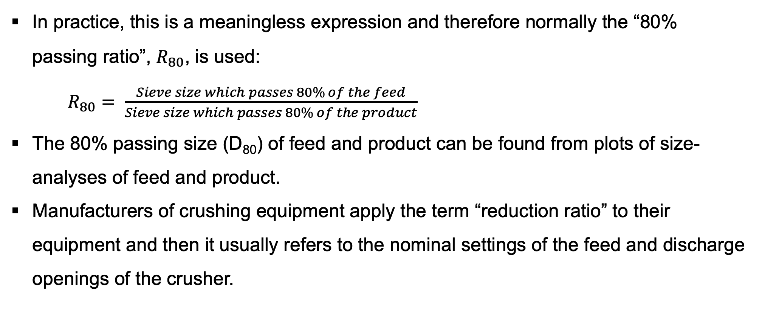
3.3. Size reduction (cont.)
In practice, this is a meaningless expression and therefore normally the “80% passing ratio”, $R_{80}$, is used:
$R_{80}= \frac{Sieve size which passes 80\% of the feed}{Sieve size which passes 80\% of the product}$
The 80% passing size (D₈₀) of feed and product can be found from plots of size-analyses of feed and product.
Manufacturers of crushing equipment apply the term “reduction ratio” to their equipment and then it usually refers to the nominal settings of the feed and discharge openings of the crusher.
MS© 2021

Slide 15
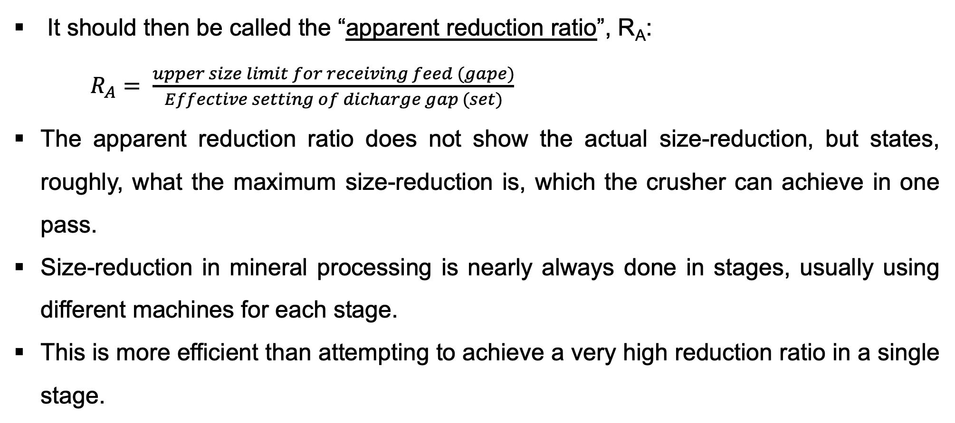
3.3. Size reduction (cont.)
It should then be called the “apparent reduction ratio”, R_{A}:
$R_{A}= \frac{upper size limit for receiving feed (gape)}{Effective setting of dicharge gap (set)}$
The apparent reduction ratio does not show the actual size-reduction, but states, roughly, what the maximum size-reduction is, which the crusher can achieve in one pass.
Size-reduction in mineral processing is nearly always done in stages, usually using different machines for each stage.
This is more efficient than attempting to achieve a very high reduction ratio in a single stage.
MS© 2021

Slide 16
3.3. Size reduction (cont.)
The apparent reduction ratio does not show the actual size-reduction, but states, roughly, what the maximum size-reduction is, which the crusher can achieve in one pass.
Size-reduction in mineral processing is nearly always done in stages, usually using different machines for each stage.
This is more efficient than attempting to achieve a very high reduction ratio in a single stage.
MS© 2021

Slide 17
Lecture content
3.1. Introduction
3.2. Liberation
3.3. Size reduction
3.4. Crushing
3.5. Type of crusher and crushing mechanism
3.6. Crushing stages and circuit
3.7. Properties of rock/ore
3.8. Comminution theory
3.9. Crushing equipment
3.10. Crushing equipment: Jaw crusher
3.11. Crushing equipment: Gyratory crusher
3.12. Crushing equipment: Cone crusher
3.13. Crushing equipment: Roll crusher
3.14. Crushing equipment: Impact/hammer crusher
MS© 2021

Slide 18
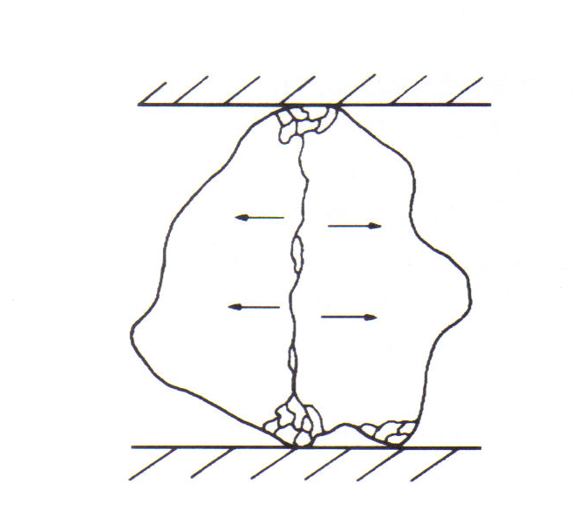
3.4. Crushing
Crushing is defined as the operations, required to reduce run-of-mine ore to the size, suitable for handling and feeding grinding mills.
Ore fracture by crushing
MS© 2021

Slide 19
3.4. Crushing (cont.)
Crushing operations are normally carried out in stages as shown below
Stage Size particle size range
1. Primary coarse from R.O.M to 15 cm
2. Secondary Intermediate 15 cm to 2.5–5 cm
3. Tertiary Fine 5 cm to 1–0.5 cm
MS© 2021

Slide 20
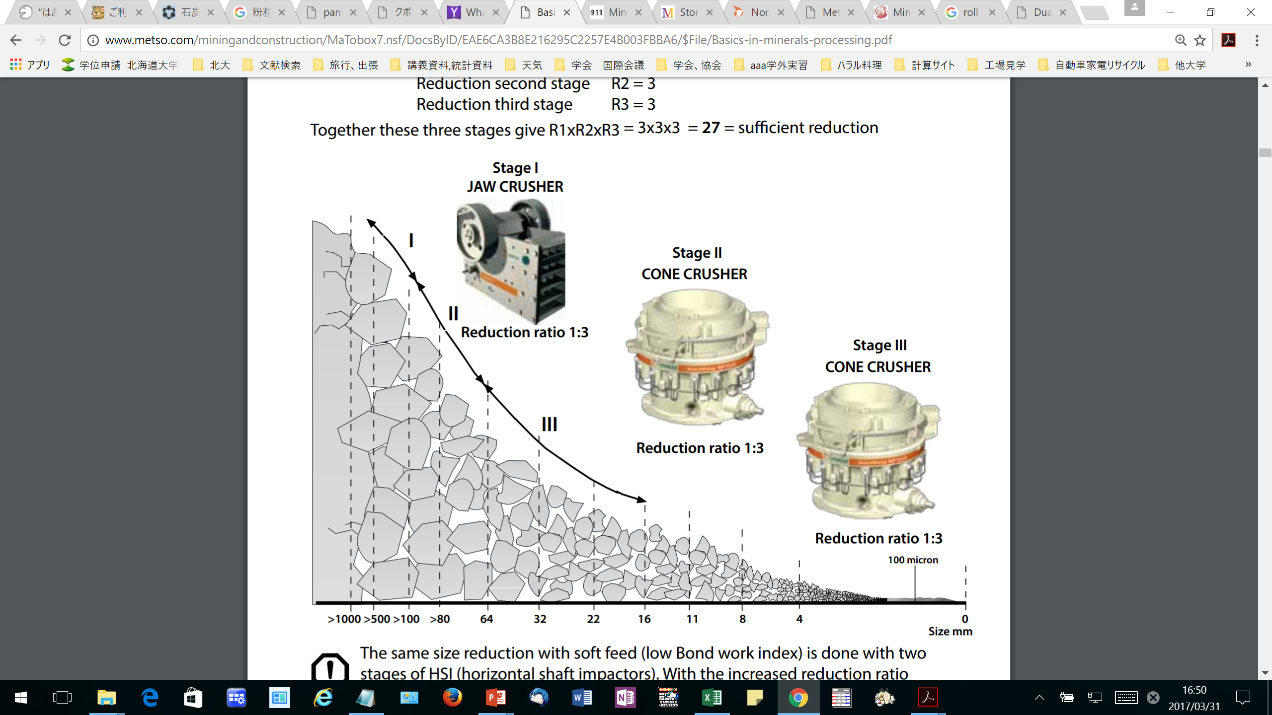
3.4. Crushing (cont.)
Crushing operations are normally carried out
MS© 2021
http://www.metso.com/miningandconstruction/MaTobox7.nsf/DocsByID/EAE6CA3B8E216295C2257E4B003FBBA6/$File/Basics-in-minerals-processing.pdf

Slide 21
Lecture content
3.1. Introduction
3.2. Liberation
3.3. Size reduction
3.4. Crushing
3.5. Type of crusher and crushing mechanism
3.6. Crushing stages and circuit
3.7. Properties of rock/ore
3.8. Comminution theory
3.9. Crushing equipment
3.10. Crushing equipment: Jaw crusher
3.11. Crushing equipment: Gyratory crusher
3.12. Crushing equipment: Cone crusher
3.13. Crushing equipment: Roll crusher
3.14. Crushing equipment: Impact/hammer crusher
MS© 2021

Slide 22
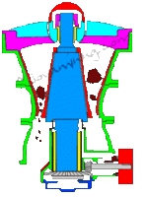
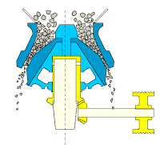
3.5. Type of crusher and crushing mechanism
Types of crushers
(1) Jaw crusher
(2) Gyratory Crusher
(3) Cone Crusher
MS© 2021
Primary Crusher
Secondary Crusher

Slide 23
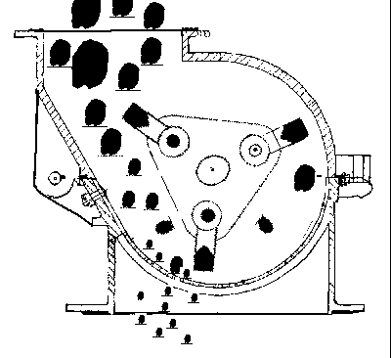
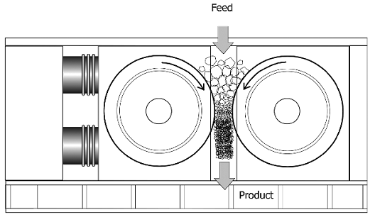
3.5. Type of crusher and crushing mechanism (cont.)
Types of crushers (cont.)
(4) Impact (5) High Pressure Grinding Roll
MS© 2021
Secondary/tertiary Crusher

Slide 24
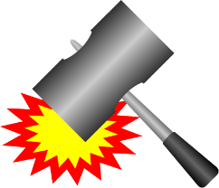
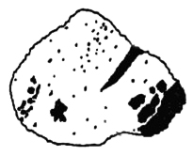
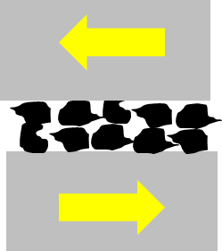
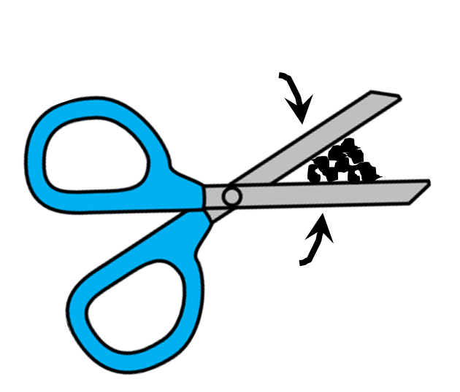
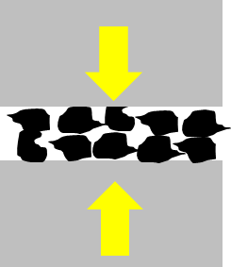
3.5. Type of crusher and crushing mechanism (cont.)
Crushing mechanism
Impact, refers to the sharp, instantaneous collision of one moving object against another
Attrition, is a term applied to the reduction of materials by scrubbing it between two hard surfaces.
Shear, consists of a trimming or cleaving action rather than the rubbing action associated with attrition.
Compression, gradual application of forces at the two opposite sides of an object.
MS© 2021

Slide 25
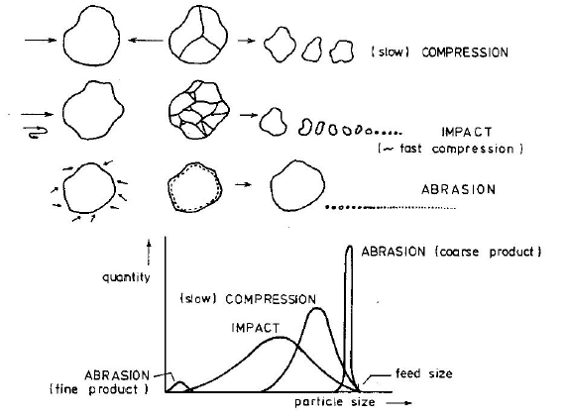
3.5. Type of crusher and crushing mechanism (cont.)
Different sizes from different crushing mechanism
MS© 2021

Slide 26
Lecture content
3.1. Introduction
3.2. Liberation
3.3. Size reduction
3.4. Crushing
3.5. Type of crusher and crushing mechanism
3.6. Crushing stages and circuit
3.7. Properties of rock/ore
3.8. Comminution theory
3.9. Crushing equipment
3.10. Crushing equipment: Jaw crusher
3.11. Crushing equipment: Gyratory crusher
3.12. Crushing equipment: Cone crusher
3.13. Crushing equipment: Roll crusher
3.14. Crushing equipment: Impact/hammer crusher
MS© 2021

Slide 27
3.6. Crushing stages and circuit
The efficiency of a crusher is greater when the reduction ratio is smaller; hence more crushing stages are desirable.
However, when the throughput is small, the equipment will be under-utilised and in such a case the installation of additional equipment for more crushing steps is not justified.
Therefore, we often find only two crushing stages and one grinding stage in small plants, while only large plants can afford to have three crushing stages.
In most cases, the operating stages are run in closed circuit, i.e. the product is sized (on a screen or other sizing device), wherefore the portion, which is sufficiently fine (the “undersize”) passes on to the next stage and the “oversize”, which is still too coarse, is returned to the breaker.
MS© 2021

Slide 28
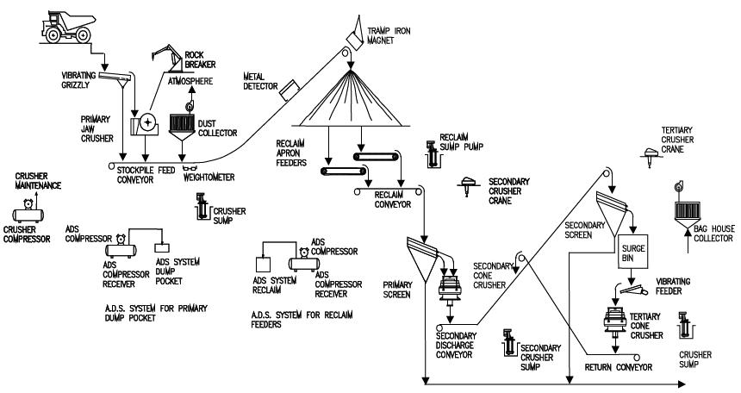
3.6. Crushing stages and circuit (cont.)
Primary
Jaw crusher
Seconday
Cone/gyratory crusher
Tertiary
Cone crusher
MS© 2021

Slide 29
3.6. Crushing stages and circuit (cont.)
Typical crushing stages: open circuit
Feed, ROM
Primary crusher
Double deck screen
Secondary crusher
Open circuit
Next stage
Product
MS© 2021

Slide 30
3.6. Crushing stages and circuit (cont.)
Typical crushing stages: closed circuit
Feed
Primary crusher
Double deck screen
Closed circuit
Secondary crusher
Next stage
Product
MS© 2021

Slide 31
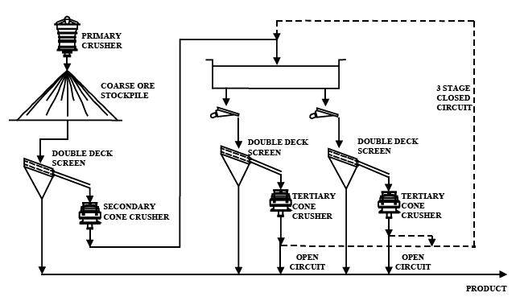
3.6. Crushing stages and circuit (cont.)
Typical crushing stages: open/closed circuit
Feed
MS© 2021

Slide 32
3.6. Crushing stages and circuit (cont.)
Difference between closed and open circuit
Closed circuit
Open circuit
Feed
Feed
Primary crusher
Secondary crusher
Primary crusher
Secondary crusher
（+）
（+）
Screen
Screen
（ー）
（ー）
Separation process or
fine grinding
Separation process or
fine grinding
MS© 2021

Slide 33
3.6. Crushing stages and circuit (cont.)
In open-circuit operation, the material passes straight through the breaker/crusher and the entire product passes on to the next stage.
In closed-circuit operation, material from the breaker/crusher is recirculated back to the screen . As long as the feed does not alter drastically (i.e., size, hardness etc., do not change), the circulating load in closed circuit operation will be fairly constant.
Circulating loads (CL) in closed circuit operation are normally expressed as a percentage of the new feed coming in.
In most crushing operations, circulating loads are relatively small (much less than 100%).
Determination of circulating loads is an important task for the metallurgical staff on the concentrator. This will be tackled in depth later.
MS© 2021

Slide 34
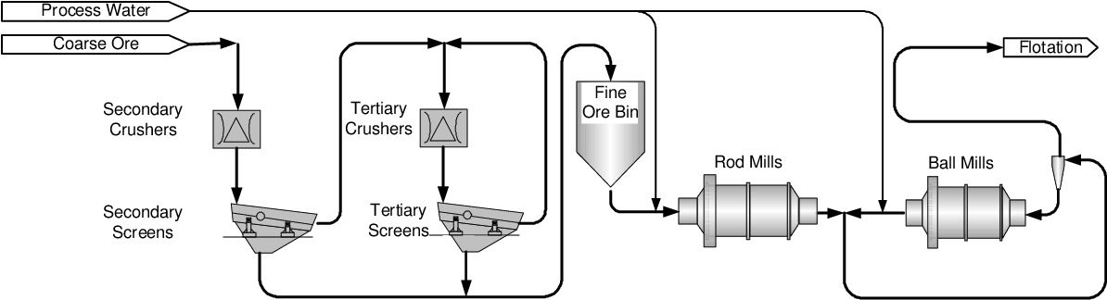
3.6. Crushing stages and circuit (cont.)
Very often the new feed to a crusher is screened to remove the material, which is already sufficiently fine to pass on to the next stage, and only the screen oversize passes through the crusher.
In the case of several stages in closed circuit, the crusher product is usually screened on the same screen.
MS© 2021

Slide 35
3.6. Crushing stages and circuit (cont.)
This “scalping” of new feed (i.e., screening of the new feed before feeding the crusher) gives the following advantages:
  Removal of undersize reduces the amount of material passing through the crusher, hence increases its capacity;
  Effective utilisation of energy in crusher in the absence of fines;
  Improved throughput (i.e., feed rate) to the crusher in the absence of most fines;
  Less dust from the crushing state and wear to the crusher.
Run-of-mine ore is sometimes screened on a “grizzley” (a very coarse screen, consisting of heavy parallel bars, e.g. old rails) which prevents very large rocks from entering and damaging the crusher.
MS© 2021

Slide 36
3.6. Crushing stages and circuit (cont.)
During mining, steel pieces from equipment or from the primary crusher or even screen may be mixed with the haulage/conveyed ore.
These steel pieces should be removed from the ore before feeding secondary crushers as these crushers have relatively small discharge openings that should be protected against large pieces of “tramp” metal which lead to crusher jamming.
These steel metals are removed by magnate or magnetic pulley positioned on conveyor systems. In some instances, metal detectors are installed in the conveyor system.
MS© 2021

Slide 37
Lecture content
3.1. Introduction
3.2. Liberation
3.3. Size reduction
3.4. Crushing
3.5. Type of crusher and crushing mechanism
3.6. Crushing stages and circuit
3.7. Properties of rock/ore
3.8. Comminution theory
3.9. Crushing equipment
3.10. Crushing equipment: Jaw crusher
3.11. Crushing equipment: Gyratory crusher
3.12. Crushing equipment: Cone crusher
3.13. Crushing equipment: Roll crusher
3.14. Crushing equipment: Impact/hammer crusher
MS© 2021

Slide 38
3.7. Properties of rock/ore
Physical properties of ore/rock
Some expressions, which are still vague, but which describe a little more accurately than “hardness” the ease of, or the resistance to comminution, are the following:
  brittleness: the ease of breaking by impact.
  friability: the ease of breaking by abrasion.
  ductility: the ability to flow, rather than break.
  toughness: the ability to resist the propagation of cracks.
The best expression, for practical purposes, is “grindability”, which is a measure of the energy consumed in the comminution process.
MS© 2021

Slide 39
Lecture content
3.1. Introduction
3.2. Liberation
3.3. Size reduction
3.4. Crushing
3.5. Type of crusher and crushing mechanism
3.6. Crushing stages and circuit
3.7. Properties of rock/ore
3.8. Comminution theory
3.9. Crushing equipment
3.10. Crushing equipment: Jaw crusher
3.11. Crushing equipment: Gyratory crusher
3.12. Crushing equipment: Cone crusher
3.13. Crushing equipment: Roll crusher
3.14. Crushing equipment: Impact/hammer crusher
MS© 2021

Slide 40
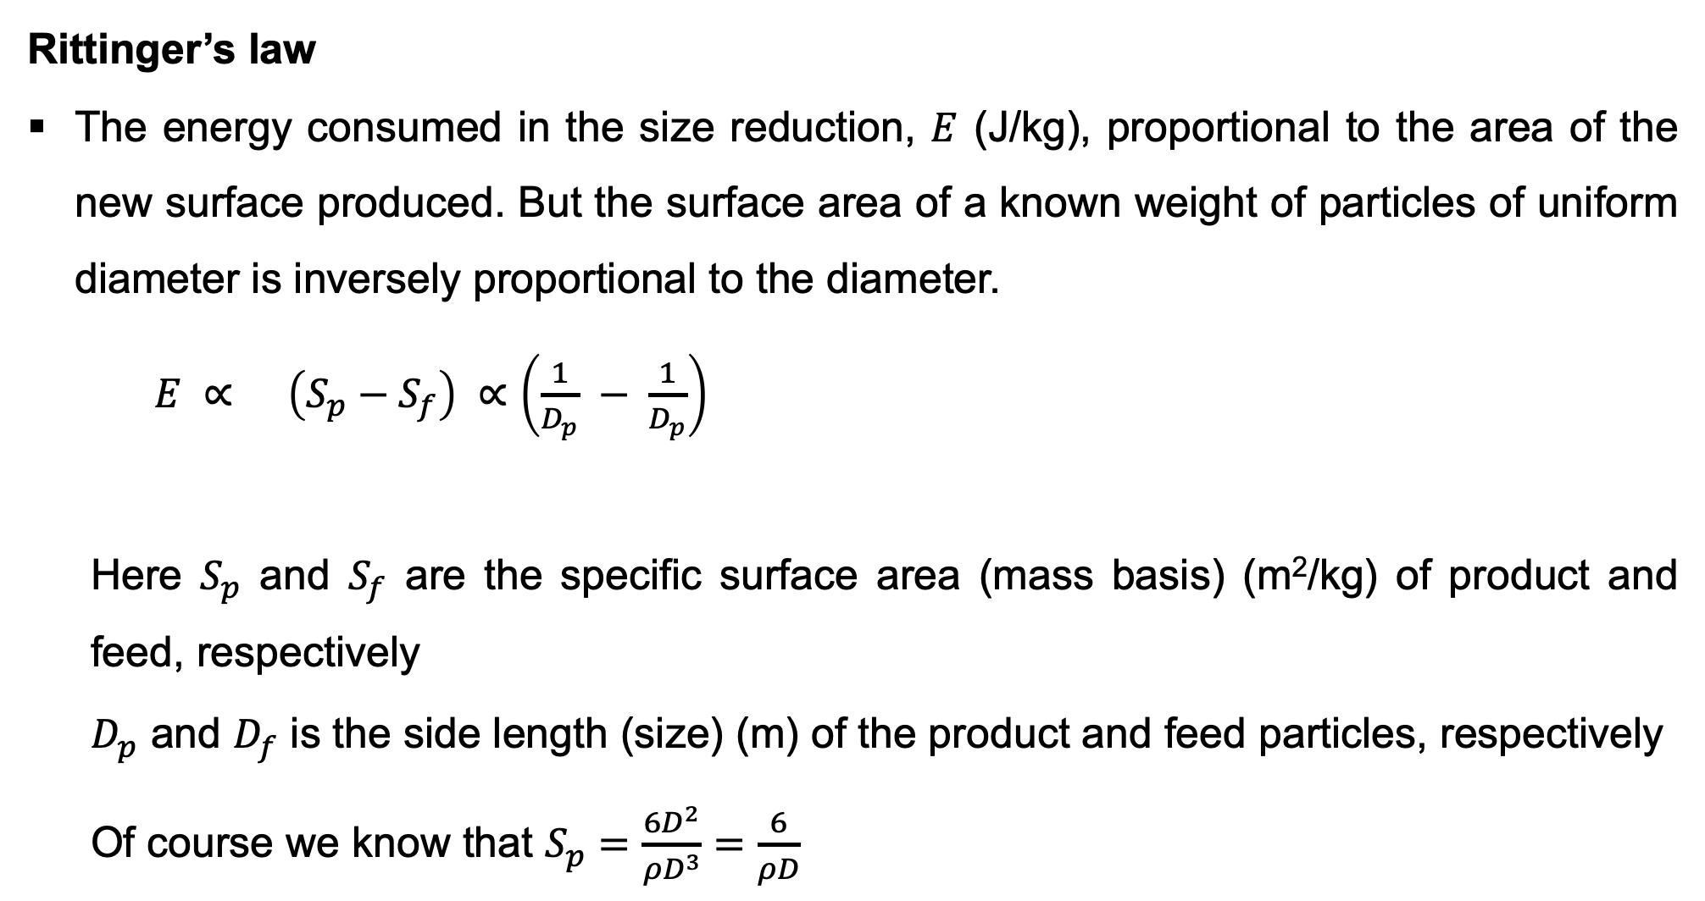


3.8. Comminution theory
Rittinger’s law
The energy consumed in the size reduction, $E$ (J/kg), proportional to the area of the new surface produced. But the surface area of a known weight of particles of uniform diameter is inversely proportional to the diameter.
$E ∝ \left(S_{p}−S_{f}\right) ∝\left(\frac{1}{D_{p}} − \frac{1}{D_{p}}\right)$
  Here $S_{p}$ and $S_{f}$ are the specific surface area (mass basis) (m²/kg) of product and feed, respectively
  $D_{p}$ and $D_{f}$ is the side length (size) (m) of the product and feed particles, respectively
  Of course we know that $S_{p}=\frac{6D^{2}}{ρD^{3}}=\frac{6}{ρD}$
$$D_{p}$$
$$D_{f}$$
MS© 2021

Slide 41
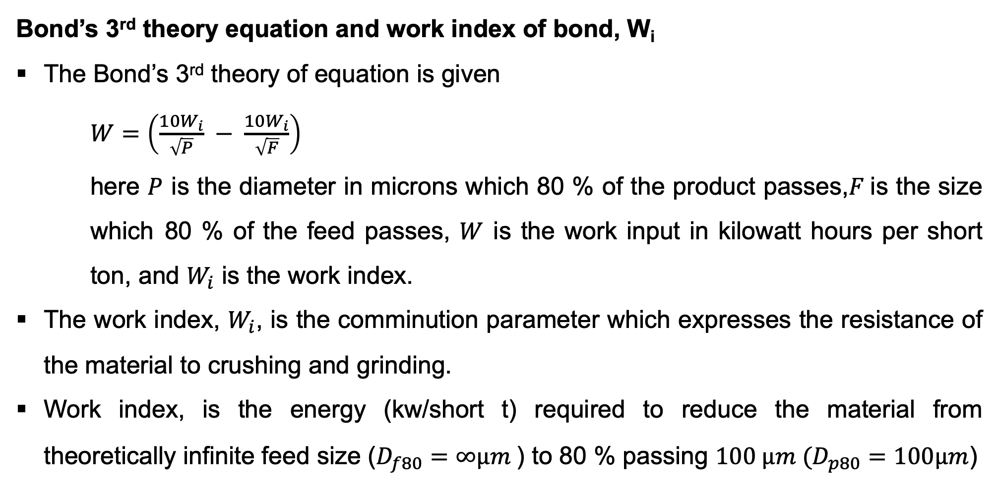
3.8. Comminution theory (cont.)
Bond’s 3rd theory equation and work index of bond, W_{i}
The Bond’s 3rd theory of equation is given
$W=\left(\frac{10W_{i}}{\sqrt{P}} − \frac{10W_{i}}{\sqrt{F}}\right)$
here $P$ is the diameter in microns which 80 % of the product passes,$F$is the size which 80 % of the feed passes, $W$ is the work input in kilowatt hours per short ton, and $W_{i}$ is the work index.
The work index, $W_{i}$, is the comminution parameter which expresses the resistance of the material to crushing and grinding.
Work index, is the energy (kw/short t) required to reduce the material from theoretically infinite feed size ($D_{f80}=∞µm$) to 80 % passing $100 µm (D_{p80}=100µm$)
MS© 2021

Slide 42
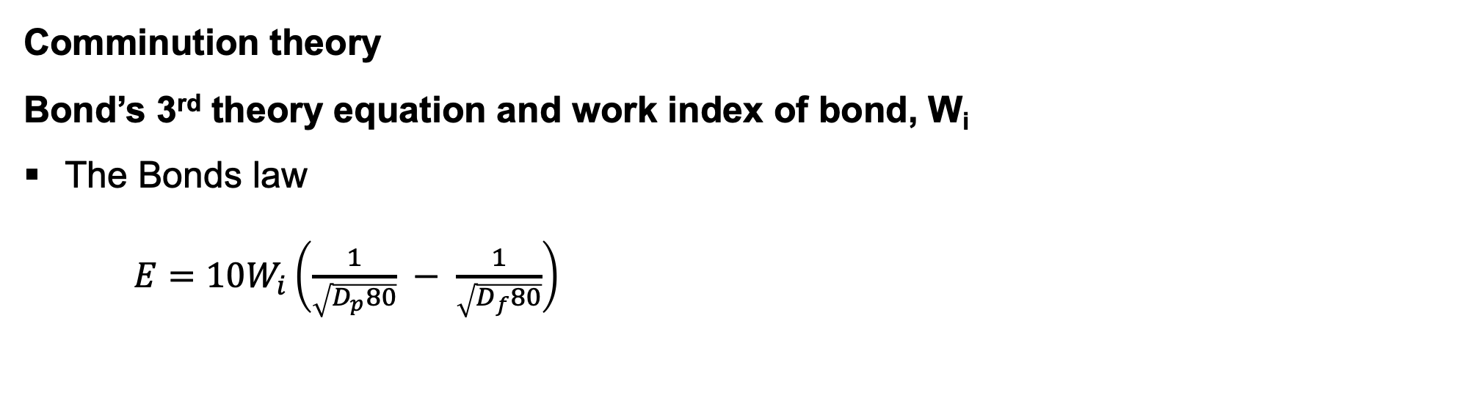
3.8. Comminution theory (cont.)
Comminution theory
Bond’s 3rd theory equation and work index of bond, W_{i}
The Bonds law
$E=10W_{i}\left(\frac{1}{\sqrt{D_{p}80}} − \frac{1}{\sqrt{D_{f}80}}\right)$
Resistance of the material to crushing and grinding
The diameter in microns which 80% of the feed passes
MS© 2021

Slide 43
Lecture content
3.1. Introduction
3.2. Liberation
3.3. Size reduction
3.4. Crushing
3.5. Type of crusher and crushing mechanism
3.6. Crushing stages and circuit
3.7. Properties of rock/ore
3.8. Comminution theory
3.9. Crushing equipment
3.10. Crushing equipment: Jaw crusher
3.11. Crushing equipment: Gyratory crusher
3.12. Crushing equipment: Cone crusher
3.13. Crushing equipment: Roll crusher
3.14. Crushing equipment: Impact/hammer crusher
MS© 2021

Slide 44
3.9. Crushing equipment
Crushing is normally a dry process, except for some moisture (2-3 %) in the ore as received.
The particles to be broken should be large enough to be “nipped” and crushed between two solid steel members, one – or both – of which moves to and fro in a fixed path cycle.
The rock particles gravitate down through the expanding and contracting gap between the members.
In coarse crushing (primary crushing), large rocks are broken into a relatively smaller rocks.
This requires very large forces, but relatively little energy for a given mass of rock.
MS© 2021

Slide 45
3.9. Crushing equipment (cont.)
If the same mass of rock is broken in intermediate and fine crushing (secondary and tertiary crushing), where the rocks are much smaller, the forces required to break individual rock particles are also much smaller, but much more energy is required because of the much larger amount of new surface created.
In grinding, the forces required to break individual particles are quite small, but the energy required to break the same mass of material is very high.
Because of these differences, the various crushing stages and grinding are carried out in machines of quite different designs.
The large forces required in crushing are obtained by means of the lever-principle and in well-designed primary crushers, the largest force is exerted upon the largest rock.
MS© 2021

Slide 46
3.9. Crushing equipment (cont.)
Primary crushing of ores is done close to the place of mining, to facilitate subsequent handling.
With underground ores, which are hoisted by skip, primary crushing is preferably carried out underground.
The most common type of crusher for underground operation is the jaw crusher.
Open pit ores are usually hauled out of the pit by trucks, which can dump the ore directly into a primary crusher (mostly gyratory crusher).
Further size-reduction of ores is done at the ore-treatment plant (concentrator).
Intermediate (secondary) crushing is nearly always done in standard cone crushers and sometimes in small gyratory crushers (reduction gyratories).
MS© 2021

Slide 47
Lecture content
3.1. Introduction
3.2. Liberation
3.3. Size reduction
3.4. Crushing
3.5. Type of crusher and crushing mechanism
3.6. Crushing stages and circuit
3.7. Properties of rock/ore
3.8. Comminution theory
3.9. Crushing equipment
3.10. Crushing equipment: Jaw crusher
3.11. Crushing equipment: Gyratory crusher
3.12. Crushing equipment: Cone crusher
3.13. Crushing equipment: Roll crusher
3.14. Crushing equipment: Impact/hammer crusher
MS© 2021

Slide 48
3.10. Crushing equipment: Jaw crusher
The general principle of the most commonly used jaw crusher (Blake-type or double-toggle jaw crusher) is as follows:
  The crusher consists essentially of two crushing surfaces set at a small angle convergent downward.
  The one surface is fixed to the main frame, the other is moveable and is caused to approach and recede from the fixed surface alternately.
  This movement is caused by the action of the toggle-plates and the pitman, actuated by the eccentric.
  In the Blake crusher, the moveable jaw is pivoted on a shaft at the top of the crusher. The jaws are protected by replaceable jaw plates.
MS© 2021

Slide 49
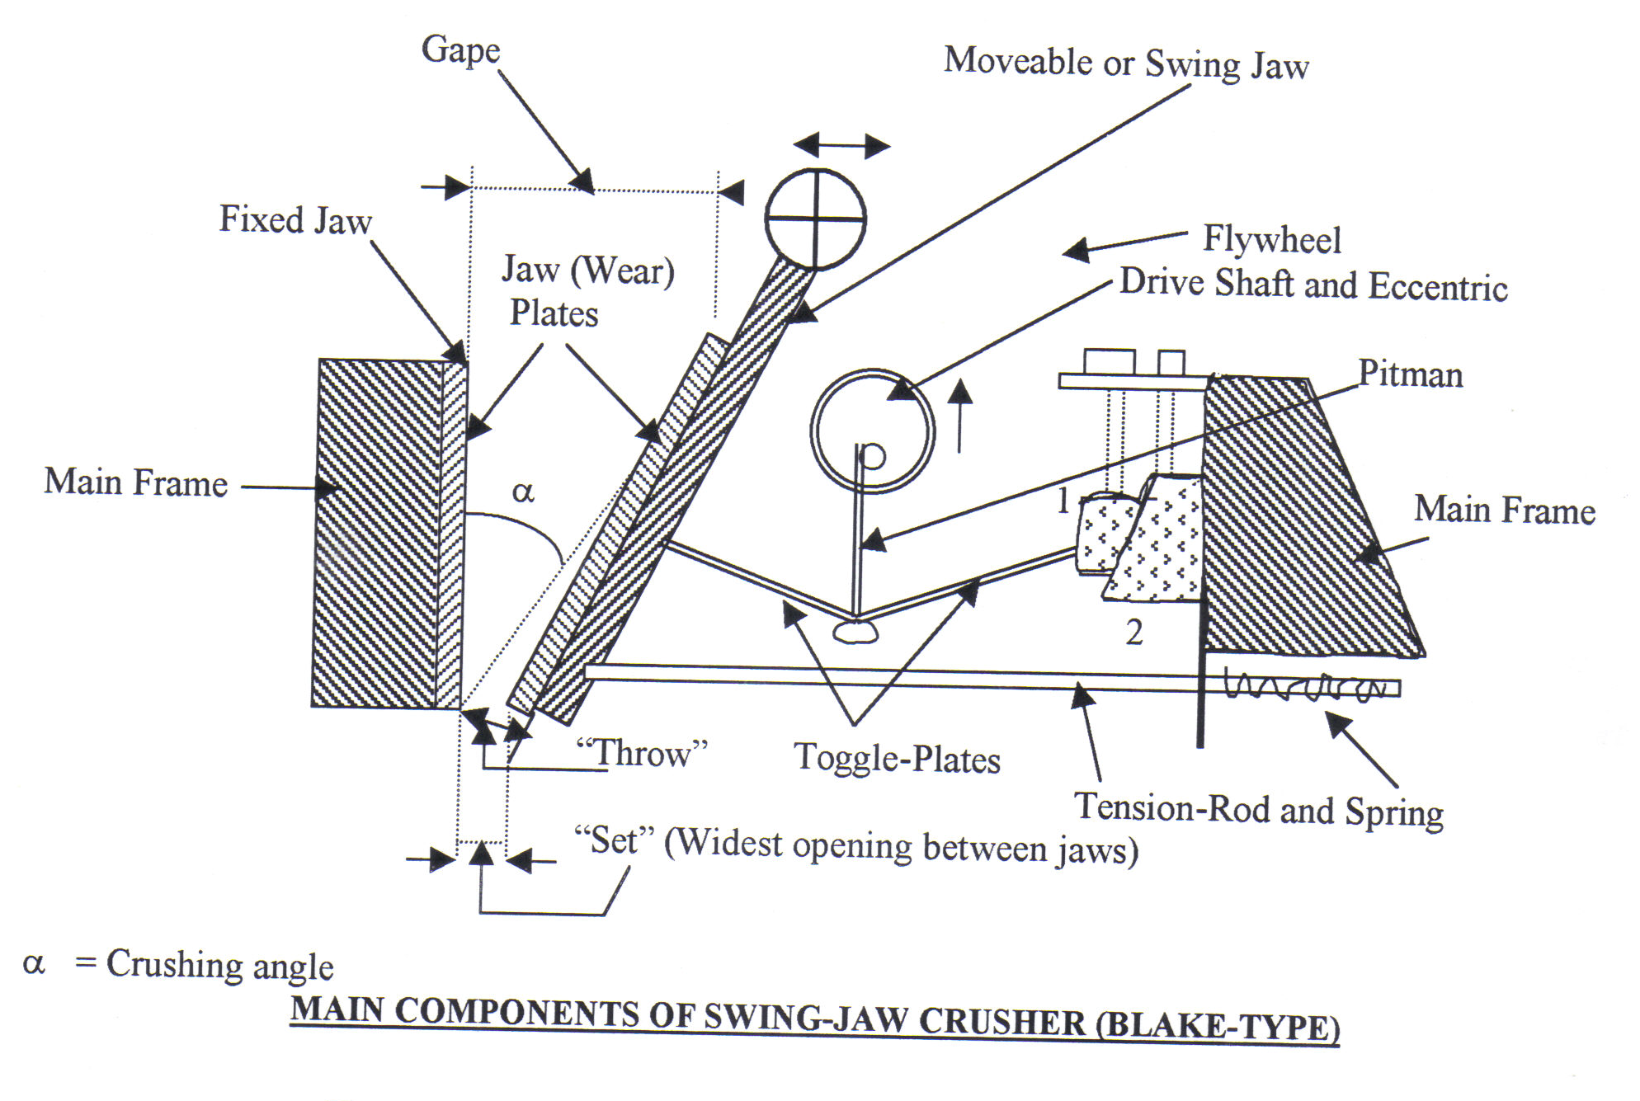
3.10. Crushing equipment: Jaw crusher (cont.)
Jaw crusher
The “set” of this crusher is the maximum opening between the jaws at the discharge point. It is the maximum size (in one dimension) that a particle should have when it leaves the crushing zone.
The gape indicates the maximum size of the rocks that can be accepted as feed to the crusher
MS© 2021

Slide 50
Lecture content
3.1. Introduction
3.2. Liberation
3.3. Size reduction
3.4. Crushing
3.5. Type of crusher and crushing mechanism
3.6. Crushing stages and circuit
3.7. Properties of rock/ore
3.8. Comminution theory
3.9. Crushing equipment
3.10. Crushing equipment: Jaw crusher
3.11. Crushing equipment: Gyratory crusher
3.12. Crushing equipment: Cone crusher
3.13. Crushing equipment: Roll crusher
3.14. Crushing equipment: Impact/hammer crusher
MS© 2021

Slide 51
3.11. Crushing equipment: Gyratory crusher
The suspended-spindle type is the most commonly used gyratory crusher. Its general principle is as follows:
  A conical breaking head is suspended on a spindle (the main shaft) from a two-armed “spider”, mounted on the main frame.
  The main frame consists of an upper and lower shell.
  The upper shell is an inverted conic frustrum with concave liners.
  The head is given an eccentric gyration by an eccentric sleeve, which is rotated by a bevel gear and pinion, driven by a countershaft, which is coupled to the drive.
  The gyrating head and the stationary concave are the crushing media. Just as concave liners protect the shell, the head is protected by a wear-resistant mantle.
MS© 2021

Slide 52
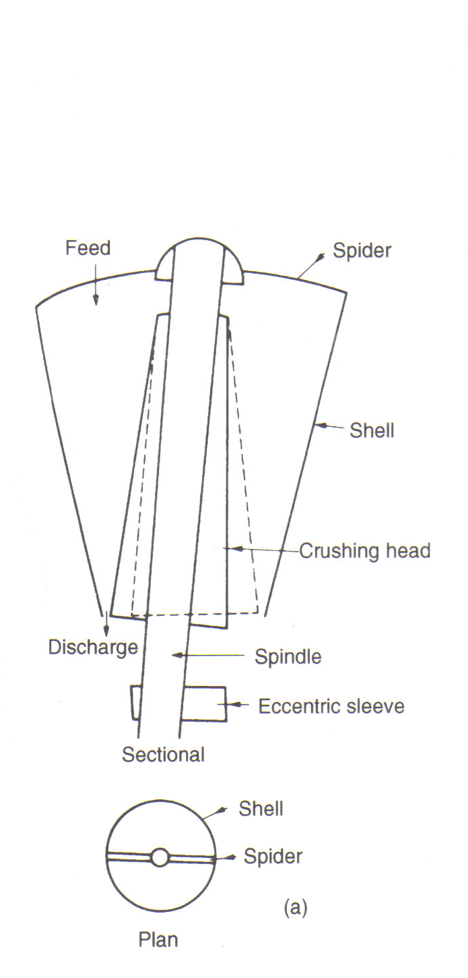
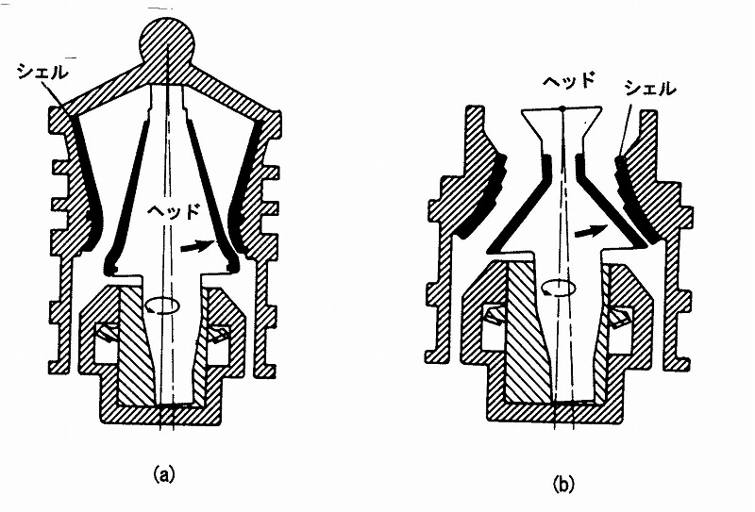
3.11. Crushing equipment: Gyratory crusher (cont.)
Gyratory crusher (cont.)
MS© 2021

Slide 53
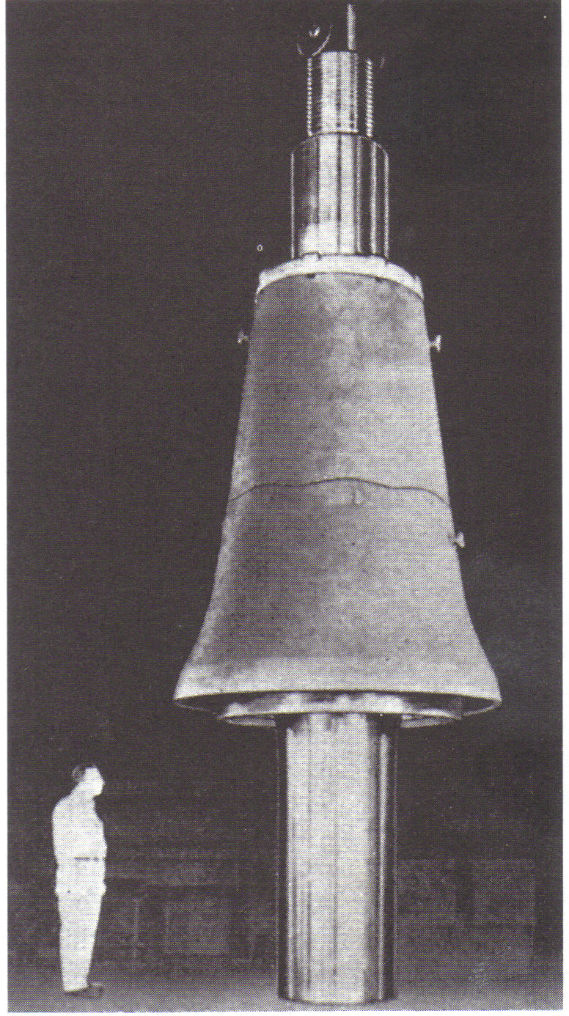
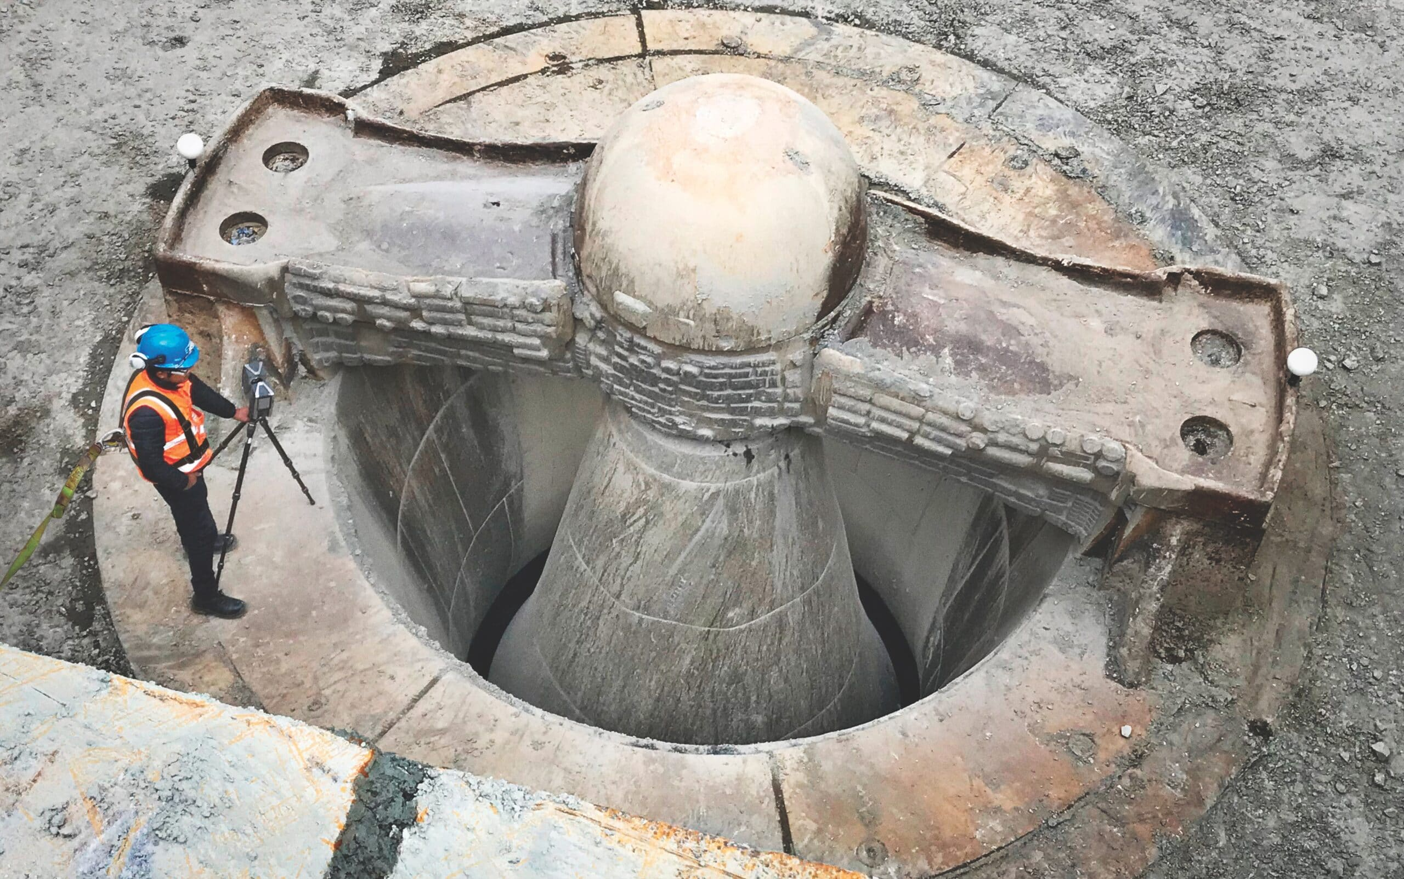
3.11. Crushing equipment: Gyratory crusher (cont.)
MS© 2021

Slide 54
Lecture content
3.1. Introduction
3.2. Liberation
3.3. Size reduction
3.4. Crushing
3.5. Type of crusher and crushing mechanism
3.6. Crushing stages and circuit
3.7. Properties of rock/ore
3.8. Comminution theory
3.9. Crushing equipment
3.10. Crushing equipment: Jaw crusher
3.11. Crushing equipment: Gyratory crusher
3.12. Crushing equipment: Cone crusher
3.13. Crushing equipment: Roll crusher
3.14. Crushing equipment: Impact/hammer crusher
MS© 2021

Slide 55
3.12. Crushing equipment: Cone crusher
The crushing mechanism of the cone crusher is similar to gyratory crushers.
The difference is between gyratory and cone crusher is that the latter has shorter head, receives finer feed and produces finer products.
Shell
Head
Shell
Gyratory Crusher
Cone Crusher
Head
Head
150-–800mm ⇒25–250mm
25–250mm ⇒ 5–40mm
MS© 2021

Slide 56
Lecture content
3.1. Introduction
3.2. Liberation
3.3. Size reduction
3.4. Crushing
3.5. Type of crusher and crushing mechanism
3.6. Crushing stages and circuit
3.7. Properties of rock/ore
3.8. Comminution theory
3.9. Crushing equipment
3.10. Crushing equipment: Jaw crusher
3.11. Crushing equipment: Gyratory crusher
3.12. Crushing equipment: Cone crusher
3.13. Crushing equipment: Roll crusher
3.14. Crushing equipment: Impact/hammer crusher
MS© 2021

Slide 57
3.13. Crushing equipment: Roll crusher
Crushing rolls consist essentially of two horizontally mounted cylinders, which are rotated in opposite directions, inward and downward.
The feed should be nipped between the approaching roll faces and be drawn down between the rolls.
In all modern roll crushers, one of the rolls is rigidly mounted and the other spring-loaded, as a protection against damage caused by the passage of an uncrushable object (tramp iron).
The distance (“set”) between the rolls is determined by the number of spacers between the moveable roll and the solidly mounted roll.
Adjustment of the set and compensation for wear can be made by changing the number of spacers.
MS© 2021

Slide 58
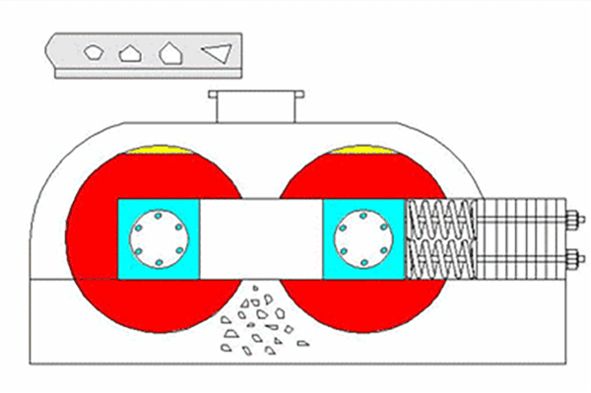
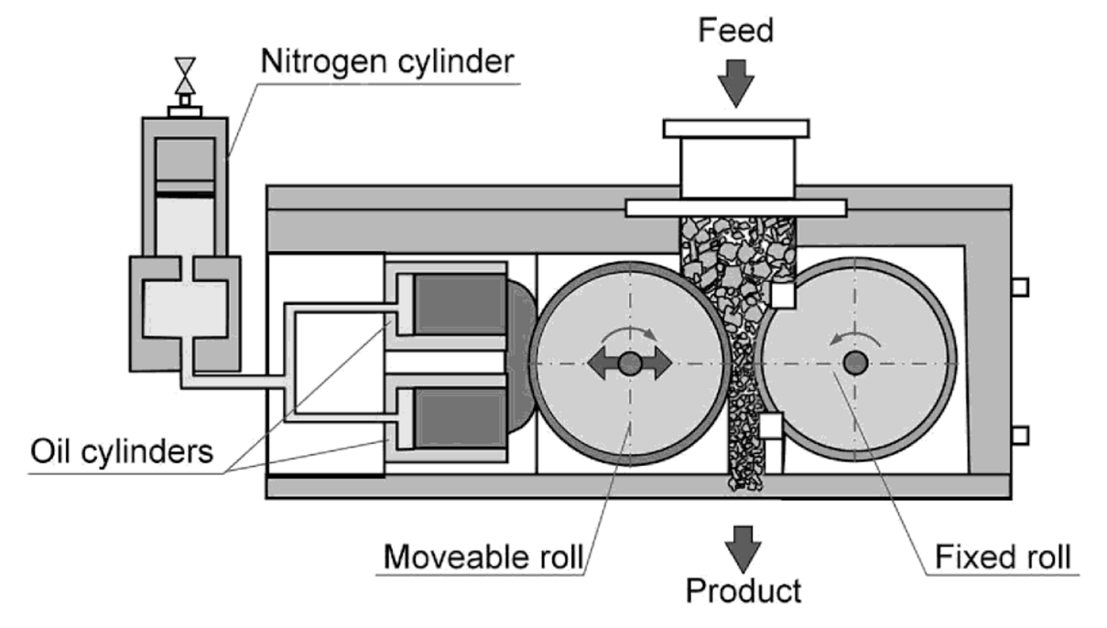
3.13. Crushing equipment: Roll crusher (cont.)
MS© 2021

Slide 59
3.13. Crushing equipment: Roll crusher (cont.)
The diameter of the rolls should be large in comparison with the feed size and therefore crushing rolls are limited to fine crushing only and the speed of rotation is relatively low (80-120 rev min⁻¹).
Higher speeds become dangerous, in particular with large, heavy rolls. Crushing rolls are generally superseded by shorthead cone crushers and rod mills, but still find application in smaller plants and laboratories.
Because of their uneven product size, crushing rolls are usually operated in closed circuit with a screen.
The circulating load is normally high (up to 600 %). To avoid production of too much fines, “graded crushing” can be practised.
MS© 2021

Slide 60
Lecture content
3.1. Introduction
3.2. Liberation
3.3. Size reduction
3.4. Crushing
3.5. Type of crusher and crushing mechanism
3.6. Crushing stages and circuit
3.7. Properties of rock/ore
3.8. Comminution theory
3.9. Crushing equipment
3.10. Crushing equipment: Jaw crusher
3.11. Crushing equipment: Gyratory crusher
3.12. Crushing equipment: Cone crusher
3.13. Crushing equipment: Roll crusher
3.14. Crushing equipment: Impact/hammer crusher
MS© 2021

Slide 61
3.14. Crushing equipment: Impact/hammer crusher
Hammer mills (impact crushers) reduce from a large size to very fine in one operation.
A great many forms exist, but the common principle is that a set of beaters (flailing hammers) spins round inside a stationary casing, with a large grid at the bottom as discharge. The size of the openings in the grid determines the product size. The crushing forces are applied instantaneously. The rock particles are broken either by impact from the hammers or by impact against the casing or against other particles.
Hammer mills are best suitable for rather soft and friable material, because they wear rapidly. They are used in particular on clayey ores, that would clog reciprocating (i.e. with a to-and-fro movement of the crushing media) crushers as jaw crushers and particularly gyratory and cone crushers.
MS© 2021

Slide 62
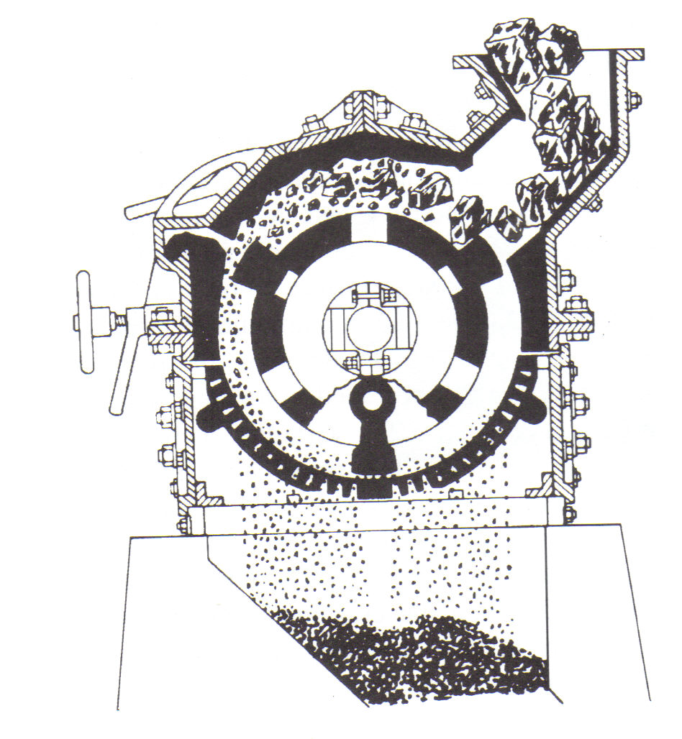
3.14. Crushing equipment: Impact/hammer crusher (cont.)
MS© 2021

Slide 63
End of Lecture 3

