Slide 1
GEE 4812:
Principles of Geomatics
Remote Sensing & GIS
LECTURER : Mr. TWATAIZYA MINANGO
EMAIL : twataizya.minango@unza.zm
OFFICE : B.Eng. Main Building, 1st Floor, Former Zagis Offices, Room 2

Slide 2
Remote Sensing: Definition
is the science and art of obtaining information about a feature through the analysis of data acquired by a device that is not in contact with the feature under investigation. (F. F. Sabins, 1996)
RS can broadly be defined as the technique of gathering information about a feature without being in direct contact.

Slide 3
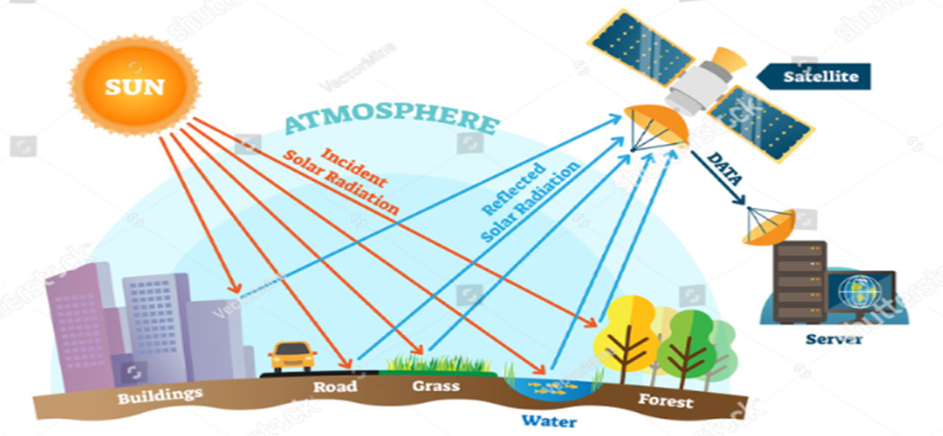
Remote Sensing: Principle

Slide 4
Remote Sensing: Principle
Electromagnetic Radiation (EMR): Remote sensing relies on the interaction of electromagnetic radiation with the Earth's surface and the objects on it. Electromagnetic radiation travels in waves and includes various forms, such as visible light, infrared, microwave, and radio waves.
Energy source: Remote sensing begins with an energy source, such as sunlight or artificial radiation, which illuminates or interacts with the target on the Earth's surface.

Slide 5
Remote Sensing: Principle
Interaction with the Target: The energy from the source interacts with the target object or surface. This interaction can be in the form of reflection, absorption, emission, or transmission of electromagnetic radiation.
Sensor: Sensors detect the energy that is either emitted by the target or reflected from it. These sensors can be passive (detect natural energy, e.g., optical sensors for visible light) or active (emit energy and measure the return signal, e.g., radar).

Slide 6
Remote Sensing: Principle
Data Acquisition: Remote sensing systems collect data in the form of digital images or other measurements. These data can be in the visible, infrared, microwave, or other parts of the electromagnetic spectrum.
Data Transmission: The acquired data is transmitted to the ground station or receiving station, typically via radio signals or other communication methods.

Slide 7
Remote Sensing: Principle
Data Processing: Once the data is received on the ground, it undergoes various processing steps, including calibration, correction for atmospheric effects, and georeferencing to ensure accuracy.
Image Analysis: Analysts interpret and analyze the processed data to extract valuable information. This can include identifying land cover types, monitoring changes over time, detecting anomalies, and more.

Slide 8
Remote Sensing: Principle
Applications: The information obtained through remote sensing is used for a wide range of applications, including agriculture (crop monitoring), forestry (deforestation assessment), environmental monitoring (water quality assessment), urban planning (land use mapping), and disaster management (natural disaster assessment).
Decision Making: The insights gained from remote sensing data help policymakers, scientists, and various stakeholders make informed decisions and take appropriate actions.

Slide 9
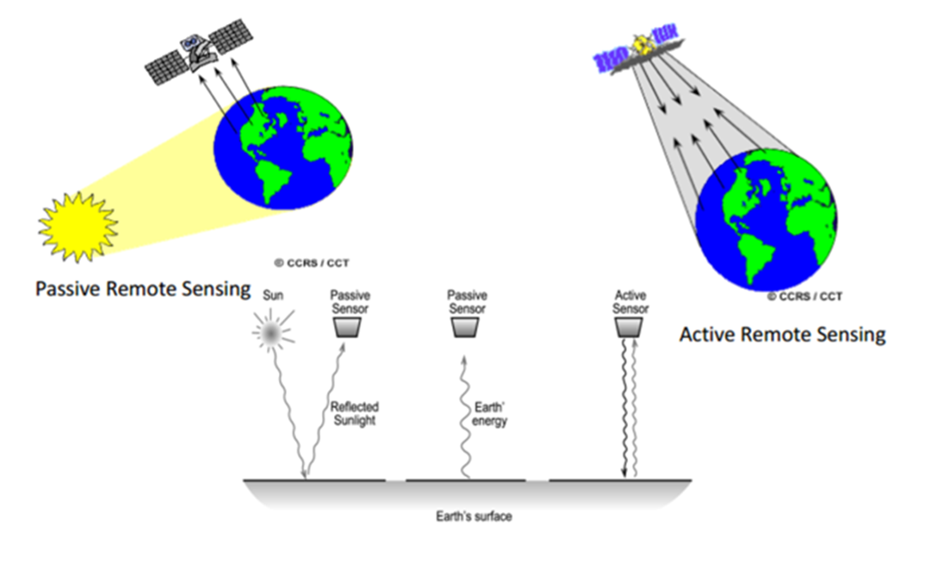
Remote Sensing: Passive vs Active Sensors
Passive sensors measure the energy naturally emitted, and the sunlight is the primary source of energy used e.g Spectrometers, Radiometers and Cameras.
Active sensors generate their electromagnetic energy source for illumination to the target and record the backscattered radiation from the target e.g radar, lidar, x-ray.

Slide 10
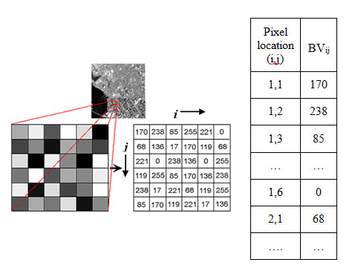
Remote Sensing: Digital Numbers
Digital Numbers (DN) is value stored within a pixel of an image.
DN represents amount of EMR reflected back to the sensor.
DNs are sometimes called Brightness Values (BV).

Slide 11
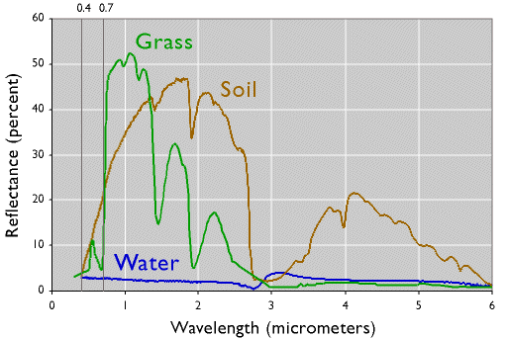
Remote Sensing: Spectral Signature
Different Earth’s features display different spectral behaviour depending upon their interactions with EMR..
Features such as water, rock, soils, and vegetation, interact with the varying wavelengths of EMR differently, which can uniquely identify the feature.

Slide 12
Remote Sensing: Application
Mining
Moisture Content measurement
Monitoring Vegetation Health
Crop Yield Estimation
Deforestation Monitoring
Meteorology, etc

Slide 13
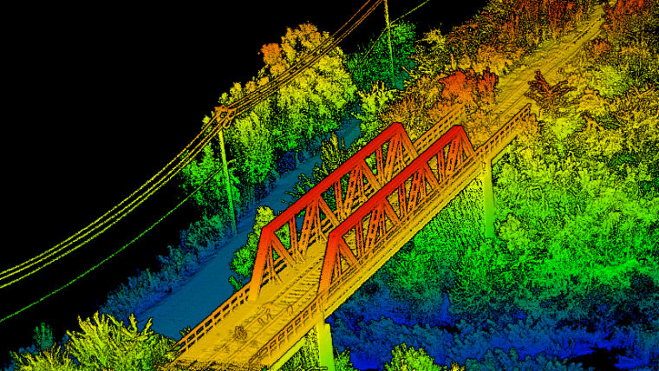
Remote Sensing: Lidar Surveying
Creation a precise 3D map of the environment.
3D model of Bridges, Power lines, trees e.t.c.

Slide 14
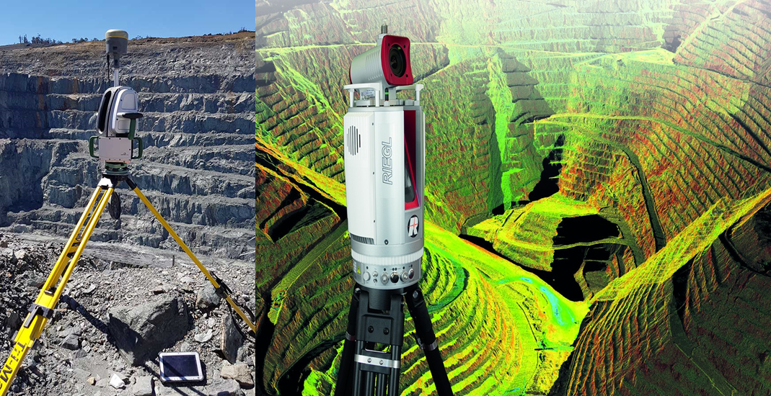
Remote Sensing: Lidar Surveying
3D modelling of an open pit mine using Lidar Surveying.
Elevation data can be generated from the model.

Slide 15
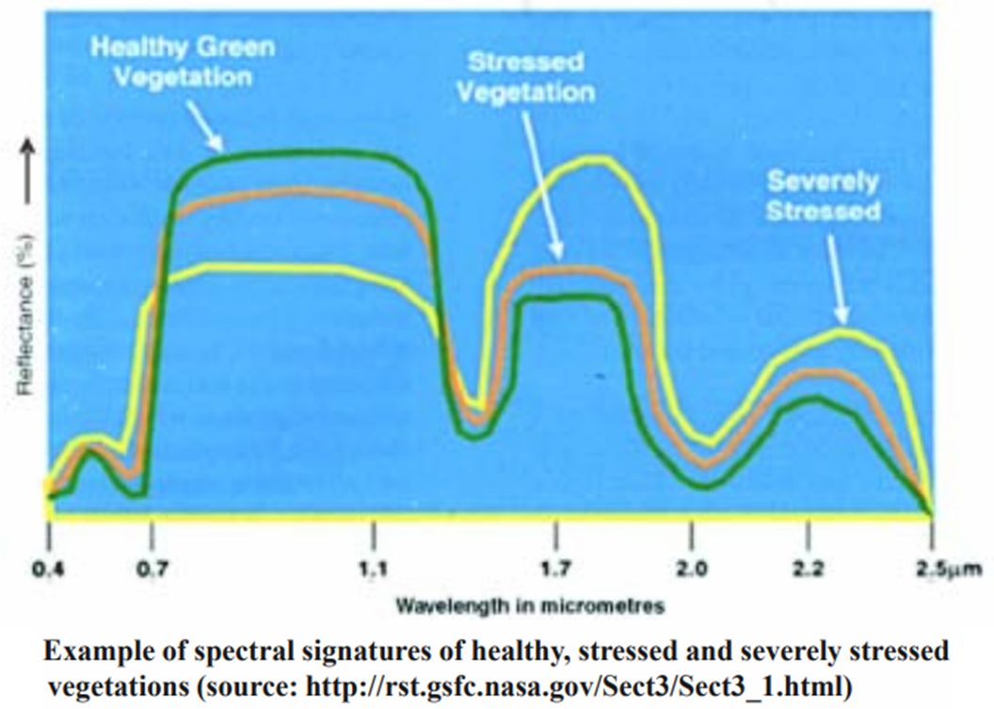
Remote Sensing: Vegetation Health
The internal structure of healthy leaves acts as excellent diffuse reflectors of near-infrared wavelengths.
Monitoring vegetation health.

Slide 16
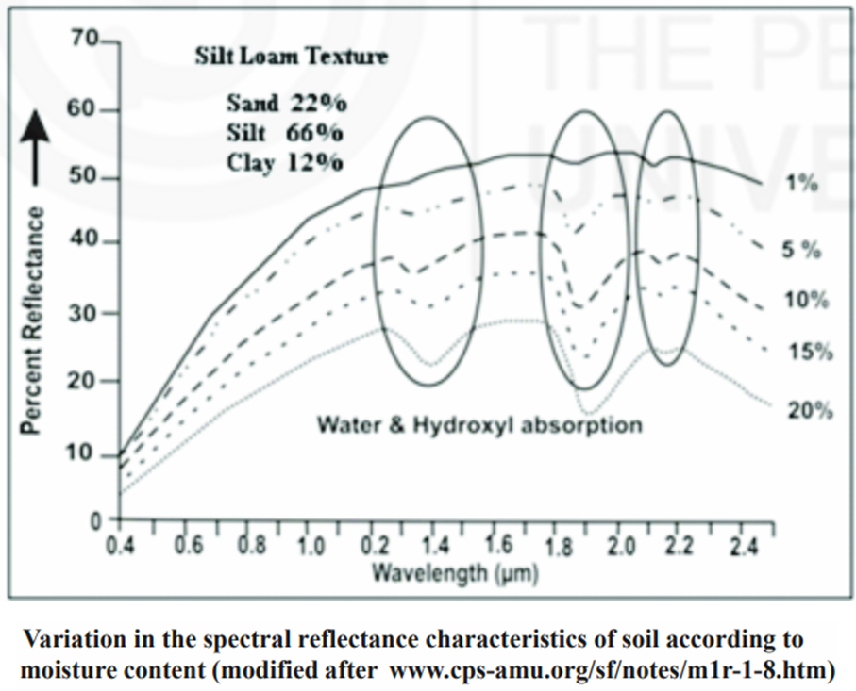
Remote Sensing: Soil Moisture Content
The presence of soil moisture reduces the surface reflectance of soil at all visible wavelengths (Jensen, 1983).
This occurs until the soil is saturated, at which point further additions of moisture have no effect on reflectance.
https://egyankosh.ac.in/bitstream/123456789/39531/1/Unit-3.pdf

Slide 17
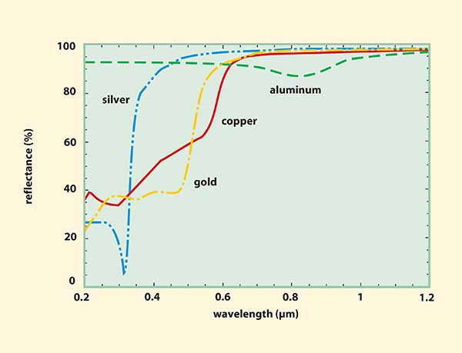
Remote Sensing: Mineral Exploration
Rocks, like soils, are single scatterer and exhibit relatively simple spectral properties.
Rock spectral reflectance primarily depends on their mineral composition.

Slide 18
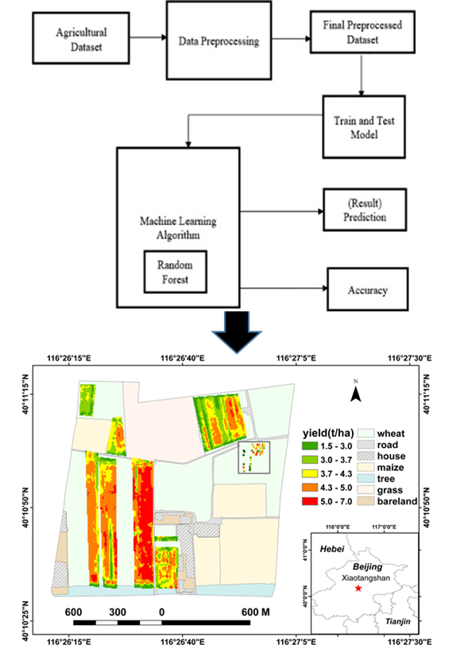
Remote Sensing: Crop Yield Estimation
A very common approach is the usage of Normalized Difference Vegetation Index (NDVI) or other satellite data bands. These bands are then combined with previous yields to build models of future yields. NDVI is obtained by the composition of near- infrared and red spectral channels.
https://isprs-annals.copernicus.org/articles/IV-3-W2-2020/59/2020/isprs-annals-IV-3-W2-2020-59-2020.pdf

Slide 19
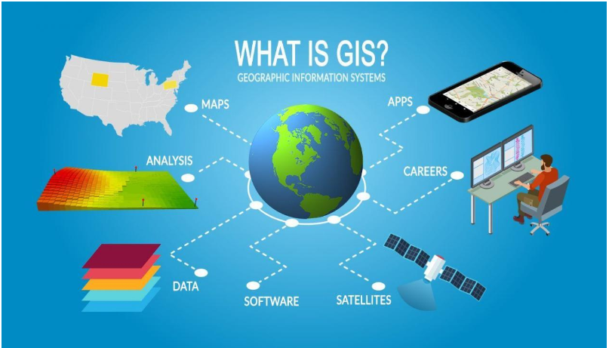
GIS (Geographic Information Science)

Slide 20
What is GIS?
GIS is an acronym for:
Geographic Information Systems (US)
Geographical Information Systems (UK, Aust., Canada)
Geographic Information Science (Academia)
Ernest Munsanje (Notes: 2015)

Slide 21
GIS: Definition
A geographic information system (GIS) is a system that creates, manages, analyzes, and maps all types of data.
GIS connects data to a map, integrating location data (where things are) with all types of descriptive information (what things are like there).
GIS can be broadly be defined as a tool for working with geographic information.

Slide 22
GIS
This provides a foundation for mapping and analysis that is used in science and almost every industry.
GIS helps users understand patterns, relationships, and geographic context.
The benefits include improved communication and efficiency as well as better management and decision making
https://www.esri.com/en-us/what-is-gis/overview

Slide 23
GIS
Data entry : early stage in which data about the studied phenomena is entered into the GIS, and representations are built
Data analysis : middle stage in which representations are manipulated and studied to gain (new) insight
Data presentation : final stage in which the results of analyses are presented (in maps or otherwise).
Data input
Database
Query and
analysis
Output and
visualisation

Slide 24
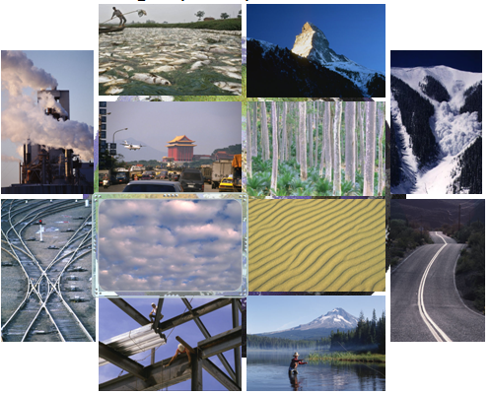
GIS: Principle
Spatial Data: GIS revolves around spatial data, which refers to information tied to specific locations on the Earth's surface.
Spatial data can include various types of information such as points, lines, polygons, and raster images.
These data elements are used to represent real-world features like buildings, roads, rivers, and more.

Slide 25
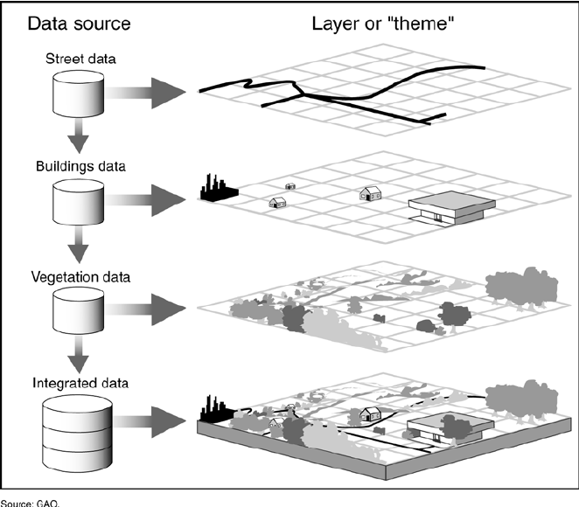
GIS: Principle
Data Integration: GIS integrates data from multiple sources and formats.
This data can come from surveys, satellite imagery, GNSS devices, paper maps, and various databases.
The ability to combine different datasets is a key strength of GIS, as it allows for the creation of comprehensive and meaningful maps and analyses

Slide 26
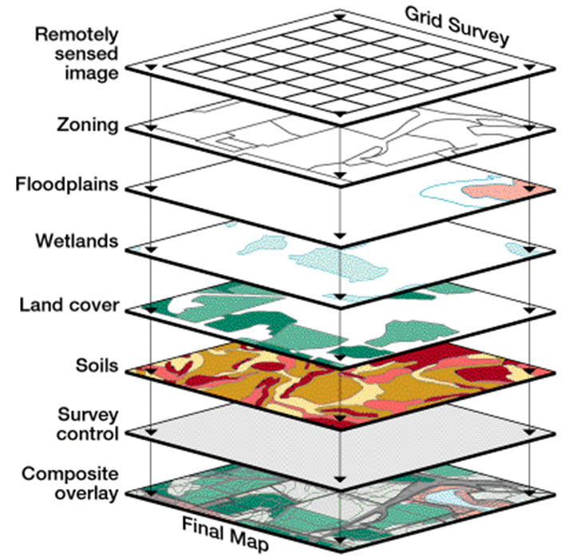
GIS: Principle
Data Layers: GIS organizes spatial data into layers.
Each layer contains a specific type of information, such as roads, land use, or population density.
These layers can be overlaid and analyzed together to gain insights and make informed decisions

Slide 27
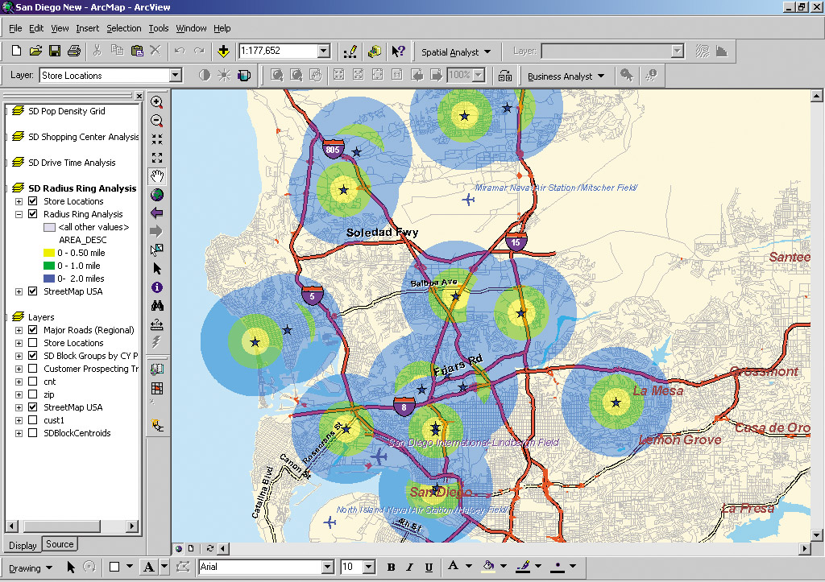
GIS: Principle
Spatial Analysis: One of the primary purposes of GIS is to perform spatial analysis.
This involves using various tools and techniques to answer questions or solve problems related to geography.
Spatial analysis can include tasks like proximity analysis, spatial modeling, and geoprocessing.

Slide 28
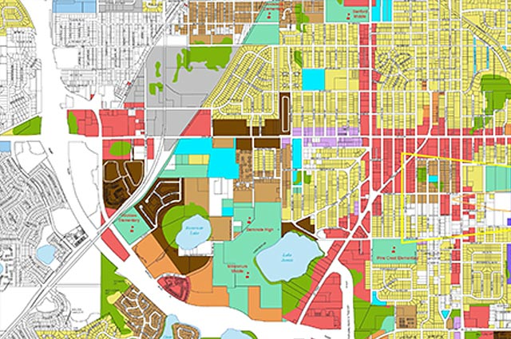
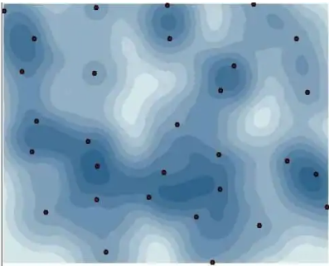
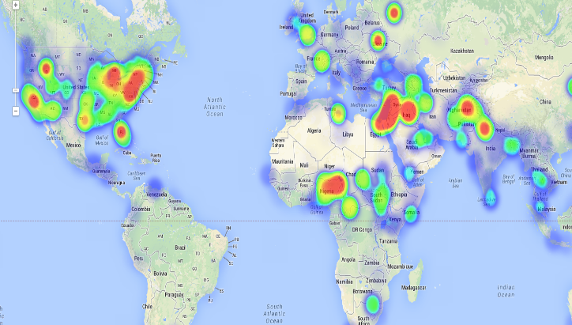
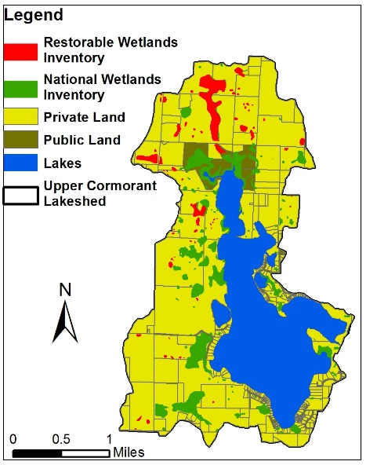
GIS: Principle
Visualization: GIS enables the creation of visual representations of spatial data through maps and charts.
Visualization is a powerful tool for understanding complex geographic patterns and conveying information to a wide audience.

Slide 29
GIS: Application
Land Surveying
Urban Planning
Map making
Health Industry
Mining
Health Industry
Agriculture
Site Suitability Analysis
Change Detection
Impact Assessment
Disaster Management
Water and Sewer Utilities etc

Slide 30
END

