Slide 1
GEE 4812:
Principles of Geomatics
Trigonometric Leveling
LECTURER : Mr. TWATAIZYA MINANGO
EMAIL : twataizya.minango@unza.zm
OFFICE : B.Eng. Main Building, 1st Floor, Former Zagis Offices, Room 2

Slide 2
Content
Introduction
Stadia/ODM Method
EDM Method
Total Station
Method of determining the elevation of a point by Theodolite/Total Station

Slide 3
Introduction
If the reduced levels of several points some distance apart in hilly terrain are required then the trigonometric levelling is employed as this method is faster than direct levelling.
Trigonometric leveling is the process of determining the different elevation of station from observed vertical angle and known distance.
The vertical angle is measured by means of theodolite and the horizontal distance may either measured or computed.
Relative heights are calculated using trigonometric formula.

Slide 4
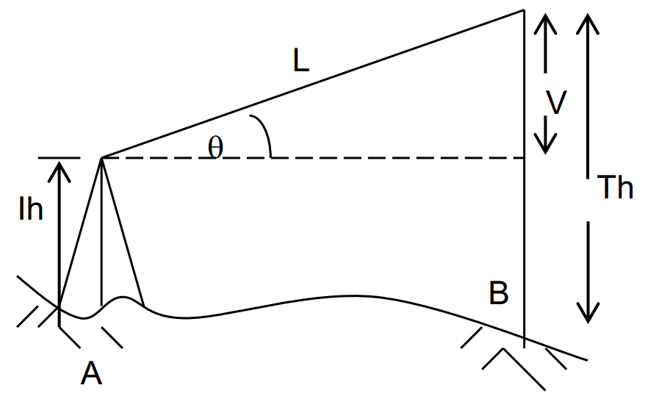
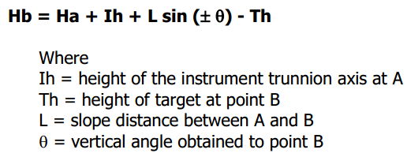
Introduction
For short sights (≤120m) the height is obtained by (see figure below)

Slide 5
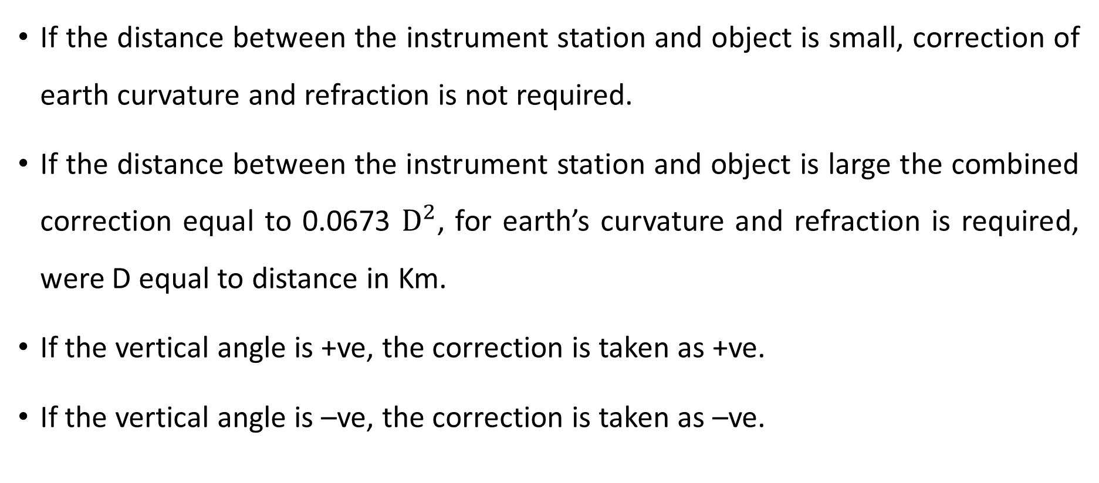
Introduction
If the distance between the instrument station and object is small, correction of earth curvature and refraction is not required.
If the distance between the instrument station and object is large the combined correction equal to 0.0673 $D^{2}$, for earth’s curvature and refraction is required, were D equal to distance in Km.
If the vertical angle is +ve, the correction is taken as +ve.
If the vertical angle is –ve, the correction is taken as –ve.

Slide 6
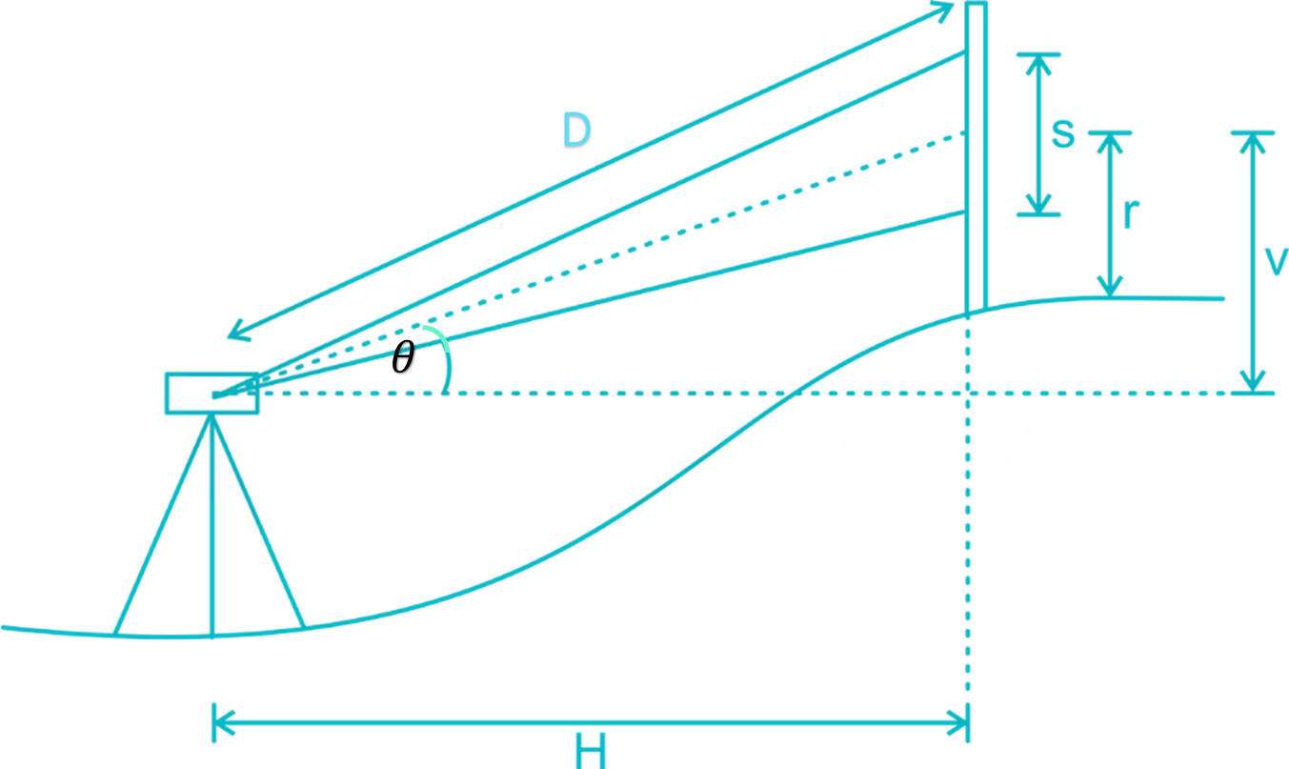
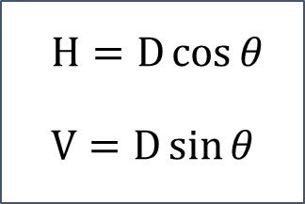
ODM Method
$$H=D\cos{θ}$$
$$V=D\sin{θ}$$
D = Slope Distance
H = Horizontal Distance
V = Vertical Distance
θ = Vertical Angle
S = Staff Intercept
r = Distance between
the middle reading and the staff bottom

Slide 7
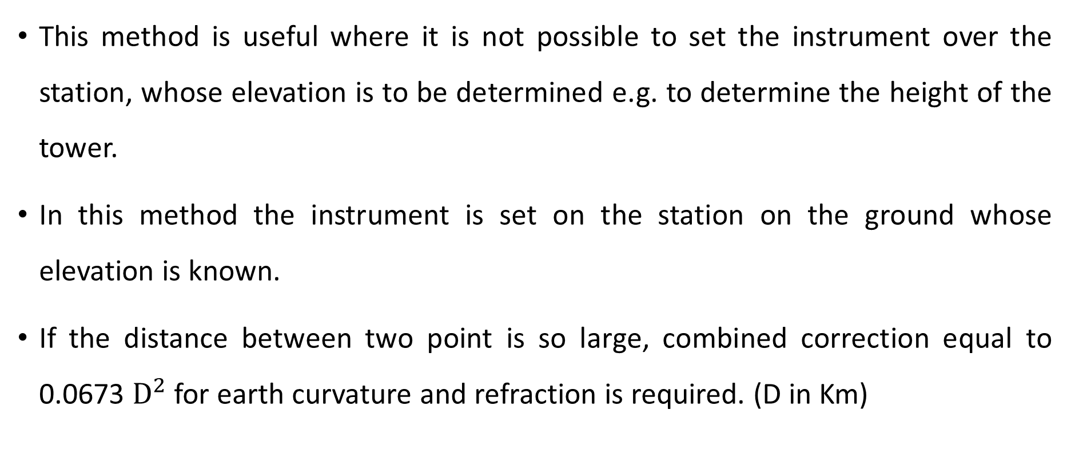
ODM Method
This method is useful where it is not possible to set the instrument over the station, whose elevation is to be determined e.g. to determine the height of the tower.
In this method the instrument is set on the station on the ground whose elevation is known.
If the distance between two point is so large, combined correction equal to 0.0673 $D^{2}$ for earth curvature and refraction is required. (D in Km)

Slide 8
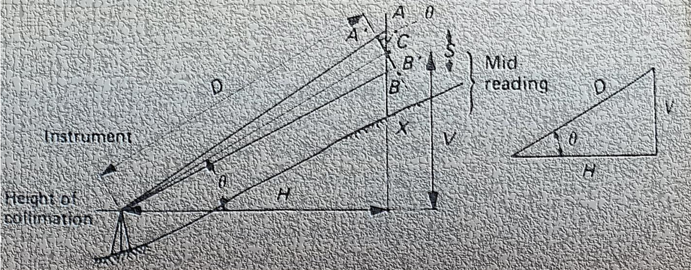
Trigonometric Leveling: Inclined Stadia
Hilly and broken terrains may pose a challenge if the line of interest was inclined to the horizontal.

Slide 9
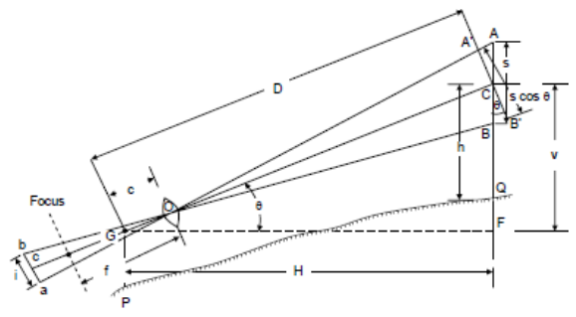
















Trigonometric Leveling: Inclined Stadia
Solving for slope distance D:
$$A$$
$A$’
$$θ$$
$$s$$
$$D$$
C
$s$’
$$θ$$
$$B$$
$B$’
$$θ$$
$$A$$
$$G$$
$$θ$$
Fig 2
Fig 1
$A$’
Applying the tachometric formula along plane GC we have:
$$\frac{s}{2}$$
$$\frac{s′}{2}$$
$$D=Cs′+K$$
$$θ$$
Fig 3
C

Slide 10


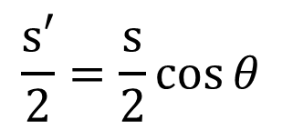



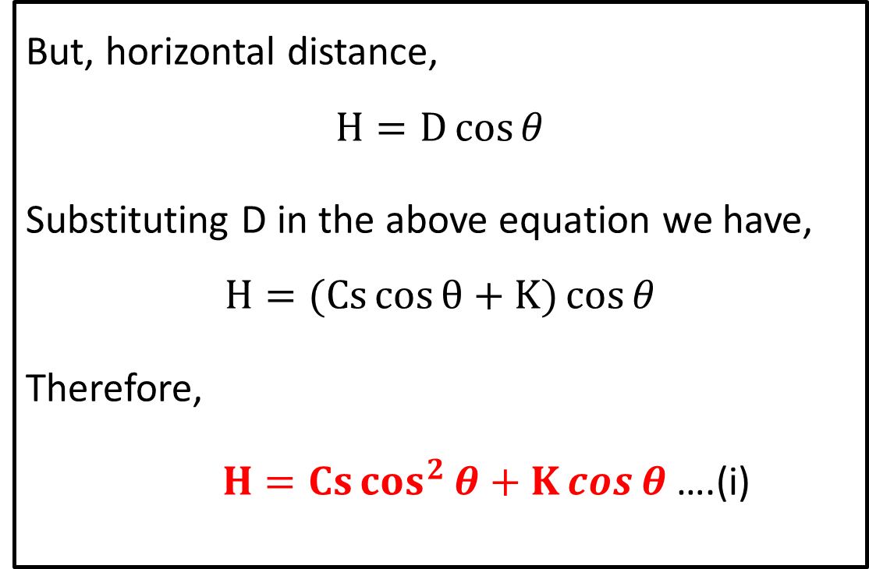


Trigonometric Leveling: Inclined Stadia
Solving for s’ :
$$A$$
But, horizontal distance,
$$H=D\cos{θ}$$
Substituting D in the above equation we have,
$$H=(Cs\cos{θ}+K)\cos{θ}$$
Therefore,
$H=Cs\cos^{2}{θ}+K\cos{θ}$ ….(i)
$$\frac{s′}{2}=\frac{s}{2}\cos{θ}$$
$A$’
$$\frac{s}{2}$$
$$\frac{s′}{2}$$
$$θ$$
C
Hence,
$$s′=s\cos{θ}$$
Thus,
$$D=Cs\cos{θ}+K$$

Slide 11


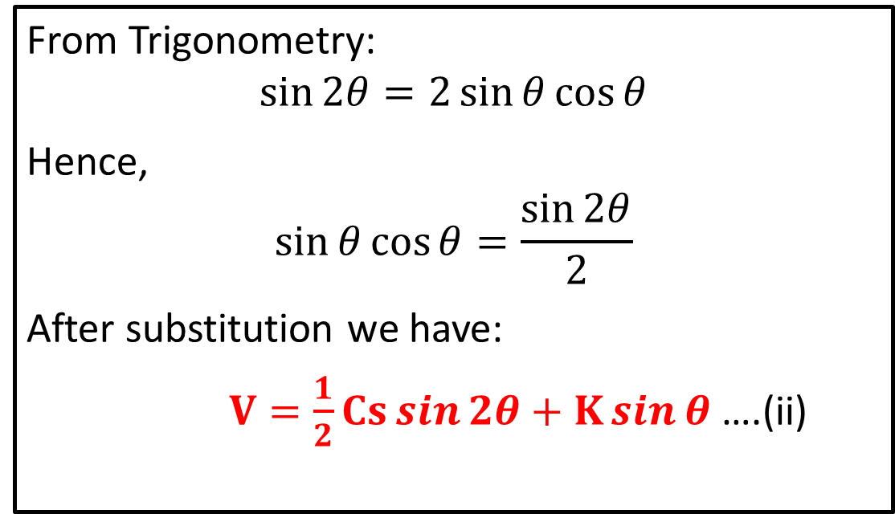

Trigonometric Leveling: Inclined Stadia
Vertical Distance:
From Trigonometry:
$$\sin{2θ}=2\sin{θ}\cos{θ}$$
Hence,
$$\sin{θ}\cos{θ}=\frac{\sin{2θ}}{2}$$
After substitution we have:
$V=\frac{1}{2}Cs\sin{2θ}+K\sin{θ}$ ….(ii)
$$V=D\sin{θ}$$
Hence,
$$V=(Cs\cos{θ}+K)\sin{θ}$$
Thus,
$$V=Cs\sin{θ}cos{θ}+K\sin{θ}$$
Note: equations (i) and (ii) apply to both horizontal and inclined sighting cases. However, 𝜃 is equal to zero during horizontal sighting.

Slide 12
Effect of Curvature & Refraction
For long sights and accurate levelling work, the effects of curvature of the earth and refraction of the line of sight shall have to be taken into consideration.
Due to curvature, the points appear to be lower than they actually are; while due to refraction, they appear to be higher than they actually are.
The effect of curvature being greater than that of refraction, the combined effect causes the points to appear to be lower than they actually are.

Slide 13
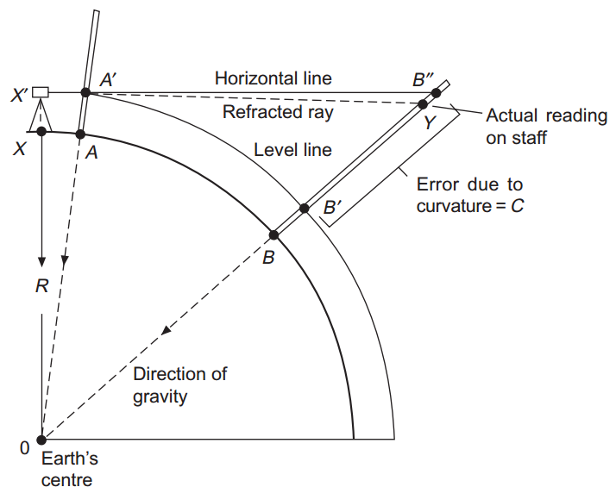
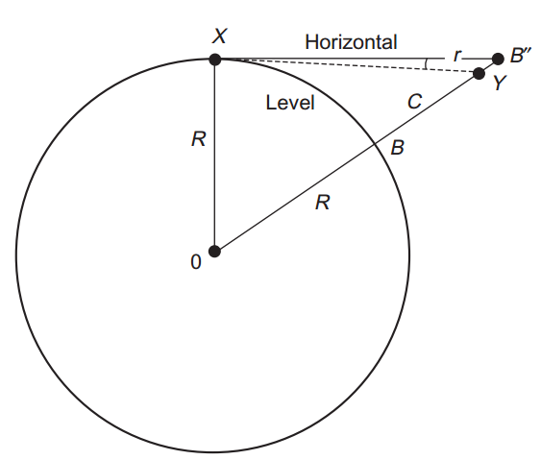
Effect of Curvature & Refraction

Slide 14
Effect of Curvature & Refraction
Two points A and B at exactly the same level. An instrument set up at X would give a horizontal line of sight through X′.
If a graduated levelling staff is held vertically on A the horizontal line would give the reading A′.
Theoretically, as B is at the same level as A, the staff reading should be identical (B′).
This would require a level line of sight; the instrument, however, gives a horizontal line and a reading at B″ (ignoring refraction).
Subtracting vertical height AA′ from BB″ indicates that point B is lower than point A by the amount B′B″

Slide 15
Effect of Curvature & Refraction
In practice the staff reading in the figure would not be at B″ but at Y due to refraction of the line of sight through the atmosphere.
In general it is considered that the effect is to bend the line of sight down, reducing the effect of curvature.

Slide 16
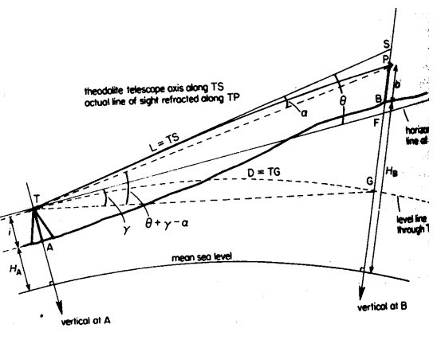
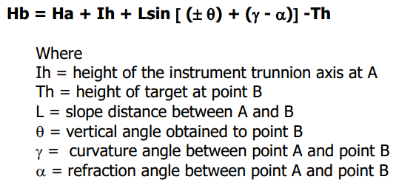
Effect of Curvature & Refraction
For longer sights (> 120 metres) the height is obtained by (see figure below)

Slide 17
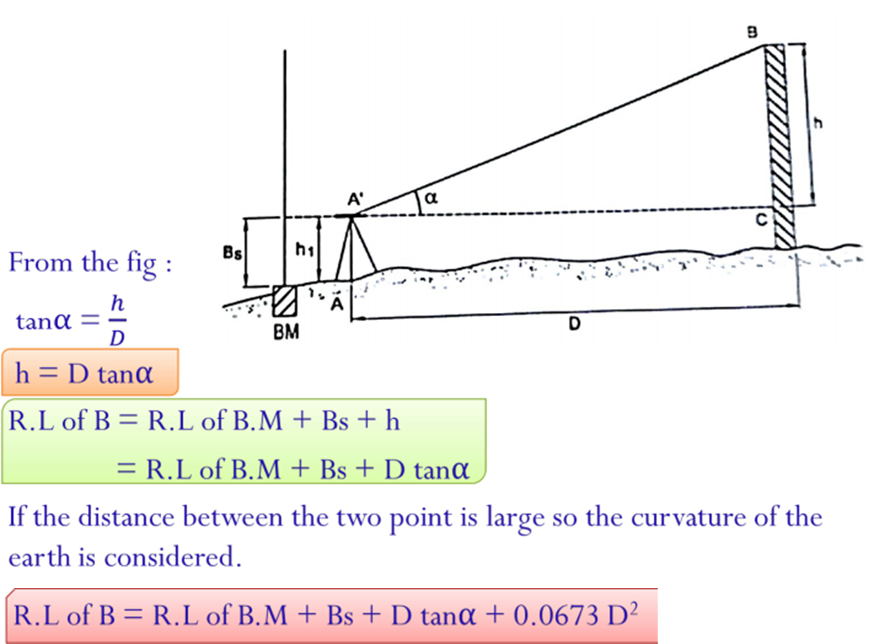
Method of determining the elevation of a point by Theodolite

Slide 18
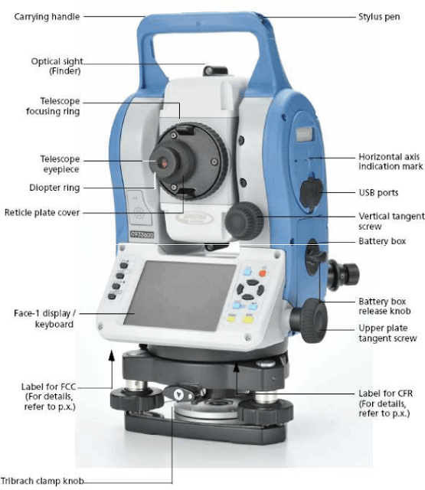
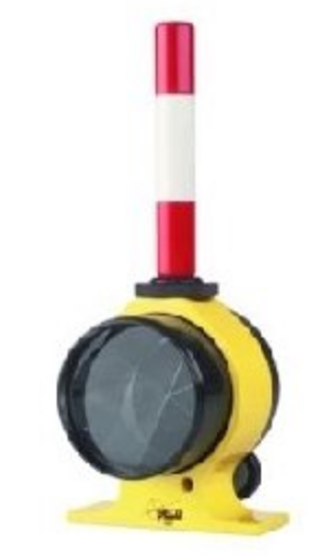
EDM: Total Station
Prism/Reflector

Slide 19
EDM: Total Station
The total station is a revolutionary improvement in surveying sectors.
It can facilitate the total work process of any device.
Digitally having data gives the accurate result of an area that saves time and error is reduced.
Microwaves and infrared signals are emitted from the total station which determines the distance between the points.
Coordinates and angles are determined by the triangle and trigonometry methods

Slide 20
Total Station: Capabilities
The average of multiple angles is measured
The average of multiple distances is measured
Horizontal distances
Distances between any two observed points
Elevations of objects on the surface
Three coordinates of the unknown observed points

Slide 21
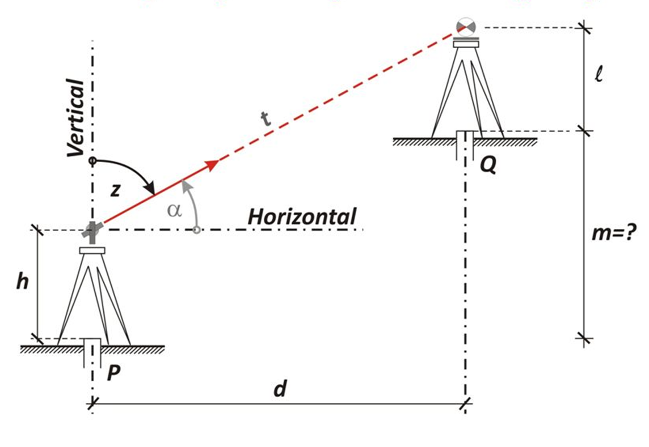
Trigonometric Leveling: EDM

Slide 22
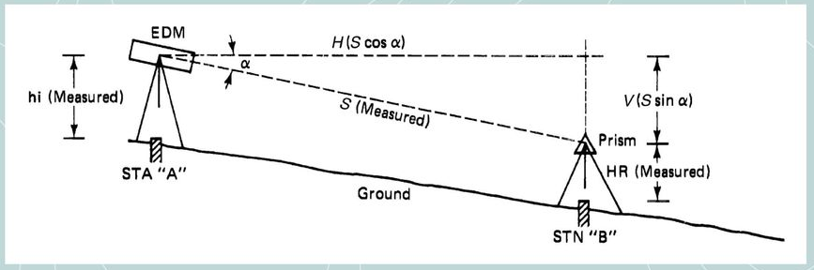
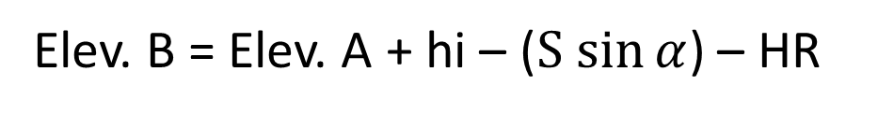
Using Vertical Angle
Elev. B = Elev. A + hi – V – HR
Elev. B = Elev. A + hi – ($S sin{α}$) – HR

Slide 23
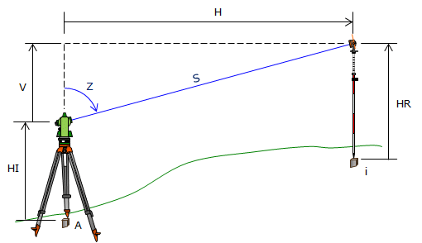
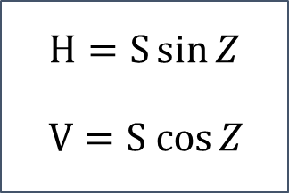
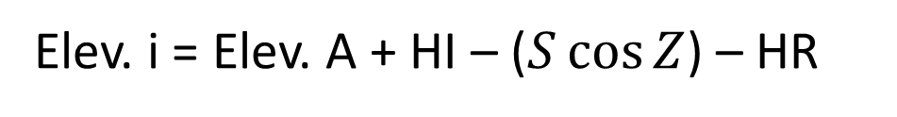
Using Zenith Angle
$$H=S\sin{Z}$$
$$V=S cos{Z}$$
Elev. i = Elev. A + HI + V – HR
Elev. i = Elev. A + HI – ($S\cos{Z}$) – HR

Slide 24
END

