Slide 1
GEE 4812:
Principles of Geomatics
Single Point Positioning
LECTURER : Mr. TWATAIZYA MINANGO
EMAIL : twataizya.minango@unza.zm
OFFICE : B.Eng. Main Building, 1st Floor, Former Zagis Offices, Room 2

Slide 2
Content
Projection
Rectangular Coordinate System
Polar Coordinate System
Intersection Method
Resection Method

Slide 3
Coordinate Systems: Introduction
The relative position of a feature or a point is defined by means of coordinates in a certain coordinate system.
Therefore, a point on the earth may be located by geographical coordinates, i.e. longitude, latitude and altitude.
Maps are made as plane reproduction of the earth.

Slide 4
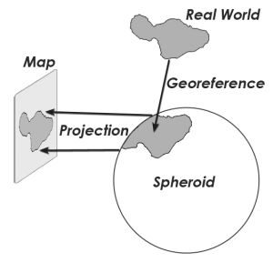
Coordinate Systems: Projection
Since the earth is spheroidal, a projection system must be used to reproduce the earth on the plane (flat surface).
Thus the projection system defines mathematically a link between the earth and the earth on the map.

Slide 5
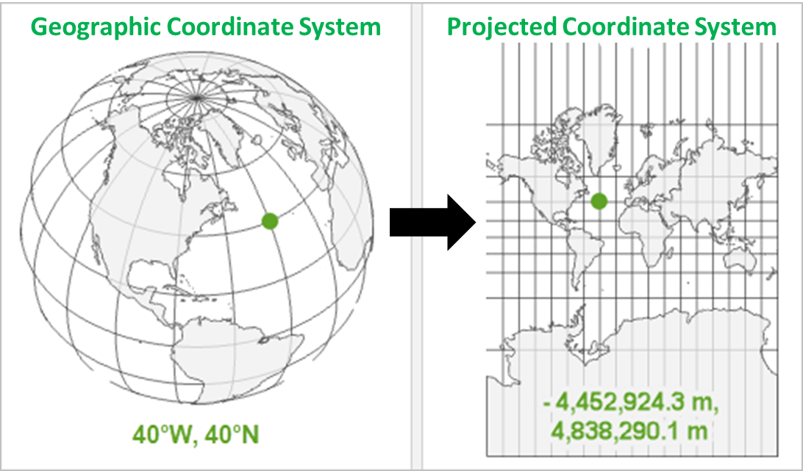
Coordinate Systems: Projection
Earth projected from 3D (spheroid) to 2D (flat surface).

Slide 6
Coordinate Systems: Types
There are two coordinate systems used in plane surveying are:
Rectangular Plane Coordinates
Polar Plane Coordinates

Slide 7
Rectangular Plane Coordinates
In surveying, the coordinate systems are different from mathematical coordinate systems in that the X- axis defined along the North-South direction and the Y- axis along the East-West direction.
For example, a point P is expressed as P (Y, X). (see figure)

Slide 8
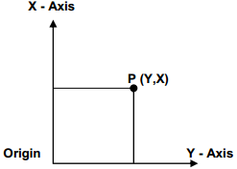
Rectangular Plane Coordinates
That is the X-axis is positive to the north, which is the zero direction and the Y-axis is positive to the east.
The calculations in both systems are exactly the same.

Slide 9
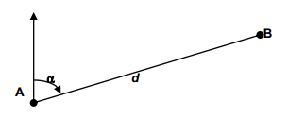
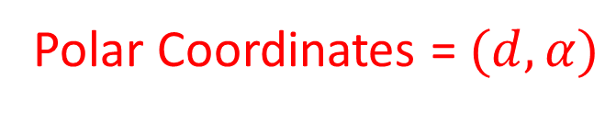
Polar Plane Coordinates
The relative position of two points can also be given by distance (d) between the points and the bearing (α).
These are referred to as Polar coordinates. (Figure below)
Polar Coordinates = $(d,α)$

Slide 10
Join and Polar
Join : means the determination of the distance and bearing between two (2) points given their rectangular coordinates.
Polar : means the determination of the coordinates of the second point given the coordinates of the first point, and the distance and bearing to the second point.

Slide 11
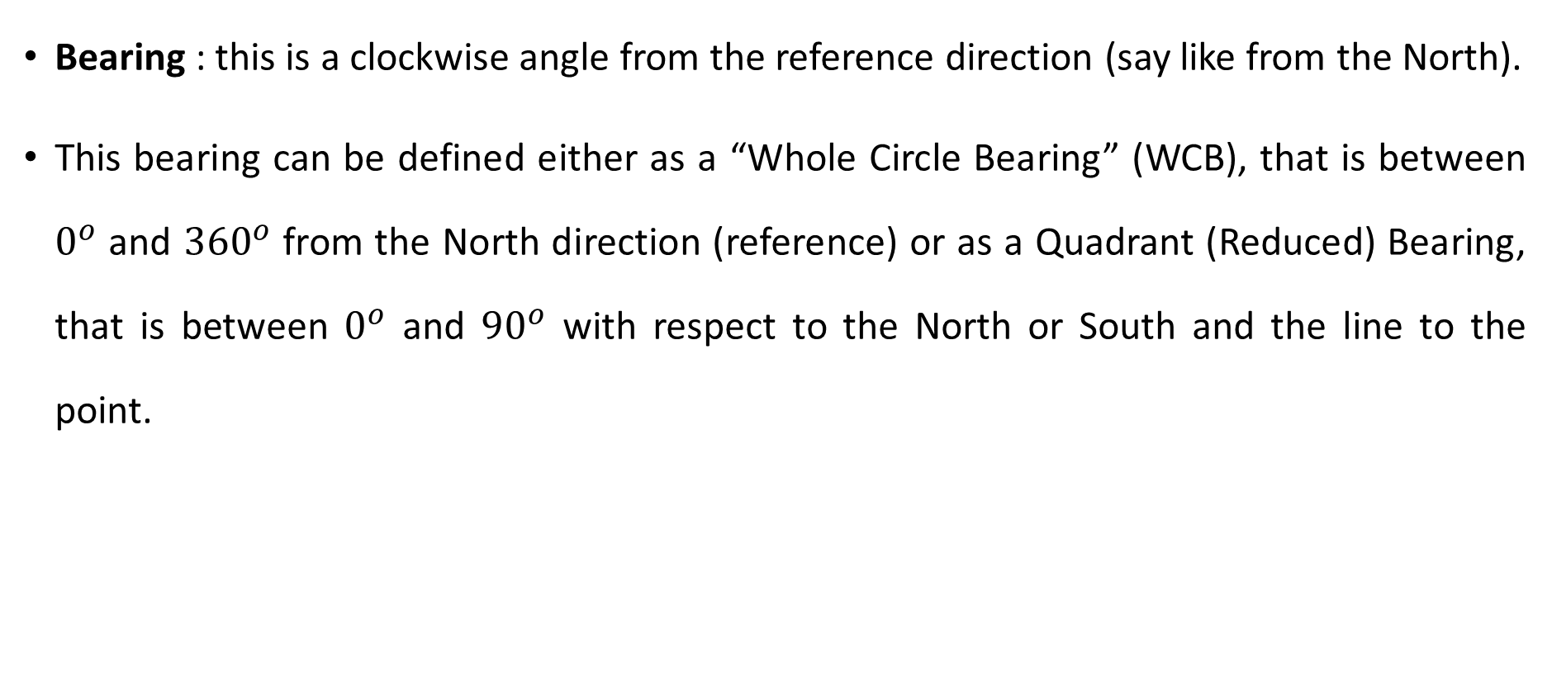
Bearing
Bearing : this is a clockwise angle from the reference direction (say like from the North).
This bearing can be defined either as a “Whole Circle Bearing” (WCB), that is between $0^{o}$ and ${360}^{o}$ from the North direction (reference) or as a Quadrant (Reduced) Bearing, that is between $0^{o}$ and ${90}^{o}$ with respect to the North or South and the line to the point.

Slide 12
Bearing
The computation of a bearing shown previously does not show the exact especially in the second, third and fourth quadrants.
The quadrants are numbered clockwise starting from the upper right one.
The quadrant where the point lies is determined by the value (+ or -) of the changes in Y and X-axes, i.e. ∆Y and ∆X in the respective quadrants.
The figure shows the values of the changes and what value has to be added.

Slide 13
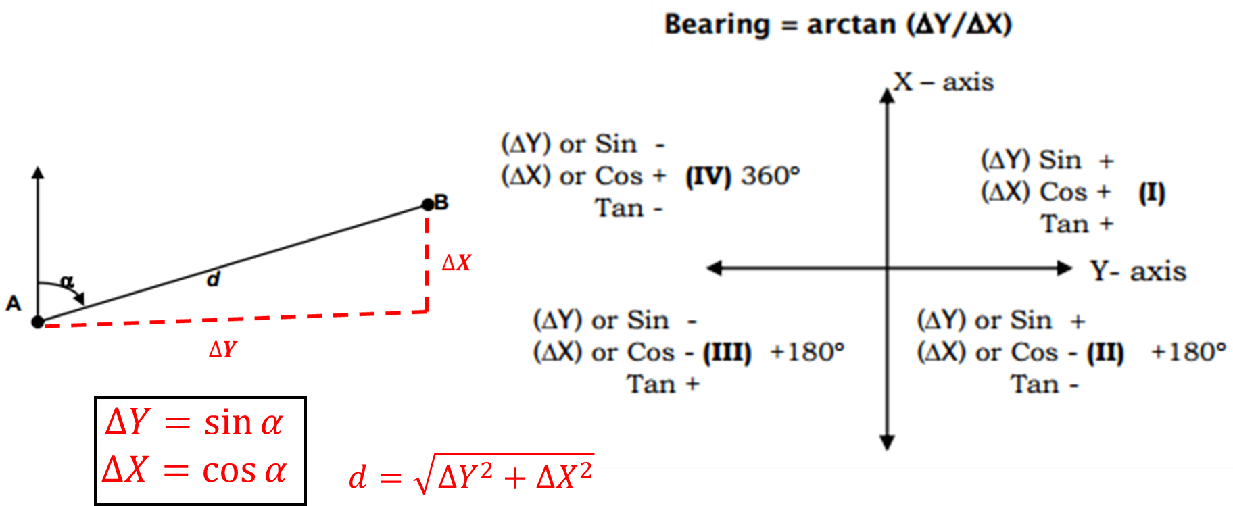
Bearing Calculation Quadrants

Slide 14
Bearing Calculation Quadrants
1st Quadrant : ∆Y and ∆X are both positive, maintain the angle.
2nd Quadrant : ∆Y is positive and ∆X is negative, add 180 degrees to the angle.
3rd Quadrant : ∆Y and ∆X are both negative, add 180 degrees to the angle.
4th Quadrant : ∆Y is negative and ∆X is positive, add 360 degrees to the angle.

Slide 15
Single Point Positioning
There are 3 types of elementary measurements.
These are Distance, Bearing and Angle.
Bearings can be measured either directly by the use of a compass or indirectly by a known bearing + angle.
Under this section, two types of single point positioning techniques are discussed.
These are: Intersection and Resection.

Slide 16
Intersection
With intersection a minimum of two known points is needed to coordinate a third point, and the unknown point is just measured to.
There are a number of combinations of quantities to be measured. These are:
Distance + distance
Distance + bearing
Distance + angle
Bearing + bearing
Bearing + angle
Angle + angle

Slide 17
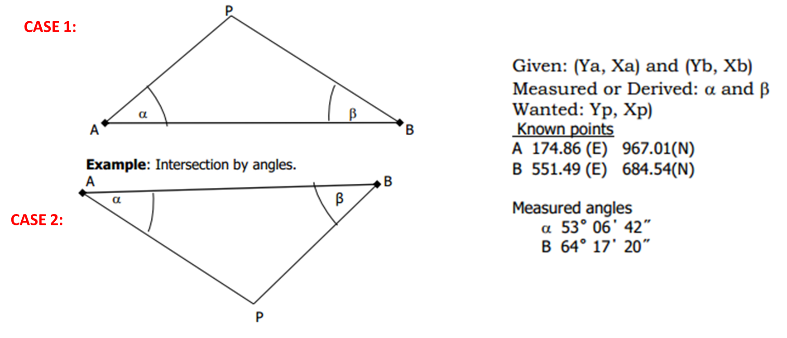
Intersection

Slide 18
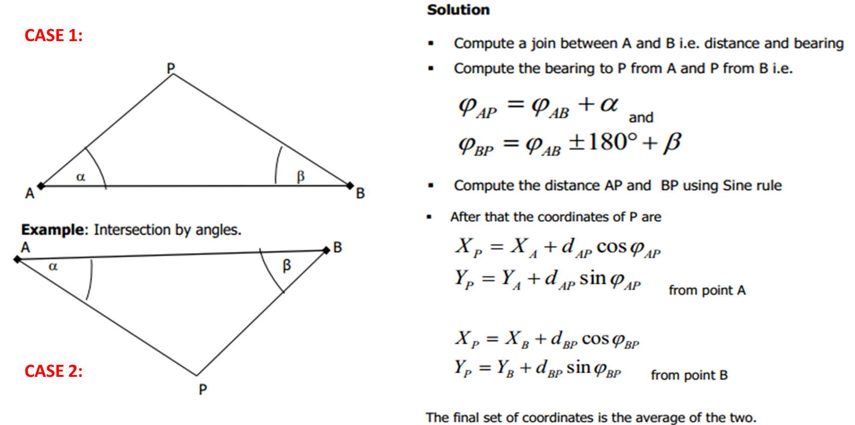
Intersection

Slide 19
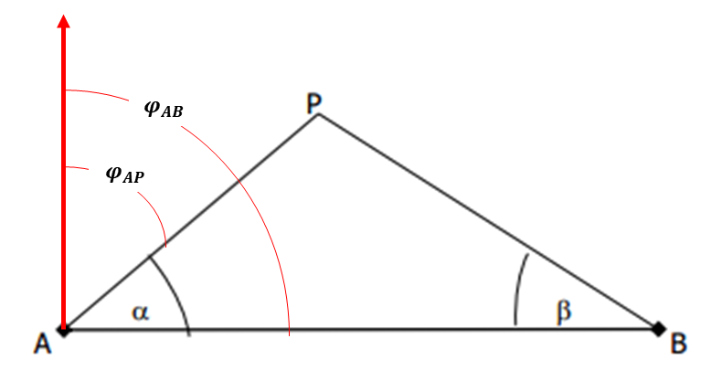
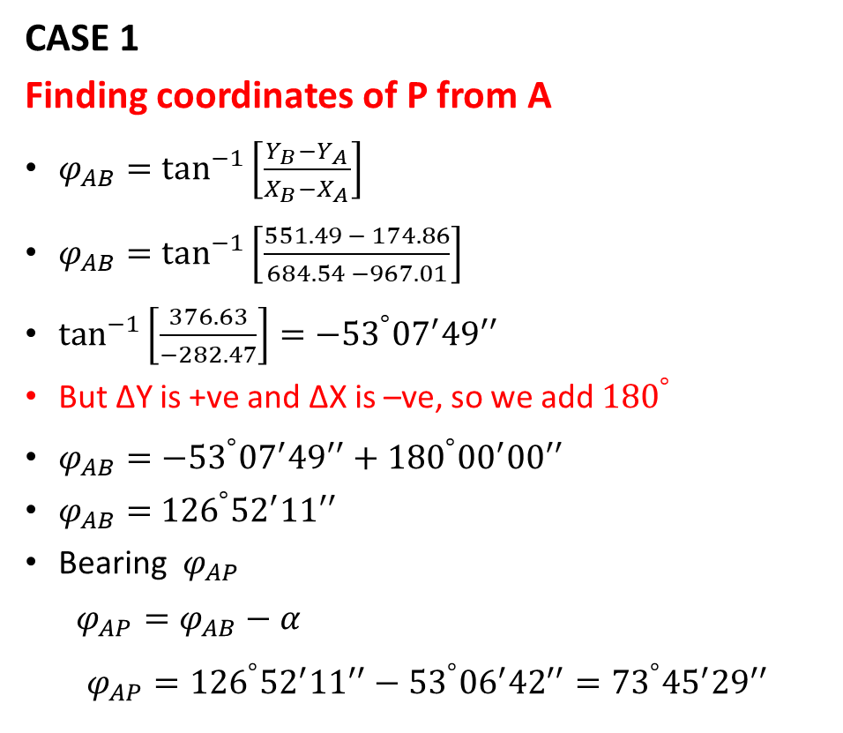
Intersection
CASE 1
Finding coordinates of P from A
$φ_{AB}=\tan^{−1}\left[\frac{Y_{B}−Y_{A}}{X_{B}−X_{A}}\right]$
$φ_{AB}=\tan^{−1}\left[\frac{551.49 − 174.86}{684.54 −967.01}\right]$
$\tan^{−1}\left[\frac{376.63}{−282.47}\right]={−53}^{°}{{07}^{′}49}^{′′}$
But ∆Y is +ve and ∆X is –ve, so we add ${180}^{°}$
$φ_{AB}={−53}^{°}{{07}^{′}49}^{′′}+{180}^{°}{{00}^{′}00}^{′′}$
$φ_{AB}=$ ${126}^{°}{{52}^{′}11}^{′′}$
Bearing $φ_{AP}$
$$φ_{AP}=φ_{AB}−α$$
$$φ_{AP}={126}^{°}{{52}^{′}11}^{′′}−{53}^{°}{{06}^{′}42}^{′′}={73}^{°}{{45}^{′}29}^{′′}$$

Slide 20
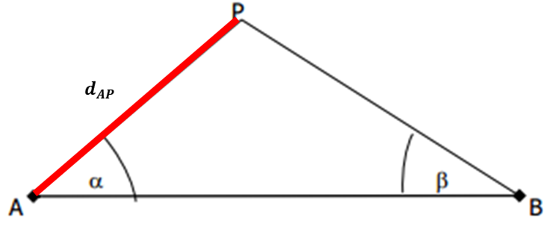
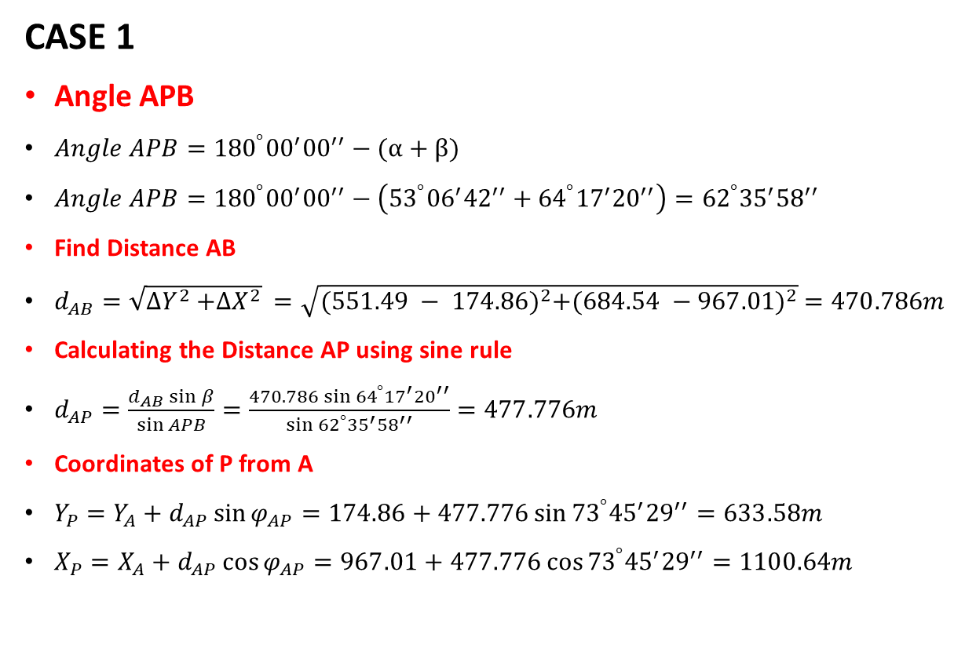
Intersection
CASE 1
Angle APB
$Angle APB={180}^{°}{{00}^{′}00}^{′′}−(α+β)$
$Angle APB={180}^{°}{{00}^{′}00}^{′′}−\left({53}^{°}{{06}^{′}42}^{′′}+{64}^{°}{{17}^{′}20}^{′′}\right)={62}^{°}{{35}^{′}58}^{′′}$
Find Distance AB
$d_{AB}=\sqrt{{∆Y}^{2}{+∆X}^{2}} =\sqrt{{(551.49 − 174.86)}^{2}{+(684.54 −967.01)}^{2}} =470.786m$
Calculating the Distance AP using sine rule
$d_{AP}=\frac{d_{AB} sin{β}}{\sin{APB}}=\frac{470.786 sin{{64}^{°}{{17}^{′}20}^{′′}}}{\sin{{62}^{°}{{35}^{′}58}^{′′}}}=477.776m$
Coordinates of P from A
$Y_{P}=Y_{A}+d_{AP}\sin{φ_{AP}}=174.86+477.776\sin{{73}^{°}{{45}^{′}29}^{′′}}=633.58m$
$X_{P}=X_{A}+d_{AP}\cos{φ_{AP}}=967.01+477.776\cos{{73}^{°}{{45}^{′}29}^{′′}}=1100.64m$

Slide 21
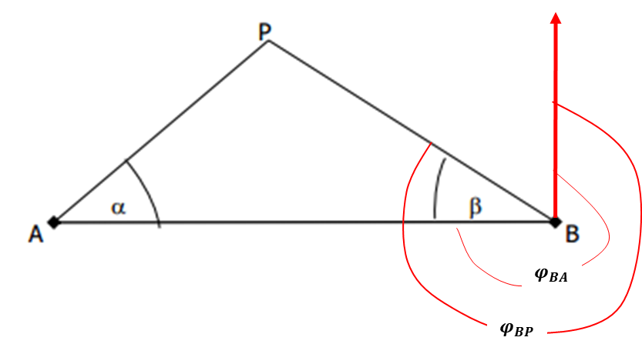
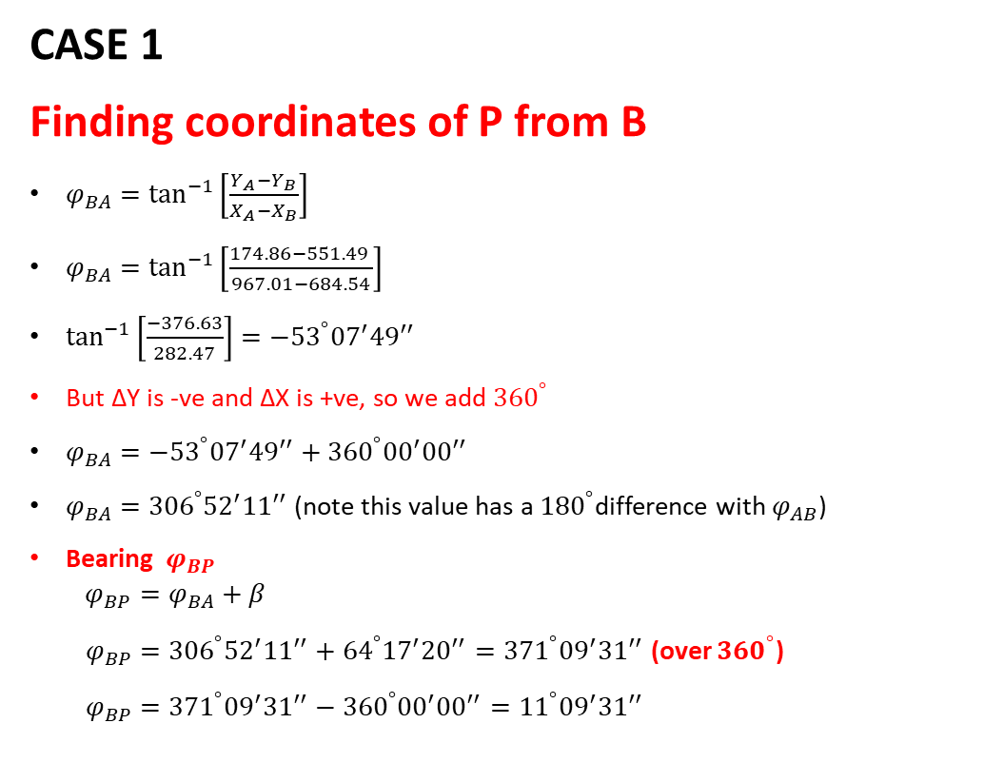
Intersection
CASE 1
Finding coordinates of P from B
$φ_{BA}=\tan^{−1}\left[\frac{Y_{A}−Y_{B}}{X_{A}−X_{B}}\right]$
$φ_{BA}=\tan^{−1}\left[\frac{174.86−551.49 }{967.01−684.54}\right]$
$\tan^{−1}\left[\frac{−376.63}{282.47}\right]={−53}^{°}{{07}^{′}49}^{′′}$
But ∆Y is -ve and ∆X is +ve, so we add ${360}^{°}$
$φ_{BA}={−53}^{°}{{07}^{′}49}^{′′}+{360}^{°}{{00}^{′}00}^{′′}$
$φ_{BA}=$ ${306}^{°}{{52}^{′}11}^{′′}$ (note this value has a ${180}^{°}$difference with $φ_{AB}$)
Bearing $φ_{BP}$
$$φ_{BP}=φ_{BA}+β$$
$φ_{BP}={306}^{°}{{52}^{′}11}^{′′}+{64}^{°}{{17}^{′}20}^{′′}={371}^{°}{{09}^{′}31}^{′′}$ (over ${360}^{°}$)
$φ_{BP}={371}^{°}{{09}^{′}31}^{′′}−{360}^{°}{{00}^{′}00}^{′′}={11}^{°}{{09}^{′}31}^{′′}$

Slide 22
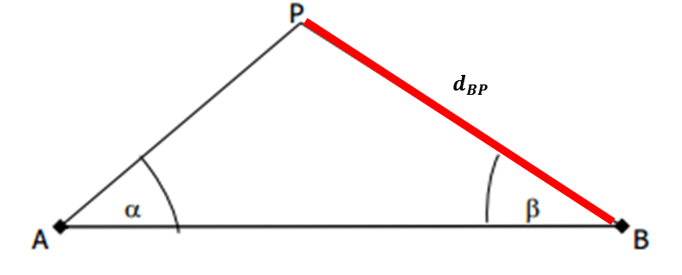
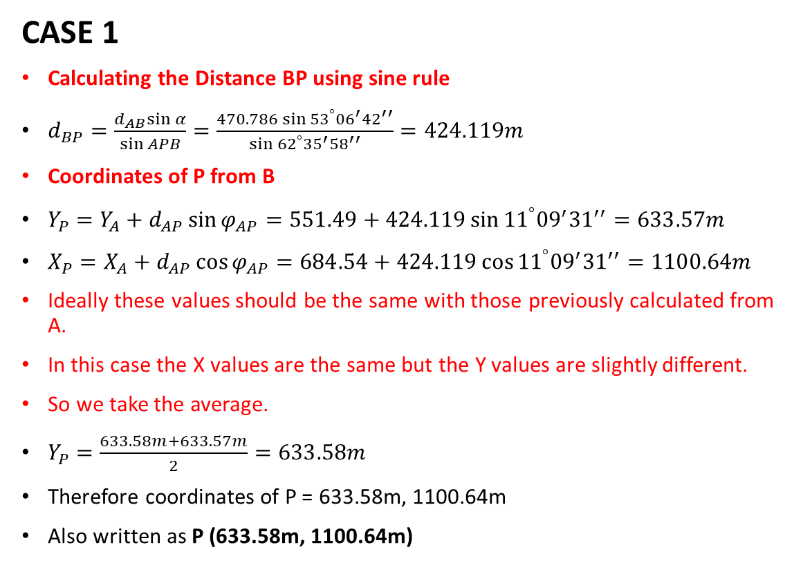
Intersection
CASE 1
Calculating the Distance BP using sine rule
$d_{BP}=\frac{d_{AB}sin{α}}{\sin{APB}}=\frac{470.786 sin{{53}^{°}{{06}^{′}42}^{′′}}}{\sin{{62}^{°}{{35}^{′}58}^{′′}}}=424.119m$
Coordinates of P from B
$Y_{P}=Y_{A}+d_{AP}\sin{φ_{AP}}=551.49+424.119\sin{{11}^{°}{{09}^{′}31}^{′′}}=633.57m$
$X_{P}=X_{A}+d_{AP}\cos{φ_{AP}}=684.54+424.119\cos{{11}^{°}{{09}^{′}31}^{′′}}=1100.64m$
Ideally these values should be the same with those previously calculated from A.
In this case the X values are the same but the Y values are slightly different.
So we take the average.
$Y_{P}=\frac{633.58m+633.57m}{2}=633.58m$
Therefore coordinates of P = 633.58m, 1100.64m
Also written as P (633.58m, 1100.64m)

Slide 23
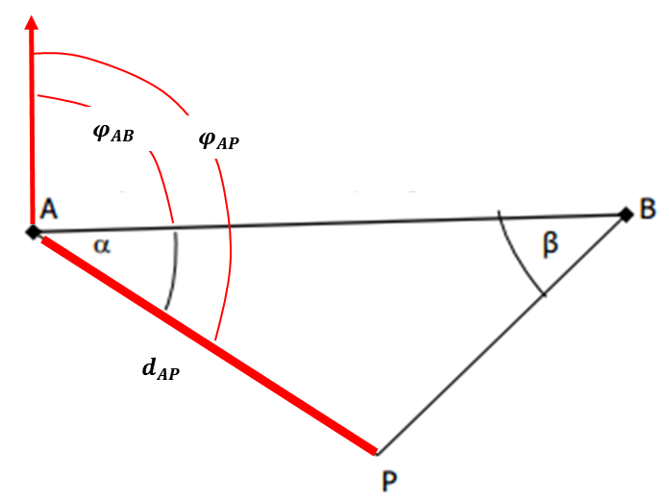
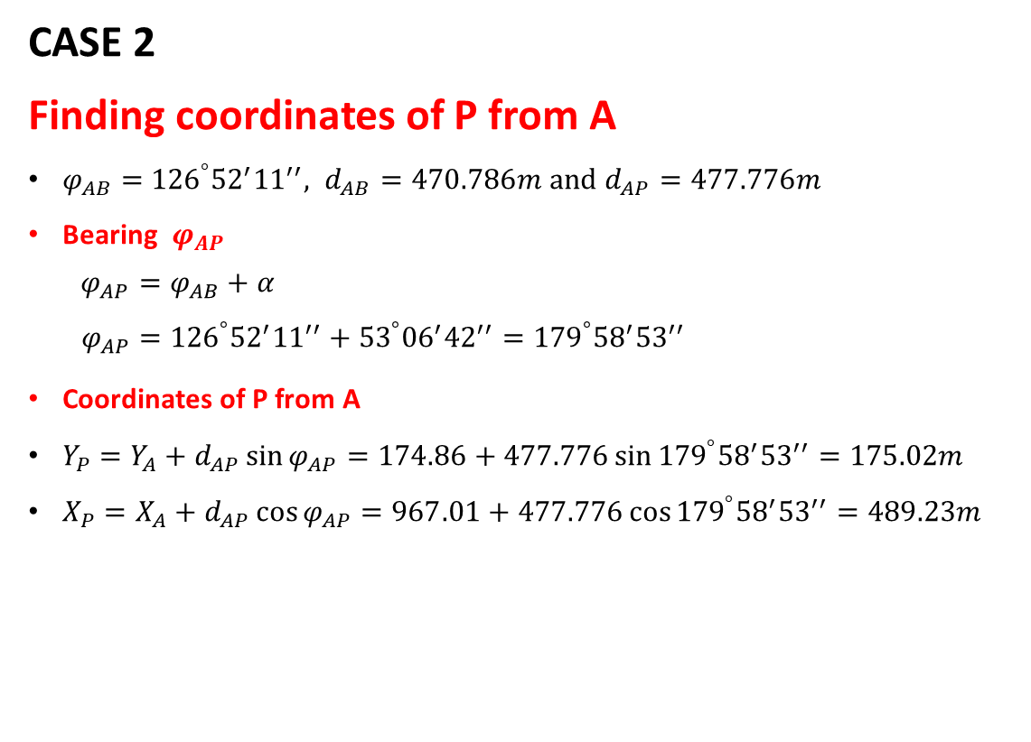
Intersection
CASE 2
Finding coordinates of P from A
$φ_{AB}=$ ${126}^{°}{{52}^{′}11}^{′′}, d_{AB}=470.786m and d_{AP}=477.776m$
Bearing $φ_{AP}$
$$φ_{AP}=φ_{AB}+α$$
$$φ_{AP}={126}^{°}{{52}^{′}11}^{′′}+{53}^{°}{{06}^{′}42}^{′′}={179}^{°}{{58}^{′}53}^{′′}$$
Coordinates of P from A
$Y_{P}=Y_{A}+d_{AP}\sin{φ_{AP}}=174.86+477.776\sin{{179}^{°}{{58}^{′}53}^{′′}}=175.02m$
$X_{P}=X_{A}+d_{AP}\cos{φ_{AP}}=967.01+477.776\cos{{179}^{°}{{58}^{′}53}^{′′}}=489.23m$

Slide 24
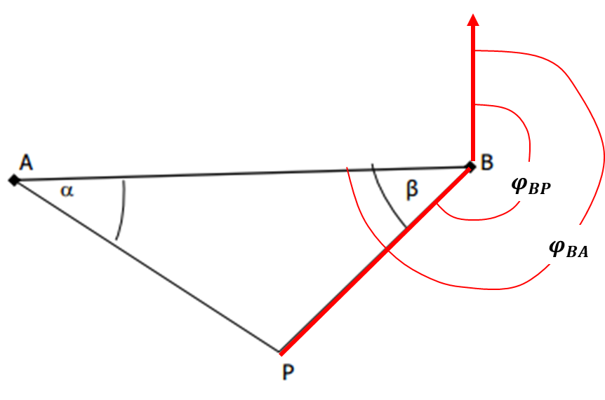
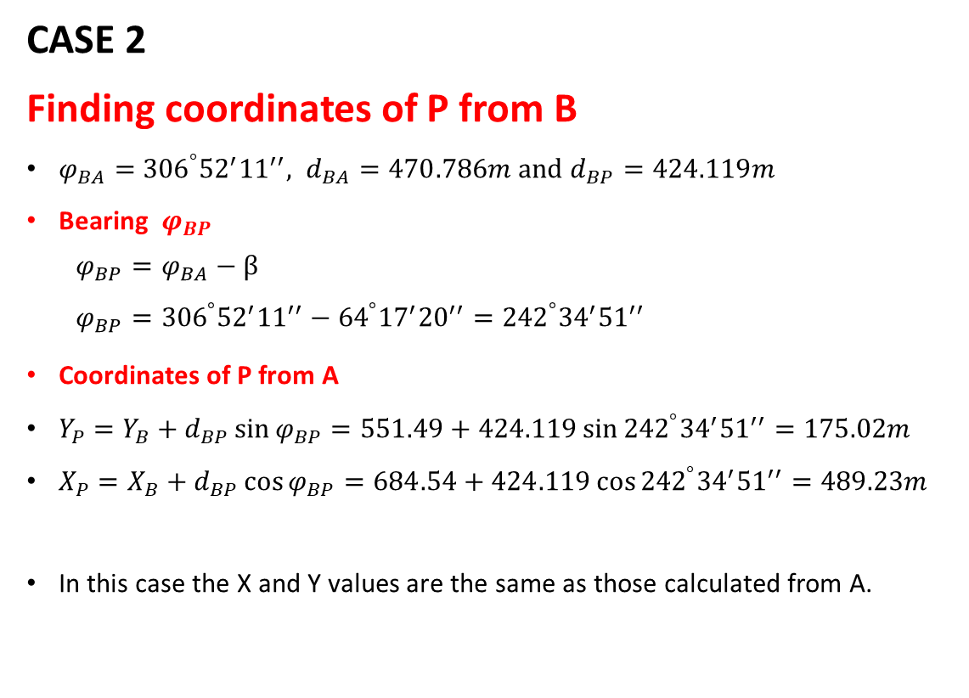
Intersection
CASE 2
Finding coordinates of P from B
$φ_{BA}=$ ${306}^{°}{{52}^{′}11}^{′′}, d_{BA}=470.786m and d_{BP}=424.119m$
Bearing $φ_{BP}$
$$φ_{BP}=φ_{BA}−β$$
$$φ_{BP}={306}^{°}{{52}^{′}11}^{′′}−{64}^{°}{{17}^{′}20}^{′′}={242}^{°}{{34}^{′}51}^{′′}$$
Coordinates of P from A
$Y_{P}=Y_{B}+d_{BP}\sin{φ_{BP}}=551.49+424.119\sin{{242}^{°}{{34}^{′}51}^{′′}}=175.02m$
$X_{P}=X_{B}+d_{BP}\cos{φ_{BP}}=684.54+424.119\cos{{242}^{°}{{34}^{′}51}^{′′}}=489.23m$
In this case the X and Y values are the same as those calculated from A.

Slide 25
Resection
This technique involves the coordination of a point by occupying the unknown point and observing only directions to at least three (3) known points.
This is very useful if you have control well on high ground and visibility from the unknown point possible.
The configuration of the points may differ from situation to situation but the formulas to use are the same.
Basically you have 3 possible configuration for a three-point resection.

Slide 26
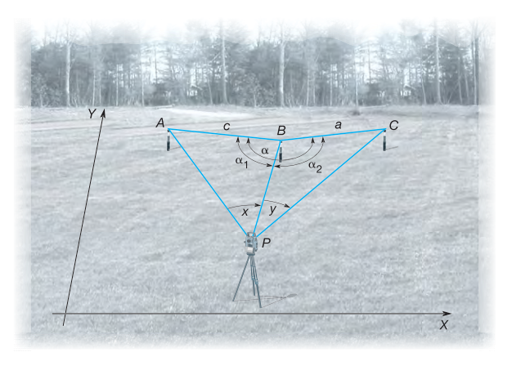
Resection

Slide 27
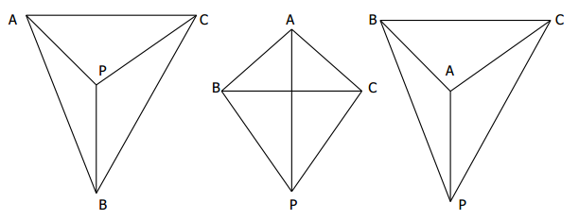
Resection
There are a number of ways of determining the coordinates with resection.
Only one will be discussed in this section i.e Tienstra method.

Slide 28
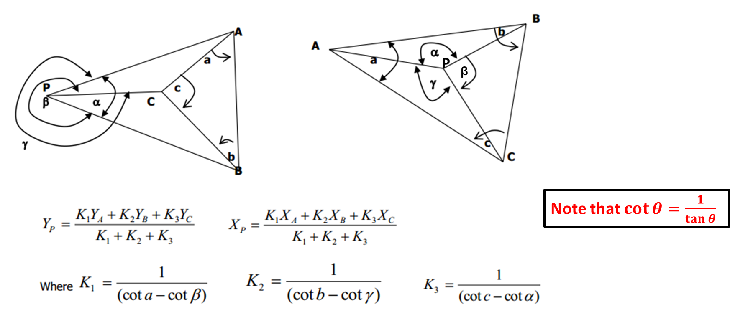
Tienstra Method

Slide 29
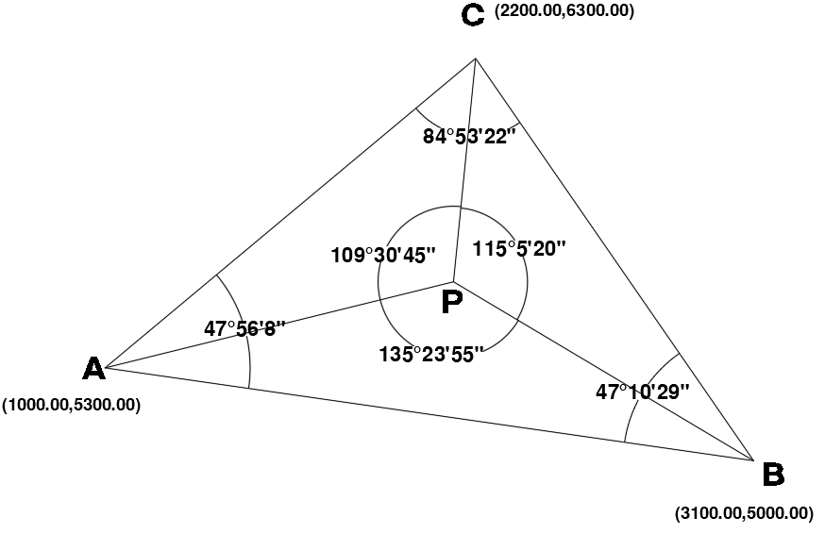
Tienstra Method
Determine the coordinates of P

Slide 30
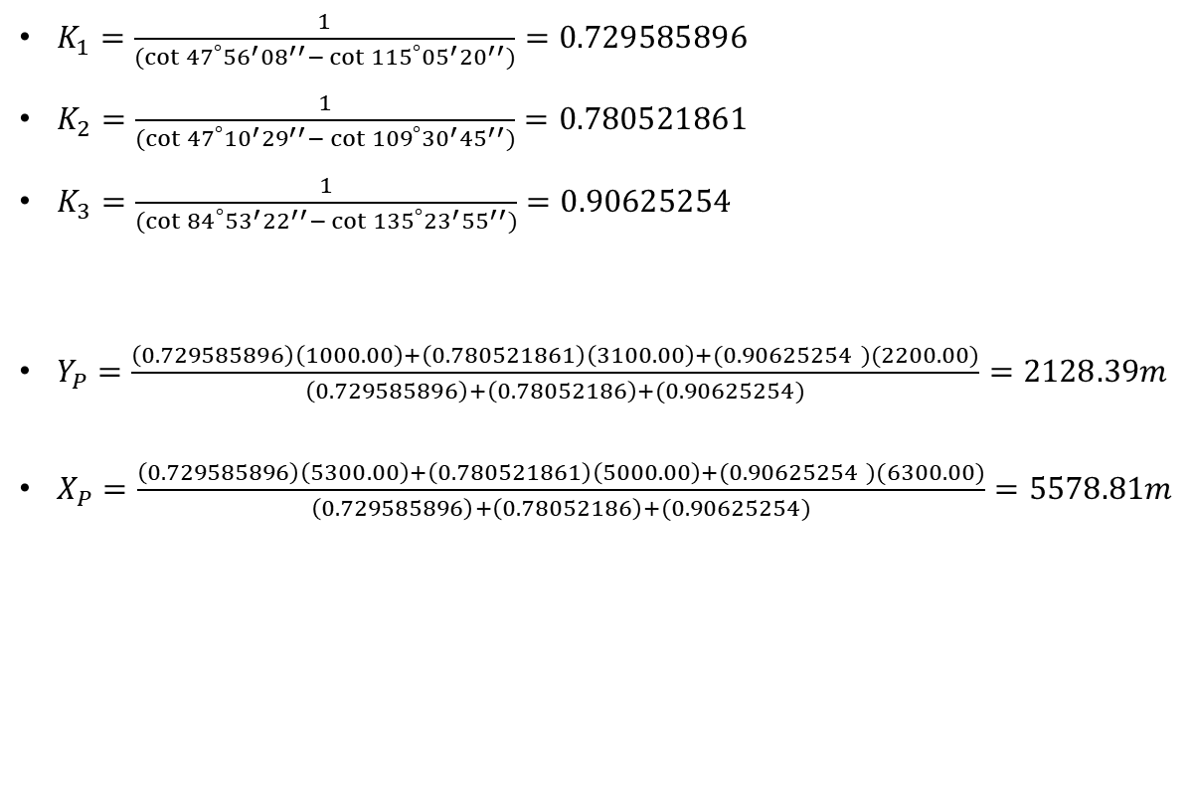
Tienstra Method
$K_{1}=\frac{1}{(\cot{{47}^{°}{{56}^{′}08}^{′′}}−\cot{{115}^{°}{{05}^{′}20}^{′′})}}=0.729585896$
$K_{2}=\frac{1}{(\cot{{47}^{°}{{10}^{′}29}^{′′}}−\cot{{109}^{°}{{30}^{′}45}^{′′})}}=0.780521861$
$K_{3}=\frac{1}{(\cot{{84}^{°}{{53}^{′}22}^{′′}}−\cot{{135}^{°}{{23}^{′}55}^{′′})}}=0.90625254$
$Y_{P}=\frac{\left(0.729585896\right)\left(1000.00\right)+\left(0.780521861\right)\left(3100.00\right)+(0.90625254 )(2200.00)}{\left(0.729585896\right)+\left(0.78052186\right)+(0.90625254)}=2128.39m$
$X_{P}=\frac{\left(0.729585896\right)\left(5300.00\right)+\left(0.780521861\right)\left(5000.00\right)+(0.90625254 )(6300.00)}{\left(0.729585896\right)+\left(0.78052186\right)+(0.90625254)}=5578.81m$

Slide 31
END

