Slide 1
GEE 4812:
Principles of Geomatics
Leveling
LECTURER : Mr. TWATAIZYA MINANGO
EMAIL : twataizya.minango@unza.zm
OFFICE : B.Eng. Main Building, 1st Floor, Former Zagis Offices, Room 2

Slide 2
Introduction
Leveling is the operation performed in surveying to determine and establish elevations of points, to determine differences in elevation between points, and for control in construction works.

Slide 3
Applications
Highway Profiling
Railways
Canals
sewer lines, pipelines
Catchment area
Volume of the reservoir
Dam Capacity Determination
Earthwork quantities for various projects
Contouring
Setting out, etc

Slide 4
Definition of Terms
A mean sea level at a location is obtained by averaging the height of the surface of the sea for all stages of tides for a long period (usually 19yrs).
It is used as a reference datum.
II. The elevation of a particular point is the vertical distance above or below a reference datum.
A level surface is a surface of constant elevation that is perpendicular to the plumb line (vertical line) at every point.
It is best represented by the surface of a still body of a sea or an ocean if it were unaffected by tides.

Slide 5
Definition of Terms
IV. A level line is a curved line on a level surface all points of which are at equal elevation.
Every element of the level line is perpendicular to the plumb line.
V. A horizontal line is tangential to the level line at one point. For short distances, the level line and the horizontal line are assumed the same.
VI. The difference in elevation between two points is the vertical distance between the levels surfaces in which the points lie.

Slide 6
Definition of Terms
VII. Benchmark (BM) is a fixed point of known elevation above the datum.
It is set as a survey marker to provide a starting point for the determination of the elevation of other points.
A permanent object is used as a marker.
VIII. The reduced level (RL) of a point is its height with respect to a datum.
The term elevation or altitude is synonymously used depending on the datum used.
IX. Temporal benchmark (TBM) is any mark fixed by the observer for reference purposes.

Slide 7
Leveling Instruments
To carry out a leveling exercise, you will need a level and a leveling rod (staff).
A level is a high-powered telescope with a spirit level connected so that the line of sight is horizontal when the bubble is centered.
The line of sight, also known as the line of collimation, is an imaginary line traced through the center of the objective from the junction point of the crosshairs.

Slide 8
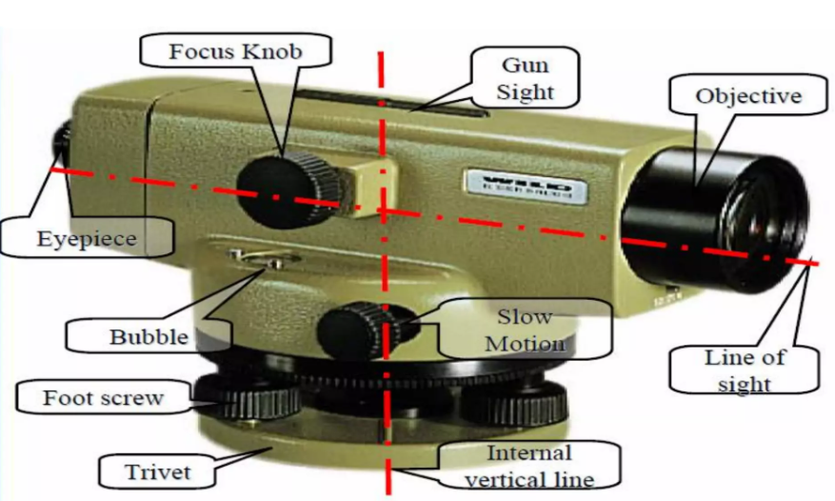
Leveling Instruments

Slide 9
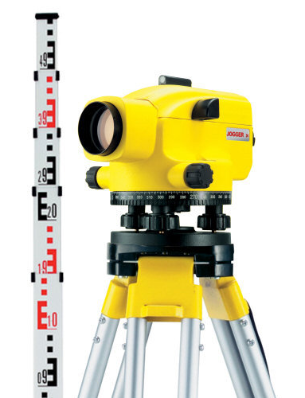
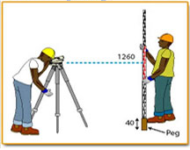
Leveling Instruments: Level & Staff

Slide 10
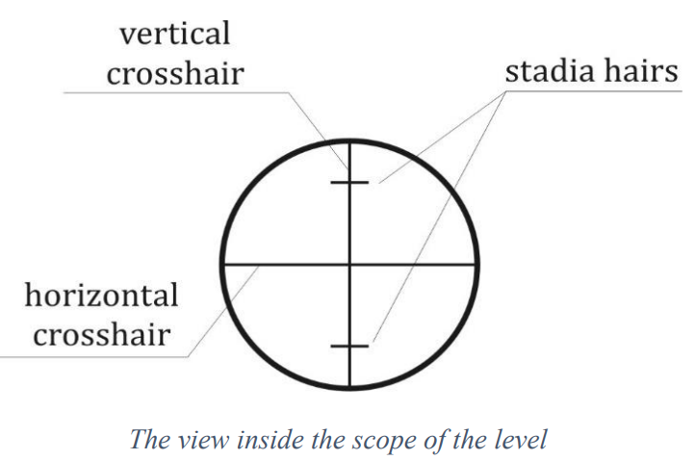
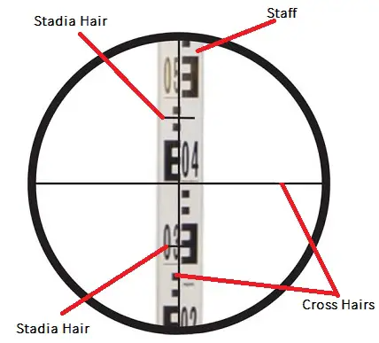
Telescope of Level

Slide 11
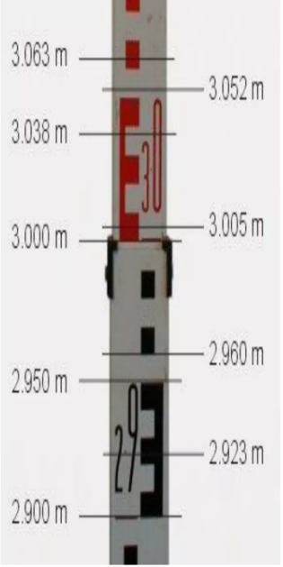
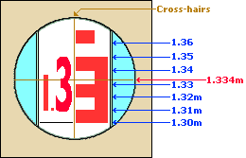
Staff Readings

Slide 12
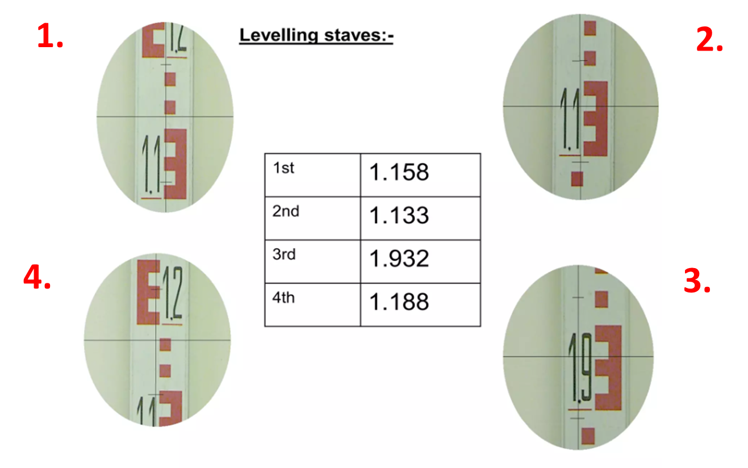
Staff Readings

Slide 13
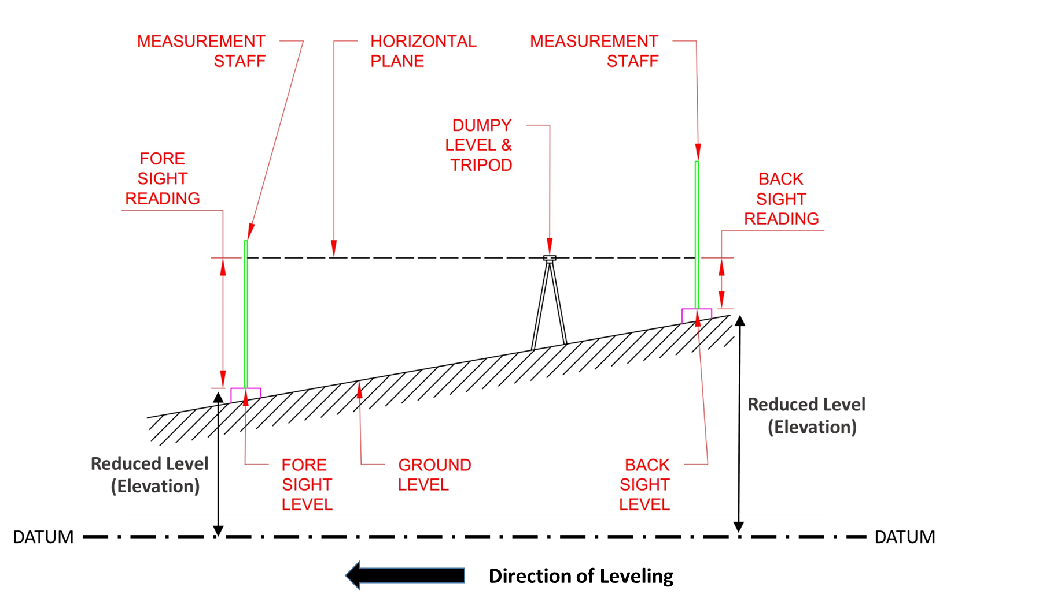
Principle of Leveling

Slide 14
More Definition of Terms
Datum: Datum is any arbitrarily assumed level surface to which elevations are referred.
Reduced level (RL): The reduced level of a place is its elevation or vertical distance above or below the datum or any ﬁxed point.
Line of sight: It is the imaginary line joining the intersection of the crosshairs of the diaphragm to the optical centre of the object glass and its continuation.

Slide 15
Back Sight (BS)
A backsight is the ﬁrst staﬀ reading taken after setting up the instrument at any position.
This will always be reading on a point of known elevation.
It ascertains the amount by which the line of sight is above or below the elevation of the point.
Backsight enables the surveyor to obtain the height of the instrument.

Slide 16
Fore Sight (FS)
A foresight is the last staﬀ reading taken before shifting the instrument.
This will always be reading on a point whose elevation is to be determined. This reading indicates the shifting of the instrument.
It is also generally known as minus sight as the fore sight-reading is always subtracted from the height of the instrument (except when the staﬀ is held inverted) to obtain the elevation.

Slide 17
Intermediate Sight (IS)
An intermediate sight is any staﬀ reading, taken on a point of unknown elevation, after the back sight and before the foresight.
This is necessary when more than two staﬀ readings are to be taken from the same position of the instrument.
It may be noted that for one set of a level there will be only a backsight and foresight but there can be any number of intermediate sights.

Slide 18
Change Point (CP)
This is an intermediate staﬀ position and it is used for the purpose of shifting of the instrument.
Both backsight and foresight are taken from this intermediate staﬀ position.
Great care is necessary for taking readings at the change point since an error in reading aﬀects every succeeding point of observation (elevation).
Any ﬁrm point, which can be easily found, may serve as a change point

Slide 19
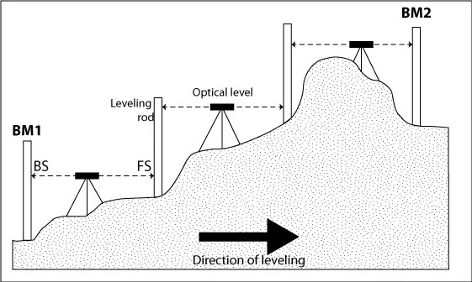
Principle of Leveling

Slide 20
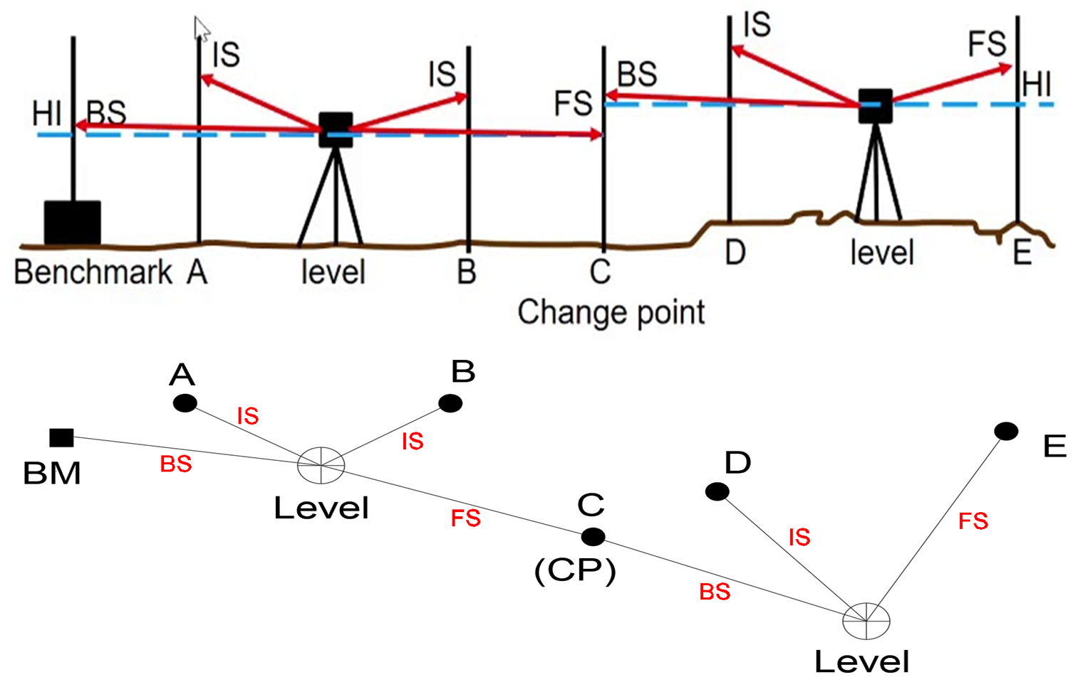
Principle of Leveling

Slide 21
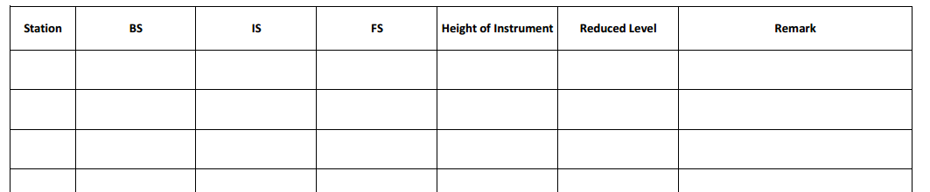
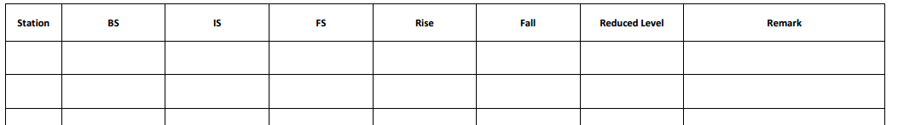
Booking Forms

Slide 22
Methods of Booking & Reduction of Levels
There are two common types of booking methods used.
These are:
Height of Instrument (HI) method
Rise and Fall (RF) method

Slide 23
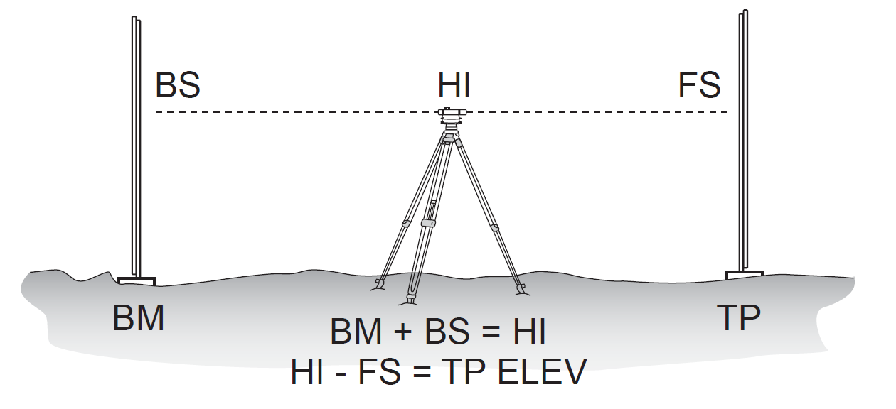
1. Height of Instrument (HI) method

Slide 24
1. Height of Instrument (HI) method
In this method the Reduced level of the line of sight is calculated in each step by adding the staff reading to a point with the known Reduced level.
The RLs of the remaining points in that step are obtained by subtracting their respective readings from the RL of the line of sight (usually indicated by H.I., the height of Instrument).

Slide 25
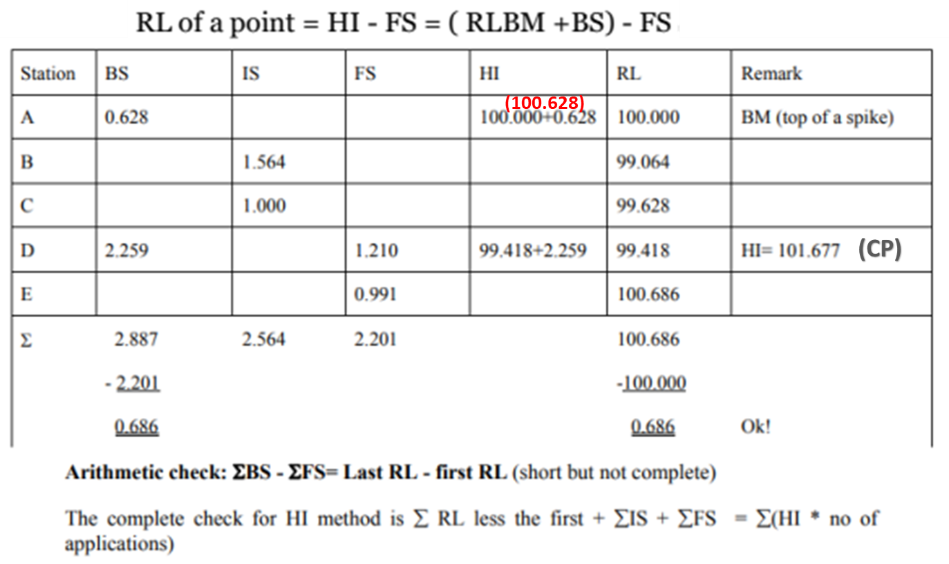
1. Height of Instrument (HI) method

Slide 26
1. Height of Instrument (HI) method
The No. of application is the number of points whose elevations are established using the given HI.
In this example elevation of A is already known, the elevation of B, C & D is determined using the 1st HI (100.625) hence for this No. of appl=3, and elevation of E is established from the 2nd HI (101.677) hence for this no of appl=1

Slide 27
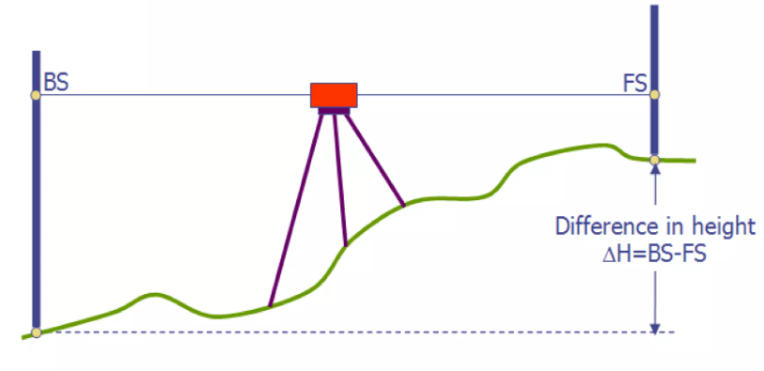
2. Rise and Fall (RF) method

Slide 28
2. Rise and Fall (RF) method
The rise or fall of the ground between successive rod stations is considered.
For the same instrument set up, If 2nd red reading > first-rod reading ⇒ fall If 2nd-rod reading < first-rod reading ⇒ rise Then,
RL of 2nd station = RL of first station - fall or RL of first station + rise

Slide 29
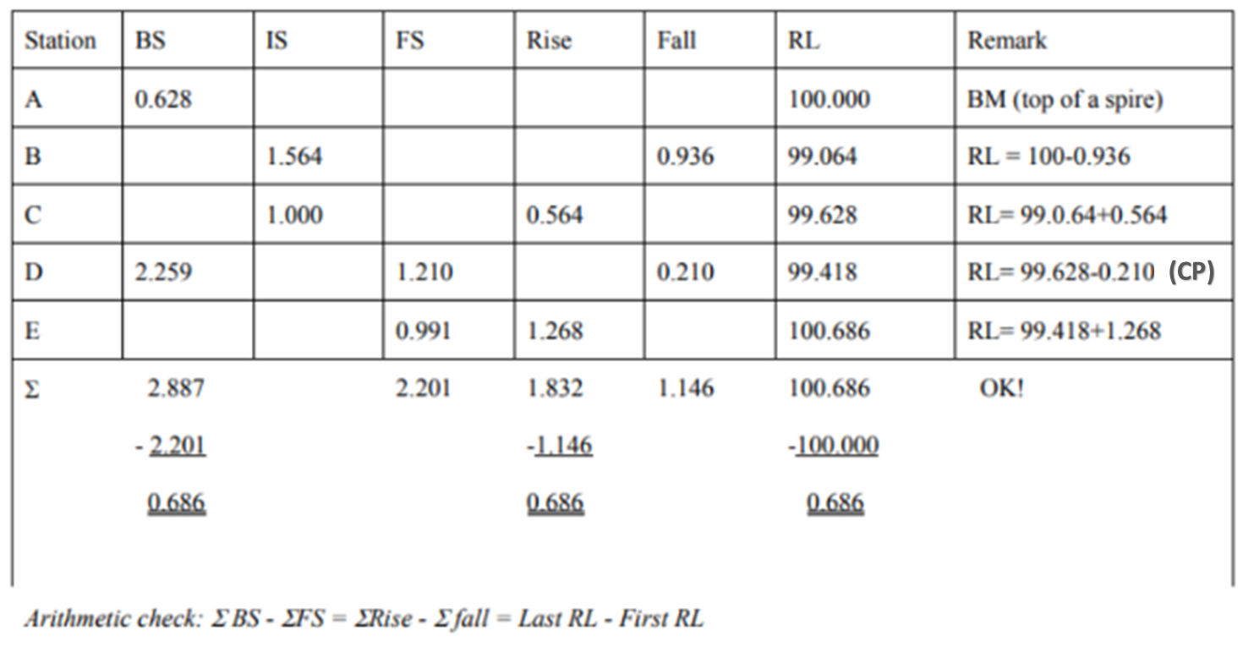
2. Rise and Fall (RF) method

Slide 30
Inverted Sights
Occasionally successive FS and BS readings are taken on an overhead point such as a point in the roof of a tunnel or the girder of a bridge or a crossway road.
The FS taken at such a point is added to the HI to obtain the elevation of the overhead point.
The BS taken on that point is subtracted from the elevation of the overhead point to obtain the HI for the next instrument set up.
To follow the conventional reduction methods, these data are recorded as negative values in the field book.

Slide 31
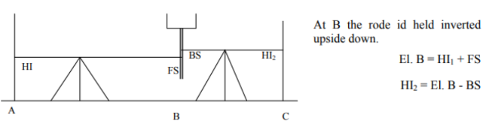
Inverted Sights

Slide 32
END

