Slide 1
GEE 4812:
Principles of Geomatics
Linear Measurements
LECTURER : Mr. TWATAIZYA MINANGO
EMAIL : twataizya.minango@unza.zm
OFFICE : B.Eng. Main Building, 1st Floor, Former Zagis Offices, Room 2

Slide 2
Contents
Surface vs Horizontal Distance
Taping
Optical Distance Measurements
Electronic Distance Measurements

Slide 3
Linear Measurements
Linear distance is the straight line distance between 2 points regardless of orientation.
The measurement of distance is one of the fundamental operations in surveying and is carried out by taping, optical Distance Measurement (ODM) or Electromagnetic Distance Measurement (EDM) techniques.
Whichever of these is used, the usual requirement in Geomatics is for horizontal distances.

Slide 4
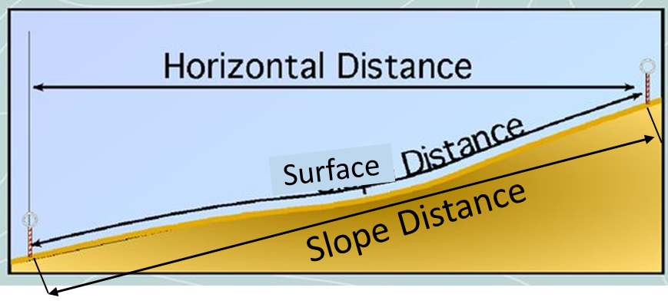
Surface vs Horizontal Distance
Surface distance between two points is a distance measured along the surface of the earth.
Horizontal distance between two points is the distance between those points measured on a horizontal plane.
Slope distance is the straight line distance along the slope between two points.

Slide 5
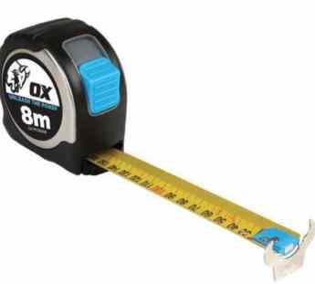
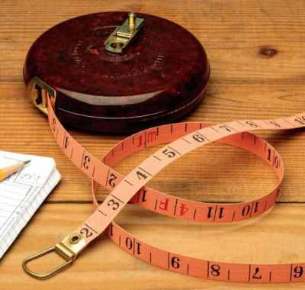
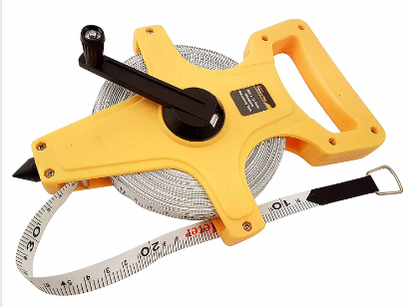
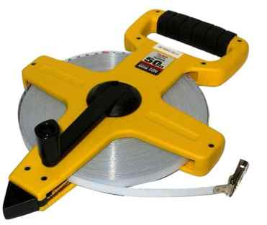
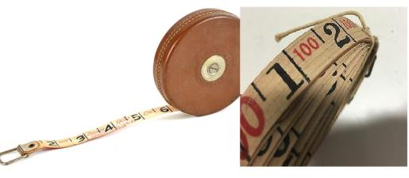
Taping
https://theconstructor.org/surveying/types-tapes-used-surveying/34973/

Slide 6
Taping
Taping involves measuring distance by use of tapes.
There are a number of types of tapes in use with different sizes ranging from 20m, 30m, 50m or 100m.
The most common types of tapes are steel, invar, glass fiber and synthetic material.
Taping comes with errors that are systematic in nature due to the atmospheric conditions and the conditions under which tape is being used.

Slide 7
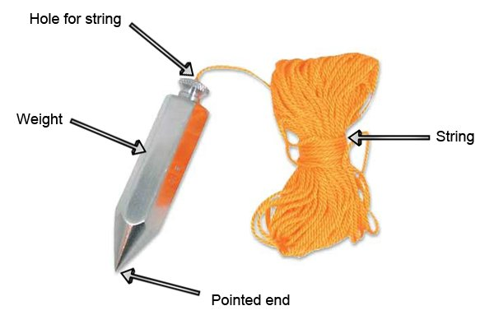
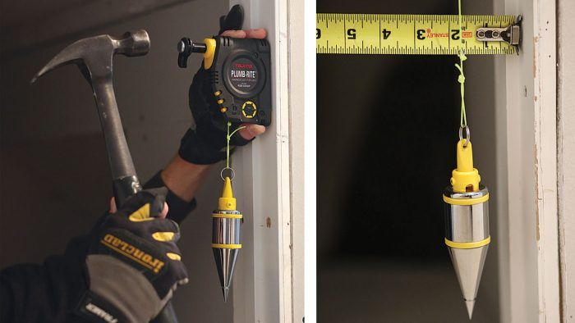
Taping Accessories: Plum Bob
Made of brass, used in taping to transfer the tape to ground.

Slide 8
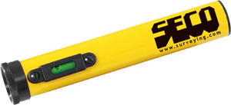
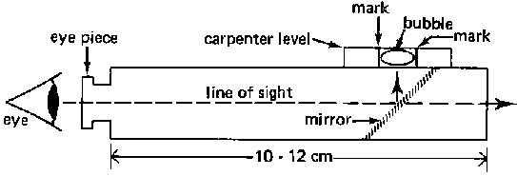
Taping Accessories: Hand Level
Used to keep the steel tape horizontal when measuring.

Slide 9
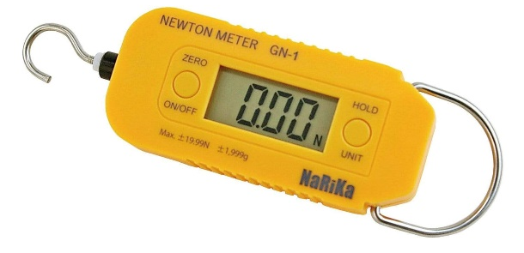
Taping Accessories: Tension Handle
Used to hold the tape correctly and with the right tension.
As tapes have a standard tension.

Slide 10
Taping: Over Level Ground
If the taping is done over level ground where there is no under-bush, the tape can rest on the ground.
A taping crew consists of two people: the head tape person and the rear tape person.
The head tape person takes one end of the tape walks down the line towards the point.

Slide 11
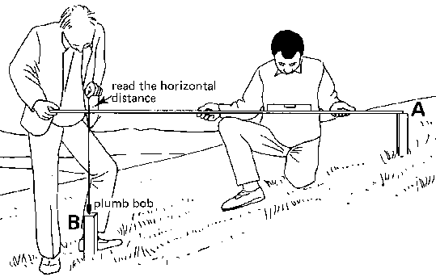
Taping: Over Sloping/Uneven Ground
To measure horizontal distance with a tape, a level and plum bob must be used.
The tape is held level, horizontal, and measurement at the elevated end is transferred using a plum bob.

Slide 12
Taping: Limitations
The following errors may arise when using taping method:
Standardization
Temperature
Slope
Tension
Sag

Slide 13
Standardization Errors
This error arises from wear and tear of the tape due to stretching.
This wear and tear is as a result of the repeated use of the tape over a long period of time as pulling tension.
Measured lengths will either be greater than the correct length.

Slide 14
Error Due To Temperature
Materials expand with rise and contract with temperature decrease.
The expansion/contraction may cause the tape to bend or distort.
Measured lengths will either be greater or lesser than the actual length.
Tapes should be stored under room temperature conditions.

Slide 15
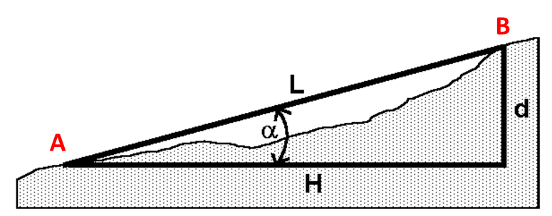
Slope Errors
All plan distances are always quoted as horizontal distances L.
Due to the unevenness of the ground surface the distances measured by tape are slope distances.
Slope distance will always be greater than horizontal distance.

Slide 16
Error Due To Tension
In this case, errors arise when the tape is pulled at a tension which differs from the standard tension used at standardization.
The tape will stretch less than its standard length when a tension less than the standard tension is applied, making the tape too short.
A tape stretches in an elastic manner until it reaches its elastic limit, when it will deform permanently and ruin the tape.

Slide 17
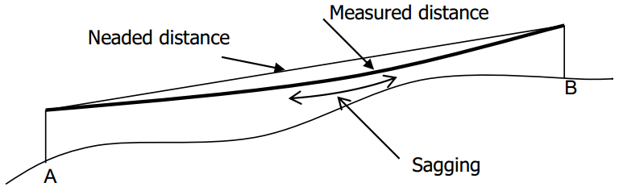
Sag Errors
If the tape cannot be supported for its length then it will hang freely and attain the form of catenary (sag) under the influence of gravity.
When used in catenary, the distance so obtained is longer than expected due to the sagging of the tape due to its weight.

Slide 18
Optical Distance Measurements (ODM)
ODM also known as tacheometry, is a branch of angular surveying in which the horizontal and vertical distances of points are obtained by optical means.
In this method distances and heights are determined from the instrument readings alone.
Quicker than the use of ordinary measurement methods i.e tape or chain.

Slide 19
Optical Distance Measurements (ODM)
All that is required necessary is that the assistant, who carries a staff on which the instrument is sighted, shall be able to reach the various points to be surveyed and levelled, and a clear line of sight exists between the instrument and the staff.
Thus, ODM is very useful in broken terrain and where obstacles such as rivers, roads and crops occur.

Slide 20
ODM: Stadia System
With the combination of a standard theodolite or level with stadia lines on the telescope diaphragms and the leveling staff the distance is determined by way of reading the stadia intercepts.
The stadia lines define a parallactic angle ϴ and the measurement process involves observing the staff intercepts subtended by this fixed angle over the required distance.

Slide 21
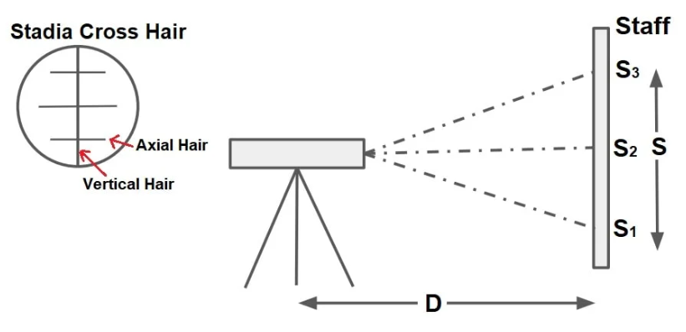




ODM: Stadia System
$$S=S_{3}−S_{1}$$
$$S_{1}−lower staff reading$$
$$S_{2}−middle staff reading$$
$$S_{3}−upper staff reading$$

Slide 22
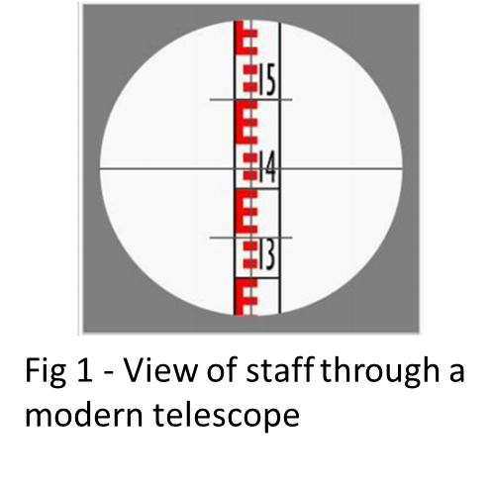
ODM: Stadia System
The stadia system uses standard theodolites and levels with lines engraved on their diaphragms to view a standard levelling staff.
With the combination of a standard theodolite or level with stadia lines on the telescope diaphragms and the leveling staff the distance is determined by way of reading the stadia intercepts (Fig 1.)

Slide 23
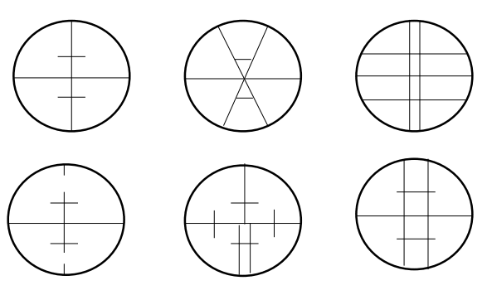
ODM: Stadia System
A transit theodolite fitted with special stadia diaphragm is known as tacheometer.
Fig 2 – Common Types of stadia diaphragms.
Its telescope contains two horizontal hairs called stadia hairs in addition to the regular crosshairs.
The stadia hairs are equidistant from the central cross-hairs and they are specially termed as stadia lines or stadia webs.

Slide 24
ODM: Stadia System
In effect, the lines define a fixed angle and the measurement process involves observing the staff intercept subtended by this fixed angle over a required distance.
The basic principles are shown in Fig.3. in which it is assumed that the telescope is level and the staff is vertical.

Slide 25
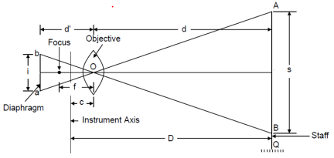
ODM: Stadia System
Considering the rays passing through the optical Centre of the objective to form an image in the plane of the diaphragm, then by similar triangles:
f = focal length of the object glass.
i = stadia hair interval = ab.
s = staff intercept = AB.
c = distance from O to the vertical axis of the instrument.
d = distance from O to the staff.
d′ = distance from O to the plane of the diaphragm.
D = horizontal distance from the vertical axis to the staff.
Fig 3

Slide 26
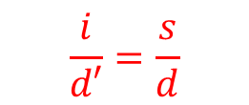


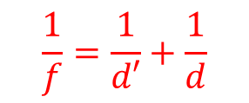
ODM: Stadia System
d’
d
A
Instrument Axis
b
O
s
$$i$$
c’
F’
G
C’
a
c
Diaphragm
f
focus
D
B
$$\frac{i}{d′}=\frac{s}{d}$$
$$\frac{1}{f}=\frac{1}{d′}+\frac{1}{d}$$
$$D=d+c$$
Staff
Similar Triangles rule
Lens formula
Distance formula
Fig 4

Slide 27
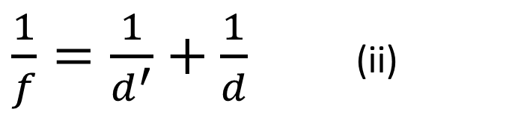
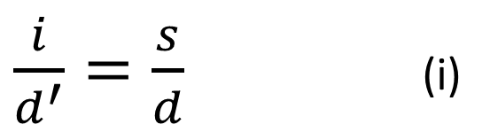


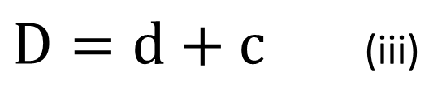
ODM: Stadia System
$\frac{i}{d^{′}}=\frac{s}{d}$ (i)
$$Similar Triangles Formula$$
$\frac{1}{f}=\frac{1}{d^{′}}+\frac{1}{d}$ (ii)
$$Lens Formula$$
$D=d+c$ (iii)
$$Distance between instrument and staff$$

Slide 28


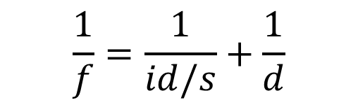
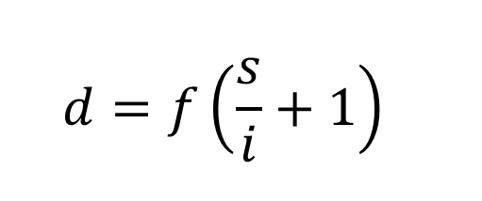
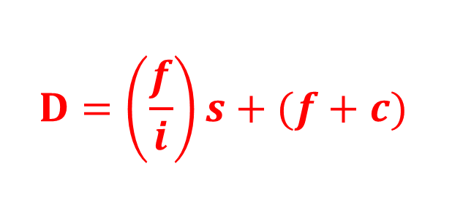







ODM: Stadia System
$$from equation \left(i\right):$$
$Recall$ equation (iii):
$$d′=\frac{id}{s}$$
$$D=d+c$$
$substituting d^{′ }into equation (ii)$ we get:
$substituting d into equation (iii)$ we get:
$$\frac{1}{f}=\frac{1}{id/s}+\frac{1}{d}$$
$D=f\left(\frac{s}{i}+1\right)$ + c
$Making d^{ }the subject of the formula$ we have:
$$Expanding the above equation we get:$$
$$D=\left(\frac{f}{i}\right)s+(f+c)$$
$$d=f\left(\frac{s}{i}+1\right)$$

Slide 29

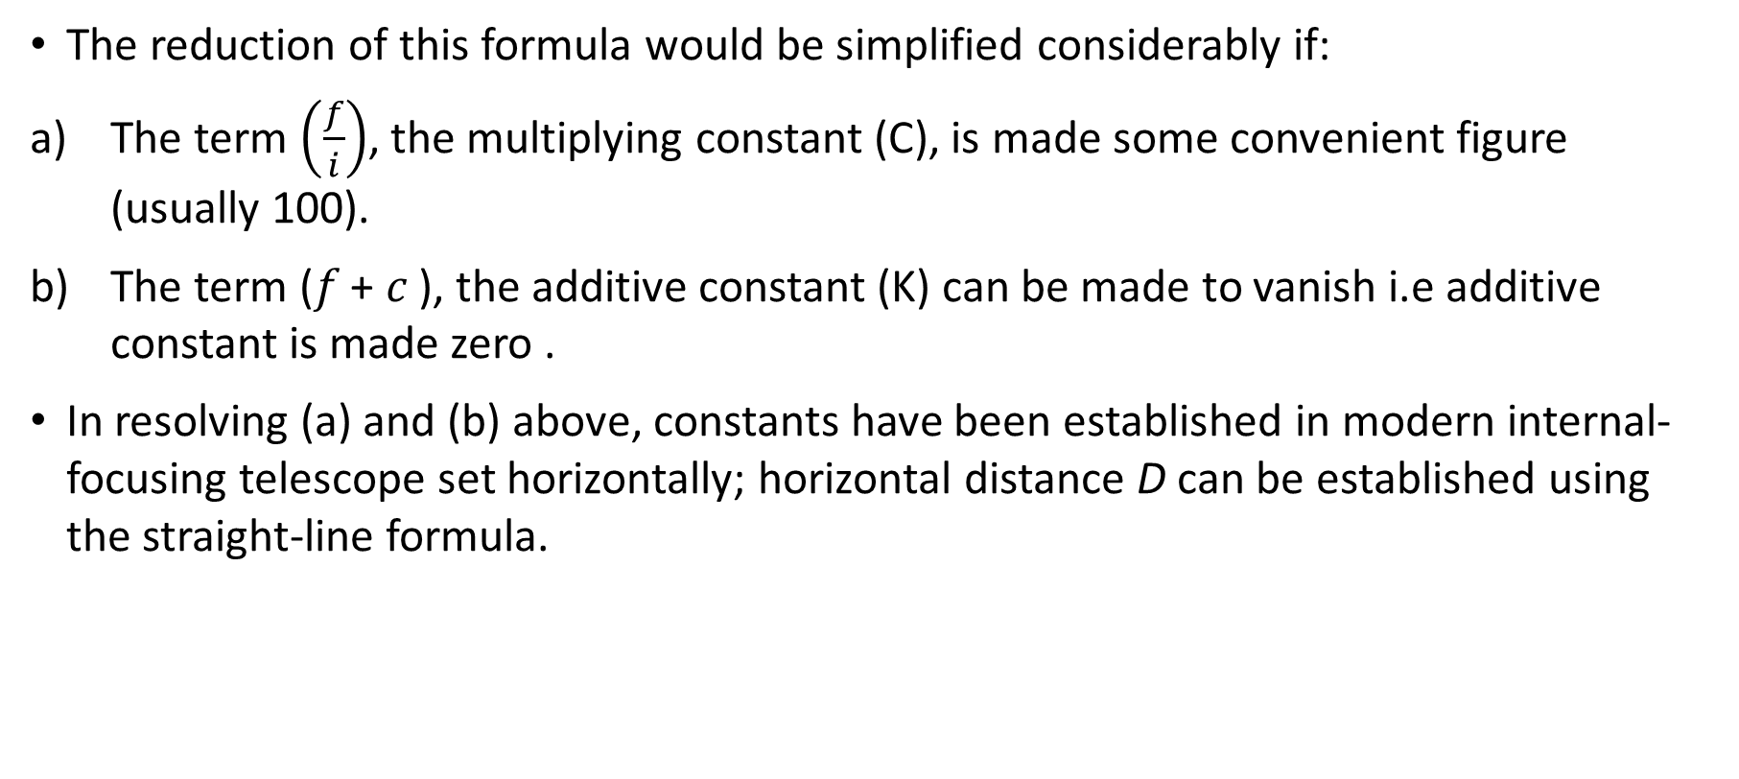
ODM: Stadia System
The reduction of this formula would be simplified considerably if:
The term $\left(\frac{f}{i}\right)$, the multiplying constant (C), is made some convenient figure (usually 100).
The term (𝑓 + 𝑐 ), the additive constant (K) can be made to vanish i.e additive constant is made zero .
In resolving (a) and (b) above, constants have been established in modern internal-focusing telescope set horizontally; horizontal distance D can be established using the straight-line formula.
……… (iv)

Slide 30
ODM: Advantages
This technique has advantages over taping. These are:
Less time taken to measure long distances.
Since distance measurement is not done on the ground, it is a little bit easier to measure on undulating grounds.

Slide 31
ODM: Limitations
Limited to distances less than 120 meters.
Affected by Curvature and Refraction.

Slide 32
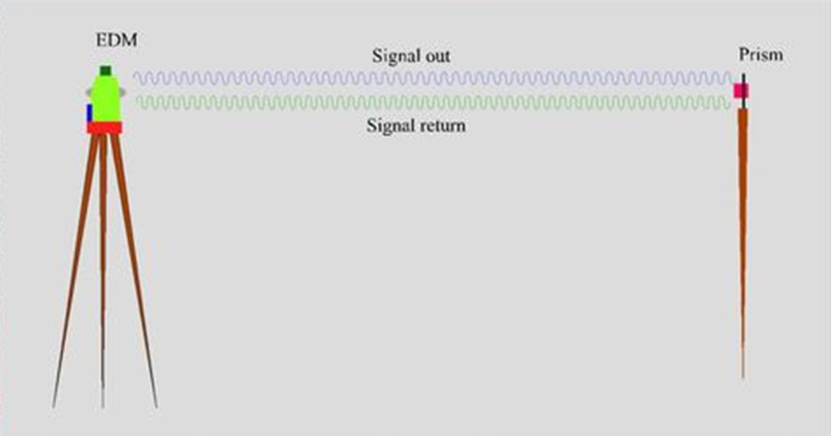
Electromagnetic Distance Measurement systems (EDM)

Slide 33
Electromagnetic Distance Measurement systems (EDM)
An EDM instrument use electromagnetic waves, which may be classified according to the type of electromagnetic radiation that carries the measuring signal.
These are microwave EDM instruments that generally employ radio waves and the electro-optical EDM instruments which utilize visible or near-infrared radiation.
The system has three major components: the propagation timer; the transmitter/receiver and the microprocessor

Slide 34
Electromagnetic Distance Measurement systems (EDM)
The propagation timer is to determine the travel time of the wave to and from the reflector
The transmitter transmits the wave and the same time the receives it.
The microprocessor does the computations of the distance.
Now for the system to work, there has to be a reflecting surface on the other end of the line. In this respect reflecting prisms are used.
Further more there has to be a clear line of sight (no blockages in the signal) between the transmitter and the reflector.

Slide 35
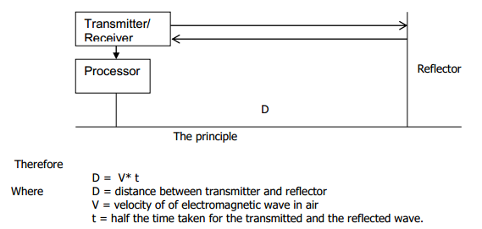
Electromagnetic Distance Measurement systems (EDM)

Slide 36
EDM: Limitations
Human Errors
Atmospheric Effects
Instrument Errors

Slide 37
EDM Limitations: Human Errors
The operator must be careful when setting up and operating the instrument in order to eliminate or minimise errors which are human.
Due care has to paid to centring the instrument, pointing to the targets (reflectors) and setting the atmospheric correction values.

Slide 38
EDM Limitations: Atmospheric Effects
The measuring wave is affected by the atmospheric conditions such as temperature, pressure and humidity.
Correction of such errors is done by measuring the temperature and pressure at the time measuring the distance are entered in the instrument.

Slide 39
END

