Slide 1
GEE 4812:
Principles of Geomatics
Multiple Point Positioning
LECTURER : Mr. TWATAIZYA MINANGO
EMAIL : twataizya.minango@unza.zm
OFFICE : B.Eng. Main Building, 1st Floor, Former Zagis Offices, Room 2

Slide 2
Content
Introduction
Types of Traverses
Linear and Angular Misclosure
Traverse Adjustments
Traverse Computation Steps

Slide 3
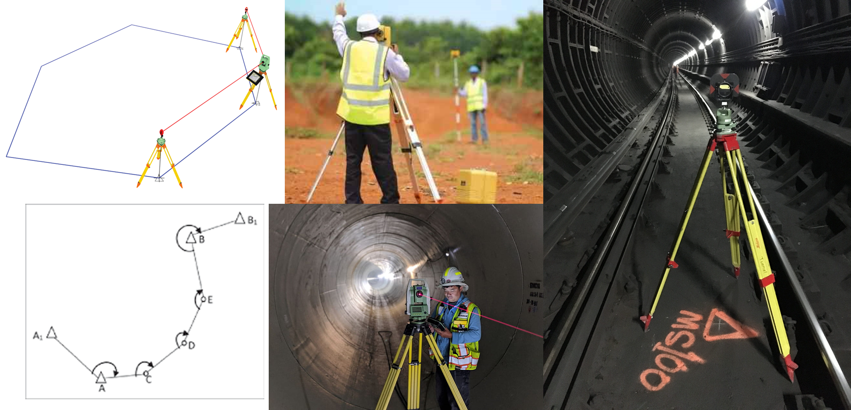
Traversing

Slide 4
Introduction
Traversing is one of many multiple point positioning methods.
Traversing is used to establish a network of control points (Reference marks).
Traverse computations are cumulative in nature, starting from a fixed point or known line, and all of the other directions or positions determined from this reference.

Slide 5
Introduction
Generally, traversing involves the measurement of the following parameters:
The length of each survey line.
The angle between the successive survey lines or the bearings of the lines.
The measurement of the directions of the lines is usually done by means of an angle measuring device such as theodolite and the length is measured with the help of tape.
The co-ordinates of the first established station, as well as the bearing of the first line, are determined, then, the co-ordinates of all the successive stations are computed.

Slide 6
Types of Traverses
There are two categories of traverses.
Depending on the way the network starts and ends, it can be either:
open
closed

Slide 7
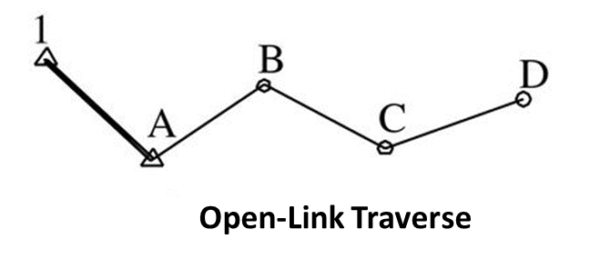
Open Traverse
This type of traverse network starts at known points and ends on unknown point.
These type of traverses are used in exceptional circumstances since there is no external check on the measurements.
However, open traverses are used mainly in tunneling work where the physical situation prevents closure on known points

Slide 8
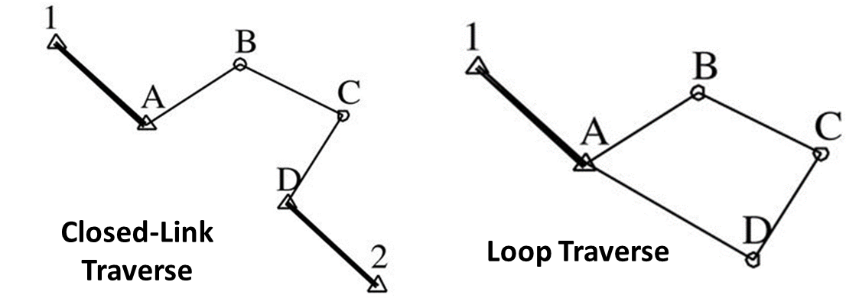
Closed Traverse
A closed traverse network is one, which starts and ends on the known points.
There are two types of closed traverses: a closed link traverse and a loop traverse.

Slide 9
Angular Computations
If angles are measured within a traverse, they need to be converted to bearings in order to be used in the traverse computation.
Before the bearings are computed, the measured angles are checked for consistency and to detect any blunders.

Slide 10
Angular Computations
For a loop before any coordinate calculations can commence, the angles or bearings measured have to be adjusted.
This is done by comparing the sum of the measured angles to the expected value (computed) or the measured final bearing to the expected (computed from coordinates).

Slide 11
Angular Computations
For closed loop traverses, a check can be applied to ensure that the measured angles can meet the required specifications.
For a closed loop traverse with n internal angles, the check that is used is:
The difference from between the two i.e. the summed up angles and the computed from the formula above is the angular misclosure.

Slide 12
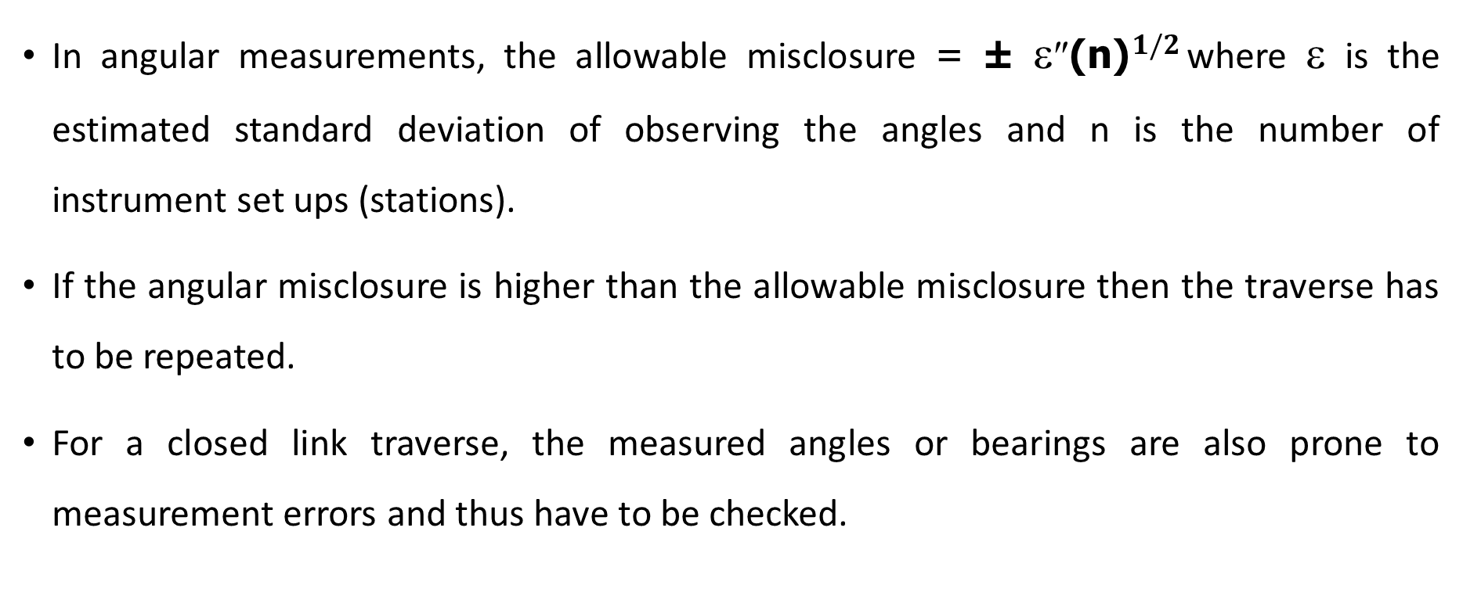
Angular Computations
In angular measurements, the allowable misclosure = ± ε″${\text{(}\text{n}\text{)}}^{1/2}$ where ε is the estimated standard deviation of observing the angles and n is the number of instrument set ups (stations).
If the angular misclosure is higher than the allowable misclosure then the traverse has to be repeated.
For a closed link traverse, the measured angles or bearings are also prone to measurement errors and thus have to be checked.

Slide 13
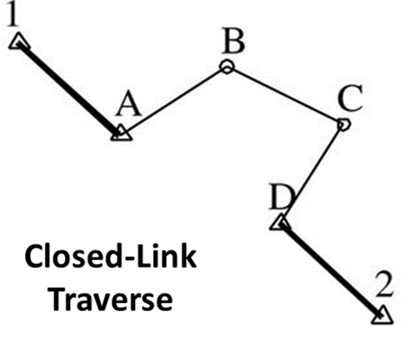

Angular Computations
In the case of bearing, the forward bearing of end points (A and D) is compared with the measured bearing of the same points (A and D).
For angle measurements, the starting bearing of the control points (1 and A) is added to the measured angles and the resulting end bearing is compared as explained earlier.

Slide 14
Angular Adjustment
The distribution or adjustment of the angular misclosure is done equally since each angle is measured in the same manner and there is an equal chance of the misclosure having occurred in any of the angles.

Slide 15
Errors in Angular Measurements
There are various sources of errors that are common in angular measurements:
Inaccurate centering of the theodolites or targets
Non verticality of targets (Hint: sight the bottom part of the target if you can)
Inaccurate bisection of the target
Lateral refraction, wind and atmospheric effects
Theodolite not level and not in adjustment when measuring angles
Incorrect use of the theodolite
Mistakes in reading and booking

Slide 16
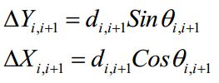
Computation of the Coordinate differences (Partials)
Having adjusted and computed the bearings, then the partials for each individual legs can be computed in combination with projected horizontal distances.
Where i = 1, 2 …n, instrument station points

Slide 17
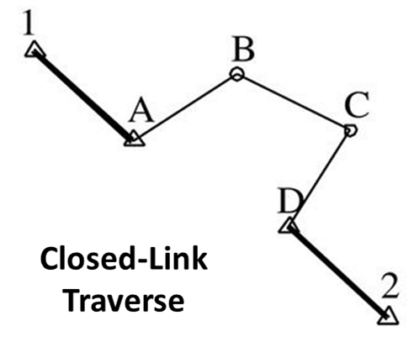
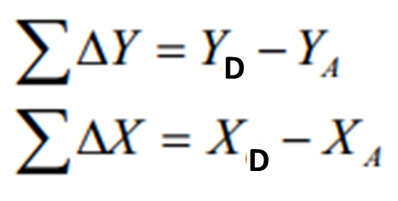
Computation of the Coordinate differences (Partials)
In an ideal situation, the sum of the shifts (partials) in Y and X coordinates should equal to zero in the case of a closed loop traverse since you are coming back to the same point.
And in the case of a closed link traverse the sum of the partials in both Y and X should equal the difference in coordinates between the start and the end points, i.e for closed link traverses.
`

Slide 18
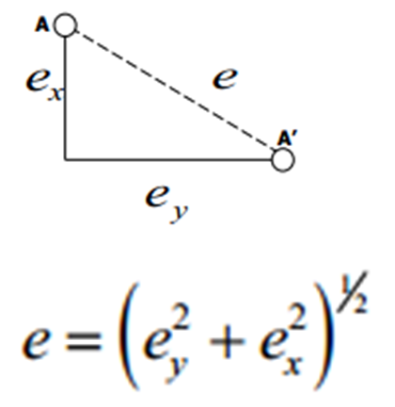
Linear Misclosure
However, due to the errors in the measured distances of the traverse and angles, there will always be a disparity on arrival at the closing point.
The resultant displacement AA’ (e) is known as the linear misclosure and it is given by

Slide 19
Linear Adjustments
During the computation of the traverse, it becomes necessary to balance the traverse because of the different errors that may persist during the field measurement.
Thus, there are a number of methods that can be used for adjusting such traverse.
We shall focus on Bowditch Method

Slide 20
Linear Adjustments (Bowditch Method)
Traverse adjustments are based on the assumptions that the errors in the linear measurements are directly proportional to the length of the traverse leg.
In this method of balancing, the total error in latitude (∆X) and in the departure (∆Y) is distributed in proportion to the length of the sides.

Slide 21
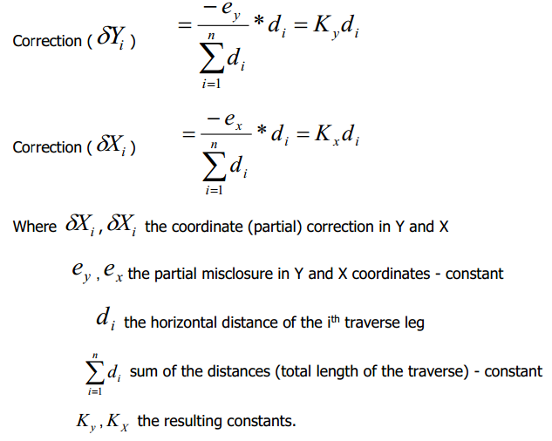
Linear Adjustments (Bowditch Method)
In this method, the values of the adjustment are directly proportional to the length of the individual traverse lines (legs).

Slide 22

Traverse specifications and Accuracy
The standard of accuracy should, according to the Zambian Regulations, be
Generally, the accuracy of the traverse is judged on basis of the resultant closure of the traverse.
This resultant closure is a function of the accuracies in the measurement of angles and distances and hence varies with the length of the traverse.

Slide 23
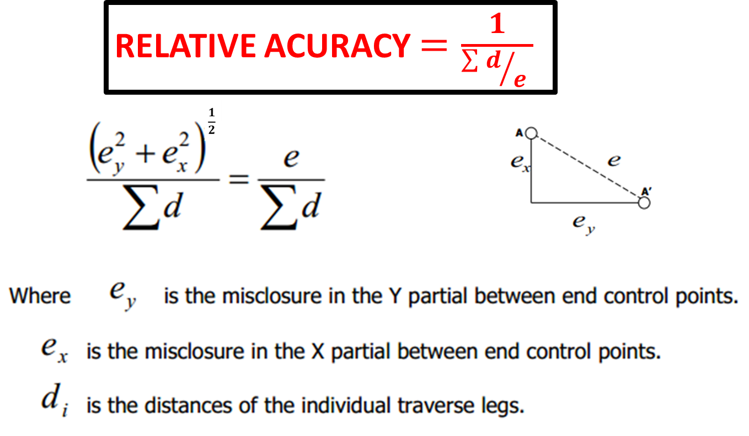
Traverse specifications and Accuracy

Slide 24
Traverse Computation
The final coordinates of the traverse points are obtained by adding or subtracting the adjusted partials, working round the traverse.
For the polygon (closed loop) traverse, the final and the initial coordinates should be the same as these represent the same point and for the closed link traverse, the final coordinates should equal those of the last known station in the traverse.
If in both cases the expected in not achieved, it should be due to arithmetic errors or rounding off errors.

Slide 25
Traverse Computation Steps
Obtain the angular misclosure, by comparing the sum of the observed angles with the sum of error-free angles in a geometrically correct figure.
Assess the acceptability or otherwise of the angular misclosure.
If the angular misclosure is acceptable, distribute it throughout the traverse in equal amounts to each angle.
From the corrected angles compute the whole circle bearing of the traverse lines relative to AB.

Slide 26
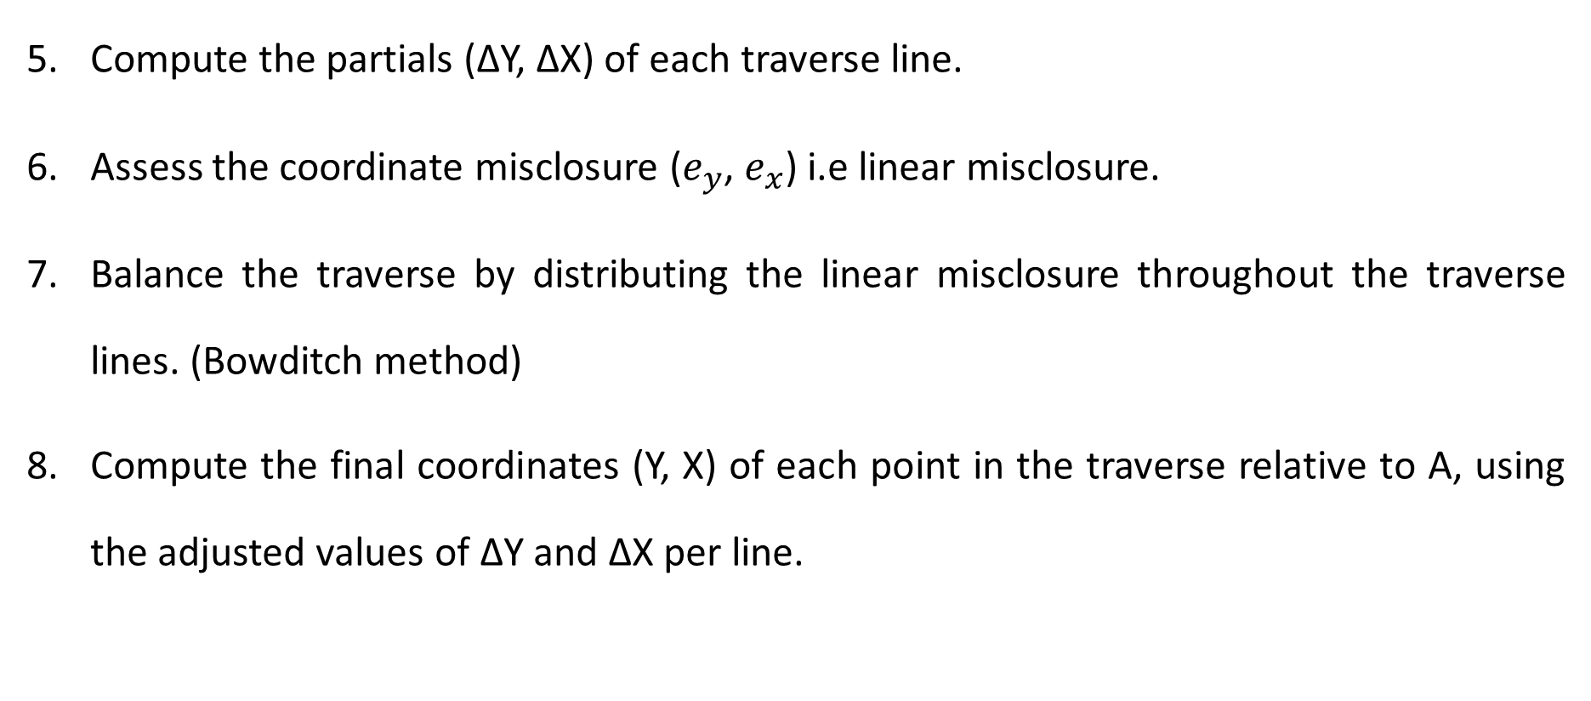
Traverse Computation Steps
Compute the partials (∆Y, ∆X) of each traverse line.
Assess the coordinate misclosure ($e_{y}$, $e_{x}$) i.e linear misclosure.
Balance the traverse by distributing the linear misclosure throughout the traverse lines. (Bowditch method)
Compute the final coordinates (Y, X) of each point in the traverse relative to A, using the adjusted values of ∆Y and ∆X per line.

Slide 27
END

