Slide 1
GEE 4812:
Principles of Geomatics
Angular Measurements
LECTURER : Mr. TWATAIZYA MINANGO
EMAIL : twataizya.minango@unza.zm
OFFICE : B.Eng. Main Building, 1st Floor, Former Zagis Offices, Room 2

Slide 2
Content
Theodolite
Unit of Measurement
Face Left and Face Right Orientation
Horizontal Angles and Vertical Angles
Angle Booking

Slide 3
Angular Measurements
Angles are one of the basic measurements in surveying.
By angles, it is referred to both horizontal and vertical angles.
The basic instrument is the theodolite.
Although there are number of varieties produced by different manufacturers, all instruments have the same basic concepts arranged in the same geometric relationship.

Slide 4
Angular Measurements
Theodolites are normally classified by the precision to which they resolve the angles and vary from say 0.1 seconds (0.1“) to 1 second (1“) and more.
The choice of which depends on the accuracy specifications for the work to be done.
At the moment there are latest electronic theodolites which measure the angles automatically as opposed to conventional ones.

Slide 5
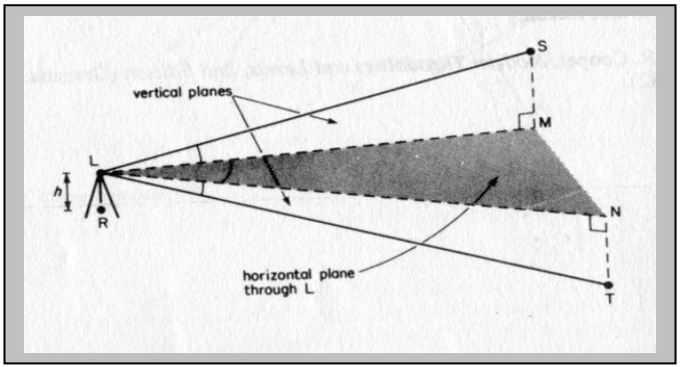
Principle of Angle Measurement

Slide 6
Principle of Angle Measurement
The figure on the next page shows two points S and T and a theodolite set up on point R.
The horizontal angle at L between S and T is angle MLN, where M and N are the vertical projections of S and T on to the horizontal plane through L.
The vertical angles to S and T from L are angle SLM (and angle of elevation) and angle TLN (an angle of depression).

Slide 7
Principle of Angle Measurement
In order to measure horizontal and vertical angles, the theodolite must be set over point R using a plumbing device and must be levelled to bring the angle reading systems of the theodolite into appropriate planes.

Slide 8
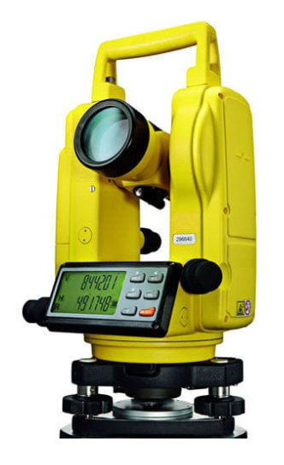
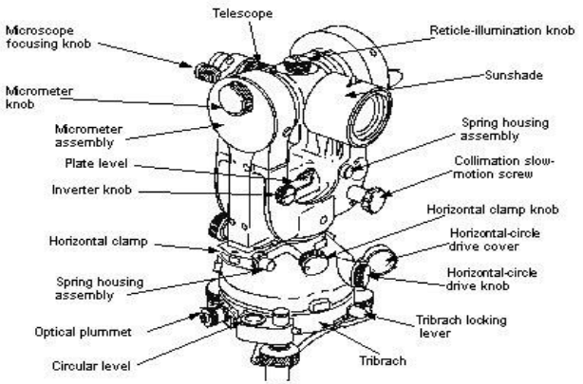
Features of the Theodolite

Slide 9
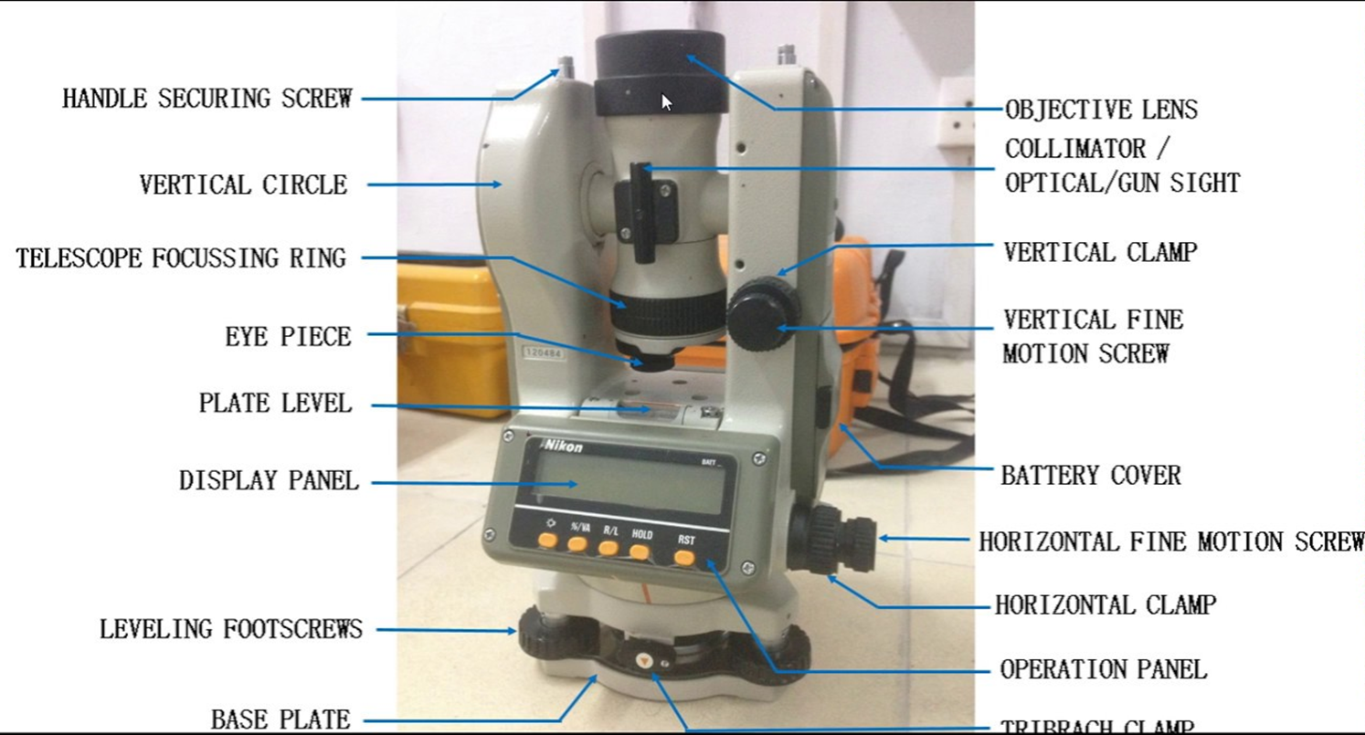
Features of the Theodolite

Slide 10
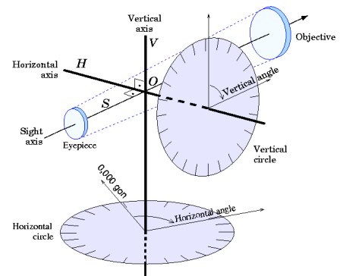
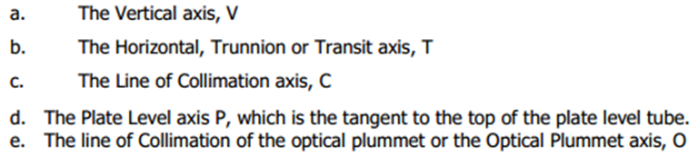
Features of the Theodolite

Slide 11
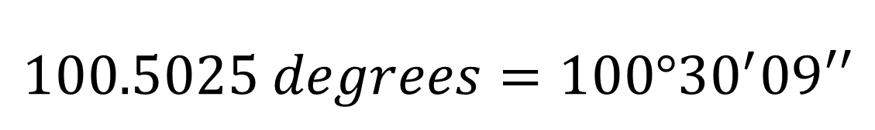
Unit of Measurement
Angles are measured in Angles e.g 100.5025 degrees (decimal degrees).
Usually presented in Sexagesimal Notation i.e degrees, minutes, seconds.
Degrees.Minutes.Seconds = ddd.mm.ss
$$100.5025 degrees=100°{30}^{′}09′′$$

Slide 12
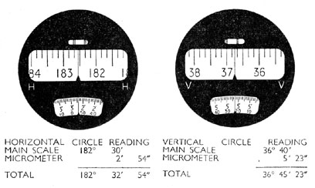
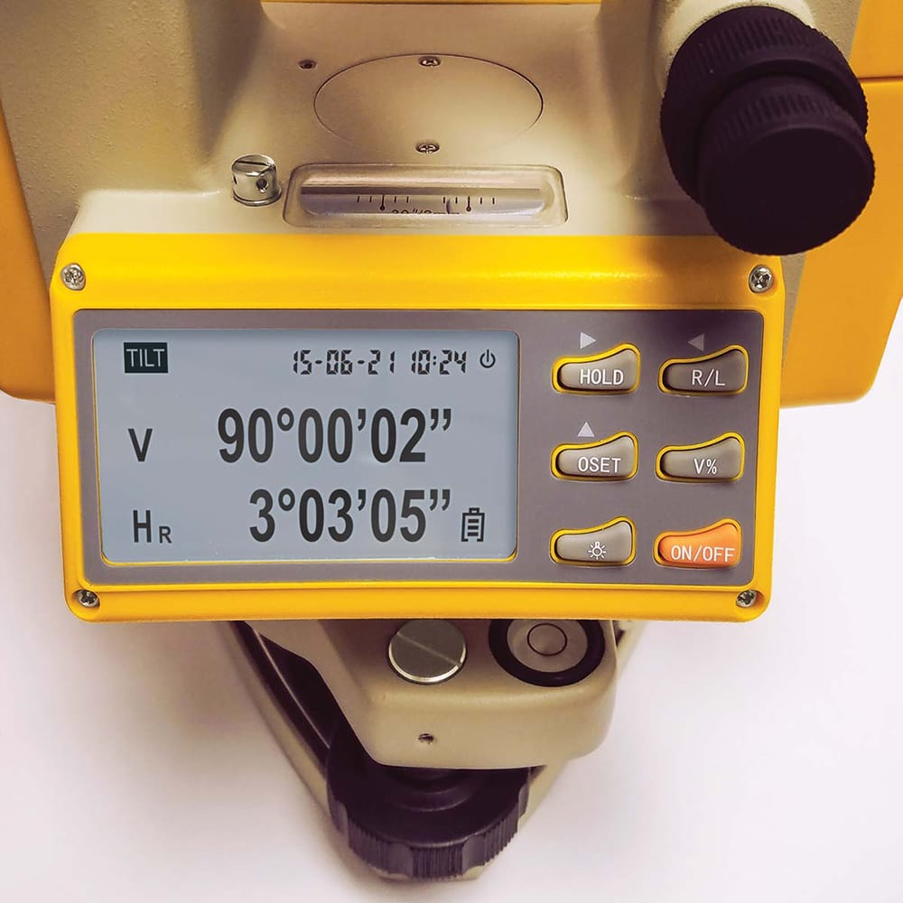
Unit of Measurement
Vertical and Horizontal Angle readings
Analog Theodolite
Digital Theodolite

Slide 13
Field Procedures
In some cases we want to have our angles with a relatively high order of accuracy, so that we must try to minimise the effects of certain systematic errors and of random errors as much as possible.
In such cases we should adopt the following rules;
Measure in both faces and use the values for calculation of the average.
Several types of possible systematic errors are eliminated in this way.

Slide 14
Field Procedures
Take more than one direction to each target point. This will reduce the effect of random errors.
Spread the observations over the horizontal circle, i.e. use all parts of the circle. In this way any small residual graduation errors may be compensated.
These rules are applied in the so-called Bessel-rounds. Each round consists of one set of Face Left and one set of the Face Right readings to the targets, transiting the instrument the instrument in between.

Slide 15
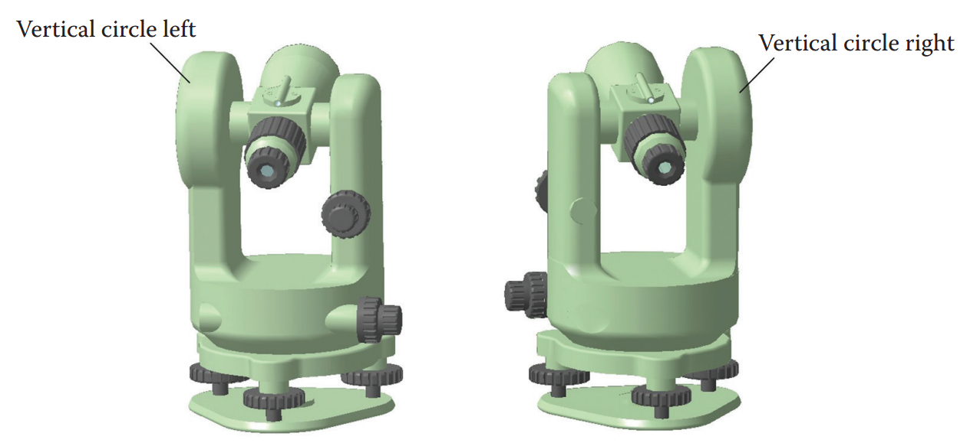
Face Left and Face Right Orientation

Slide 16
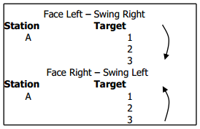
Face Left and Face Right Orientation
When observing e.g. 3 targets from station point A, the sequence for one round is as follows:

Slide 17
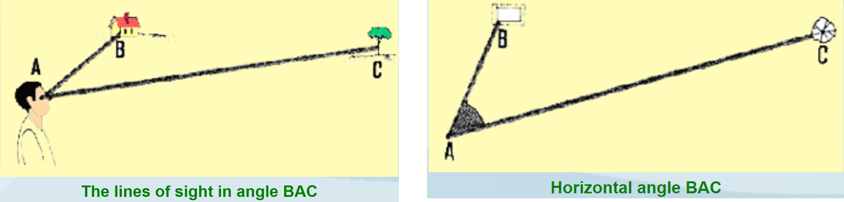
Horizontal Angles

Slide 18
Horizontal Angles
The mean horizontal circle readings are obtained by averaging the FL and FR readings. To simplify these calculations, the degrees of the FL readings are carried through and only the minutes and the seconds values are averaged.
The final horizontal angles are obtained by meaning the values obtained from each round.

Slide 19
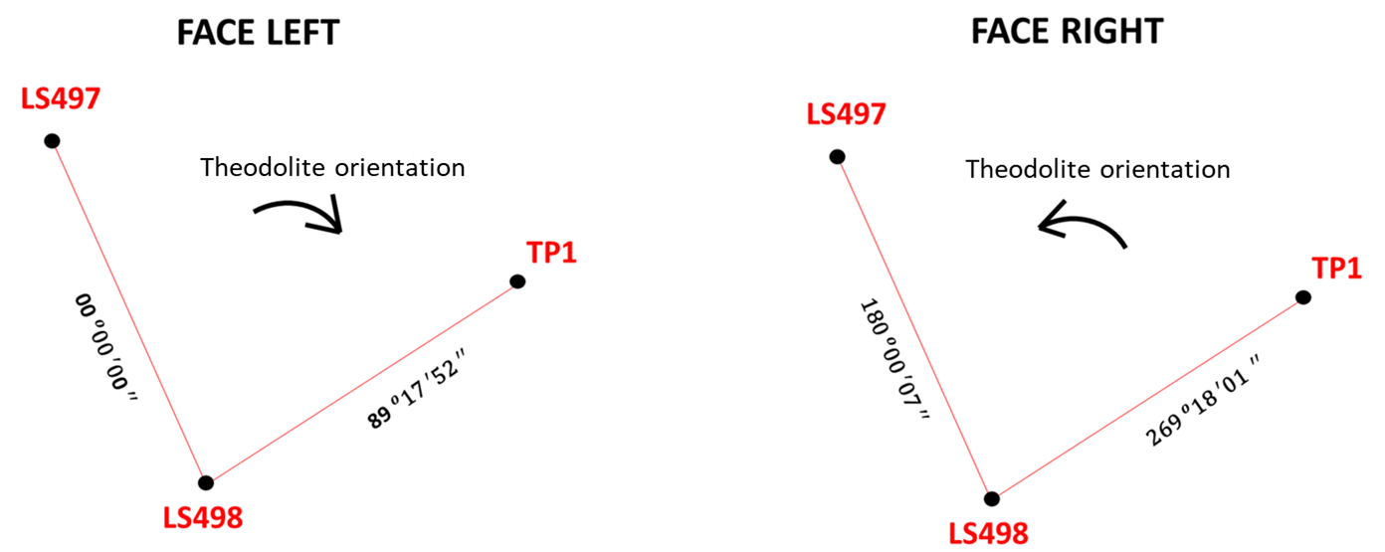
Horizontal Angles
Theodolite set up at LS498.

Slide 20
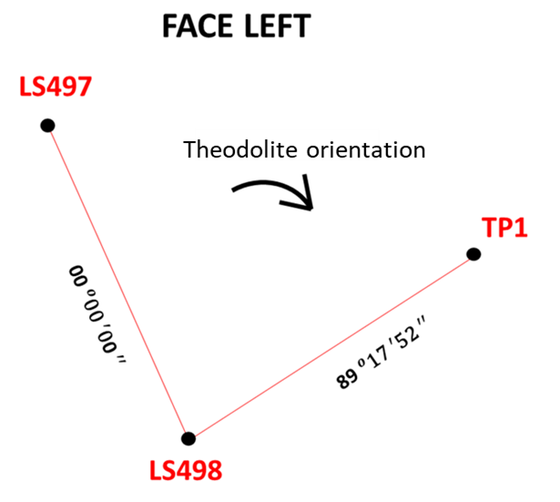
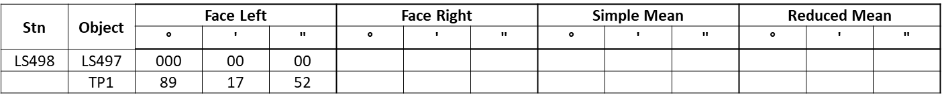
Horizontal Angles: Face Left Readings

Slide 21
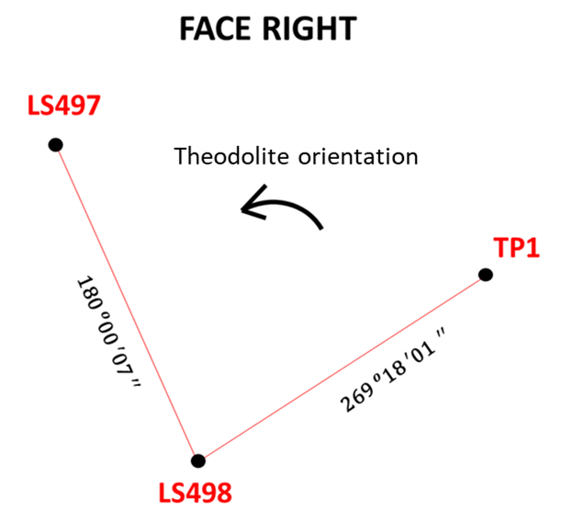
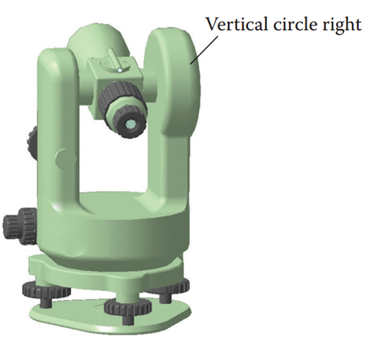
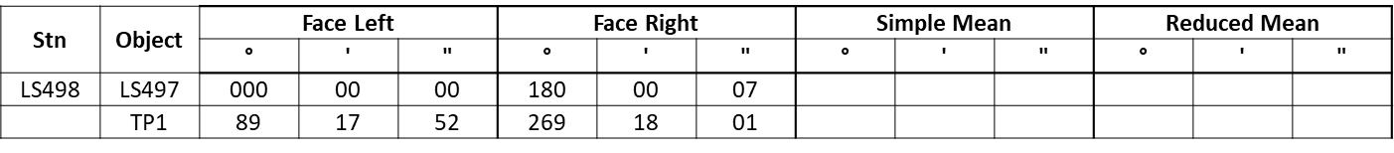
Horizontal Angles: Face Right Readings

Slide 22
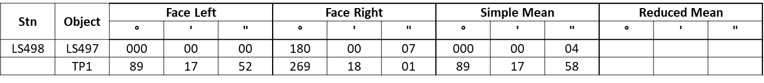
Horizontal Angles: Simple Mean
Adopt the Face Left degree value.
Then find the average of the FL and FR minutes and seconds.

Slide 23
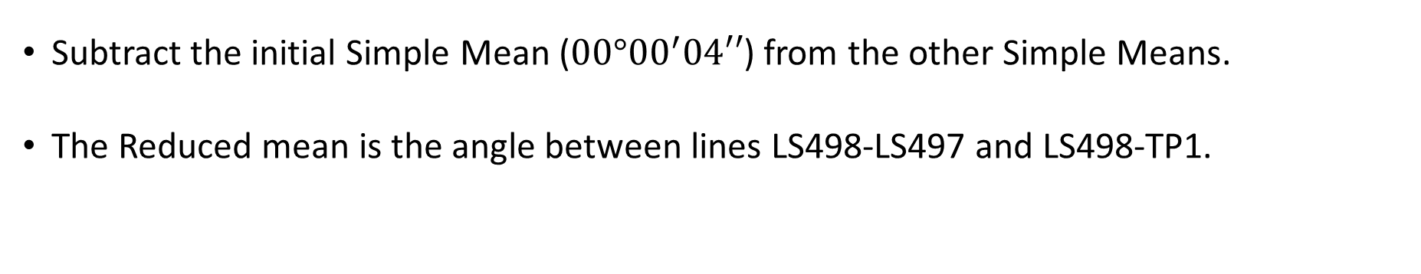
Horizontal Angles: Reduced Mean
Subtract the initial Simple Mean ($00°{00}^{′}04′′$) from the other Simple Means.
The Reduced mean is the angle between lines LS498-LS497 and LS498-TP1.

Slide 24
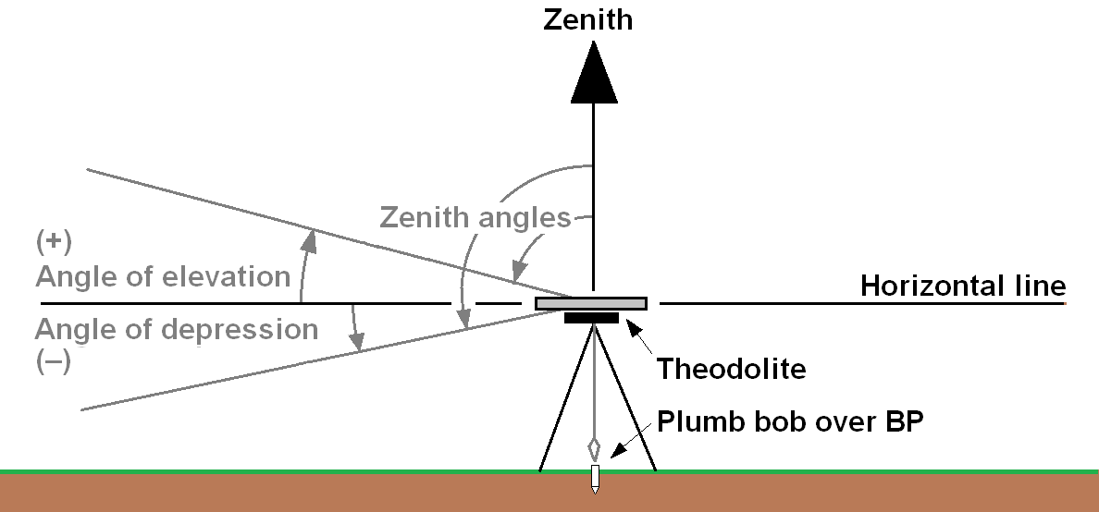
Vertical Angles

Slide 25
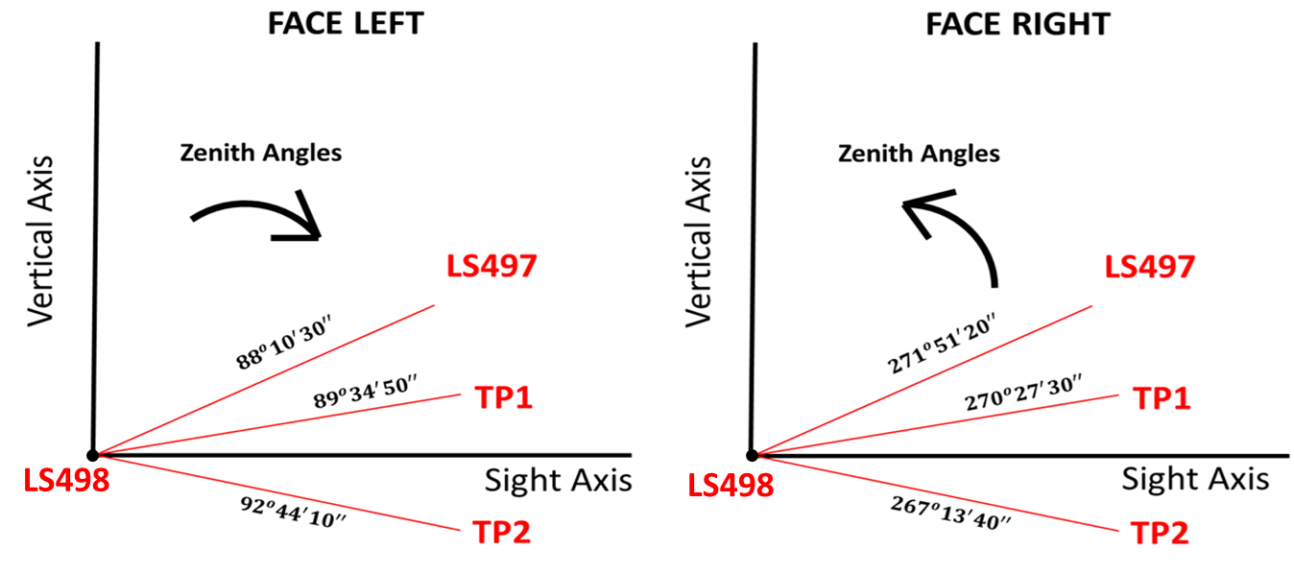
Vertical Angles

Slide 26
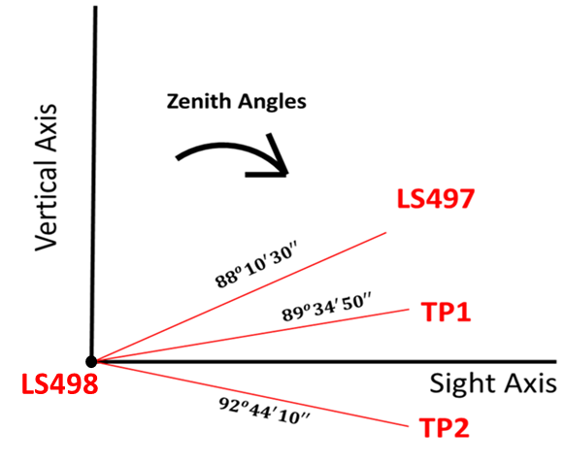
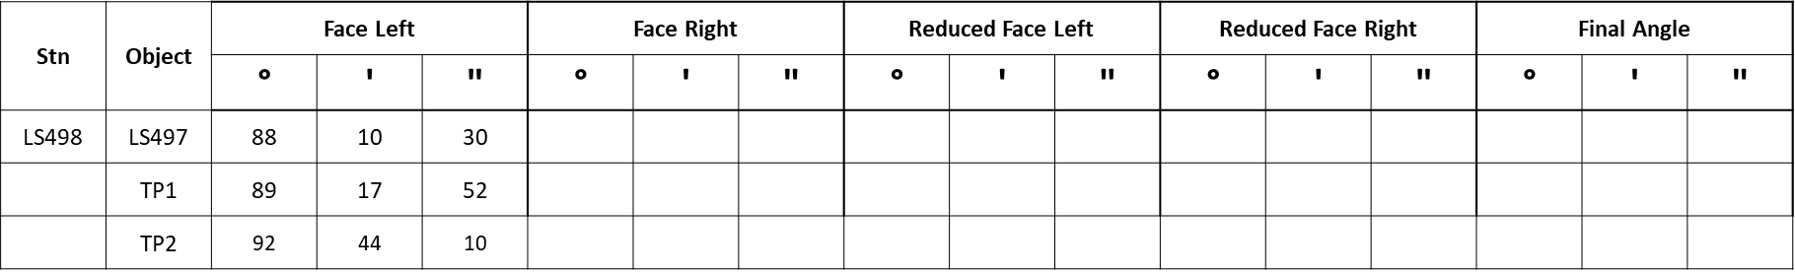
Vertical Angles: Face Left Readings

Slide 27
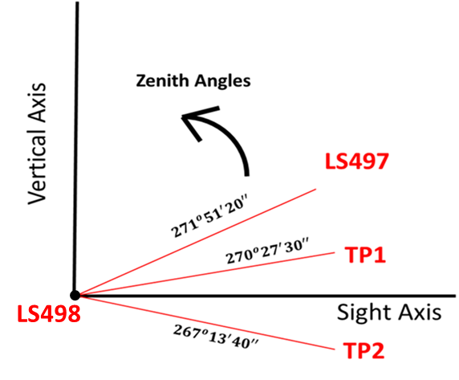
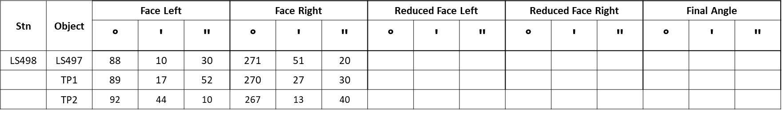
Vertical Angles: Face Right Readings

Slide 28
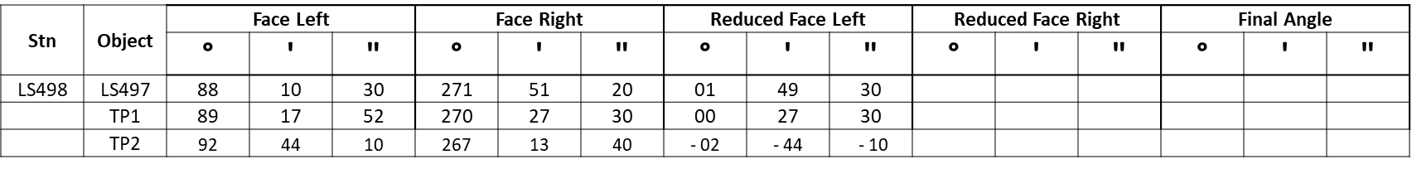
Vertical Angles: Reduced Face Left
$$Vertical Angle(FL)=90°−Zenith Angle$$
Positive Angle = Angle of Elevation
Negative Angle = Angle of Depression

Slide 29
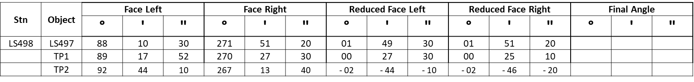
Vertical Angles: Reduced Face Right
$$Vertical Angle\left(FR\right)=Zenith Angle−270°$$
Positive Angle = Angle of Elevation
Negative Angle = Angle of Depression

Slide 30
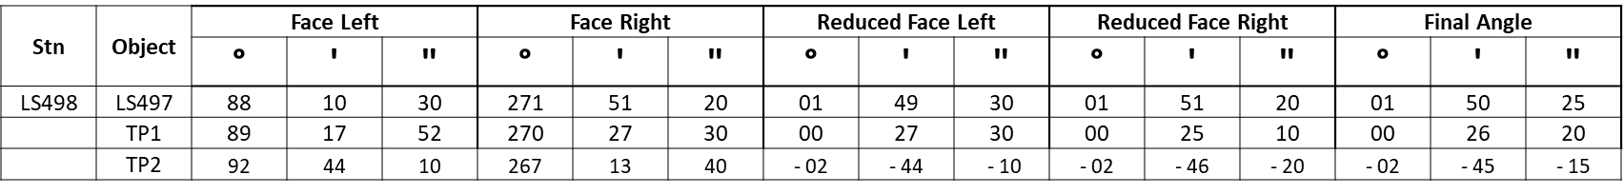

Vertical Angles: Final Angle
$$Final Angle=\frac{Reduced FL+Reduced FR}{2}$$
Positive Angle = Angle of Elevation
Negative Angle = Angle of Depression

Slide 31
END

