Slide 1
GEE 4812:
Principles of Geomatics
GNSS & Photogrammetry
LECTURER : Mr. TWATAIZYA MINANGO
EMAIL : twataizya.minango@unza.zm
OFFICE : B.Eng. Main Building, 1st Floor, Former Zagis Offices, Room 2

Slide 2
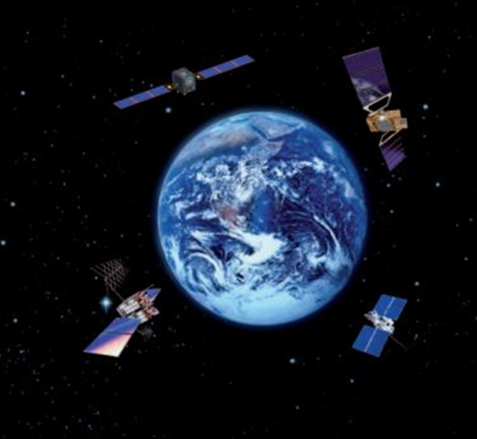
GNSS: Global Navigation Satellite Systems
Global Navigation Satellite Systems (GNSS) include constellations of Earth-orbiting satellites that broadcast their locations in space and time, of networks of ground control stations, and of receivers that calculate ground positions by trilateration.
GNSS are used in all forms of transportation: space stations, aviation, maritime, rail, road and mass transit.
https://www.unoosa.org/oosa/en/ourwork/psa/gnss/gnss.html

Slide 3
GNSS: Constellations
GPS (United States)
GLONASS (Russia)
BeiDou (China)
Galileo GNSS system (European Union)
IRNSS regional navigation satellite system (India)
QZSS regional navigation satellite system (Japan)
https://www.gnss.ca/gnss/1281-chapter-2-basic-gnss-concepts?active=1281&chapter=Chapter+2+-+Basic+GNSS+Concepts

Slide 4
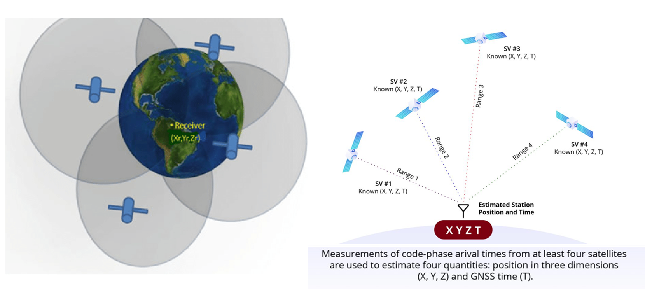
GNSS: Principle

Slide 5
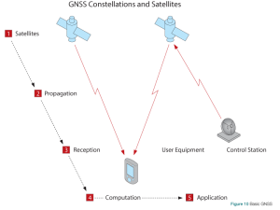
GNSS: Principle
https://www.gnss.ca/gnss/1281-chapter-2-basic-gnss-concepts?active=1281&chapter=Chapter+2+-+Basic+GNSS+Concepts

Slide 6
GNSS: Principle
Step 1- Satellites: GNSS satellites orbit the earth. The satellites know their orbit ephemerides (the parameters that define their orbit) and the time very, very accurately. Ground-based control stations adjust the satellites’ ephemerides and time, when necessary.
Step 2 - Propagation: GNSS satellites regularly broadcast their ephemerides and time, as well as their status. GNSS radio signals pass through layers of the atmosphere to the user equipment.
https://www.gnss.ca/gnss/1281-chapter-2-basic-gnss-concepts?active=1281&chapter=Chapter+2+-+Basic+GNSS+Concepts

Slide 7
GNSS: Principle
Step 3 - Reception: GNSS user equipment receives the signals from multiple GNSS satellites then, for each satellite, recovers the information that was transmitted and determines the time of propagation, the time it takes the signals to travel from the satellite to the receiver.
Step 4 - Computation: GNSS user equipment uses the recovered information to compute time and position.
Step 5 - Application: GNSS user equipment provides the computed position and time to the end user application, for example, navigation, surveying or mapping.
https://www.gnss.ca/gnss/1281-chapter-2-basic-gnss-concepts?active=1281&chapter=Chapter+2+-+Basic+GNSS+Concepts

Slide 8
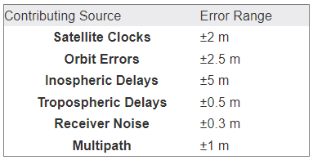
GNSS: Sources of Error
There are several factors that make it difficult for a GNSS receiver to calculate an exact position.
These errors are acceptable for smart phone location, Hand-held GNSS, Car tracking and military purposes.
However, these errors are not acceptable in Geomatics engineering works as the requirement is at least centimeter accuracy.

Slide 9
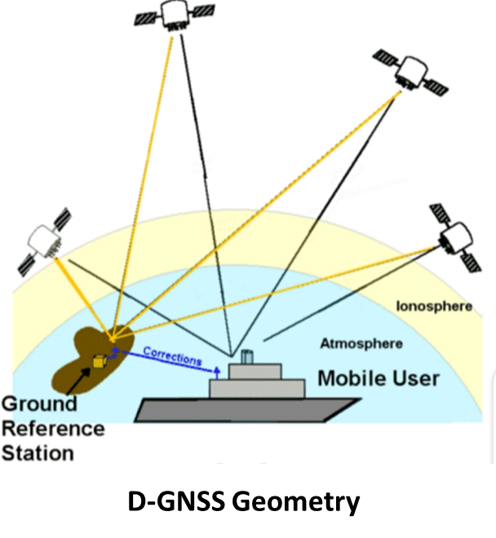
GNSS: Differential GNSS
Differential Global Navigation Satellite System (D-GNSS), is an enhancement to GNSS that was developed to correct these errors and inaccuracies in the GNSS system, allowing for more accurate positioning information.
D-GNSS was developed to prevent signal degradation. Instead of directly locating their position, differential D-GPS attempts to locate their position relative to a fixed reference point.

Slide 10
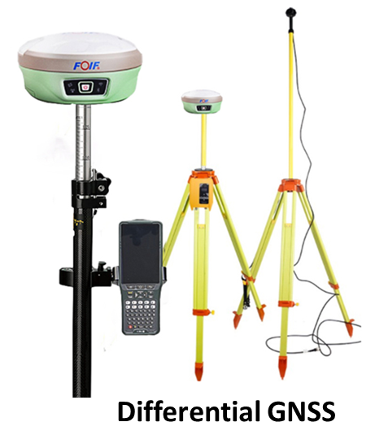
GNSS: D-GNSS Equipment
The D-GNSS system is used by both the rover and the reference receiver. Rovers play the role of users, whereas stationary receivers play the role of reference receivers.
In general, access to this correction information makes DGNSS receivers much more accurate than other receivers; with these errors removed, a GNSS receiver has the potential to achieve centimeter to millimeter accuracy.
Hence why D-GNSS equipment is used in Geomatics.

Slide 11
GNSS: Application
Land Surveying
Ground Mapping
Construction
Surface Mining
Precision Agriculture
Aerial Photogrammetry
RESEARCH
Consumer
Transportation
Meteorology (Water Vapor)
Estimation of Soil Moisture
Machine Control
Port Automation
Marine
Unmanned Vehicles
Defense

Slide 12
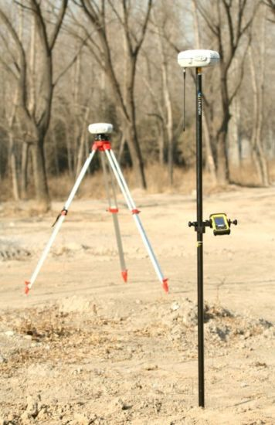
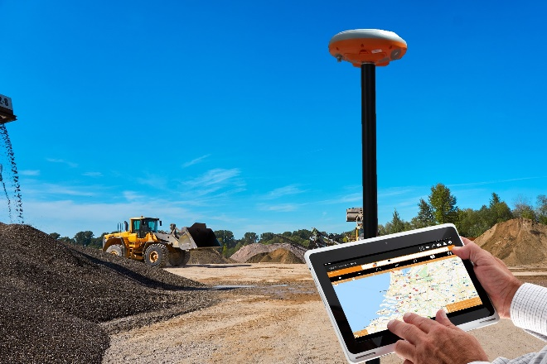
GNSS: Land Surveying
GNSS-based surveying reduces the amount of equipment and labour required to determine the position of points on the surface of the Earth, when compared with previous surveying techniques.
Demarcation of Land Parcels to obtain title deeds.
Setting out Power lines.
Ground Mapping.
Agricultural Dam surveys

Slide 13
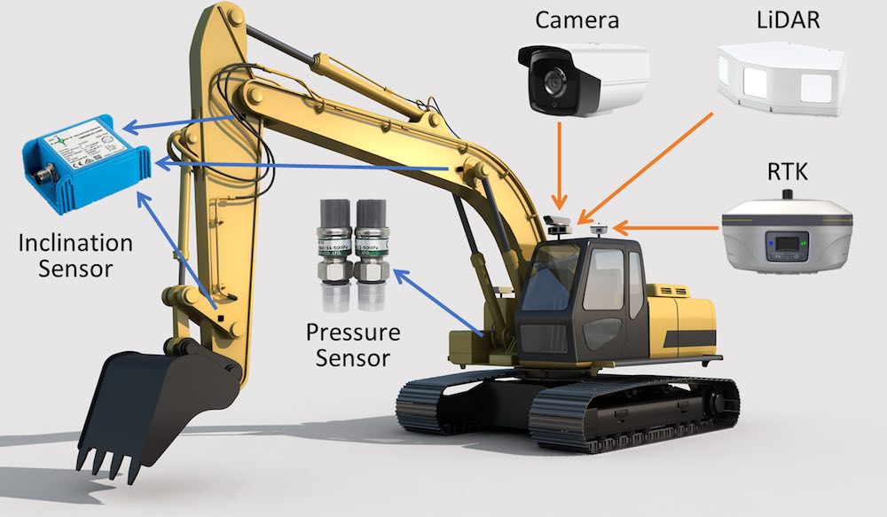
GNSS: Construction
Setting out Buildings and Roads using coordinates.
Setting out Water and Sewer network.
GNSS information can be used to position the cutting edge of a blade (on a bulldozer or grader, for example) or a bucket (excavator), and to compare this position against a 3D digital design to compute cut/fill amounts.

Slide 14
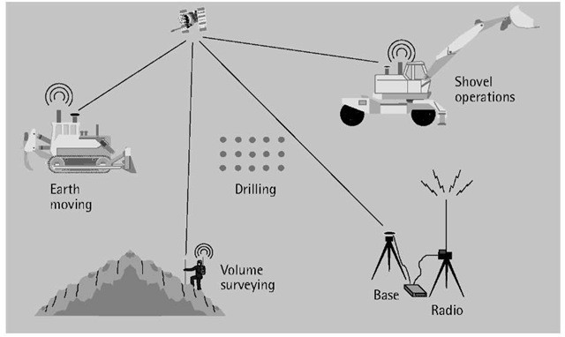
GNSS: Surface Mining
Measuring Reduced levels (Open Pit) for volume calculations.
Deformation Monitoring.
Setting out blast hole patterns.
Position information is used by blast hole drills to improve fracturization of the rock material and control the depth of each hole that is drilled, to keep the benches level.

Slide 15
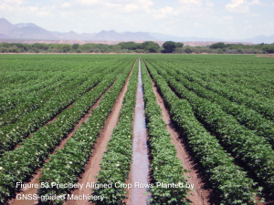
GNSS: Precision Agriculture
In precision agriculture, GNSS-based applications are used to support farm planning, field mapping, soil sampling, tractor guidance, and crop assessment.
More precise application of fertilizers, pesticides and herbicides reduces cost and environmental impact.
GNSS applications can automatically guide farm implements along the contours of the earth in a manner that controls erosion and maximizes the effectiveness of irrigation systems.
Farm machinery can be operated at higher speeds, day and night, with increased accuracy. This increased accuracy saves time and fuel, and maximizes the efficiency of the operation.
Operator safety is also increased by greatly reducing fatigue.

Slide 16
GNSS: Advantages
Function under all weather conditions
Operational Day and Night
Global Coverage i.e signals available world-wide
Provide location data in near real time
High accuracy and Precision (the case of Differential GNSS)

Slide 17
GNSS: Disadvantages
Expensive (the case of Differential GNSS)
Signal interference i.e buildings and trees may block GNSS signals
Cannot be used underground i.e no GNSS signals

Slide 18
Photogrammetry
Is the science and technology of obtaining spatial measurements and other geometrically reliable derived products from photographs.
Can be broadly defined as the art and science of using photography to obtain measurements of natural and man-made features on earth.

Slide 19
Photogrammetry: Introduction
Photogrammetric procedures can rage from:
Obtaining approximate distances, areas and elevations using hard copy photographic products with unsophisticated equipment to generating precise Digital Elevation Models (DEM), Orthophotos and mapping.
Orthophotos combine the geometric utility of a map with the extra “real-word image” information provided by a photograph.

Slide 20
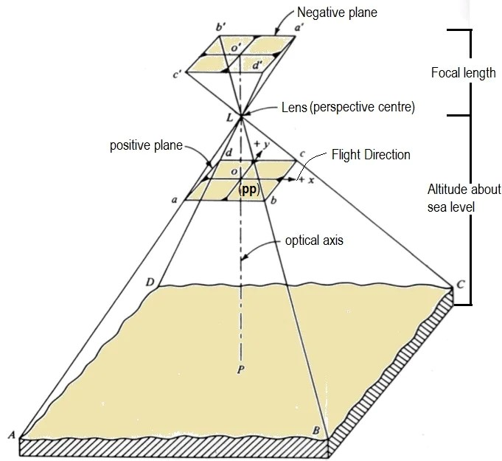
Photogrammetry: Principle
A photographic image is a central perspective, which implies that every light ray, which reaches the film surface during exposure, passed through the camera lens.
Photography implies the position of all the points is controlled by a single point of the image, which controls the Geometry of the entire photographs.
Principal point (PP)- is the point on the image where the optical axis intersects the image plane.

Slide 21
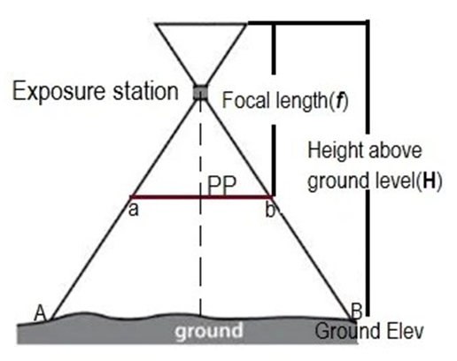

Photogrammetry: Principle
The Scale (S) of the Aerial photograph can be computed either by considering the ratio of the flying height (H) above the ground and the focal length (f) or by the ratio of a known distance in the photograph (ab) and the distance on the ground (AB).

Slide 22
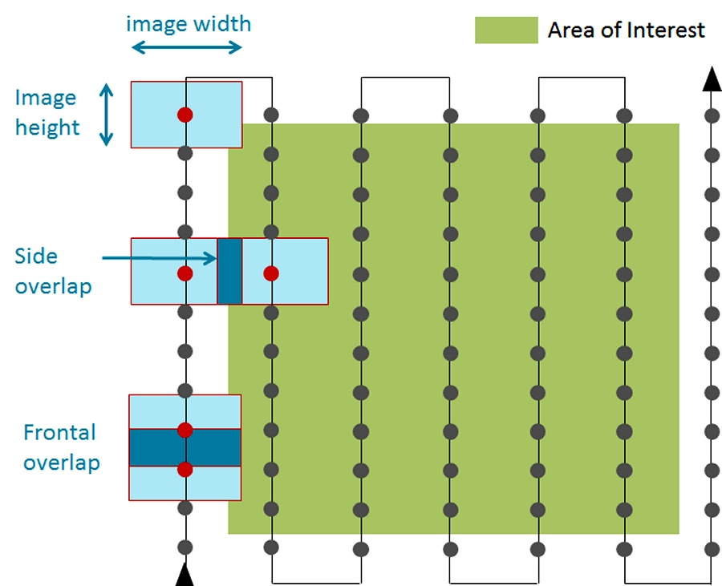
Photogrammetry: Flight Planning
Vertical aerial photographic coverage of an area is normally taken as a series of overlapping flight strips.
Overlapping is required to avoid gaps on the overall image or photograph of the whole area.
Frontal overlap (End lap) is in the direction of the flight line and is kept at 60%.
Lateral overlap (Side lap) is the overlap between adjacent which is kept to about 20%-40%.
Flight planning

Slide 23
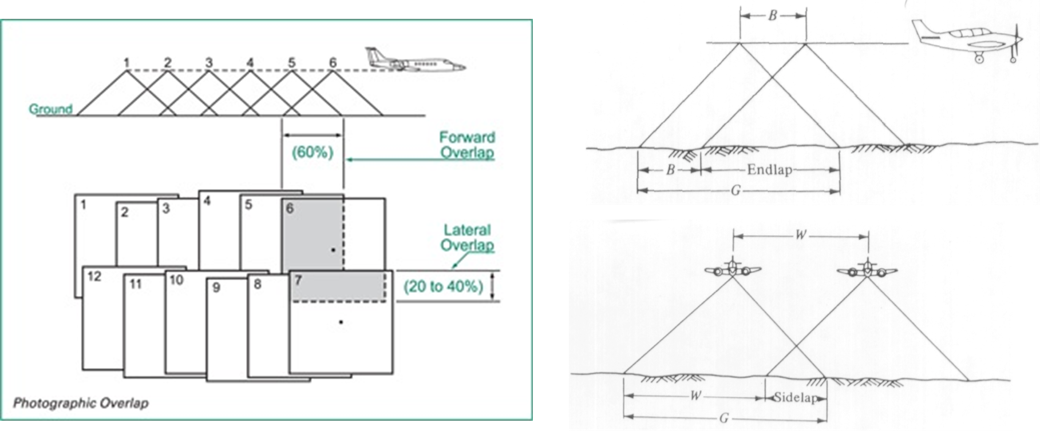
Photogrammetry: Overlaps

Slide 24
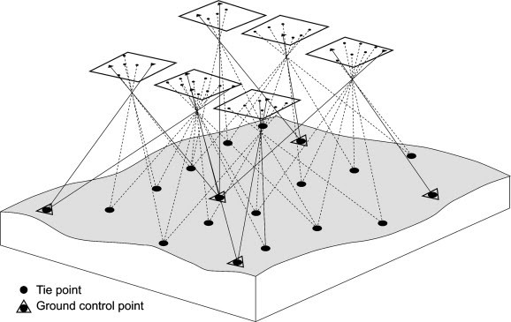
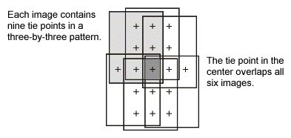
Photogrammetry: Tie Points
A tie point (TP) is a feature that you can clearly identify in two or more images.
TPs are used to combine individual photographs to form one overall photograph.
TPs do not have known ground coordinates therefore Ground Control Points (GCP) are required.

Slide 25
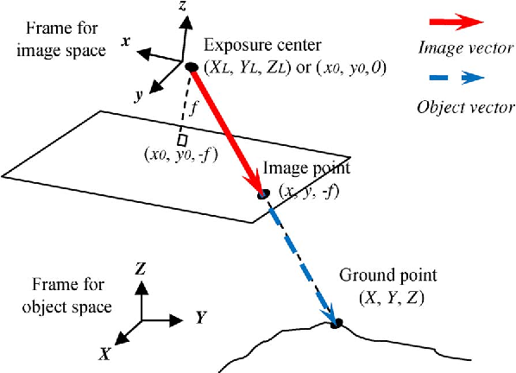
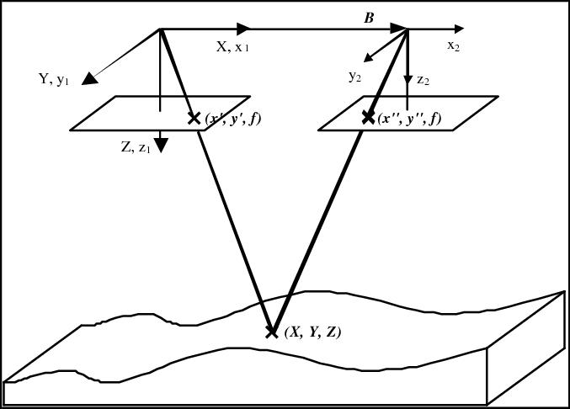
Photogrammetry: GCP
The overall photograph generated from the photogrammetric process is not spatial i.e have a random coordinate system.
GCPs are used to geo-reference the overall photograph i.e tie the photograph to the ground coordinate system (orthophoto).
GCPs have both plane coordinates and elevation i.e (X, Y, Z)
GCP both on photo and ground
Same GCP on both overlapping photographs

Slide 26
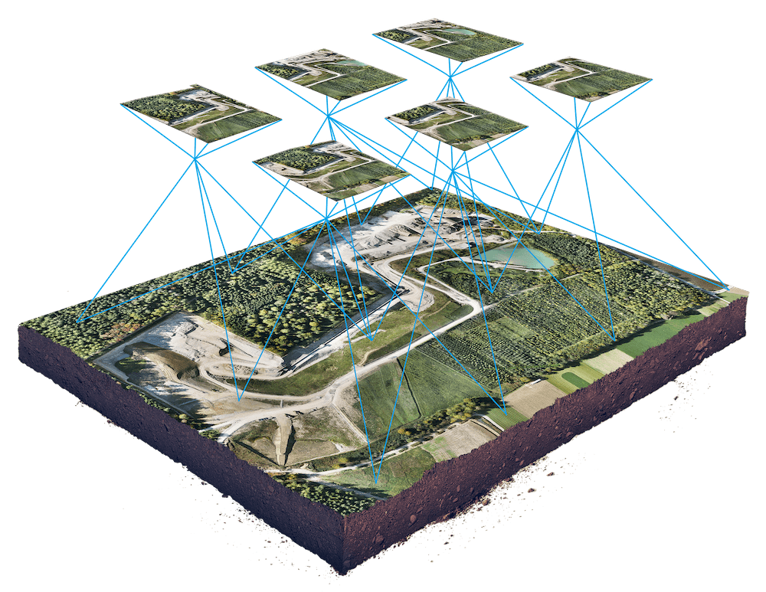
Photogrammetry: Mosaicking
Mosaic is an image produced as a result of joining a series of smaller photographs together to form one photograph.
Mosaicking is done using image processing software.
Individual photographs are stitched together using tie points.
The GCPs are used to geo-reference the mosaic i.e the overall image is tied to the ground coordinate system.

Slide 27
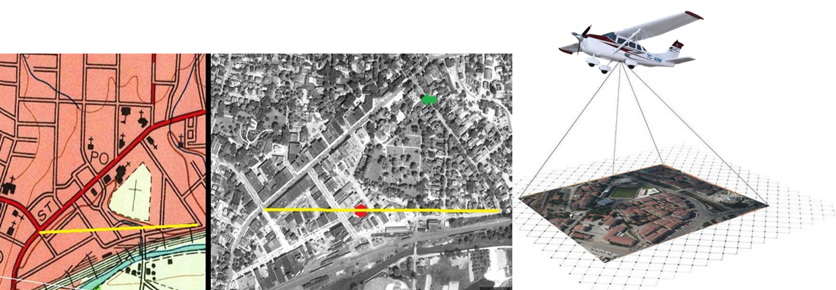
Photogrammetry: Aerial (Aircraft Based)
Photographs taken from an camera mounted on an aerial vehicle.
Make measurements using photographs.
Map
Orthophoto

Slide 28
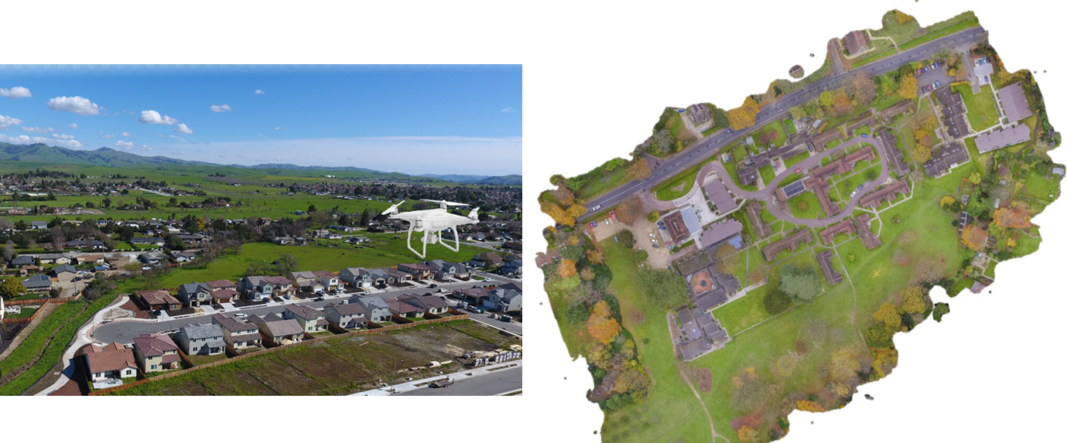
Photogrammetry: Aerial (UAV/Drones)
Use of drones to capture aerial photographs.
Portable and cheaper than aircraft based.

Slide 29
Photogrammetry: Applications
Land Surveying
Topographic Mapping
Geological Mapping
Terrain Modelling
Engineering Design
Criminology
Medical Photogrammetry
Archaeological Mapping
Industrial Machinery
RESEARCH

Slide 30
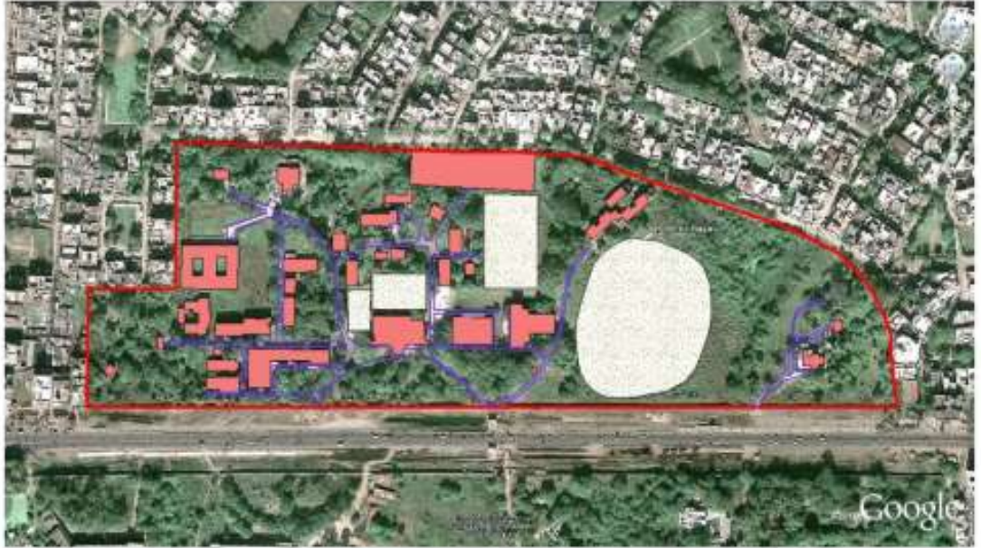
Photogrammetry: Land Surveying
Surveying or land surveying is the technique, profession, and science of determining the terrestrial or three-dimensional position of points and the distances and angles between them.
It involves land use land cover planning urban planning wasteland mapping, etc.
Area demarcation for land surveying

Slide 31
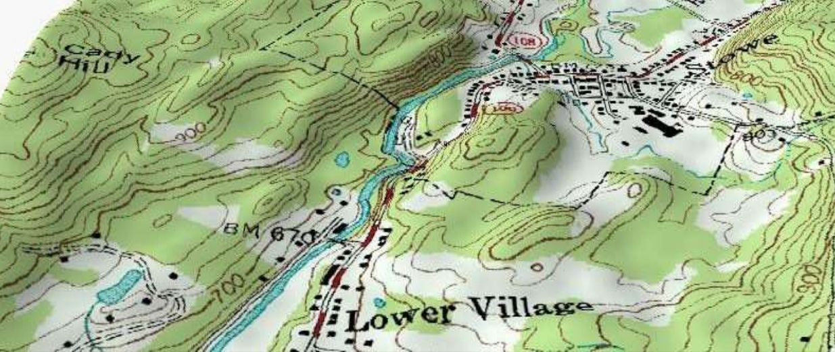
Photogrammetry: Topographic Mapping
Mapping of natural and artificial physical features.
These features include buildings, roads, rivers, lakes, vegetation e.tc.
It provides topographical information of the area.
Elevation is represented by contour lines.
Contours draped over the topography of the area

Slide 32
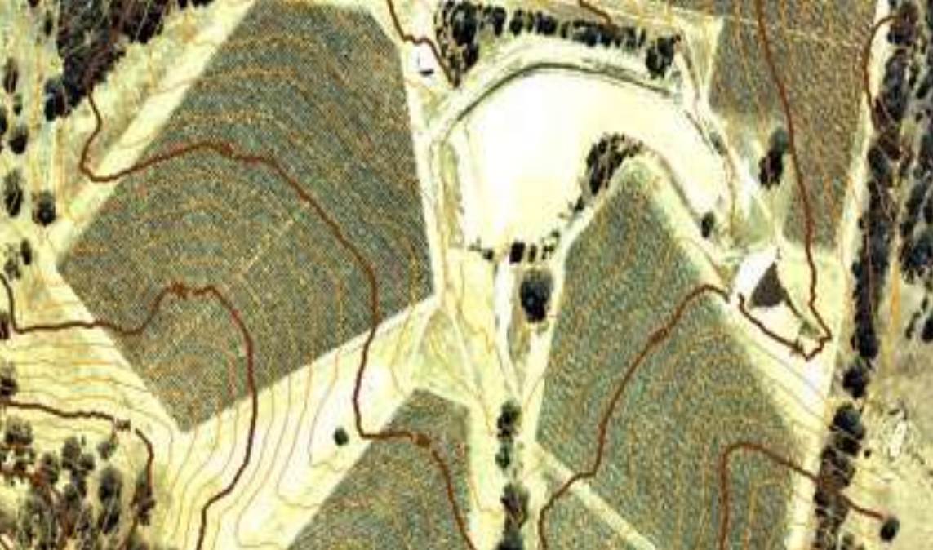
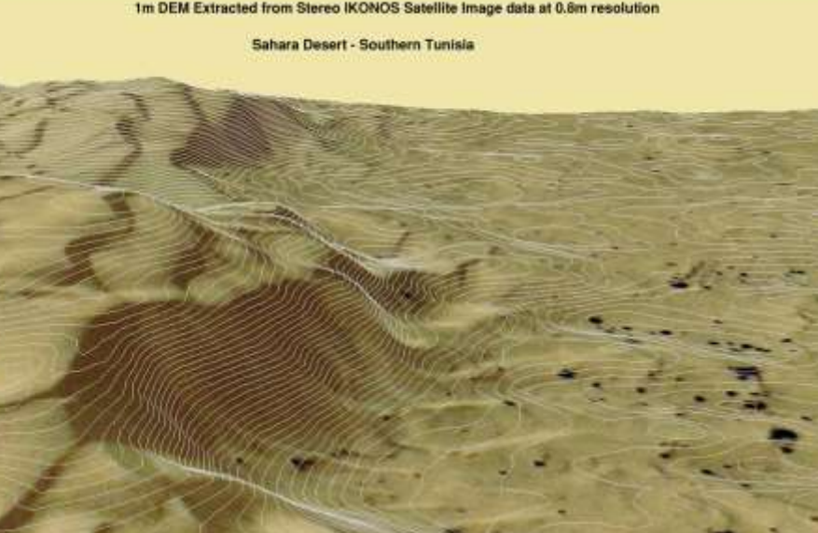
Photogrammetry: Terrain Modelling
Digital Elevation Models (DEMs), Spot Heights and Contours used for:
Superimposed over an orthophoto
determine irrigation requirements
determine drainage requirements
Contour superimposed on an orthophoto
DEM extracted from Stereo IKONOS satellite image data

Slide 33
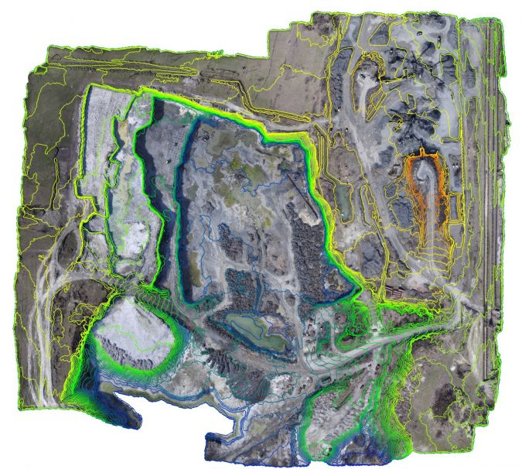
Photogrammetry: Surface Mining
Drones/UAVs capture aerial photos of an open pit mine.
A mosaic is produced using software.
Contours are generated from the mosaic.
Contours are used to calculate the volume of stock piles and excavations.
Contours generated from an orthophoto of an open pit mine

Slide 34
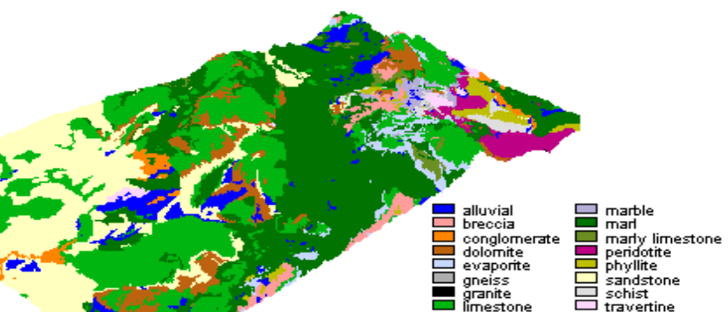
Photogrammetry: Geological/Soil Mapping
The spatial pattern of joints in nature can be investigated using the software.
This might help to understand how physical rock properties influence the
Orthophotos can be used to classify different soil types through image classification.
Lithological map draped over the topography

Slide 35
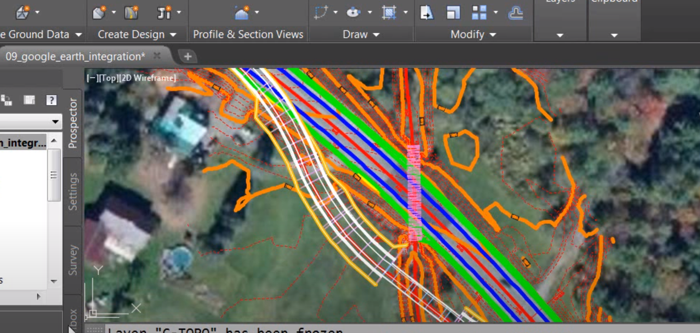
Photogrammetry: Engineering Design
3D model of a busy intersection and railway junction.
useful for urban infrastructure planning.
useful for infrastructure design and modelling.
Road Design superimposed over an orthophoto.

Slide 36
Photogrammetry: Advantages
Covers large areas quickly
Less time consuming
Can reach inaccessible and restricted area.
Cheap/cost effective for large area and in a long run.
Illustrates great detail.

Slide 37
Photogrammetry: Disadvantages
Complex system, highly trained human resource needed.
Heavy and sophisticated equipment needed.
Lengthy administrative procedure for getting permission to fly.
Weather dependent.

Slide 38
END

