Slide 1
DRILLING AND BLASTING
LAB 1
BY MR KABASO MD

Slide 3
INTRODUCTION
Safety.
Drilling is the means of achieving penetration in the rock substance.
Direction of drilling (use of pegs)

Slide 4
TYPES OF DRILLING METHODS
ROTARY DRILLING
AUGER DRILLING
PERCUSSIVE DRILLING

Slide 5
TYPES OF DRILLING RIGS
JACKHAMMER
DRIFTER MACHINE
REAMER UNIT

Slide 6
TYPES OF DRILLING ACCESSORIES
DRILL BITS
Buttons bits
Cross bits
X-bits
Reamer bits
Cone bits
2. DRILL STEELS
Intergral
Extention

Slide 7
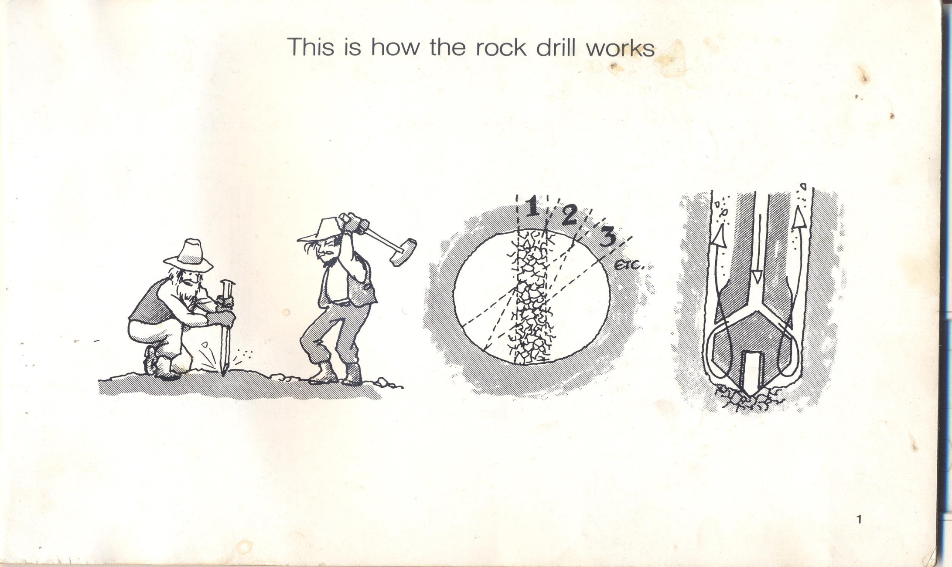
Operations of the rock drill

Slide 8
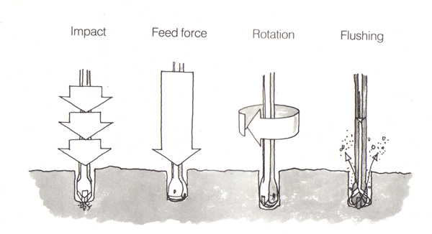
Operations of the rock drill.

Slide 9
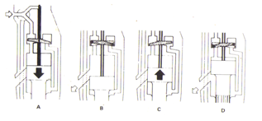
Valve system

Slide 10
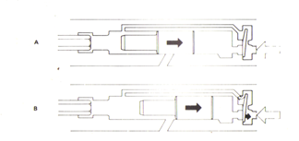
Impact mechanism

Slide 11
Valve system

Slide 12
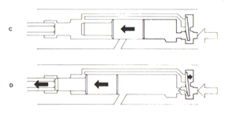
Impact mechanism

Slide 13
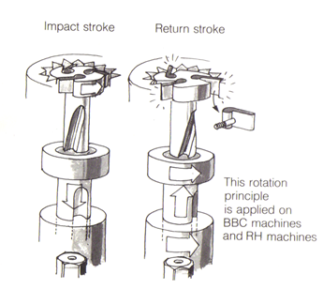
Rotation mechanism

Slide 14
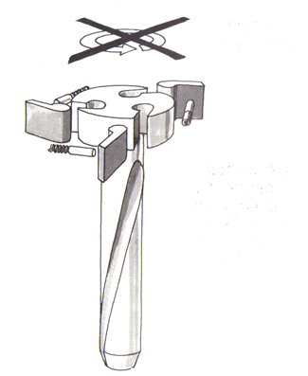
Rotation mechanism

Slide 15
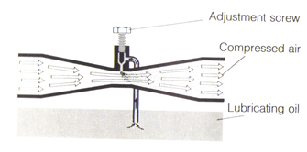
lubrication

Slide 16
TECHNIQUES OF BLASTING

Slide 17
TECHNIQUES OF BLASTING

Slide 18
TECHNIQUES OF BLASTING
Powder factors
Drilling efficiency. (stuck rods)
Hole deviations
Impact of blasting on the above.

Slide 19
BLASTING ASSECCORIES
An explosive is a chemical compound which on detonation produces huge volumes of gases and heat and exert pressure on the rock to break it.

Slide 20
Blasting accessories
Blasting agents
Detonators

Slide 21
Drilling patterns
Burn cut
Wedge cut
Stope drilling

Slide 22
Blasting
The aspects of blasting will be covered when we visit the quarry and the explanations will be done from there.

Slide 23
THE END OF PRESENTATION
GOOD DAY!!!!

