Slide 1

THE ILUMIDE BELT OF ZAMBIA by
SIKASUKWE ARON
2018202006

Slide 2
INTRODUCTION
The Irumide Belt is bounded by the Late Proterozoic Lufilian Arc to the west.
To the north by the Bangweulu Block.
And to the east the Irumide passes into the high-grade gneisses of the southern Mozambique Belt.
Belt extends for about 700 km northeastward into northern Malawi.

Slide 3
AGE
The Irumide Belt is Mesoproterozoic in age (1700-900 Ma).
Irumide orogeny took place around (1350-1100 Ma).
The orogeny generated the NE-SW trending rocks which are highly folded and thrusted

Slide 4
STRATIGRAPH
The Basement of the Irumide Belt consists of the Mkushi Gneiss Complex.
The Irumide Basement has older protoliths (2700 Ma and 2050-1900 Ma).
southern part of the Irumide Belt, the Basement Complex is known as the Musenseshi Group.
Overlying the Basement Complex is the Muva Supergroup which is essentially a thick sequence of alternating quartzite and pelitic lithologies.

Slide 5
STRATIGRAPH
NW part of the Irumide Belt, the Muva Supergroup has been subdivided into several lithostratigraphic units.
a) basal is Mitoba River Group overlain by, marine sediments of Manganga River Formation and Manshya River Group.
b) Manganga River Formation and Manshya River Group were deposited by a marine transgression.

Slide 6
ROCK TYPE
The major rock types are gneiss, granite, schist, migmatites, quartzite and amphibolite
Mukushi Gneisses forms the Basement to the Mesoproterozoic Muva Supergroup.
There are two varieties of gneisses.
a) porphyloblastic gneiss
b) banded gneiss
Granites are coarse-grained.

Slide 7
TECTONIC SETTING
OCCURRENCE
The belt occurs in southern hemisphere of Africa.
It covers parts of the central, northeastern and southern parts of Zambia.

Slide 8
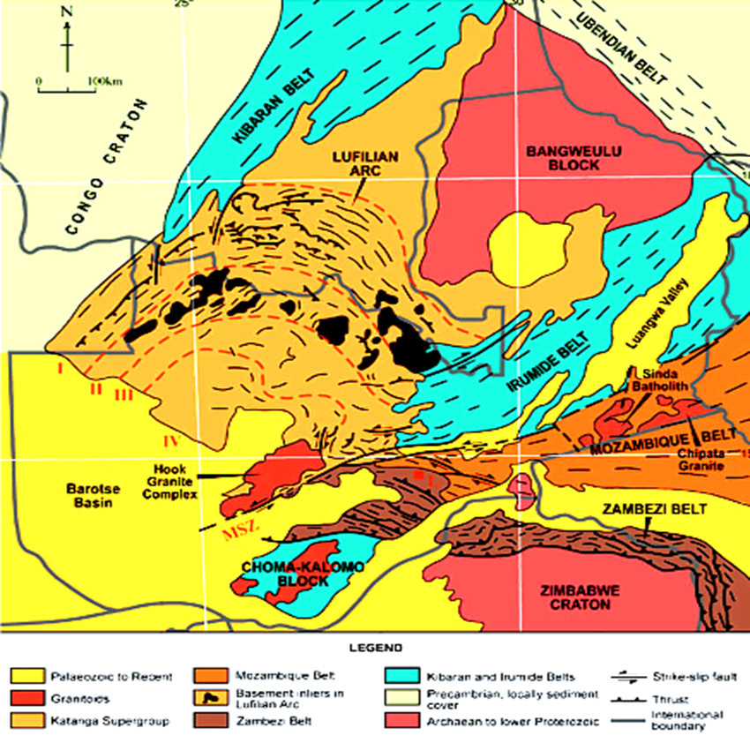
MAP SHOWING ILUMIDE BELT OF ZANBIA
The Irumide Belt in Zambia

Slide 9
IGNEOUS ACTIVITIES
Igneous activities include tholeiitic and andesitic amphibolitic volcanics with pillow lavas locally developed as shown by Barr, 1976.
According to Daly (1988)’s structural analysis, the Irumide orogeny is a fold and thrust belt with considerable crustal shortening.
Structurally, the belt is divided into a foreland zone and an internal zone.

Slide 10
EVOLUTION OF THE ILUMIDE BELT
Poorly constrained protracted phase of extension and thinning of the crust commenced as early as ~ 1800 Ma and accommodated along traverse NW directed faults.
The thinning crust gave rise to granite magmatism through out the Irumide Belt around ~1400 Ma (The Mutangoshi gneissic granite (Chinsali) 1407±71 Ma Rb-Sr.
Compression started around~1350 Ma though poorly documented, by various Rb-Sr and K-Ar age datings.

Slide 11
EVOLUTION OF THE ILUMIDE BELT
Further compression and related granitoid magmatism occurred between 1180-1040 Ma. This phase is constrained mainly by resetting of Rb-Sr and K-Ar. systems.1140±54, Nthonga Granite (Mafingi Hills, NE Zambia).
Late magmatism emplaced the Kaunga and Lufila Granites, Chinsali (970±5 Ma) U-Pb, 947±89 Ma (1088±159 Ma).

Slide 12
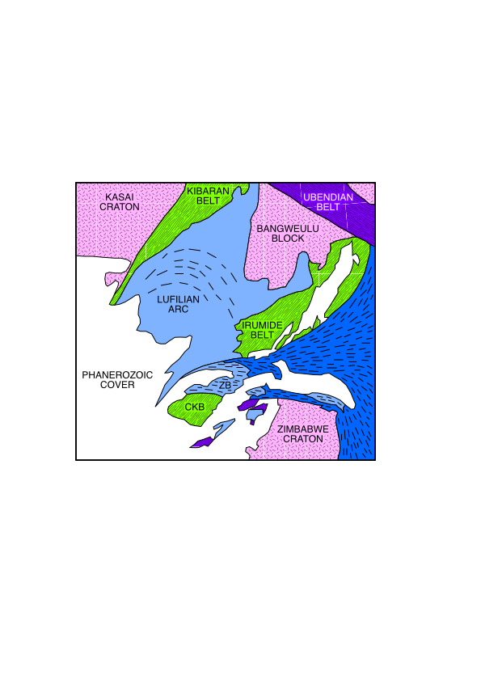
REGIONAL SETTING OF THE ILUMIDE BELT
Structural trends of Irumide belt
(NE –SW)
The Irumide Belt (NE –SW)
Choma-Kalomo Block (NE –SW)
Structural trends of CKB (NE –SW)

Slide 13
REGIONAL SETTING CONT’S
Correlation of the Choma-Kalomo Block and the Irumide Belt is the fact that they both have NE-SW structural trends and they are both Mesoproterozoic in age.
Irumide Belt
  Daly (1986) 1407±39 Ma (Rb-Sr whole rock isochron of Mutangoshi gneisses).
Choma-Kalomo Block
  Hanson et al (1988) 1343±6 Ma (U-Pb zircon upper intercept age for Zongwe orthogenesis).

Slide 14
ECONOMIC POTENTIAL
Copper in Rufunsa area east of Lusaka
Gold mineralization in the in Chongwe area east of Lusaka.
Amethyst mineralization in Kalomo’s Mapatizya area.
Granites can be used in road making

Slide 15
REFFERENCES
GGY 4101 Dr. S. Musiwa lecture notes.
GGY 4101 Prof Uppretti lecture notes.
The Mesopretozoic ilumide belt of Zambia Science direct.

Slide 16
THANK
YOU
FOR
LISTENING

