Slide 1

PLAGIOCLASE
By
SIKASUKWE ARON
2018202006

Slide 2
INTRODUCTION
Plagioclase is a series of tectosilicate (framework silicate) minerals within the feldspar group.
plagioclase is a continuous solid solution series, more properly known as the plagioclase feldspar series.
The series ranges from albite to anorthite endmembers (with respective compositions NaAlSi₃O₈ to CaAl₂Si₂O₈),
where sodium and calcium atoms can substitute for each other in the mineral's crystal lattice structure.
Plagioclase in hand samples is often identified by its polysynthetic crystal twinning or 'record-groove' effect.
Plagioclase is a major constituent mineral in the Earth's crust.
important diagnostic tool in petrology for identifying the composition, origin and evolution of igneous rocks.
Its name comes from Ancient Greek plágios (πλάγιος 'oblique') + klásis ((κλάσις 'fracture'), in reference to its two cleavage angles.

Slide 3
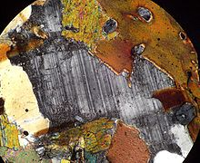
A photomicrograph of a plagioclase crystal under cross polarized light. The plagioclase crystal shows a distinct banding effect called polysynthetic twinning.

Slide 4
GENERAL INFORMATION
General
Category | Feldspar mineral group, tectosilicate
Formula (repeating unit) | NaAlSi₃O₈ – CaAl₂Si₂O₈
IMA symbol | Pl
Crystal system | Triclinic
Crystal class | Pinacoidal (1) (same H-M symbol)
Space group | C1

Slide 5
IDENTIFICATIN OF PLAGIOCLASE
Identification
Color | White, gray, or bluish white
Mohs scale hardness | 6–6.5
Luster | Vitreous
Streak | White
Diaphaneity | Transparent to translucent
Specific gravity | 2.62 (albite) to 2.76 (anorthite)
Optical properties | Biaxial (+) albite, biaxial (-) anorthite
Refractive index | Albite: n_{α} 1.527, n_{β} 1.532 n_{γ} 1.538 Anorthite: n_{α} 1.577 n_{β} 1.585 n_{γ} 1.590
Solubility | Albite insoluble in HCl, anorthite decomposed by HCl

Slide 6
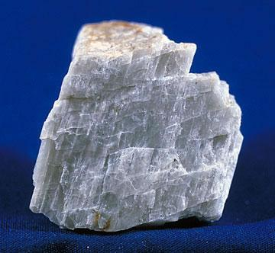
Plagioclase displaying cleavage.

Slide 7
PROPERTIES
it is abundant in igneous and metamorphic rock, and it is also common as a detrital mineral in sedimentary rock.
It is not a single mineral, but is a solid solution of two end members, albite or sodium feldspar (NaAlSi₃O₈) and anorthite or calcium feldspar (CaAl₂Si₂O₈).
The composition of plagioclase can thus be written as Na_{1-x}Ca_{x}Al_{1+x}Si_{3-x}O₈ where x ranges from 0 for pure albite to 1 for pure anorthite. This solid solution series is known as the plagioclase series.
The composition of a particular sample of plagioclase is customarily expressed as the mol% of anorthite in the sample. For example, plagioclase that is 40 mol% anorthite would be described as An40 plagioclase.
The ability of albite and anorthite to form solid solutions in any proportions at elevated temperature reflects the ease with which calcium and aluminium can substitute for sodium and silicon in the plagioclase crystal structure.

Slide 8
PROPERTIES
The luster is vitreous to pearly.
The diaphaneity is transparent to translucent.
The tenacity is brittle
The fracture is uneven or conchoidal, but the fracture is rarely observed due to the strong tendency of the mineral to cleave instead.
At low temperature, the crystal structure belongs to the triclinic system.
Plagioclase is usually white to greyish-white in color, with a slight tendency for more calcium-rich samples to be darker
Plagioclase almost universally shows a characteristic polysynthetic twinning that produces twinning striations on [010].

Slide 9
PLAGIOCLASE SERIES MEMBERS
The composition of a plagioclase feldspar is typically denoted by its overall fraction of anorthite (%An) or albite (%Ab). There are several named plagioclase feldspars that fall between albite and anorthite in the series. The following table shows their compositions in terms of constituent anorthite and albite percentages
The distinction between these minerals cannot easily be made in the field. The composition can be roughly determined by specific gravity, but accurate measurement requires chemical or optical tests

Slide 10
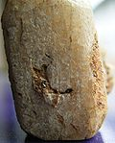
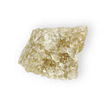



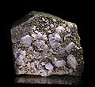
Table Of Plagioclase Mineral Composition
Plagioclase minerals and their compositions
Name | % CaAl₂Si₂O₈ | % NaAlSi₃O₈ | Image
Anorthite | 90–100 | 10–0
Bytownite | 70–90 | 30–10
Labradorite | 50–70 | 50–30
Andesine | 30–50 | 70–50
Oligoclase | 10–30 | 90–70
Albite | 0–10 | 100–90

Slide 11
Endmembers
Anorthite was named by Gustav Rose in 1823 from Greek an- ('not') + orthós ('straight'), literally 'oblique', referring to its triclinic crystallization.^{[20]}Anorthite is a comparatively rare mineral but occurs in the basic plutonic rocks of some orogenic calc-alkaline suites.^{[21]}
Albite is named from the Latin albus, in reference to its unusually pure white color. The name was first applied by Johan Gottlieb Gahn and Jöns Jacob Berzelius in 1815.^{[22]} It is a relatively common and important rock-making mineral associated with the more silica-rich rock types, in hydrothermal veins, with greenschist facies metamorphic rocks,^{[23]} and in pegmatite dikes, often as the variety cleavelandite and associated with rarer minerals like tourmaline and beryl.

Slide 12
Intermediate members
The intermediate members of the plagioclase group are very similar to each other and normally cannot be distinguished except by their optical properties.
Bytownite - is a rare mineral occasionally found in more basic rocks
Labradorite is the characteristic feldspar of the more basic rock types such as gabbro or basalt
Andesine is a characteristic mineral of rocks such as diorite which contain a moderate amount of silica and related volcanics such as andesite
Oligoclase is common in granite and monzonite.

Slide 13
Petrogenesis
Plagioclase is the primary aluminium - bearing mineral in mafic rocks formed at low pressure.
It is normally the first and most abundant feldspar to crystallize from a cooling primitive magma.
Anorthite has a much higher melting point than albite, and, as a result, calcium-rich plagioclase is the first to crystallize.
The plagioclase becomes more enriched in sodium as the temperature drops, forming Bowen's continuous reaction series.
However, the composition with which plagioclase crystallizes also depends on the other components of the melt, so it is not by itself a reliable thermometer.

Slide 14
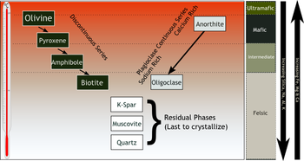
Petrogenesis

Slide 15
Classification in rock types
Igneous rock - Low-silica igneous rocks are further divided into dioritic rocks having sodium-rich plagioclase (An<50) and gabbroic rocks having calcium-rich plagioclase (An>50). Anorthosite is an intrusive rock composed of at least 90% plagioclase.
metamorphic rocks- Plagioclase tends to be albite in low-grade metamorphic rock, while oligoclase to andesine are more common in medium- to high-grade metamorphic rock.
sedimentary rocks - Alkali feldspar is usually more abundant than plagioclase in sandstone, but sandstone derived from volcanic rock contains more plagioclase.. Plagioclase weathers relatively rapidly to clay minerals such as smectite.

Slide 16
uses
In addition to its importance to geologists in classifying igneous rocks, plagioclase finds practical use as construction aggregate, as dimension stone, and in powdered form as a filler in paint, plastics, and rubber. Sodium-rich plagioclase finds use in the manufacture of glass and ceramics.
Anorthosite could someday be important as a source of aluminium.

Slide 17
References
GGY 4070 (PETROLOGY) lecture notes by Dr. A .Ahmed.
https://en.wikipedia.org/wiki/Plagioclase
GGY 3020 ( MINERALOGY and PETROLOGY) BY DR. A . Ahmed
Milam, K. A.; et al. (2010). "Distribution and variation of plagioclase compositions on Mars". Journal of Geophysical Research: Planets.
Warr, L.N. (2021). "IMA–CNMNC approved mineral symbols". Mineralogical Magazine. 85: 291–320

Slide 18
THANK
YOU
FOR
LISTENING

