Slide 1
HYDROTHERMAL PROCESSES – MOVEMENT OF FLUIDS

Slide 2
HYDROTHERMAL FLUIDS MOVEMENT IN THE CRUST
DRIVING FORCES INCLUDE:
  GRAVITY-DRIVEN HYDRAULIC HEAD
  OROGENIC COMPRESSION
  THERMAL GRADIENT
  DILATANCY (OR CHANGE IN VOLUME)
  OTHERS

Slide 3
GRAVITY-DRIVEN HYDRAULIC HEAD
AT RELATIVELY SHALLOW CRUSTAL LEVELS PERVASSIVE FLUID FLOW, ALONG POROUS AQUIFERS, OCCURS IN RESPONSE TO A GRAVITY-DRIVEN HYDRAULIC HEAD FORMED BY UPLIFTED TOPOGRAPHY

Slide 4
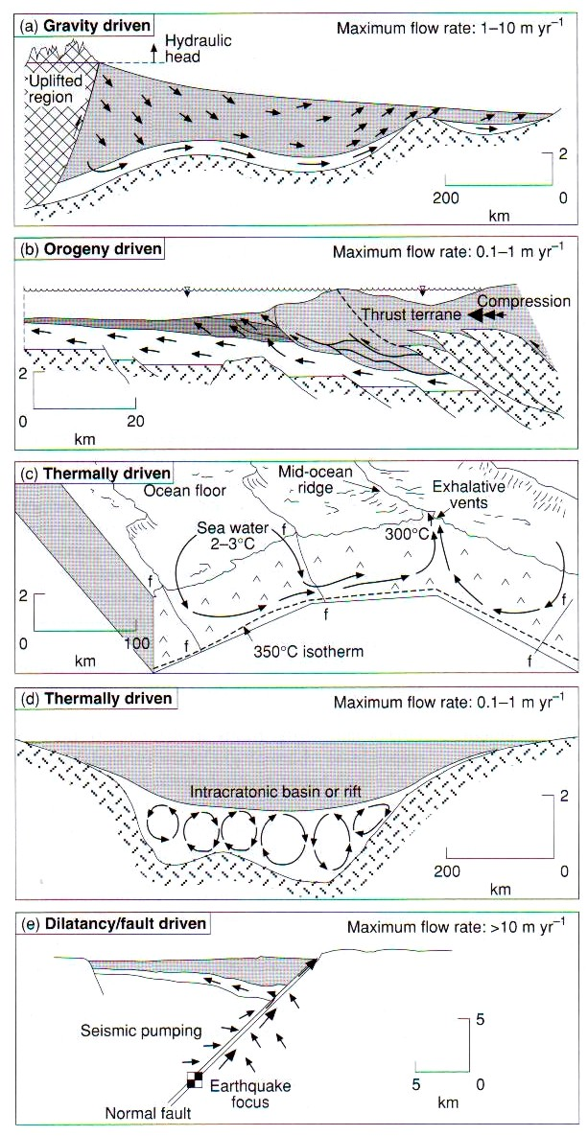

Slide 5
OROGENIC COMPRESSION
DURING OROGENIC COMPRESSION WHICH SQUEEZES FLUID OUT OF ONE PACKAGE OF ROCK INTO CHANNELWAYS (E.G. THRUSTS) OR HIGH PERMEABILITY AQUIFERS IN ANOTHER SUCH ARE BELIEVED TO BE RESPONSIBLE FOR FORMATION OF MVT Pb-Zn ORE PROVINCE IN SOUTHEAST USA

Slide 7
THERMAL GRADIENT
OCEANIC CRUST FLUID FLOWS IN RESPONSE TO THERMAL GRADIENTS FORMED DUE TO HIGH HEAT FLOW CHARACTERISING MID-OCEANIC RIDGES
THERMALLY-DRIVEN CONVECTIVE FLUID FLOW CAN ALSO OCCUR IN CLOSE PROXIMITY TO HIGH CRUSTAL LEVEL MAGMATIC INTRUSIONS
MAY ALSO OCCUR IN DEEP INTRACRATONIC RIFT BASINS WHERE HIGH HEAT FLOW OR FLUID DENSITY GRADIENTS RESULT IN CONVECTIVE FLOW

Slide 9
DILATANCY
LARGE-SCALE FLUID FLOW CAN OCCUR IN ASSOCIATION WITH DILATANCY OF A ROCK MASS THAT ACCOMPANIES FAULTING & SEISMIC RAPTURE
OROGENIC-DRIVEN FLUIDS MAY BE PARTIALLY ASSOCIATED WITH THIS PROCESS

Slide 11
OTHER FORCES
FLUID MIGRATION AT SMALLER-SCALE IS EVIDENCED AT MESOSCALE BY INDIVIDUAL QUARTZ VEINS OR AT MICROSCALE BY FLUID INCLUSION TRACES IN INDIVIDUAL MINERALS
AT THESE SCALES EFFECTIVE FLUID FLOW THROUGH A ROCK IS DETERMINED BY HYDRAULIC CONDUCTIVITY OR THE EXTENT TO WHICH FRACTURES ARE INTERCONNECTED

Slide 12
Permeability
Percolation
Threshold
Fracture Density

Slide 13
EVIDENCE THAT A FLUID HAD ONCE FLOWED THROUGH A ROCK MASS IS PROVIDED BY EITHER:
  ALTERATION OR
  PRESENCE OF VEINS THAT ARE TYPICALLY FILLED WITH QUARTZ OR A CARBONATE PHASE TOGETHER WITH OTHER LESS COMMON GANGUE MINERALS

Slide 14
FRACTURE FILL WILL DEVELOP IN ONE OF THE TWO WAYS:
  BY DIFFUSSION OF SOLIDS FROM THE SURROUNDINGSS & PRECIPITATION WITHIN A FRACTURE OR OPEN SPACE (E.G. VUG)
  BY PRECIPITATION OF MINERALS FROM FLUIDS FLOWING THROUGH A FRACTURE

