Slide 1
VOLCANOGENIC MASSIVE SULPHIDE (VMS) DEPOSITS
O. SIKAZWE

Slide 2
INTRODUCTION
ALSO CALLED VOLCANIC HOSTED MASSIVE SULPHIDE (VHMS) DEPOSITS
IS A FAMILY OF MAINLY Cu-Zn DEPOSITS WITH MINOR Pb & Au
FORMED DURING EPISODES OF MAJOR OROGENESIS THROUGHOUT EARTH HISTORY
FORMED BY METAL PRECIPITATION FROM SEA WATER DOMINATED HYDROTHERMAL FLUIDS CIRCULATING IN VOLCANICALLY ACTIVE ENVIRONMENTS

Slide 3
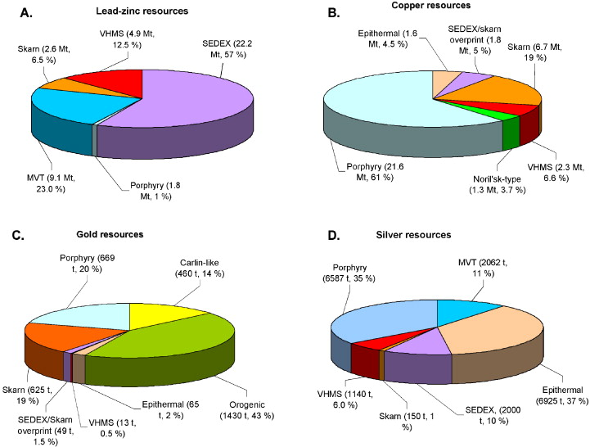
IMPORTANCE OF VMS DEPOSITS
Pb-Zn Resources

Slide 5
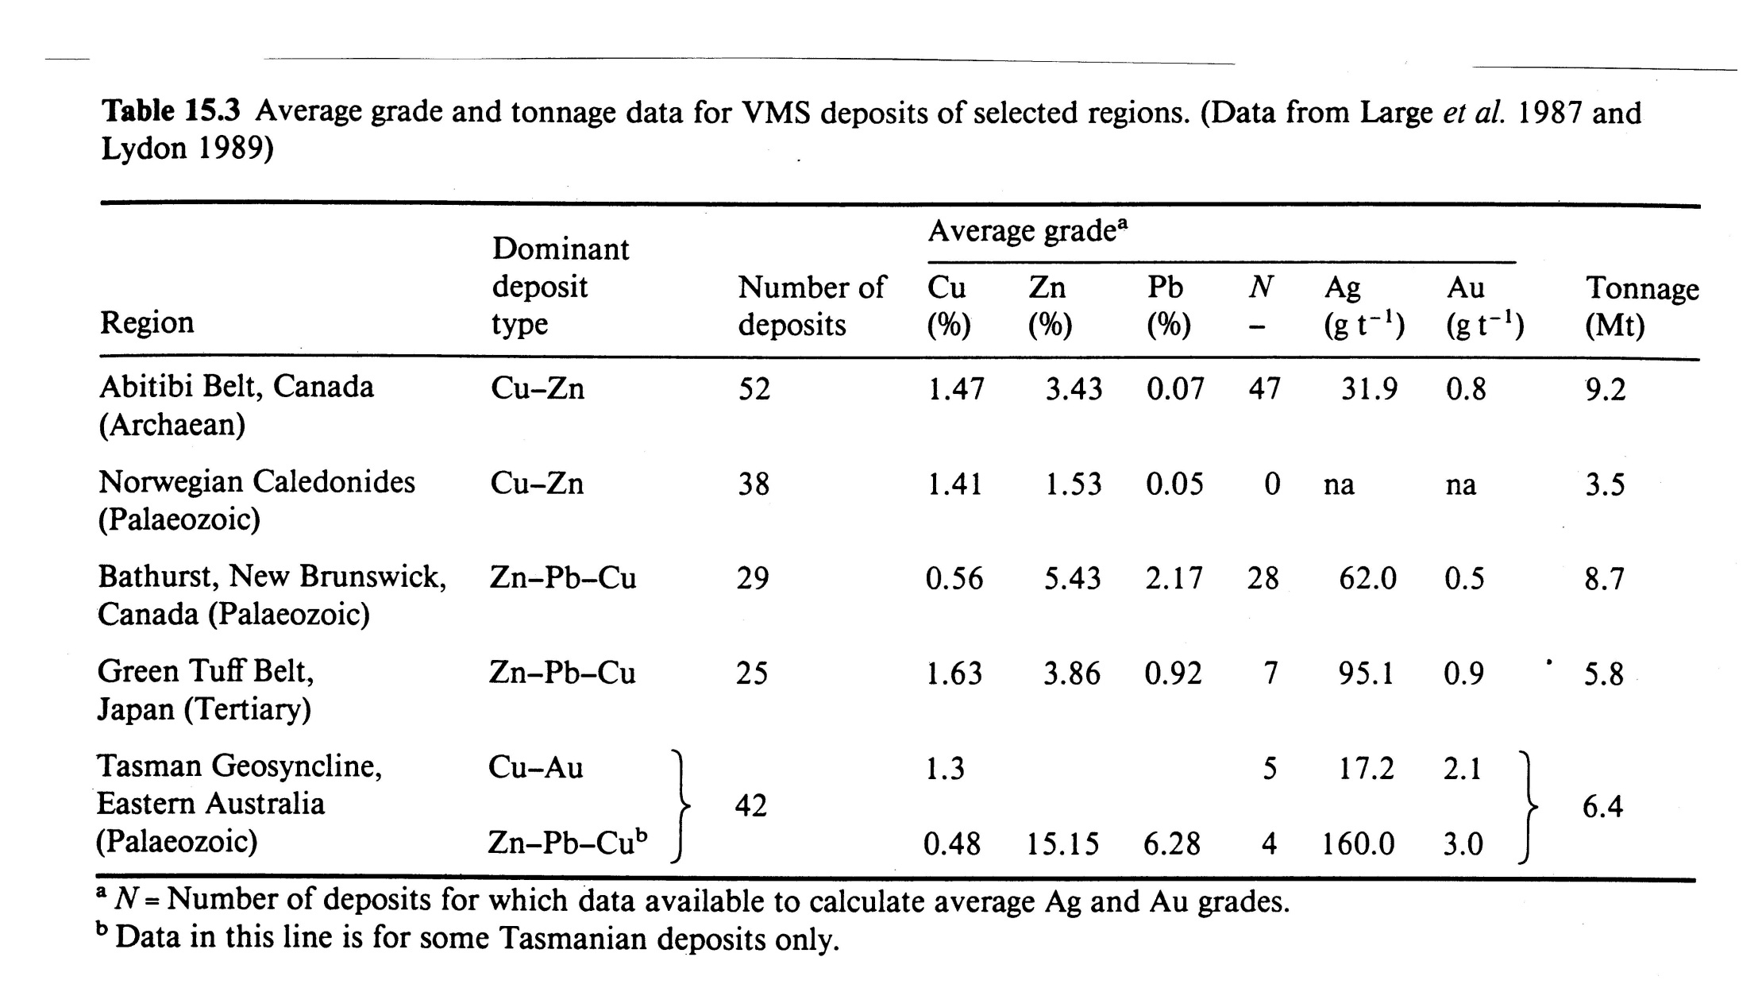

Slide 6
BLACK SMOKERS
A MODERN ANALOGUE TO VMS DEPOSIT FORMATION
ARE HOT (UPTO 400ºC), METAL-CHARGED, REDUCED & SLIGHTLY ACIDIC HYDROTHERMAL FLUIDS THAT VENT ONTO THE SEA FLOOR IN ZONES OF EXTENSION & ACTIVE VOLCANISM ALONG MID-OCEANIC RIDGES
FLUIDS ORIGINATE FROM COLD (2ºC), ALKALINE, OXIDIZING & METAL-DEFICIENT SEA WATER
BY CIRCULATING THROUGH THE BASALTIC OCEANIC CRUST FLUIDS SCAVENGE METALS TO FORM HYDROTHERMAL SOLUTIONS

Slide 7
BLACK SMOKER FLUIDS USUALLY VENT THROUGH TUBE-LIKE STRUCTURES CALLED CHIMNEYS CREATED FROM A MIXTURE OF ANHYDRITE, BARITE & SULPHIDE SUCH AS PYRITE, PYRRHOTITE, CHALCOPYRITE & SPHALERITE & OPALINE SILICA
BS VENTING ALONG MID-OCEANIC RIDGES REPRESENTS A DIRECT ANALOGUE FOR ONE SPECIFIC TYPE OF VMS FAMILY OF DEPOSITS, OPHIOLITE-HOSTED Cu-Zn DEPOSITS SUCH AS THE TROODOS MASSIF IN CYPRUS

Slide 8
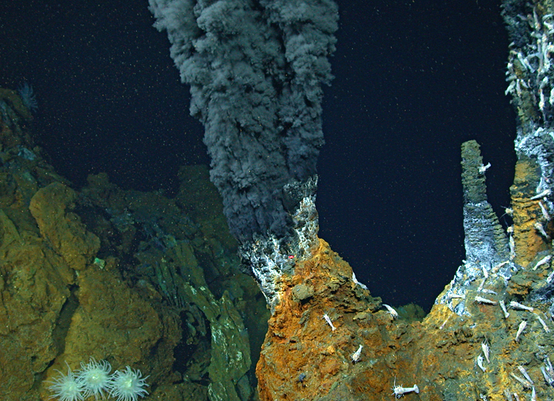
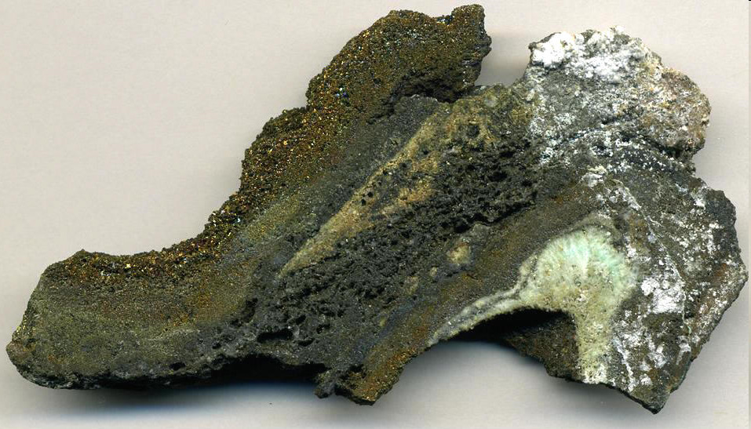
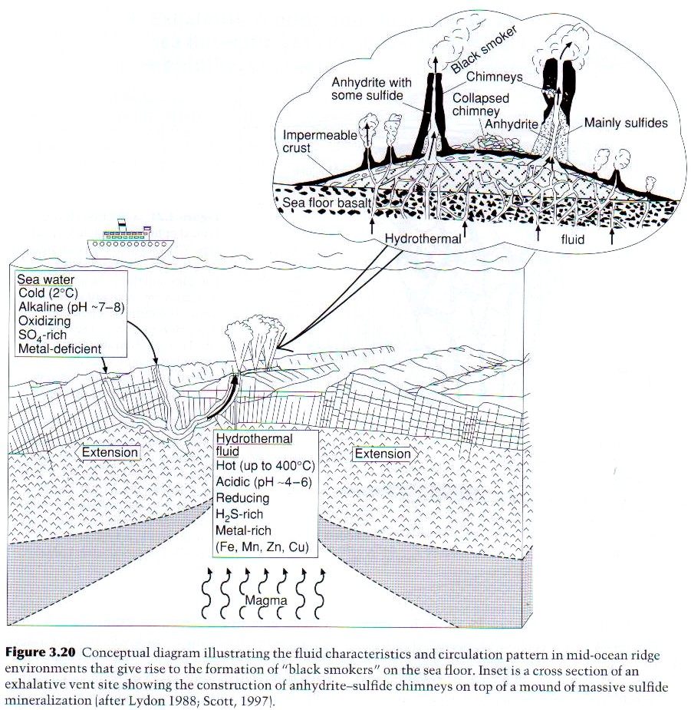
Anhydrite
Chalcopyrite
Pyrite
Sphalerite

Slide 9
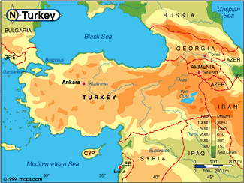

Slide 10
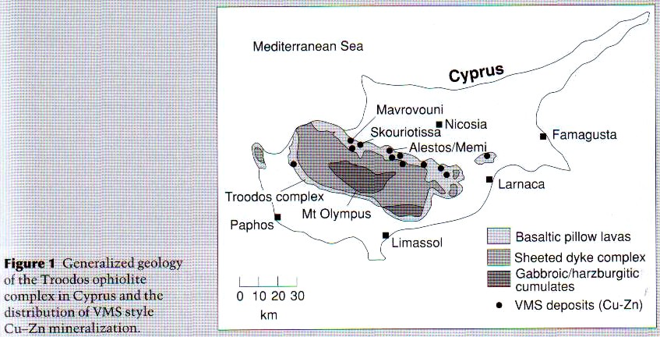

Slide 11
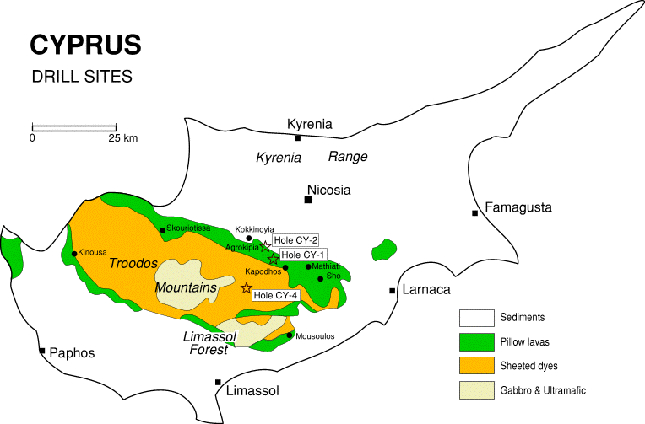
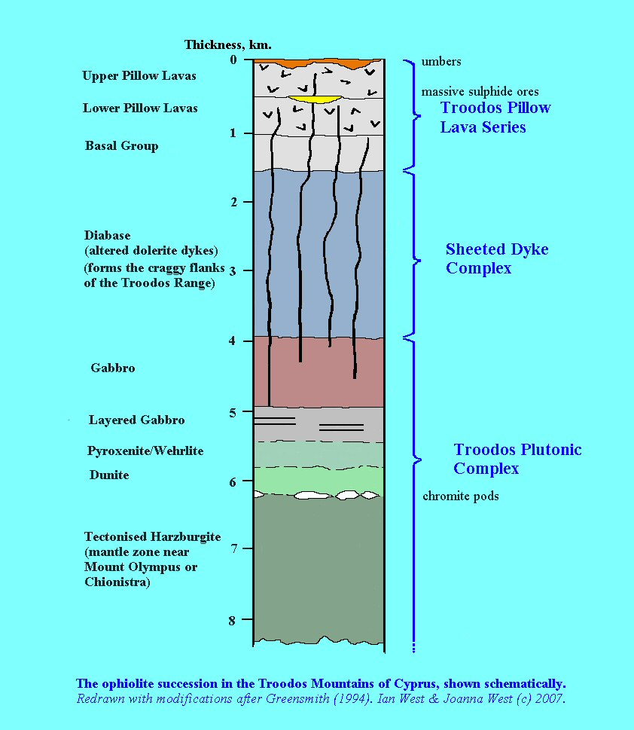
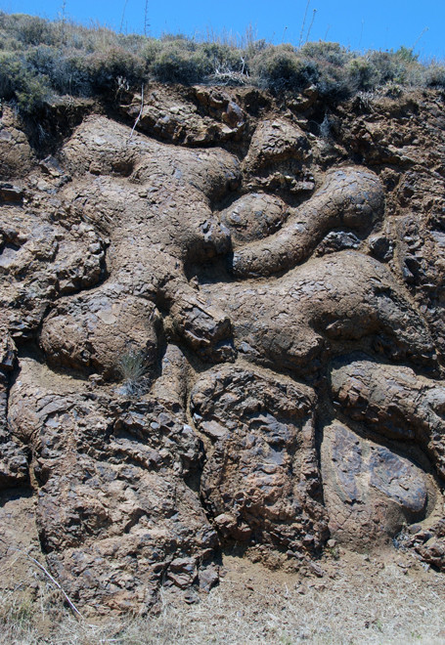
PILLOW LAVAS

Slide 12
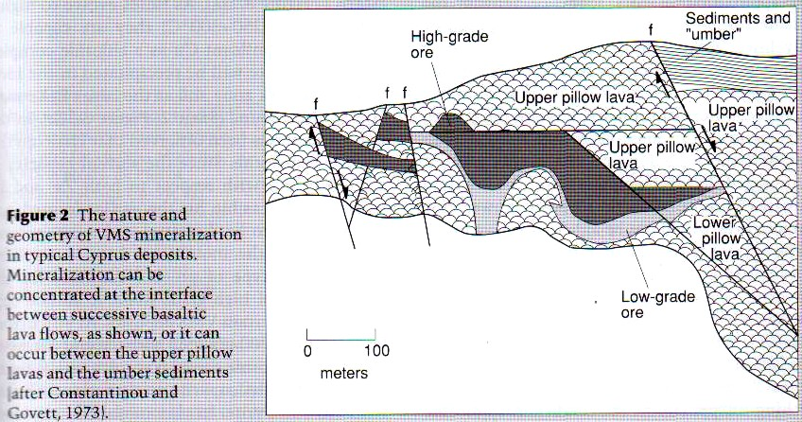

Slide 13
  OPHIOLITE IS A SECTION OF A MID-OCEANIC RIDGE THAT IS PRESERVED BY OBDUCTION ONTO CONTINENTAL MATERIAL & IS CHARACTERISED BY:
    SHEETED DYKE COMPLEX (BOTTOM);
    PILLOWED BASALT; &
    PELAGIC SEDIMENTS (TOP)

Slide 14
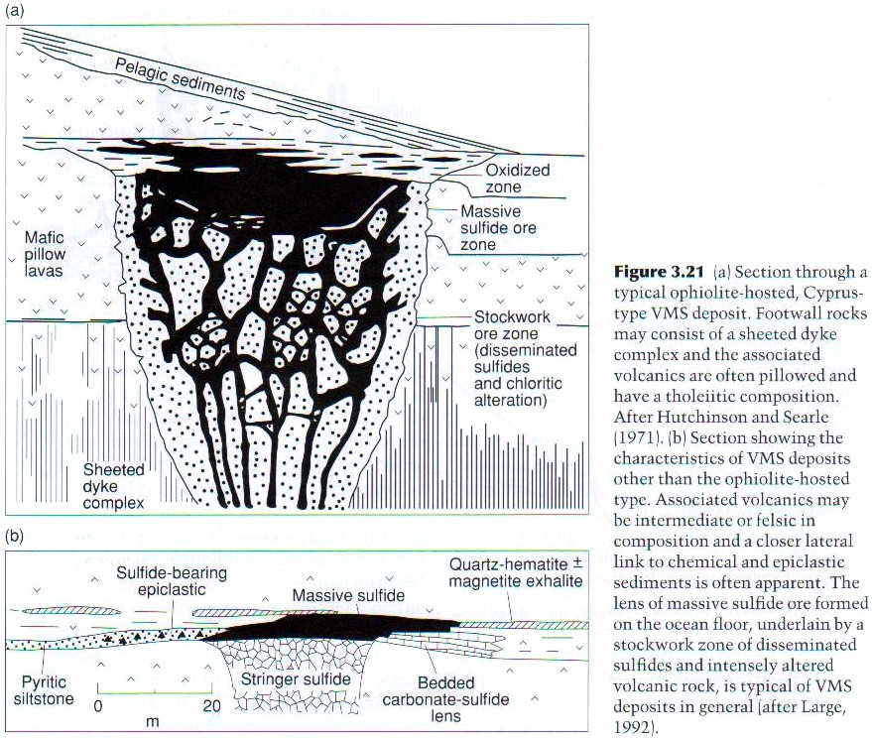

Slide 15
DEPOSIT GEOMETRY
A LENS OF MASSIVE SULPHIDE ORE CONSISTING OF PYRITE, Cp & Sp IS LOCATED AT THE OCEAN-FLOOR INTERFACE
THIS IS UNDERLAIN BY A PIPE-LIKE ZONE OF DISSEMINATED SULPHIDES & INTENSE CHLORITIC ALTERATION REPRESENTING A CONDUIT FOR FLUID FLOW
THIS GEOMETRY IS TYPICAL FOR VMS DEPOSITS DESPITE THEIR FORMATION IN OTHER TECTONIC SETTINGS SUCH AS ISLAND ARCS, BACK-ARC BASINS & FORE-ARC TROUGHS

Slide 16
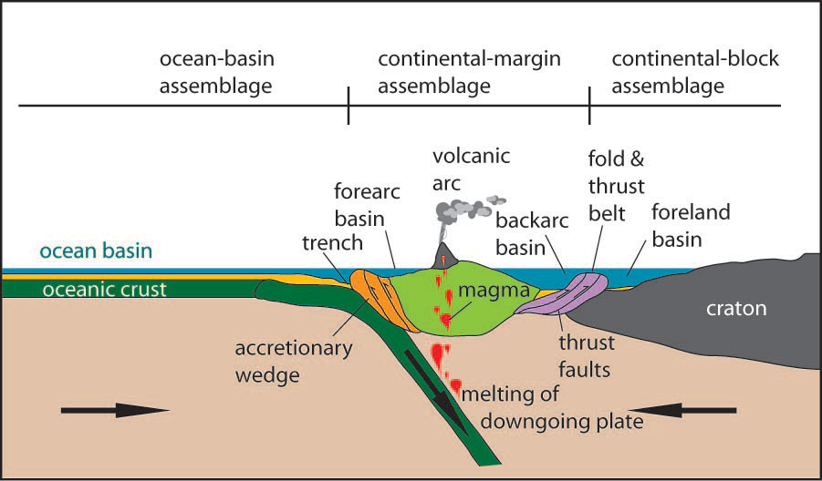

Slide 17
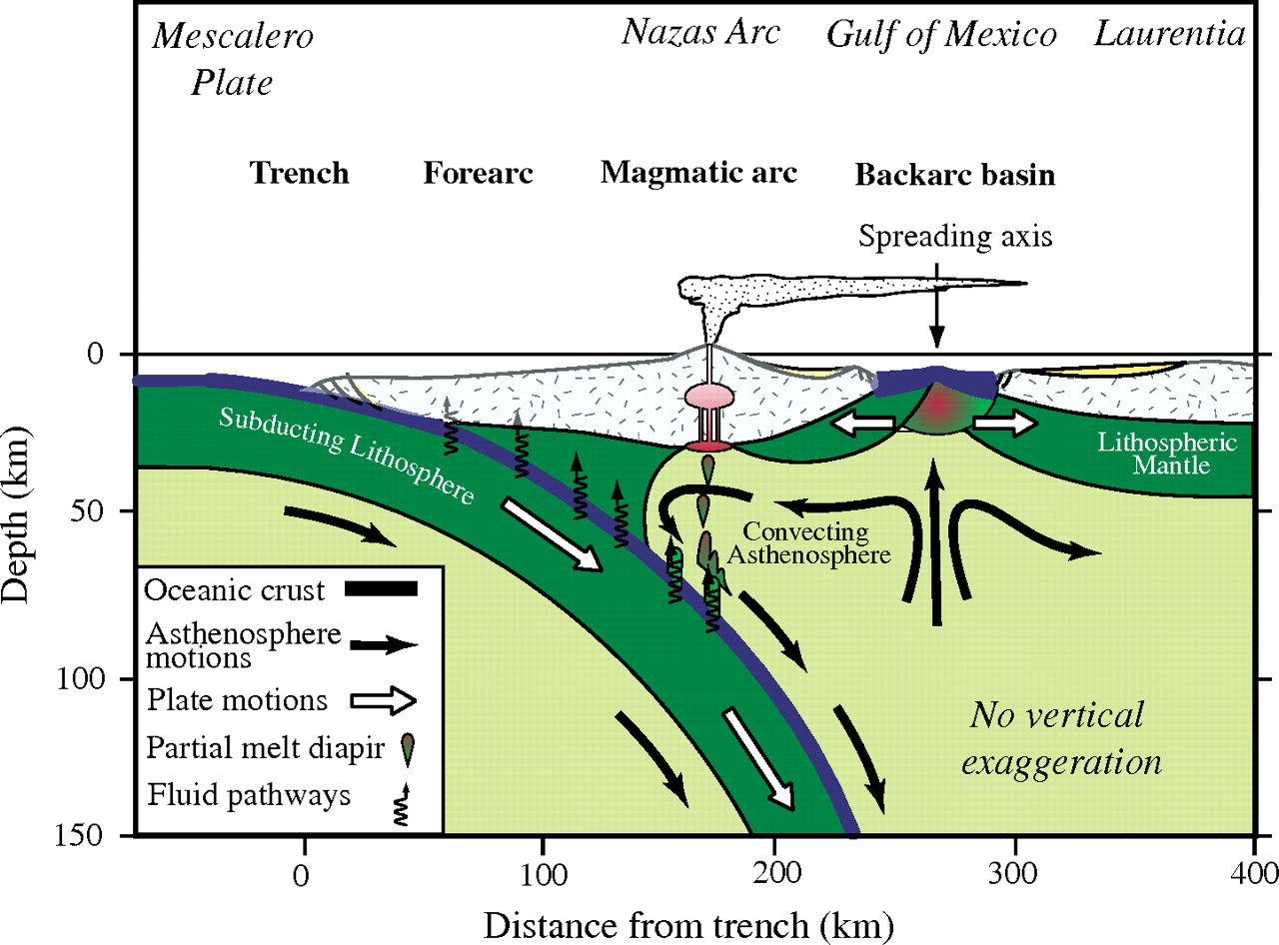

Slide 18
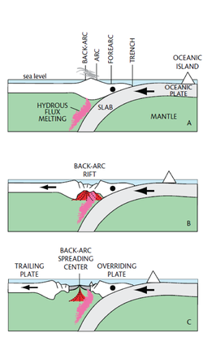

Slide 19
EXAMPLE DEPOSITS
EXAMPLE VMS DEPOSITS ASSOCIATED WITH OTHER TECTONIC SETTINGS INCLUDE:
  GREENSTONE BELT-HOSTED KIDD CREEK & MATTABI DEPOSITS OF CANADA
  JAPANESE ISLAND ARC BESSHI & KUROKO-TYPE DEPOSITS
  THE IBERIAN PYRITE BELT RIO TINTO & NEVES CORVO IN SPAIN & PORTUGAL

Slide 20
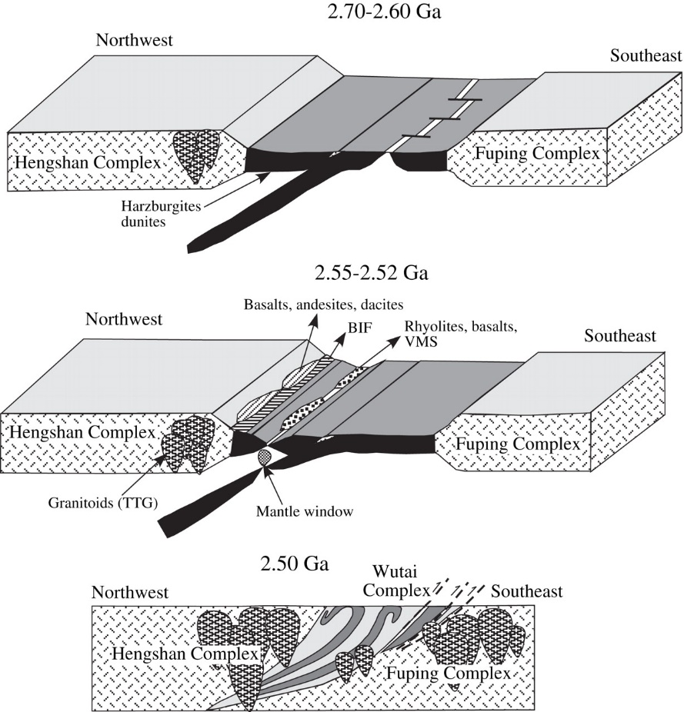
Greenstone belts are zones of variably metamorphosed mafic to ultramafic volcanic sequences with associated sedimentary rocks that occur within Archaean and Proterozoiccratons between granite and gneiss bodies
Greenstone belts have been interpreted as having formed at ancient oceanic spreading centers and island arc terranes

Slide 21
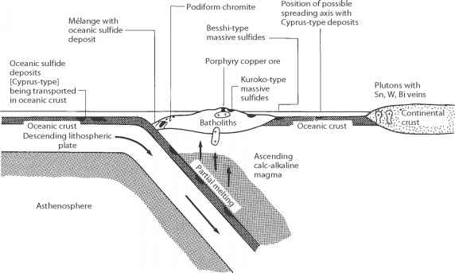

Slide 22
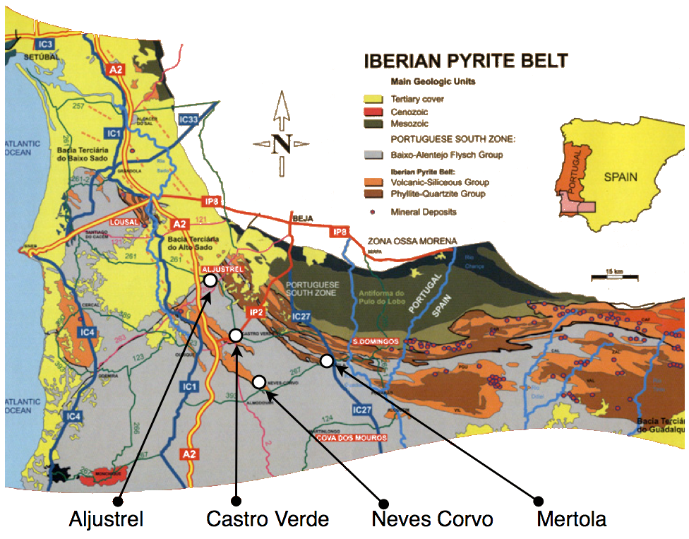
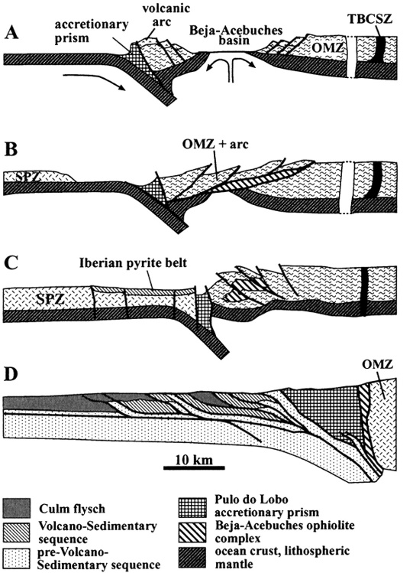
The Iberian Pyrite Belt is a vast geographical area with particular geological features that stretches along much of the south of the Iberian Peninsula, from Portugal to Spain.
It is about 250 km long and 30–50 km wide, running northwest to southeast from Alcácer do Sal (Portugal) to Sevilla (Spain)
The Iberian Pyrite Belt was formed 350 million years ago in the Devonian Period, connected to active and hydrothermal volcanism that led to the formation of a volcanic-sedimentary complex

Slide 23
SOURCE OF FLUIDS, METALS & SULPHUR
FLUIDS ARE MOSTLY DERIVED FROM SEA WATER WITH MINOR INPUT FROM MAGMA
METALS ARE SOURCED FROM MAFFIC VOLCANIC ROCK THROUGH WHICH HOT SEA WATER PASSES
SULPHUR IS SOURCED BY REDUCTION OF SEA WATER SULPHATE TO SULPHIDE DURING FLUID-ROCK INTERACTION BEFORE VENTING
Ended here on 16-07-19

Slide 24
METAL ZONATION
VMS DEPOSITS ARE CHARACTERISED BY A WELL DEVELOPED ZONATION DEFINED BY A SEQUENCE FROM Fe TO Fe-Cu TO Cu-Pb-Zn TO Pb-Zn-Ba BOTH VERTICALLY & LATERALLY
THIS SEQUENCE REFLECTS THE VARIABLE SOLUBILITIES OF METALS AT PROGRESSIVELY LOWER T
DEVELOPMENT OF THIS ZONATION IS HOWEVER MORE COMPLEX & REFLECTS:
  EVOLUTION OF FLUIDS
  GROWTH MECHANISM OF SULPHIDES MOUND WITH TIME

Slide 25
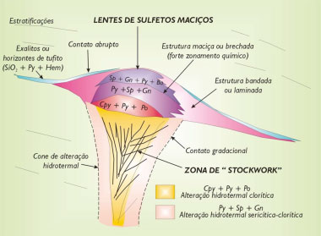

Slide 26
TRANSPORT MECHANISMS
LOW T FLUIDS WOULD NOT PROMOTE DISSOLUTION OF MUCH BASE METALS THOUGH SUCH FLUIDS COULD TRANSPORT SULPHATE COMPLEXES & PRECIPITATE ANHYDRITE OR BARITE ON MIXING WITH SEA WATER (“WHITE SMOKERS”)
AT Ts OF ABOUT 250ºC SOLUBILITIES OF Pb & Zn AS CHLORIDE COMPLEXES WOULD BE HIGH REACHING 100 ppm
AS FLUIDS EVOLVE TO HIGHER Ts (250 – 300ºC) THEY ARE CAPABLE OF CARRYING SIGNIFICANT AMOUNTS OF Cu AS A CHLORIDE COMPLEX & PRECIPITATE Cp IN THE FOOTWALL STOCKWORK ZONE & AT THE BASE OF MASSIVE SULPHIDE MOUND

Slide 27
AT STILL HIGHER Ts (300-350ºC) Cu & Au ARE IN SOLUTION AS CHLORIDE COMPLEXES PRODUCING Cp PRECIPITATION WITH Au & PYRITE
BIOLOGICALLY MEDIATED PRECIPITATION MECHANISM E.G. INVOLVING SULPHIDE-REDUCING BACTERIA IN EXHALATIVE VENT PROCESSES ARE LIKELY TO BE IMPORTANT FACTORS IN FORMATION OF VMS DEPOSITS

Slide 28
VMS DEPOSIT MODEL

Slide 29
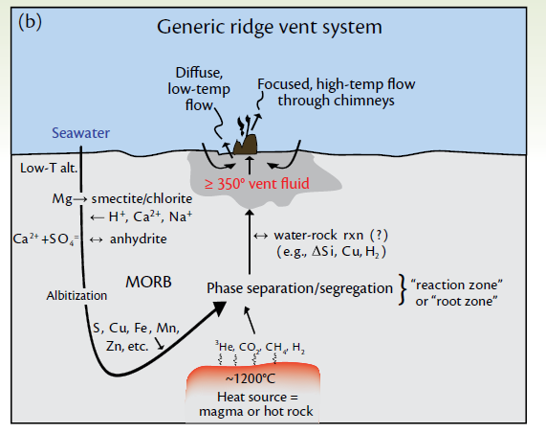

Slide 30
MINERALOGY & CHEMICAL DATA

Slide 31
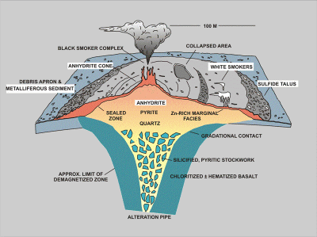

Slide 32
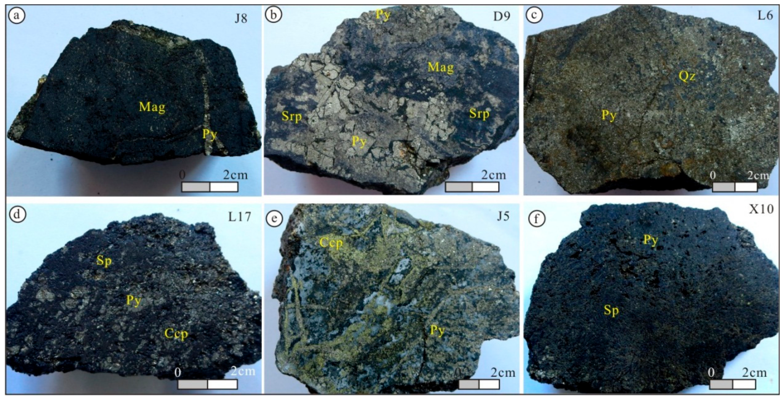

Slide 33
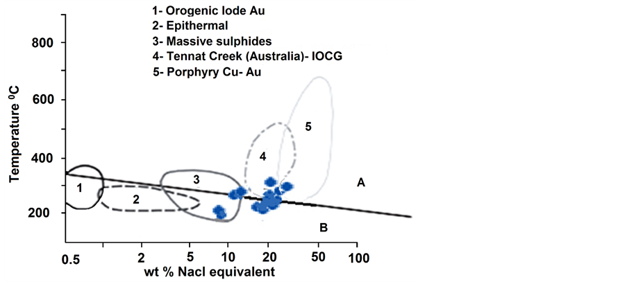

Slide 34
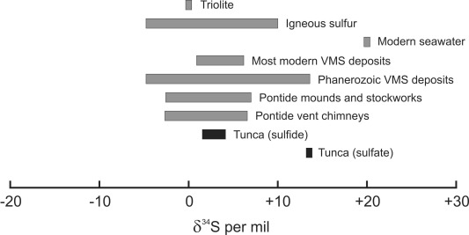

Slide 35
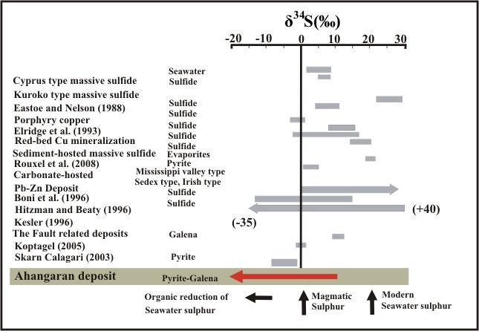

Slide 36
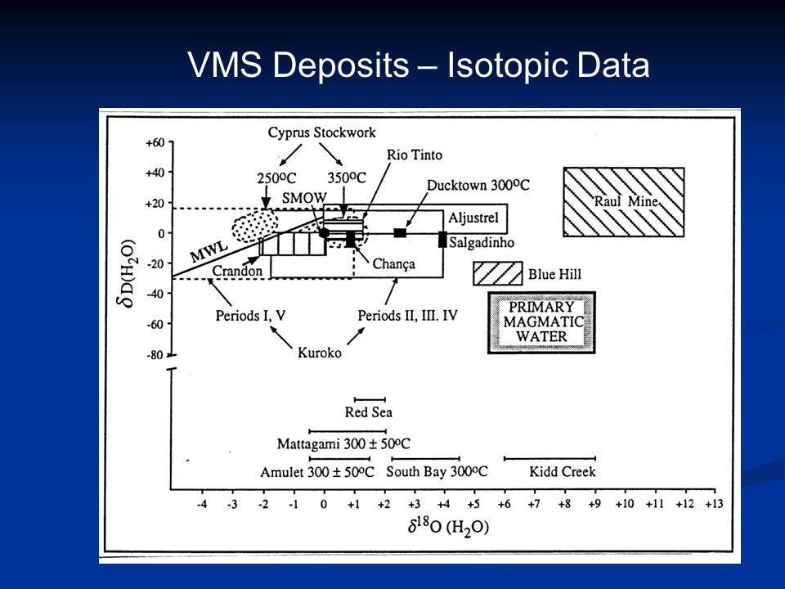

Slide 37
MODEL
VMS DEPOSITS ARE SOURCES OF MAINLY Pb & Zn & TO LESSER EXTENT Cu & Au
VMS DEPOSITS ARE OF HYDROTHERMAL ORIGIN

Slide 38
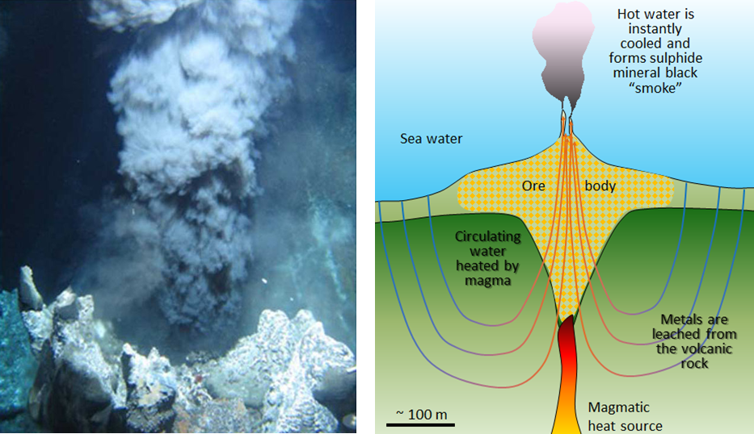

Slide 39
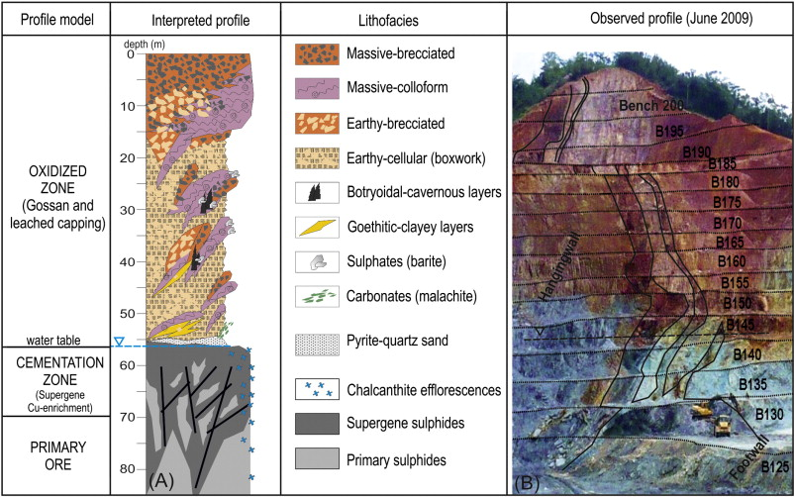

Slide 40
EXPLORATION METHODS
Electromagnetics (both airborne and ground) because of contracts in conductivity between massive sulphides and the host rocks

