Slide 1
INTRODUCTION TO THE GENERAL GEOLOGY OF ZAMBIA

Slide 2
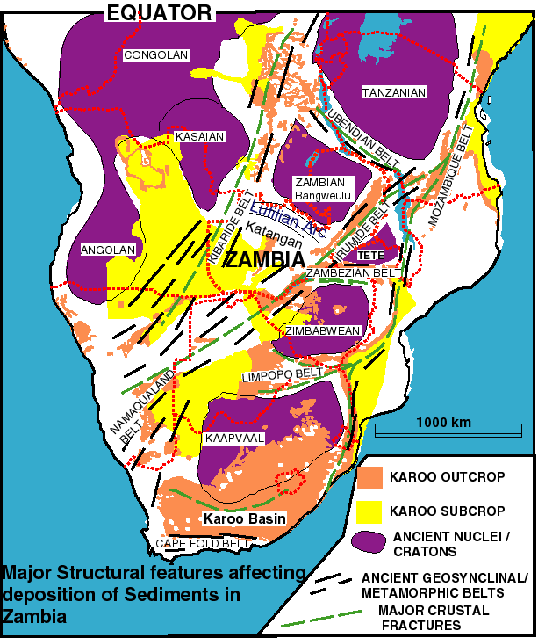
1. GENERAL GEOLOGY

Slide 3
Stratigraphy
1. Geology is complex but reflect the multiplicity of tectonic events which has resulted from its position within the Kasai, Zimbabwe-Kaapvaal & Tanzania cratons
2. Differential movements between these stable blocks & their buttressing effects played an important role in the GEOLOGICAL EVOLUTION of the country
These effects also played a part in the GENESIS of the country’s mineral & energy resources

Slide 4
Oldest succession is Basement Supergroup (3000 -1800 Ma), which consist mainly:
1. Granitic gnesses and migmatites which occur in Eastern, Central, & Southern Zambia
2. In places in-folded with meta-Carbonate, Quartizite, and meta-pelite units

Slide 5
Next succession is Muva Supergroup (1800 -1100 Ma) with a Tectonized Contact with Basement & consist mainly:
1. In folded sequence of meta-pelites & quartzites forming the core of the Irumide Belt
2. These sequence also form a major component of the Zambezi Belt south and east of Lusaka
3. Over the Bangweulu Block - Mporokoso Group (5km thick) - continental sediments of rudites, arenites, quartzites and argillites
4. Overlain by Kasama Formation - which are quartzites, hematitic sandstones, mudstones & minor conglomerates.

Slide 6
Katanga Supergroup (1000 - 450 Ma), which overlies Basement & Muva Sequences with an Angular Unconformity & consist mainly:
1. Mine Series and Kundelungu Groups exposed on Zambian Copperbelt, North-Western Zambia & also occur within the Zambezi Belt south & east of Lusaka
2. Mine Series Group hosts the Copper -Cobalt mineralisation of the Copperbelt

Slide 7
3. Group deposited by a marine incursion across a deeply dissected continental landscape divided into TWO.
Lower Roan Fm; Conglomerates, aelian Sandstones, followed by Siliciclastic sediments, then argillites, dolostones and arenites.
Upper Roan Fm; dolomite - argillite sequence succeded by carbonaceous shales, argillite & minor Carbonate rocks of Mwashia Fm

Slide 8
Kundelungu Group, after a hiatus of 100 Ma followed by a period of glaciation & deposition of a Tillite at the base - Grand Conglomerat:
Followed by thick Sequence of dolomitic limestones, shale, another tillite & fine shale unit.
KATABA Group: poorly known & defined (Ordovician - Silurian) - intersected by boreholes below KAROO. Consists of:
Unmetamorphosed marine sandstones & mudstones
KAROO SUPERGROUP (Late Carboniferous to Early Jurassic)

Slide 9
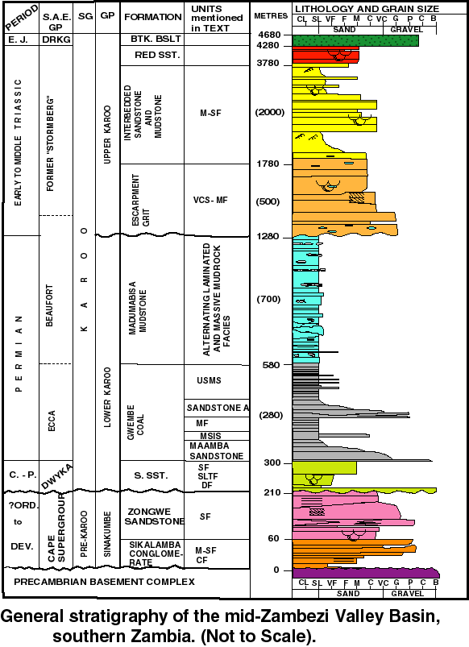

Slide 10
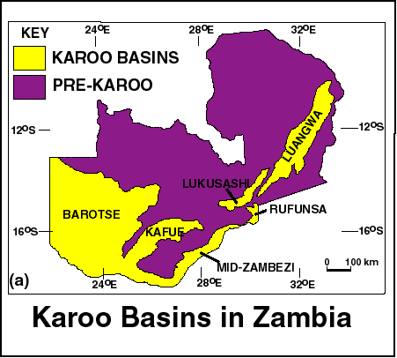

Slide 11
KALAHARI Group, which consists of 100m of continental sandstones and mudstones of Cretaceous Age - mostly in Western Zambia and within the mid-Zambezi Valley
Followed by aeolian sands and epiclastic sediments of Quaternary to Present Age

Slide 12
TECTONIC EVENTS
UBENDIAN OROGENY: c2000-1800 Ma
Generated the NW-SE trending fold belt of high grade metamorphic rocks that demarcates the north-eastern margin of the Bangweulu Block
IRUMIDE OROGENY: 1350- 1100 Ma
Generated the NE-SW to east, north-east trending extensive folding and shearing of Basement & Muva Rocks in Central & Eastern Zambia.

Slide 13
LOMAMIAN AND LUFILIAN OROGENIES: c 950-450 Ma (Broadly termed Pan-African Orogeny)
represents a complex series of tectonic and thermal events which led to the NW-SE trending fold belt of high TWO structural domains:
The Lufilian Arc and the Zambezi-Mozambique Belts separated by the Mwembeshi Shear Zone
KAROO RIFTING associated with the break-up of Gondwanaland during PERMIAN followed by opening of the proto-Indian Ocean in the Jurassic
RIFTING related to the development of the East African Rift system in the Cretaceous and early Tertiary times
ALL this RIFTING led to the eruption of the Karoo Batoka Basalts

Slide 14
These events gave rise to wide SPECTRUM of MINERAL & ENERGY RESOURCES

