Slide 1
soils
One of the major products of chemical weathering are soils. Soils are composed of air, water, mineral material, organic material and organisms. Soils consist of materials derived from the four major spheres of the earth
Soils are affected by a number of cycles that operate in the environment such as carbon cycle, moisture cycle, nitrogen cycle, oxygen cycle, mineral cycle. Soils are layered. A soil horizon is a distinct layer. A set of soil horizons form a soil profile.

Slide 2
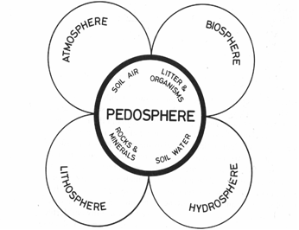
Components of the pedosphere

Slide 3
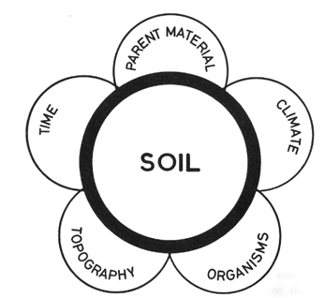
FACTORS OF SOIL FORMATION

Slide 4
Composition of Some parent materials

Slide 5
Climate
Climate determines the rate and extent of soil forming processes. Climate is the major factor that controls the type and rate of soil formation. Important aspects of climate are precipitation and temperature. Temperature controls the rate of development of soils. The movement of moisture results in chemical reactions and the differentiation of horizons.

Slide 6
ORGANISMS
The development of soils is affected by living organisms such as higher plants, vertebrates, microorganisms and mesofauna.
Higher plants influence soil development through: (1) the binding effect of their roots, (2) opening of passages in the soil that facilitate the movement of air and water and (3) addition of organic matter to the soil surface.

Slide 7
Mammals that burrow deeply into the soil cause considerable mixing of topsoil and subsoil. Uncontrolled grazing by animals such as goats tends to destroy vegetation and promote soil erosion.
Microorganisms (bacteria, fungi, actinomycetes, algae and viruses) are important in humification (the decomposition of organic matter in soils) and nitrogen transformation processes.

Slide 8
Mesofauna include earthworms, nematodes, mites, millipedes, gastropods and insects. These are concentrated in the top 2 to 5 cm. The mesofauna are useful in the ingestion and decomposition of organic matter. Termites transport soil matter from depth to the ground surface.

Slide 9
TOPOGRAPHY
Topography controls the rate of flow of water and depth of development of the soil. The thickness of soil varies with topography. Thick soils are associated with flat or gently sloping sites while thin soils develop on steep slopes due to high rate of soil erosion. Topography also influences drainage and the amount of moisture in the soil.

Slide 10
TIME FACTOR
Soil formation is a very long and slow process requiring thousands to millions of years. Most soils have developed in the last 100 million years. Most soils have been affected by successive waves of pedogenesis.

Slide 11
SOIL FORMING PROCESSES
The types of processes that are involved in the development of soil include chemical processes, physical processes and biological processes.
Chemical processes: hydration, hydrolysis, solution, oxidation, ion exchange and reduction. Physical processes:translocation, aggregation, expansion and contraction. Biological processes: humification, ammonification, nitrification, nitrogen fixation and translocation of material from one place to another.

Slide 12
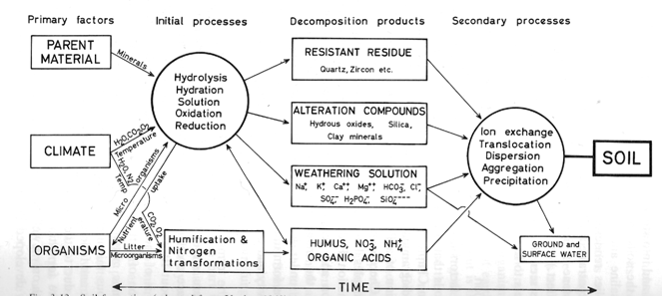
SOIL FORMING PROCESSES AND FACTORS

Slide 13
These processes combine with the other factors to form the very wide range of soils that occur on the surface of the earth. The soil forming processes contribute to the geochemical evolution of groundwater.

Slide 14
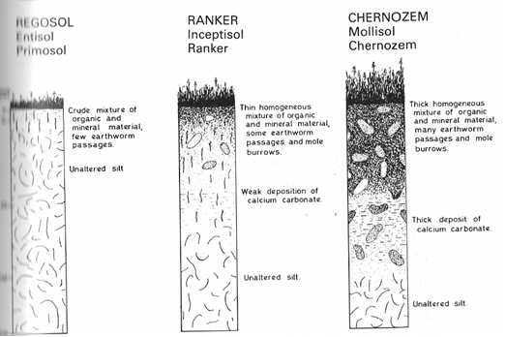
STAGES IN THE FORMATION OF SOILS

Slide 15
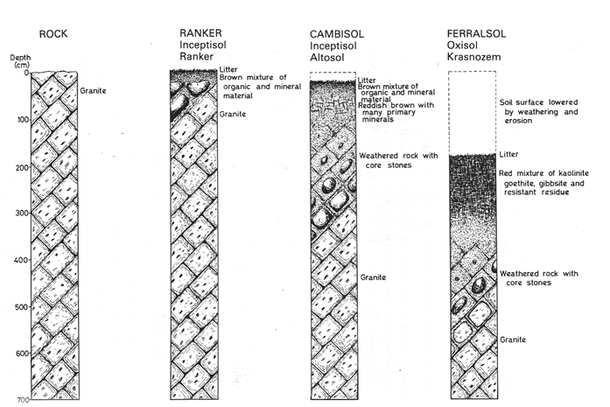
STAGES IN THE FORMATION OF A FERRASOL

Slide 16
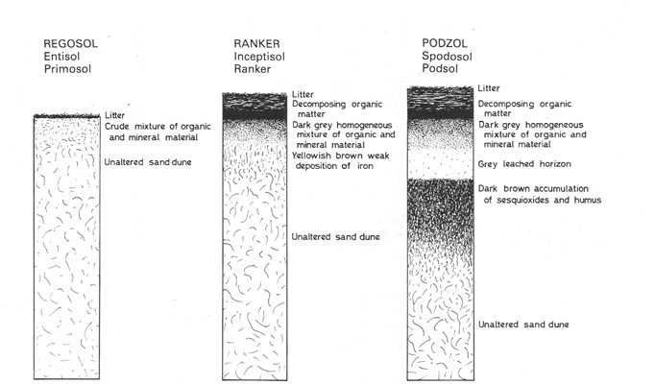
STAGES IN THE FORMATION OF A PODZOL

Slide 17
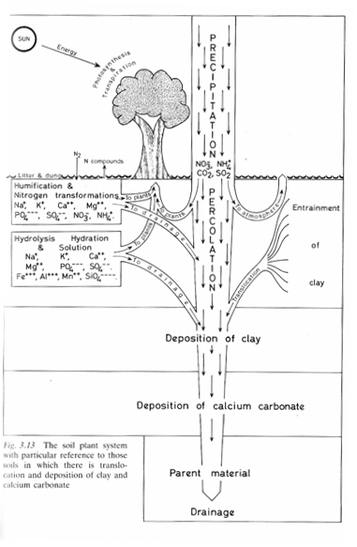
SOIL FORMING PROCESSES

Slide 18
Formation of Soil Profiles
The development of a soil profile is the result of vertical movement of material in solution and suspension, accompanied by a complex series of chemical reactions. This transfer and reconstitution takes place in water. Most well developed soil profiles (fig. 7.2) can be divided into four principal horizons (A, B, C, R). A and B constitute the true soil or solum. The C horizon is the partly weathered parent material from which the soil has been derived by soil forming processes.

Slide 19
The R horizon is the underlying rock material. A horizon of purely organic matter (O or AO) may lie above the A horizon. In detailed studies each of the major divisions may be further subdivided. The distribution of metals may vary markedly with major changes down the profile. It is therefore necessary to distinguish the master horizons during geochemical prospecting operations in the field.

Slide 20
Soil profiles are important objects of investigation in geochemical prospecting. The mobility of the metals that are contained in parent materials varies during the development of the soil horizons. Metals contained in resistant minerals tend to accumulate in the A horizon. The soluble metals and those adsorbed on colloidal particles tend to migrate to B horizon and accumulate along with Fe- and Mn-oxides or clays in this horizon.

Slide 21
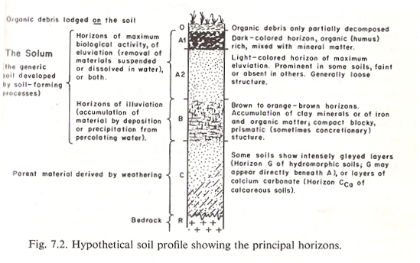
HYPOTHETICAL SOIL PROFILE

Slide 22
CLASSIFICATION OF SOILS
Various classification schemes have been developed by soil scientists.
The unified soil classification scheme
USA soil taxonomy system
Old classification scheme. In the old classification scheme three categories of soils may be distinguished, azonal, zonal and intrazonal. Zonal soils are characterized by the presence of a mature soil profile. The characteristics of zonal soils are determined mainly by climate and vegetation. Zonal soils include podzols, chernozems, latosols (ferralsols) and desert soils. In the intrazonal soils a local condition such as drainage is the dominant influence on the character of the soil. A good example are hydromorphic soils (waterlogged soils) in humid regions that are characterised by the presence of mottled gley horizons (reducing subsurface zones). In arid regions low or poorly drained areas develop saline soils.

Slide 23
AZONAL SOILS
In azonal soils the nature of the soil is determined mainly by the parent material and only incipient horizons are present. Representatives of this group include immature soils developed on recent alluvium, volcanic ash, wind-blown sands, and shallow bedrock. Azonal soils include lithosols, regosols and alluvial soils.

Slide 24
ZONAL SOILS
Zonal soils are characterized by the presence of a mature soil profile. The characteristics of zonal soils are determined mainly by climate and vegetation. Zonal soils include podzols, chernozems, latosols (ferralsols) and desert soils.

Slide 25
INTRAZONAL SOILS
In the intrazonal soils a local condition such as drainage is the dominant influence on the character of the soil. A good example are hydromorphic soils (waterlogged soils) in humid regions that are characterised by the presence of mottled gley horizons (reducing subsurface zones). In arid regions low or poorly drained areas develop saline soils.

Slide 26
PROPERTIES OF SOILS
position and thickness of horizons
Mineral composition
Texture
Colour
Structure
Coatings
Density
pH
Organic matter
Cation exchange capacity
Soluble salts
Carbonates
Elemental composition
Concretions

Slide 27
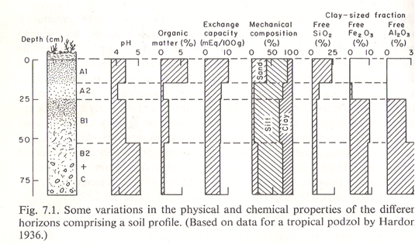

Slide 28
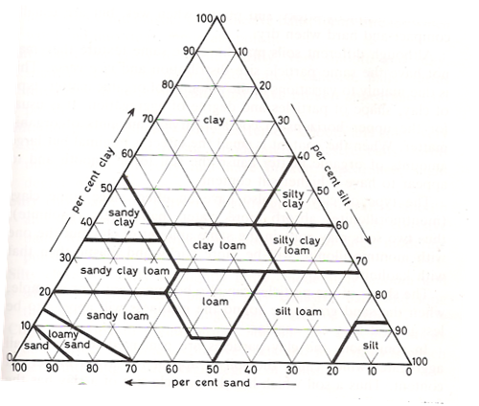
SOIL TEXTURE

Slide 29
pH classification of soil
extremely acid <4.5
very strongly acid 4.5-5.0
strongly acid 5.0-5.5
moderately acid 5.5-6.0
slightly acid 6.0-6.5
Neutral 6.5-7.3
Slightly alkaline 7.3-7.8
Moderately alkaline 7.8-8.5
Strongly alkaline 8.5-9.0
Very strongly alkaline >9.0

Slide 30
MOST IMPORTANT PROPERTIES OF SOILS
The properties of greatest importance that affect geochemical dispersion of the elements are pH, organic matter content, clay mineral type and assemblage, and the amount of Fe-Al-Mn-oxides.

Slide 31
Elemental composition of soils
The chemical composition of soils is of great interest to Soil fertility scientists, environmental geochemists and exploration geochemists. Most of applied geochemical laboratories are preoccupied with analysis of soil samples for information on environmental quality and mineralization potential.
Soil Fertility
This largely depends on the concentrations of the nine macroelements (C, H,O, N, P, K, Ca, Mg, S) and eight microelements (Mn, Cu, Zn, Mo, B, Cl, Fe, Co) in the soil.

Slide 32
The geochemist is concerned with the distribution of both major and trace elements in soils. The major element geochemistry of soils can give us information on the extent of chemical weathering and mobilization of elements during soil formation. The major elements that are measured in soil samples include Si, Al, Fe, Na, K, Ca, Mg, Mn, Ti, Zr, N and P. The major element composition of some soils is given in table 2.

Slide 33
In geochemical exploration and environmental surveys the concentration of some trace elements is very important. Knowledge of the normal or background contents of trace elements in soils (fig. 8) is essential to the applied Geochemist. The concentration of trace elements in soils of the USA was investigated by Connor and Shacklette (1975). The results of this study suggested that wide variations in background content occur for some trace elements in soils (table 3). Trace elements tend to be concentrated in soil horizons that are rich in organic matter or clay minerals.

Slide 35
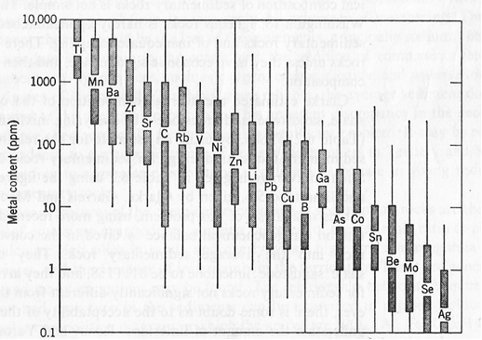
DISTRIBUTION OF ELEMENTS IN SOILS

