Slide 1
COMPOSITION OF THE EARTH MATERIALS
Table 1 Abundance of elements in average crustal rocks (ppm). Source: Rose et al (1979)
Element Abundance Element Abundance
Aluminium 81000 Mercury 0.02
Antimony 0.1 Molybdenum 1.5
Arsenic 2 Nickel 75
Barium 580 Niobium 20
Beryllium 2 Oxygen 473000
Bismuth 0.1 Palladium 0.01
Boron 8 Phosphorus 900
Bromine 1.8 Platinum 0.005
Cadmium 0.1 Potassium 25000
Calcium 33000 Rhenium 0.0006
Carbon 230 Rubidium 150
Cerium 81 Scandium 13
Cesium 3 Selenium 0.1
Chlorine 130 Silicon 291000

Slide 2
COMPOSITION OF THE EARTH MATERIALS
Chromium 100 Silver 0.05
Cobalt 25 Sodium 25000
Copper 50 Strontium 300
Fluorine 600 Sulphur 300
Gallium 26 Tantalum 2
Germanium 2 Tellurium 0.002
Gold 0.003 Thallium 0.45
Hafnium 3 Thorium 10
Indium 0.1 Tin 2
Iodine 0.15 Titanium 4400
Iron 46500 Tungsten 1
Lanthanum 25 Uranium 2.5
Lead 10 Vanadium 150
Lithium 30 Zinc 80
Magnesium 17000 Zirconium 150
Manganese 1000

Slide 3
Table 2 Chemical composition of igneous and sedimentary rocks
Element, Z Ultramafic Basalt High- Ca Granite Low- Ca Granite Shale Sandstone Carbonate Rocks Deep- Clay
3 Li 0.5 26 24 40 66 15 5 57
4 Be 0.2 0.7 2 3 3 - - 2.6
5 B 2 5 9 10 100 35 20 230
9 F 100 385 520 850 740 270 330 1300
11 Na (%) 0.49 1.87 2.84 2.85 0.96 0.33 0.04 4
12Mg (%) 23.2 4.55 0.94 0.16 1.50 0.70 4.70 2.10
13 Al (%) 1.2 8.28 8.20 7,20 8 2.50 0.42 8.40
14 Si (%) 19.8 23.5 31.40 34.70 7.30? 36.80 2.40 25
15 P 195 1130 920 600 700 170 400 1500
16 S 200 300 300 300 2400 240 1500 1300
17 Cl 45 55 130 200 180 10 150 12000
19 K (%) 0.017 0.83 2.52 4.20 2.66 1.07 0.27 2.50
20 Ca(%) 1.6 7.2 2.53 0.51 2.21 3.91 30.23 2.90
21 S 10 27 14 7 13 1 1 19
22 Ti 300 11400 3400 1200 4600 1500 400 4600
23 V 40 225 88 44 130 20 20 120
24 Cr 1800 185 22 4.1 90 35 11 90
25 Mn 1560 1750 540 390 850 - 1100 6700
26 Fe(%) 9.64 8,60 2.96 1.42 4.72 0.98 0.33 6.50

Slide 4
Table 2 Chemical composition of igneous and sedimentary rocks
27 Co 175 47 7 1 19 0.3 0.1 74
28 Ni 2000 145 15 4.5 68 2 20 225
29 Cu 15 94 30 10 45 - 4 250
30 Zn 40 118 60 39 95 16 20 165
31 Ga 1.8 18 17 17 19 12 4 20
32 Ge 1.3 1.4 1.3 1.3 1.6 0.8 0.2 2
33 As 0.8 2.4 1.9 1.5 13 1 1 13
34 se 0.05 0.05 0.05 0.05 0.6 0.05 0.08 0.17
35 br 0.8 3.3 4.5 1.3 4 1 6.2 70
37 Rb 11 38 110 170 140 60 3 100
38 sr 5.5 452 440 100 300 20 610 180
39 Y _ 21 35 40 26 40 30 90
40 Zr 38 120 140 175 160 220 19 150
41 Nb 9 20 20 21 11 - 0.3 14
42 Mo 0.3 1.5 1 1.3 2.6 02 0.4 27

Slide 5
Element, Z Ultramafic Basalt High- Ca Granite Low- Ca Granite Shale Sandstone Carbonate Rocks Deep- Clay
47 Ag 0.05 0.11 0.051 0.037 0.07 0.01 0.01 0.11
48 Cd 0.05 0.21 0.13 0.13 0.3 - 0.035 0.42
49 In 0.012 0.22 - 0.26 0.1 - - 0.08
50 Sn 0.5 1.5 1.5 3 6 0.1 0.1 1.5
51 Sb 0.1 0.6 0.2 0.2 1.5 0.01 0.2 1
53 I 1.3 0.5 0.5 0.5 2.2 1.7 1.2 0.05
55 Cs 0.1 1.1 2 4 5 0.1 0.1 6
56 Ba 0.7 315 420 840 580 10 10 2300
57 La 1.3^{c} 6.1^{d} 45 55 92 30 1 115
58 Ce 3.5^{c} 16^{d} 81 92 59 92 11.5 345
59 Pr 0.49^{c} 2.7^{d} 7.7 8.8 5.6 8.8 1.1 33
60 Nd 1.9^{c} 14^{d} 33 37 24 37 4.7 140
62 Sm 0.42^{c} 4.3^{d} 8.8 10 6.4 10 1.3 38
63 Eu 0.14^{c} 1.5^{d} 1.4 1.6 1 1.6 0.2 6
64 Gd 0.54^{c} 6.2^{d} 8.8 10 6.4 10 1.3 38
65 Tb 0.12^{c} 1.1^{d} 1.4 1.6 1 1.6 0.2 6
66 Dy 0.77^{c} 5.9^{d} 6.3 7.2 4.6 7.2 0.9 27
67 Ho 0.12^{c} 1.4^{d} 1.8 2 1.2 2 0.3 7.5
68 Er 0.30^{c} 3.6^{d} 3.5 4 2.5 4 0.5 15

Slide 6
69 Tm 0.041^{c} 0.60^{d} 0.3 0.3 0.2 0.3 0.04 1.2
70 Yb 0.38^{c} 3.2^{d} 3.5 4 2.6 4 0.5 15
71 Lu 0.036^{c} 0.55^{d} 1.1 1.2 0.7 1.2 0.2 4.5
72 Hf 0.4 1.5 2.3 3.9 2.8 3.9 0.3 4.1
73 Ta 0.5 0.8 3.6 4.2 0.8 0.01 0.01 0.1
74 W 0.5 0.9 1.3 2.2 1.8 15 0.6 1
79 Au 0.006 0.004 0.004 0.004 - - - -
80 Hg 0.01 0.09 0.08 0.08 0.4 0.03 0.04 0.1
81 Ti 0.04 0.21 0.72 2.3 1.4 0.82 0.01 0.8
82 Pb 0.5 7 15 19 20 7 9 80
90 Th 0.0045 3.5 8.5 17 12 1.7 1.7 7
92 U 0.002 0.75 3 3 3.7 0.45 2.2 1.3
(After G. Faure, 1991)

Slide 7
DISTRIBUTION OF ELEMENTS IN WATER

Slide 8
The distribution of trace elements in Soils (after Mitchell, 1964)

Slide 9
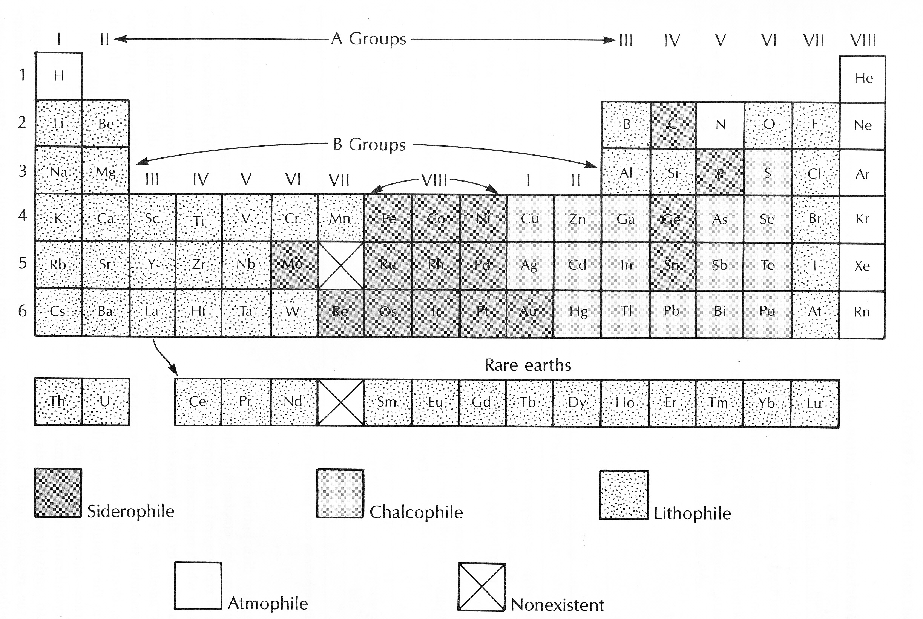
Geochemical Classification of elements

Slide 10
GEOCHEMICAL ENVIRONMENT
A geochemical environment is an environment in which the dispersion of chemical elements takes place. Two major types of geochemical environments have been distinguished:
The Deep-seated geochemical environment
The Surficial geochemical environment
The deep-seated geochemical environment is characterized by high pressure and temperature, relatively low free-oxygen content and restricted flow of fluids. This is the environment in which high temperature geochemical reactions and processes take place. The dominant processes in this environment include igneous, metarmorphic and hydrothermal processes. Geochemical anomalies of deep-seated origin are formed in this environment.

Slide 11
The surficial environment is the environment at or near the surface of the earth. This environment is characterized by low temperatures and pressure, and a high flow of fluids. The conditions prevailing in this environment promotes surficial processes such as weathering, leaching, dispersion, erosion, precipitation and deposition of naturally occurring materials. These processes result in the alteration of rocks and mineral deposits and the migration of chemical elements on a very large scale.

Slide 12
The migration of an element in the geochemical environments depends on the conditions prevailing in the environment and the geochemical properties of an element. Migration of elements in the outer part of the earth is described by the exogenic cycle while migration in the lithosphere is described by the endogenic cycle. The migration of elements in the geochemical environments results in formation of distribution patterns of chemical elements that may provide clues to the presence of mineral deposits in these environments. The processes which affect the migration of elements in the geochemical environments are illustrated in figure 2.

Slide 13
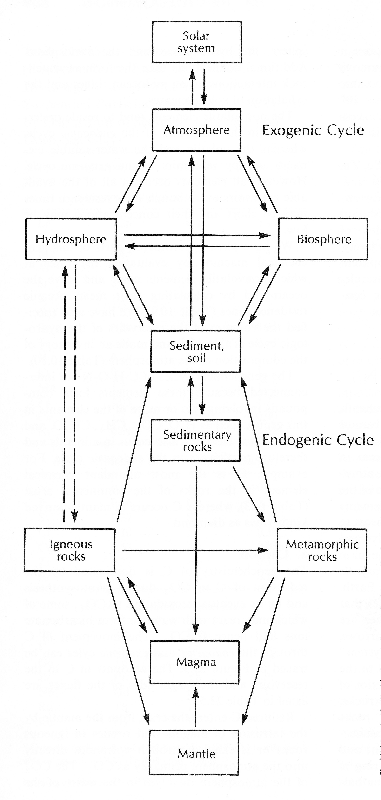
Processes involved in the migration of elements in the geochemical environments

Slide 14
CHEMICAL PROCESSES AT THE SURFACE OF THE EARTH
Most chemical processes of interest to the Geochemist which occur at the surface of the earth involve chemical reactions in which minerals interact with chemical species in water and gases in the atmosphere. These chemical reactions are represented by chemical equations.
Natural chemical reactions have a tendency to progress towards equilibrium.

Slide 15
Reactions in geochemical environments are caused by changes in physicochemical conditions such as pressure, temperature and chemical composition.

Slide 16
CHEMICAL WEATHERING
Chemical weathering is the decomposition of rocks and minerals in the secondary geochemical environment that is caused by interaction of these solids with agents of weathering such as water and gases. The type of reactions that are involved in weathering include the following:
Solution of minerals (congruent solution)
Hydration
Ion exchange
Redox reactions
Organic reactions
Hydrolysis

Slide 17
These reactions may take place above the ground surface, in soils and sediments, in surface water bodies and below the groundwater table.

Slide 18
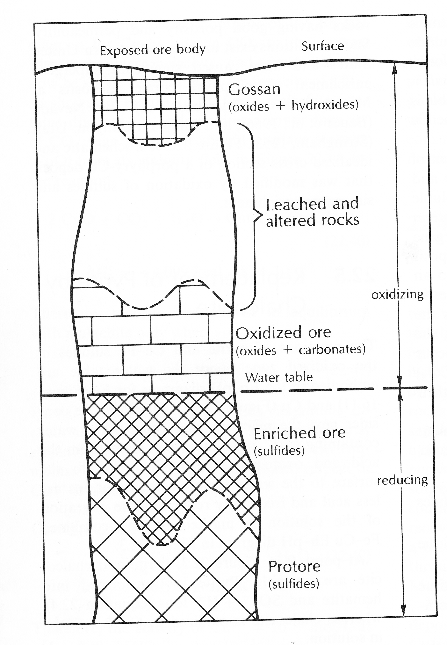
CHEMICAL WEATHERING OF A COPPER SULPHIDE DEPOSIT

