Slide 1
Super Continents

Slide 2
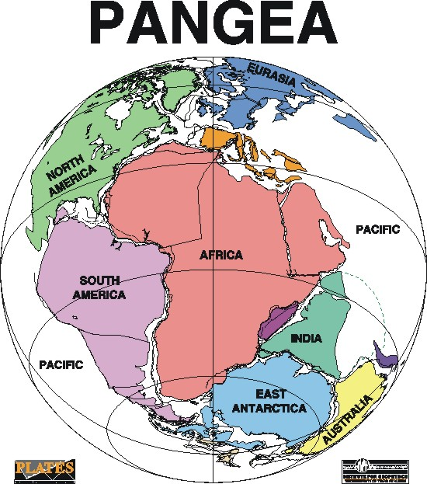
Before Pangea

Slide 3
SUPERCONTINENTS
Supercontinents result when separate continental plates collide with each other in a general process known as suturing.
Pangea — the youngest of Earth’s supercontinents — was preceded by an older supercontinent generally known as Rodinia (Russian for “motherland”).

Slide 4
It had grown out an earlier cycle of continental suturing at about 1.3 billion years (Ga) and entered a time of rifting, and
fragmentation starting between ca. 800 and 550 Ma.
Those and other fragments collided to became Pangea.

Slide 5
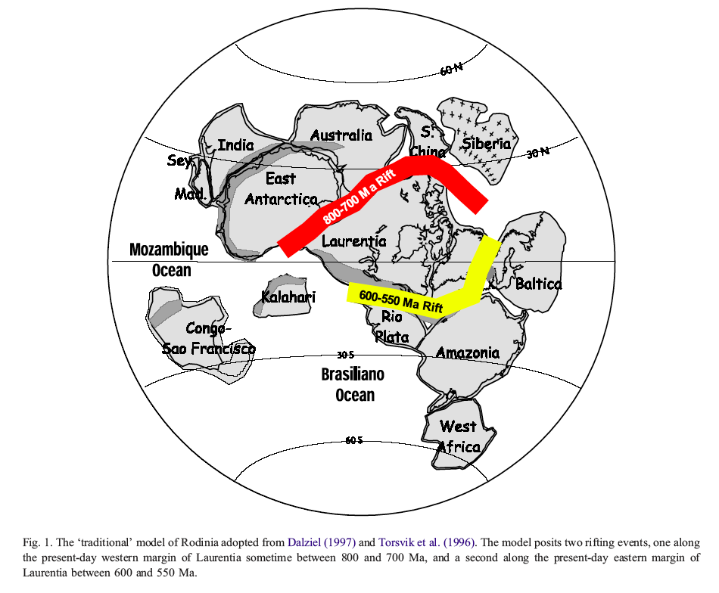
NEOPROTEROZOIC RIFTING
RODINIA
CAMBRIAN
RIFTING

Slide 6
As Rodinia was being rifted apart at ca 750 Ma — along what is now the western margin of North America — some of its fragments were coming together 100 million years later in a collisional belt across what is now eastern Africa.
Therefore, Pangea was already starting to form while Rodinia was breaking up!

Slide 7
Is there a problem here? In the Rodinia map, rifting along the eastern side of Laurentia (now North America) is said to have occurred between 600 and 550 Ma, thus forming an ocean basin. Yet in the Pangea map of ca. 220 Ma there is no open ocean along the eastern edge of North America — only a continental orogenic belt. ?????

Slide 8
IAPETUS
OCEAN
WAS AN EARLY OCEAN (IAPETUS) THAT OPENED BETWEEN 600 AND 500 MA, LATER CLOSED BY 220 MA? … AND THEN RE-OPENED AGAIN WITH THE BREAKUP OF PANGEA? THAT WAS A QUESTION ASKED BY J. TUZO WILSON IN 1966

Slide 9
THE WILSON CYCLE
THE WILSON CYCLE
The Making and Unmaking of Supercontinents ….

Slide 10
The Wilson Cycle (after J. B. Murphy and R. D. Nance, Scientific American, April 1992)
GOOGLE :
James Wilson’s Cycle
?

Slide 11
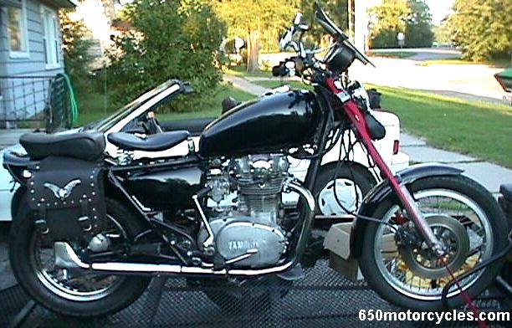
The Wilson Cycle (after J. B. Murphy and R. D. Nance, Scientific American, April 1992)
GOOGLE :
James Wilson’s Cycle

Slide 12
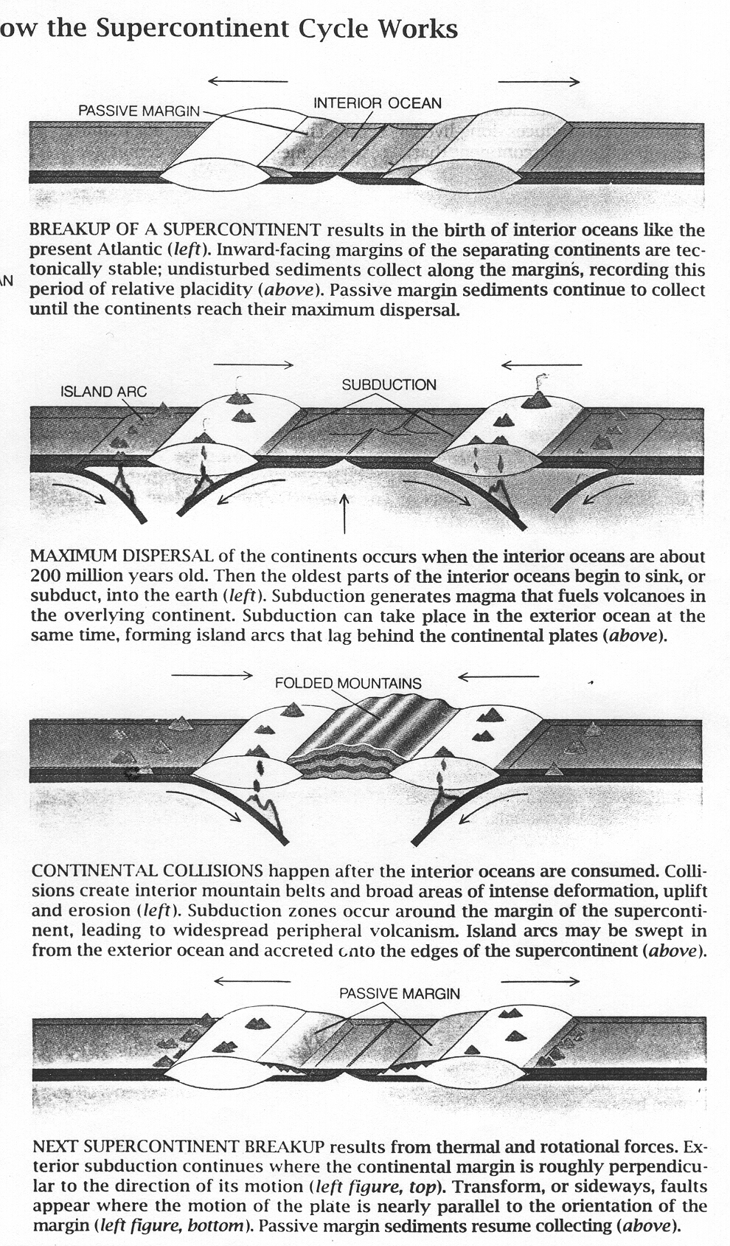
The Wilson Cycle (after J. B. Murphy and R. D. Nance, Scientific American, April 1992)
________________________
These diagrams can be too simple. For example, in the first “rifting” diagram the “interior ocean” doesn’t have to close by “subduction”.
The spreading ocean can continue to spread so that the rifted continental fragments may come together in a “collision” on the other side of planet Earth!
rifting
subduction
collision
rifting

Slide 13
The Wilson Cycle (after J. B. Murphy and R. D. Nance, Scientific American, April 1992)
________________________
These diagrams can be much too simple. For example, in the first “rifting” diagram the “interior ocean” doesn’t have to close by “subduction”.
The spreading ocean can continue to spread so that the rifted continental fragments may come together in a “collision” on the other side of planet Earth!
rifting
subduction
collision
rifting

Slide 14
Did the Atlantic Ocean
Close and Reopen?

Slide 15
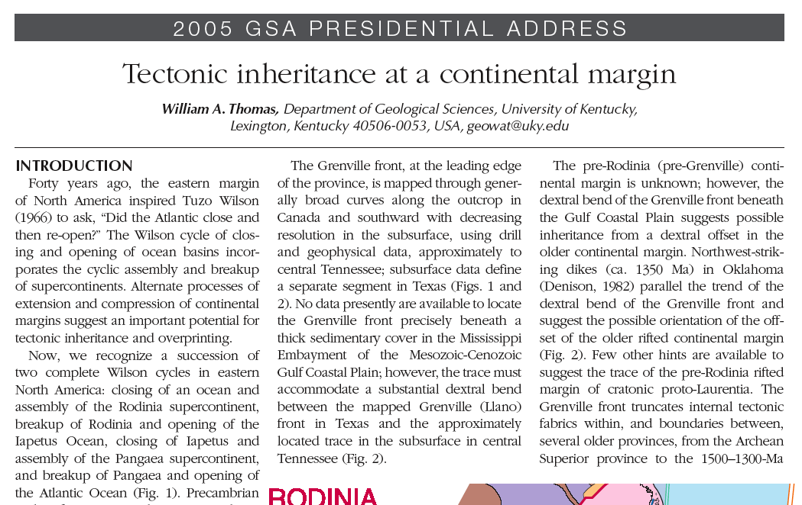
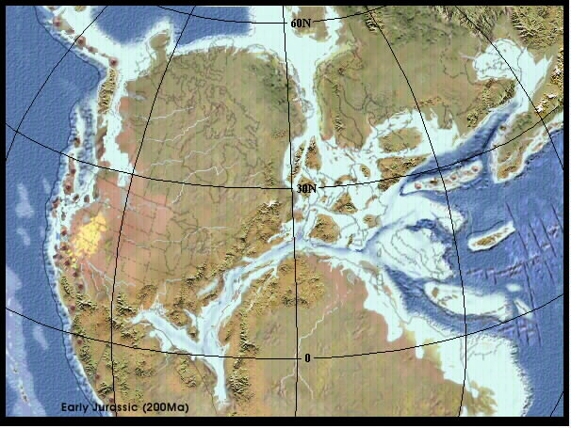

Slide 16
Yes! Twice!
RODINIA
IAPETUS OCEAN
PANGEA
ATLANTIC OCEAN

Slide 17
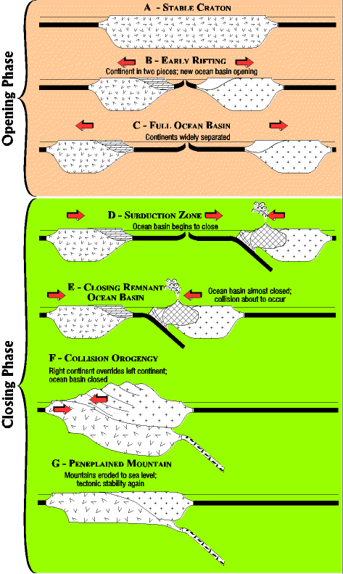
RODINIA
rifting
IAPETUS OCEAN
subduction, convergence
collision and closing of IAPETUS
APPALACHIAN and
CALEDONIAN OROGEN
PANGEA

Slide 18
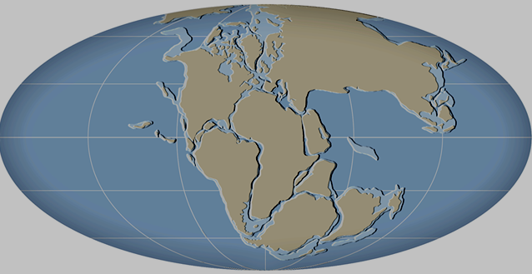
The continents have changed shapes and positions throughout geologic time! This is a reconstruction of the supercontinent Pangea as it ay have looked in Permian time.
PANGEA

Slide 19
The continents have changed shapes and positions throughout geologic time! This is a reconstruction of the supercontinent Pangea
as it may have looked in Permian time.
LAURASIA
TETHYS
GONDWANA

Slide 20
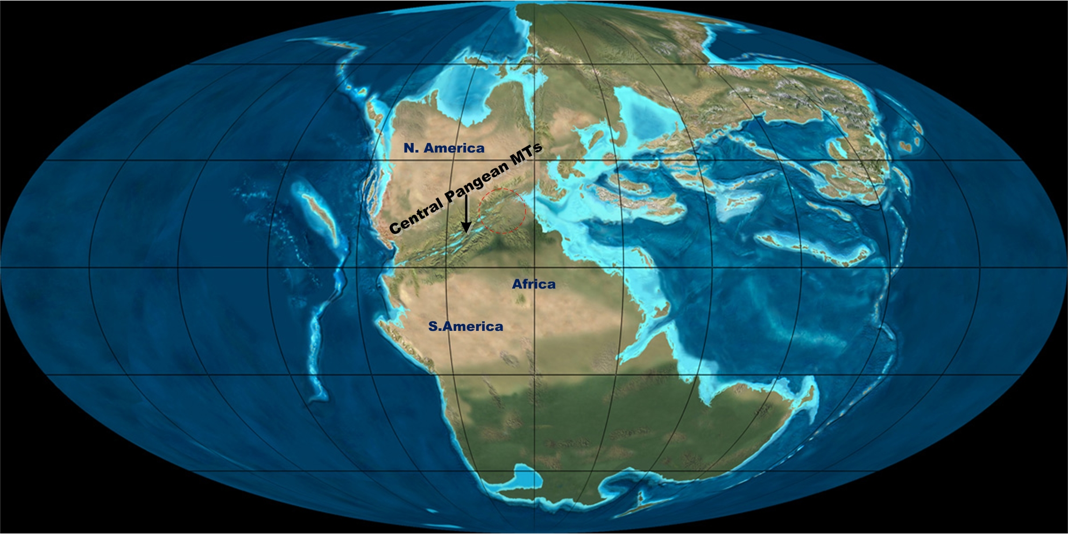
PANGEA — AN IMPROVEMENT OVER WEGENER

Slide 21
Since Pangea

Slide 22
Beginning in the Triassic around 230-220 million years ago, Pangea began to split up

Slide 23
ATLA NTIC
OCE AN
RIFT ING

Slide 24
The process was complicated in space and in time. for example, the Atlantic Ocean opened in 3 stages:
Jurassic, Cretaceous, and Tertiary

Slide 25
The process was complicated in space and in time. for example, the Atlantic Ocean opened in 3 stages:
Jurassic, Cretaceous, and Tertiary

Slide 26
The process was complicated in space and in time. for example, the Atlantic Ocean opened in 3 stages:
Jurassic, Cretaceous, and Tertiary

Slide 27
How could JUST the middle Atlantic open?

Slide 28
This way! By transform fault zones as shown …

Slide 29
TRANSFORM FAULTING
RIFTING

Slide 30
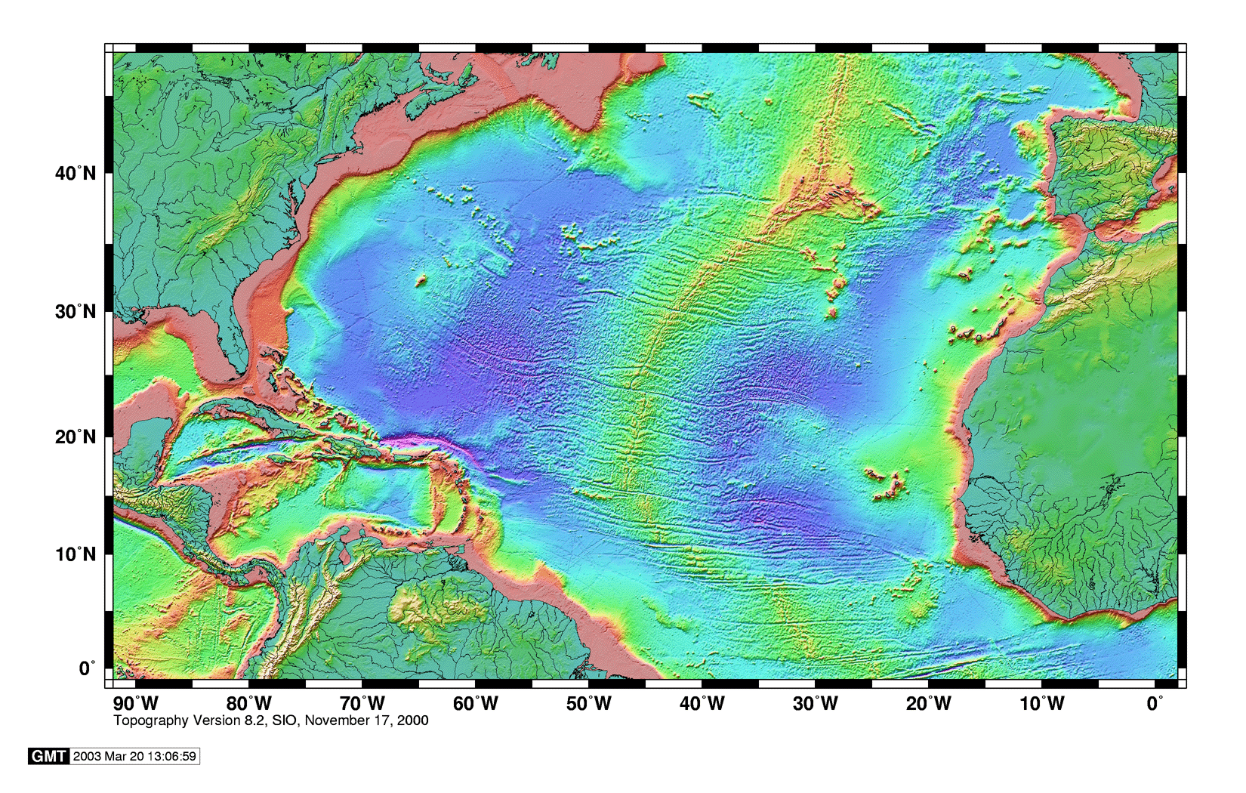
Broad, distributed
transform zones

Slide 31
The process of the splitting up of Pangea continues to this day in the Red Sea, Gulf of Aden, and
East Africa.

Slide 32
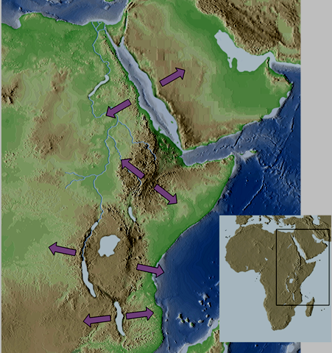
EAR Topography
CONTINENTAL
RIFTING IN
PROGRESS
FROM
NORTH
TO
SOUTH
WITH
OCEAN
LITHOSPHERE
IN RED &
PINK
Red Sea
Afar Triangle
East African rift system

Slide 33
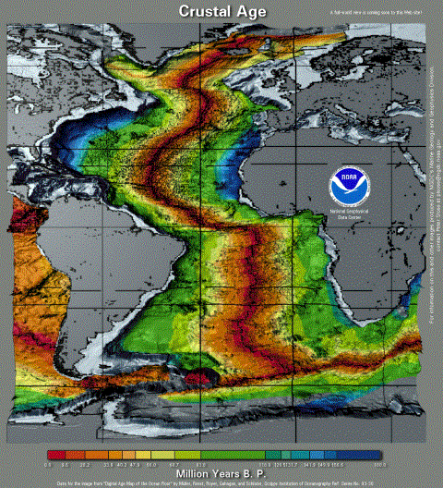
Cenozoic rifting
Jurassic rifting
Cretaceous
rifting

Slide 34
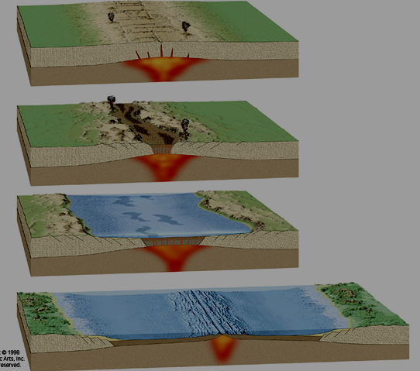
Rifting Sequence
East African
rift system
Afar Triangle
Red Sea
Atlantic Ocean

Slide 35
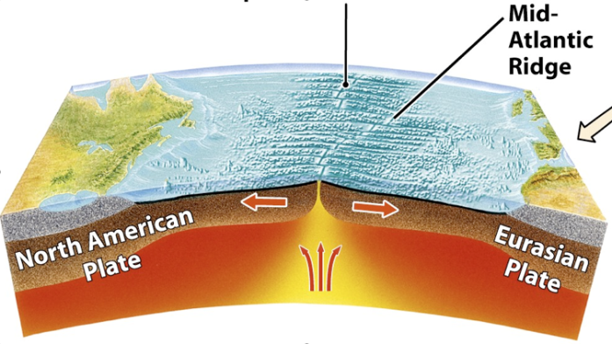
As the plates move
apart the rising hot plastic mantle beneath the ridges begins to melt — producing not just mafic (basaltic) volcanoes, but the mafic oceanic crust they sit on. For the
Atlantic this process began 180 million years ago.

Slide 36
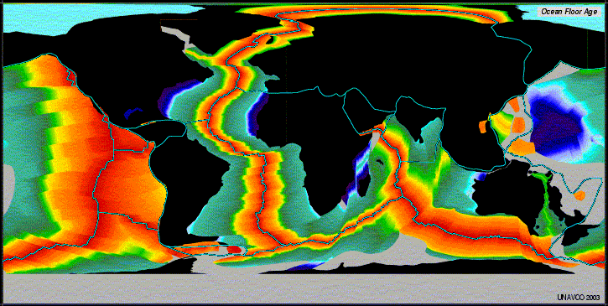
The break-up of Pangea created three new rifted
ocean basins — the Atlantic, the Arctic, and Indian
and so what happened to the pre-existing Pacific Ocean?

Slide 37
?

Slide 38
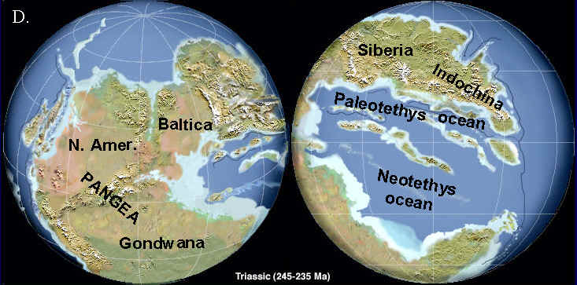
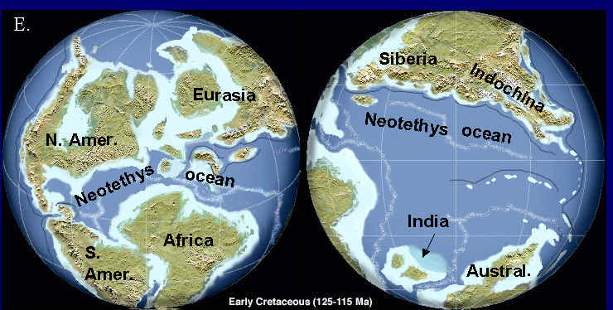
What is now the central Atlantic
Ocean was not present in Triassic
time, but was well developed by the
Middle Jurassic. Study of this
region tells us much about
the continental rifting process for
this example of continental breakup
TRIASSIC
EARLY CRETACEOUS

Slide 39
How to go from this
(Pangea), to this? —>

Slide 40
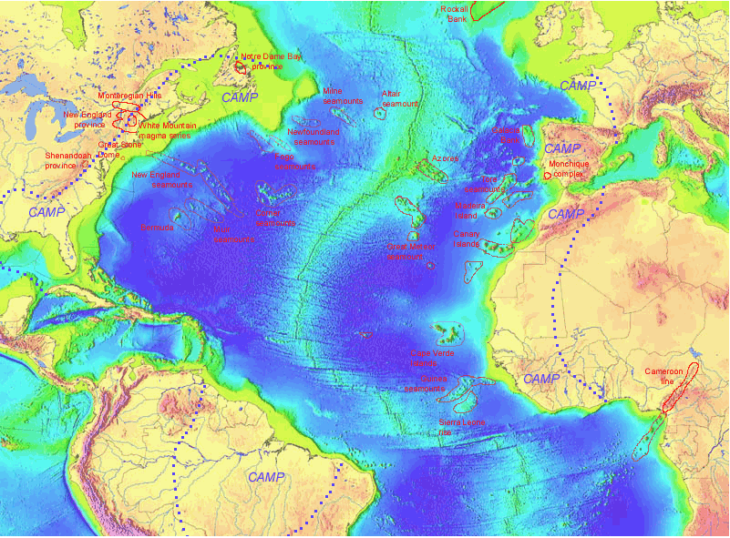

Slide 41
PANGEA
TETHYS
OCEAN

Slide 42
WERE THERE
PRE-EXISTING
LITHOSPHERIC
CONTROLS ON
CENTRAL ATLANTIC RIFTING?

Slide 43
PALEOZOIC
COLLISIONAL BELT
YES !

Slide 44
NEOPROT. GRENVILLE OROGEN
CAMBRIAN CONTINENTAL RIFTING
EARLY TO LATE PZ CONT’L COLLISIONS

Slide 45
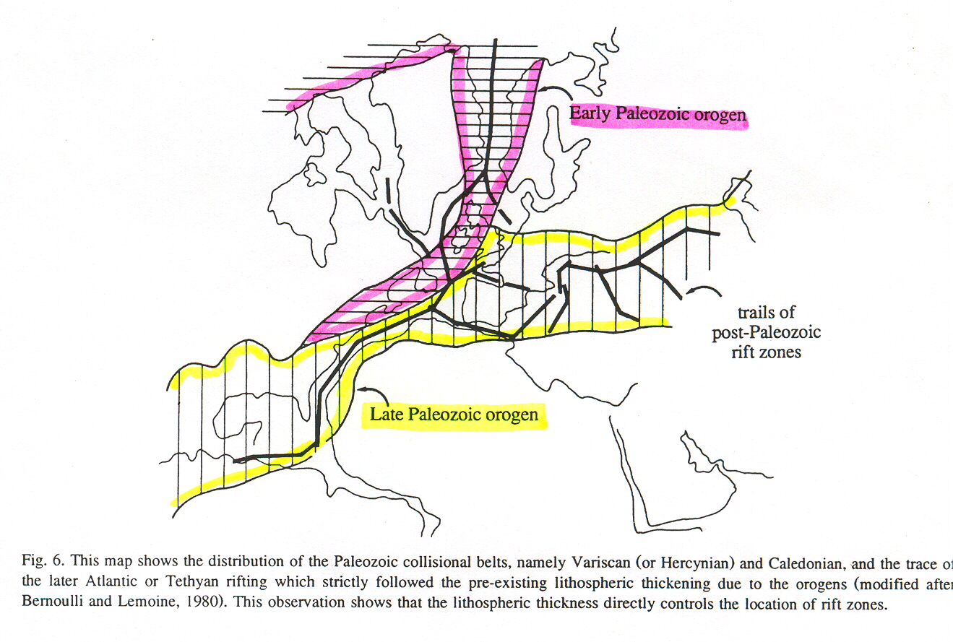
North Atlantic Paleozoic orogenic belts and younger Atlantic rift zones (heavy black lines)
C. Doglionii, 1995, Tectonophysics, v. 252, p. 253-67

Slide 46
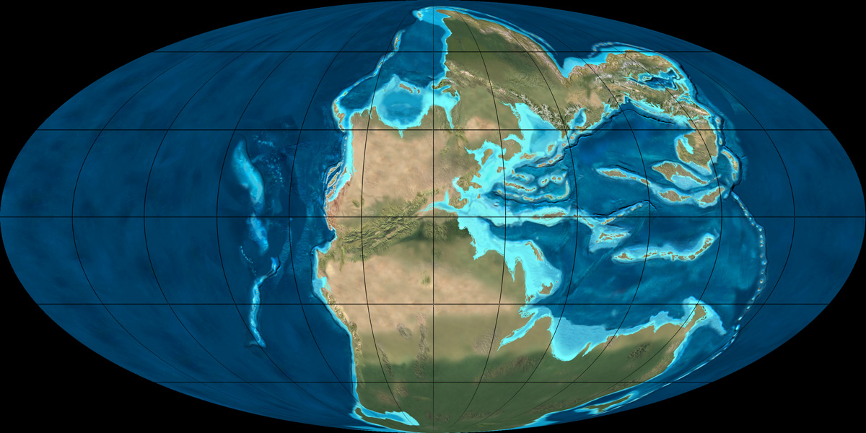
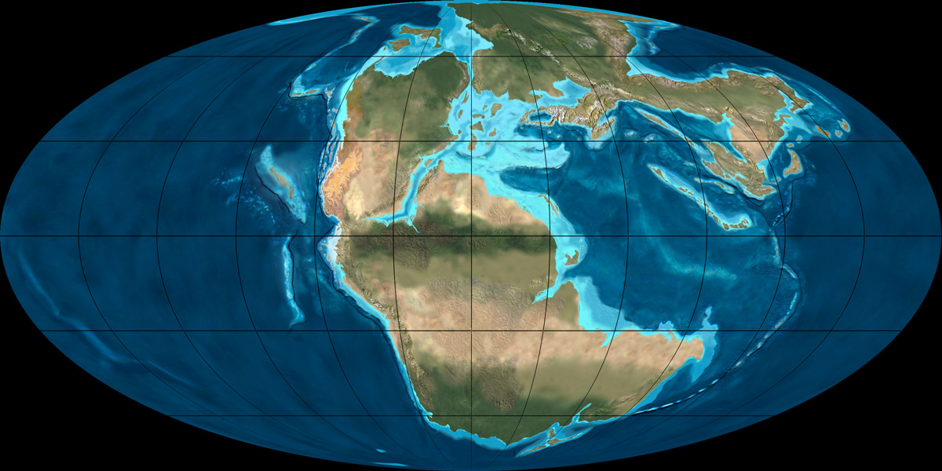
EARLY TRIASSIC
240 MY
(R. BLAKEY)
http://jan.ucc.nau.edu/~rcb7/200moll.jpg
EARLY
JURASSIC
200 MY
(R. BLAKEY)

Slide 47
WERE THERE
PRE-EXISTING
LITHOSPHERIC
CONTROLS ON
SOUTH ATLANTIC RIFTING?

Slide 48
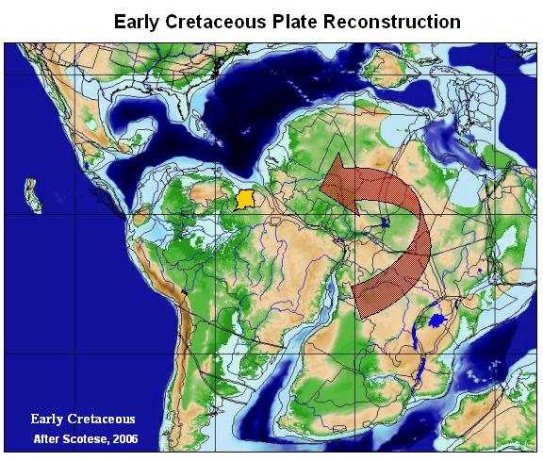

Slide 49
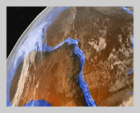

~~ 120 Ma

Slide 50
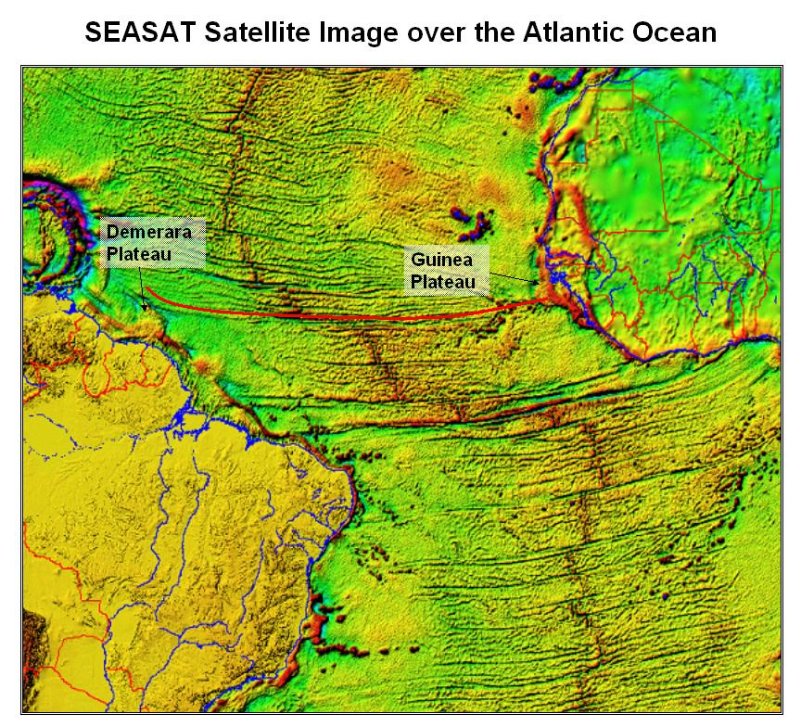
Fracture zones appear to offset the MAR, but they do not. They formed when the initial rift had offsets along it
The Mid-Atlantic Ridge (MAR) has the general geometry of the initial Cretaceous continental rift of about 120 Mybp
MAR

Slide 51
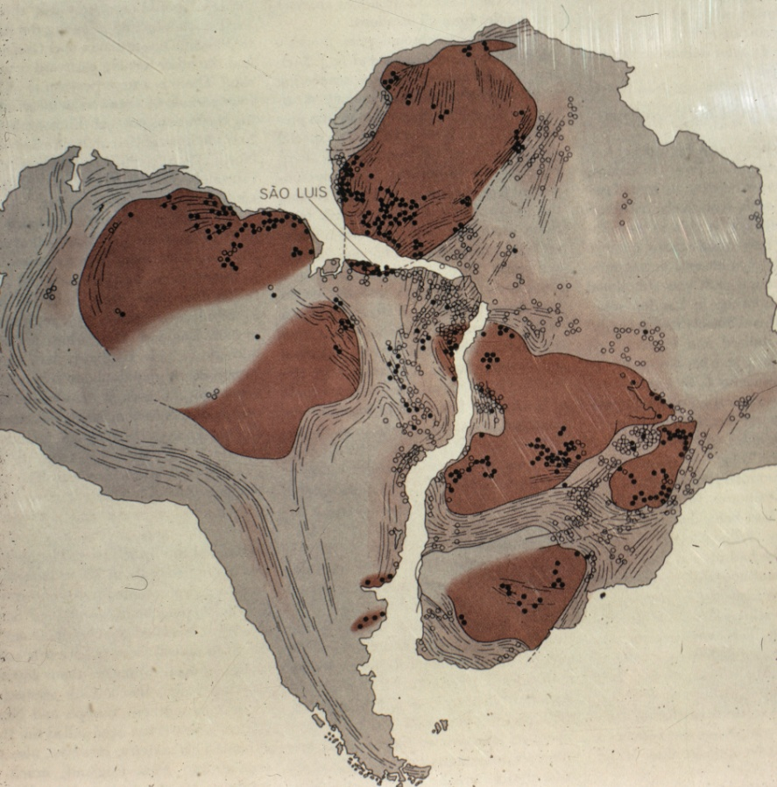
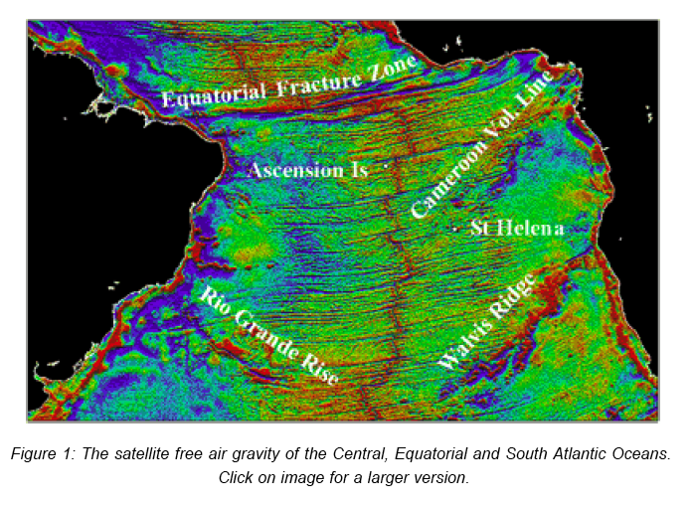
Were there
pre-rifting lithospheric
controls in the South Atlantic?

Slide 52
Were there
pre-rifting lithospheric
controls in the South Atlantic?
NO !

Slide 53
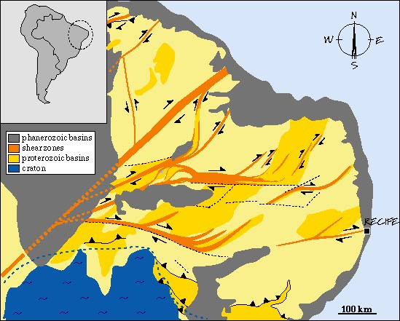
The rifted margin cuts across huge Neoproterozoic
ductile shear zones
(as seen in Brazil).
The Borborema
dextral shear zone

Slide 54
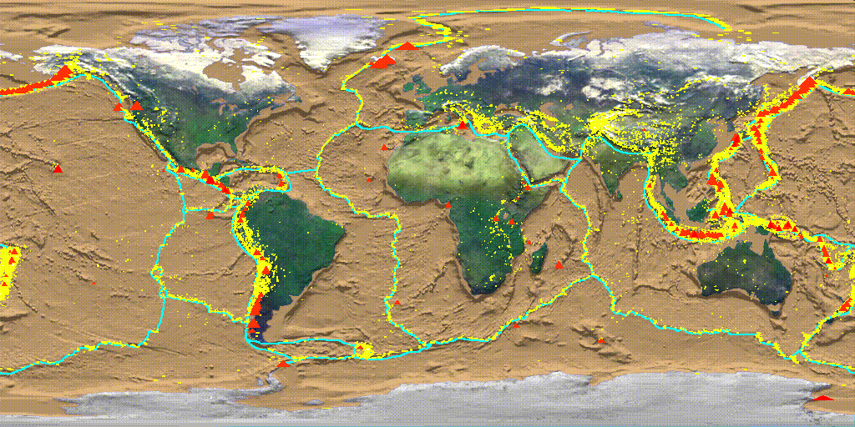
Active (Leading Edge) Continental Margins
[convergent, ie. subduction, zones]
Passive (Trailing Edge) Continental Margins
[original rifted continental margins)

Slide 55
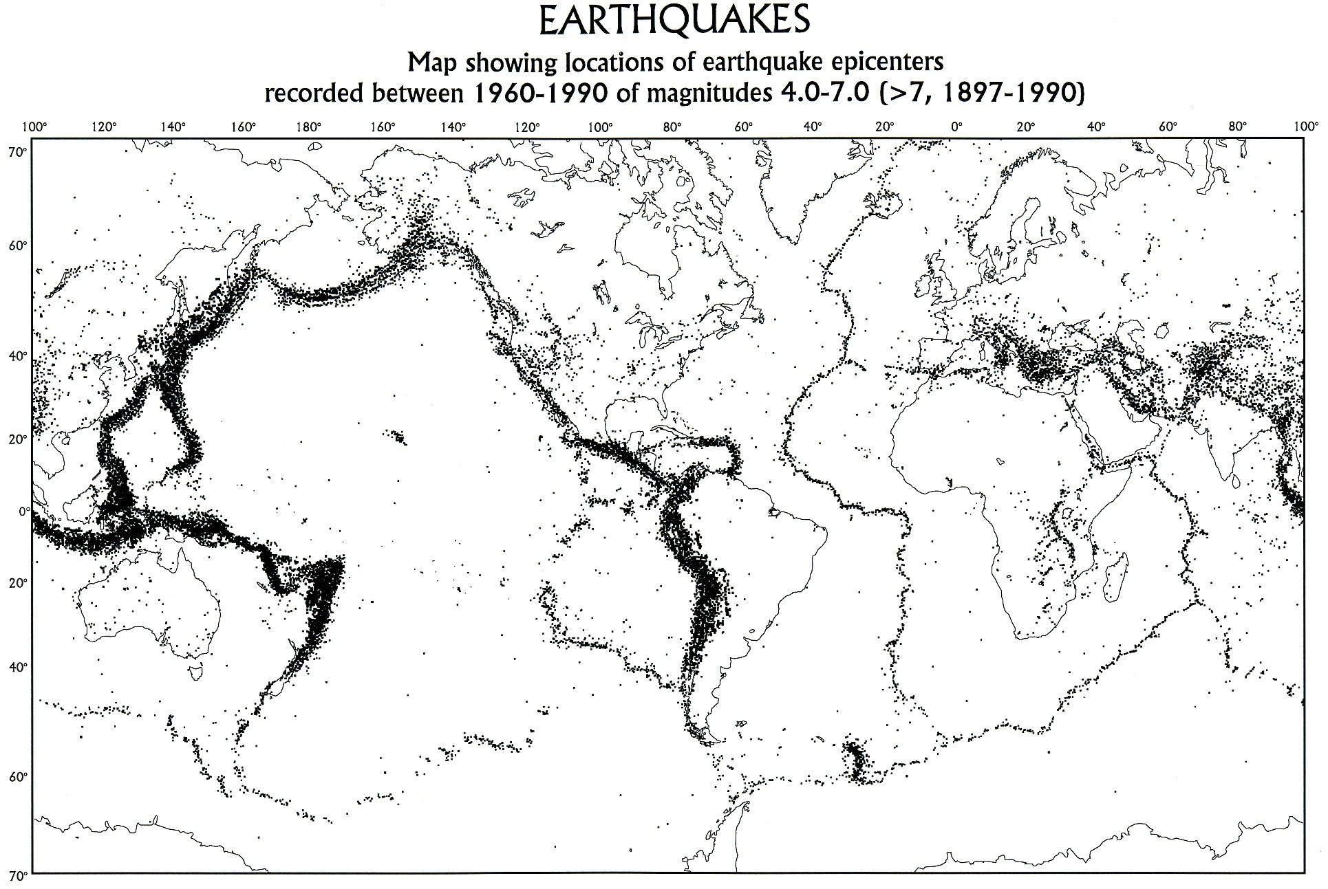
Obviously, all continent-ocean boundaries are NOT plate boundaries.

Slide 56
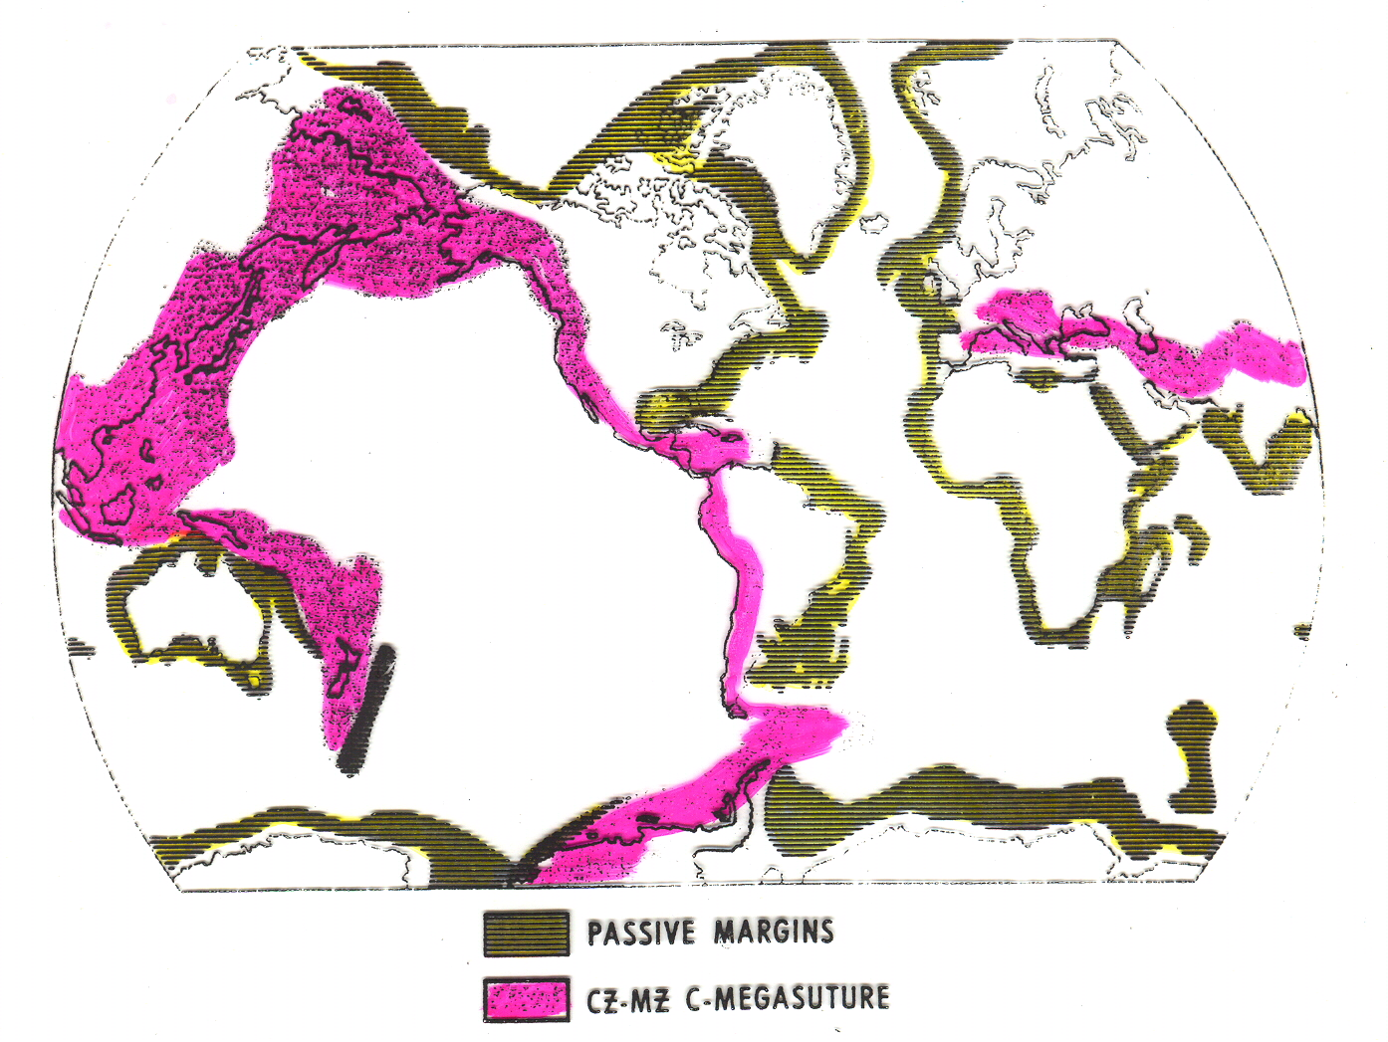
Passive (Rifted) Continental Margins

Slide 57
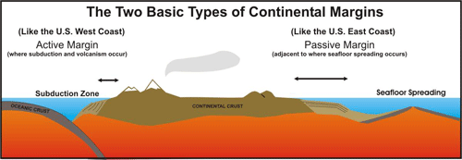
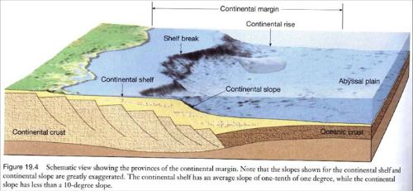
LEADING EDGE TRAILING EDGE

Slide 58
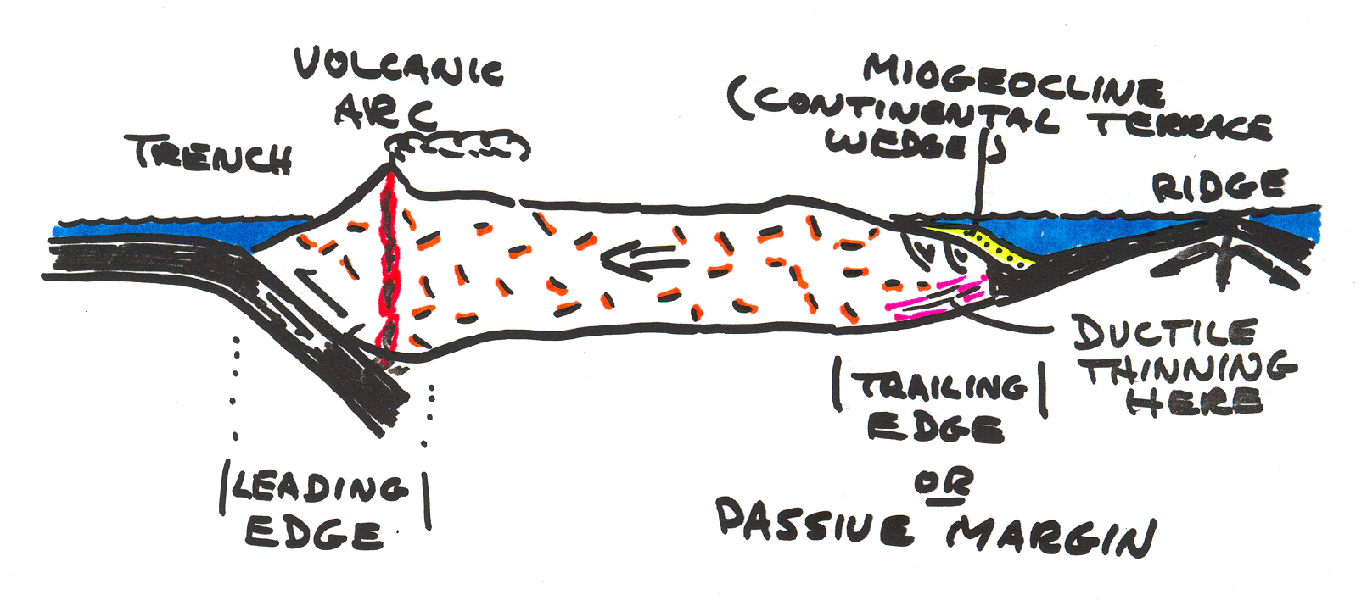
passive margin sedimentary strata =
“continental terrace wedges” or “miogeoclines”

Slide 59
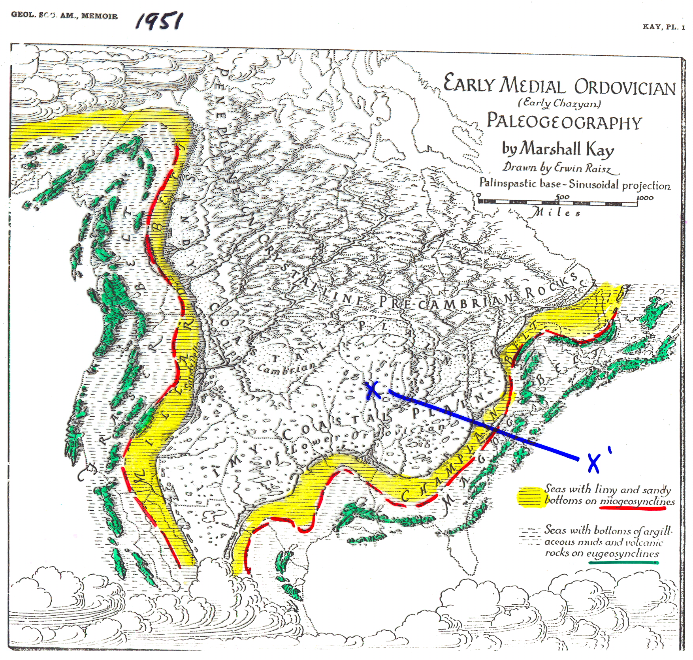
GEOSYNCLINES
Marshall Kay, 195l

Slide 60
“GEOSYNCLINES” — A common geologic or tectonic term in the earth science literature that no longer has significance and should be abandoned.
Most mountain belts (Andes, Appalachians, Yanshan) contain thick, deformed sequences of marine (ocean-deposited) strata that were deposited in shallow water [Marshall Kay = “miogeosynclines”]
Most mountain belts also contain deep water marine sedimentary strata, deformed mafic igneous rocks, granitic plutons, metamorphic rocks [Kay = “eugeosynclines”]

Slide 61
A MISTAKEN IDEA !
Marshall Kay, 195l

Slide 62
eugeosynclines +
miogeosyncline =
geosyncline
Marshall Kay, 195l

Slide 63
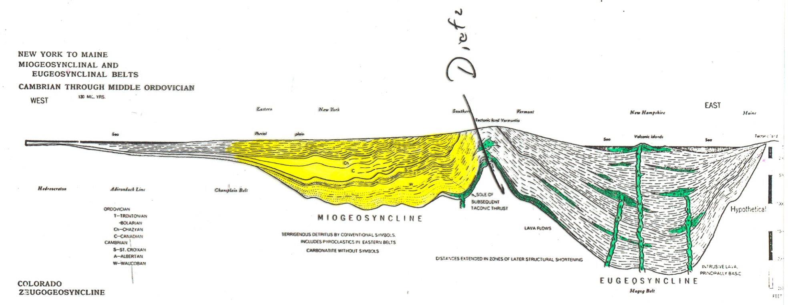
Kay’s Ordovician reconstruction of the Appalachian “geosyncline”
North American
craton
GEOSYNCLINE
Miogeosyncline Eugeosyncline
shallow water
sediments, no
volcanic rocks
deeper water
sediments, mafic
& silicic volcanics
Kay: Geosynclines become orogenic mountain belts such as the Alps & Appalachians when deformed by contraction

Slide 64

GEOSYNCLINE
The Appalachian “geosyncline”
CRATON
North American
craton
MIOGEOSYNCLINE EUGEOSYNCLINE
Miogeosyncline Eugeosyncline
Kay’s miogeosyncline was the North American Paleozoic continental terrace wedge —> a miogeocline
Kay’s eugeosyncline was never a separate basin, but was the result of later subduction along the passive margin, the deformation, metamorphism, and intrusion of the deeper parts of the continental terrace wedge, and the addition of oceanic crustal and mantle materials to the collisional zone

Slide 65
Students — if you are interested in learning more about “geosynclines” and “continental terrace wedges” the internet reading below is a good summary of how ideas evolved …
http://www.uwsp.edu/geo/projects/geoweb/participants/dutch/platetec/geosync.htm

Slide 66
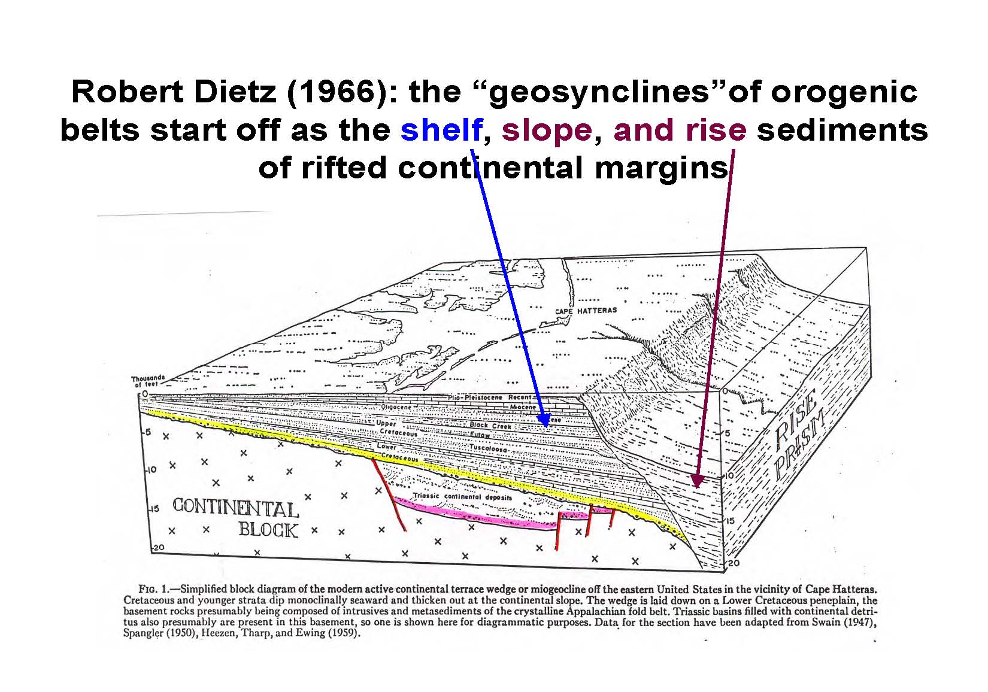

Slide 67
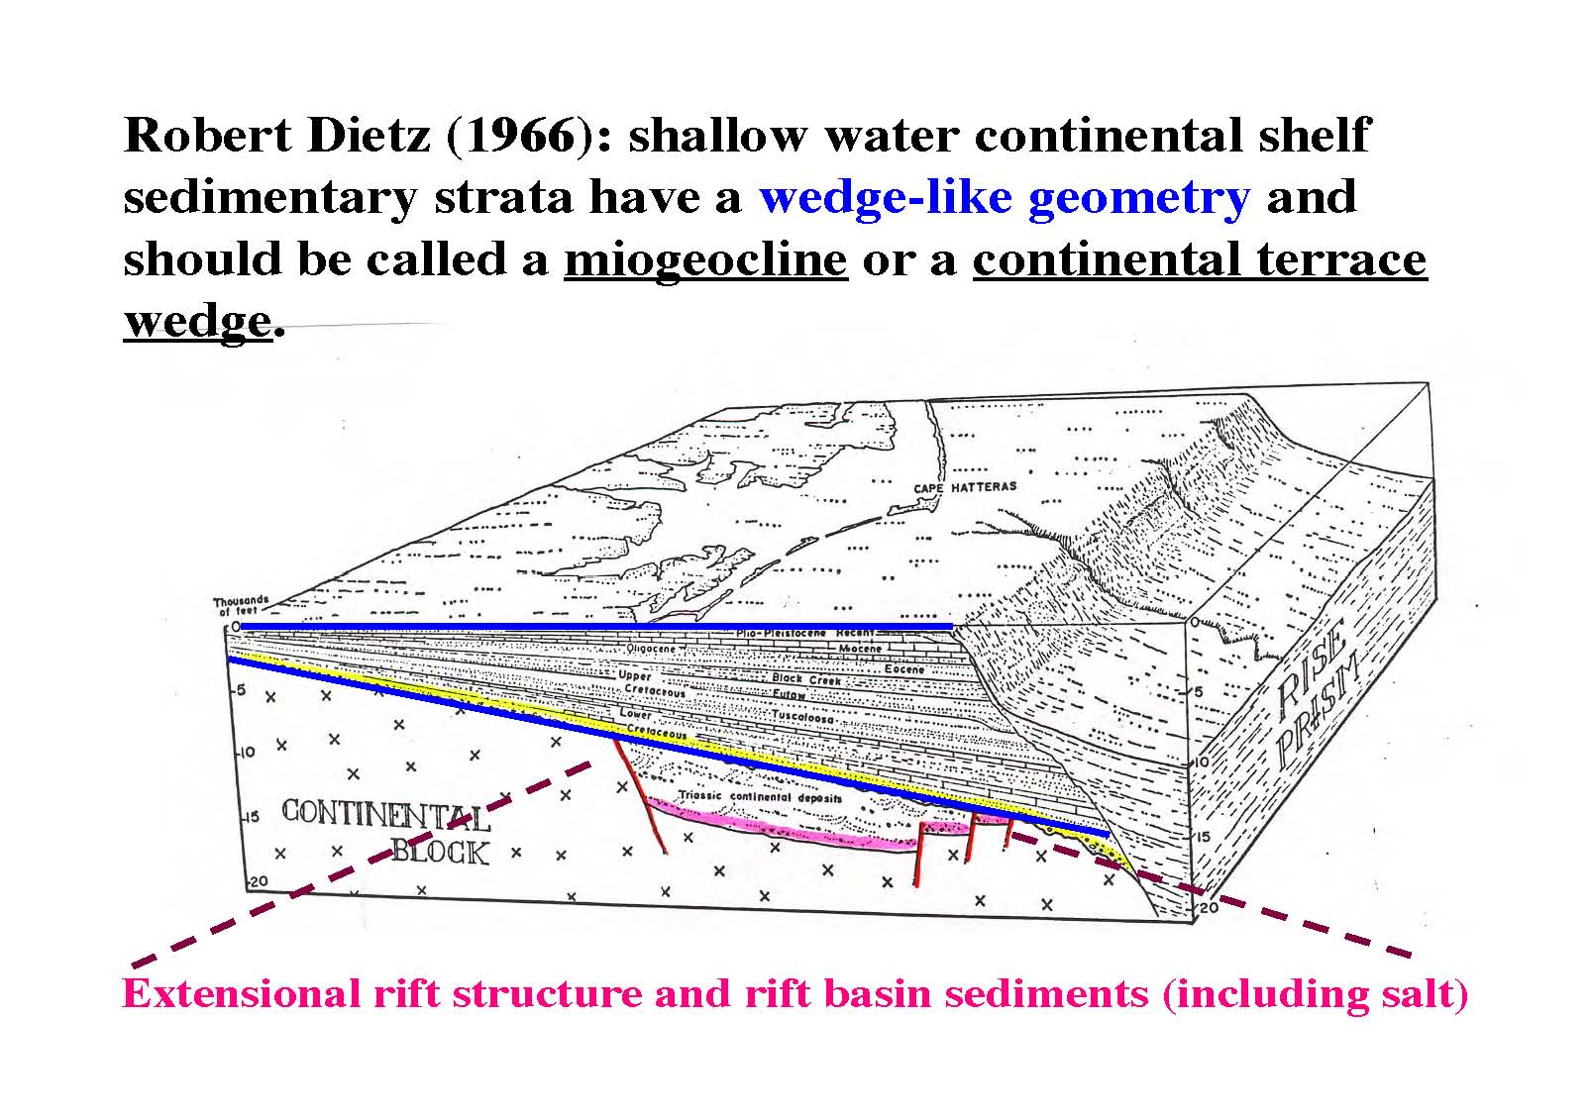
These rift basins form during the early extension of continental crust.

Slide 68
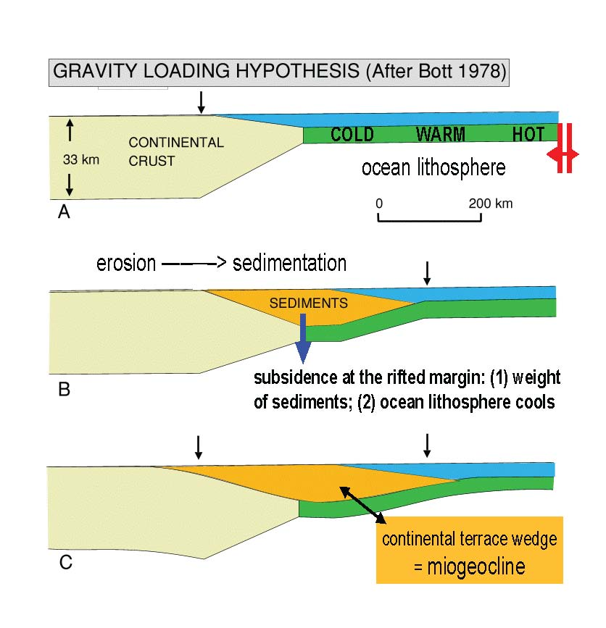

Slide 69
GEOSYNCLINE
North American
craton
Miogeosyncline Eugeosyncline
The geologic terms "geosyncline","miogeosyncline",
and "eugeosyncline" should no
longer be used. "Miogeocline" is
an acceptable term for continental
terrace wedges.

Slide 70
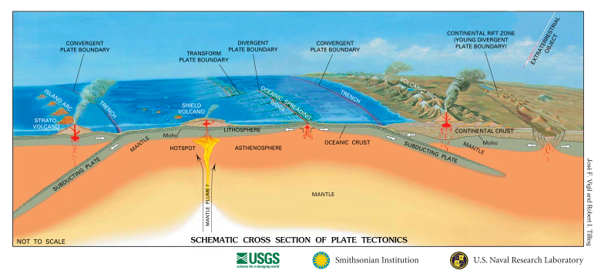
SCHEMATIC CROSS SECTION OF PLATE TECTONICS
convergent transform divergent convergent boundaries

Slide 71
Convergence — I:
subduction tectonics
Greg Davis 5/27/2016 DIZHI DAXUE/Beijing

Slide 72
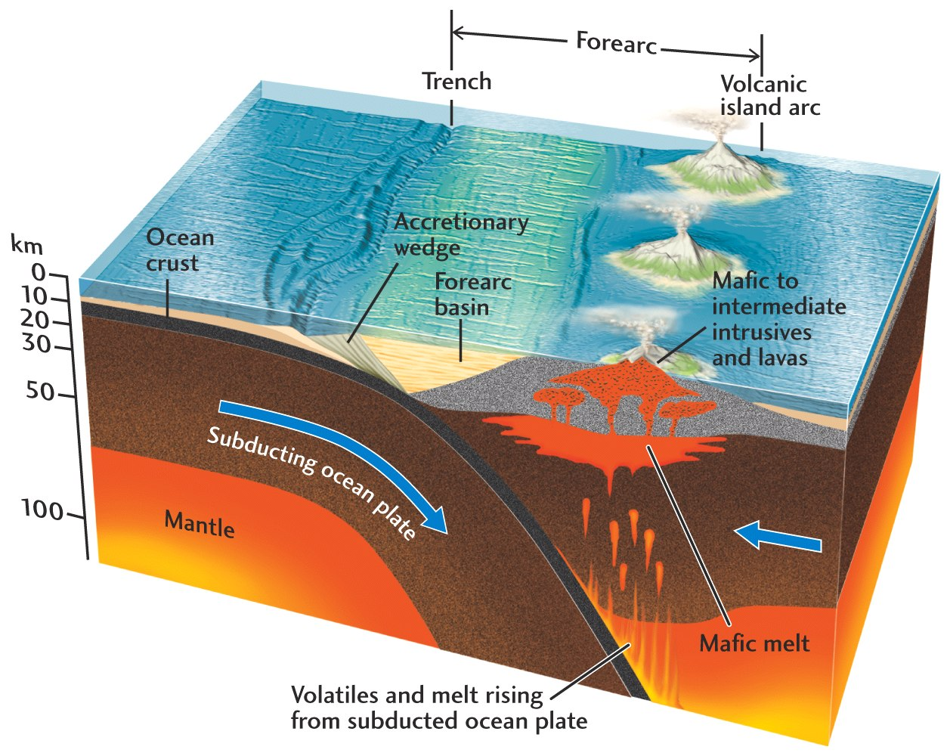

Slide 73
The deepest parts of the ocean are the ocean trenches next to continents and arcs. They receive sediment eroded from the nearly land masses AND they receive sediment deposited out in the oceans and carried into the trenches on the tops of subducting plates.
WHAT HAPPENS TO THIS SEDIMENT?
Accretionary Wedges

Slide 74
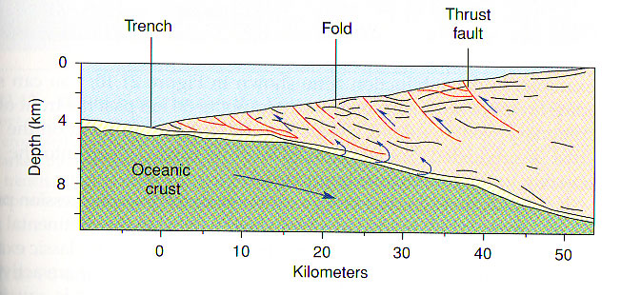
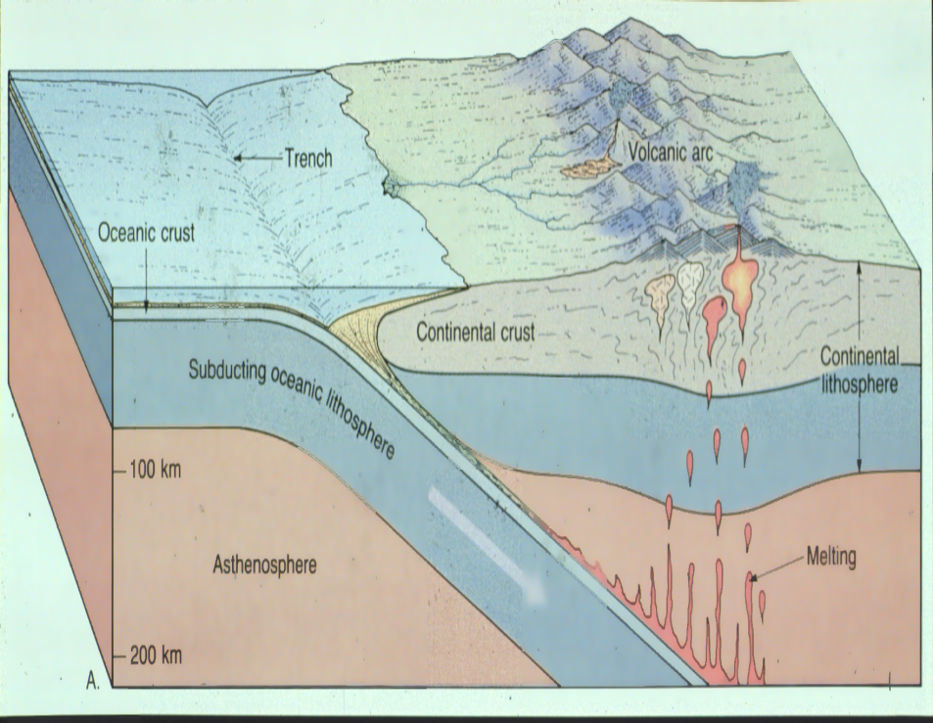
Accretionary Wedges
www.geosci.usyd.edu.au/…/Report2/hydro.htm
www.phys.ocean.dal.ca/…/lect12/lect12.html

Slide 75
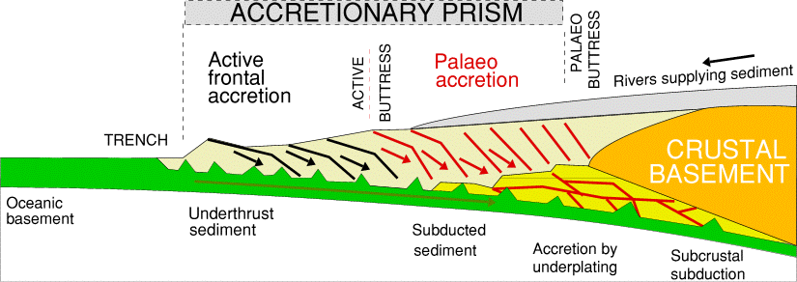
An oversimplified view of an accretionary prism or wedge (both terms are used). Prisms typically grow by the addition of sediment at their near-trench fronts, but they can also grow from below by “underplating” of subducted materials
(sediments, sea-floor volcanoes, etc.)

Slide 76
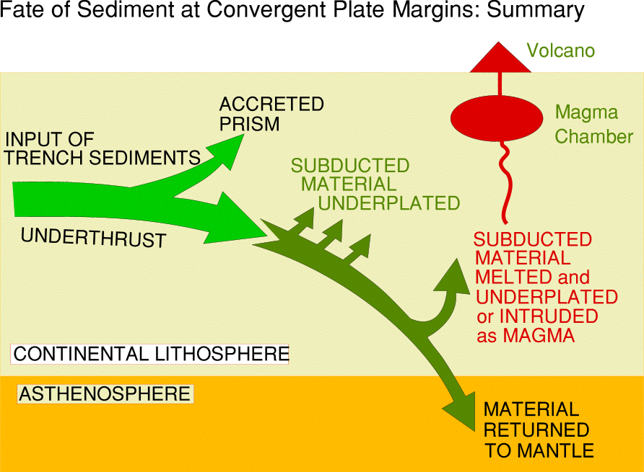
ACCRETIONARY WEDGE (PRISM)

Slide 77
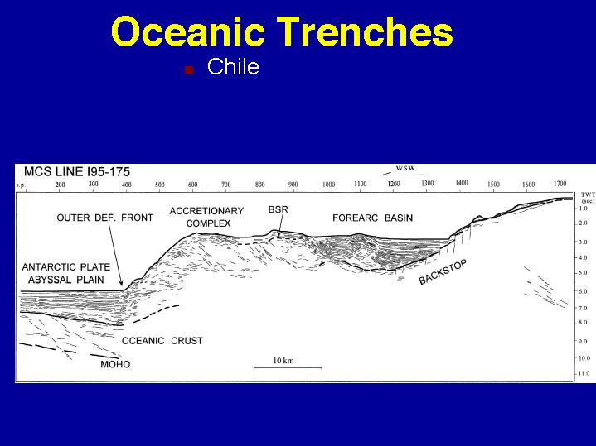
Chile: accretionary prism, forearc, backstop
(with great vertical exaggeration)
DEFORMATION
FRONT
backstop

Slide 78
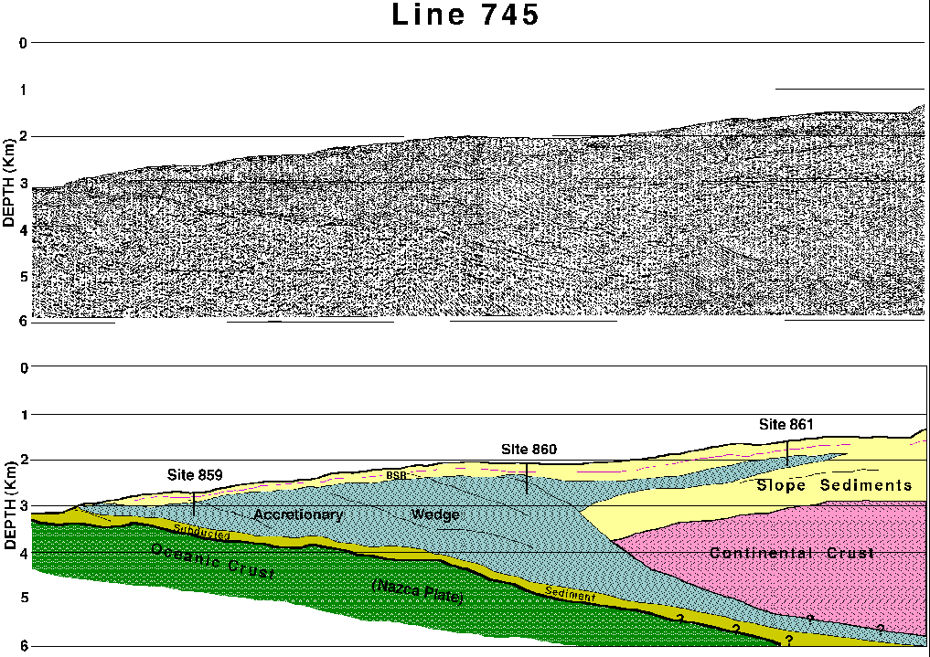
This geometry of a Chilean subduction zone is closer to
reality, but still has a vertical exaggeration ..
backstop

Slide 79
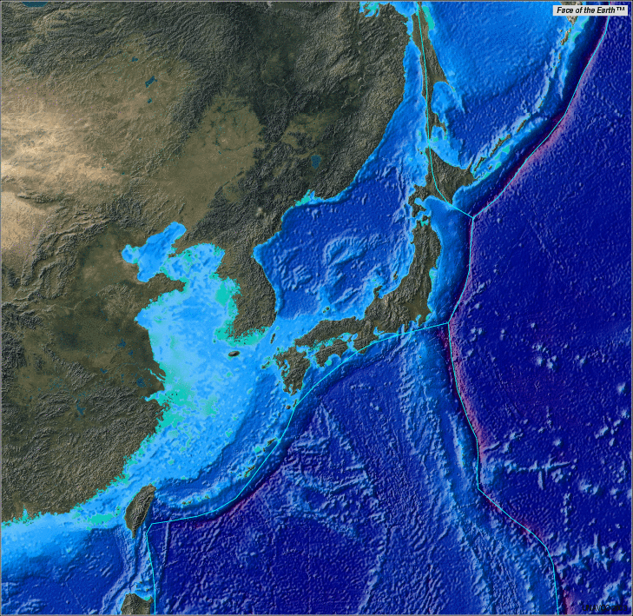
The best example of what happens to sediments when they enter an oceanic trench is the Nankai trough (trench) south of Shikoku Island, Japan

Slide 80
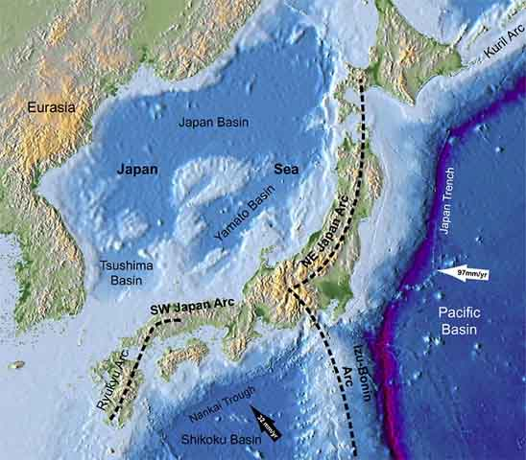
Subduction of the Philippine plate in the Nankai Trough of southwestern Japan

Slide 81
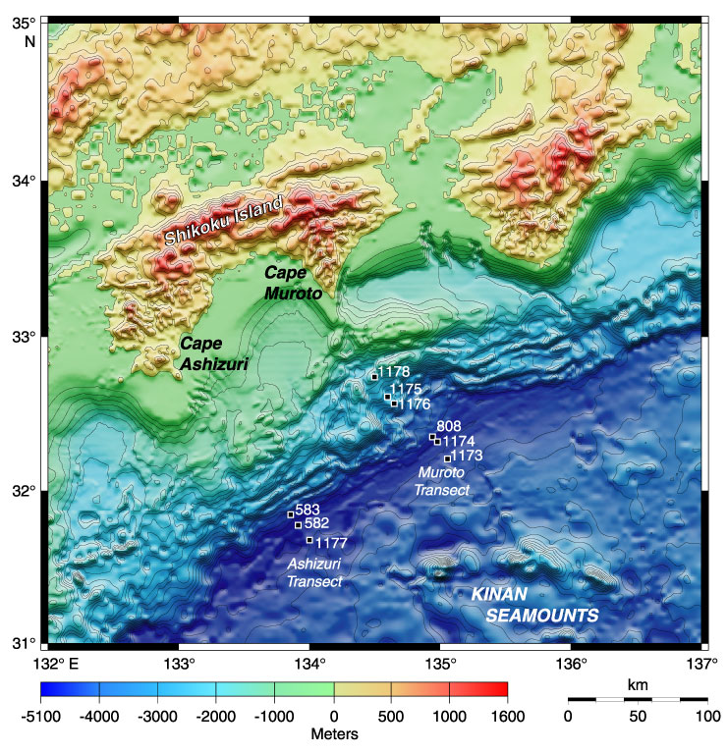

Slide 82
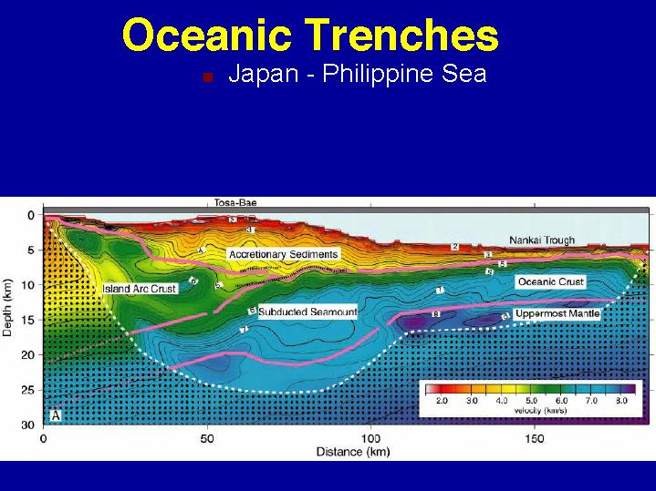
The accretionary wedge (prism) inland from the Nankai Trough
continues onshore at Shikoku island. This figure shows only that
part of the huge wedge that lies between the Trough and the island.
The V.E. is about 2x (V:H). Most of this wedge is Pliocene and
younger in age (< 6 Ma)! At a convergent rate of about 4 cm/year, this
adds about 40 km of material per million years (before internal shortening).

Slide 83

Pliocene and younger
V.E. ~ 1.8

Slide 84


decollement

Slide 85

Thrust (deformation) front in Nankai trough, SW Japan

Slide 86

off-scraped sediments; the front of
the accretionary wedge is here
VE = 3.5
5 km
Deformation front
subducted basin sediments Shikoku basaltic crust

Slide 87



Slide 88

True scale geometries of various accretionary wedges
(and the Himalayan thrust belt)
Japan (Nankai)
Barbados

Slide 89

Nankai and Barbados Accretionary Wedges

Slide 90

Snow plow tectonics — the plow (the backstop) advances over the snow-covered road …. and snow accumulates in front of it
Accretionary wedge tectonics — the sediment-covered subducting plate advances towards the backstop … and off-scraped sediment accumulates in front of it

Slide 91

(only if the wedge thickens above critical taper angle!)

Slide 92

Critical Taper Theory
alpha too large,
wedge thins
wedge extension
alpha too small,
wedge thickens
wedge stable

Slide 93

The critical wedge angle must be maintained for stable sliding or displacement between the wedge and its basal slip surface.!

Slide 94

CRITICAL
TAPER
ANGLE
ACCRETIONARY
WEDGE
UPPER PLATE
SUBDUCTING PLATE
BACKSTOP

Slide 95
End of 3-hour lecture here ….

