Slide 1
Modern theories
on
Structural evolution of
the Earth´s crust

Slide 2
K.C. Condie,, 1997, Plate tectonics and Crustal evolution
One of the unique features of the Earth is its crust.
None of the other terrestrial planets seems to have a crust similar to that of the Earth.
The reason for this is related to plate tectonics, which in turn is related to the way the mantle cools and how it has evolved.

Slide 3
Thus, most investigators now agree that the history of the Earth's crust and mantle are closely related,
and that many of the features we find in the crust are controlled by processes in the mantle.

Slide 4
We will now discuss just how closely the evolution of the crust is tied to the that of the mantle,
and review how this dynamic system has evolved as planet Earth has cooled over the last 4.6 Ga.
As a starting point, let us consider the thermal history of the Earth.

Slide 5
The Earth's thermal history
There are two lines of evidence indicating that the mantle was hotter during the Archean.
The most compelling evidence is that the present-day heat loss from the Earth is approximately twice the amount of heat generated by radioactive decay, which requires that the excess heat come from cooling of the Earth (50-50%).

Slide 6
U, Th, and K isotopes provide most of the Earth's radiogenic heat.
From the decay rates of these isotopes, it would appear that heat production in the Archean was three to four times higher than today (Richter, 1988).

Slide 7
A second argument for higher Archean mantle temperatures is the presence of high-Mg komatiites in Archean greenstones which, (as discussed later), require higher mantle temperatures for their generation.

Slide 8
Komatiite /koʊˈmɑːti.aɪt/^{[1]} is a type of ultramafic mantle-derived volcanic rock. Komatiites have lowsilicon, potassium and aluminium, and high to extremely high magnesium content. Komatiite was named for its type locality along the Komati River in South Africa.

Slide 9
True komatiites are very rare and essentially restricted to rocks of Archean age, with few Proterozoic or Phanerozoic komatiites known (although high-magnesian lamprophyres are known from the Mesozoic).
This restriction in age is thought to be due to cooling of the mantle, which may have been up to 500 °C hotter during the early to middle Archaean (3.8 to 2.8 billion years ago). The early Earth had much higher heat production, due to the residual heat from planetary accretion, as well as the greater abundance of radioactive elements.

Slide 10
Estimates of the average Archean mantle temperature at 3 Ga vary from about 100 to 300 °C higher than modem temperatures (Figure 5.1).

Slide 11
Figure 5.1 Average temperature, viscosity, and Rayleigh number of the mantle with time. Modified after McGovem and Schubert (1989).

Slide 12
It is commonly thought that the most realistic approach to calculating the Earth's thermal history is by:
using parameterized convection models in which expressions are solved that relate convective heat transport to the temperature difference between the surface and interior of a convecting cell in the mantle and to the viscosity distribution in that cell.

Slide 13
Results for whole-mantle convection show that:
    mantle temperature,
    heat production, and
    Rayleigh number
decrease with time,
while mantle viscosity increases with time, all in accordance with a cooling Earth (McGovem and Schubert, 1989) (Figure 5.1).

Slide 14
Early in the Earth's history, when the mantle was very hot, viscosity was low and convection very rapid, perhaps chaotic, as dictated by the high Rayleigh numbers.
During this period of about 500 My the Earth cooled rapidly, followed by gradual cooling of about 100 °C/Gy to the present time.

Slide 15
Figure 5.1 Average temperature, viscosity, and Rayleigh number of the mantle with time. Modified after McGovem and Schubert (1989).

Slide 16
The Earth's primitive crust
Origin of the first crust
With an everincreasing data base, several outstanding questions related to the origin of the Earth's early crust can be addressed:
Was the first crust of local or global extent?
When and by what process did the first
crust form?
What was the composition of the early crust?
When and how did oceanic and continental crustal types develop?

Slide 17
As discussed below, the oldest-preserved fragments of continental crust is at 4.0-3.8 Ga (4.28 Ga).
They are chiefly of tonalitic gneisses containing fragments of komatiite and basalt (amphibolite), some of which may be remnants of the early oceanic crust.

Slide 18
Tonalite is an igneous, plutonic (intrusive) rock, of felsic composition, with phaneritic texture. Feldspar is present as plagioclase (typically oligoclase or andesine) with 10% or less alkali feldspar. Quartz is present as more than 20% of the rock. Amphiboles and pyroxenes are common accessory minerals.
The name is derived from the type locality of tonalites, adjacent to the Tonale Line, a major structural lineament and mountain pass, Tonale Pass, in the Italian and Austrian Alps.
Trondhjemite is an orthoclase-deficient variety of tonalite with minor biotite as the only mafic mineral, named after Norway's third largest city, Trondheim.

Slide 19
Model lead ages of the Earth and isotopic ages from meteorites suggest that the earliest terrestrial crust may have formed just after or during the late stages of planetary accretion at about 4.5 Ga.
Although the original extent of Early Archean continental fragments is not known, they comprise less than 10 per cent of preserved Archean crust (Figure 5.2).

Slide 20
Figure 5.2 Map showing the distribution of the Earth's oldest rocks.

Slide 21
(TTG: tonalite, trondhjemite, and granodiorite, the so-called TTG suite,

Slide 22
The sparsity of rocks older than 3.0 Ga may be related to losses resulting from recycling of early crust into the mantle.
It may be possible to learn more about the first terrestrial crust by comparison with the lunar crust and crusts of other terrestrial planets.

Slide 23
The lunar highlands, for instance, are remnants of an early lunar crust (~ 4.5 Ga), which covered most or all of the Moon's surface (Taylor, 1982).

Slide 24
Studies of topographic features and cratering histories of Mercury and Mars also suggest the preservation of widespread primitive crusts.
If the early history of the Earth was similar to these planets, it also may have had an early crust that covered most of its surface.

Slide 25
Because remnants of this crust appear not to be preserved in the continents, if such a crust existed on the Earth soon after planetary accretion,
it must have been destroyed by continuing impacts on the surface and/or by recycling into the mantle.

Slide 26
Origin of the first crust
Theories for the origin of the Earth's crust fall into three broad categories:
1 Heterogeneous accretion of the Earth
2 Impact models
3 Terrestrial models.

Slide 27
The heterogeneous accretion model
In this model, the last compounds to condense from the Solar Nebula produce a thin veneer on planetary surfaces rich in alkali and other volatile elements, which may form or evolve into the first crust.

Slide 28
A major problem with this model is that many non-volatile elements, such as U, Th, and REE, which are concentrated in the core and lower mantle in a heterogeneously-accreted Earth, are today concentrated in the crust.

Slide 29
This necessitates magmatic transfer from within the Earth, thus producing a crust of magmatic origin.
Also, heterogeneous accretion of the Earth is faced with other geochemical problems.

Slide 30
2. Impact models
Several models have been proposed for crustal origin either directly or indirectly involving Impact of accreting objects.

Slide 31
All call upon surface impacting that leads to melting in the mantle producing either mafic or felsic magmas that rise to the surface forming a crust.
Large impacts may have produced mare-like craters on the terrestrial surface that were filled with impact-produced magmas (Grieve, 1980).

Slide 32
If the magmas or their differentiation products were felsic, continental nuclei may have formed and continued to grow by magmatic additions from within the Earth.
Alternatively, if the impact craters were flooded with basalt, they may have become oceanic crust.

Slide 33
Although initially attractive, impact models are faced with many difficulties in explaining crustal origin.
For instance, most or all of the basalts that flood lunar maria formed later than the impacts and are not related directly to impacting.

Slide 34
Also, only relatively small amounts of magma were erupted into lunar mare craters.
Perhaps the most significant problem with the lunar mare analogy, is that mare basins formed in still older anorthositic crust.

Slide 35
3 Terrestrial models
Models that call upon processes operating within the Earth have been most popular in explaining the origin of the Earth's early crust.
The fact that textures and geochemical relationships indicate that the early anorthositic crust on the Moon is a product of magmatic processes favours a similar origin for the Earth's earliest crust.

Slide 36
It is likely that sufficient heat was retained in the Earth, after or during the late stages of planetary accretion, to melt the upper mantle partially or entirely.
Complete melting of the upper mantle would result in a magma ocean which, upon cooling, should give rise to a widespread crust.

Slide 37
Even without a magma ocean, extensive melting in the early upper mantle should produce large quantities of magma, some of which rises to the surface forming an early basaltic crust.

Slide 38
Whether plate tectonics was operative at this time is not known.
However, some mechanism of plate creation and recycling must have been operative to accommodate the large amounts of heat loss and vigorous convection in the early mantle.

Slide 39
Composition of the primitive crust
Numerous compositions have been suggested for the Earth's earliest crust.
Partly responsible for diverging opinions are the different approaches to estimating composition.
  Find the relict of the primitive crust
  Deduce composition from Archean crust
  Comparison with the moon rocks
  Geochemical models

Slide 40
1. The most direct approach is to find and describe a relict of the primitive crust.
Although some investigators have not given up on this approach, the chances of a remnant of this crust being preserved seem very small.

Slide 41
2. Another approach is to deduce the composition from studies of the preserved Archean crust.
However, compositions and field relations of rock types in the oldest preserved Archean terrains may not be representative of the earliest terrestrial crust.

Slide 42
3. Another approach has been to assume that the Earth and Moon have undergone similar early histories and hence to go to the Moon, where the early record is well-preserved, to determine the composition of the Earth's primitive crust.

Slide 43
4. Geochemical models based on crystal-melt equilibria and a falling geothermal gradient with time have also been used to constrain the composition of the early terrestrial crust.

Slide 44
Early crustal composition and
their mode of origin
There are three models of the early crustal composition and their origin:
    Felsic models
    Anorthosite models
    Basalt models

Slide 45
(a) Felsic models
Some models for the production of a primitive felsic or andesitic crust rely on the assumption that low degrees of partial melting in the mantle will be reached before high degrees.
Hence felsic magmas should be produced before mafic ones.

Slide 46
Other models call upon fractional crystallization of basalt to form andesitic or felsic crust.
Shaw (1976) proposed that the mantle cooled and crystallized from the centre outwards, concentrating incompatible elements into a near-surface basaltic magma layer.

Slide 47
This layer underwent fractional crystallization, resulting in the accumulation of an anorthositic scum (froth or layer) in irregular patches and in residual felsic magmas that crystallized to form the first stable crust by about 4 Ga.

Slide 48
Two main obstacles face the felsic crustal models.
First, the high heat generation in the Early Archean probably produced large degrees of melting of the upper mantle, and it is unlikely therefore that felsic melts could form directly.

Slide 49
Second, although felsic or andesitic crust could be produced by fractional crystallization of basaltic magmas, this requires a large volume of basalt, which probably would have formed the first crust.

Slide 50
(b) Anorthosite models
Studies of lunar samples indicate that the oldest rocks on the lunar surface are gabbroic anorthosites and anorthosites of the lunar highlands.
They are the remnants of a widespread crust formed between 4.5 and 4.4 Ga (Taylor, 1982).

Slide 51
This primitive crust appears to have formed in response to catastrophic heating that led to widespread melting of the lunar interior and production of a voluminous magma ocean.
As the magma ocean rapidly cooled and underwent fractional crystallization, pyroxenes and olivine sank and plagioclase (and some pyroxenes) floated, forming a crust of anorthosite and gabbroic anorthosite.

Slide 52
Impact disrupted this crust and produced mare craters, and these craters were later filled with basaltic magmas (3.9-2.5 Ga).
Most Early Archean anorthosites are similar in composition (i.e., high An content, associated chromite) to lunar anorthosites and not to younger terrestrial anorthosites.

Slide 53
It is clear from field relationships, however, that these Archean anorthosites are not remnants of an early terrestrial crust, since they commonly intrude tonalitic gneisses.
If, however, the Earth had an early melting history similar to that of the Moon, the first crust may have been composed dominantly of gabbroic anorthosites.

Slide 54
In this scenario, preserved Early Archean anorthosites may represent the last stages of anorthosite production, which continued after both mafic and felsic magmas were also being produced.

Slide 55
The increased pressure gradient in the Earth limits the stability range of plagioclase to depths considerably shallower than on the Moon.
Experimental data suggest that plagioclase is not a stable phase at depths > 35 km in the Earth.
Hence, if such a model is applicable to the Earth, the anorthositic fraction, either as floating crystals or as magmas, must find its way to very shallow depths to be preserved.

Slide 56
The most serious problem with the anorthositic model, however, is related to the hydrous nature of the Earth. Plagioclase will readily float in an anhydrous lunar magmatic ocean, but even small amounts of water in the system cause it to sink (Taylor, 1987; 1992).
Hence in the terrestrial system, where water was probably abundant in the early mantle, an anorthositic scum (froth) on a magma ocean would not form.

Slide 57
(C) Basalt models
In terms of our understanding of the Earth's early thermal history and from the geochemical and experimental data base related to magma production, it seems likely that the Earth's primitive crust was mafic in composition.
If a magma ocean existed, cooling would produce a widespread basaltic crust.

Slide 58
Without a magma ocean (or after its solidification), basalts also may have composed an important part of the early crust.
The importance of basalts in Early Archean greenstone successions attests to its probable importance on the surface of the Earth prior to 4 Ga.

Slide 59
The Earth's oldest rocks
The oldest-preserved rocks occur as small, highly deformed terranes tectonically incorporated within Archean crustal provinces (Figure 5.2).

Slide 60
Figure 5.2 Map showing the distribution of the Earth's oldest rocks.

Slide 61
These terranes are generally <500 km across, and are separated from surrounding crust by shear zones.
Although the oldest known rocks on Earth are the 4.0-Ga Acasta Gneisses from northwest Canada, the oldest minerals are detrital zircons from the 3-Ga Mt Narryer quartzites in Western Australia.

Slide 62
Detrital zircons from these sediments have U-Pb ion probe ages ranging from about 3.5 Ga to 4.3 Ga, although only a small fraction of the zircons are >4.0 Ga (Froude et al., 1983).
Nevertheless, these old zircons are important in that they indicate the presence of felsic sources, some of which contained domains that were 4.3 Ga.

Slide 63
These domains may have been remnants of continental crust, although the lateral extent of any given domain may have been much smaller than microcontinents such as Madagascar and the Lord Howe Rise.

Slide 64
The oldest, isotopically-dated rocks on Earth are the Acasta gneisses in north-west Canada (Figure 5.3).
These gneisses are a heterogeneous assemblage of highly deformed tonalites, tectonically interleaved on a centimetre scale with amphibolites, ultramafic rocks, granites and, at a few locations, metasediments (Bowring et al., 1989; 1990).

Slide 65
Tonalite is an igneous, plutonic (intrusive) rock, of felsic composition, with phaneritic texture. Feldspar is present as plagioclase (typically oligoclase or andesine) with 10% or less alkali feldspar. Quartz is present as more than 20% of the rock. Amphiboles and pyroxenes are common accessory minerals.

Slide 66
Acasta amphibolites appear to represent basalts and gabbros, many of which are deformed dykes and sills.
The metasediments include calc-silicates, quartzites, and biotite-sillimanite schists. The rare occurrence of the assemblage tremolite-serpentine-talc-forsterite in ultramafic rocks indicates that the metamorphic temperature was in the range of 400-650 °C.

Slide 67
U-Pb zircon ages from the tonalitic and amphibolite fractions of the gneiss yield ages of 4.03-3.96 Ga with some components, especially the pink granites, having ages as low as 3.6 Ga.

Slide 68
Thus, it would appear that this early crustal segment evolved over about 400 My, and developed a full range in composition of igneous rocks from mafic to K-rich felsic types.
Because of the severe deformation of the Acasta gneisses, the original field relations between the various lithologies is not well-known.

Slide 69
However, the chemical compositions of the Acasta rocks are very much like less deformed Archean greenstone-TTG assemblages (tonalite, trondhjemite, and granodiorite, the so-called TTG suite, compose most of the preserved Archean crust), suggesting a similar origin and tectonic setting.

Slide 70
The largest and best-preserved fragment of Early Archean continental crust is the Itsaq Gneiss Complex in Southwest Greenland (Nutman et al., 1993; Nutman et al., 1996).
In this area, three terranes have been identified, each with its own tectonic and magmatic history, until their collision at about 2.7 Ga (Figure 5.4) (Friend et al., 1988).

Slide 71
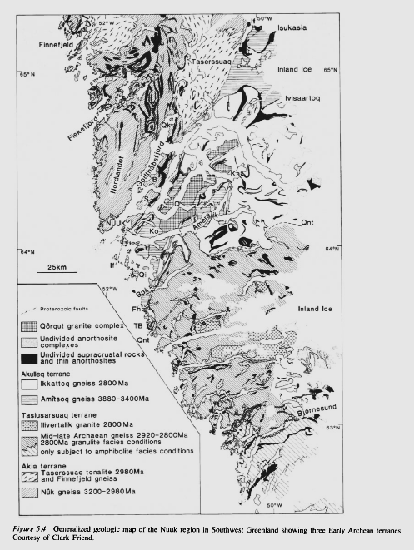

Slide 72
The Akulleq terrane is dominated by the Amitsoq TTG complex, most of which formed at 3.9- 3.8 Ga and underwent high-grade metamorphism at 3.6 Ga.
Each of the terranes also contains remnants of highly deformed supracrustal rocks.

Slide 73
Crustal Origin
The probable characteristics of the early oceanic and continental crust are summarized in Table 5.1.
Oceanic crust is generated today at ocean ridges by partial melting of the upper mantle, and there is no reason to believe that early oceanic crust did not form in the same way.

Slide 74
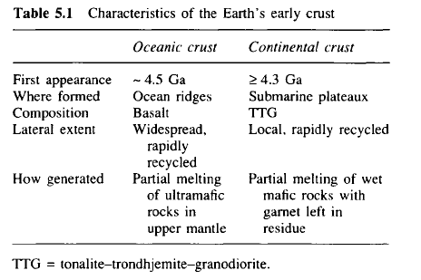

Slide 76
Just when the first oceanic crust formed is unknown because it was undoubtedly recycled into the mantle, but it is probable that it crystallized from a magma ocean soon after planetary accretion.

Slide 77
Because of the greater amount of heat in the Archean upper mantle, oceanic crust may have been produced 4-6 times faster than at present, and thus would have been considerably thicker than modem oceanic crust.
Like modem oceanic crust, however, it was probably widely distributed on the Earth's surface.

Slide 78
The Earth may be the only terrestrial planet with continental crust. If so, what is unique about the Earth which gives rise to continents? Two factors immediately stand out:
1 the Earth is the only planet with significant amounts of water
2 it may be the only planet on which plate tectonics has been operative.

Slide 79
An important constraint on the origin of Archean continents is the composition of Archean TTG (tonalite-trondhjemite- granodiorite).
Experimental data favour an origin for Archean tonalites by partial melting of amphibolite or eclogite in the presence of significant amounts of water (Rapp and Watson, 1995). Without the water, magmas of TTG compositions cannot form.

Slide 80
The production of large amounts of Archean continental crust require subduction of large quantities of hydrated basalt and large quantities of water.
Hence, with the possible exception of Venus, the absence of continental crust on other terrestrial planets may reflect the small amounts of water and the absence of plate tectonics on these planets.

Slide 81
It is likely that the earliest felsic crust developed from mafic submarine plateaux, either by partial melting of the thickened mafic roots of the plateaux or by melting of slabs subducted around their margins.
In either case, the resulting TTG magmas rise and underplate mafic and komatiitic rocks, some of which are preserved today in greenstone belts.

Slide 82
True granites do not appear in the geologic record until about 3.2 Ga and do not become important until after 2.6 Ga.
Geochemical and experimental data suggest that these granites are produced by partial melting or fractional crystallization of TTG (Condie, 1986), and it is not until TTG is relatively widespread that granites appear in the geologic record.

Slide 83
Thus, the story of early continental crust is the story of three rock types:
basalt, tonalite, and granite
listed in the general order of appearance in the Archean geologic record.
Field relations in most Archean granite-greenstone terranes also indicate this order of relative ages.

Slide 84
It would appear that Early Archean basalts were hydrated by seafloor alteration and later they partially melted, either in descending slabs or in thickened root zones of submarine plateaux, giving rise to TTG magmas.
TTG, in turn, was partially melted or fractionally crystallized to produce granites.

Slide 85
Thus, unlike the first oceanic crust, which probably covered much or all of the Earth's surface, the first continental crust was probably of more local extent associated with subduction zones and submarine plateaux.

Slide 86
Now that we have continental crust.
The next question is that of:
    how and
    at what rate
did continents grow?

Slide 87
How continents grow
Although most investigators agree that production of post-Archean continental crust is related to subduction, just how continents are produced in arc systems is not well understood.
Oceanic terranes such as island arcs and submarine plateaux may be important building blocks for continents as they collide and accrete to continental margins.

Slide 88
However, the fact that these terranes are largely mafic (Kay and Kay, 1985; DeBari and Sleep, 1991), yet upper continental crust is felsic in composition, indicates that oceanic terranes must have undergone dramatic changes in composition to become part of the continents.

Slide 89
Although details of the mechanisms by which mafic oceanic terranes evolve into continental crust are poorly known, delamination of lower crust during or soon after collision may play a role.
Perhaps colliding oceanic terranes partially melt and felsic magmas rise to the upper continental crust leaving a depleted mafic restite in the lower crust.

Slide 90
Because there is no apparent seismic evidence for thick, depleted continental roots beneath recently accreted crust, if this mechanism is important, the depleted root must delaminate and sink into the mantle, perhaps during plate collisions.
Supporting the possibility of modem collisional delamination is a major vertical seismic gap in the Western Mediterranean basin.

Slide 91
Tomographic images in this region indicate the presence of a high-velocity slab beneath low-velocity mantle, interpreted to be a piece of delaminated continental mantle lithosphere (Seber et al., 1996).
As an alternative to delamination, oceanic terranes may evolve into continental crust by the introduction of felsic components coming from mantle wedges above subduction zones.

Slide 92
Various mechanisms have been suggested for the growth of the continents, the most important of which are:
Magma additions by crustal over- and underplating, and
By terrane collisions with continental margins (Rudnick, 1995).

Slide 93
Magma from the mantle may be added to the crust by underplating, involving the intrusion of sills and plutons, and by overplating of volcanic rocks (Figure 5.6a).

Slide 94
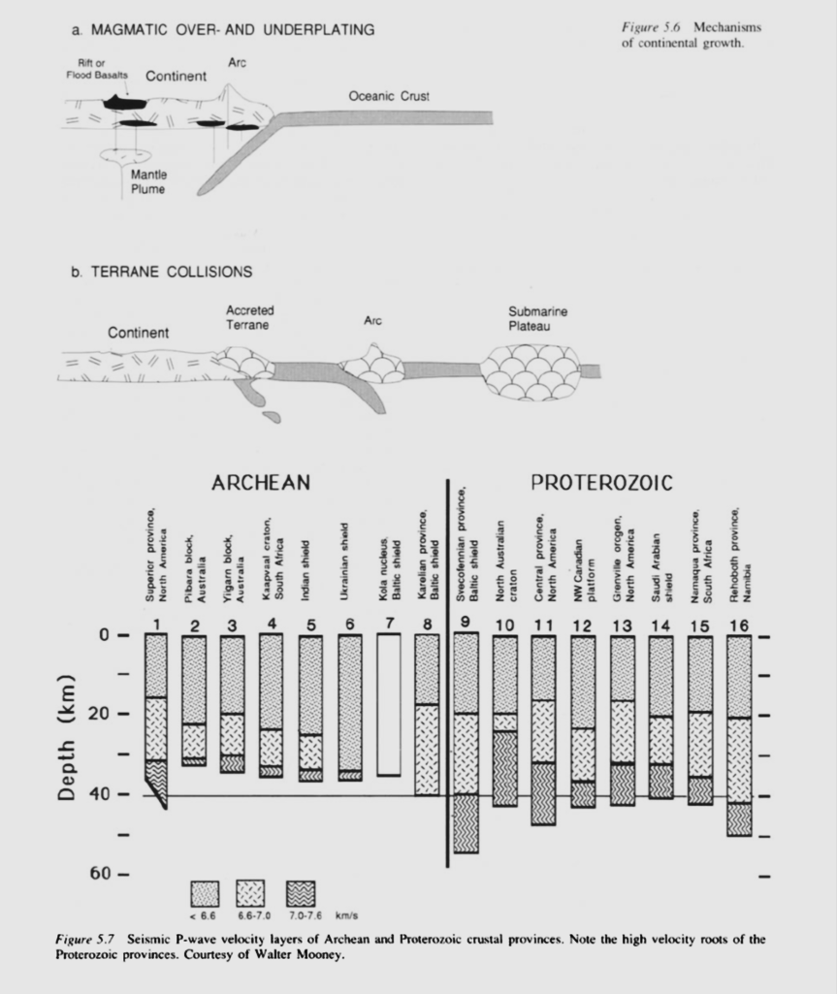
Fig. 5.6: Mechanism of continental growth

Slide 95
Magma additions can occur in a variety of tectonic environments, the most important of which are:
    arcs,
    continental rifts, and
    beneath flood basalts.
Up to 20 per cent of the crust in the Basin and Range Province in Nevada was added during the Tertiary by juvenile volcanism and plutonism (Johnson, 1993).

Slide 96
Large volumes of juvenile magma from the mantle are added to both oceanic and continental margin arcs.
Major continental growth by this mechanism can occur during seaward migration of subduction zones, when arc magmatism must keep up with slab migration.

Slide 97
Field relationships in exposed lower crustal sections, such as the Ivrea Zone in Italy, suggest that many mafic granulites are intrusive gabbros and that additions of mafic magmas to the lower continental crust may be important.
Also, a high-velocity layer at the base of Proterozoic shields has been interpreted as a mafic underplate (Durrheim and Mooney, 1991).

Slide 98
This accounts for a difference in average thickness of Archean shields (~ 35 km) and Proterozoic shields (~ 45 km) (Figure 5.7).
Just why Archean continents were not also underplated with mafic magma is not understood, but may be related to the thick, depleted lithospheric roots beneath Archean shields that somehow protect the crust from underplating.

Slide 99
Continental growth also occurs when oceanic terranes collide with and become sutured to continents (Figure 5.6b).
Collision of submarine plateaux with continental margins may be one of the most important ways in which continents have grown (Abbott and Mooney, 1995; Condie, 1994).

Slide 100
Fig. 5.6: Mechanism of continental growth

Slide 101
Most of the Cordilleran and Appalachian orogens in North America represent collages of oceanic terranes added by collisions, either at convergent plate boundaries or along transform faults.

Slide 102
Lithologic associations, chemical compositions, terrane lifespans, and tectonic histories of Cordilleran terranes in northwestern North America are consistent with collisional growth of the continent in this area (Condie and Chomiak, 1996).

Slide 103
Figure 5.7 Seismic P-wave velocity layers of Archean and Proterozoic crustal provinces. Note the high velocity roots of the Proterozoic provinces.

Slide 104
The Cordilleran crust appears to have formed mostly from oceanic terranes with pre-collisional histories of variable complexities and durations.
Although some of these terranes began to evolve into immature continental crust before accretion to North America, this evolution most probably began at or not long before the time when they accreted to the continent.

Slide 105
This was accomplished largely by incompatible element enrichment resulting from subduction-related processes associated with collisionally-thickened crust. Similar mechanisms have been proposed for Archean continents (Percival and Williams, 1989).

Slide 106
Thank You

