Slide 1
Driving Mechanism
For
Plate Tectonics

Slide 2
What drives plate motion?
It is clear that the tectonic plates move. But why do they move?
Ultimately, the energy that drives plate tectonics is heat transported out of the hot core and mantle to Earth's surface.
Plate tectonics is a type of convection and is the result of Earth's effort to cool and reach thermal equilibrium with cold space.

Slide 3
The mantle consists of solid rock. But beneath the base of the Iithosphere, this rock is so hot that it behaves somewhat plastically, and it can flow at very slow rates- 1 to 15 cm per year.
Because of its ability to flow, the mantle beneath the lithosphere convects, like a vast vat (drum) of simmering chocolate.
During convection, hotter mantle from greater depths rises, while cooler mantle at shallow levels sinks.

Slide 4
When geoscientists first proposed plate tectonics, they thought the process occurred simply because convective flow in the asthenosphere actively dragged plates along, as if the plates were rafts on a flowing river.
Thus, early images depicting plate motion showed simple convection cells-elliptical flow paths of convecting asthenosphere-beneath mid-ocean ridges (Fig. 4.27, 19.21A).

Slide 5
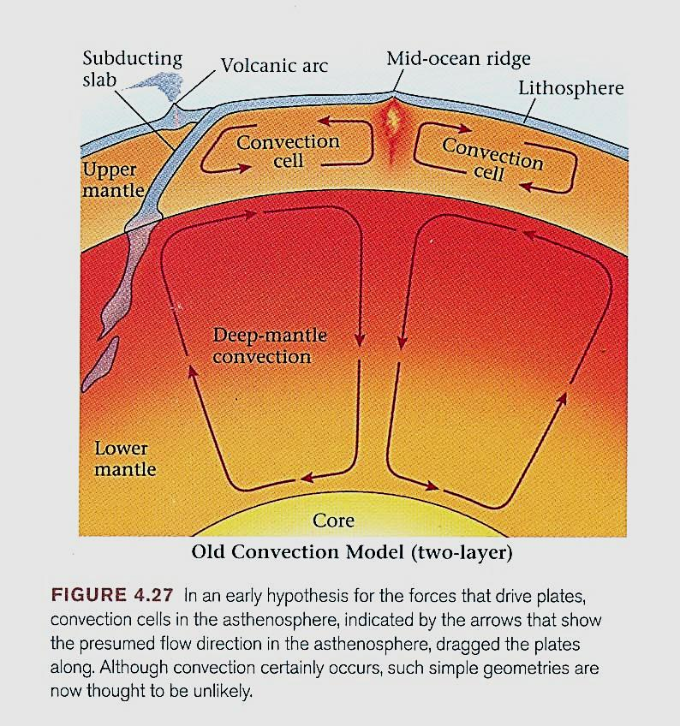

Slide 6
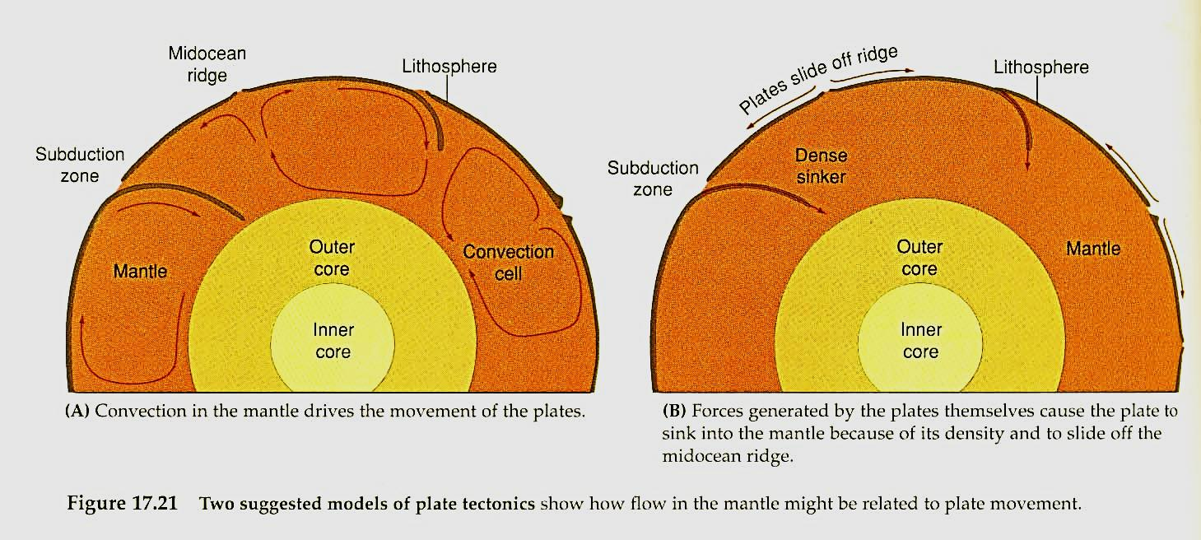
Fig. 19.21. Two suggested models of plate tectonics show how flow of the mantle might be related to plate movements

Slide 7
The rising limbs of the convecting cells in the mantle would therefore determine the positions of the oceanic ridges.
The convecting mantle would cause the lithosphere to split, and the moving mantle would carry the lithosphere laterally toward the subduction zone.
The descending cell would mark the location of the trench and would drag the lithosphere down into the mantle.

Slide 8
Movements in the asthenosphere were thought to be coupled strongly to the lithosphere. In other words, convection cells in the mantle supposedly caused ridges, trenches, and the movement of plates.
The distance between plate boundaries was thought to be caused by the size of the convection cell.

Slide 9
These models to explain the driving mechanism of plate tectonics suggested that convection cells within the mantle carried the plates, and that the plates played little or no active part in the convection (Fig. 17.21A).

Slide 10
Fig. 17.21. Two suggested models of plate tectonics show how flow of he mantle might be related to plate movements

Slide 11
The New Concept
At first glance, this hypothesis looked pretty good, but on closer examination, it failed.
Among other reasons, it is impossible to draw a global arrangement of convection cells that can explain the complex geometry of plate boundaries on Earth.

Slide 12
Gradually, geoscientists came to the conclusion that convective flow within the asthenosphere does occur, but does not directly drive plate motion.
In other words, hot asthenosphere does rise in some places and sink in others because of temperature contrasts, but the specific directions of this flow do not necessarily coincide with the directions of plate motion.

Slide 13
The Active lithosphere
Another model of convection theory considers the plates themselves to be active participants in the convection process (Fig. 17.21B), not passive passengers on a churning mantle.
In this model, the lithosphere is the cold upper layer of the convection cell. Because of its greater density, the lithosphere eventually sinks.

Slide 14
Fig. 17.21. Two suggested models of plate tectonics show how flow of he mantle might be related to plate movements

Slide 16
Subduction occurs not because the plate is pulled down by the descending mantle, but simply because the plate becomes denser than the underlying asthenosphere.
Thus, the plate may be moved by forces that are largely independent of the motion of the mantle beneath the plate.

Slide 17
Today, geoscientists favor the hypothesis that two forces:
  Ridge- push force and
  Slab-pull force
strongly influence individual plate motion.

Slide 18
Ridge-push force:
It develops because mid-ocean ridge axis lie at a higher elevation than the adjacent abyssal plains of the ocean (Fig. 4.28a).
Thus, the surface of the sea floor overall slopes away from the ridge axis. Gravity causes the elevated lithosphere at the ridge axis to push on the lithosphere that lies farther from the axis making it move away.

Slide 19
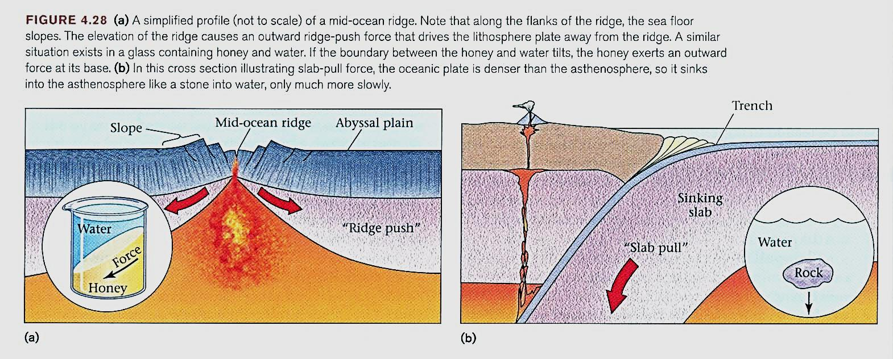

Slide 20
As lithosphere moves away from the ridge axis, new hot asthenosphere rises to fill the gap; it then moves away, cools, and it- self becomes lithosphere.
Note that the upward movement of asthenosphere beneath a mid-ocean ridge is a consequence of sea-floor spreading, not the cause.

Slide 21
Slab-pull force
It is the force that subducting plates (also called down going slabs) apply to oceanic lithosphere at a convergent margin, arises simply because lithosphere that was formed more than 10 million years ago is denser than asthenosphere, so it can sink into the asthenosphere (Fig. 4.28b).

Slide 23
Thus, once an oceanic plate starts to sink down into the mantle, it gradually pulls the rest of the plate along behind it, like an anchor pulling down the anchor line.
This "pull" is the slab-pull force.

Slide 24
Now let's summarize our discussion of forces that drive plate motions:
Plates move away from ridges- in other words, sea-floor spreading occurs- in response to the ridge-push force. Subducting Iithosphere generates a slab-pull force that tow (pull) the rest of the plate along with it.
But ridge push and slab pull are not the only forces acting on the plate.

Slide 25
The asthenosphere does convect, and the flow of the asthenosphere probably exerts a force on the base of the plate, just as flowing water exerts a force on the bottom of a boat tied to a dock.
If this force, or shear, happens to be in the same direction the plate is already moving, it can speed up the plate motion, but if the shear is in the opposite direction, it might slow the plate down.

Slide 26
Also, where one plate grinds against another, as occurs along a transform fault or at the base of an overriding plate at a convergent margin, friction (the force that resists sliding on a surface) may slow the plate down.

Slide 27
Forces that influence the motion of a plate include:
  slab-pull,
  (2) ridge-push,
  (3) basal drag,
  (4) friction along transform faults, and
  (5) friction between the converging slabs
  of the lithosphere in a subduction
  zone.

Slide 28
To better understand why the plates move, let us examine the forces that act upon them. The most important forces are shown diagrammatically in Fig. 17.22, 10.66.

Slide 29
Forces that influence motion of the plate include:
Slab-pull: a pull exerted on the plate as the dense oceanic slab descends under its own weight into the asthenosphere in a subduction zone.
In essence, the slab sinks because it is denser than the asthenosphere, and it pulls the rest of the lithosphere along with it.

Slide 30
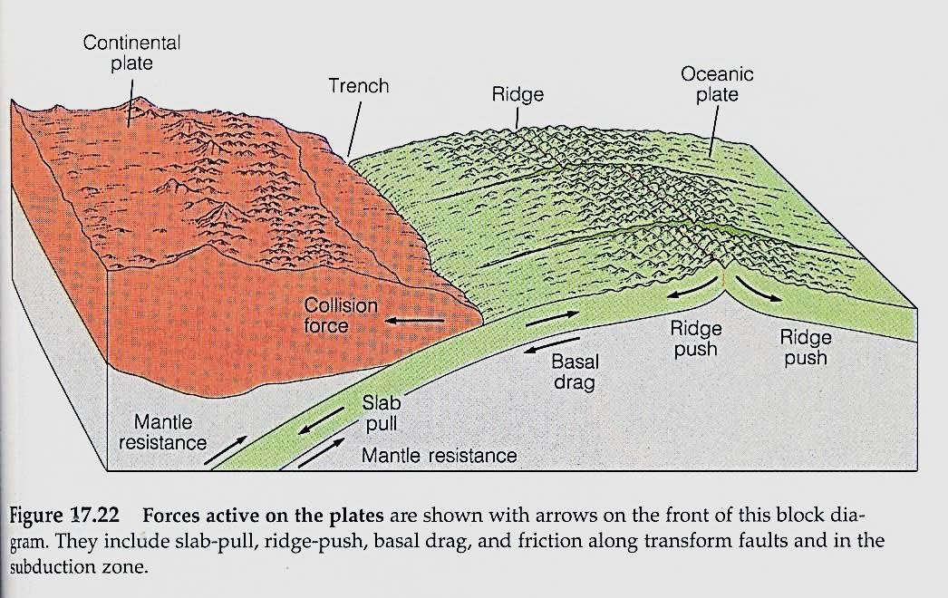

Slide 31
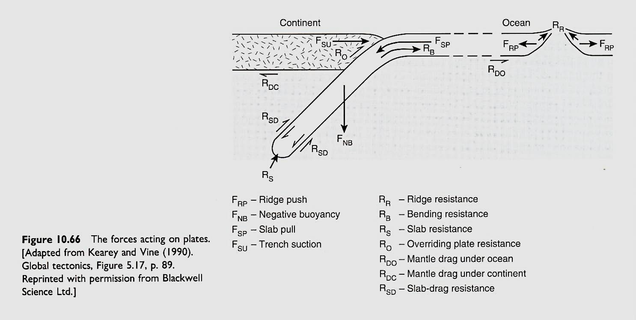

Slide 32
Ridge-push: gravity makes the lithosphere slip off the elevated ridge.
Basal drag: resistance to flow exerted on the bottom of the plate by the underlying asthenosphere. Depending on the direction of flow in the asthenosphere, this could aid or hinder plate movement.
Mantle resistance: resistance to the movement of the subducting plate through the asthenosphere and mesosphere.

Slide 33
Friction: resistance along transform faults and between the converging slabs of lithosphere in a subduction zone.
Although the basic description of plate tectonics was worked out in the 1960s, we do not yet know which of these forces is most important for plate movement.
Testing the actions of the possible driving forces is extremely difficult. Moreover, different forces act in different proportions on different plates at different times.

Slide 34
In as much as each plate has a nearly constant velocity- is neither accelerating nor decelerating- most researchers believe that the forces that drive the plates are approximately balanced by forces that resist their movement.
Thus, the driving forces provided by slab-pull and ridge-push are probably balanced by resisting forces such as basal drag, mantle resistance, and friction at plate boundaries.

Slide 35
The absolute velocity of a plate is strongly related to the proportion of its margin that is subducting.
For example, plates like the Pacific and Cocos plates, which have about 40% of their margins represented by subduction zones, have high plate velocities (greater than 5 cm/yr).

Slide 36
Plates like the North American, which have smaller proportions of subducting margins, move more slowly (1 to 3 cm/yr). Hence, many researchers have concluded that slab-pull is a major driving force.
The correlation between the rate of plate motion and the proportion of subducting edges is so strong that other forces may be only minor.

Slide 37
Slab-pull is aided by the metamorphic phase transitions that occur in subducting plates.
As the plate moves deeper into the mantle, low density phases convert into higher density phases. These changes effectively create a sinker that pulls the plate deeper into the mantle.

Slide 38
Ridge-push is believed to be a less important, but still significant, motivator of tectonic plates.
Ridge-push is related to the elevation of the ridge, which in turn is caused by the hot buoyant material that rises beneath it. The asthenosphere acts as a slippery layer beneath the slab, and the lithosphere simply slides downhill.

Slide 39
Observations of plate movement and theoretical calculations both suggest that the forces supplied by slab-pull and ridge-push are so large that the question may become, what slows the plates down?
The major retarding force is probably resistance in the mantle to the sinking of a subducting slab. Friction at plate boundaries must also slow the movement of the plates.

Slide 40
Thank you

